Slide 1
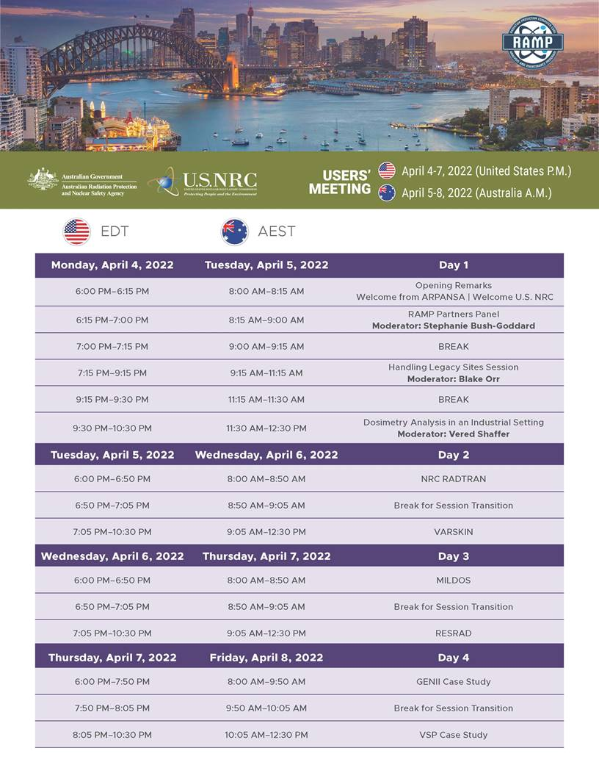



Welcome to the
2022 April RAMP User’s Group Virtual Meeting
bem-vindo
ברוך הבא
Ласкаво просимо
Bienvenue
환영
Willkommen
欢迎
benvenuto
Ya' at' teeh
'ahlaan bik
fáilte a chur roimh
Bienvenidas
Welkom
أهلًا وسهلًا
Notes:
Good Evening from United States and Good Morning from Australia. My name is Stephanie Bush-Goddard and welcome to the 2022 April RAMP User’s Group Virtual Meeting.
Before we get started there are a few housekeeping issues.
The platform we are using to conduct these meetings is Zoom

Slide 2
Zoom Logistics
Audio – All participants will be muted, keep yourself muted.
The majority of the meeting will be recorded.
Questions –
  Questions will be addressed at the end of the presentations.
  Please type your name, country, the question, and the person the question is directed to in the CHAT (see image below):
Closing Session – there will be no closing session.
Electronic Certificates – available per request only.
American Board of Health Physicists Credits – 16 credit hours are available.
Zoom Tech Issues – please email Tanya Korotkov at RAMP.ADMIN@pnnl.gov
Notes:
This user meeting will be conducted via Zoom.
Feel free to umute yourself if you have a question or comment.
However, if you are presenting it will not be disabled.
*************************
This meeting (aside from selected small sessions) is being recorded and may be posted on NRC’s website or used internally. If you do not wish to have your voice recorded, please do not speak during the meeting or disconnect now. If you do not wish you have your image recorded, please turn off your camera or participate only by phone. If you speak or use a video connection, you are presumed to consent to recording and to the use of your voice or image

Slide 3
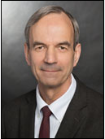

The Office of Nuclear Regulatory Research:
Welcome
Raymond Furstenau, Director
Notes:
We will begin with a Welcome by The US NRC, Director of Nuclear Regulatory Research. Mr Ray Furstenau.

Slide 4
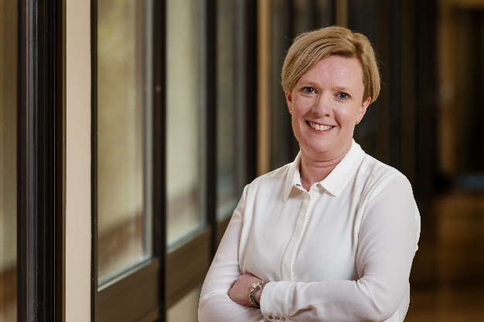
ARPANSA:
Welcome
Dr. Gillian Hirth, CEO
Notes:
We will continue with a welcome from Dr. Gillian Hirth. She is the newly minted CEO of Australian Radiation Protection and Nuclear Safety Agency

Slide 5
Again Welcome!
We are glad you are here!
For questions, comments, issues, suggestions and others:
EMAIL: RAMP@nrc.gov RAMP.ADMIN@pnnl.gov
Notes:
Welcome again and Ray I will turn it over to you.

Slide 6

Time for a group picture

