Slide 1
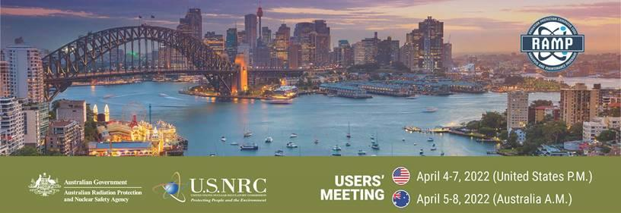

Intro to RAMP and Its Partnerships:
A conversation
Stephanie Bush-Goddard, Ph.D., Radiation Protection Branch
Office of Nuclear Regulatory Research,
United States Nuclear Regulatory Commission
April 2022 RAMP User Meeting
1
1
Notes:
Thank you RAY and Thank you Gillian, if I may, for that warm welcome.
We were told that Gillian is the newly minted CEO of ARPANSA, so we extend our congratulations on your appointment and wish you well.
Now lets move on to the first session, which is an Introduction to RAMP and a conversation with its partnerships.
I will start off with a quick summary of the program, but the bulk of this presentation or shall I say conversation is focused on our Partners and how they use the RAMP program.
Lets get started.
Next slide please.
40 sec
April 5th Australia 8:15am (AEST)
April 4th United States6 :15 PM (18: 15) US EST, 5:15 PM (17:15) US Central Standard Time, 3:15 PM (15:15) US Pacific Standard TimeA
April 4th, Canada 6:15 PM (18:15) (EDT)
April 5th South Africa 12:15 AM (SAST)
April 5th South Korea 7:15 AM (KST)
April 5th Israel 1:15 AM (IST)
April 5th Ukraine 1:15 AM (EEST)

Slide 2

RAMP: What is it?
Other Dose Assessment Codes
Emergency Response Codes
DCFPAK
IMBA
VARSKIN
RASCAL
Atmospheric Assessment Codes
Turbo
FRMAC
Radiological
Toolbox
PiMAL
HABIT
PAVAN
RADTRAD
ARCON96
GALE
NRCDose
RADTRAN
RESRAD
MILDOS
NPP Licensing Codes
GENII
DandD
VSP
Environmental Assessment Codes
Information and descriptions of codes: https://ramp.nrc-gateway.gov/
Notes:
RAMP stands for the Radiation Protection Computer Code Analysis and Maintenance Program.
This program is a cradle to grave life cycle of radiation protection codes in that we develop, distribute, train and continue to maintain the codes.
Here we have a display of all 18 codes in circles or bubbles. In fact, we call it the “bubble picture” and I admit it pretty busy.
but, they are organized into 5 different categories based on their utilization.
At the bottom, there are the Environmental Assessment Codes, which is the main focus of this user meeting. They are codes like RESRAD that are used in NRCs decommissioning space and GENII that is used in a number of unique applications.
To the right of the screen are codes used in Nuclear Power Plant Licensing.
At the top right are our Emergency Response Codes,
To the far left are our Atmospheric Assessment Codes
And our fifth category are “other Dose Assessment Codes” which are a combination of codes, dababses and a graphical user interface.
Of note is VARSKIN which is also being highlighted this week.
Information on our codes are found in the URL at the bottom and we are always one email away at ramp@nrc.gov.
Next slide please.
1 min 30 sec

Slide 3
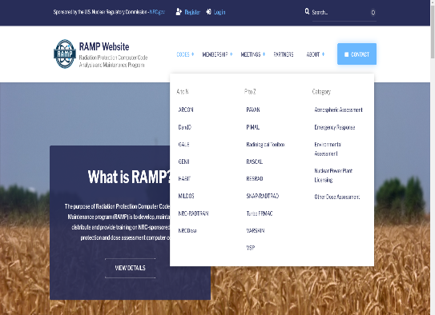
RAMP Website https://ramp.nrc-gateway.gov/
Major communication tool for RAMP Program
  Download most codes
  Documentation
  Training/webinar recordings
  User Meetings
What’s New/Upcoming?
  More targeted communication
    Surveys
    Support
  University Corner
  International pages
Notes:
The website is the major communication tool fthe RAMP Program. You can download most codes you saw on the last slide because there are a few exceptions and you can download documentation, such as user guides and technical base documents.
There is also online training for codes like RASCAL and VARSKIN and most content of the user meetings are recorded and uploaded to the website.
I want to point out that we have a University Corner where students work is highlighted, and we are developing our international or country pages because we find that each countries needs are unique and we think they would benefit from a separate page that has information unique to them.
Lastly, we welcome RAMP users to tell us what can be changed and improved on the website.
Next Slide Please
50 minutes

Slide 4



RAMP by the Numbers
48
Countries
14
Agreements
18
Codes
2786
Active Users
656
Organizations
Notes:
...and speaking of our users....
We have under 3000 from 48 countries. Within those 48 countries, we have what you call RAMP Agreements with 14 of those countries., I come back to that on the next slide.
And of the under 3000 users, there are 656 organizations for the 18 codes we service.
Next Slide Please.
25 minutes

Slide 5
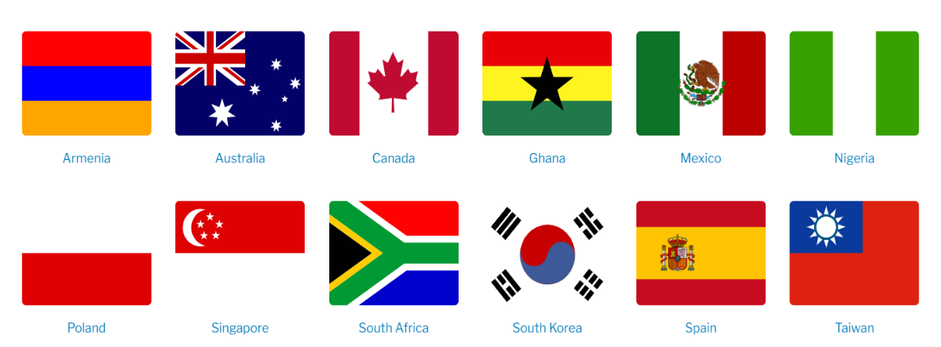
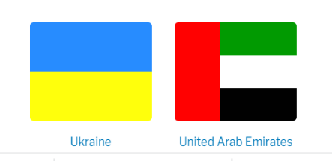
RAMP International Agreements
Notes:
With regards to RAMP Agreements, as I said on the last slide there are 14 countries that we have agreements with.
The countries and their flags are listed here.
These agreements are normally from regulator to regulator, and we really get to work in the spirt of international collaboration at the staff level.
For example, this meeting is possible, in part because we have a RAMP Agreement with ARPANSA.
and we do other things as you will hear about in the conversations with our panel shorty, but first, let me give you a few RAMP Updates...
Next slide please
40 sec

Slide 6
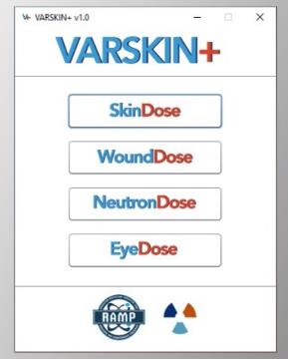
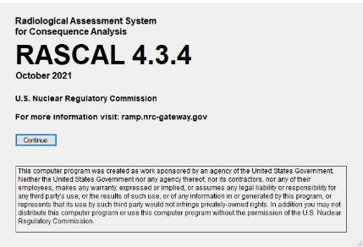
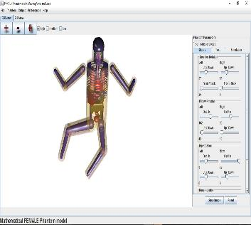
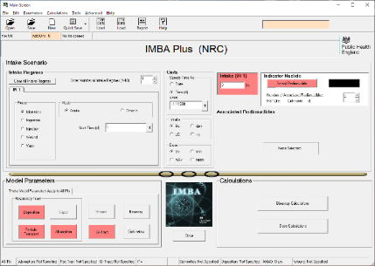
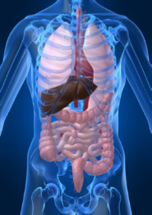
RAMP Updates
Updates:
  RASCAL 4.3.4
  VARSKIN+ 1.1
  PIMAL 5.0
New code!
  IMBAPro 5.01
Available on the RAMP website. (https://ramp.nrc-gateway.gov/).
Notes:
We just put out updates to RASCAL, VARSKIN and PiMAL. Information on that is on the website.
And as of March 1 of this year, we are proud to bring in IMBA under the RAMP Program. IMBA stands for Integrated Modules for Bioassay Analysis and is a suite of software modules for internal dosimetry. This was made availability thru the UK Health and Security Agency, who gave the RAMP program a license to distribute IMBA worldwide, excluding Europe.
Next Slide Please
40 sec

Slide 7
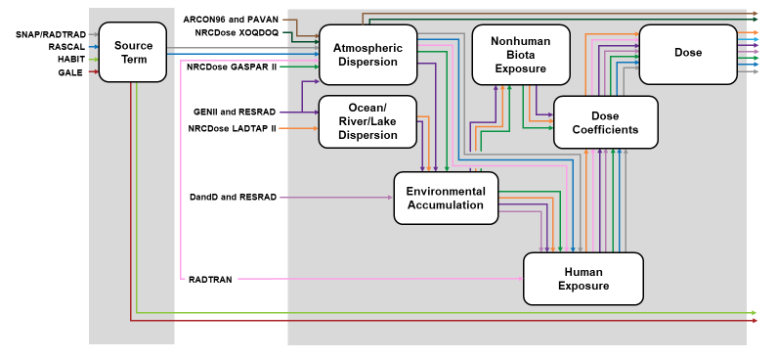
RAMP Consolidated Code
“Engines/Modules”
Notes:
Lastly is a big project on code consolidation.
On one of the first slides, I called it the bubble slide, you saw about 18 codes.
You see some of those codes here in small print, but you also see, what we call “Engines or Modules.”
In the past, codes were developed based on their end usage, meaning whether they were for nuclear power point licensing or environmental purposes, you get the picture.
However, these codes had a lot in common. Some generate a source term, but most have, an atmospheric dispersion component, water dispersion components and environmental accumulation models.
They also have some type of human and non-human dosimetric models because the very nature of our business is radiation protection and health effects.
As such, we are developing a new consolidated codes that will incorporate these engines or modules. However, this code is being developed over the next 3 to 5 years and we give detail updates at the annual meeting later in the year.
Next slide please.
1 min 20 sec

Slide 8






1st Questions
Your name, country, and organization?
What is your title and a description of your job?
NRC International Assignee
Notes:
Now let starts the conversation.
Today we selected four partners, these are countries that have RAMP agreements that I spoke of, and one international assignee from Israel. Israel does not have an agreement with the US NRC, however we asked the gentlemen to speak because he was on sabbatical to the NRC for an entire year and did a project with one of the RAMP codes.
For this question, I’ve asked each panel member to introduce themselves, their title and job description.
We will start with our co-host Australia, then in alphabetical order with Canada, Israel, South Africa and South Korea
Take it away Blake
50 sec
Blake Orr
Blake.Orr@arpansa.gov.au
Kyuwon Choi
kyuwon.choi@kins.re.kr
Nana Kwamena, Director, EAD
nana-owusua.kwamena@cnsc-ccsn.gc.ca
Henriette van Graan
hvangraan@nnr.co.za
Shlomi Halfon
shlomi.halfon1@gmail.com

Slide 9
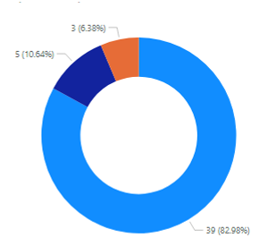

RAMP in Australia
47
8
5
Total Users
Organizations
Years in RAMP
Industry Breakdown

Slide 10
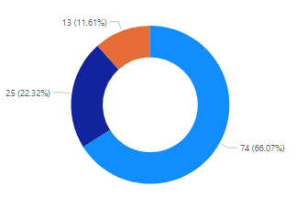
RAMP in Canada
112
25
7
Total Users
Organizations
Years in RAMP
Industry Breakdown

Slide 11
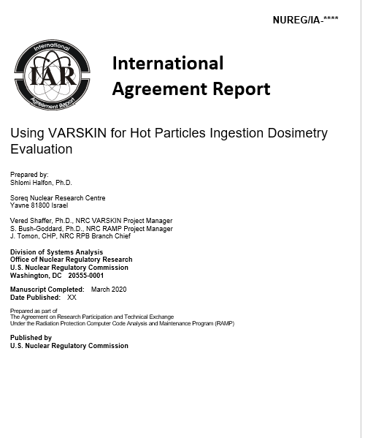

Israel: International Assignee

Slide 12
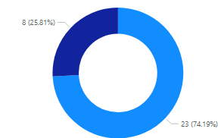

RAMP in South Africa
31
6
7
Total Users
Organizations
Years in RAMP
Industry Breakdown

Slide 13
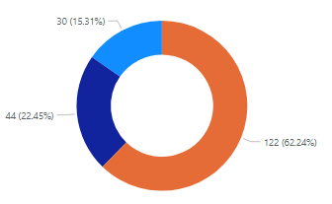
RAMP in South Korea
196
25
6
Total Users
Organizations
Years in RAMP
Industry Breakdown

Slide 14
1st Polling Question
What Country are you from?
Notes:
Thank you for that introduction.
Now we will have a polling question to find out where everyone else is from.
While that polling question is taking place, I would like to spotlight another country
Next slide please

Slide 15




Spotlight: Ukraine
26
Active Users
2
Government Organizations
3
Years in RAMP Membership
Notes:
..and that country is Ukraine.
Ukraine has a RAMP Agreement and has been very active. They hosted last year’s RAMP international meeting, provided a seminar before that and we are working to collaborate on a few codes, especially RASCAL.
They have 26 active users, there are two government organization in RAMP and they have been here for 3 years.
In fact, we were going to invite them to be on the panel, but for obvious reason we did not.
However, we are happy that some of them registered for this meeting and our thoughts are with them.
Now let's see the polling results.
Next slide please
40 sec

Slide 16
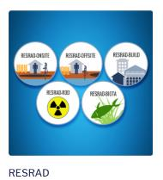


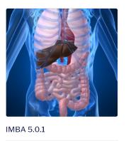
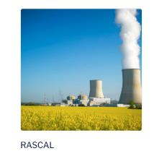
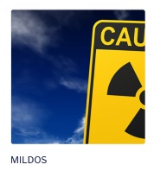
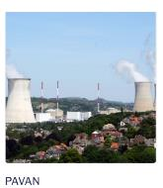
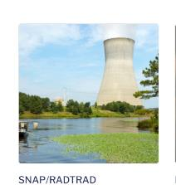
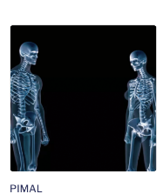
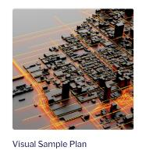
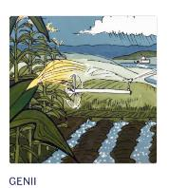
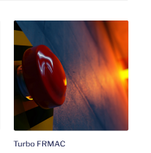
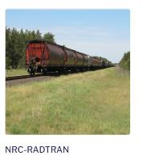

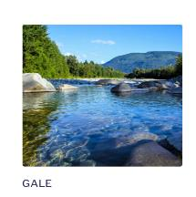

2nd Round of Questions
What RAMP codes does your organization use?
What other Radiation/Health Physics Codes does your organization use?
Notes:
Lets go into the 2nd question, which is:
What RAMP codes does your organization use?
What other Radiation Protection or Health Physics or Environemetal Codes does your organization use?
Lets start with Canada this time, followed by Israel, South Africa, South Korea and Australia.
Its all your Nana.

Slide 17
Polling Question #2
What type of work/school?
Government (Federal, Province, State, Local)
Research Institution
Laboratory
Private Industry/Licensee
University – Undergrad/Grad
University – Professor
RAMP Contractor
Other

Slide 18

Third Round of Questions
How has RAMP been a benefit to your agency?
What needs improving in RAMP, what has been challenging?
What other collaborations would you like to see?
Notes:
Thank you for that, we will move into the third question, which is intended to be a bit more thought provoking.
How has RAMP been a benefit to your agency?
What needs improving in RAMP, what has been challenging?
What other collaborations would you like to see?
Lets start with Isreal, South Africa, South Korea, Austalia then Canada

Slide 19

RAMP Partner’s Fourth Questions
Does your organization/agency have an international collaboration strategy?
If so, what is it?
Any other statements or comments about the US NRC RAMP program.
Notes:
The fourth question is
Does your organization/agency have an international collaboration strategy?
If so, what is it?
Any other statements or comments about the US NRC RAMP program.

Slide 20
Open Forum
Notes:
With regards to RAMP Agreements, as I said on the last slide there are 14 countries that we have agreements with.
The countries and their flags are listed here.
These agreements are normally from regulator to regulator, and we really get to work in the spirt of international collaboration at the staff level.
For example, this meeting is possible, in part because we have a RAMP Agreement with ARPANSA.
and we do other things as you will hear about in the conversations with our panel shorty, but first, let me give you a few RAMP Updates...
Next slide please
40 sec

Slide 21
THANK YOU! RAMP PARTNERS!!!!!
NRC International Assignee
Notes:
We will start by the panel introducing themselves.
Blake Orr
Blake.Orr@arpansa.gov.au
Kyuwon Choi
kyuwon.choi@kins.re.kr
Nana Kwamena, Director, EAD
nana-owusua.kwamena@cnsc-ccsn.gc.ca
Henriette van Graan
hvangraan@nnr.co.za
Shlomi Halfon
shlomi.halfon1@gmail.com

Slide 22
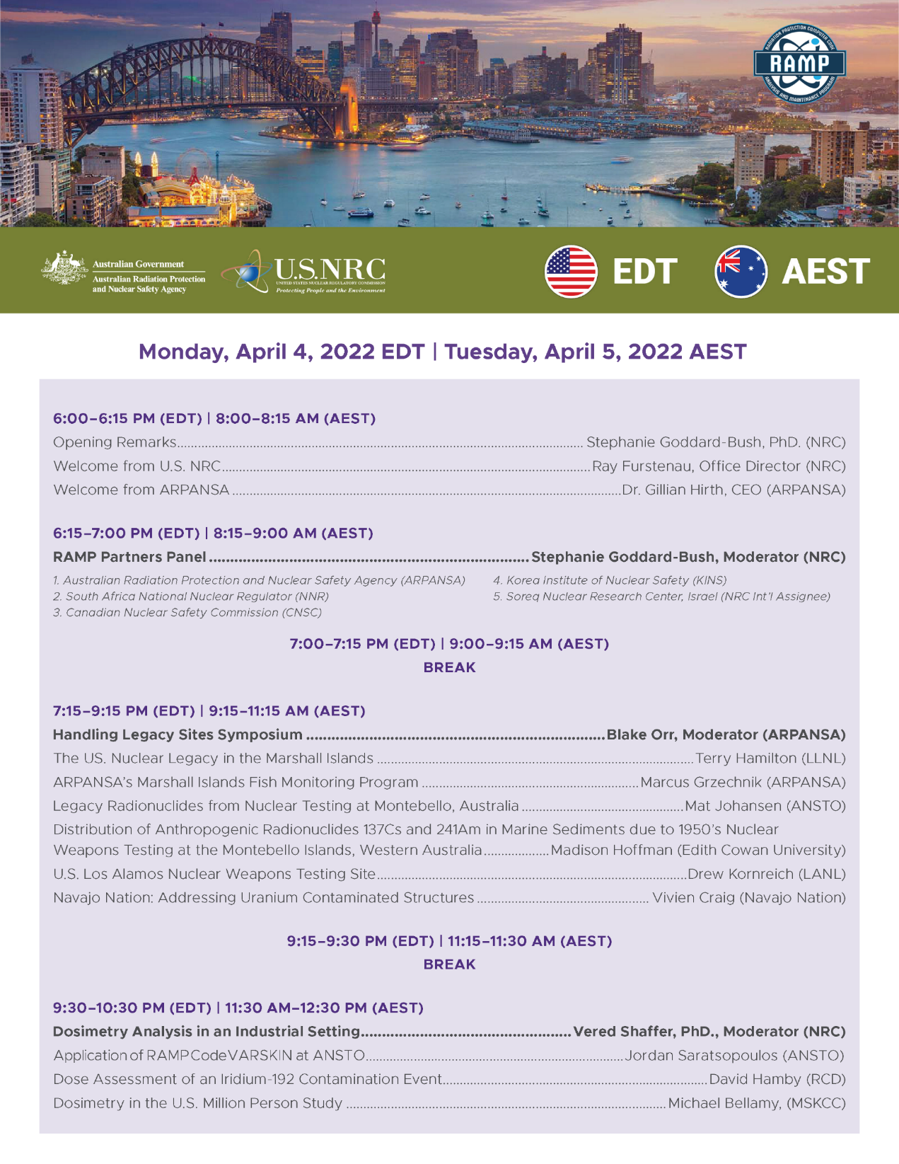

Slide 23
Polling Questions #3
Area that you work in Nuclear?
Nuclear Power Plant
Medical
Industrial
Environmental
Other

