Slide 1
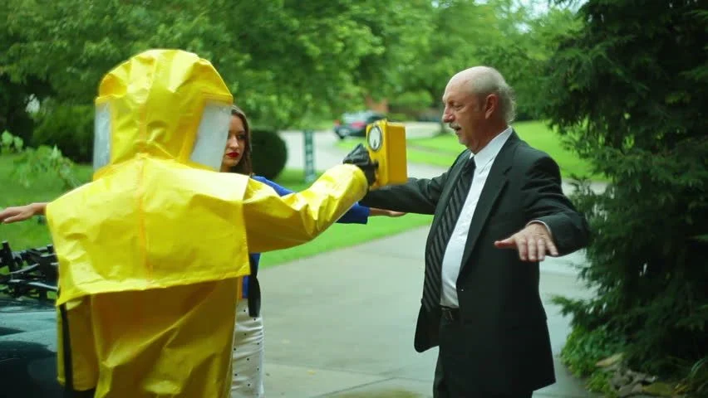
Dose Assessment of an Iridium-192 contamination event
Colby D. Mangini, PhD, CHP
David M. Hamby, PhD
Renaissance Code Development, LLC

Slide 2
Incident description
In October of 2019, a radiological incident occurred involving a 37 GBq (1 Ci) source of Ir-192 on ceramic beads, a portion of which was dispersed into the air
Beads were in a pressurized vessel that rapidly decompressed
Resulting in ‘explosive’ dispersal of a small portion of the activity toward a technician’s face about 10 inches away
Technician was wearing only a Tyvek suit and shoe covers, no other PPE

Slide 3
Incident description
9 months later, the technician went to the emergency room complaining of chest pains and revealed having had recent radiation exposure
Recollection was …
  technician washed their eyes many times that day in the bathroom and at an eye-wash station
  technician and another employee carried out additional decontamination attempts
  radiation safety reported that the day after decontamination ceased, no readings were above background on floors, drains, eye-wash station, etc.

Slide 4
Retrospective dose assessment
Case brought to RCD by the NRC for a retrospective dose assessment
With poor record keeping and insufficient documentation, an exposure reconstruction is quite difficult
Licensee did not handle the situation appropriately
  e.g., TLD was either not worn or discarded with the Tyvek suit
Relying on statements/data years later as to what really happened
Attempting conservative, yet moderately reasonable, dose estimation

Slide 5
Dose estimates
Committed Effective Dose Equivalent (CEDE)
External Effective Dose Equivalent (XEDE)
  TEDE = CEDE + XEDE
Shallow Dose Equivalent to the face (SDE)
Lens Dose Equivalent (LDE)

Slide 6
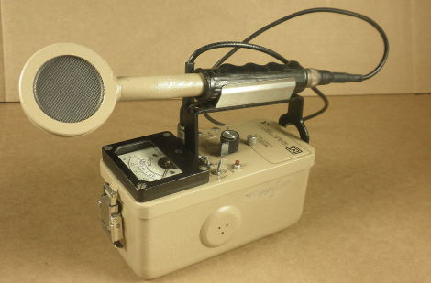
Critical Information
Radiation safety estimated …
  2.9 GBq (78 mCi) of Ir-192 was blown into the air on depressurization
  all other activity remained in the vessel
On the day of the event, using a Ludlum 44-9 GM probe (pictured), an exposure rate of 200 mR/h was recorded “on contact” with the technician’s eye/face area
Subsequent measurements over the next 2 weeks, and one at 103 days, provide critical data to use in V+ SkinDose to estimate the activity lodged on the technician’s face and how long it stayed there

Slide 7
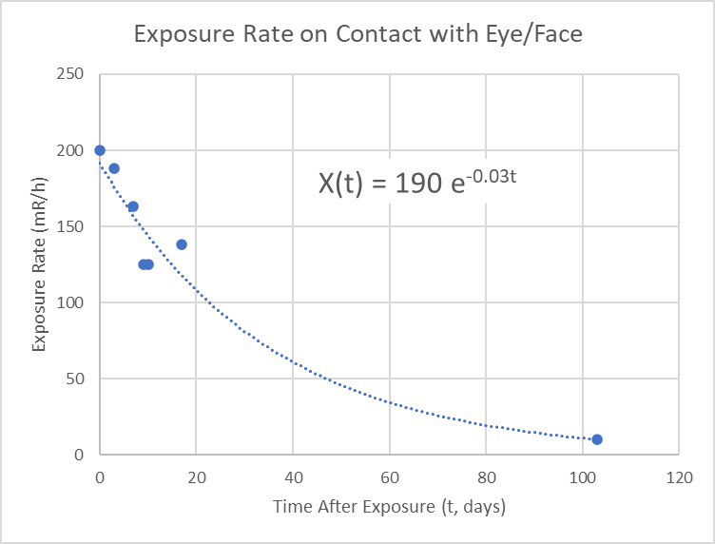
Effective half-life
Exposure Rate
mR/h
200
188
163
125
125
138
10
Day
0
3
7
9
10
17
103
Data indicate an effective half-life of 23 days (residence time of 34 days)

Slide 8
CEDE Estimate
9 months later, the employee had in-vivo lung and whole-body counts
Lung count showed no activity
Two consecutive whole-body counts indicated internal activity of about 160 Bq
A back-calculation predicts an original intake of 1,940 Bq
  considering loss only by radioactive decay
CEDE inhalation (largest) dose coefficient (FGR 11) is 7.61x10⁻⁹ [Sv/Bq]
Resulting in a CEDE of 0.015 mSv

Slide 9
XEDE Estimate
Conservatively, the technician stated that they exited the room and removed their Tyvek suit within minutes of the release
Assuming the activity (2.9 GBq) is contained within 10 m³ and exposure occurs for 5 minutes
The External EDE would be --- 3.4 mSv
Alternatively, using EDE factors calculated by EPRI (2004) for a point source at the “front head”
Assuming a residence time of 34 days on the face
The integrated External EDE is approximately 0.036 mSv

Slide 10
Sde Estimate
First, V+ SkinDose was used to back-calculate the activity present on the face
  Ludlum 44-9 GM has a 1.7 mg/cm² window and a probe area of 15.5 cm²
  “on contact” was simulated assuming an air gap of 0.5 inches
  200 mR/h was measured
  SkinDose indicates that a surface activity of 52 kBq (1.4 µCi) would result in that exposure rate
Second, V+ SkinDose was used to estimate SDE to 10 cm² of tissue at 7 mg/cm² depth
Dose to the skin is integrated over the 34-day residence time
Conservatively modeled as a point source, the SDE is 6,600 mSv
If modeled with activity spread over the face, the SDE is about 1,000 mSv

Slide 11
Lde Estimate
For this calculation, the activity on the face (54 kBq) is conservatively assumed to be located at a point in front of the face, on-axis with the lens of the eyeball
  the influence of off-axis activity is minimal
V+ EyeDose was used to estimate LDE
At 0.1 cm, the integrated LDE is 120 mSv
At 1 cm, the integrated LDE is 21 mSv

Slide 12
Summary of dose estimates
10 CFR 20
Dose Limit (mSv)
-
-
50
500
150
Dose Type
CEDE
XEDE
TEDE
SDE
LDE
Dose (mSv)
0.015
0.036 – 3.4
0.051 – 3.4
1,000 - 6,600
21 - 120

Slide 13
conclusions
This retrospective analysis serves the purpose of identifying tissues/organs that might have received significant radiation dose
A conservative dose assessment indicates …
  the SDE (facial area) may have exceeded 10 CFR 20 limits by as much as a factor of 10
  the TEDE and LDE most likely remained below regulatory limits
Improvements …
  radiation safety protocol
  record keeping
  increased analytical measures
  and a new RSO

