Slide 1

Contaminated Structures Program(CSP)on Navajo
Vivian Craig
Sr. Environmental Specialist
Navajo Nation EPA Superfund Program

Slide 2
Background of CSP
USEPA and NNEPA Superfund Program Contaminated Structures Program (CSP) are homes that may have been constructed with uranium materials and built on or near abandoned uranium mine sites. The CSP is responsible for conducting full assessment of possible contaminated structures and or yards which requires cleanup of the contamination that is an exposure risk to humans. The CSP is for Navajo residents living close to mine site and or who may suspect their home was built with uranium contaminates. Participation in the program is voluntary and at no cost to the resident.
In some cases it was found that older structures were built using abandoned mining materials potentially leading to exposure exceeding background (naturally occurring) levels. These materials include ore and waste rock used for foundations, walls, or fireplaces; mine tailings mixed into cement used for foundations, floors, and cinder block walls; and other contaminated building materials (wood, metal, etc.) that people may have unknowingly salvaged from the abandoned uranium mine areas.

Slide 3
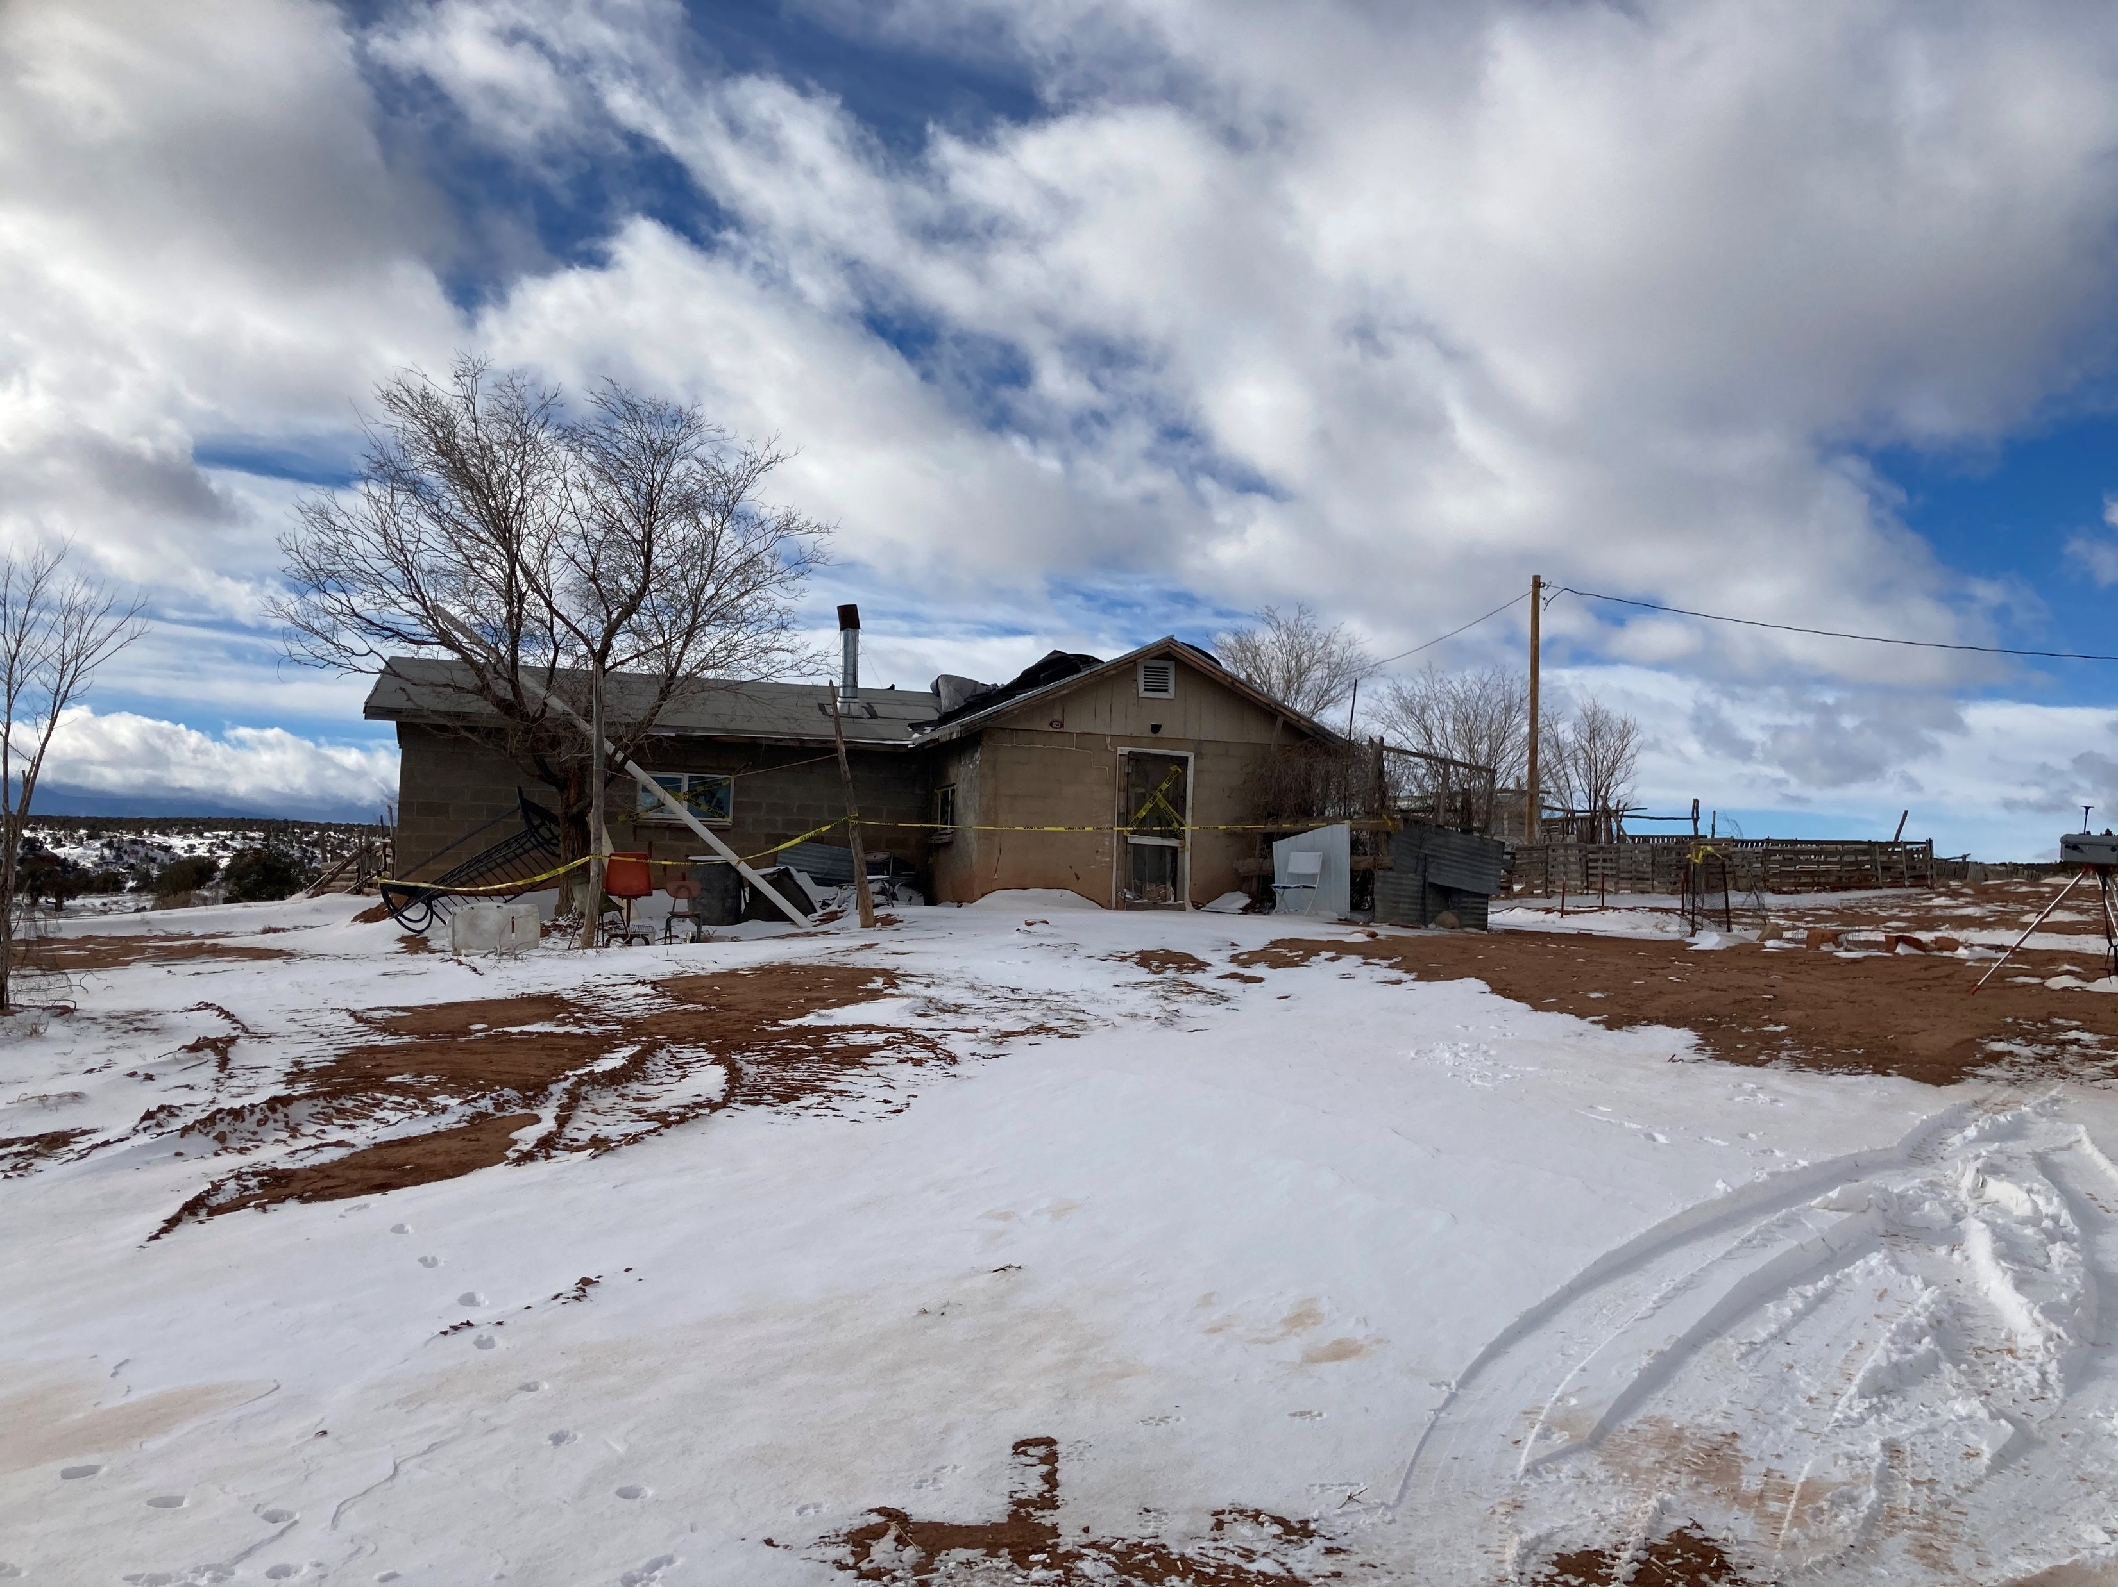
CSP on Navajo for RV-013

Slide 4
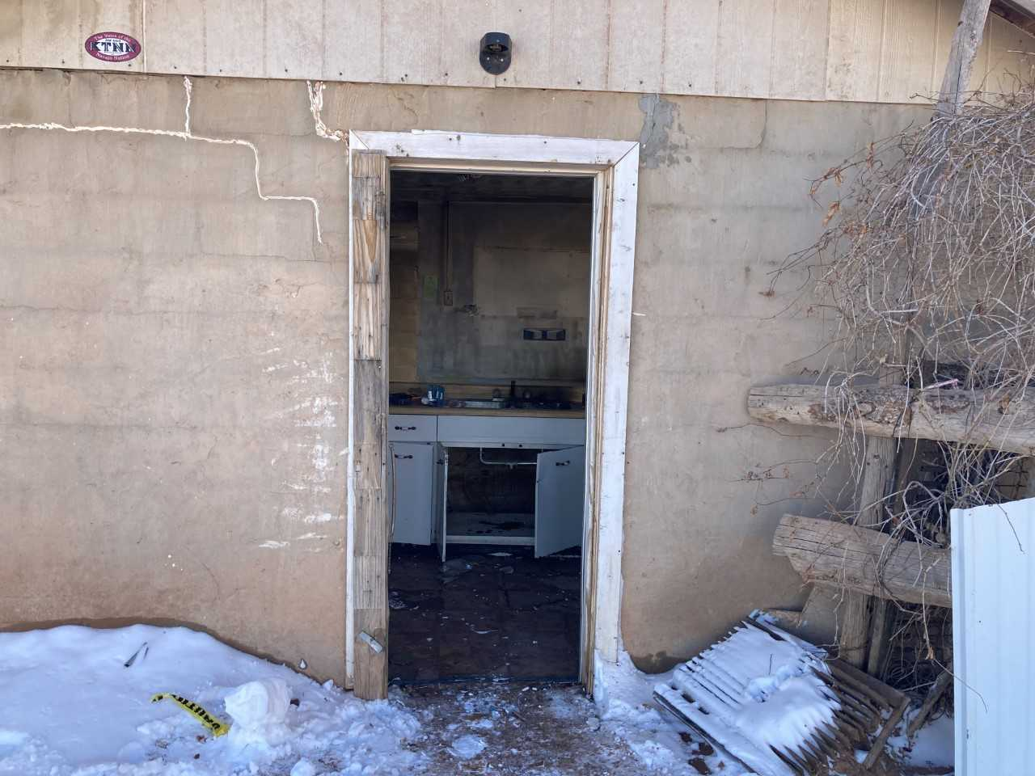
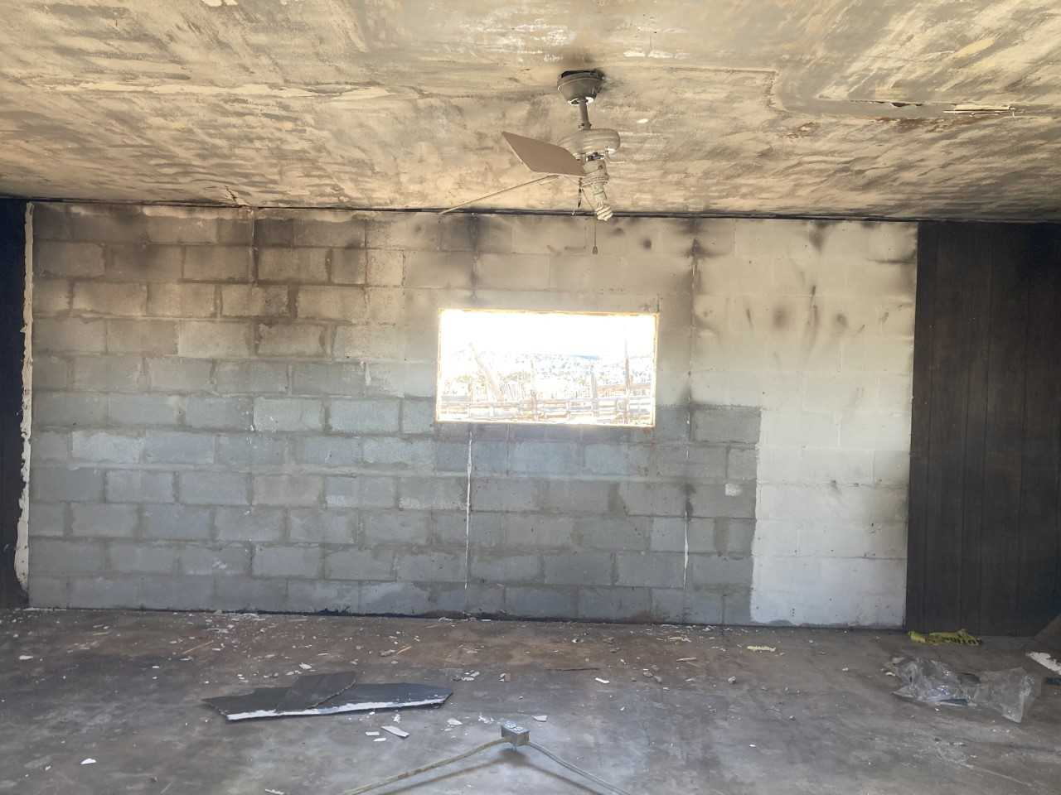
CSP RV-013 (Red Valley)

Slide 5
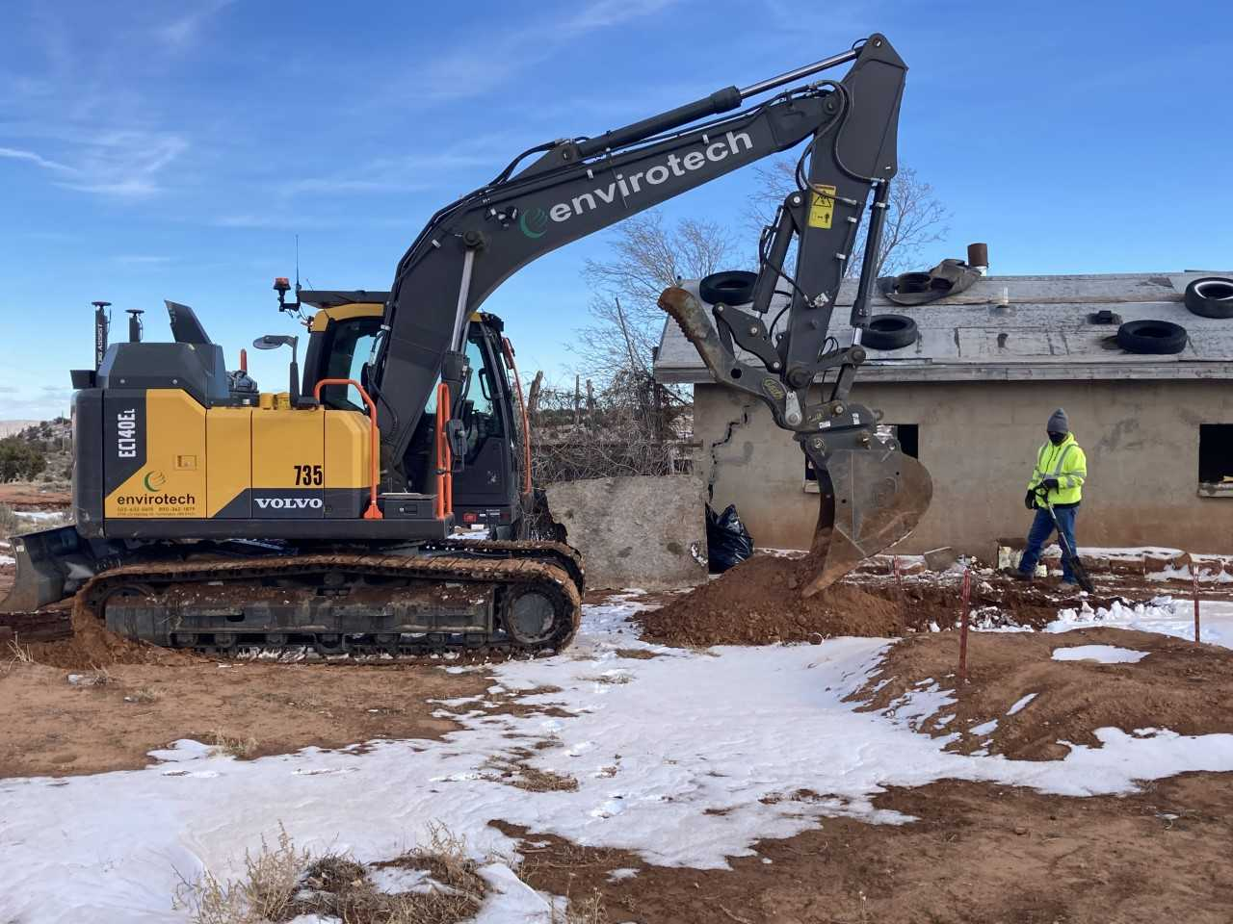
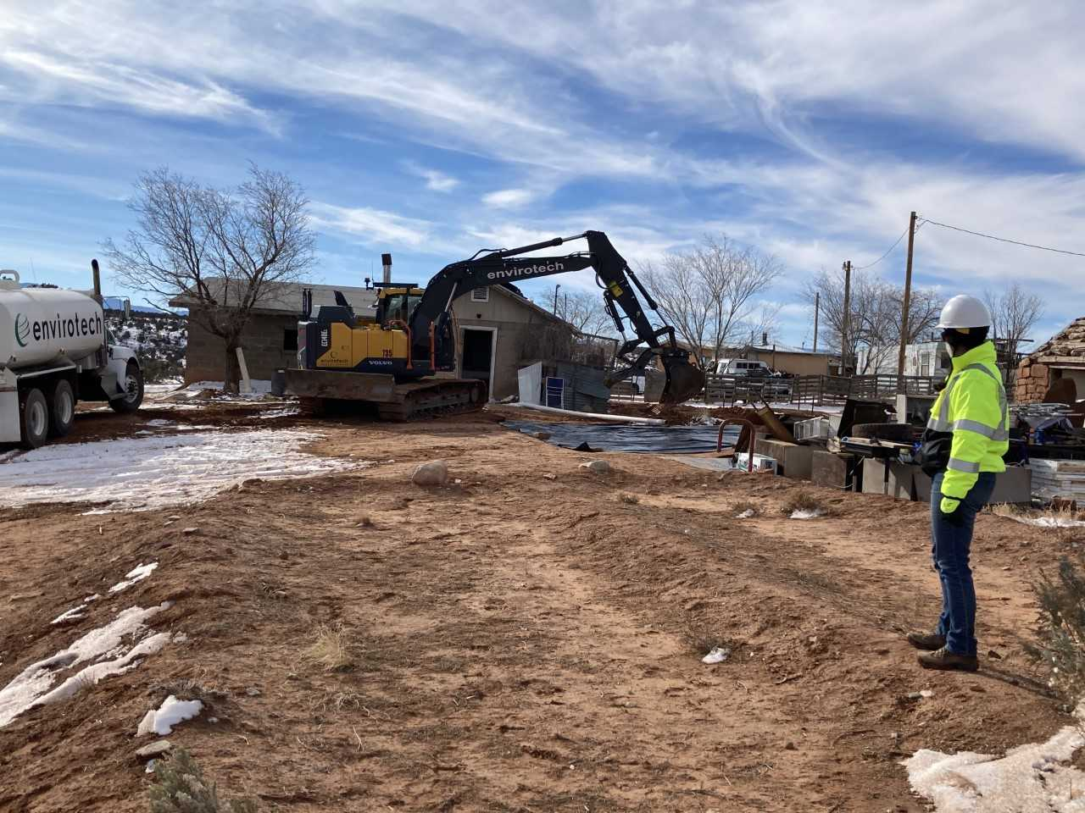
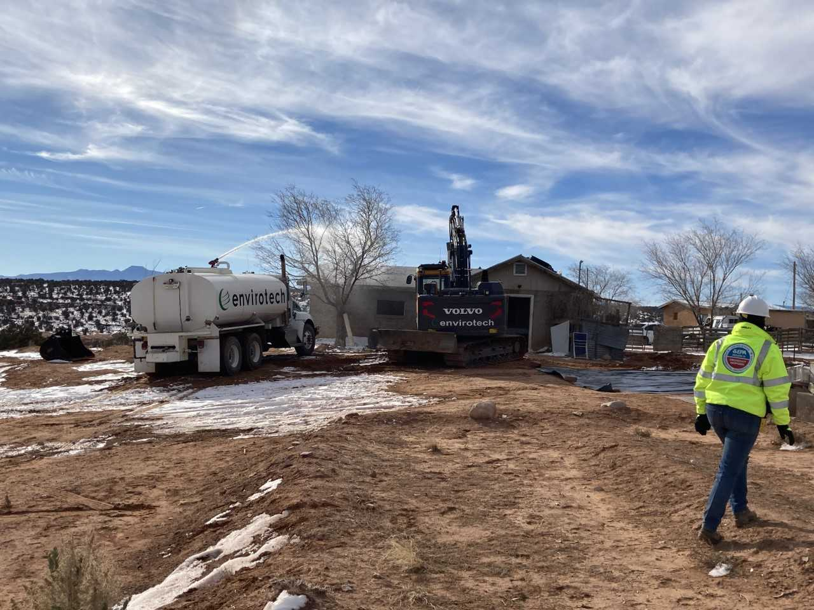
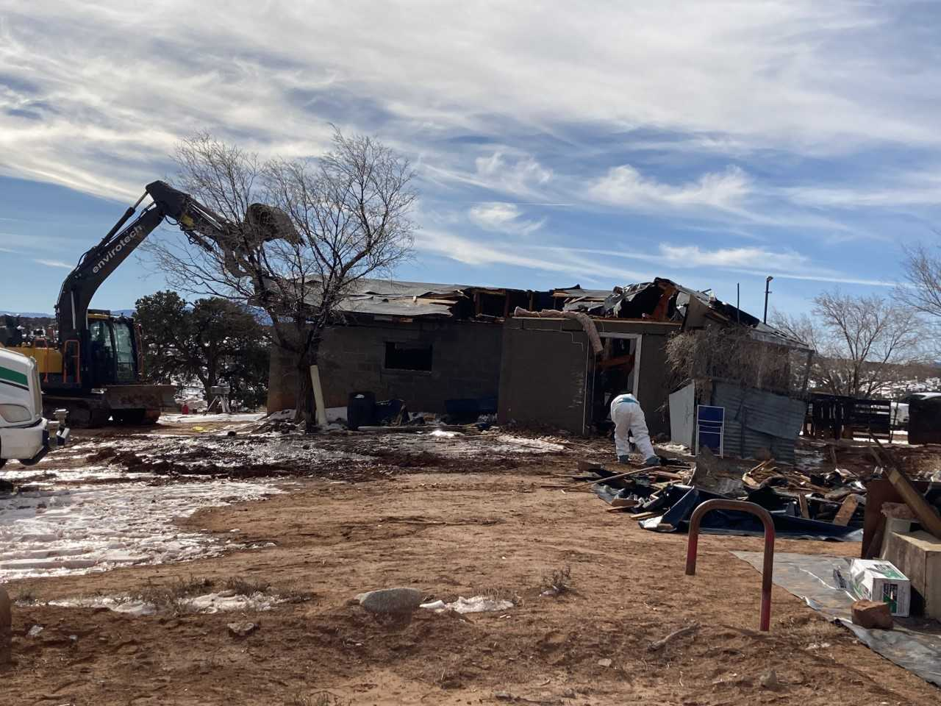
Demolition Begins for RV-013

Slide 6
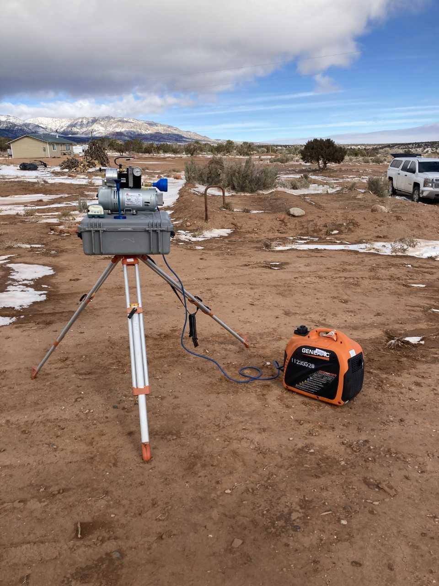
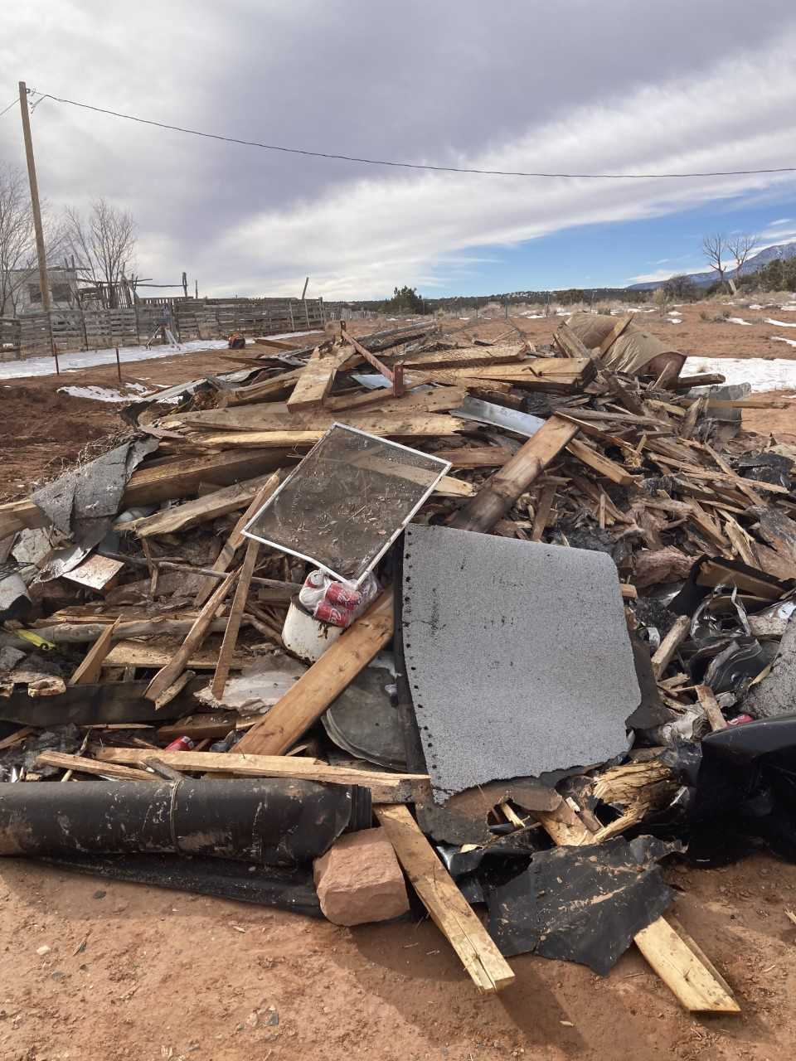
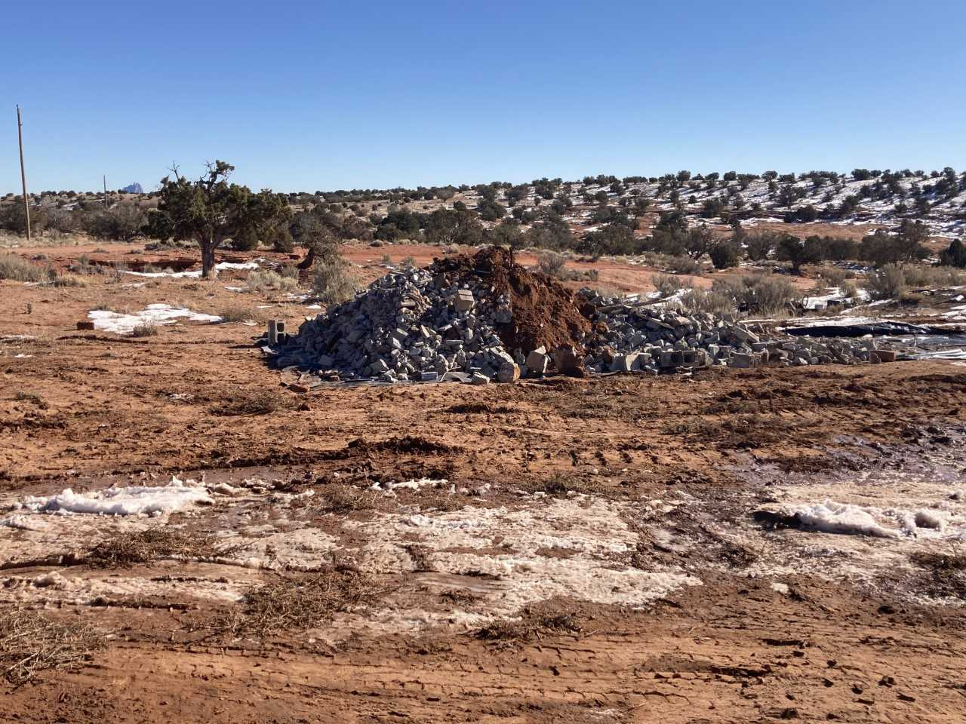
PM Monitoring & Scanning.

Slide 7
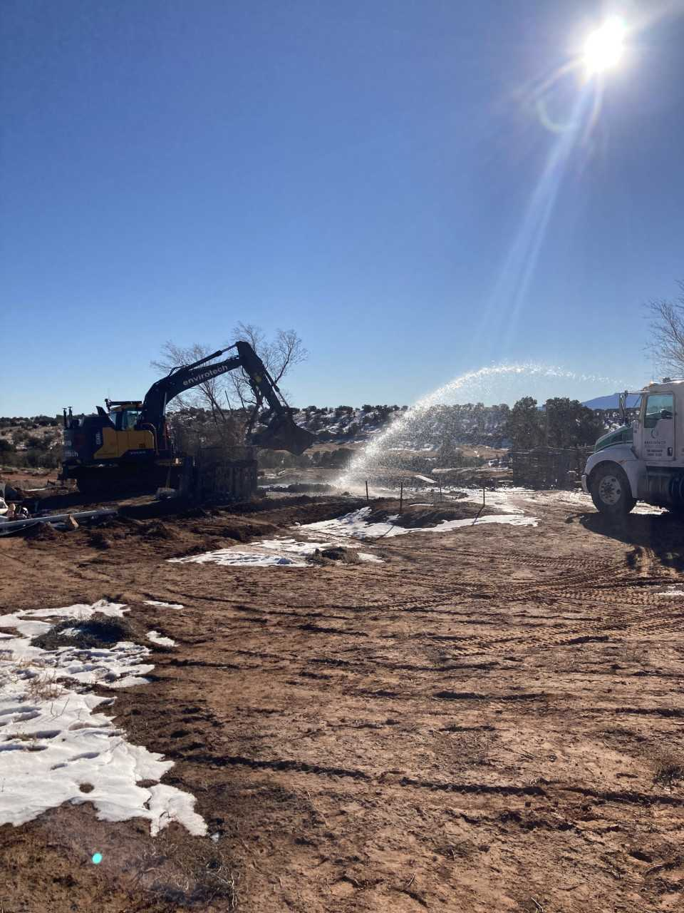
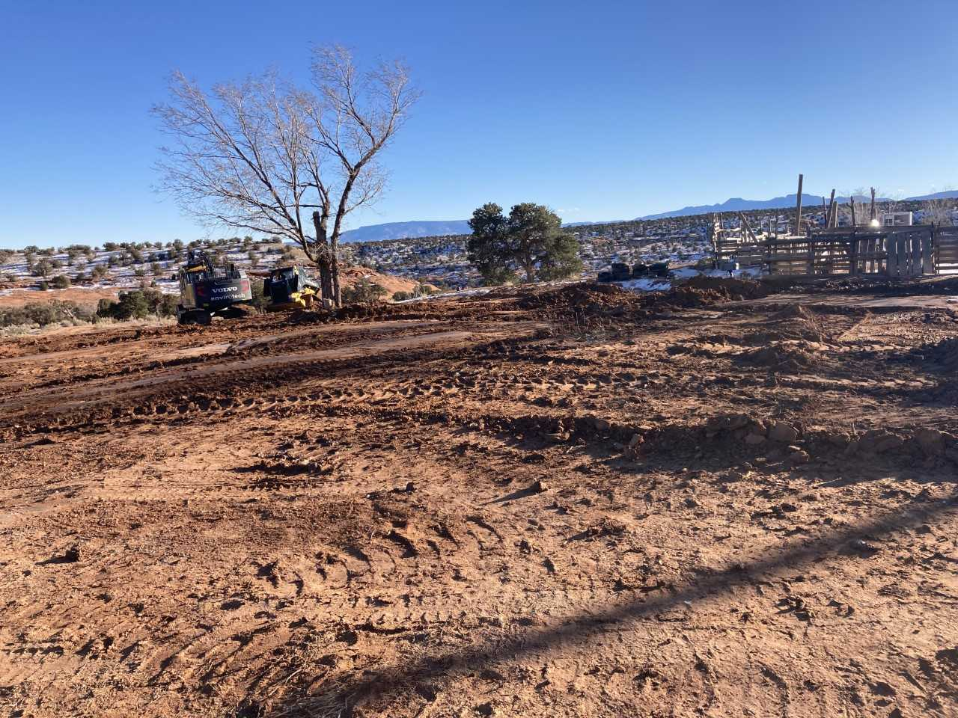
Water, Compaction & Clean Fill

Slide 8
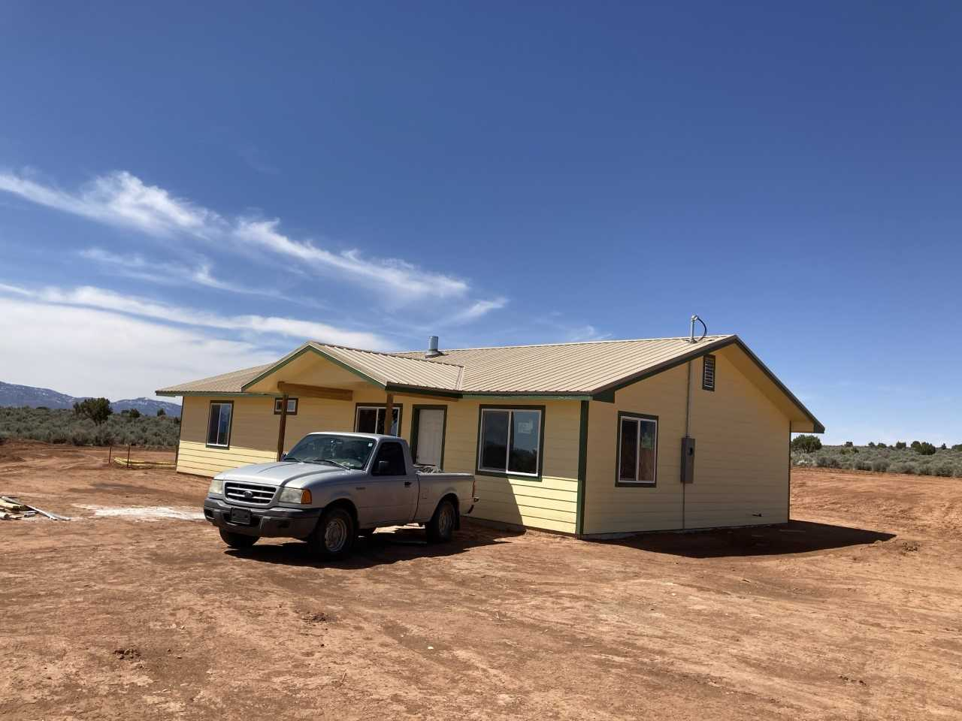
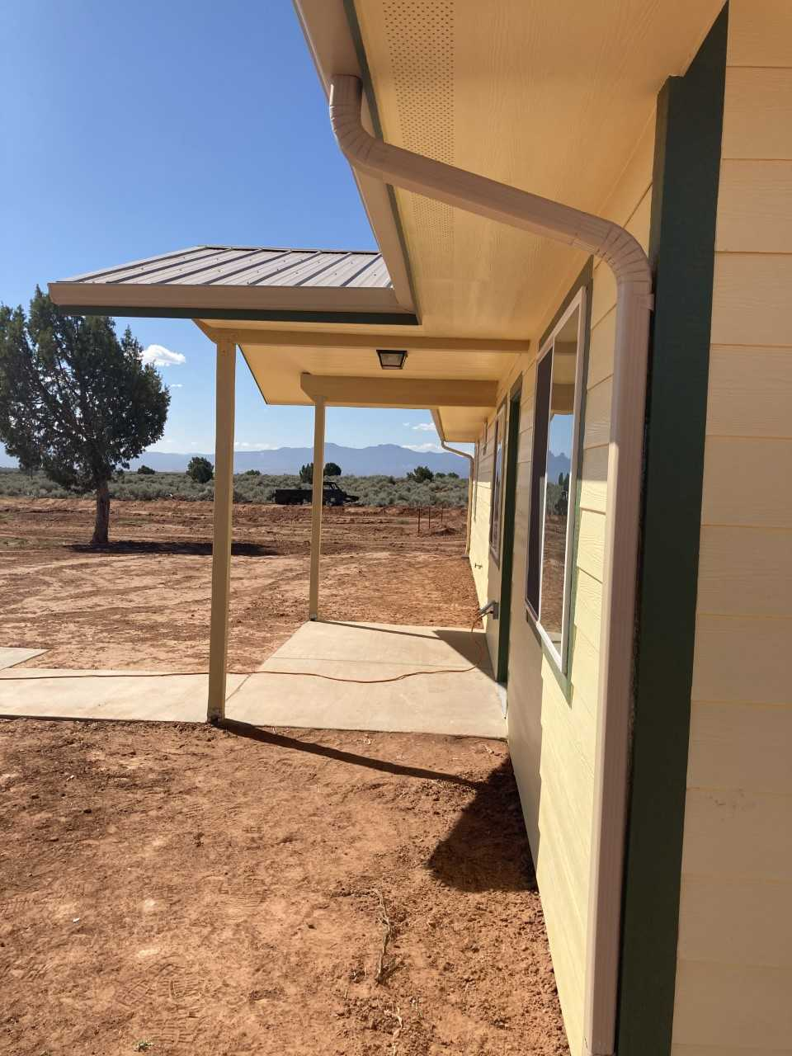
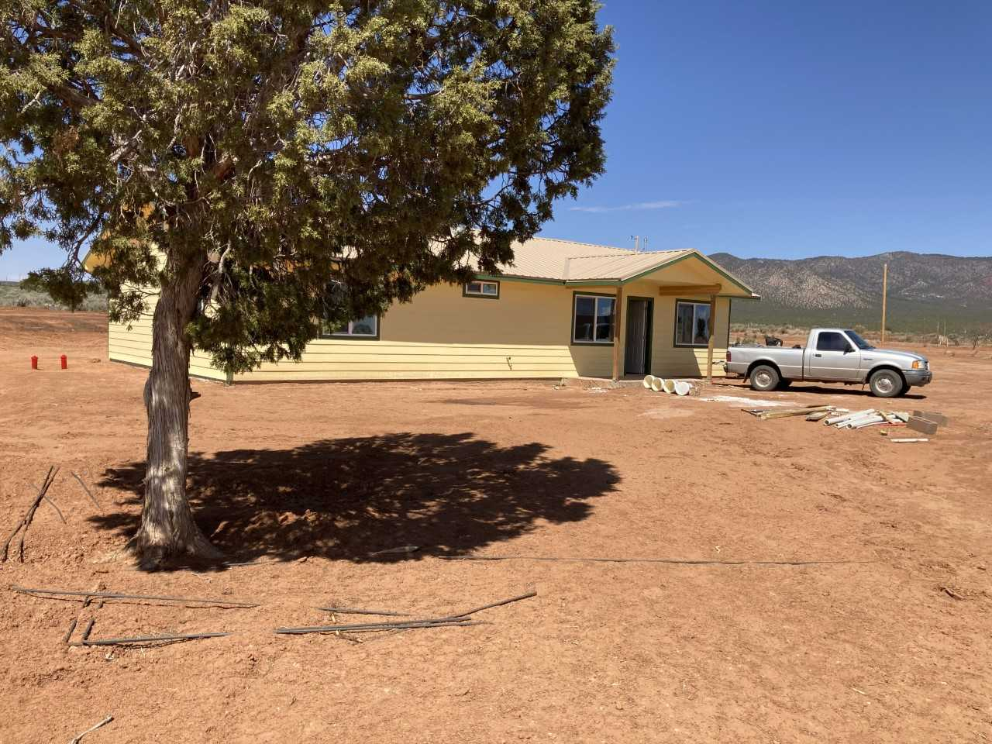
The New CSP Home “Hooghan”

Slide 9
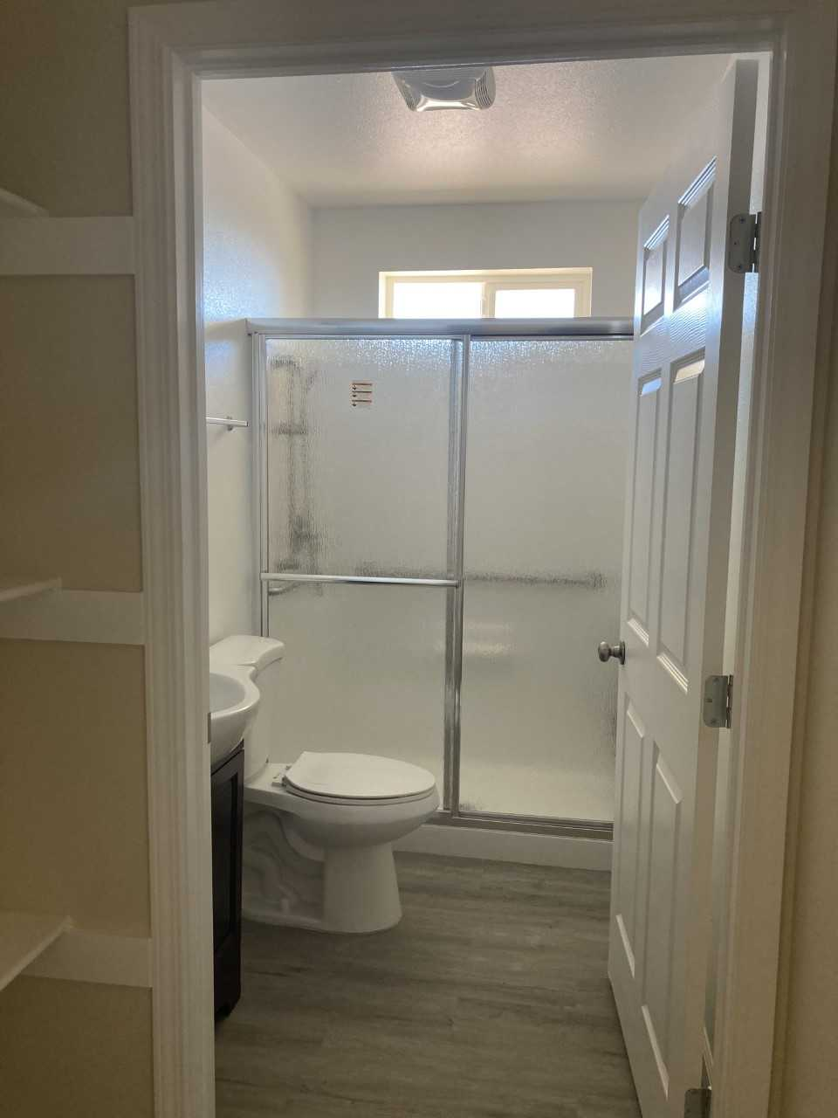
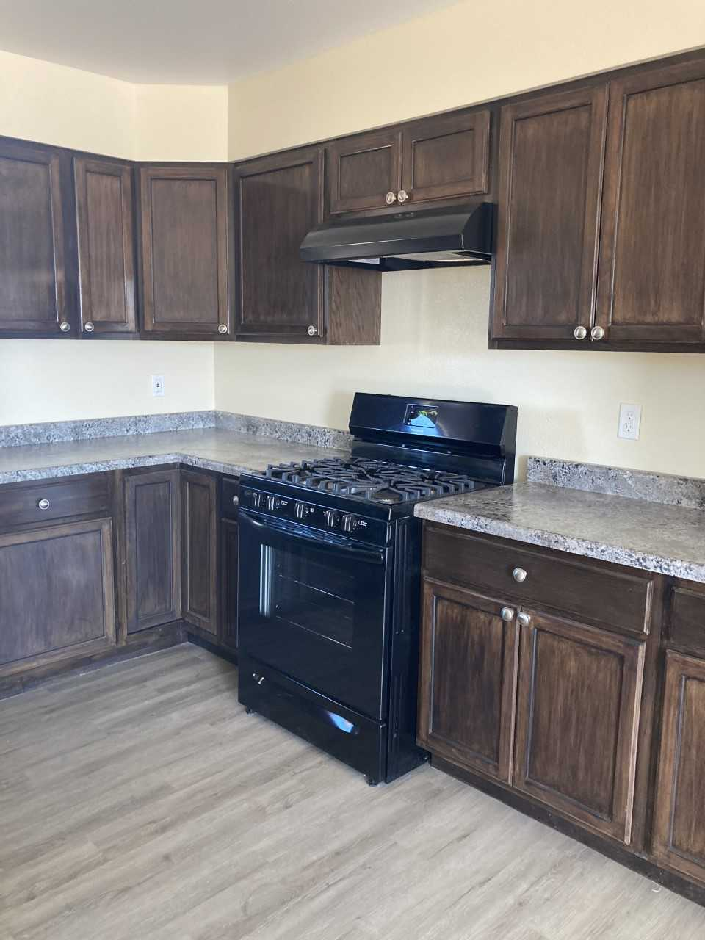
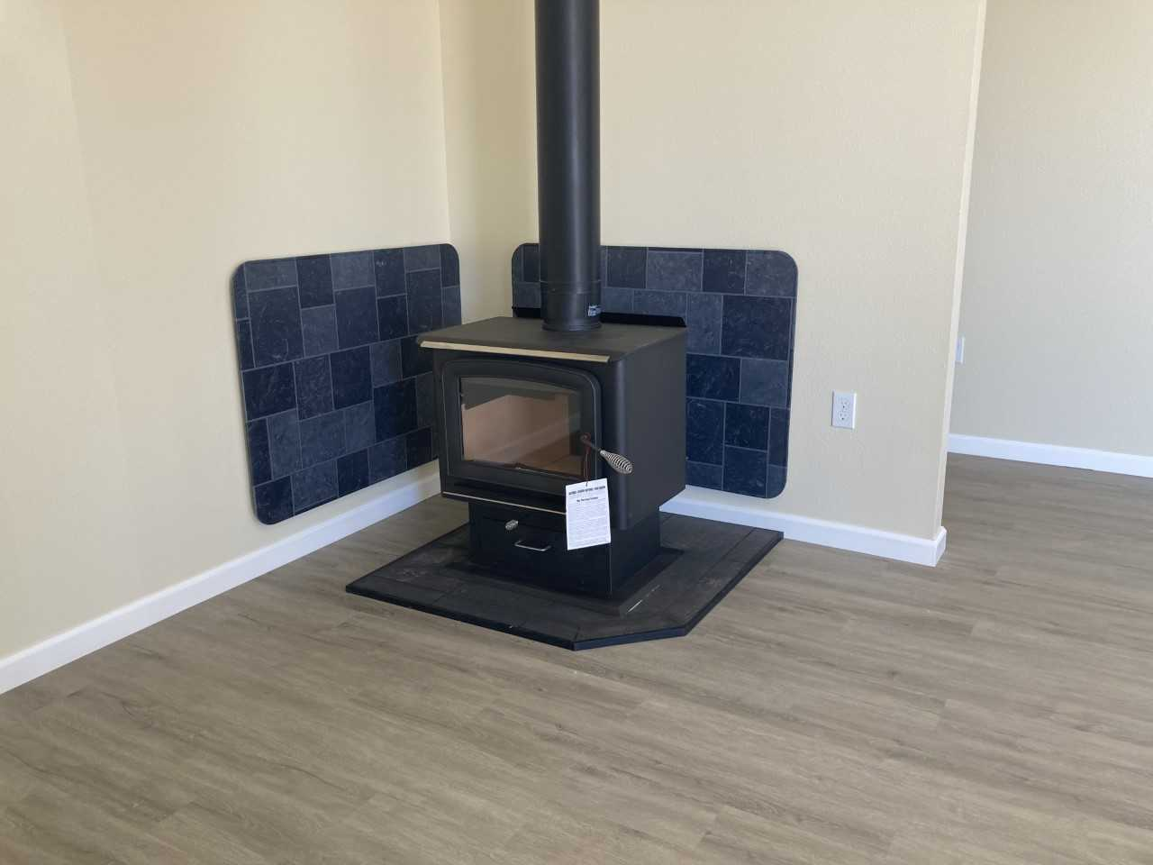
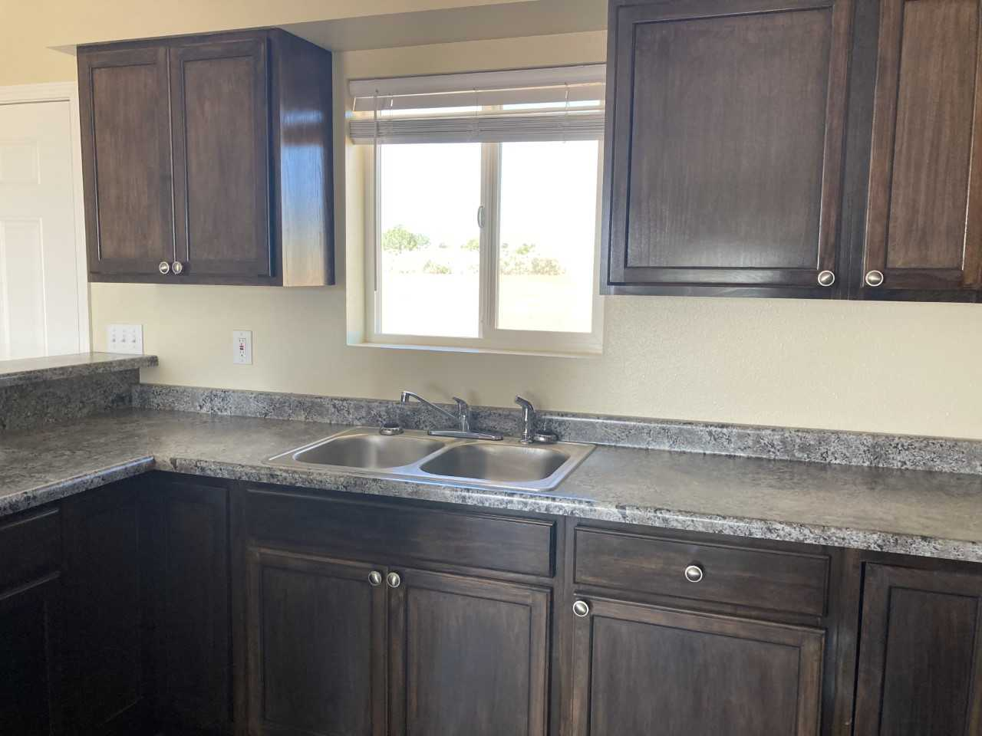
RV-013

Slide 10
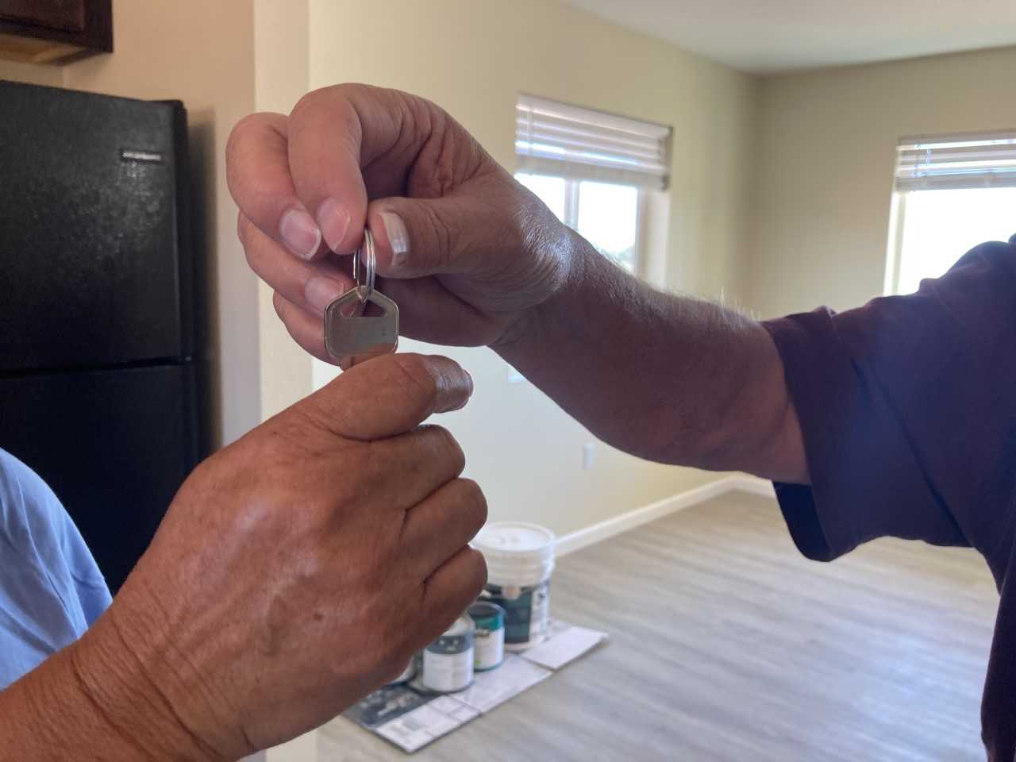
Ahéhee’ (Thank you)

