Slide 1
Application of RAMP Code VARSKIN at ANSTO
Jordan Saratsopoulos
Operations Leader,
Radiation Protection Services
ANSTO

Slide 2
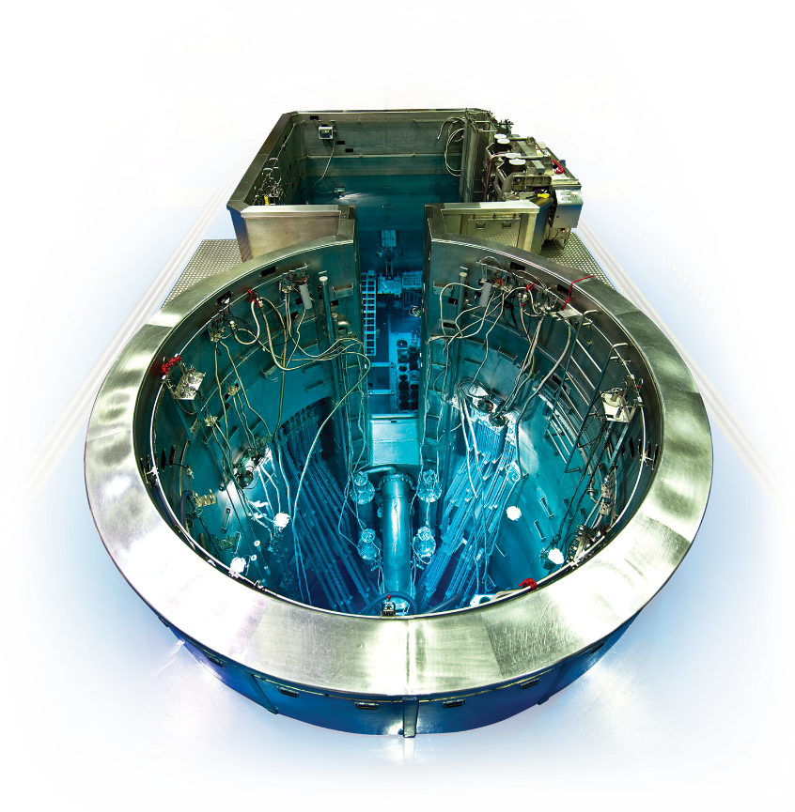
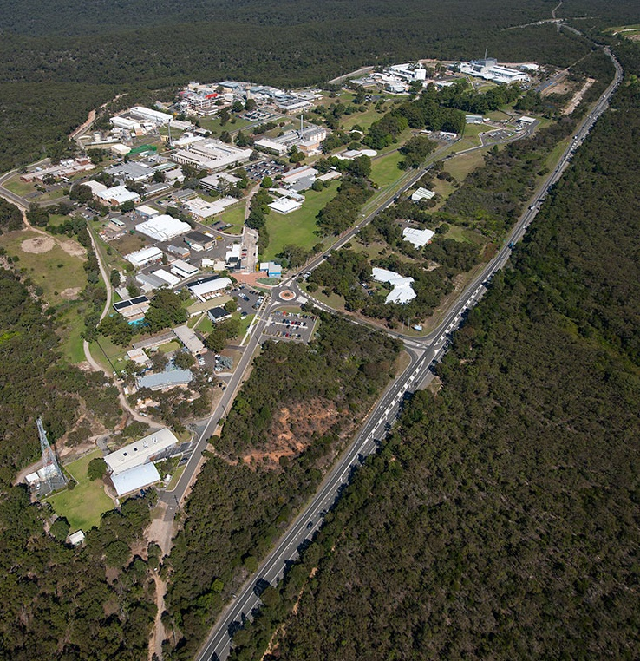
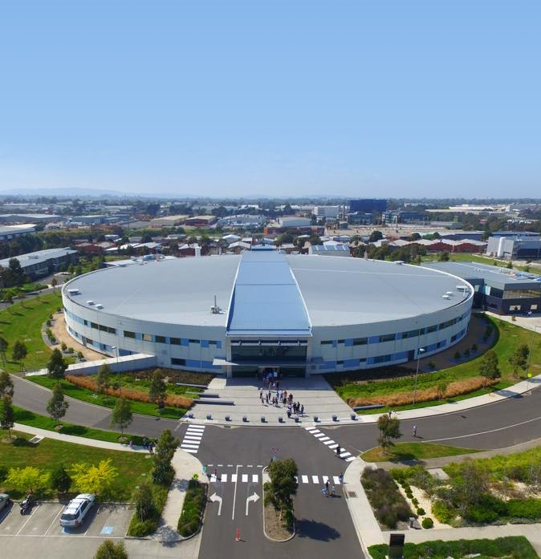

The Australian Nuclear Science and Technology Organisation (ANSTO)
OPAL multi-purpose reactor
Nuclear medicine
Neutron beam instruments
Research
Advice to Australian Government on nuclear
Lucas Heights campus, NSW
Australian Synchrotron, Clayton VIC

Slide 3
Radiation Protection Services
Promote excellence in the practice of radiation protection through our professionals
5 operational Health Physicists
15 operational Health Physics Surveyors
Dosimetry team
Other specialist roles
7 active users of VARSKIN
Notes:
See speaker notes

Slide 4
Our VARSKIN Journey
Where are we now
Where are we now (Radiation Protection Services)
Novice
Advanced Beginner
Competent
Proficient
Expert
Notes:
See speaker notes

Slide 5
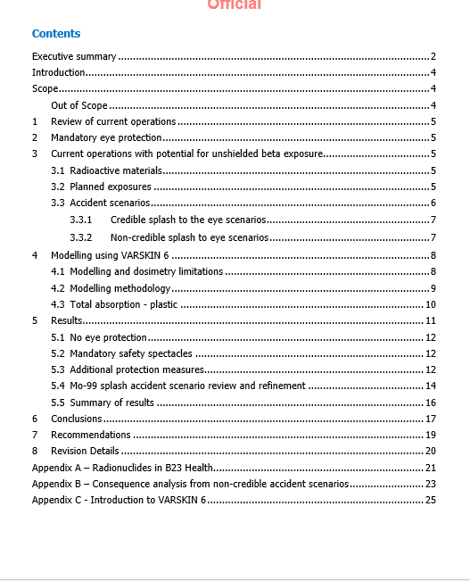
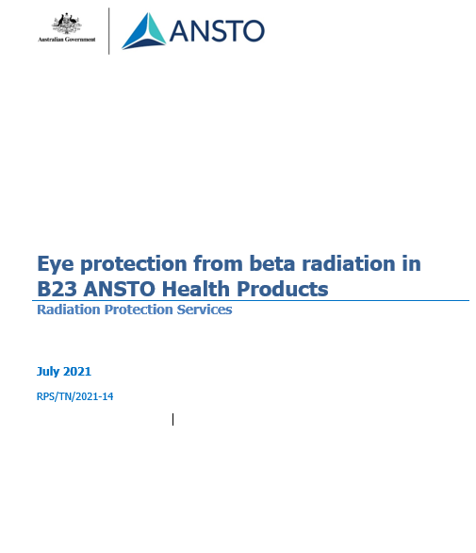
Application of VARSKIN
Effectiveness of eye protection for beta radiation within ANSTO’s nuclear medicine production facility
VARSKIN 6.2.1 employed to model potential lens of the eye equivalent dose from various splash accident scenarios
Emphasis on the magnitude of the exposure rather than the specific calculated doses
Results used as a planning tool to allow for conservative decision making
Consequence analysis only
Notes:
See speaker notes

Slide 6
Application of VARSKIN
Effectiveness of eye protection for beta radiation within ANSTO’s nuclear medicine production facility
# | Parameter | Value
a | Software version | VARSKIN 6.2.1
b | Source Geometry | Cylinder
c | Source Diameter | 1.13 mm
d | Source Thickness | 0.5 mm
e | Source Density | 1.0 g/cm³
f | Skin (Dose) Averaging Area | 1 cm²
g | Exposure Time | 5 minutes
h | Skin Thickness (equivalent to tissue thickness) | 3 mm
i | Radionuclide Library | ICRP 107D
j | Activity Units | Bq
k | Air Gap Thickness | a), b), c)
l | Cover Thickness | a), b), c)
m | Cover Density | 1.0 g/cm³
Modelling methodology
Exposure to the eye with:
a) no eye protection
b) mandatory safety glasses
c) additional face shield of any thickness

Slide 7


Application of VARSKIN
50µl
5 min
Effectiveness of eye protection for beta radiation within ANSTO’s nuclear medicine production facility
Outcomes
Nuclide | Activity
P-32 | 0.05 GBq
Mo-99 | 37 GBq
I-131 | 2.47 GBq
Sm-153 | 0.1 GBq
Lu-177 | 15 GBq
Tl-201 | 0.4 GBq
No eye protection:
  All nuclides with exception of Sm-153 would result in an equivalent dose to the lens of the eye greater than legal limit
Notes:
See notes

Slide 8


Application of VARSKIN
10mm air gap + 2 mm cover thickness
Effectiveness of eye protection for beta radiation within ANSTO’s nuclear medicine production facility
Outcomes
No eye protection:
  All nuclides with exception of Sm-153 would result in an equivalent dose to the lens of the eye greater than legal limit
Mandatory eye protection:
  Introduction of 10 mm air gap and 2 mm shielding
    Reduce exposure by an order of magnitude
  Still a potential significant exposure for Lu-177, I-131 and Mo-99 due to photon dose contribution

Slide 9
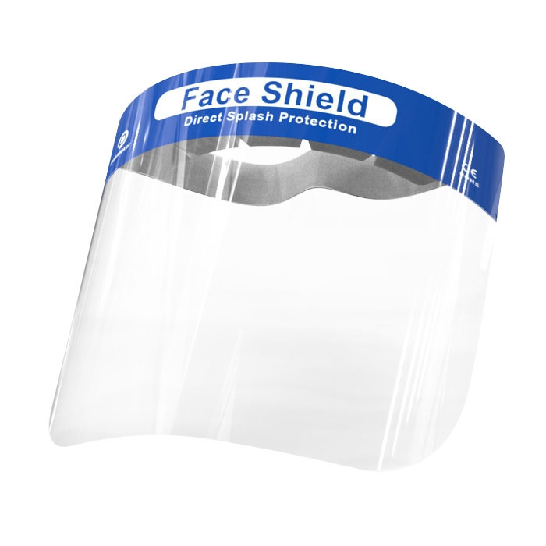
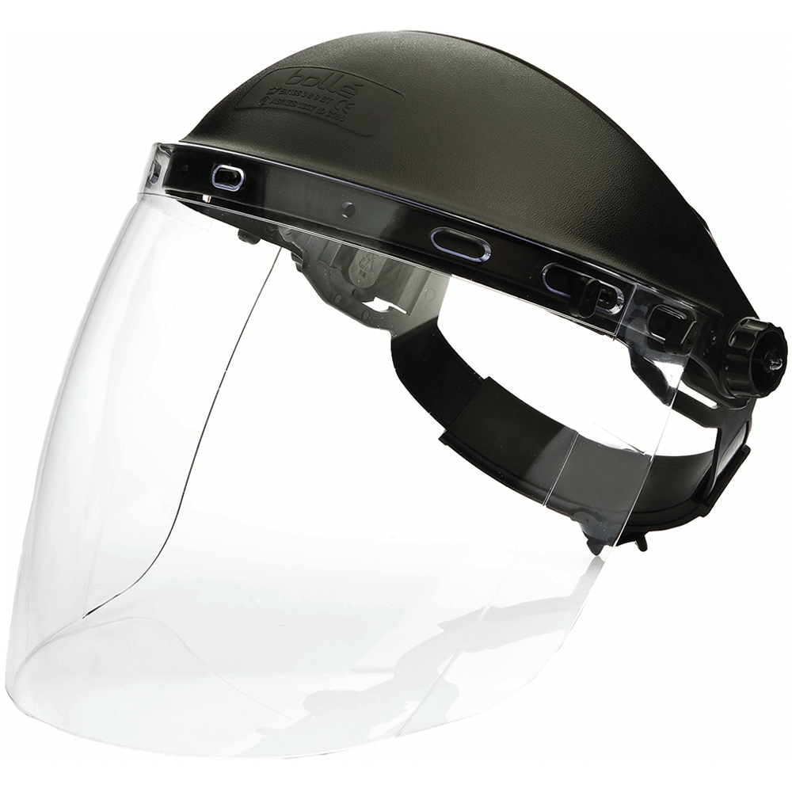
Application of VARSKIN
Effectiveness of eye protection for beta radiation within ANSTO’s nuclear medicine production facility
Additional protective measures:
  Introduction of face shield significantly reduces dose to the lens of the eye for I-131 and Lu-177
    Due to the additional 65 mm air gap introduced with a face shield
  Thickness of face shield is not an important consideration for these radiological hazards
    Use of thin plastic face shield e.g. covid face shield is just as effective as thicker industrial type face shield

Slide 10
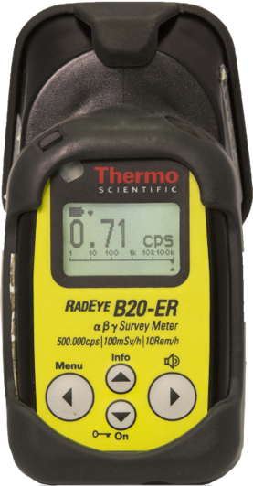
Application of VARSKIN
Mo
99
!
Nuclide specific operational decision making tool
Mo-99 potential skin contamination
Conservative assumptions:
  Mo-99/Tc-99m
  5 minute exposure time
  No reduction from PPE e.g. lab coats, pants
  No reduction from radiation attenuation gloves
Isotope
Exposure time
Skin dose coefficient
Instrument
Detector area
Detector efficiency
Mo-99/Tc-99m
5 min
1.82 mGy/kBq/h
RadEye B-20ER
15.2 cm²
21.5 %
Notes:
See notes

Slide 11
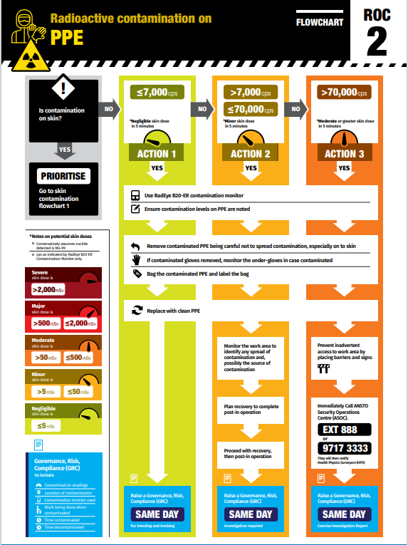
Application of VARSKIN
Nuclide specific operational decision making tool
Outcomes
Decision-making flow charts
  1. Skin
  2. PPE
  3. Tools & Equipment
  4. Empty container

Slide 12
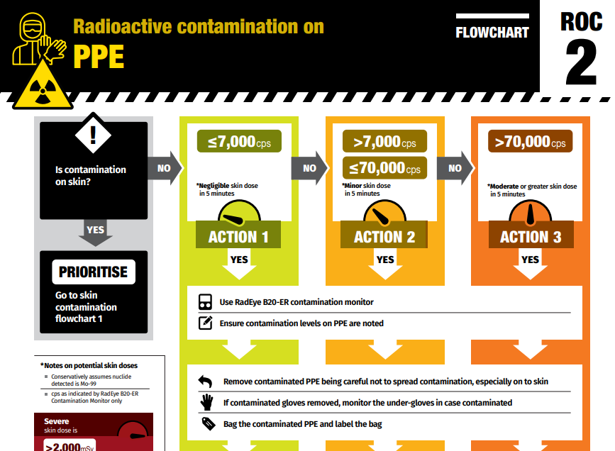
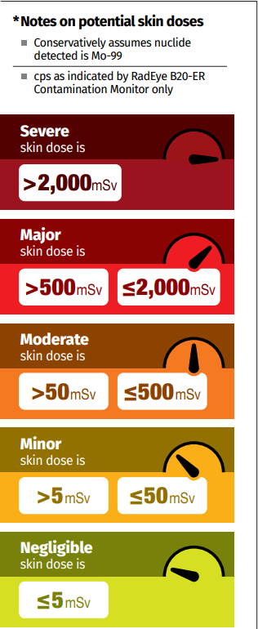
Application of VARSKIN
Nuclide specific operational decision making tool
Outcomes
Action levels align with ANSTO Risk Analysis Matrix
  Action 1: ≤ 7,000 cps = ≤ 5 mSv skin dose (negligible)
  Action 2: ≤ 70,000cps = > 5 mSv - ≤ 50 mSv skin dose (minor)
  Action 3: > 70,000cps = > 50 mSv - ≤ 500 mSv skin dose (moderate)

Slide 13
Application of VARSKIN
Nuclide specific operational decision making tool
Outcomes
Allows the operators to make consistent decisions for the variety of potential situation

Slide 14

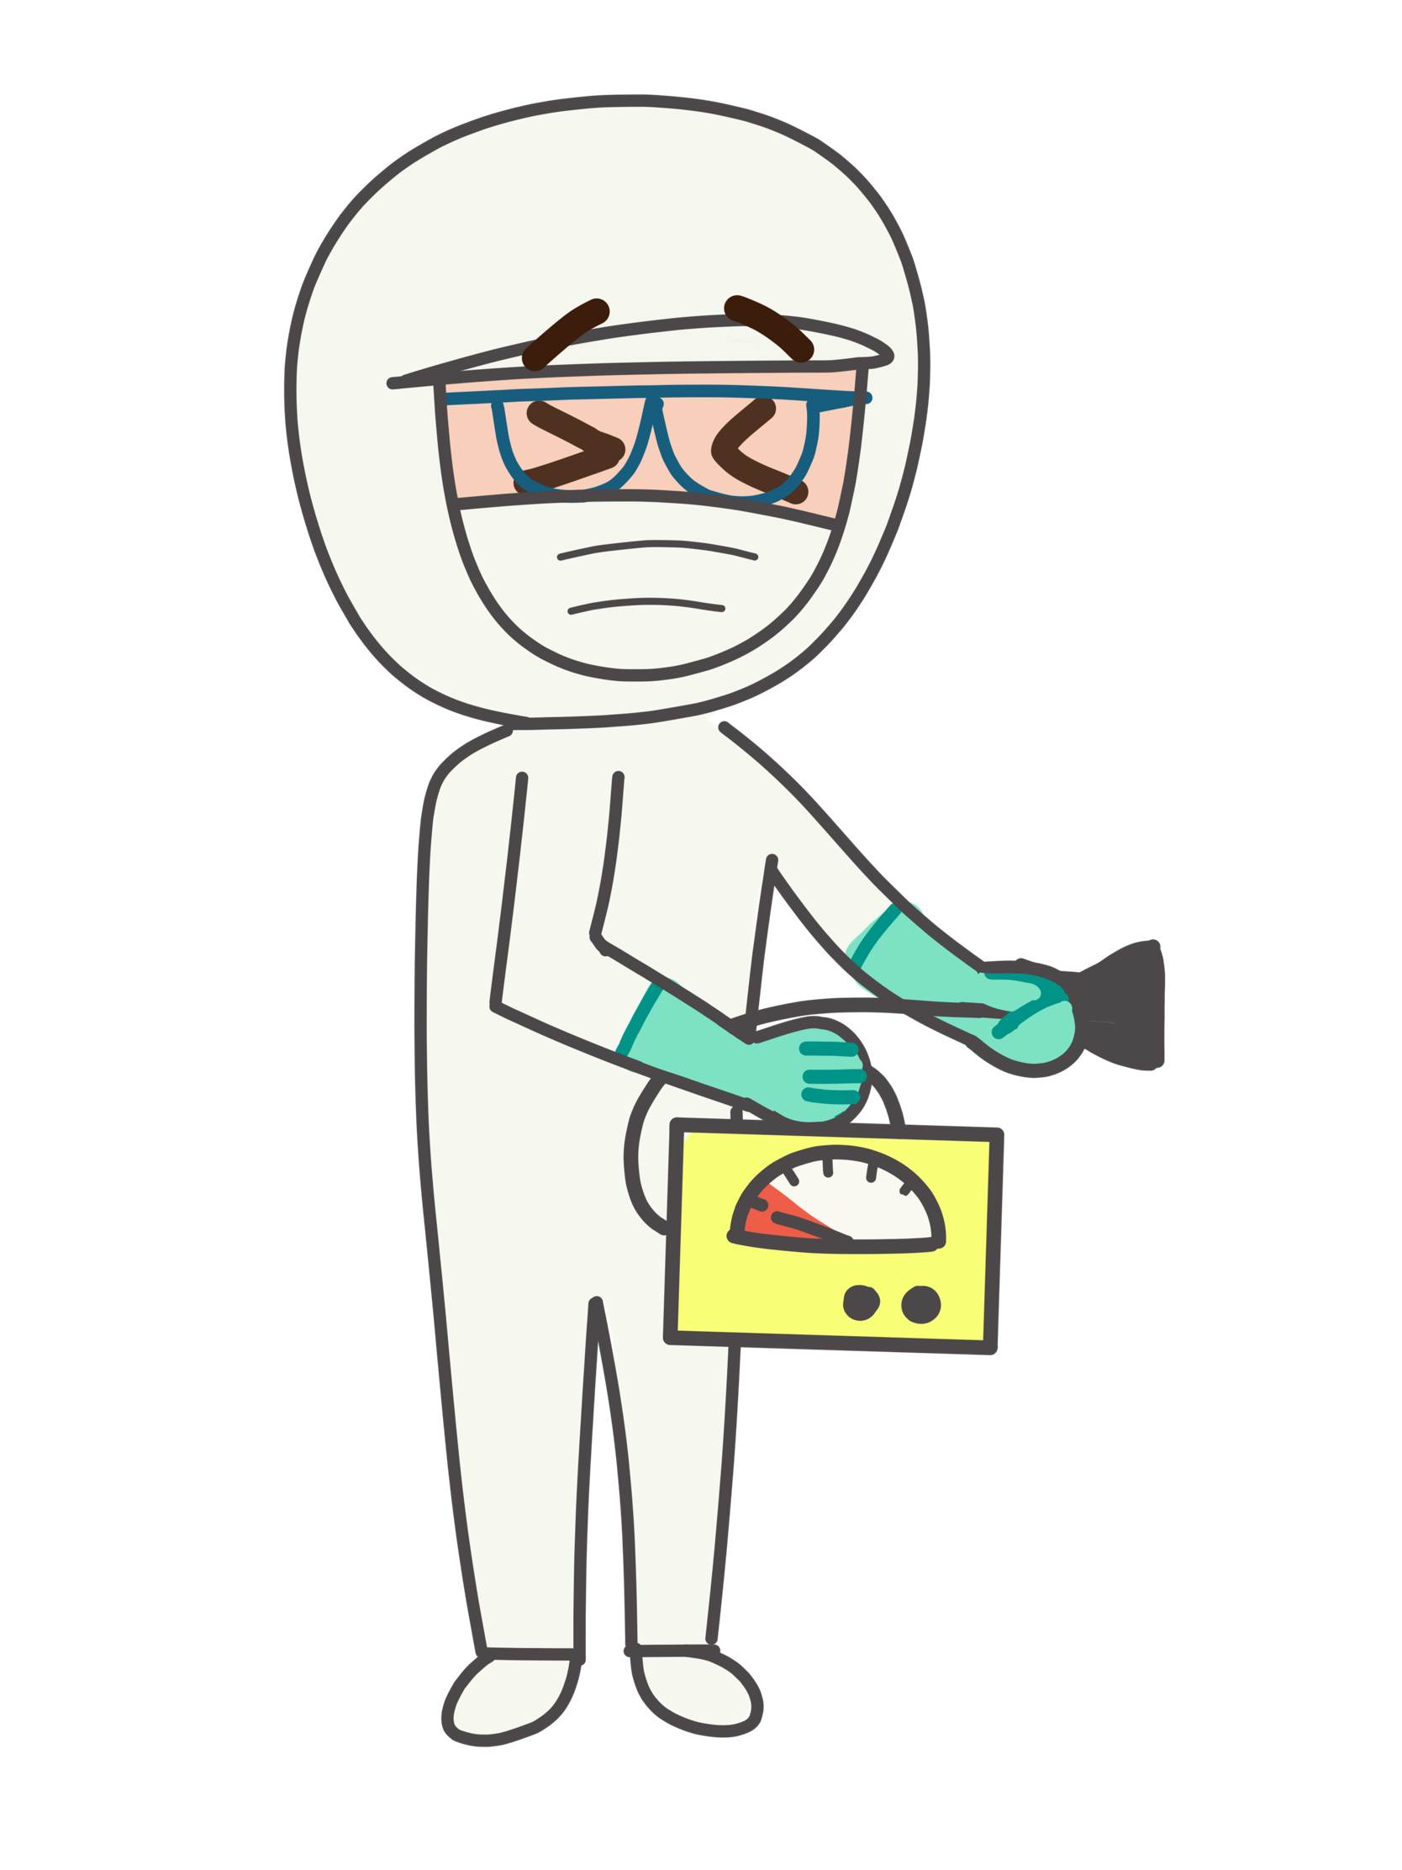
Application of VARSKIN
Skin dose assessment following contamination event
Health Physicist will run VARSKIN
Point source geometry to determine order of magnitude
Conservative exposure time
Comparison against ANSTO risk matrix
  ≤ 50 mSv no further modelling
  > 50 mSv look at ways to refine model
Notes:
See notes

Slide 15
Application of VARSKIN
 | Radionuclide |  | Terbium-161
 |  |  | Tb-161
 | Half Life |  | 165.84 |  | hours
 | Activity on Skin |  | 1.5 |  | MBq
 | Exposure Time |  | 5.0 |  | minutes
 | Scenario |  | Contamination with a small amount of material
 | Model |  | 1 μL/ 1 cm² Uniform Deposit
 | Radioactivity Level on Skin (kBq) |  | 1500
 | Dose Coefficient (mSv.h⁻¹.kBq⁻¹) |  | 1.29E+00
 | Initial Skin Dose Rate (mSv.h⁻¹) |  | 1935
 | Estimated Skin Dose (mSv) |  | 161.2
 | Statutory Dose (500 mSv) Annual Limits |  | This dose is 32% of the skin dose annual statutory limit
 | Tissue Reactions (ICRP 118)
 | Common Scenarios |  | Skin Dose (mSv) |  | Potential Effects
 | The following scenarios should be assessed whenever manual chemistry is to be performed with an active solution.
 | Contaminated since the previous 5 minute routine check | Contamination for 5 minutes | 161.2 |  | This dose is 32% of the skin dose annual statutory limit
 | Contaminated for two 5 minute routine check periods | Contamination for 10 minutes | 322.4 |  | This dose is 64% of the skin dose annual statutory limit
 | Contaminated for an hour before detection and removal | Contamination for 60 minutes | 1931.0 |  | This dose is 386% of the skin dose annual statutory limit
 | Contaminated for half a standard 12 hour shift before detection and removal | Contamination for 6 hours | 11465.6 |  | This dose is 2293% of the skin dose annual statutory limit. This dose may lead to radiation induced injuries to the skin such as reddening of the skin (Erythema), hair loss (Epilation), thinning of the skin (Dermal Atrophy) and occurrence of spider veins (Telangiectasia)
 | Contamination for a day before detection and removal, such as due to the contamination being fixed | Contamination for 24 hours | 44186.8 |  | This dose is 8837% of the skin dose annual statutory limit. This dose may lead to radiation induced injuries to the skin such as reddening of the skin (Erythema), hair loss (Epilation), breakdown of the skin (Desquamation), thinning of the skin (Dermal Atrophy), occurrence of spider veins (Telangiectasia) and death of the skin (Dermal Necrosis)
 | Skin Dose Impact Levels (AG2395) |  | Skin Tissue Reactions (ICRP 118)
 |  |  | Approximate threshold single doses and time of onset for the reaction of human skin to ionising radiation delivered in fluoroscopy exposures. These threshold doses are considered to be near to ED1 (the estimated dose for 1% incidence).
 |  |  | Effect |  | Approximate Threshold Doses (Sv) | Time of onset
 |  |  | Early Transient Erythema |  | 2 | 2-24 h
 |  |  | Main Erythema Reaction |  | 6 | ~1.5 weeks
 | Severe/ Catastrophic | >2000 mSv | Late Erythema |  | 15 | 8-10 weeks
 |  |  | Temporary Epilation |  | 3 | ~3 weeks
 | Major | 500 - 2000 mSv | Permanent Epilation |  | 7 | ~3 weeks
 |  |  | Dry Desquamation |  | 14 | ~4-6 weeks
 | Moderate | 50-500 mSv | Moist Desquamation |  | 18 | ~4 weeks
 |  |  | Secondary Ulceration |  | 24 | > 6 weeks
 | Minor | 5-50 mSv | Ischaemic Dermal Necrosis |  | 18 | > 10 weeks
 |  |  | Dermal Atrophy (First Phase) |  | 10 | > 52 weeks
 | Negligible | < 5 mSv | Telangiectasia |  | 10 | > 52 weeks
 |  |  | Dermal Necrosis (Late Phase) |  | >15? | > 52 weeks
In-house skin dose calculator (excel)
Overview:
  Utilises skin dose coefficients derived from VARSKIN code
  In the process of updating coefficients to align with latest version of VARSKIN

Slide 16
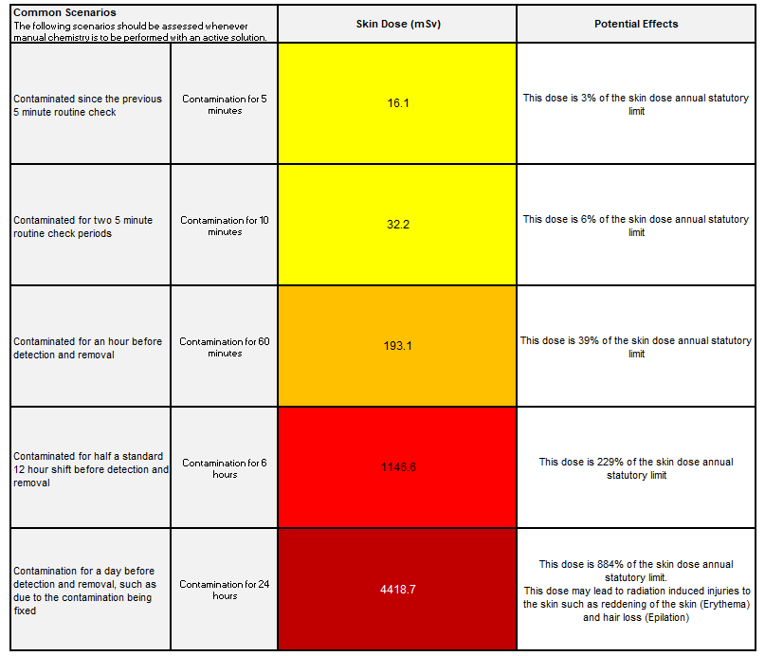
Application of VARSKIN
 | Radionuclide |  | Terbium-161
 |  |  | Tb-161
 | Half Life |  | 165.84 |  | hours
 | Activity on Skin |  | 1.5 |  | MBq
 | Exposure Time |  | 5.0 |  | minutes
 | Scenario |  | Contamination with a small amount of material
 | Model |  | 1 μL/ 1 cm² Uniform Deposit
 | Radioactivity Level on Skin (kBq) |  | 1500
 | Dose Coefficient (mSv.h⁻¹.kBq⁻¹) |  | 1.29E+00
 | Initial Skin Dose Rate (mSv.h⁻¹) |  | 1935
 | Estimated Skin Dose (mSv) |  | 161.2
 | Statutory Dose (500 mSv) Annual Limits |  | This dose is 32% of the skin dose annual statutory limit
 | Tissue Reactions (ICRP 118)
 | Common Scenarios |  | Skin Dose (mSv) |  | Potential Effects
 | The following scenarios should be assessed whenever manual chemistry is to be performed with an active solution.
 | Contaminated since the previous 5 minute routine check | Contamination for 5 minutes | 161.2 |  | This dose is 32% of the skin dose annual statutory limit
 | Contaminated for two 5 minute routine check periods | Contamination for 10 minutes | 322.4 |  | This dose is 64% of the skin dose annual statutory limit
 | Contaminated for an hour before detection and removal | Contamination for 60 minutes | 1931.0 |  | This dose is 386% of the skin dose annual statutory limit
 | Contaminated for half a standard 12 hour shift before detection and removal | Contamination for 6 hours | 11465.6 |  | This dose is 2293% of the skin dose annual statutory limit. This dose may lead to radiation induced injuries to the skin such as reddening of the skin (Erythema), hair loss (Epilation), thinning of the skin (Dermal Atrophy) and occurrence of spider veins (Telangiectasia)
 | Contamination for a day before detection and removal, such as due to the contamination being fixed | Contamination for 24 hours | 44186.8 |  | This dose is 8837% of the skin dose annual statutory limit. This dose may lead to radiation induced injuries to the skin such as reddening of the skin (Erythema), hair loss (Epilation), breakdown of the skin (Desquamation), thinning of the skin (Dermal Atrophy), occurrence of spider veins (Telangiectasia) and death of the skin (Dermal Necrosis)
 | Skin Dose Impact Levels (AG2395) |  | Skin Tissue Reactions (ICRP 118)
 |  |  | Approximate threshold single doses and time of onset for the reaction of human skin to ionising radiation delivered in fluoroscopy exposures. These threshold doses are considered to be near to ED1 (the estimated dose for 1% incidence).
 |  |  | Effect |  | Approximate Threshold Doses (Sv) | Time of onset
 |  |  | Early Transient Erythema |  | 2 | 2-24 h
 |  |  | Main Erythema Reaction |  | 6 | ~1.5 weeks
 | Severe/ Catastrophic | >2000 mSv | Late Erythema |  | 15 | 8-10 weeks
 |  |  | Temporary Epilation |  | 3 | ~3 weeks
 | Major | 500 - 2000 mSv | Permanent Epilation |  | 7 | ~3 weeks
 |  |  | Dry Desquamation |  | 14 | ~4-6 weeks
 | Moderate | 50-500 mSv | Moist Desquamation |  | 18 | ~4 weeks
 |  |  | Secondary Ulceration |  | 24 | > 6 weeks
 | Minor | 5-50 mSv | Ischaemic Dermal Necrosis |  | 18 | > 10 weeks
 |  |  | Dermal Atrophy (First Phase) |  | 10 | > 52 weeks
 | Negligible | < 5 mSv | Telangiectasia |  | 10 | > 52 weeks
 |  |  | Dermal Necrosis (Late Phase) |  | >15? | > 52 weeks
In-house skin dose calculator (excel)
Benefits
  Available for all personnel to use as a planning tool
  Simultaneously display multiple exposure scenarios based on predetermined exposure times

Slide 17
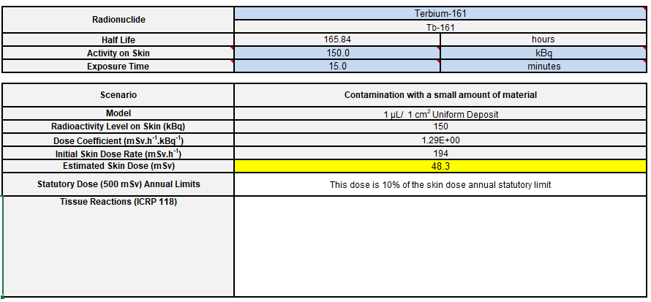
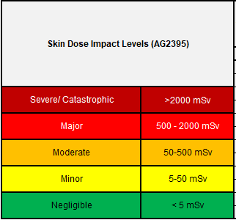
Application of VARSKIN
 | Radionuclide |  | Terbium-161
 |  |  | Tb-161
 | Half Life |  | 165.84 |  | hours
 | Activity on Skin |  | 1.5 |  | MBq
 | Exposure Time |  | 5.0 |  | minutes
 | Scenario |  | Contamination with a small amount of material
 | Model |  | 1 μL/ 1 cm² Uniform Deposit
 | Radioactivity Level on Skin (kBq) |  | 1500
 | Dose Coefficient (mSv.h⁻¹.kBq⁻¹) |  | 1.29E+00
 | Initial Skin Dose Rate (mSv.h⁻¹) |  | 1935
 | Estimated Skin Dose (mSv) |  | 161.2
 | Statutory Dose (500 mSv) Annual Limits |  | This dose is 32% of the skin dose annual statutory limit
 | Tissue Reactions (ICRP 118)
 | Common Scenarios |  | Skin Dose (mSv) |  | Potential Effects
 | The following scenarios should be assessed whenever manual chemistry is to be performed with an active solution.
 | Contaminated since the previous 5 minute routine check | Contamination for 5 minutes | 161.2 |  | This dose is 32% of the skin dose annual statutory limit
 | Contaminated for two 5 minute routine check periods | Contamination for 10 minutes | 322.4 |  | This dose is 64% of the skin dose annual statutory limit
 | Contaminated for an hour before detection and removal | Contamination for 60 minutes | 1931.0 |  | This dose is 386% of the skin dose annual statutory limit
 | Contaminated for half a standard 12 hour shift before detection and removal | Contamination for 6 hours | 11465.6 |  | This dose is 2293% of the skin dose annual statutory limit. This dose may lead to radiation induced injuries to the skin such as reddening of the skin (Erythema), hair loss (Epilation), thinning of the skin (Dermal Atrophy) and occurrence of spider veins (Telangiectasia)
 | Contamination for a day before detection and removal, such as due to the contamination being fixed | Contamination for 24 hours | 44186.8 |  | This dose is 8837% of the skin dose annual statutory limit. This dose may lead to radiation induced injuries to the skin such as reddening of the skin (Erythema), hair loss (Epilation), breakdown of the skin (Desquamation), thinning of the skin (Dermal Atrophy), occurrence of spider veins (Telangiectasia) and death of the skin (Dermal Necrosis)
 | Skin Dose Impact Levels (AG2395) |  | Skin Tissue Reactions (ICRP 118)
 |  |  | Approximate threshold single doses and time of onset for the reaction of human skin to ionising radiation delivered in fluoroscopy exposures. These threshold doses are considered to be near to ED1 (the estimated dose for 1% incidence).
 |  |  | Effect |  | Approximate Threshold Doses (Sv) | Time of onset
 |  |  | Early Transient Erythema |  | 2 | 2-24 h
 |  |  | Main Erythema Reaction |  | 6 | ~1.5 weeks
 | Severe/ Catastrophic | >2000 mSv | Late Erythema |  | 15 | 8-10 weeks
 |  |  | Temporary Epilation |  | 3 | ~3 weeks
 | Major | 500 - 2000 mSv | Permanent Epilation |  | 7 | ~3 weeks
 |  |  | Dry Desquamation |  | 14 | ~4-6 weeks
 | Moderate | 50-500 mSv | Moist Desquamation |  | 18 | ~4 weeks
 |  |  | Secondary Ulceration |  | 24 | > 6 weeks
 | Minor | 5-50 mSv | Ischaemic Dermal Necrosis |  | 18 | > 10 weeks
 |  |  | Dermal Atrophy (First Phase) |  | 10 | > 52 weeks
 | Negligible | < 5 mSv | Telangiectasia |  | 10 | > 52 weeks
 |  |  | Dermal Necrosis (Late Phase) |  | >15? | > 52 weeks
In-house skin dose calculator (excel)
Benefits
  Available for all personnel to use as a planning tool
  Simultaneously display multiple exposure scenarios based on predetermined exposure times
  Output provides direct comparison to:
    Statutory limits
    ANSTO’s Skin Dose Impact Rating (risk matrix)

Slide 18
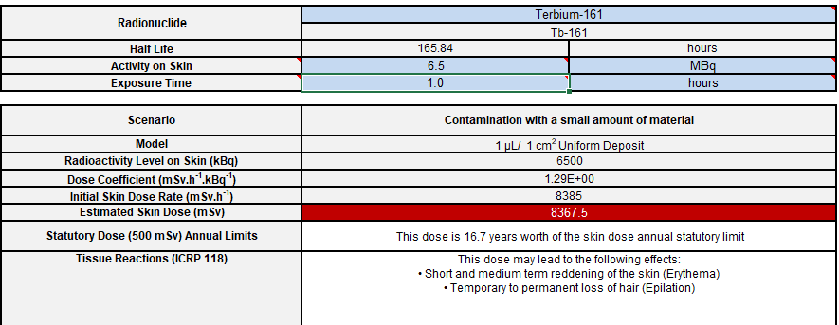
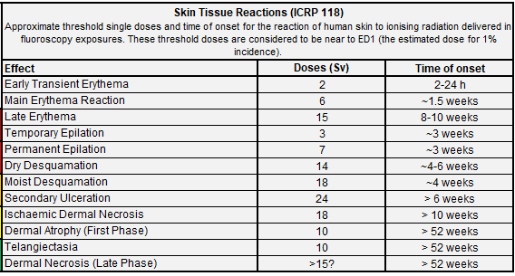
Application of VARSKIN
 | Radionuclide |  | Terbium-161
 |  |  | Tb-161
 | Half Life |  | 165.84 |  | hours
 | Activity on Skin |  | 1.5 |  | MBq
 | Exposure Time |  | 5.0 |  | minutes
 | Scenario |  | Contamination with a small amount of material
 | Model |  | 1 μL/ 1 cm² Uniform Deposit
 | Radioactivity Level on Skin (kBq) |  | 1500
 | Dose Coefficient (mSv.h⁻¹.kBq⁻¹) |  | 1.29E+00
 | Initial Skin Dose Rate (mSv.h⁻¹) |  | 1935
 | Estimated Skin Dose (mSv) |  | 161.2
 | Statutory Dose (500 mSv) Annual Limits |  | This dose is 32% of the skin dose annual statutory limit
 | Tissue Reactions (ICRP 118)
 | Common Scenarios |  | Skin Dose (mSv) |  | Potential Effects
 | The following scenarios should be assessed whenever manual chemistry is to be performed with an active solution.
 | Contaminated since the previous 5 minute routine check | Contamination for 5 minutes | 161.2 |  | This dose is 32% of the skin dose annual statutory limit
 | Contaminated for two 5 minute routine check periods | Contamination for 10 minutes | 322.4 |  | This dose is 64% of the skin dose annual statutory limit
 | Contaminated for an hour before detection and removal | Contamination for 60 minutes | 1931.0 |  | This dose is 386% of the skin dose annual statutory limit
 | Contaminated for half a standard 12 hour shift before detection and removal | Contamination for 6 hours | 11465.6 |  | This dose is 2293% of the skin dose annual statutory limit. This dose may lead to radiation induced injuries to the skin such as reddening of the skin (Erythema), hair loss (Epilation), thinning of the skin (Dermal Atrophy) and occurrence of spider veins (Telangiectasia)
 | Contamination for a day before detection and removal, such as due to the contamination being fixed | Contamination for 24 hours | 44186.8 |  | This dose is 8837% of the skin dose annual statutory limit. This dose may lead to radiation induced injuries to the skin such as reddening of the skin (Erythema), hair loss (Epilation), breakdown of the skin (Desquamation), thinning of the skin (Dermal Atrophy), occurrence of spider veins (Telangiectasia) and death of the skin (Dermal Necrosis)
 | Skin Dose Impact Levels (AG2395) |  | Skin Tissue Reactions (ICRP 118)
 |  |  | Approximate threshold single doses and time of onset for the reaction of human skin to ionising radiation delivered in fluoroscopy exposures. These threshold doses are considered to be near to ED1 (the estimated dose for 1% incidence).
 |  |  | Effect |  | Approximate Threshold Doses (Sv) | Time of onset
 |  |  | Early Transient Erythema |  | 2 | 2-24 h
 |  |  | Main Erythema Reaction |  | 6 | ~1.5 weeks
 | Severe/ Catastrophic | >2000 mSv | Late Erythema |  | 15 | 8-10 weeks
 |  |  | Temporary Epilation |  | 3 | ~3 weeks
 | Major | 500 - 2000 mSv | Permanent Epilation |  | 7 | ~3 weeks
 |  |  | Dry Desquamation |  | 14 | ~4-6 weeks
 | Moderate | 50-500 mSv | Moist Desquamation |  | 18 | ~4 weeks
 |  |  | Secondary Ulceration |  | 24 | > 6 weeks
 | Minor | 5-50 mSv | Ischaemic Dermal Necrosis |  | 18 | > 10 weeks
 |  |  | Dermal Atrophy (First Phase) |  | 10 | > 52 weeks
 | Negligible | < 5 mSv | Telangiectasia |  | 10 | > 52 weeks
 |  |  | Dermal Necrosis (Late Phase) |  | >15? | > 52 weeks
In-house skin dose calculator (excel)
Benefits
  Available for all personnel to use as a planning tool
  Simultaneously display multiple exposure scenarios based on predetermined exposure times
  Output provides direct comparison to:
    Statutory limits
    ANSTO’s in-house Skin Dose Impact Rating (risk matrix)
  Highlights potential tissue reaction (ICRP 118)

Slide 19
Application of VARSKIN
In house skin dose calculator
All hazard assessments should be performed in consultation with a Radiation Protection Advisor
Radionuclide |  | Terbium-161
 |  | Tb-161
Half Life |  | 165.84 |  | hours
Activity on Skin |  | 2.0 |  | MBq
Exposure Time |  | 1.0 |  | hours
Scenario |  | Contamination with a small amount of material
Model |  | 1 μL/ 1 cm² Uniform Deposit
Radioactivity Level on Skin (kBq) |  | 2000
Dose Coefficient (mSv.h⁻¹.kBq⁻¹) |  | 1.29E+00
Initial Skin Dose Rate (mSv.h⁻¹) |  | 2580
Estimated Skin Dose (mSv) |  | 2574.6
Statutory Dose (500 mSv) Annual Limits |  | This dose is 5.1 years worth of the skin dose annual statutory limit
Tissue Reactions (ICRP 118) |  | This dose may lead to the following effects: • Short term reddening of the skin (Erythema)
Limitations
  Single isotope only
  No shielding or cover material capability
  No breakdown of dose contribution from electrons or photons
  No modification to source configuration
Notes:
See notes

Slide 20
Our VARSKIN Journey
Where we’d like to be (Radiation Protection Services)
Novice
Advanced Beginner
Competent
Proficient
Expert

Slide 21
Future VARSKIN applications
Revisit the lens to the eye equivalent dose modelling from 2021 using VARSKIN+ EyeDose
Formalise training for new recruits by modifying the exposure scenarios outlined in NUREG/CR-6918:
    aligning the scenarios with previous events which have occurred at ANSTO including isotopes and exposure times
Continue to develop decision making criteria for specific isotopes and instruments used across the organisation

Slide 22
Thank you

