Slide 1
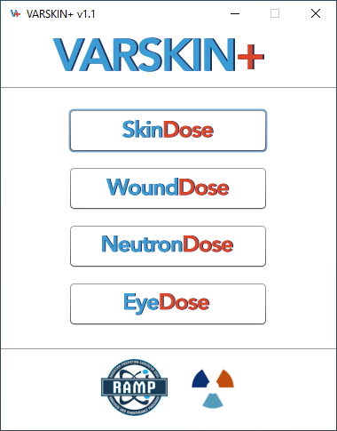
An overview of theory and execution
VARSKIN+
David M. Hamby, phd
April 6, 2022

Slide 2
outline
From Classic VARSKIN to VARSKIN+
SkinDose Module
WoundDose Module
NeutronDose Module
EyeDose Module

Slide 3
Classic Varskin to varskin+
VARSKIN (1987)
  originally designed to calculate radiation dose around a hot-particle point source in water from beta emitters; point and disk sources
SADDE (1989)
  new calculation of scaled absorbed dose distributions for betas emitted by nuclides that are not listed in the MIRD No. 7 publication
VARSKIN Mod 2 (1992)
  new routine to calculate scaled absorbed dose distributions for more nuclides and mixtures thereof; includes volumetric sources, layers of protective clothing, and a basic gamma dose estimator; backscatter correction applied; conversion and Auger electrons now considered along with beta emissions

Slide 4
Classic Varskin to varskin+
VARSKIN 3 (2006)
  new Windows operating environment; syringe model added; new backscatter correction model; upgraded photon model; considers airgap and cover materials for electrons
VARSKIN 4 (2011)
  syringe model removed; enhanced photon dosimetry model to account for attenuation, charged particle buildup, and electron scatter; airgap and cover materials now considered for photons
VARSKIN 5 (2014)
  electron dosimetry model is enhanced and based on EGS Monte Carlo simulations rather than Berger’s point kernels; takes better account of electron scatter and energy loss in tissue, air, and volumetric sources; new backscatter correction model
VARSKIN 6 (2018)
  choice of including daughter emissions (full equilibrium); the ICRP 107 nuclide decay database is made available

Slide 5
Classic Varskin to varskin+
VARSKIN+ (2021)
  created to house next version of VARSKIN, called SkinDose, and more!
V+ employs a new user interface written in Java and updated Fortran for physics calculations based on Fortran 2018
  computational speed has increased by as much as 25x
  alpha dosimetry has been added (SkinDose & WoundDose)
Additional computational modules added to VARSKIN+
  WoundDose
  NeutronDose
  EyeDose

Slide 6
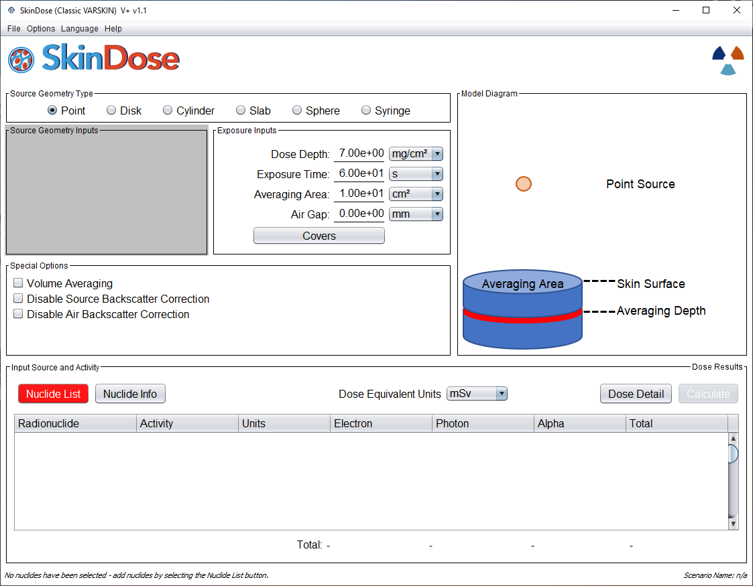
Skindose i.e., Classic Varskin
SkinDose

Slide 7
outline
SkinDose
Basic Theory
  Photon dosimetry
  Electron dosimetry
  Alpha dosimetry
Examples

Slide 8
Basic Theory
SkinDose
Photon Model
  point-kernel methodology numerically integrated over 300 dose point for each source point (up to 3,375)
  accounts for attenuation, charged particle buildup, and off-axis scattering
Electron Model
  point-kernel methodology numerically integrated over 60 dose points for each source point (512)
  accounts for air and source backscattering effects and source self-absorption
Alpha Model (new)
  calculated from the mass stopping power of particles as they pass through the dose averaging area
  assumed point source and limited definition of covers and airgaps given limited range of alphas

Slide 9
SKINDOSE Photon dosimetry
SkinDose
The SKINDOSE photon dosimetry model considers:
  photon point-kernel methodology
  charge-particle buildup; material attenuation; off-axis scatter
  numerical integration of 300 dose kernels for each source kernel
  multiple geometries (point, disk, cylinder, sphere, slab, syringe)
  dose calculated to an averaging disk (0.01 to 100 cm²) at user-specified depth beneath skin surface
  variable dose averaging
    2D averaging areas (regulatory compliance)
    3D averaging volumes (detector simulation)

Slide 10
Fundamentals: photon interactions
SkinDose
Photon interactions are random events, yet quantifiable
Photons generally interact with orbital electrons
Interaction probability is governed by:
  absorbing material (Z, electron density)
  photon energy (E)
… and is described by an interaction coefficient
Principal mechanisms of interaction include (by increasing energy):
  Thomson/Rayleigh scatter (no E transfer)
  photoelectric
  Compton scatter
  pair production
  photo-disintegration (very high E)

Slide 11
Charged-Particle Equilibrium
SkinDose
Using a transfer coefficient, KERMA is easily estimated from photon flux
Dose, as a function of depth, must then be determined from a conversion of KERMA based on the buildup of electronic charge with tissue depth
Charged-Particle Equilibrium (CPE) is established once this charge buildup is complete
At shallow (e.g., SDE) depths, however, CPE is generally not yet established

Slide 12
Elements of the photon dose calculation
SkinDose
Material
Attenuation
Equilibrium
Fraction
Source Strength
$$\dot{D}\left(d\right) = \left[E⋅\frac{S}{4πd^{2}}e^{−μd} ⋅\frac{μ_{tr}(E)}{ρ}\right] ⋅f_{cpe}(d,E)⋅F_{oa}\left(θ,E\right)$$
Photon Energy
Off-Axis
Adjustment
Geometric
Attenuation
Probability of
Energy Transfer

Slide 13
Range-Energy Observations
SkinDose
Electrons lose energy via tortuous paths
Electron range (penetration depth) increases with increasing energy
Linear range is largely dependent on electron density of the absorber atoms
And, to a lesser degree, range is a function of Z
  result has practical implications for shielding
  density thickness (mg/cm²) is the best indicator of electron range
  important tissue depths → 7, 100, 300, 1000 mg/cm²

Slide 14
Electron Interactions
SkinDose
As energetic electrons pass through material, they transfer energy
  primarily via “soft” (Coulombic) collisions
  or “hard” (physical) collisions with orbital electrons
Energy loss is a function of KE & charge density
Energy loss can result in:
  excitation – characteristic X-rays
  ionization – scattered energetic electrons
  bremsstrahlung (>1 MeV electrons) – low-energy photons
Scattered electrons may produce additional ion pairs
  e.g., clusters, delta rays, further excitation/ionization
air
skin
R_{β}

Slide 15
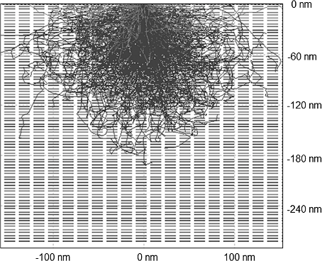
Electron Track Simulation
SkinDose
Average Range
~90% Range
“Maximum” Range

Slide 16
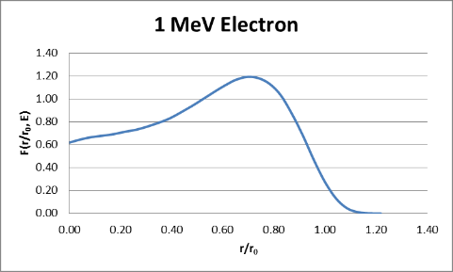
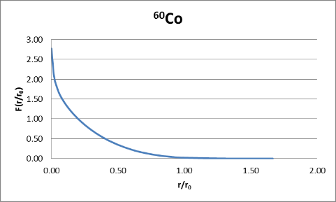
Scaled Absorbed Dose Distributions
SkinDose
The factor F(r/r₀,E) represents the SADD and is essentially a modified Bragg curve; shown for monoenergetic electrons of energy E, and for beta particles of distributed E, normalized over their maximum range, r₀
r₀
r

Slide 17
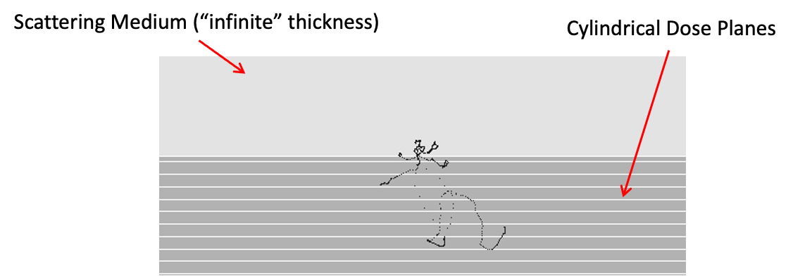
Backscatter Correction Factors
SkinDose

Slide 18
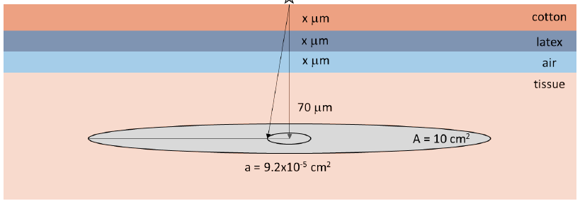
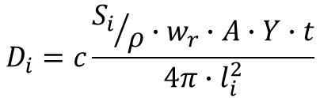
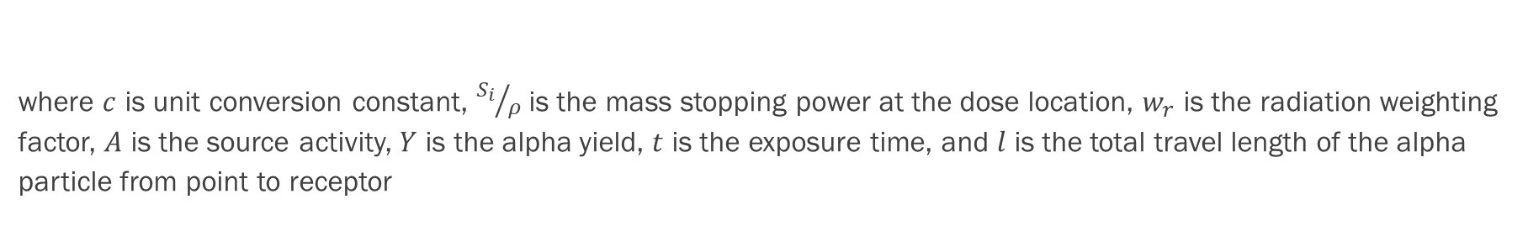
Alpha dosimetry
Alpha dose (SDE) to receptor location I on an infinitely thin averaging disk is:
$$D_{i}=c\frac{{S_{i}}/ρ∙w_{r}∙A∙Y∙t}{4π∙l_{i}^{2}}$$
where $c$ is unit conversion constant, ${S_{i}}/ρ$is the mass stopping power at the dose location, $w_{r}$ is the radiation weighting factor, $A$ is the source activity, $Y$ is the alpha yield, $t$ is the exposure time, and $l$ is the total travel length of the alpha particle from point to receptor

Slide 19
Skindose sensitivities
SkinDose
Direct Propagators | Regulatory Defined Values | Parametric Uncertainty
Exposure time Source activity Distributed activity | Volume averaging depth Skin averaging area Skin thickness | Airgap thickness Cover thickness and density Source geometry
Direct propagators – uncertainty in these parameters propagates completely through the model to the dose estimate (e.g., twice the exposure time will yield twice the dose)
Regulatory Defined Values – while these inputs can be manipulated in VARSKIN, the regulations call for dose averaged over 10 cm² at a depth of 7mg/cm², for example
Parametric Uncertainty – variations in these inputs will affect dose output; however, the effect is not as intuitive as compared to the direct propagators

Slide 20
Sensitive parameters – photon dose
SkinDose
Parameter | E < 20 keV | 20 keV - 500 keV | E > 500 keV
3D Geometry | LOW | LOW | LOW
3D Source volume | MODERATE | LOW | LOW
3D Source density (assumed to be air) | LOW | LOW | LOW
2D Source area* | LOW | LOW/MODERATE | LOW/MODERATE
Cover density | LOW | LOW | LOW
Cover thickness | LOW | MODERATE | MODERATE
Airgap thickness | LOW | MODERATE | MODERATE

Slide 21
sensitive parameters – electron dose
SkinDose
Parameter | E < 200 keV | 200 keV – 2 MeV | E > 2 MeV
3D Geometry | LOW | LOW | LOW
3D Source volume | HIGH | HIGH/MODERATE | MODERATE
3D Source density | HIGH | HIGH/MODERATE | MODERATE
2D Source area (relative to avg area) | LOW | LOW/MODERATE | LOW/MODERATE
Cover density | MODERATE | MODERATE | LOW
Cover thickness | HIGH | LOW | LOW
Airgap thickness | LOW | MODERATE | MODERATE

Slide 22
capabilities and limitations
SkinDose
Calculates dose equivalent for photon, electron, and alpha radiation for more than 1200 radionuclides
  uses either ICRP 38 or 107 decay data and accounts for decay products
Dose at depth can be averaged over an area from 0.01 cm² to 100 cm²
Allows for an airgap of up to 20 cm between the source and the skin surface and for source covers
Source materials are defined by atomic number and density with geometries of:
  point and disk sources
  volumetric sources (i.e., spherical; cylindrical; slab; syringe)
GUI warns the user that an input value is out of range but continues with the calculation!

Slide 23
EXAMPLE 1: Co-60 hot particle
SkinDose
A 1 µCi “speck” of Co-60 (activated metal) is found on a worker’s arm
Thought to be on the arm for the past hour
Using ICRP 107 decay data with Z_{eff} of 27
No air gap and no cover material
Estimate the SDE to a 10 cm² averaging area at a depth of 7 mg/cm²

Slide 24
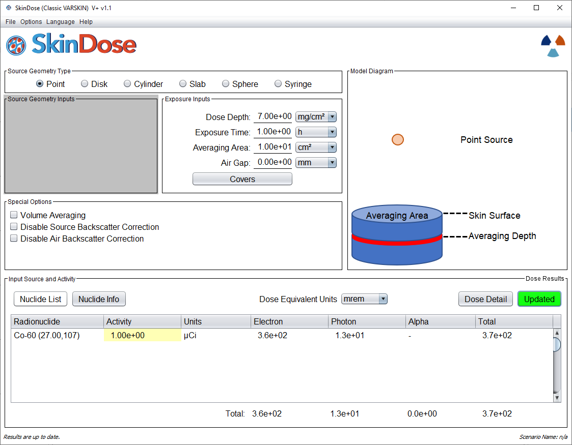
SkinDose

Slide 25
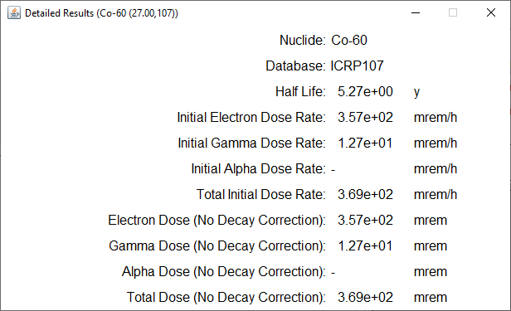
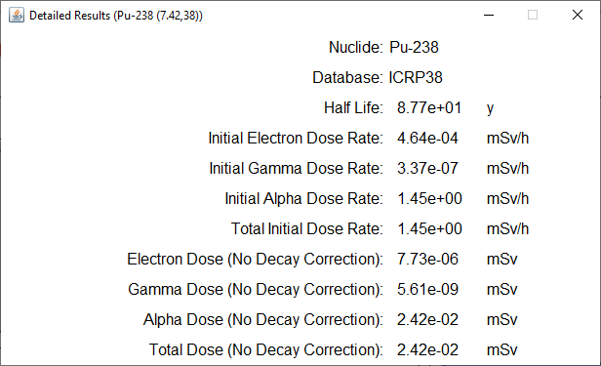

SkinDose
1 micron
70 microns

Slide 26
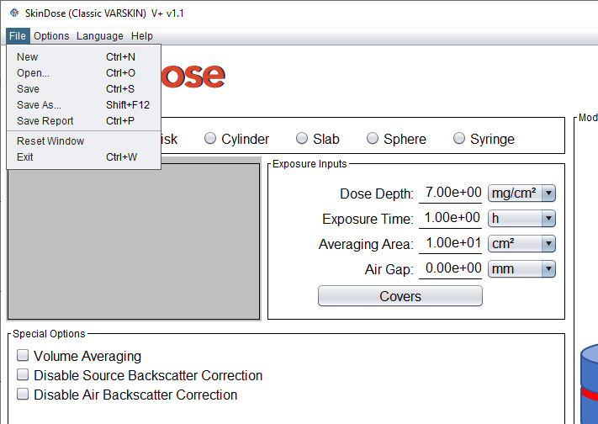
SkinDose

Slide 27
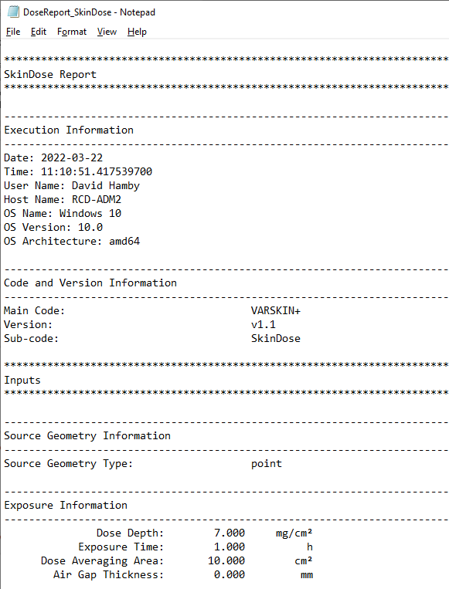
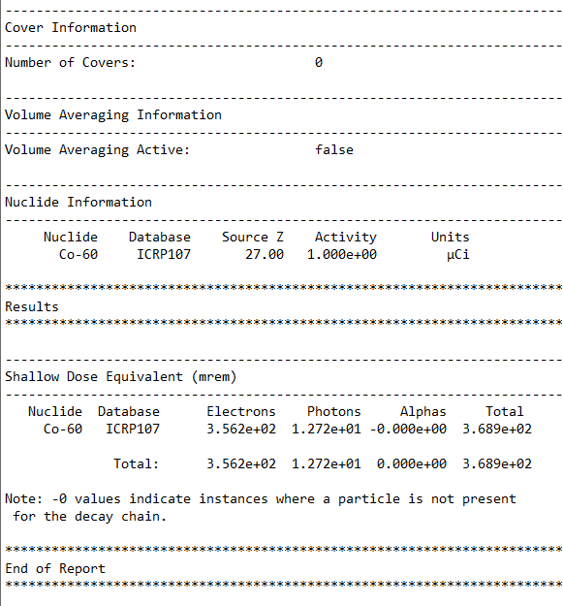
SkinDose

Slide 28
SkinDose

Slide 29
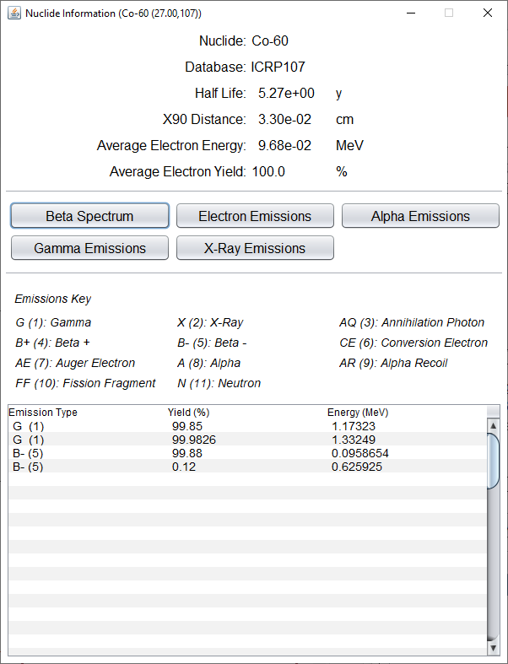
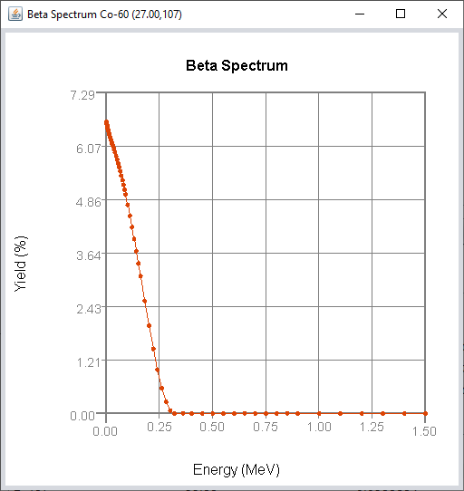
SkinDose

Slide 30
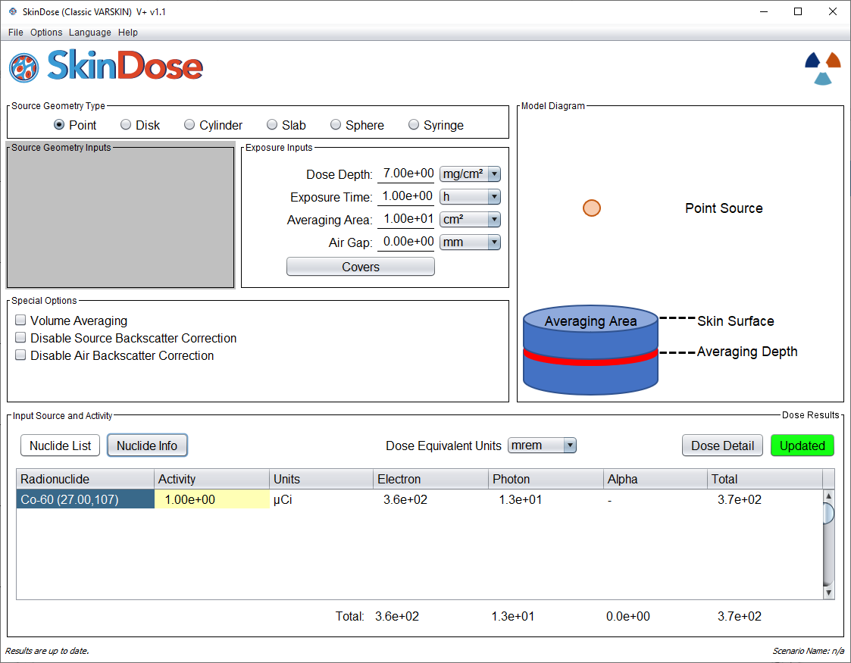
SkinDose

Slide 31


SkinDose

Slide 32
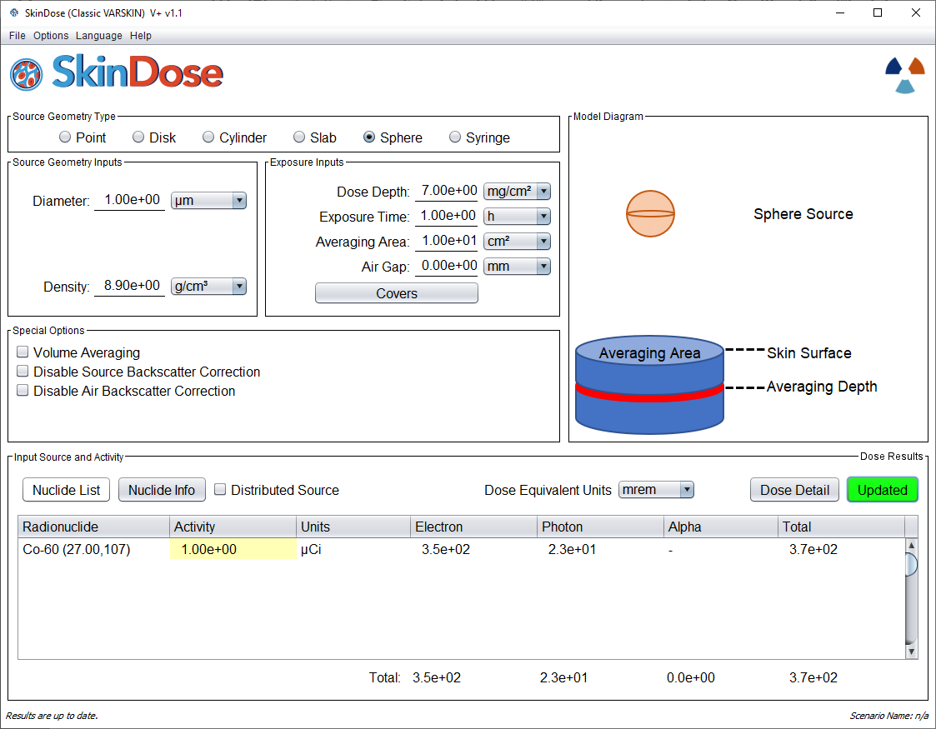
SkinDose
point source

Slide 33
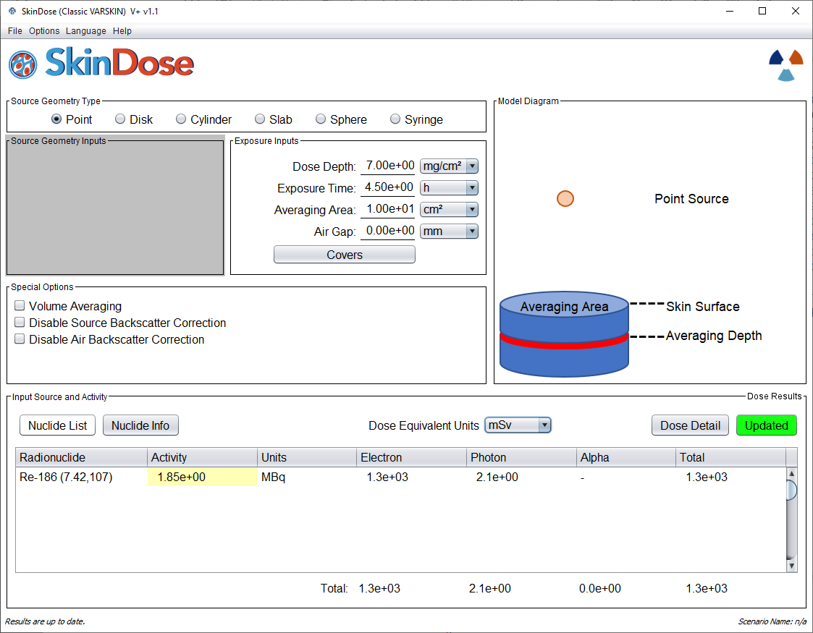
Example 2: Liquid radioactivity spilled on the arm (point)
SkinDose
Technician exposed to 1.85 MBq of ¹⁸⁶Re for 4.5 hours
Start with the point-source geometry to determine order-of-magnitude, most conservative dose
Dose calculated at a depth of 7 mg/cm² with 10 cm² averaging:
1,300 mSv from electrons
2.1 mSv from photons

Slide 34
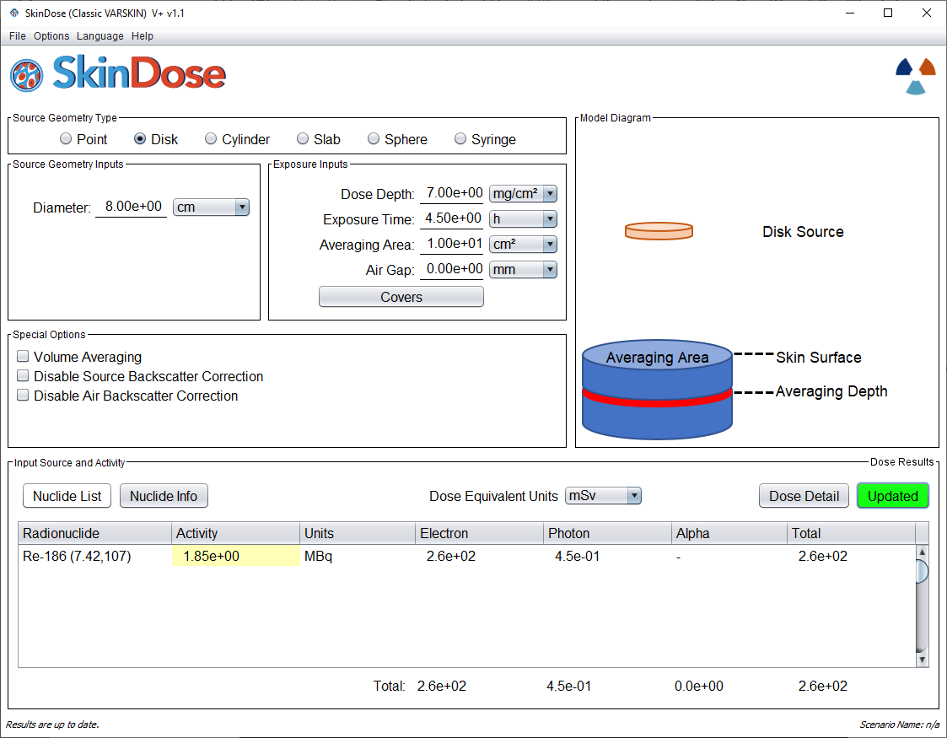
Liquid radioactivity spilled on the arm (disk)
SkinDose
Now let’s work toward more realism
Assume the source takes the shape of a 50 cm² spot directly on the skin (no air gap and no cover)
Therefore, we use the disk geometry with an 8 cm diameter
Dose calculated at a depth of 7 mg/cm² with 10 cm² averaging:
260 mSv from electrons
0.45 mSv from photons

Slide 35
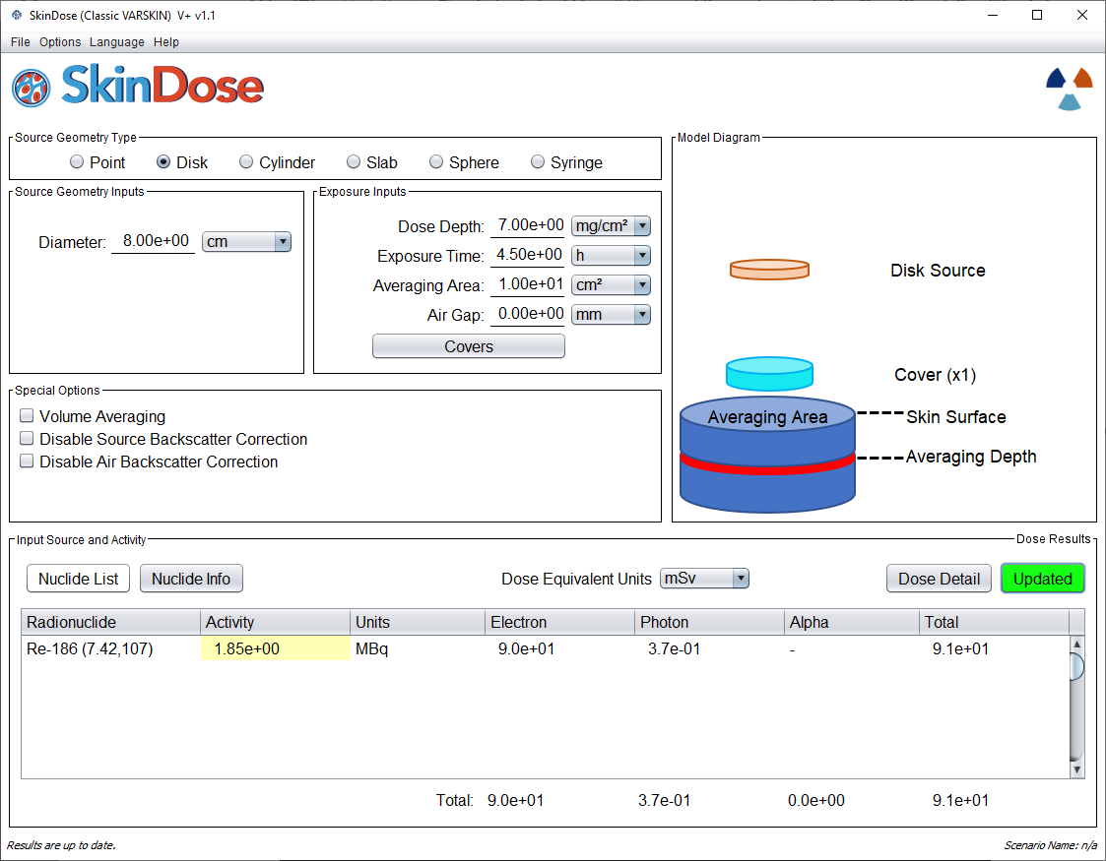
Liquid radioactivity spilled on a lab coat (disk)
SkinDose
Now assume the 50 cm² spot is on top of a lab coat, which has a thickness of 0.04 cm and a density of 0.9 g/cm³
Again, we use the disk geometry with an 8 cm diameter, but now the lab coat material acts as a cover
Dose calculated at a depth of 7 mg/cm² with 10 cm² averaging:
90 mSv from electrons
0.37 mSv from photons

Slide 36
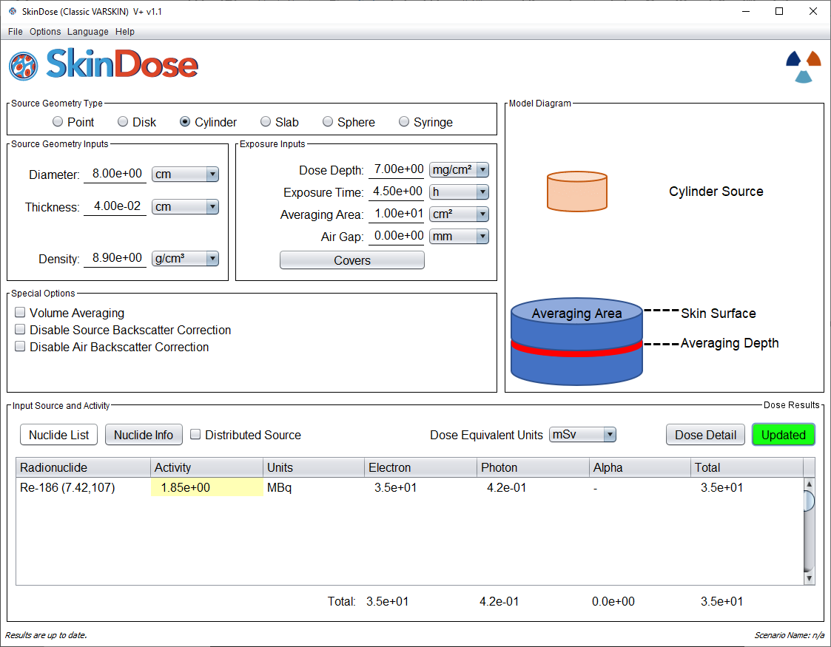
Liquid radioactivity in the lab coat (cylinder)
SkinDose
For the most realistic assessment, we assume the 50 cm² spot is soaked into the lab coat
This time we use the cylinder geometry, and the source is the coat itself
8 cm diameter, a 0.04 cm thickness, and a density of 0.9 g/cm³
Dose calculated at a depth of 7 mg/cm² with 10 cm² averaging:
160 mSv from electrons
0.42 mSv from photons

Slide 37
Dose Summary
SkinDose
Geometry | Electron Dose (mSv) | Photon Dose (mSv)
Point on Skin | 1,300 | 2.1
Disk on Skin | 260 | 0.45
Disk above Coat | 90 | 0.37
Cylinder in Coat | 160 | 0.42
Bounding
Most realistic

Slide 38
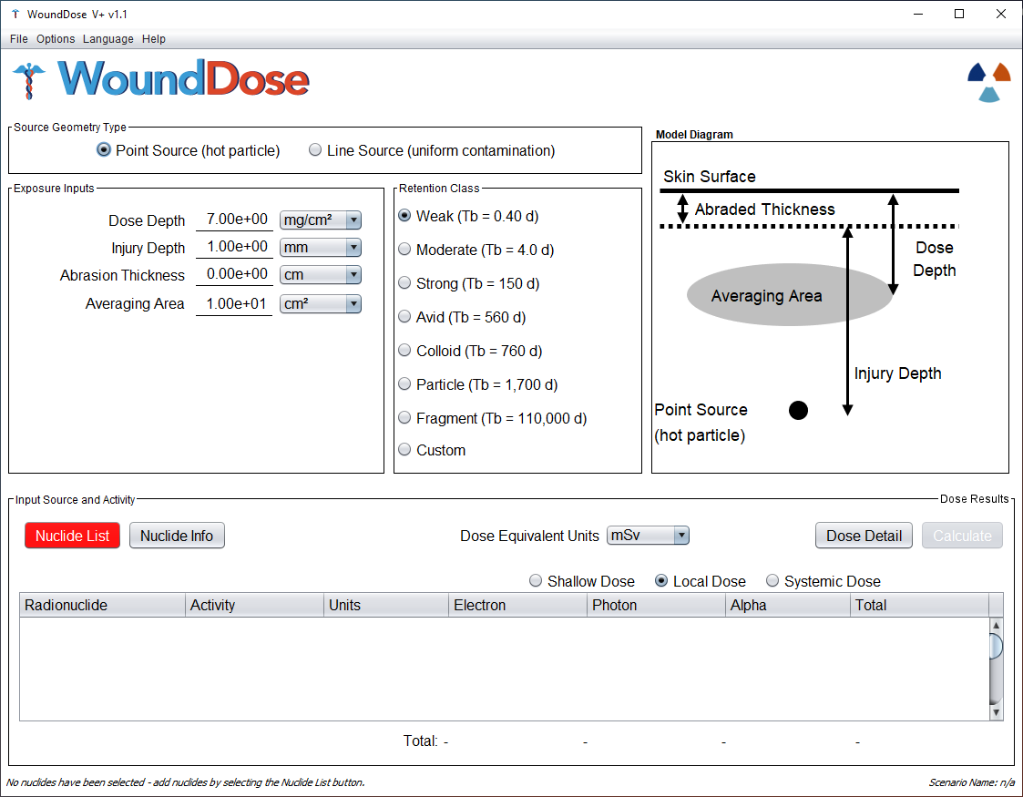
wounddose
WoundDose

Slide 39
outline
WoundDose
Technical Basis and Theory
Overview of new WoundDose GUI
  Shallow dose equivalent
  Local dose equivalent
  CEDE and CODE (systemic)
Examples

Slide 40
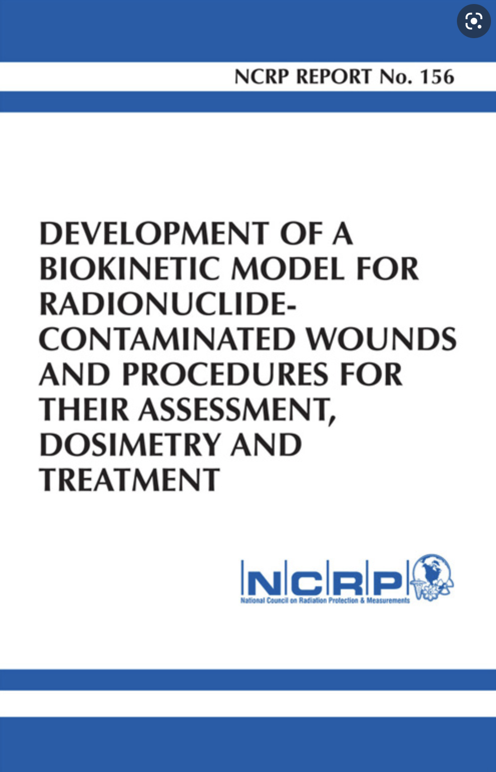
Basis for Wound Model Dosimetry
WoundDose
NCRP Report No. 156, “Development of a Biokinetic Model for Radionuclide-Contaminated Wounds and Procedures for Their Assessment, Dosimetry, and Treatment” (2007)
The wound model consists of three distinct dosimetry calculations:
  (1) Shallow dose Equivalent (@ 7 mg/cm2)
  (2) Local dose equivalent (to tissue)
  (3) organ/effective dose equivalent (systemic uptake)
Type of wound will determine applicable dose calculations

Slide 41
General method
WoundDose
Designed for penetrating wounds where radioactive contamination has been forced under the skin surface
Consists of three distinct dosimetry calculations: (1) SDE; (2) local dose equivalent; and (3) committed organ/effective dose equivalent (systemic)
SDE
  Total dose at the shallow depth (7 mg cm⁻² ) with an embedded wound source and dose area of 10 cm²
  Dose models same as SkinDose, except for retention class, abrasion thickness (for point source), and wound penetration depth inputs
Local Dose
  Dose equivalent to the tissue surrounding the contaminated wound volume
  Volume surrounding a point source at a given depth or volume surrounding the penetration depth of a line source

Slide 42
General method
WoundDose
Systemic Dose
  The biokinetic model considers four uptake categories: (1) radionuclides in soluble form; (2) particulates, aggregates, and bound states; (3) colloid and intermediate states; and (4) fragments
  Movement of material from the wound and through the body to the bloodstream is characterized by the biokinetic model in NCRP 156
  Dose is estimated using tabulated internal dose coefficients for radionuclides (limited number) reaching the bloodstream via penetrating wounds
    for all seven solubility characteristics provided by the NCRP 156 model
    allows for custom biological half-life at wound site

Slide 43
Historical wound experience
WoundDose
Industrial
  vast majority of contaminated wounds involved actinides
  > 90% occur in hands and arms, primarily fingers
  ~ 90% involve punctures and chemical burns
Military
  embedded U and Pu compounds/fragments
Medical
  needle sticks in radiopharmaceutical labs
  accidental injections of Thorotrast® (²³²Th)

Slide 44
Intact Skin, Abrasions and Non-severe Burns
WoundDose
For contamination events involving less-severe wounds where the skin remains intact, is lightly abraded, or has been lightly burned, dose assessments can be conducted using WoundDose to estimate the SDE calculations in a manner like that of SkinDose (i.e., no activity gets in the bloodstream)
The shallow dose model is altered only by the removal of some or all of the protective dead layer of skin
NCRP 156 states the following …
  For contaminated wounds in which the skin is largely intact, [VARSKIN] dose calculations may be directly applicable. For embedded contamination, Berger’s point kernels may be integrated over the depth of interest
Previous versions of VARSKIN (before V5) for beta dosimetry were based on point kernels developed by Berger (1971). The more recent VARSKIN and SkinDose packages (V5.0 and later) have their foundation in Monte Carlo simulations using EGSnrc for electron dosimetry, but the methods are essentially the same.
  WoundDose draws on the shallow dose model of SkinDose

Slide 45
Severe Burns, Lacerations and Penetrating Wounds
WoundDose
For penetrating wounds where radioactive contamination has been forced under the skin surface, WoundDose will calculate dose for electrons, photons, and alpha particles for all three dose outcomes:
(1) Shallow dose Equivalent (@ 7 mg/cm2)
  draws on SkinDose
(2) Local dose equivalent (to surrounding tissue)
  refers to a determination of the dose to tissue surrounding the contaminated wound
(3) Organ/effective dose equivalent (systemic uptake)
  committed systemic dosimetry for uptakes to the bloodstream

Slide 46
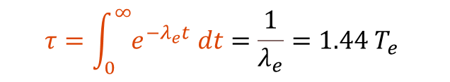
Residence time
WoundDose
Calculations of shallow and local dose are conducted for the estimated time that the radioactive contamination remains at the wound site (e.g., residence time)
This residence time (τ) is the time-integration of the retention function:
$$τ=\int_{0}^{∞}{e^{−λ_{e}t} dt}=\frac{1}{λ_{e}}=1.44 T_{e}$$

Slide 47
Wound Residence time by Retention class
WoundDose
Class | Biological Half-life (d) | Biological Residence Time* (d) | Biological Residence Time (yr)
Weak | 0.40 | 0.58
Moderate | 4.0 | 5.7
Strong | 150 | 210 | 0.58
Avid | 560 | 810 | 2.2
Colloid | 760 | 1,100 | 3.0
Particle | 1,700 | 2,400 | 6.6
Fragment | 110,000 | 150,000 | 410**
*time integral of triple-exponential wound retention; derived from NCRP 156 Table 4.11
**50-year maximum

Slide 48
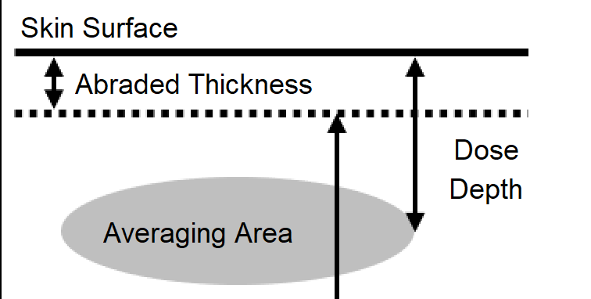
Shallow Dose
WoundDose
In 10 CFR 20.1003, shallow skin dose is defined for external exposures and is to be determined at a basal-layer depth of 70 microns (7 mg/cm²; 0.007 cm; 70 microns) beneath the surface of the skin
  this depth is assumed to be appropriate for the determination of risk (~dead layer thickness)
The regulation in 10 CFR 20.1201 also requires that shallow skin dose be “averaged over the contiguous 10 square centimeters of skin receiving the highest exposure”
If an abrasion were to occur, in which a portion or all of the dead layer of skin were removed, the depth at which shallow dose is determined would be altered by the thickness of removed tissue (alive or dead)

Slide 49
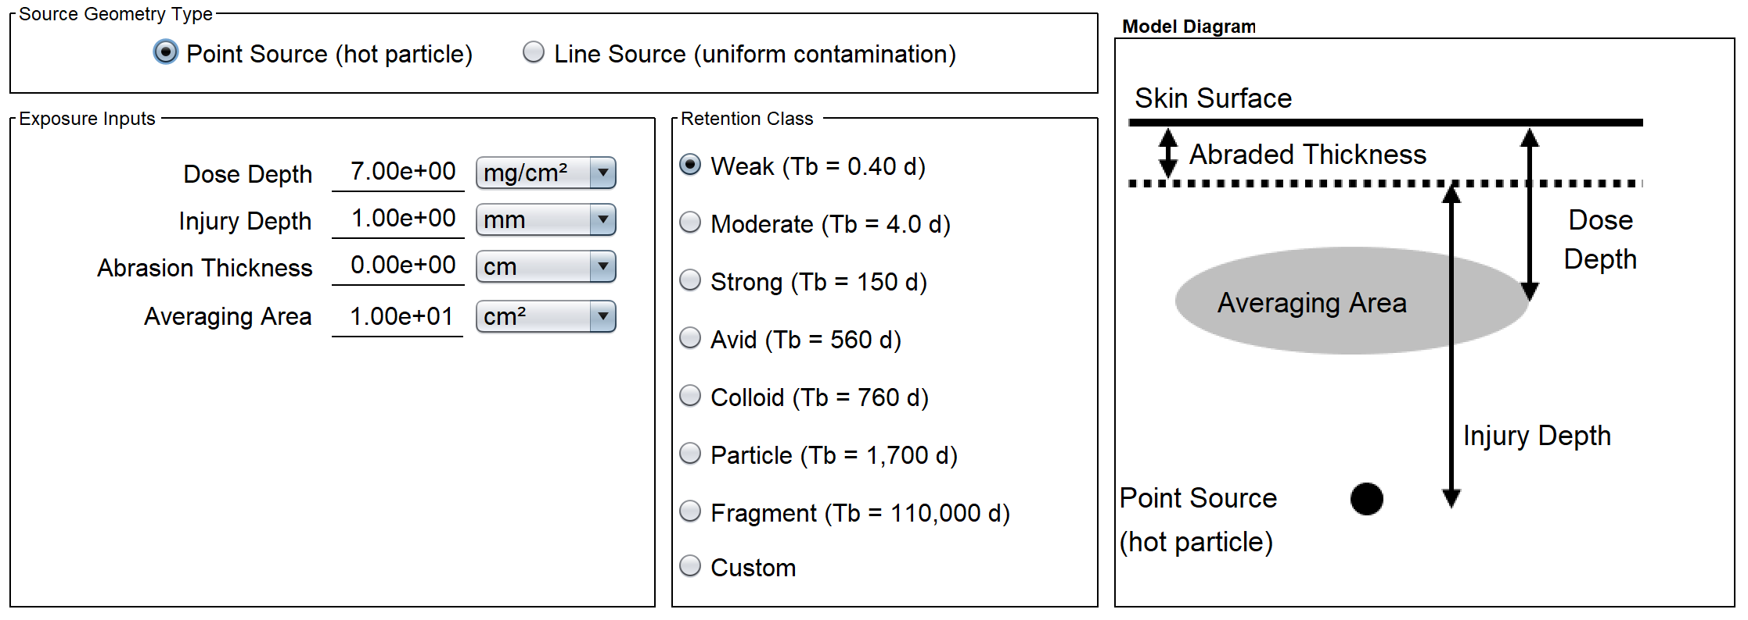
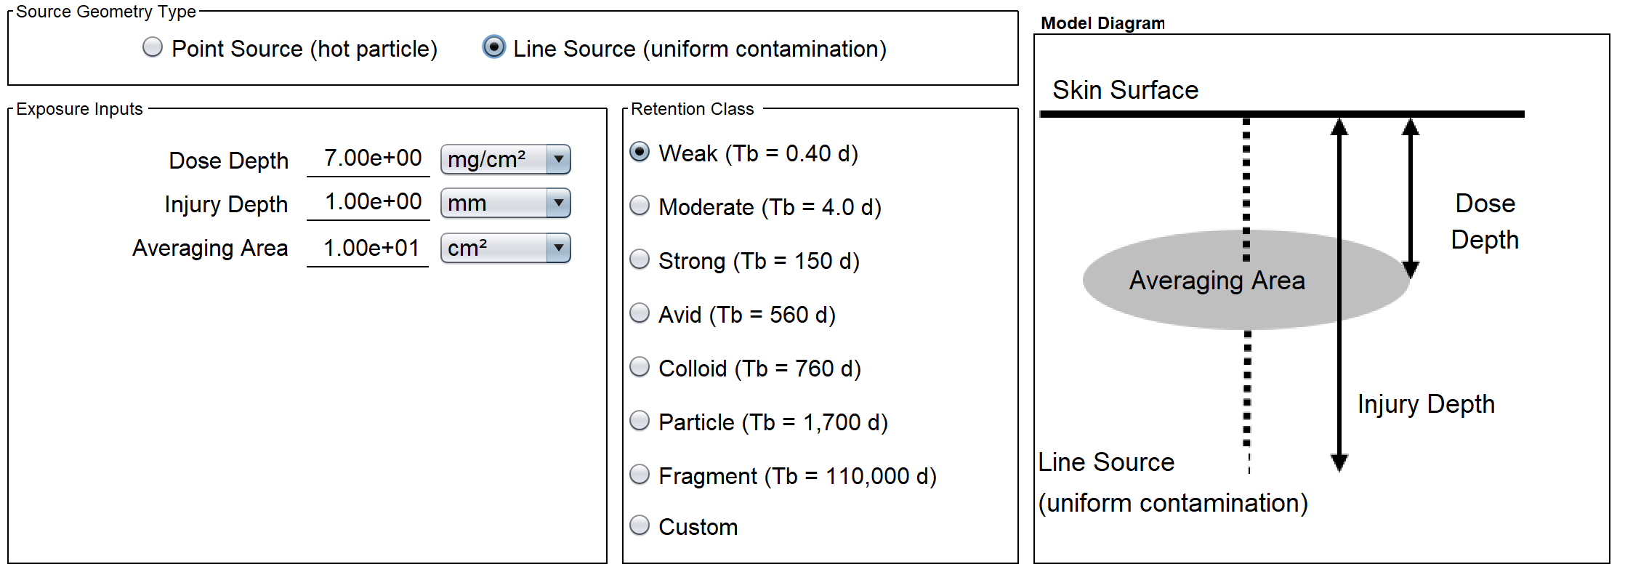
Shallow Dose
WoundDose
To estimate total dose at the shallow depth (70 microns) with an embedded wound source, the models of SkinDose are accessed, but with modified backscatter correction (full correction in current version)
In addition to the typical skin dosimetry inputs, the user would enter the thickness of any surface tissue that might have been removed by the wound, as well as the wound retention class (e.g., weak, moderate, strong), and an estimate of its penetration depth

Slide 50
Shallow Dose
WoundDose
Point Source at Depth: In this case, the distance between source and skin averaging area is determined by the difference between source depth and the defined shallow depth (70 microns)
The user still has the option to select the depth at which dose is calculated, but 70 microns is the default
SkinDose
point
source
WoundDose
Air
Skin
Air
Skin
dose averaging
area (at 70 μm)
dose averaging
area (at 70 μm)
point
source

Slide 51
Shallow Dose
WoundDose
Line Source Surface to Depth: In this instance, it is assumed that a puncture has occurred (e.g., contaminated screwdriver or a needle stick) and any remnant of contamination is evenly distributed along the puncture route
The shallow dose at 70 microns to a specified skin averaging area (10 cm²) is calculated under the assumption that the perpendicular line source begins at the surface, possibly penetrates the averaging area, and continues to the user-specified wound depth
The problem in this case requires the integration of dose over a series of point sources at depth, along the wound penetration line
Air
Skin
dose averaging
area (at 70 μm)
line
source

Slide 52
Local dosE
WoundDose
Local wound dosimetry is straightforward … energy absorbed per unit mass
NCRP 156 states, “If the activity in the wound is known … dose calculations may be limited to the volume [mass] of tissue actually irradiated …”
But “irradiated mass” can be ambiguous
For radioactivity in the liver, the mass of liver is assumed to be uniformly irradiated
If radioactivity is localized in a tissue wound, the irradiated mass is that which absorbs energy
  i.e., a tissue sphere with radius equal to the range of the most penetrating particle
For example, ³²P electrons have a range (95%) of about 0.54 cm in tissue i.e., ρV = 6.7x10⁻¹ g
whereas, ¹⁵⁰Gd alphas have a range of about 18 microns in tissue i.e., ρV = 2.4x10⁻⁸ g

Slide 53
Local dosE
WoundDose
X
Dose for a 1 kBq point source of ³²P (E_{avg} = 0.695 MeV): Local DE = 0.60 mSv/h
And a 1 kBq point source of ¹⁵⁰Gd (E_{α} = 2.75 MeV): Local DE = 1.3 MSv/h
But a wound with both nuclides (i.e., using larger volume??): Local DE = 48 mSv/h
However, with a standard volume (1 cm³, r = 0.62 cm):
  1 kBq ³²P Local DE = 0.4 mSv/h
  1 kBq ¹⁵⁰Gd Local DE = 31.7 mSv/h
  1 kBq ¹⁵⁰Gd + 1 kBq ³²P Local DE = 32.1 mSv/h
All alpha and electron energy is assumed deposited within 1 cm³
  good assumption for 95% absorption until about E_{e} > 2 MeV

Slide 54
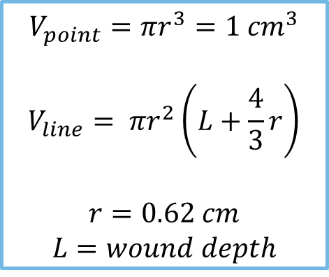
Local Dose
WoundDose
For a point source, particle/photon emitted energy is assumed to be deposited in a standard spherical volume of 1 cm³ (radius = 0.62 cm). For a line source, the deposition volume is assumed to be a cylinder of radius 0.62 cm with hemispherical endcaps (NRCP 156).
Source geometry options:
$$V_{point}=πr^{3}=1 {cm}^{3}$$
$$V_{line}= πr^{2}\left(L+\frac{4}{3}r\right)$$
$$r=0.62 cm$$
$$L=wound depth$$
spherical volume
around the point source
cylindrical volume
along the line source

Slide 55

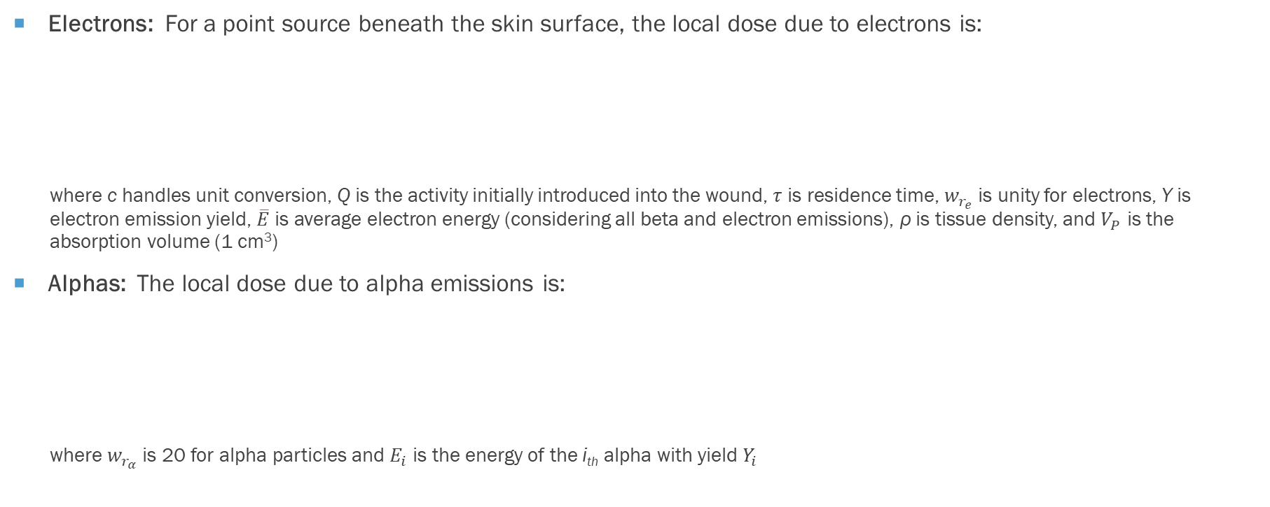

Local Dose
WoundDose
Electrons: For a point source beneath the skin surface, the local dose due to electrons is:
  where c handles unit conversion, Q is the activity initially introduced into the wound, $τ$ is residence time, $w_{r_{e}}$is unity for electrons, Y is electron emission yield, $\overline{E}$is average electron energy (considering all beta and electron emissions), ρ is tissue density, and $V_{P}$ is the absorption volume (1 cm³)
Alphas: The local dose due to alpha emissions is:
  where $w_{r_{α}}$is 20 for alpha particles and $E_{i}$ is the energy of the i_{th} alpha with yield $Y_{i}$
$$D_{e}=c\frac{Q τ w_{r_{e}} }{ρ V_{P}}Y \overline{E}$$
$$D_{α}=c\frac{Q τ w_{r_{α}}}{ρ V_{P}}\sum_{i}{Y_{i} E_{i}}$$

Slide 56



Local Dose
WoundDose
Photons. The photon dose for an embedded point source is calculated for energy deposited in a surrounding 1 cm3 sphere, using:
  where w is unity for photons, and the fraction of photon energy deposited within a sphere of radius r (0.62 cm) around the source is:
  with $μ_{en}$and $μ_{i}$ representing energy-specific linear absorption and attenuation coefficients in tissue, respectively
$$D_{γ}=c\frac{Q τ w_{r_{γ}}}{ρ V_{P}}\sum_{i}{Y_{i} E_{i} f_{i}}$$
$$f_{i}=\frac{{\left(μ_{en}\right)}_{i}}{μ_{i}}\left(1−e^{{−μ}_{i}r}\right)$$

Slide 57
Systemic Dose
WoundDose
The biokinetic model for radiologically contaminated wounds considers four uptake categories:
  radionuclides in soluble form (4 classes)
  colloids and intermediate states
  particulates, aggregates, and bound states
  fragments
Movement of material from the wound, through the body to the bloodstream is characterized by the biokinetic model in NCRP 156

Slide 58
NCRP 156 systemic uptake model
WoundDose
Accidental Injection
Fragment
Trapped Particles & Aggregates
Soluble
Particles, Aggregates & Bound States
Colloid & Intermediate State
Lymph Nodes
Blood

Slide 59
NCRP 156 systemic model default transfer rates
WoundDose
Transfer Rates (d⁻¹) | Weak | Moderate | Strong | Avid | Colloids | Particles | Fragments
Soluble to blood | 45 | 45 | 0.67 | 7.0 | 0.5 | 100 | -
Soluble to CIS | 20 | 30 | 0.6 | 30 | 2.5 | - | -
CIS to soluble | 2.8 | 0.4 | 0.024 | 0.03 | 0.025 | - | -
CIS to PABS | 0.25 | 0.065 | 0.01 | 10 | 0.05 | - | -
CIS to lymph nodes | 0.00002 | 0.00002 | 0.00002 | 0.00002 | 0.002 | - | -
PABS to soluble | 0.08 | 0.02 | 0.0013 | 0.005 | 0.0015 | 0.0002 | -
PABS to lymph nodes | 0.00002 | 0.00002 | 0.00002 | 0.00002 | 0.0004 | 0.0036 | 0.004
PABS to TPA | - | - | - | - | - | 0.04 | 0.7
TPA to PABS | - | - | - | - | - | 0.0036 | 0.0005
Lymph nodes to blood | - | - | - | - | 0.03 | 0.0006 | 0.03
Fragment to soluble | - | - | - | - | - | - | -
Fragment to PABS | - | - | - | - | - | - | 0.008

Slide 60
Wound dose coefficients for systemic uptake
WoundDose
For 38 radionuclides, Toohey et al. (2014)* contains tables of:
  compartment transfer rates by retention class
  CODE coefficients by retention class
  CEDE coefficients by retention class
  and derived regulatory guides and clinical decision guides for a subset of radionuclides
For example, each nuclide (²⁴¹Am in this case) has 7 effective dose coefficients [x10⁻⁴ Sv/Bq]:
  Soluble 3.97 (weak) 3.96 (moderate) 3.91 (strong) 3.79 (avid)
  Insoluble 3.80 (colloid) 2.23 (particle) 0.141 (fragment)
*Toohey, R.E; Bertelli, L.; Sugarman, S.L.; Wiley, A.L.; Christensen, D.M. Dose coefficients for intakes of radionuclides via contaminated wounds. Oak Ridge Institute for Science and Education. US DOE Contract No. DE-AC05-06OR23100. Oak Ridge, TN; Ver. 2, August 2014.

Slide 61
capabilities and limitations
WoundDose
Considers all radionuclides in ICRP 38 and 107
Geometry limited to point source (hot particle) and line source (uniform contamination)
7 wound retention classes (plus custom biological half-life)
User defined abrasion depth, injury penetration depth, and shallow dose depth
Separate outputs for SDE, local DE, and systemic CEDE
Systemic dose is limited (at the moment) to select radionuclides with available dose coefficients

Slide 62
Example 1: Embedded cobalt-60
WoundDose
Assume a 1 kBq Co-60 (ICRP 107) point source
5 mm injury depth
1 mm abrasion depth
Examine “colloid”, “particle” and “fragment” retention classes
SDE to a 10 cm² averaging area at a depth of 7 mg cm⁻²
Local DE to a 1 cm³ sphere around the point source
System CEDE

Slide 63
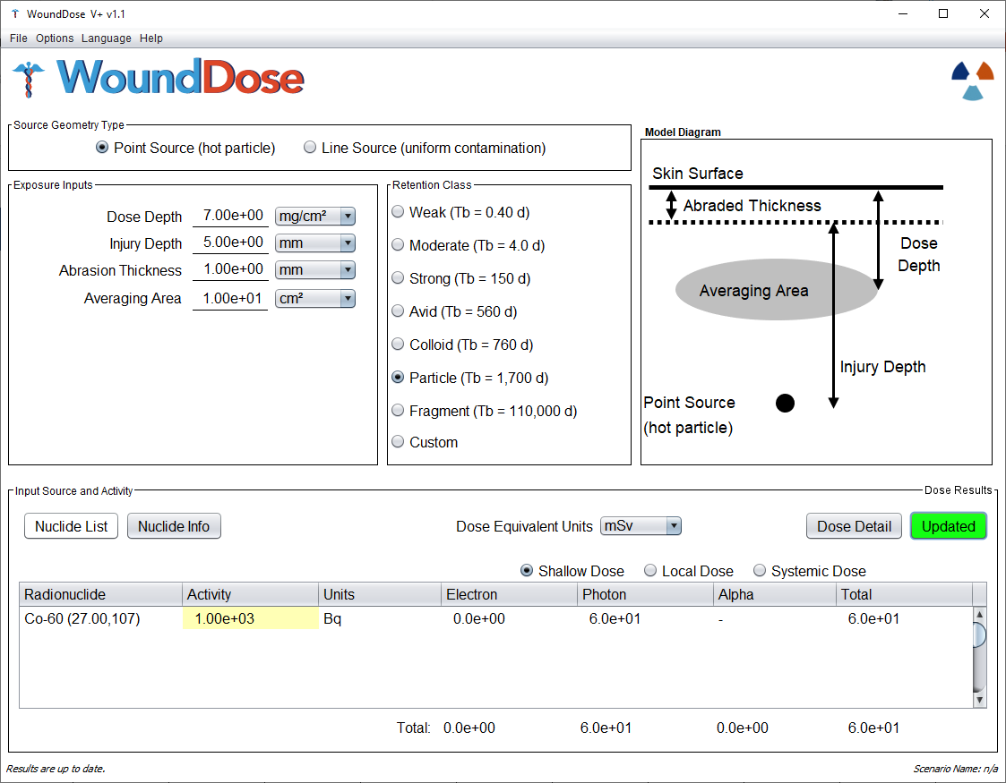


WoundDose

Slide 64
Cobalt-60 wound dosimetry for 3 retention classes
WoundDose
Retention Class | Shallow Electron Dose (mSv) | Shallow Photon Dose (mSv) | Local Electron Dose (mSv) | Local Photon Dose (mSv) | CEDE (mSv)
Colloid | 0.0 | 39 | 1,000 | 480 | 0.014
Particle | 0.0 | 60 | 1,700 | 800 | 0.0061
Fragment | 0.0 | 100 | 3,600 | 1,700 | 0.00025

Slide 65
Example 2: Tc-99m Needle Stick
WoundDose
A nuclear medicine technologist sustains a needlestick to the index finger
  2.2 MBq of Tc-99m is assumed injected to a depth of 2 mm
WoundDose will be used to estimate SDE, local DE, and systemic CEDE
We’re not confident with our knowledge of ^{99m}Tc retention (at the wound site), therefore we will calculate dose according to the “weak”, “moderate” and “strong” retention models
We will estimate dose for both point- and line-source geometries
SDE will be averaged over a 1 cm² area (because the stick was to the index finger)

Slide 66


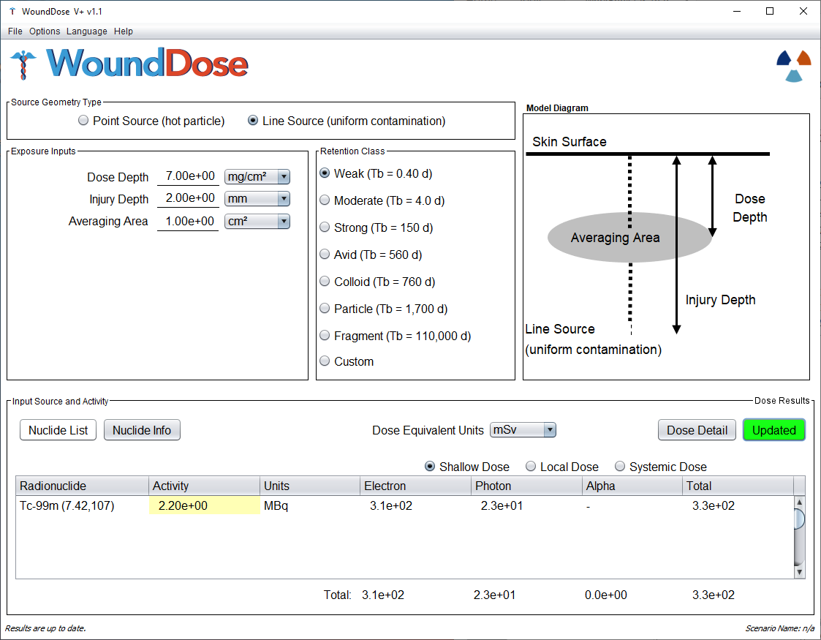
WoundDose

Slide 67
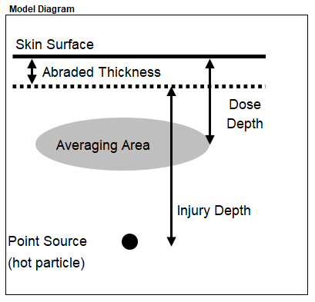
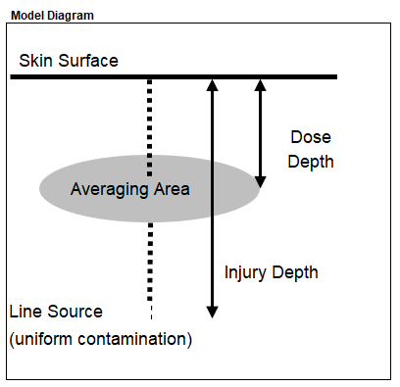
Tc-99M Needle-stick dosimetry summary
WoundDose
Geometry | Retention Class | Shallow Electron Dose (mSv) | Shallow Photon Dose (mSv) | Local Electron Dose (mSv) | Local Photon Dose (mSv) | CEDE (mSv)
Point | Weak | 0.0 | 11 | 860 | 16 | 0.033
 | Moderate | 0.0 | 15 | 1,300 | 25 | 0.026
 | Strong | 0.0 | 16 | 1,400 | 26 | 0.0071
Line | Weak | 310 | 23 | 690 | 13 | 0.033
 | Moderate | 410 | 31 | 1,100 | 20 | 0.026
 | Strong | 420 | 32 | 1,100 | 21 | 0.0071

Slide 68
Example 3: Pu-238 puncture wound
WoundDose
An employee experiences a 1-mm deep puncture wound (from a braided steel cable) to the finger
Determined that 392 Bq of Pu-238 was initially injected into the wound
Excision and chelation therapy resulted in the remove of 322 Bq, for a net intake of 70 Bq
The “Avid” retention model was determined to be appropriate
Dose will be estimated for point- and line-source geometries

Slide 69

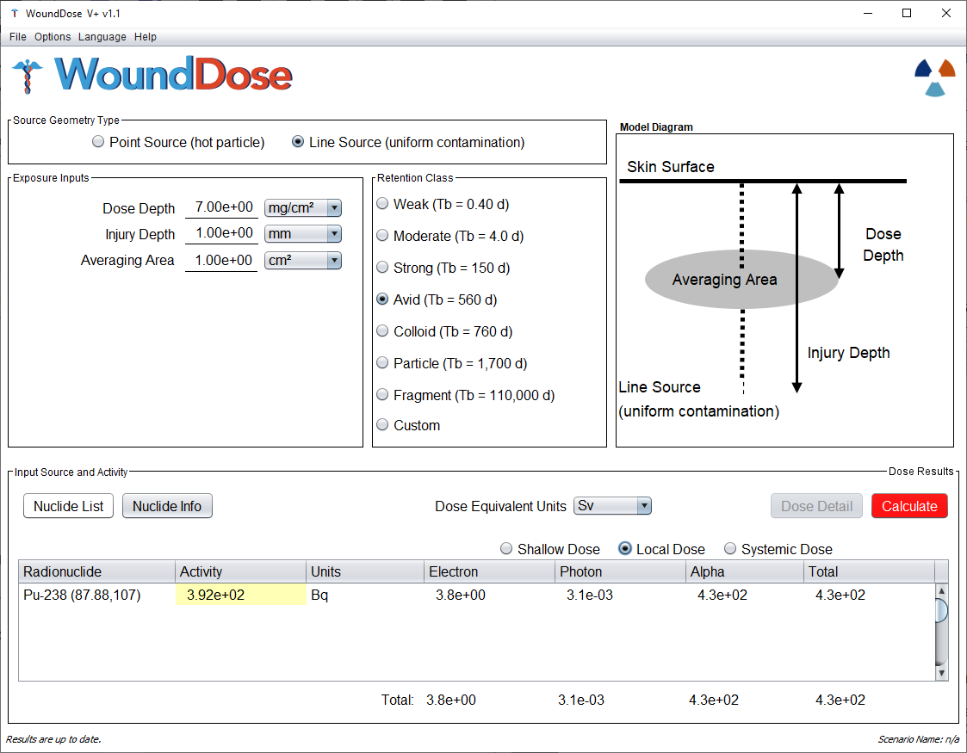
WoundDose

Slide 70
Pu-238 puncture Wound dosimetry summary
WoundDose
Wound Activity (Bq) | Geometry | Shallow Electron Dose (Sv) | Shallow Photon Dose (Sv) | Shallow Alpha Dose (Sv) | Local Electron Dose (Sv) | Local Photon Dose (Sv) | Local Alpha Dose (Sv) | CEDE* (Sv) | CODE (Sv)
392 | Point | 0.0 | 0.0049 | 0.0 | 4.2 | 0.0035 | 480 | 0.16 | 5.4
 | Line | 0.57 | 0.012 | 6,500 | 3.8 | 0.0031 | 430 | 0.16 | 5.4
70 | Point | 0.0 | 0.00088 | 0.0 | 0.76 | 0.00062 | 85 | 0.029 | 0.97
 | Line | 0.10 | 0.0021 | 1,200 | 0.68 | 0.00056 | 77 | 0.029 | 0.97
*Radiation safety staff determined a pre-treatment CEDE of 0.1638 Sv and a post-treatment CEDE of 0.0296 Sv

Slide 71
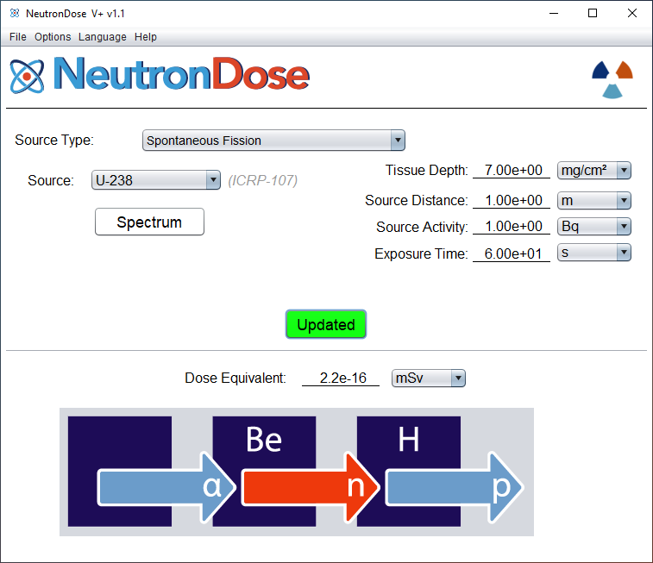
Neutrondose
NeutronDose

Slide 72
outline
NeutronDose
Basic theory
  scatter (elastic and inelastic)
  radiative capture
  absorption reactions
General dosimetry equations
KERMA response
Charged particle equilibrium
Neutron sources
Examples

Slide 73
Basic Neutron Dosimetry
NeutronDose
Consideration is made for neutron interactions from energies spanning thermal to fast (up to 20 MeV)
  set of KERMA values can be generated using neutron interaction equations
  depth-dose equations can then be applied to these values for an estimate of neutron dose at a specific depth
  this is especially important for incident neutrons above 1 MeV where charged particle KERMA is not equivalent to dose at shallow depths
Principle concern of occupational radiation exposure is carcinogenesis in mitotically active cells (stratum basale)
  ICRU 4-component soft tissue
How radiation interacts with matter depends on its type, energy, and elemental composition of the medium
  similar to photons, neutrons are indirectly ionizing
  they interact with the nucleus of an atom, however, rather than its atomic orbitals

Slide 74

KERMA
NeutronDose
Neutron KERMA represents the kinetic energy transferred from neutrons to charged particles in an absorbing medium
The type and abundance of reactions that could occur depends on the incident neutron energy, elemental composition of tissue, and the various reaction cross sections:
where N_{j} is the number of atoms per unit mass of element j defined by the ICRU 44 elemental composition of soft tissue
ϵ_{ij} (E) is the energy transferred to charged particles as kinetic for nuclide j and interaction I
and σ_{ij} (E) is the microscopic cross section for a given reaction
$$K\left(d,E\right)=\sum_{j}{N_{j}}\sum_{i}{ε_{ij}\left(E\right)∙σ_{ij}\left(E\right)∙Φ\left(d , E\right)}$$

Slide 75
KERMA
NeutronDose
The neutron fluence after attenuation through thickness d of tissue is:
The total macroscopic cross section (Σ_{t}) describes the probability of any interaction within that medium and can be calculated by:
Unlike KERMA, absorbed dose requires consideration of energy transferred specifically to ionization by secondary charged particles within the dose volume. However, these two values are closely related such that determination of KERMA can be used to approximate dose, with the appropriate application of fractional CPE when they are not equal
$$Φ\left(d,E\right)=Φ\left(E\right)∙e^{−Σ_{t}d}$$
$$Σ_{t}\left({cm}^{−1}\right)=\sum_{i}{N_{i}∙σ_{elastic}}+ N_{i}∙σ_{inelastic}+ N_{i}∙σ_{capture}+ N_{i}∙σ_{transfer}$$

Slide 76
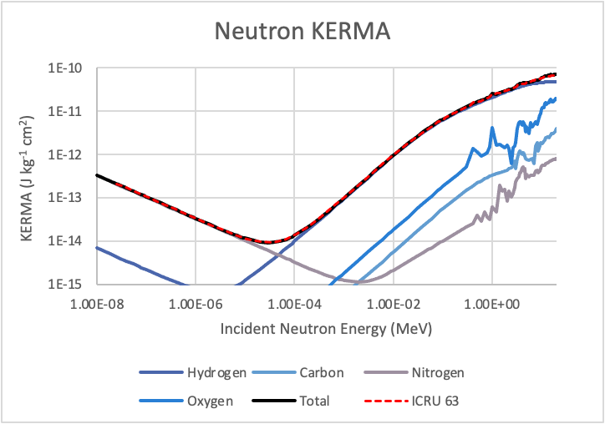
kerma
NeutronDose
Pertinent cross sections were gathered from the Evaluated Nuclear Data File (ENDF) to build neutron KERMA in tissue
Each of the possible neutron reactions was evaluated individually before summation to determine the total KERMA at a given incident neutron energy

Slide 77
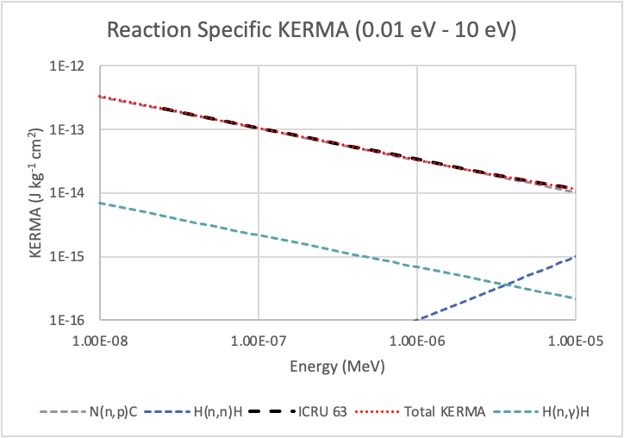
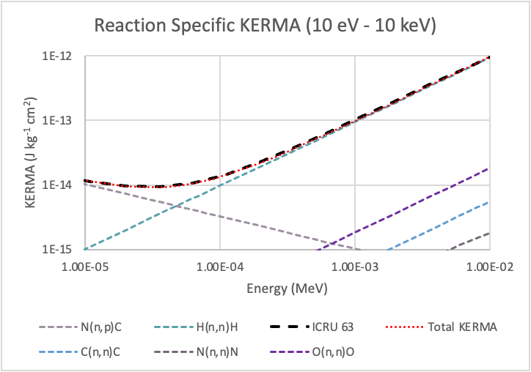
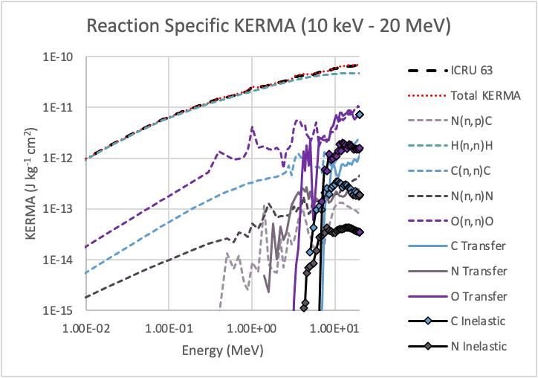
KERMA
NeutronDose

Slide 78
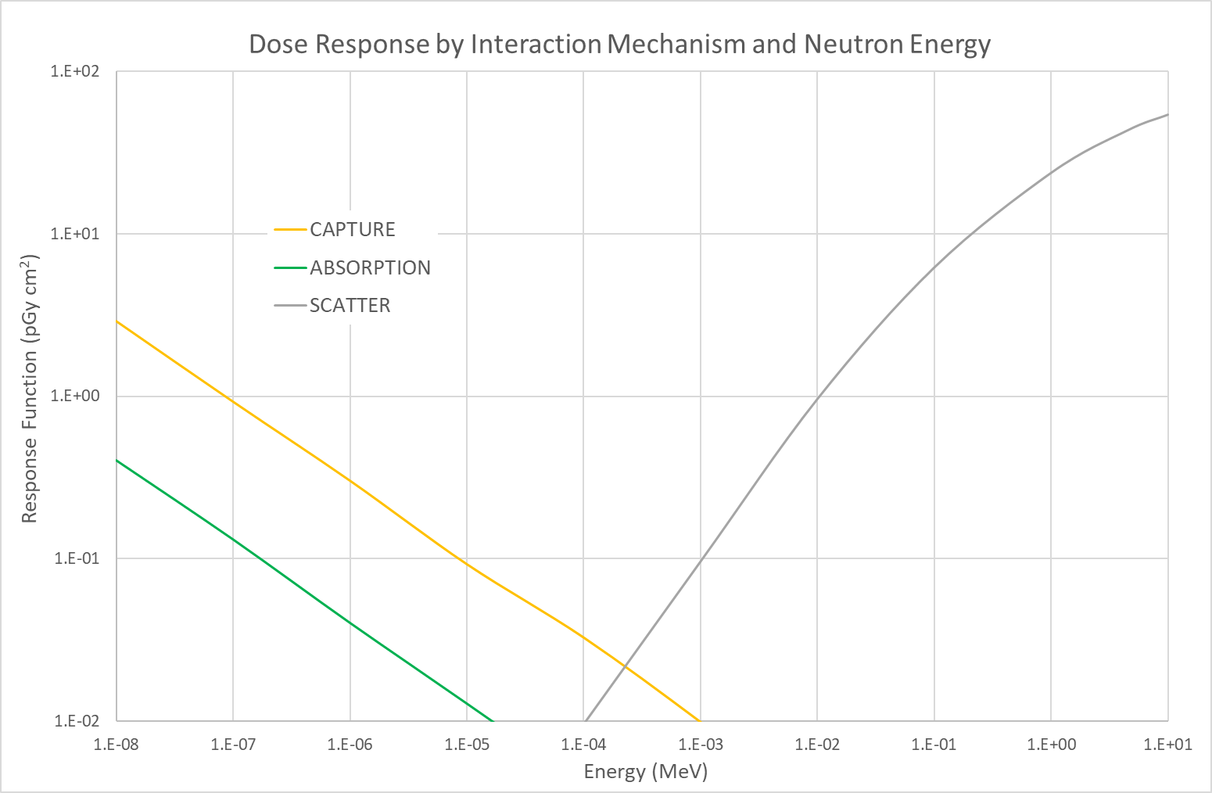
Response Function by Mechanism
NeutronDose
f_{CPE} = 1

Slide 79
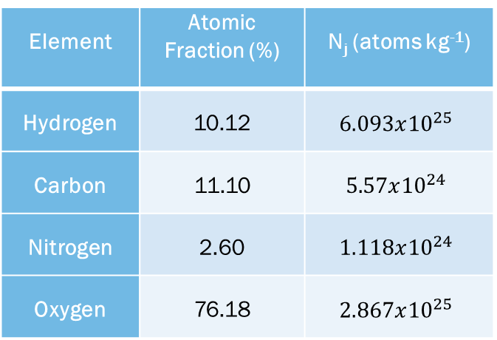
Neutron Dosimetry: Scatter
NeutronDose
Dominant at higher neutron energies
Neutrons transfer kinetic energy by direct collision with the atomic nuclei that make up tissue (H, C, N, and O)
The majority of energy (>85%) deposited by scatter occurs due to neutron collisions with hydrogen nuclei
Collisions with oxygen nuclei account for as much as 15% of scatter dose above ~1 MeV
Element | Atomic Fraction (%) | N_{j} (atoms kg⁻¹)
Hydrogen | 10.12 | $$6.093x{10}^{25}$$
Carbon | 11.10 | $$5.57x{10}^{24}$$
Nitrogen | 2.60 | $$1.118x{10}^{24}$$
Oxygen | 76.18 | $$2.867x{10}^{25}$$

Slide 80
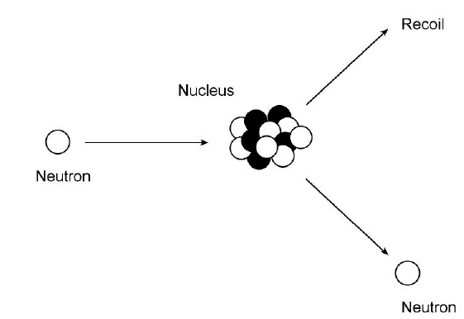
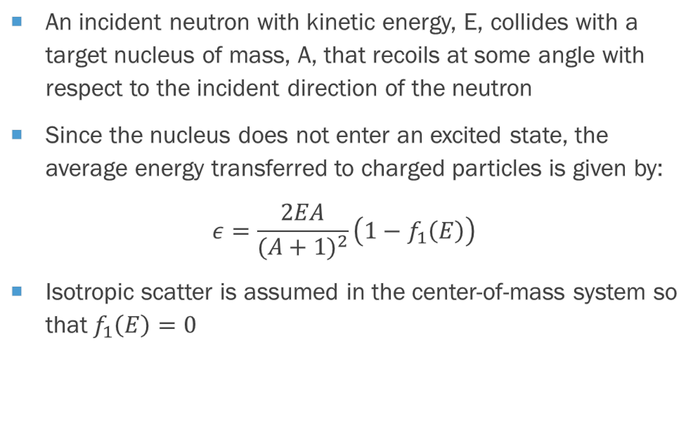
Neutron Dosimetry: Elastic Scatter
NeutronDose
An incident neutron with kinetic energy, E, collides with a target nucleus of mass, A, that recoils at some angle with respect to the incident direction of the neutron
Since the nucleus does not enter an excited state, the average energy transferred to charged particles is given by:
$$ε=\frac{2EA}{{(A+1)}^{2}}\left(1−f_{1}\left(E\right)\right)$$
Isotropic scatter is assumed in the center-of-mass system so that $f_{1}\left(E\right)=0$

Slide 81
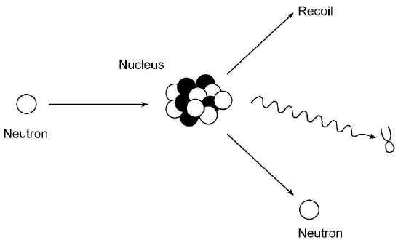
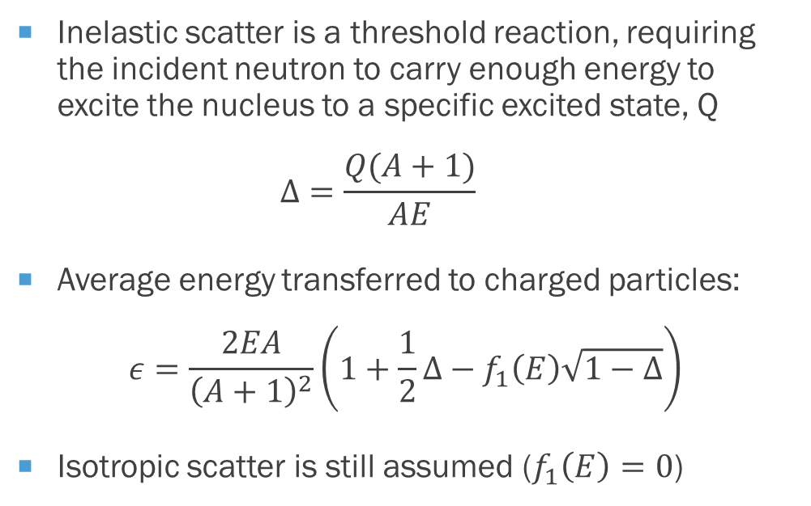
Neutron Dosimetry: Inelastic scatter
NeutronDose
Inelastic scatter is a threshold reaction, requiring the incident neutron to carry enough energy to excite the nucleus to a specific excited state, Q
  $$Δ=\frac{Q(A+1)}{AE}$$
Average energy transferred to charged particles:
$$ε=\frac{2EA}{{\left(A+1\right)}^{2}}\left(1+\frac{1}{2}Δ−f_{1}\left(E\right)\sqrt{1−Δ}\right)$$
Isotropic scatter is still assumed ($f_{1}\left(E\right)=0$)

Slide 82
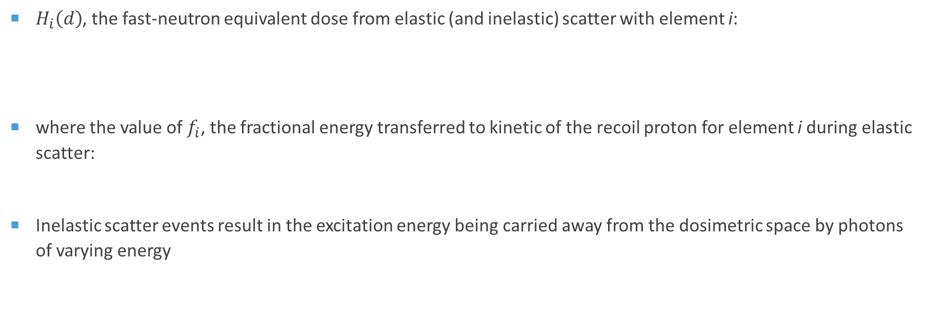
Neutron Dosimetry: Scatter
NeutronDose
$H_{i}\left(d\right)$, the fast-neutron equivalent dose from elastic (and inelastic) scatter with element i:
where the value of $f_{i}$, the fractional energy transferred to kinetic of the recoil proton for element i during elastic scatter:
Inelastic scatter events result in the excitation energy being carried away from the dosimetric space by photons of varying energy
$$H_{i}\left(d\right)=1.602x{10}^{−13} \left(J/{MeV}\right)∙N_{i}∙f_{i}\int_{0}^{∞}{\left(E∙w_{R}\left(E\right)∙σ_{i}\left(E\right)∙f_{CPE}\left(d,E\right)∙Φ′\left(d,E\right)\right) dE}$$
$$f_{i}= \frac{2A}{{\left(A+1\right)}^{2}}$$

Slide 83
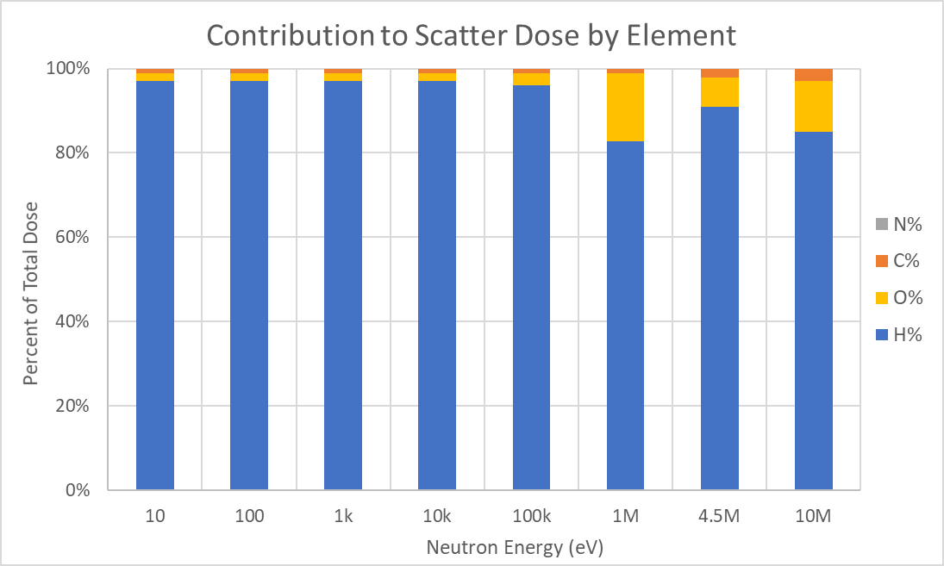
Neutron Dosimetry: Scatter
NeutronDose
f_{CPE} = 1

Slide 84


Neutron Dosimetry: Radiative Capture
NeutronDose
Target nucleus of mass A absorbs an incident neutron with kinetic energy E, briefly forming an excited atom A’.
The atom de-excites through the emission of a photon with energy E_{γ} that may deposit energy elsewhere or leave the tissue medium
Conservation of momentum dictates an energy balance between the recoil nucleus and photon emission:
$$ε=\frac{E}{A+1}+\frac{{\left(E_{γ}+\frac{AE}{A+1}\right)}^{2}}{A′c^{2}}$$

Slide 85


Neutron Dosimetry: absorption Reactions
NeutronDose
A compound nucleus is briefly formed before the emission of a charged particle
Subsequent nucleus may be left in an excited state depending on the incident neutron energy
Energy transferred depends on the incident energy of the neutron, E_{n}, the mass difference, Q, and the level of the excited state, E_{s}:
$$ε=E_{n}+Q−E_{s}$$

Slide 86
Neutron Dosimetry: Capture/Absorption
NeutronDose
Dominant at low (thermal) energies
Two significant capture/absorption interactions emerge:
  ¹H(n,γ)²H Q = 2.224 MeV
  ¹⁴N(n,p)¹⁴C Q = 0.626 MeV
Capture results in the emission of a high-energy photon to be absorbed elsewhere
  this mechanism may be insignificant when evaluating shallow dose equivalent
  but the generation of photons in shielding materials can be significant (not currently handled by NeutronDose)
Absorption in tissue results in an energetic proton and carbon recoil, the combined energy of which is deposited within the range of the proton
  i.e., about 10 microns in tissue

Slide 87
Neutron Dosimetry: Capture/Absorption
NeutronDose
𝐻(𝑑), the equivalent dose at depth, d, due to neutron capture by ¹H or absorption by ¹⁴N is calculated using:
where N is the atomic mass density of ¹H or ¹⁴N (atoms kg⁻¹)
Q is the reaction energy (MeV), AF is the fraction of energy absorbed locally in tissue
𝑤_{𝑅} (𝐸) is the radiation weighting factor (Sv/Gy)
𝜎(𝐸) is the energy-dependent cross section (cm² atom⁻¹)
𝑓_{𝐶𝑃𝐸} (𝑑,𝐸) accounts for fractional charged particle equilibrium
and Φ′(𝑑,𝐸) is the neutron fluence at depth (cm⁻² MeV⁻¹)
$$H\left(d\right)=1.602x{10}^{−13} \left(\frac{J}{MeV}\right)∙N∙Q∙AF\int_{0}^{∞}{\left(w_{R}\left(E\right)∙σ\left(E\right)∙f_{CPE}\left(d,E\right)∙Φ′\left(d,E\right)\right) dE}$$

Slide 88



Neutron Dosimetry
NeutronDose
Equivalent dose $H_{i,j}$ for interactions by neutrons of energy E, with element i, by mechanism j, at depth d:
$$H_{i,j}\left(d\right)=K∙\frac{N_{A}∙f_{i}}{{AW}_{i}}∙ε_{i,j}\int_{0}^{∞}{\left(w_{R_{j}}\left(E\right)∙σ_{i,j}\left(E\right)∙f_{cpe}\left(d,E\right)∙Φ′\left(d,E\right)\right) dE}$$
where:
$K$ = energy conversion [J MeV⁻¹];
$N_{A}$ = Avogadro's number [atoms mol⁻¹];
$f_{i}$ = atom weight-fraction;
${AW}_{i}$ = atomic weight [kg mol⁻¹];
$ε_{i,j}$= interaction energy absorbed locally [MeV];
$w_{R_{j}}\left(E\right)$= radiation weighting factor [Sv Gy⁻¹];
$σ_{i,j}\left(E\right)$= interaction cross section [cm² atom⁻¹];
$f_{cpe}\left(d,E\right)$= fractional charged particle equilibrium; and
$Φ′\left(d,E\right)$= neutron fluence at depth [cm⁻² MeV⁻¹].
$$ε_{i,s}=\frac{2A_{i}E}{{\left(A_{i}+1\right)}^{2}} (scatter)$$
$$ε_{i,a}=Q_{i,a}∙{AF}_{i,a} (absorption)$$
A_{i} is the mass number of element i;
E is the incident neutron energy [MeV];
Q_{i} is the reaction energy [MeV];
and AF_{i} is the absorbed fraction.

Slide 89


Fractional Charged Particle equilibrium
NeutronDose
Neutron KERMA is equivalent to dose where charged particle equilibrium is established
CPE is said to exist if for every charged particle leaving a volume an identical enters
In the buildup region each subsequent volume of interest approaches equilibrium
For shallow dosimetry, however, the CPE approximation is not an accurate reflection of dose
Equilibrium fraction by incident neutron energy was modeled with MCNP

Slide 90






Neutron f_{CPE} in Tissue
NeutronDose

Slide 91

Neutron Sources
NeutronDose
The NeutronDose module provides dosimetry for six different source types:
  - spontaneous fission - photoneutrons (γ,n)
  - neutron-induced fission - monoenergetic neutrons
  - alpha-reaction neutrons (α,n) - user-uploaded custom energy distributions

Slide 92




Neutron Sources
NeutronDose
Both spontaneous fission and neutron-induced fission sources use the Watt fission spectrum equation:
The values A and B are taken from ICRP 107 for spontaneous fission sources, and from Shultis and Faw (2000) for neutron-induced fission as a function of incident neutron energy, E, up to a maximum of 10 MeV
The leading coefficients, B_{r} and $\overline{ν}$, represent the branching ratio and average number of neutrons produced per fission for spontaneous fission events
Fissile or fissionable nuclides:
  ²³³U, ²³⁵U, ²³⁸U, ²³⁹Pu, ²³²Th
Spontaneous fission for nuclides of these elements:
  U, Np, Pu, Am, Cm, Bk, Cf, Es, Fm
$$χ\left(E\right)=B_{r}\overline{ν}\exp\left(−\frac{E}{A}\right)\sinh\left(\sqrt{BE}\right)$$

Slide 93
Neutron Sources
NeutronDose
Characteristics of Photoneutron Sources Provided in V+ (Shultis & Faw 2000)
Source | Reaction | Avg. Neutron Energy (MeV) | Number of photons per decay | Neutron yield per decay*
As-76 / ⁹Be | ⁹Be(γ,n)⁸Be | 0.108; 0.382 | 0.010 | 1.9E-6
Ga-72 / ⁹Be | ⁹Be(γ,n)⁸Be | 0.173; 0.476; 0.733; 0.748 | 0.0517 | 1.4E-6
Ga-72 / D₂O | ²H(γ,n)¹H | 0.131; 0.139 | 0.205 | 1.6E-6
In-116m / ⁹Be | ⁹Be(γ,n)⁸Be | 0.396 | 0.154 | 2.2E-7
La-140 / ⁹Be | ⁹Be(γ,n)⁸Be | 0.761 | 0.034 | 8.0E-8
La-140 / D₂O | ²H(γ,n)¹H | 0.146 | 0.034 | 2.0E-7
Mn-56 / ⁹Be | ⁹Be(γ,n)⁸Be | 0.128; 0.397; 0.761 | 0.425 | 7.8E-7
Mn-56 / D₂O | ²H(γ,n)¹H | 0.146; 0.214 | 0.017 | 8.0E-8
Na-24 / ⁹Be | ⁹Be(γ,n)⁸Be | 0.967 | 1.0 | 3.5E-6
Na-24 / D₂O | ²H(γ,n)¹H | 0.262 | 1.0 | 7.3E-6
Sb-124 / ⁹Be | ⁹Be(γ,n)⁸Be | 0.022; 0.378 | 0.547 | 5.1E-6
Y-88 / ⁹Be | ⁹Be(γ,n)⁸Be | 0.151; 0.949 | 0.999 | 2.7E-6
Y-88 / D₂O | ²H(γ,n)¹H | 0.252 | 0.006 | 8.0E-8
Characteristics of Alpha Reaction Sources Provided in V+ (Lorch 1973)
Source | Reaction | Avg. Neutron Energy (MeV) | Neutron yield per alpha
Am-241 / ¹⁰B | ¹⁰B(α,n)¹³N | 3.0 | 1.39E-5
Am-241 / ⁹Be | ⁹Be(α,n)¹²C | 4.4 | 7.22E-5
Am-241 / ¹⁹F | ¹⁹F(α,n)²²Na | 1.5 | 4.17E-6
Cm-242 / ⁹Be | ⁹Be(α,n)¹²C | 4.1 | 9.17E-5
Pu-239 / ⁹Be | ⁹Be(α,n)¹²C | 4.6 | 4.70E-5
Pu-239 / ¹³C | ¹³C(α,n)¹⁶O | 4.2 | 3.17E-6
*neutrons emitted from 1 g of Be or D₂O placed 1-cm away

Slide 94

Capabilities and current limitations
NeutronDose
Neutron sources include
  spontaneous fission
  neutron-induced fission
  alpha reaction neutrons (α,n)
  photoneutrons (γ,n)
  a monoenergetic neutron
  a user-uploaded custom energy distribution
User inputs depend on source selection
  inputs are used to define an orthogonal beam at the skin layer
Source geometries not allowed; all assumed to be orthogonal beams
No shielding or source covers
On contact sources not permitted at this time!

Slide 95


EXAMPLE 1: exposure to a PuBe source
NeutronDose
Assume (α,n) reaction with Pu-239/Be-9 source
At a distance of 1 m and source strength of 1 Ci
Shallow dose at 7 mg/cm² for a 1-hr exposure time

Slide 96

Example 2: exposure to a Cf-252 laboratory source
NeutronDose
A student is to conduct a laboratory experiment requiring an 80-minute exposure to Cf-252 at 5 meters
Cf-252 has …
  an intrinsic specific activity of 19.86 TBq/g
  fission neutron emissions from zero to 13 MeV, with a mean of 2.3 MeV and a most probable energy of 1 MeV
This source had a mass of 1 gram 500 days prior to the experiment
Its current activity is therefore 13,860 MBq
Calculate SDE and dose at depth of 10 cm

Slide 97


Cf-252 exposure
NeutronDose

Slide 98

Example 3: neutron dose rate from SbBe source
NeutronDose
Sb-124 mixed with beryllium provides a photoneutron source
Results in two monoenergetic neutrons of about 22 and 380 keV
NeutronDose calculates a dose rate factor of 5.0 pSv m² h⁻¹ MBq⁻¹

Slide 99


SbBe neutron dose rate
NeutronDose
Alternatively, we can assume a point source with negligible self-absorption and use a neutron emission yield from the literature of 5.1x10⁻⁶ n/dis
… to determine a fluence factor (at 1 meter) of 0.14 n/cm² per hour per MBq
Then, using the monoenergetic feature we can estimate the dose rate factor for each of the two monoenergetic neutrons (along with their related photon emission yields):
$$DRF=1.1\left(0.896\right)+36\left(0.104\right)=4.7 \frac{pSv m^{2}}{h MBq}$$

Slide 100

eyedose
EyeDose

Slide 101
outline
EyeDose
Regulatory Basis
Early estimates with VARSKIN
Basic Structure
  photons
  electrons
  protective glasses
  off-axis corrections
V&V
Limitations
Examples

Slide 102

Sensitivity by Structure
EyeDose
In order of decreasing sensitivity (Rohrschneider, 1929)
  Lens
  Conjunctiva
  Cornea
  Uvea
  Retina
  Optic Nerve
Assumption: Protect the lens and protect the eye

Slide 103
Regulatory basis for eyedose
EyeDose
In the United States from 10 CFR 20.1201 (1991):
  150 mSv/yr
Internationally from ICRP 118 (2012):
  20 mSv/yr averaged over 5 consecutive years, not to exceed 50 mSv in any single year
Many nations adopted the ICRP recommendations, causing a renewed interest in eye dosimetry
  some RAMP users wanted to use the VARSKIN code to estimate eye dose

Slide 104

Prior to Eyedose
EyeDose
We compared VARSKIN 5.3 to Monte Carlo simulation (MCNP6)
Using a simplified eye model with cornea, lens, and surrounding tissue all assumed to be of unit density
  to be closest to VARSKIN assumptions
Point sources located along centerline from contact to 20 cm
Dose estimated per incident electron
  to normalize for geometry
  cross-sectional area of 1 cm² with 20 mm thickness, centered at a depth of 3 mm
Lens
Surrounding tissue
Cornea

Slide 105



Source on Contact
EyeDose
*
VARSKIN underestimates by at least 10%

Slide 106


with Air gap
EyeDose
5 1
*
*

Slide 107


20 10
EyeDose
*
*

Slide 108

1 cm Gap with Plastic
EyeDose
1cm
*

Slide 109


2 cm Gap with Plastic
EyeDose
2cm
*

Slide 110
Eyedose model
EyeDose
Driven by a set of deterministic equations developed from a vast array of probabilistic simulations (MCNP)
  simulations of monoenergetic photons and electrons originating at varying distances from a stylized eye model
  source is assumed to be an infinitely small, isotropic point source located on the geometric axis
  dose calculated to the lens of the eye
Accounts for particle type, energy, source emission rate, and protective eyewear for:
  photon energies from 7 keV to 11 MeV
  electron energies from 100 keV to 11 MeV
  distances from 0 to 20 meters
Nuclide emissions (ICRP 38 and 107 data) are incorporated into the model
  as well as a placeholder for incorporation of emissions from X-ray machines (future project)

Slide 111


Eye Geometry
EyeDose
The source in EyeDose is modeled as a monoenergetic, isotropic point source of energy E
The source is located on the geometric axis of the eye and the distance between the surface of the eyeball and the source is labeled r
Photons and electrons are modeled as they interact with structures of the eyeball
Bremsstrahlung created in the eyeball is incorporated into the dose calculation

Slide 112


Photon Dosimetry
EyeDose

Slide 113


Electron dosimetry
EyeDose
This new path opens at around r = 0.3 cm. The electron rays radiating from the source can be considered parallel at about 10 cm, at which point both the bremsstrahlung and direct contribution obey the inverse square law.

Slide 114



Shielded vs Unshielded Dose
EyeDose
Protective glass thickness of 2 mm placed 1.25 cm from the cornea’s surface
Bremsstrahlung created in the safety glasses is incorporated into the dose calculation
1.25 cm

Slide 115




Total Dose
EyeDose
In the presence of discrete energy particles (e.g., Auger electrons, characteristic X rays or gamma rays) and continuous energy spectra (e.g., beta radiation or X-ray machines), total dose is given by:
$${\dot{D}}_{total}=\sum_{\begin{aligned}&discrete \\ &photons\end{aligned}}{{A_{i}D}_{p}\left(E\right)}$$
$$+\sum_{\begin{aligned}&continuous \\ &photons\end{aligned}}{A_{i}\int_{E}{D_{p}\left(E\right)∙P_{i}\left(E\right)dE}}$$
$$+\sum_{\begin{aligned}&discrete \\ &electrons\end{aligned}}{{A_{i}D}_{e}\left(E\right)}$$
$$+\sum_{\begin{aligned}&continuous \\ &electrons\end{aligned}}{A_{i}\int_{E}{D_{e}\left(E\right)∙P_{i}\left(E\right)dE}}.$$

Slide 116






Off-axis source
EyeDose

Slide 117


Verification and validation - photons
EyeDose
Unshielded
Shielded

Slide 118


Verification and validation - electrons
EyeDose
Unshielded
Shielded

Slide 119

Current Limitations
EyeDose
Cannot adjust eye-glass parameters – built directly into the model (0.75 mm lead equivalent at 125 kVp)
Assumes the eyeball is centered on-axis for the entire exposure
  sensitivity study shows dependency on off-axis angle and energy
  difference between the on-axis and off-axis dose is within about 15% for θ < 20°
HOWEVER, the model accurately accounts for the curvature of the eye, the curvature of the lens, and the varying densities of the tissues of the eye and is a significant upgrade over using SkinDose to model a similar configuration

Slide 120
Example 1: dose rate to the lens from Co-60
EyeDose
A person is exposed to a 37 MBq Co-60 source at 2.5 meters
What is the dose equivalent to the lens?
A back-of-the-envelope estimate to a small tissue volume is:
Now, we’ll use EyeDose (in two configurations) for the same calculation …
$$\dot{H}=1.25\left[MeV\right]∙2\left[\frac{γ}{dis}\right]∙\frac{37x{10}^{6}\left[{dis}/s\right]}{4π{\left(250\left[cm\right]\right)}^{2}}∙0.0297\left[\frac{{cm}^{2}}{g}\right]∙0.576\left[\frac{s μSv J g}{h Sv MeV kg}\right]=2.0\left[\frac{μSv}{h}\right]$$

Slide 121


EyeDose
$$\dot{H}=7.2x{10}^{−12}\left[\frac{μSv}{γ}\right]∙2\left[\frac{γ}{dis}\right]∙37x{10}^{6}\left[{dis}/s\right]∙3600\left[\frac{s}{h}\right]=1.9\left[\frac{μSv}{h}\right]$$

Slide 122


Example 2: exposure to sr-90
EyeDose
A technician is exposed to an “old” 2.3 mCi Sr-90 source with negligible encapsulation
What is the dose equivalent rate delivered to the lens of the eye at 30 cm?
What is the effect on dose from wearing 2-mm thick leaded glasses?
Nuclide | Geometry | Electron Lens Dose (mrem/h) | Shielding Effectiveness Factor
Sr-90 | Unshielded | 0.00025 | 6
 | Shielded | 0.000040
Y-90 | Unshielded | 210 | 4,000
 | Shielded | 0.053

Slide 123


Effectiveness of leaded glasses
EyeDose

Slide 124
QUESTIONS
DISCUSSION

