Slide 1
NRC-RADTRAN PRIMER
2022 RAMP User Meeting
Jonathan Napier, PNNL
Harish Gadey, PNNL
PNNL Release Number: PNNL-SA-171790
Notes:
About the Image: PNNL Aerial Photo
Aerial photo of the Pacific Northwest National Laboratory campus from the west.
https://www.flickr.com/photos/pnnl/42712951642/in/album-72157670058514908/

Slide 2
Overview
NRC-RADTRAN Calculation Concepts
NRC-RADTRAN Installation
NRC-RADTRAN Use

Slide 3
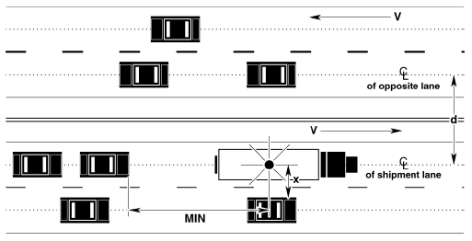
NRC-RADTRAN Calculation Concept
Calculations
  With traffic
  Opposing traffic
  Population
Treats shipment as a stationary object
  Relative velocity used for everything
Taken From RADTRAN 6 Technical Manual SAND2014-0780

Slide 4
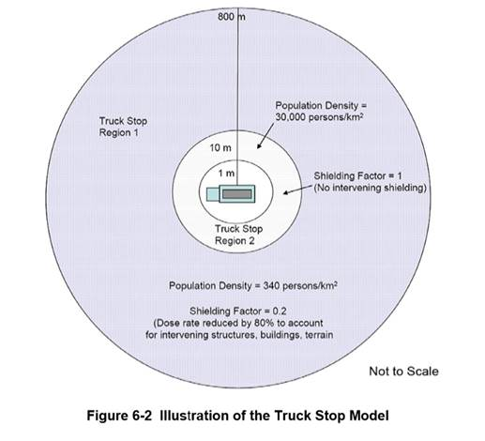
Calculation Areas
Example Truck Route Stop Figure from page 6-29 of U.S. NRC Environmental Impact Statement for an Early Site Permit (ESP) at the Clinch River Nuclear Site
NUREG-2226, Vol. 1
Notes:
These are based on the following assumptions

Slide 5
Accident Risk Analysis
Two types of exposure modeled:
  Direct exposure from loss of shielding
  Exposure associated with release of particulates, gases, volatiles, and crud; several pathways:
    Inhalation
    Cloudshine
    Resuspension
    Groundshine

Slide 6
Accident Dose-Risk Calculation
Doses are calculated and summed for all appropriate exposure pathways for all isotopes in each material for the shipment(s) being analyzed and for all downwind isopleths for each accident severity to yield a consequence (total dose) per accident of each severity
Probability of occurrence of each accident severity class is calculated from input values for accident rate, fractional occurrence, and distance traveled
Total Dose is multiplied by probability of occurrence for each accident severity to yield Dose-Risk
Results and intermediate calculations are included in the output file

Slide 7
Changes from RADTRAN 6
Command line is no longer used for any functionalities
RadCat is no longer maintained, distributed, or used
NRC-RADTRAN 1.0 is current version
  Runs RADTRAN 6.02.1
  New Graphic User Interface for Inputs
RADTRAN/RadCat 6 User Guide and Technical Manual are still valid references

Slide 8
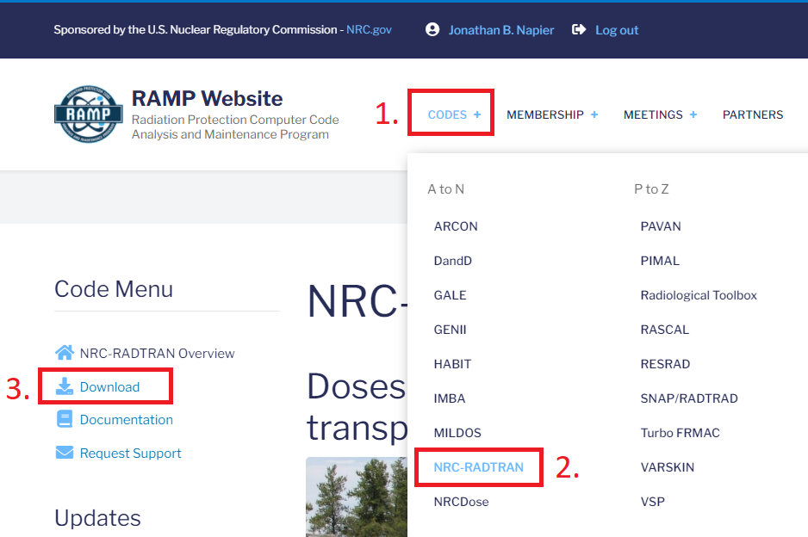
Obtaining
NRC-RADTRAN
Codes
NRC-RADTRAN
Download

Slide 9
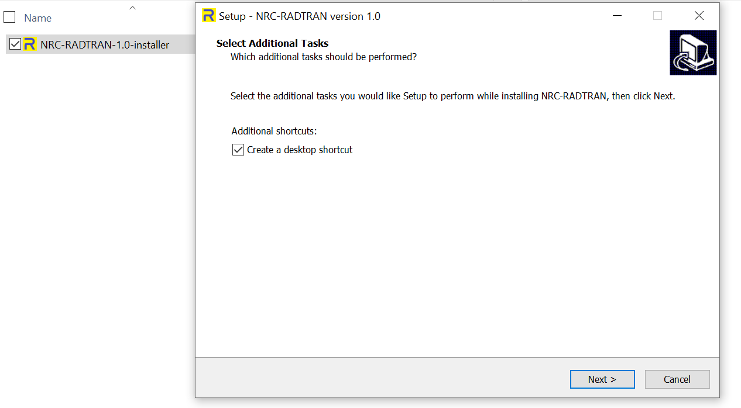
Installing
Double click on the downloaded file to install

Slide 10
Using NRC-RADTRAN

Slide 11
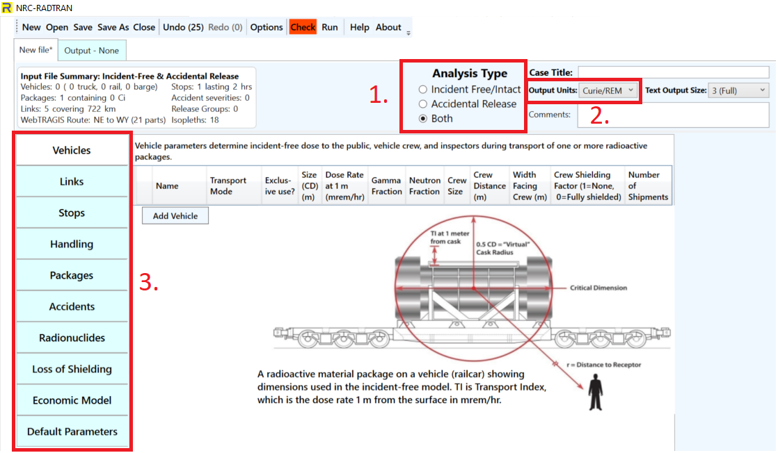
Defining the Problem
1. Type of Analysis
2. Units
  Curie/REM (default)
  Bq/Sv
3. Item 1 will dictate available inputs

Slide 12
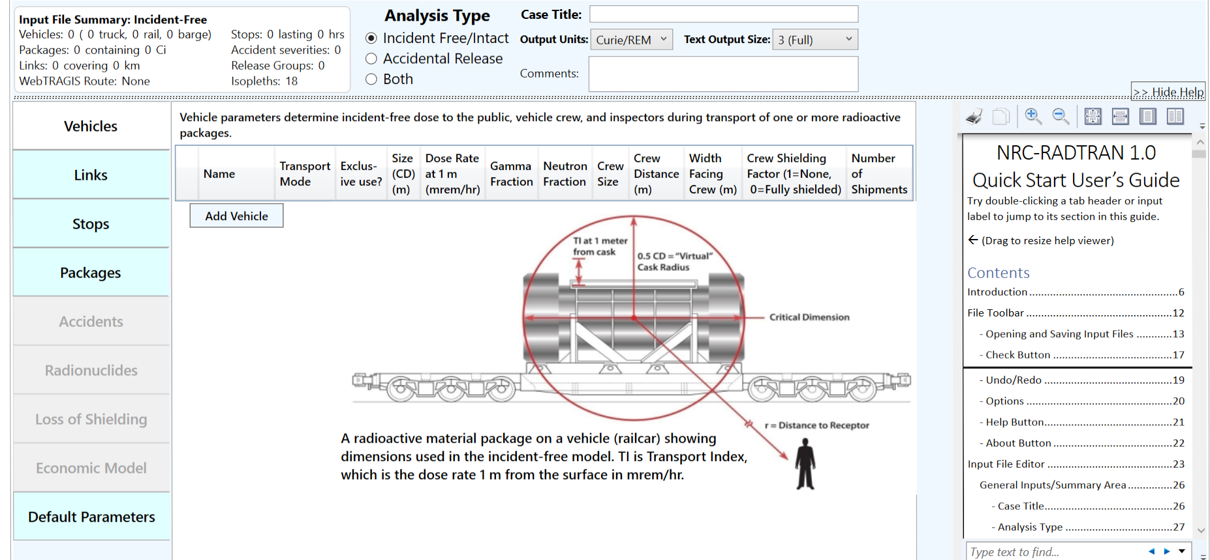
File Toolbar
Basic functions: opening, closing, and saving files
Undo/ Redo: maintains list of prior 99 actions
Options: display, file, open/save, and other legacy options
Check: Indicates any file errors (errors, warnings)
Help/ About: opens the viewer and provides basic information about NRC-RADTRAN
Help Viewer

Slide 13
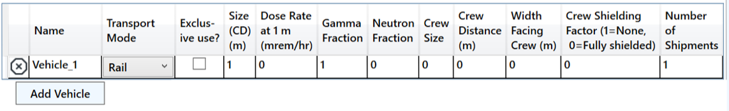
Vehicle
Transport Mode: highway, rail, waterway
Size (CD): Largest dimension of package (max. 9 m)
Gamma/ Neutron Fraction: split between gamma and neutron external package dose (must add to unity)
Crew Distance: Average distance of crew to nearest radioactive package
Width Facing Crew: largest dimension of the cargo facing crew
Crew Shielding Factor: fraction of radiation exposed to the crew
Number of Shipments: values calculated for single shipment and multiplied

Slide 14
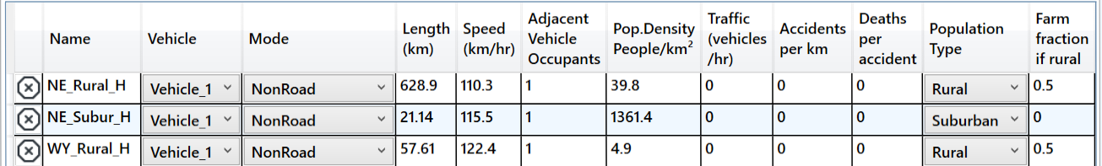
Links
Mode: highway, secondary road/ non road. Do not select unknown
Adjacent Vehicle Occupants: average number in vehicles
Traffic: number of vehicles travelling per hour on the link
Traffic, Accidents per km, and Deaths per accident are user defined
Population Type: Either rural, suburban or urban. Affects shielding factors and dose to pedestrians
Farm fraction if rural: fraction of surrounding area used for agriculture (only for rural)

Slide 15
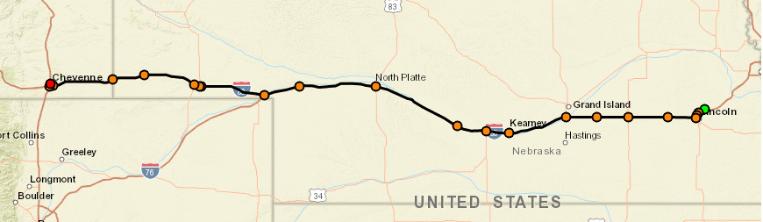
Creation of Links
Creation of Links using WebTRAGIS
  Limited to contiguous 48 states
  Requires US Government Sponsorship
  Populations are not currently being updated
Creation of Links in Google Earth
  Requires population density files
Manual Entry

Slide 16
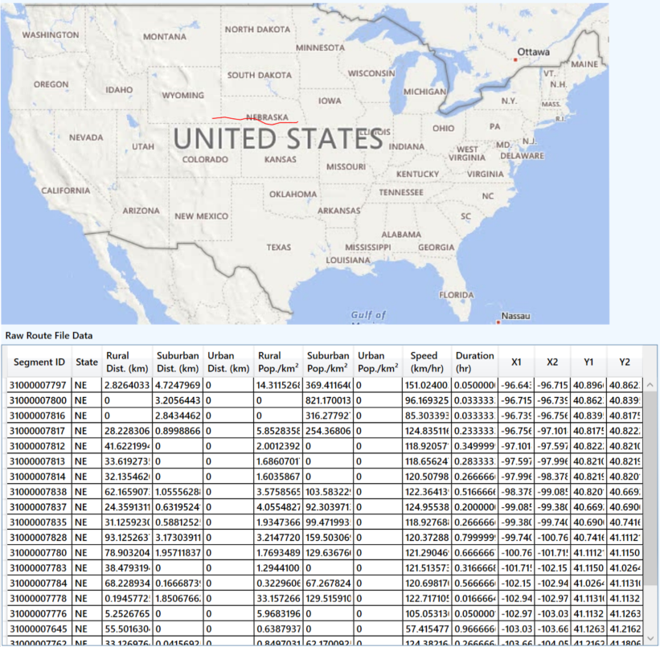
Actual Imported Information
WebTRAGIS information is intersection based
Each link is the distance between two intersections
  Uses known
    Population density
    Distance
    Speed
    Time of transit

Slide 17
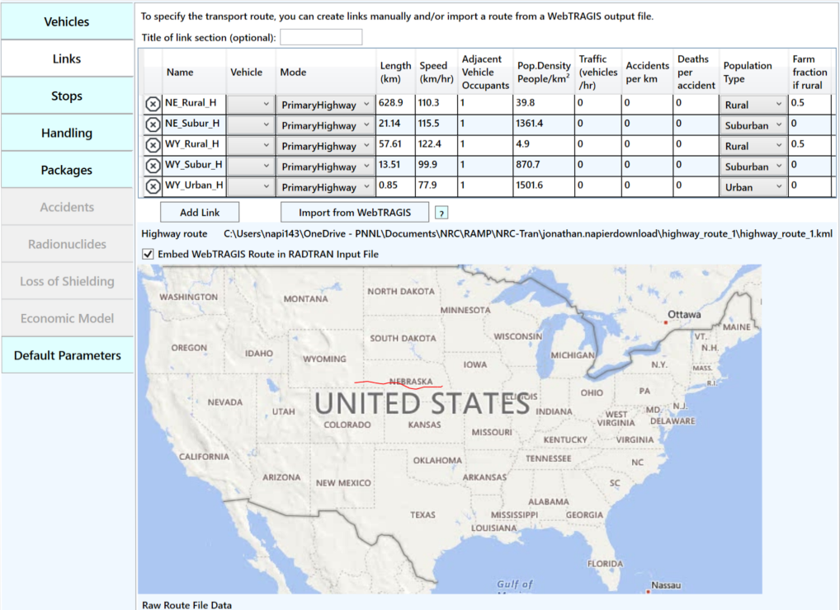
Import of Links from WebTRAGIS to NRC-RADTRAN
Summarized into three links per state
  Rural
  Urban
  Suburban

Slide 18
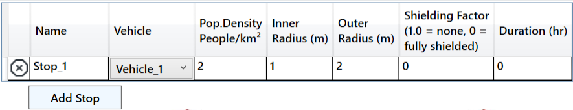
Stops
Vehicle: select any vehicle defined in the vehicles tab
Population Density: the population density in # per km²
Inner Radius: minimum distance from where dose to public is calculated
Outer Radius: maximum distance till where dose to public is calculated
Shielding Factor: used for dose calculations during a stop
Duration: time period for a given stop in hours

Slide 19
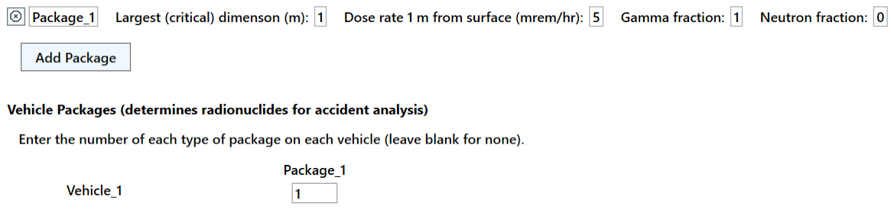
Packages
Optional for incident free analysis
Required for accident analysis
Enter the critical dimension in meters
Package Dimensions greater than 9 m should not be used
Enter dose at 1 m from surface and gamma/ neutron fraction
Enter number of packages of given type in each vehicle

Slide 20
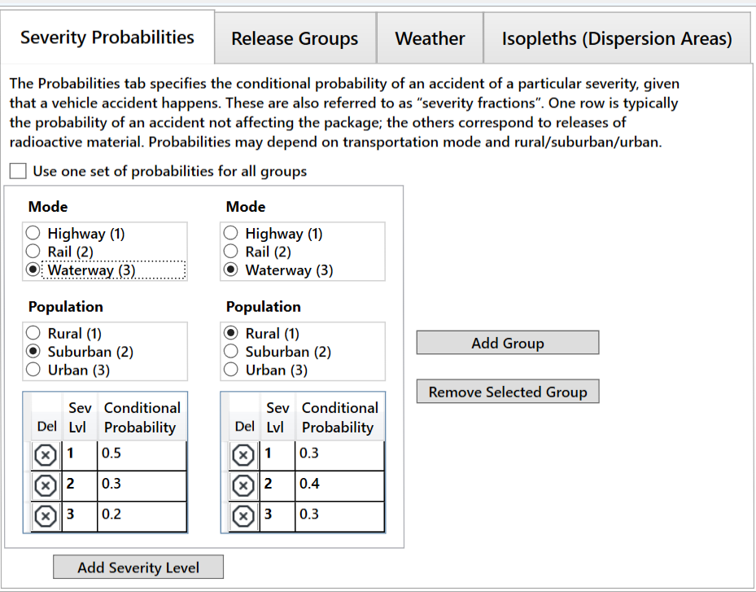
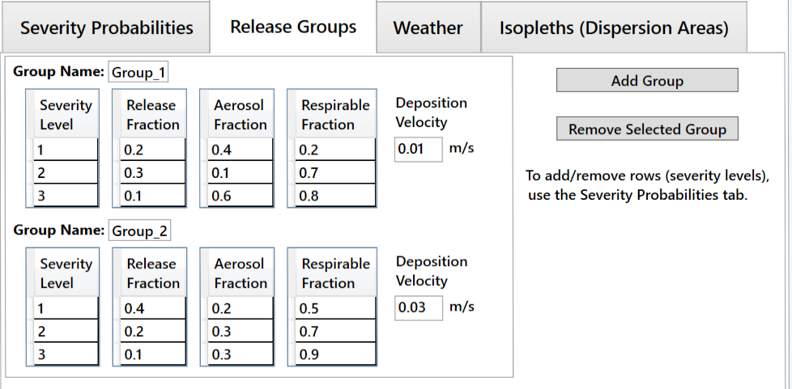
Accident
Select the mode of transportation and population type
Add probability of each severity level (must sum to unity)
Define Release Fractions → Aerosol Fractions → Respirable Fraction
Enter Deposition Velocity:
  Above 0.384 m/s (error)
  Above 0.1 m/s (warning)

Slide 21
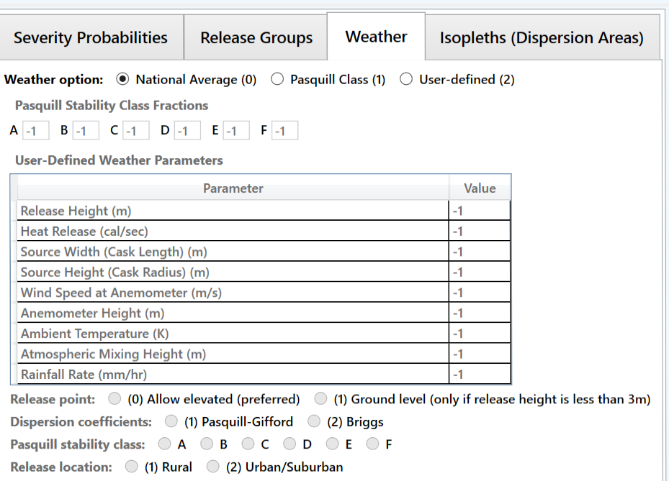
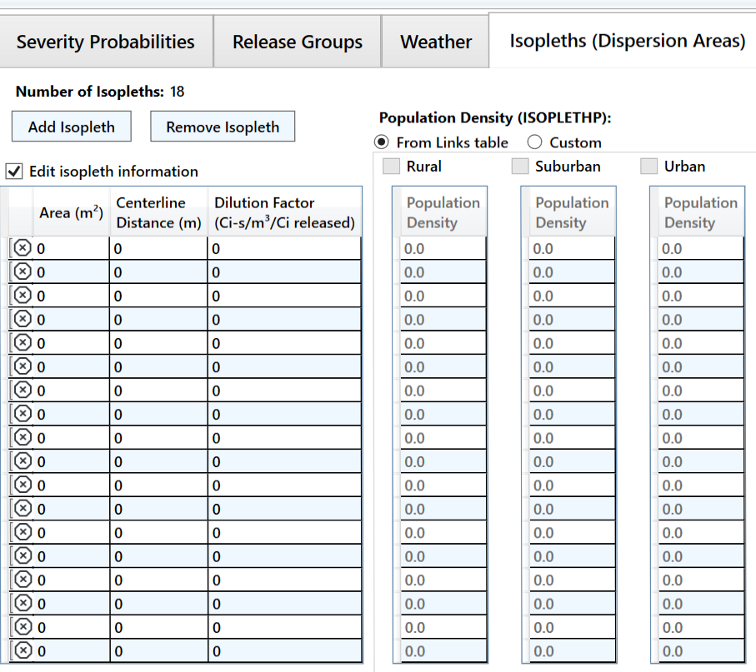
Accident (cont.)
National Average (0): simplest and requires no inputs
Pasquill Class (1): requires values for each Pasquill stability class
User-Defined (2): allows more detailed analysis
Define area, centerline distance, and dilution factor of each isopleth (max. number of isopleths: 18)
NOTE: if population density is being used, first two isopleths shall have same population density

Slide 22
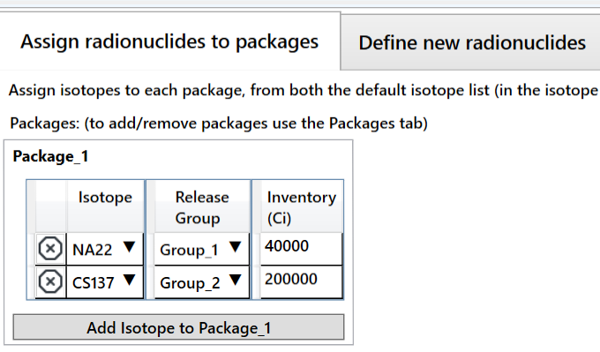
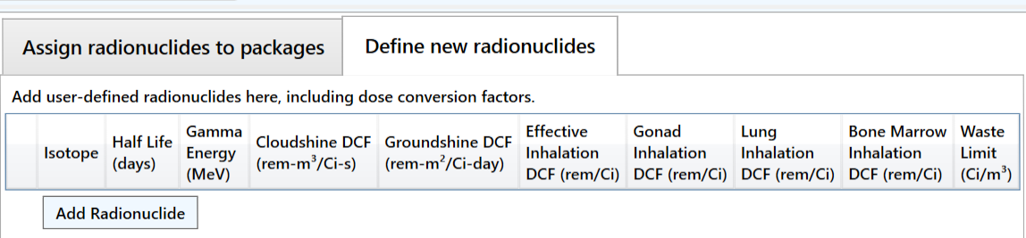
Radionuclides
Radionuclide inventory can be defined for package
Isotope inventory assigned according to release group
Each package has independent isotope inventory
User-defined radionuclides can also be defined
Half-lives, energies, and Dose Conversion Factors (DCFs) are required to be specified

Slide 23
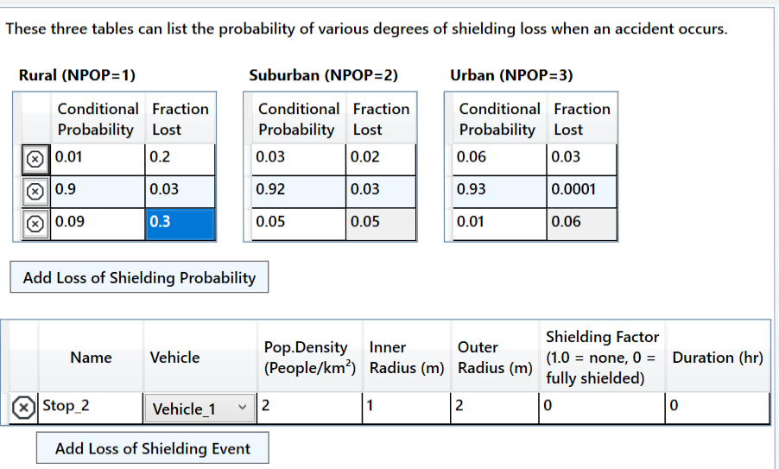
Loss of Shielding
Conditional Probability and Fractional Loss are defined
Probability for all scenarios shall sum to unity
Parameters for stop are defined

Slide 24
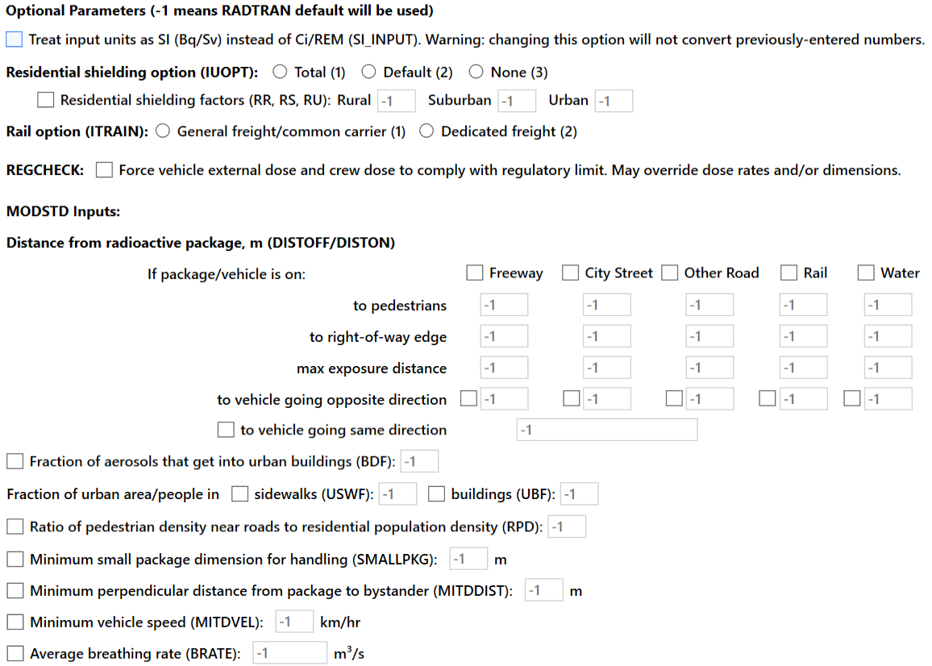
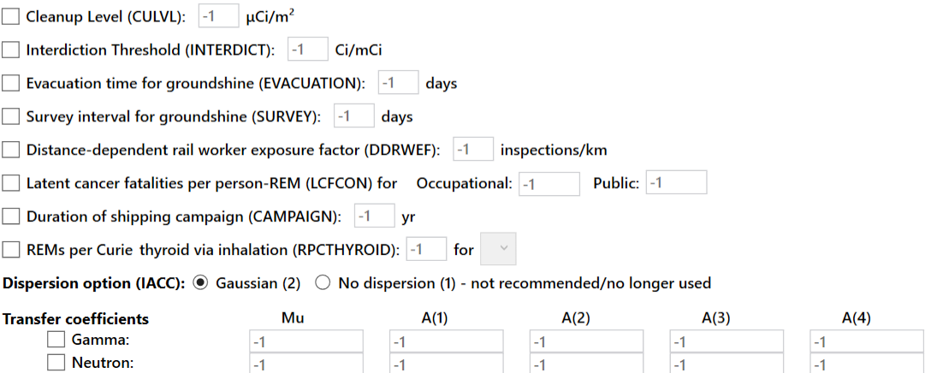
Default Parameters
Values of “-1” mean NRC-RADTRAN defaults shall be used
Potential user defined options include:
  Residential shielding factors
  Distance from radioactive packages
  Dispersion options
  Transfer coefficients
REGCHECK: used to force regulatory limits for external dose and crew dose

Slide 25
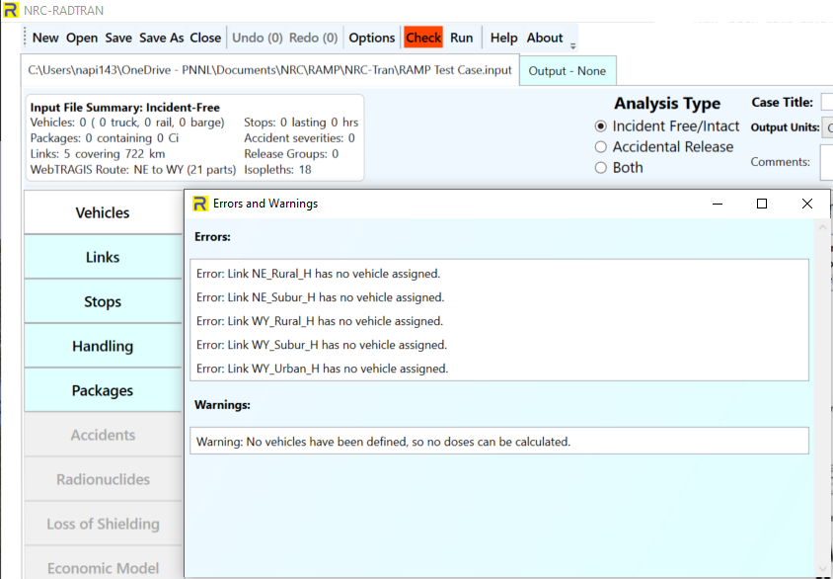
Check prior to Running or Saving
Check button changes color based on potential Errors and Warnings
Be certain to resolve errors/ warnings before running or saving
  Some saved files may not be recoverable without editing the saved text files
Default save location is not OneDrive

Slide 26
Running NRC-RADTRAN
Click the Run button
Output window will populate
  Input Echo – text version of all inputs into the GUI
  NRC-RADTRAN Output – standard text output also viewable in spreadsheet form
    Non-rad incident summary
    Exposure Summary for links and Rural, Suburban, Urban transit zones
    Input sensitivity analysis (effect of 1% change of input value)
Automatically saves each run in a new output file

Slide 27
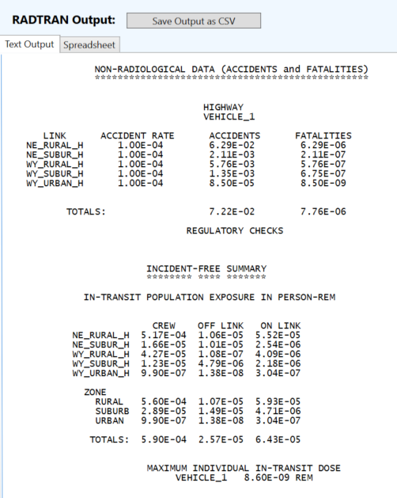
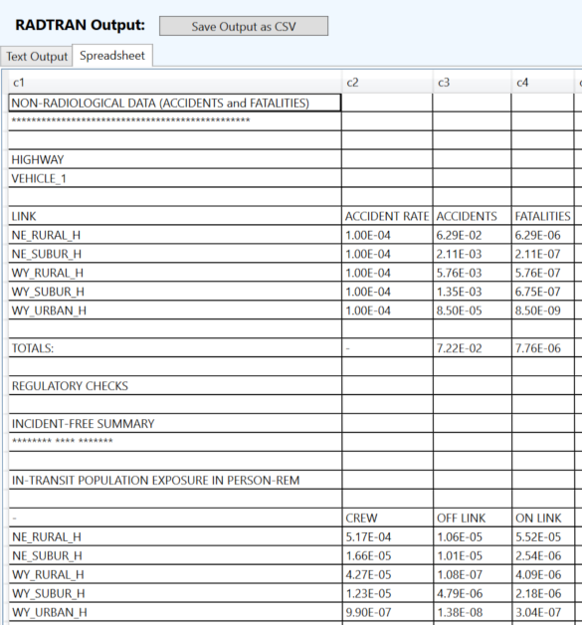
Varying Outputs

Slide 28
NRC-RADTRAN User Information
Shielding Factors. Two runs should be completed using 100% neutron or 100% gamma emissions and the results ratioed externally.
Incident-Free Off-Link Neutron Doses. Hand-calculated MEI results do not match NRC-RADTRAN results. Until this issue is investigated and resolved, it is recommended that NRC-RADTRAN should be used to estimate incident-free off-link doses through gamma radiation only.
Rail Crew Doses. For the rail crew gamma and neutron doses calculating a stop with duration of transit will provide a more representative crew dose estimate.
MEI In-Transit Doses. The MEI in-transit doses estimated by NRC-RADTRAN cannot be duplicated using spreadsheet calculations. In addition, gamma and neutron MEI in-transit doses are estimated using the same equations. For this reason, it is recommended that the MEI in-transit doses not be.

Slide 29
NRC-RADTRAN User Information
The LOS model was developed for gamma radiation exposures and does not consider neutron radiation exposures.
The LOS model was based on modeling simulations performed for a generic 5.21-meter-long steel-lead-steel spent nuclear fuel truck transportation cask, and Dennis et al. (2009) states that the model should only be applied to truck transportation casks.
For the inhalation, resuspension, and immersion pathways, NRC-RADTRAN calculates doses using the geometric mean of the depleted atmospheric dilution factors (χ/Qs). For the groundshine pathway, NRC-RADTRAN calculates doses using the depleted χ/Qs, not the geometric mean of the depleted χ/Qs.
For accident risks, NRC-RADTRAN output does not provide totals for the expected values of population risks across all links, and users must sum these quantities externally.

