Slide 1
Estimating Radiological Health Impacts from In Situ Recovery Operations using MILDOS
Bruce Biwer
Sunita Kamboj
David LePoire
Argonne National Laboratory
2021 Spring RAMP Users Group Virtual Meeting
April 15, 2021

Slide 2
MILDOS 4.21
Computer code
  Based on U.S. Nuclear Regulatory Commission (NRC) regulations and guidance
  Origin dates back to 1979
Estimates radiological impacts from airborne emissions
  Uranium mining and milling facilities
  Uranium-238 and thorium-232 decay chains including radon
  Conventional uranium ore operations & in situ recovery facilities
  Human exposure from contaminated ground, air, and food
Licensing tool
  Applicants and licensees
  NRC staff

Slide 3
Primary Basis for MILDOS Models
NRC Regulatory Guides
  3.51 – Calculational Models for Estimating Radiation Doses to Man from Airborne Radioactive Materials Resulting from Uranium Milling Operations (1982)
  3.59 – Methods for Estimating Radioactive and Toxic Airborne Source Terms for Uranium Milling Operations (1987)
NRC Reports
  Compliance Determination Procedures for Environmental Radiation Protection Standards for Uranium Recovery Facilities 40 CFR Part 190 [NUREG-0859 (1982)]
  Standard Review Plan for In Situ Leach Uranium Extraction License Applications [NUREG-1569 (2003)]
NRC Interim Staff Guidance
  DUWP-ISG-001, Evaluations of Uranium Recovery Facility Surveys of Radon and Radon Progeny in Air and Demonstrations of Compliance with 10 CFR 20.1301, Final Report (2019)
  All MILDOS documentation available at mildos.evs.anl.gov

Slide 4
Program Scope
Impact estimation from radioactive emissions from uranium milling facilities (traditional ore and in-situ recovery)
  Dose commitments to individuals and regional population
  Air, ground, and food concentrations
  Different processes occur at different times in the facility's operational lifetime
    For example: well drilling, operations, storage, restoration
Only radioactive emissions from airborne release
  Uses sector averaged plume model
  Includes deposition, resuspension, accumulation, weathering, decay & ingrowth
  No release to surface water or groundwater
Exposure pathways include
  External from groundshine and cloudshine
  Inhalation
  Ingestion of meat, milk, and vegetables

Slide 5
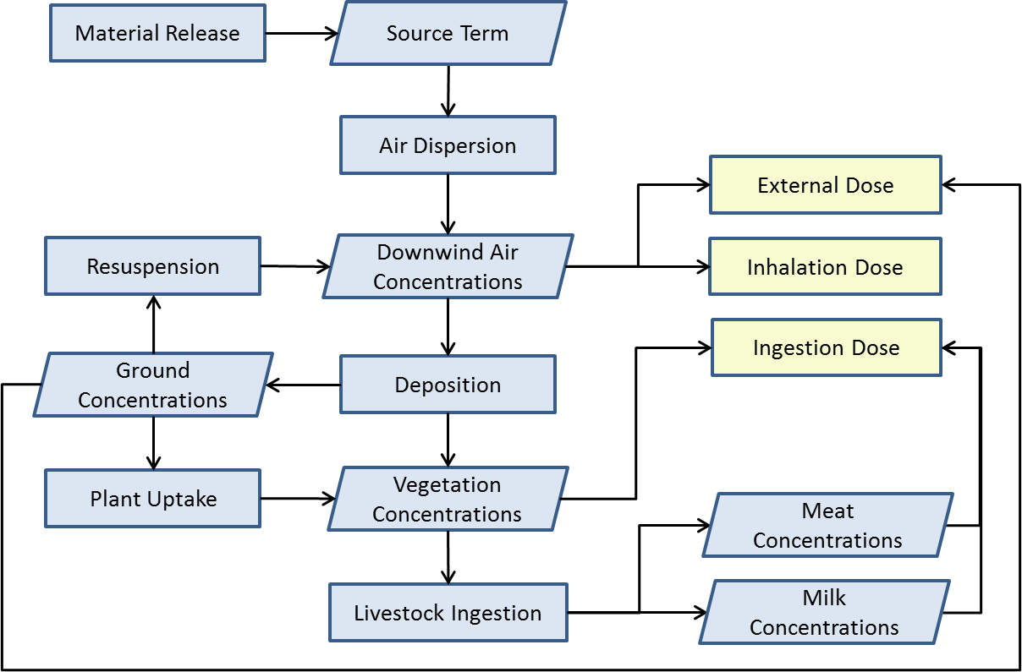
Exposure Pathways

Slide 6
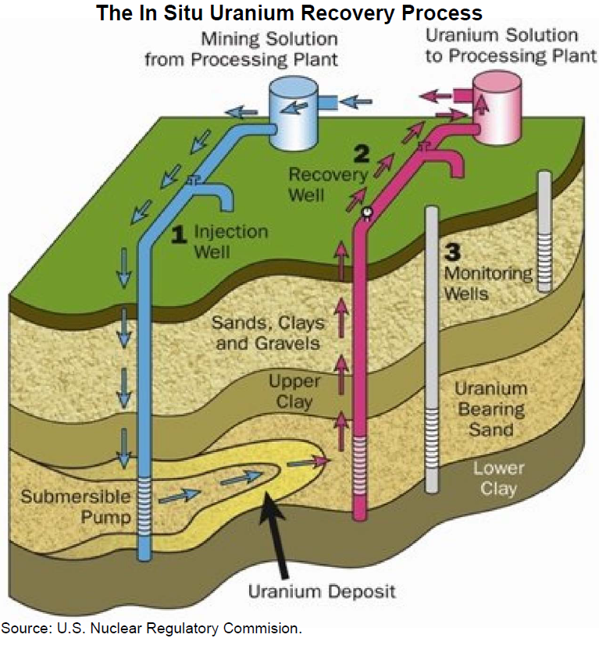
In Situ Recovery

Slide 7
In Situ Recovery
New Well Field Development
Well Fields
Drying and Packaging of Yellowcake
Purge/Bleed and Land Application
Ion Exchange

Slide 8
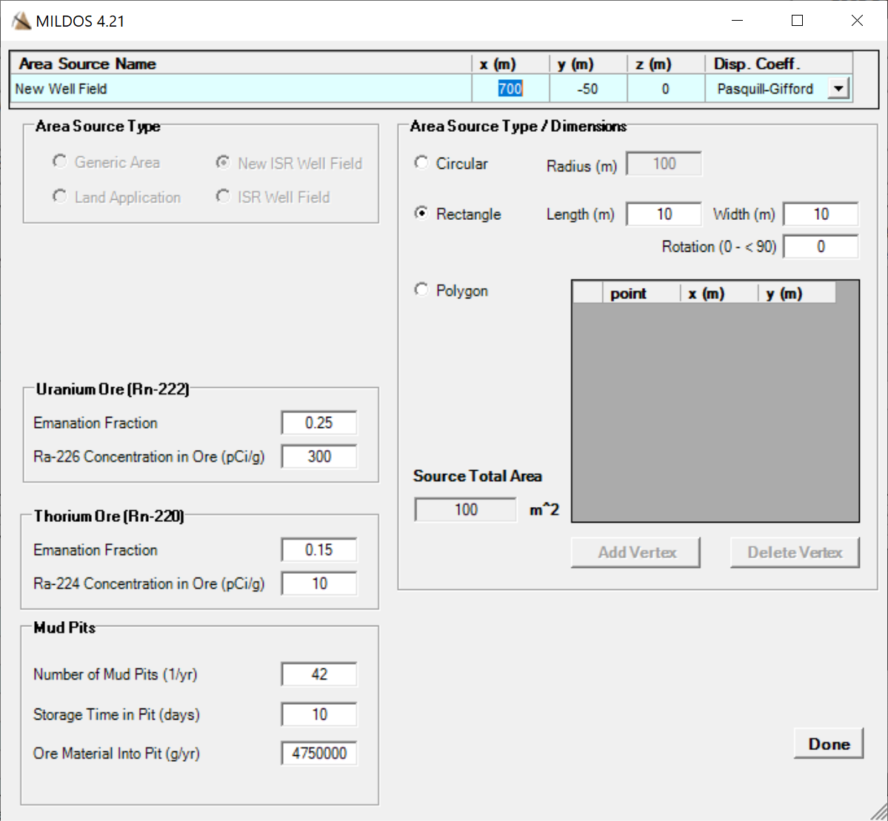
  New Well Field
Particulates: No release
  During drilling, a bentonite slurry flows out of the drill head and through the borehole
Radon: released from the cuttings that are temporarily stored in the “mud” pits
  average mass of cutting that are temporarily stored in the slurry pits
    Number of mud pits generated per year
    Average mass of cutting in a mud pit
    Storage time of cuttings in mud pit

Slide 9
  ‘Production’ Well Field
Particulates: No release
  Closed loop from the production well
  through the ion exchange column to
  the injection well
Radon: Released from the ore
body into the process water
  Radon circulates and builds up in the
  process water – released in 3 ways:
    Purge: From process water that is purged
        Production well extracts more fluid than is pumped in through the injection well to maintain a cone of depression to prevent migration of mining solutions out of the ore in the production area
    Resin Unloading: From the process water that is discharged during resin unloading from the ion exchange columns
    Venting: From pipes and valves

Slide 10
  ‘Restoration’ Well Field
Pump and treat with fresh water
injection. Similar to production
well.
Particulates: No release
  There is a closed loop from the well
  through to the injection well
Radon: Released from the ore body into the process water
  Radon circulates and builds up in the process water – released in 2 ways:
    Purge: From process water that is purged
        Well extracts more fluid than is pumped in through the injection well to maintain a cone of depression to prevent migration of mining solutions out of the ore in the production area
    Venting: From pipes and valves

Slide 11
  Drying and Packaging
Particulates:
  Stack release from thermal dryers
    Use a fraction of the production based on information from facilities that are operational
    Progeny releases are a fraction of
    the uranium releases
  No release from vacuum dryers
  under normal operating conditions
U-238 series only
  Purified yellowcake (no Rn or
  Th-series)

Slide 12
  Land Application Area
Release of particulates
  Surface soil is contaminated
    Purge water from production
    wells and waste water from
    well field restoration are treated
    to unrestricted release levels
    and disposed of by irrigating the
    land
  Uniform contamination over a specified depth
  Equilibrium adsorption of nuclide between soil and the applied irrigation
  Release from the area source
Notes:
Purge water from production well fields or restoration wastewater from restoration well field after treatment is used for irrigation that in turn contaminates the soil. To calculate the wind-generated source term first the soil concentration is calculated from the concentration in the treated water.

Slide 13




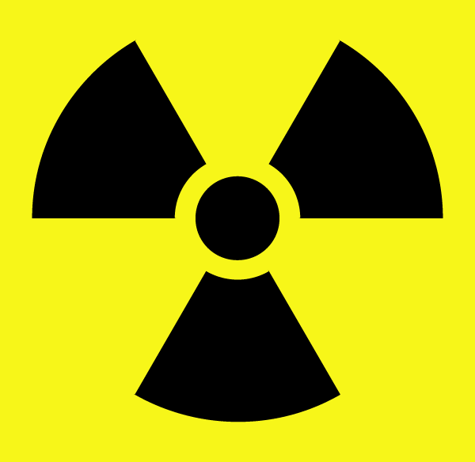
Input Components
Receptor
Location
Indoor/outdoor occupancy
Local food consumption
Meteorology
Direction, speed, stability
Frequency
Deposition
Source release
Types
Radon / Particulates Releases
Particulate characterization
Source time dependence
Land
Food yield
Weathering
Resuspension

Slide 14
Customizable Table and Graph Output Options
Impacts
  Normalized Air Conc. (χ/Q)
  Media Concentrations
  Doses
Receptors
Sources
Radionuclide
  U-238 / Th-232 decay chains
Particle Size
  Gas, 1.5, 3, 7.7, or 54 μm
Time Step
Media
  Air / ground / 7 food stuffs
Organ
  Effective, bone, lung, liver, kidney
Pathway
  Inhalation and ingestion (plant, meat, milk)
  Ground or cloud shine
Format
  Single table or graph; Series (e.g., dose for each time step); or Set (e.g., conc. for each nuclide by media type)

Slide 15
In Situ Recovery Example Demo
Follows well field development, production, and restoration
  For a given well field
    New well field source – area source
    Well field source (production vent) – area source
    Well field source (production purge) – point source
    Well field source (restoration vent) – area source
    Well field source (restoration purge) – point source
    Area sources are given the same location by the user
    Point sources can be in a different location

Slide 16

More Information
Web sites
mildos.evs.anl.gov
ramp.nrc-gateway.gov
Contacts
Bruce Biwer
bbiwer@anl.gov
Dave LePoire
dlepoire@anl.gov
Sunita Kamboj
skamboj@anl.gov
Casper Sun – NRC project manager
(301) 415-1646
casper.sun@nrc.gov
For technical support, send questions or comments to mildos@anl.gov

