Slide 1

GENII Training
Legacy Sites
Spring 2021 RAMP USERS GROUP MEETING
April 4 – 7, 2021
U.S. Nuclear Regulatory Commission Virtual Meeting
Bruce Napier and Caitlin Condon
Pacific Northwest National Laboratory
PNNL-SA-171892

Slide 2
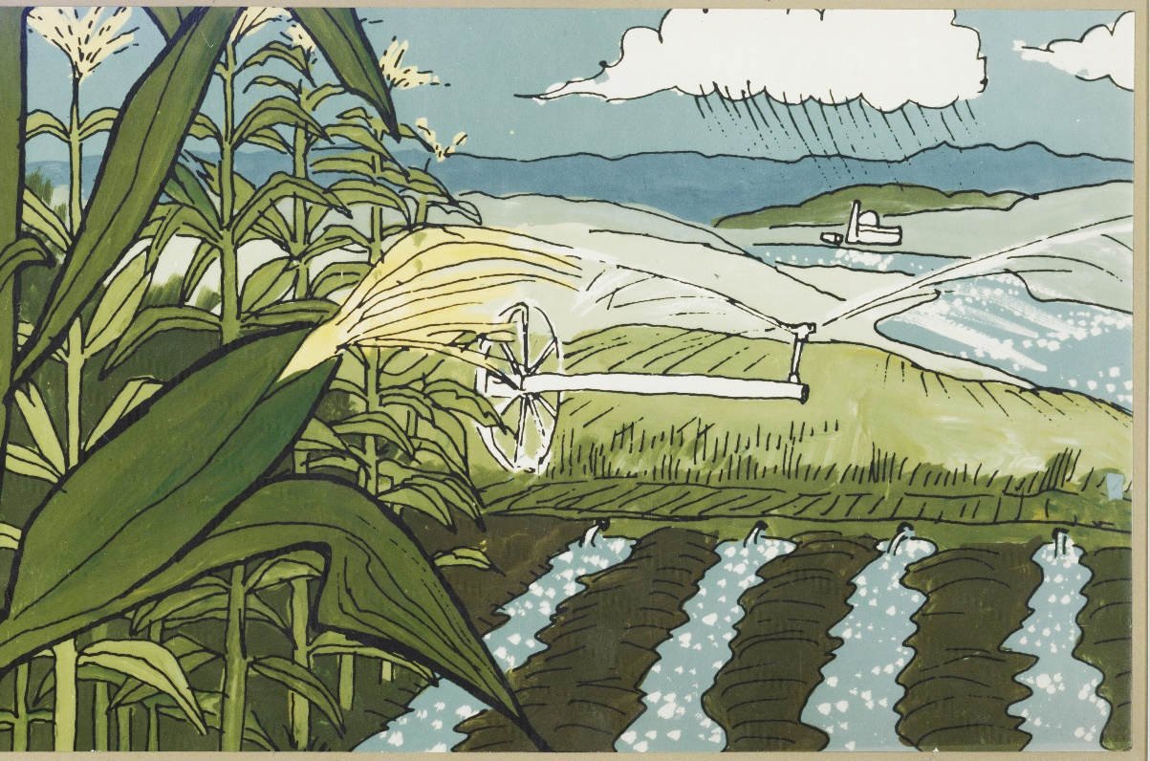
Outline
Introduction to GENII
Legacy Site Scenario Examples
User Questions
Throughout this GENII training session, we will be answering user questions in the chat

Slide 3
Poll Questions

Slide 4
GENII
Originally developed at PNNL as an environmental dispersion code for the Hanford Site
Later generalized for the EPA by PNNL to handle a variety of sites and scenarios
Powerful environmental dispersion software
It is now officially an NRC RAMP code

Slide 5
What is the Assessment Question?
Are we compliant?
  Often regulatory requirements for facility operations are posed in terms of radiation dose limits.
Design requirements
  How much material may be released and still meet the criteria?
Safety analyses
  How much redundancy is necessary to prevent this event?
Accident planning
  How bad could this event be?

Slide 6
Scenario Analysis
All of these questions can be answered through the analysis of a scenario that considers:
  Radionuclide inventories
  Radionuclide releases
  Environmental transport
  Environmental accumulation and dilution
  Subsequent human exposure

Slide 7
Scenarios
A scenario is a conceptual model that describes patterns of human activity, events, and processes that result in radiation exposure to people
GENII is designed to allow flexible application to most scenarios of interest in a regulatory setting at an appropriate level of detail

Slide 8
Types of Scenarios
Far-Field scenarios
  Atmospheric transport (Acute or chronic)
  Surface water transport (Acute or chronic)
Near-Field scenarios
  Spills
  Buried waste
  Groundwater use (Ground water transport modeling is NOT an explicit part of GENII)

Slide 9
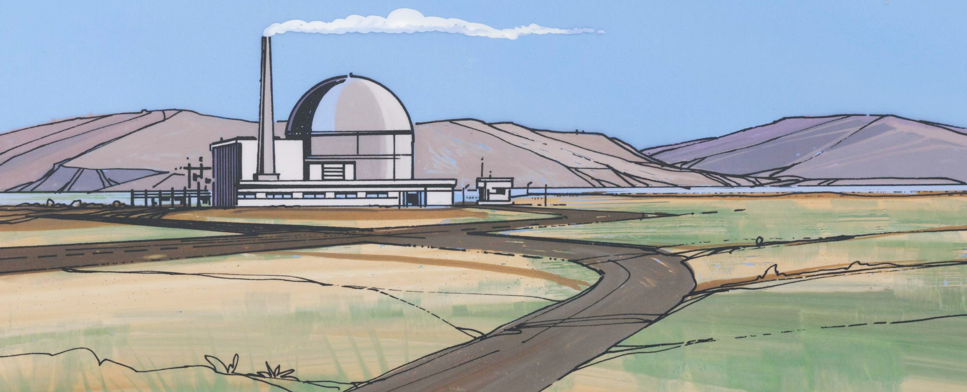
Radionuclide Source Terms
GENII does not calculate reactor inventories
Input is flexible; chain decay progeny grow in

Slide 10
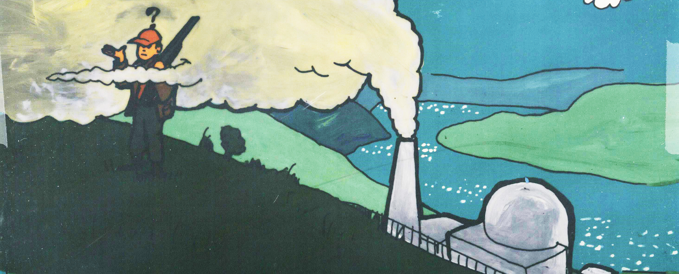
Atmospheric Transport Models
Chronic Plume
Acute Plume
Acute 95th Percentile Plume
Chronic Puff
Acute Puff
Chronic X/Q
Acute X/Q

Slide 11
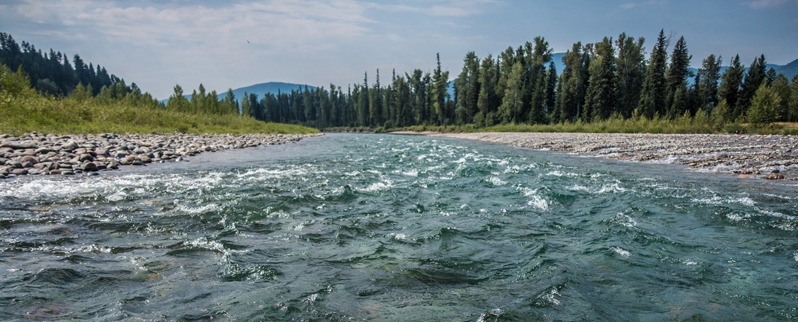
Surface Water Models
Chronic River
Chronic Flow Dilution
Acute River
Near-shore Lake/Ocean
  Once-through pond
  Fully-mixed pond
  Partially-mixed pond

Slide 12
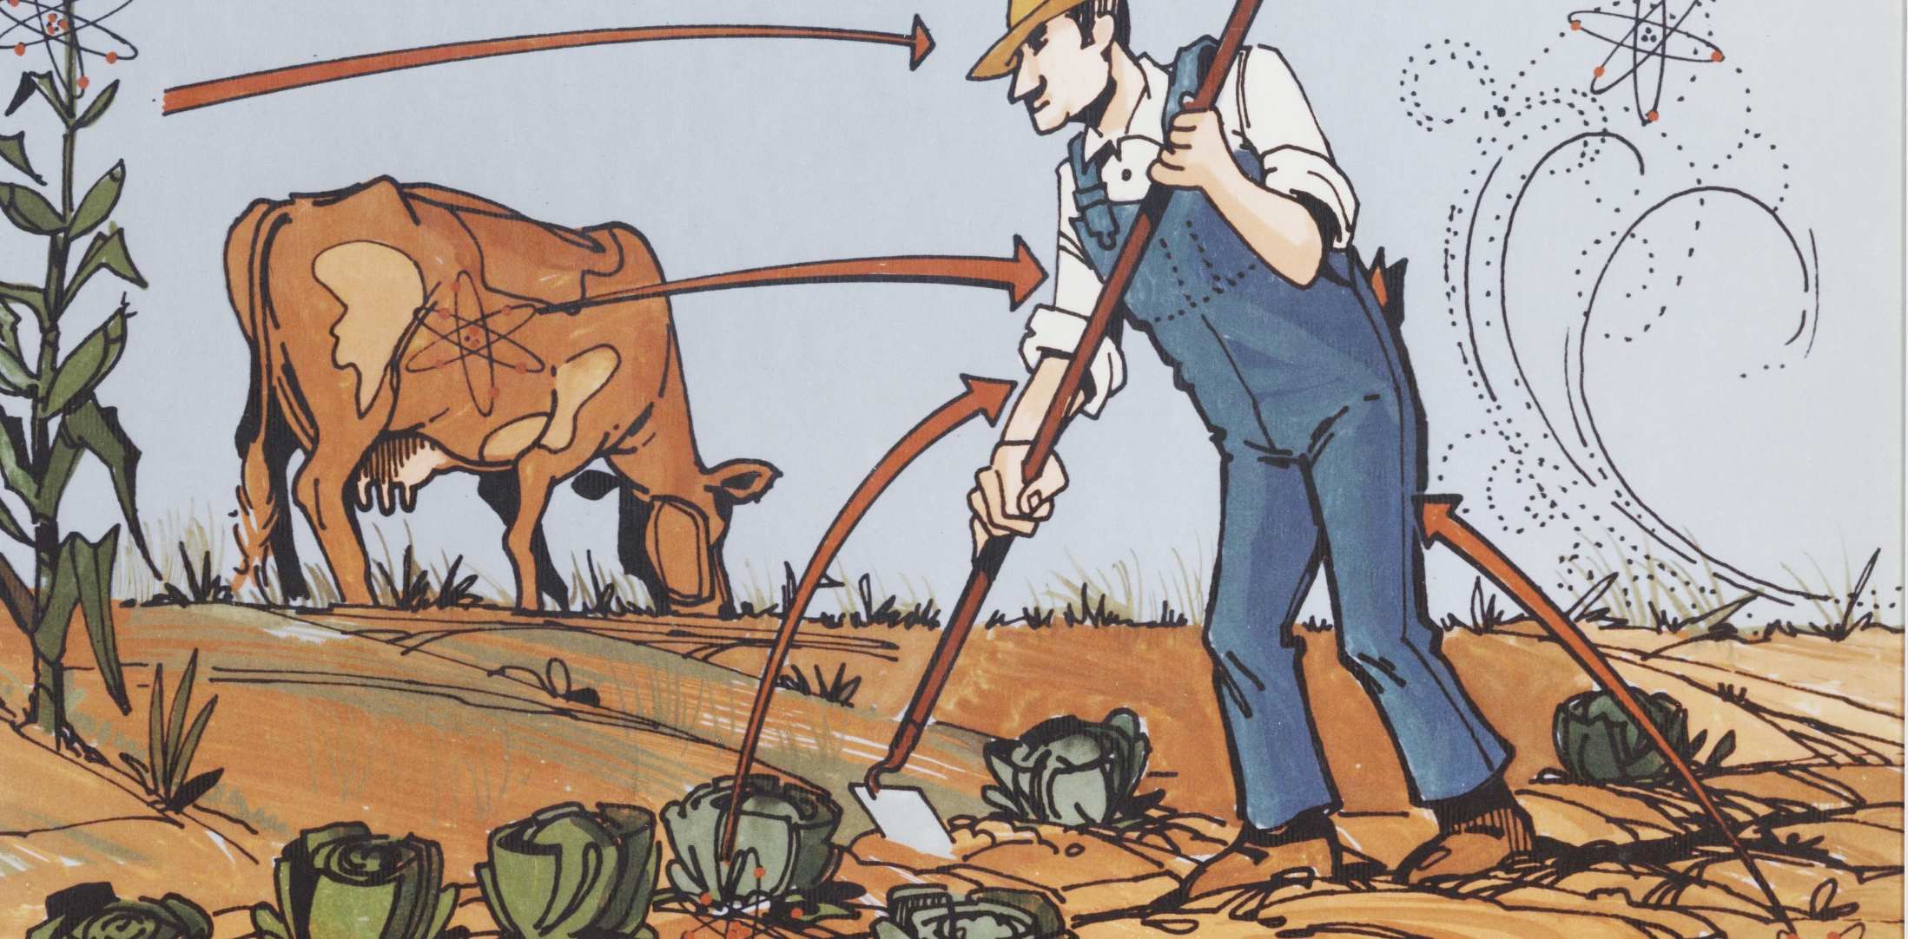
Accumulation/Exposure Models
Initial contaminated conditions
Acute deposition
Chronic deposition

Slide 13
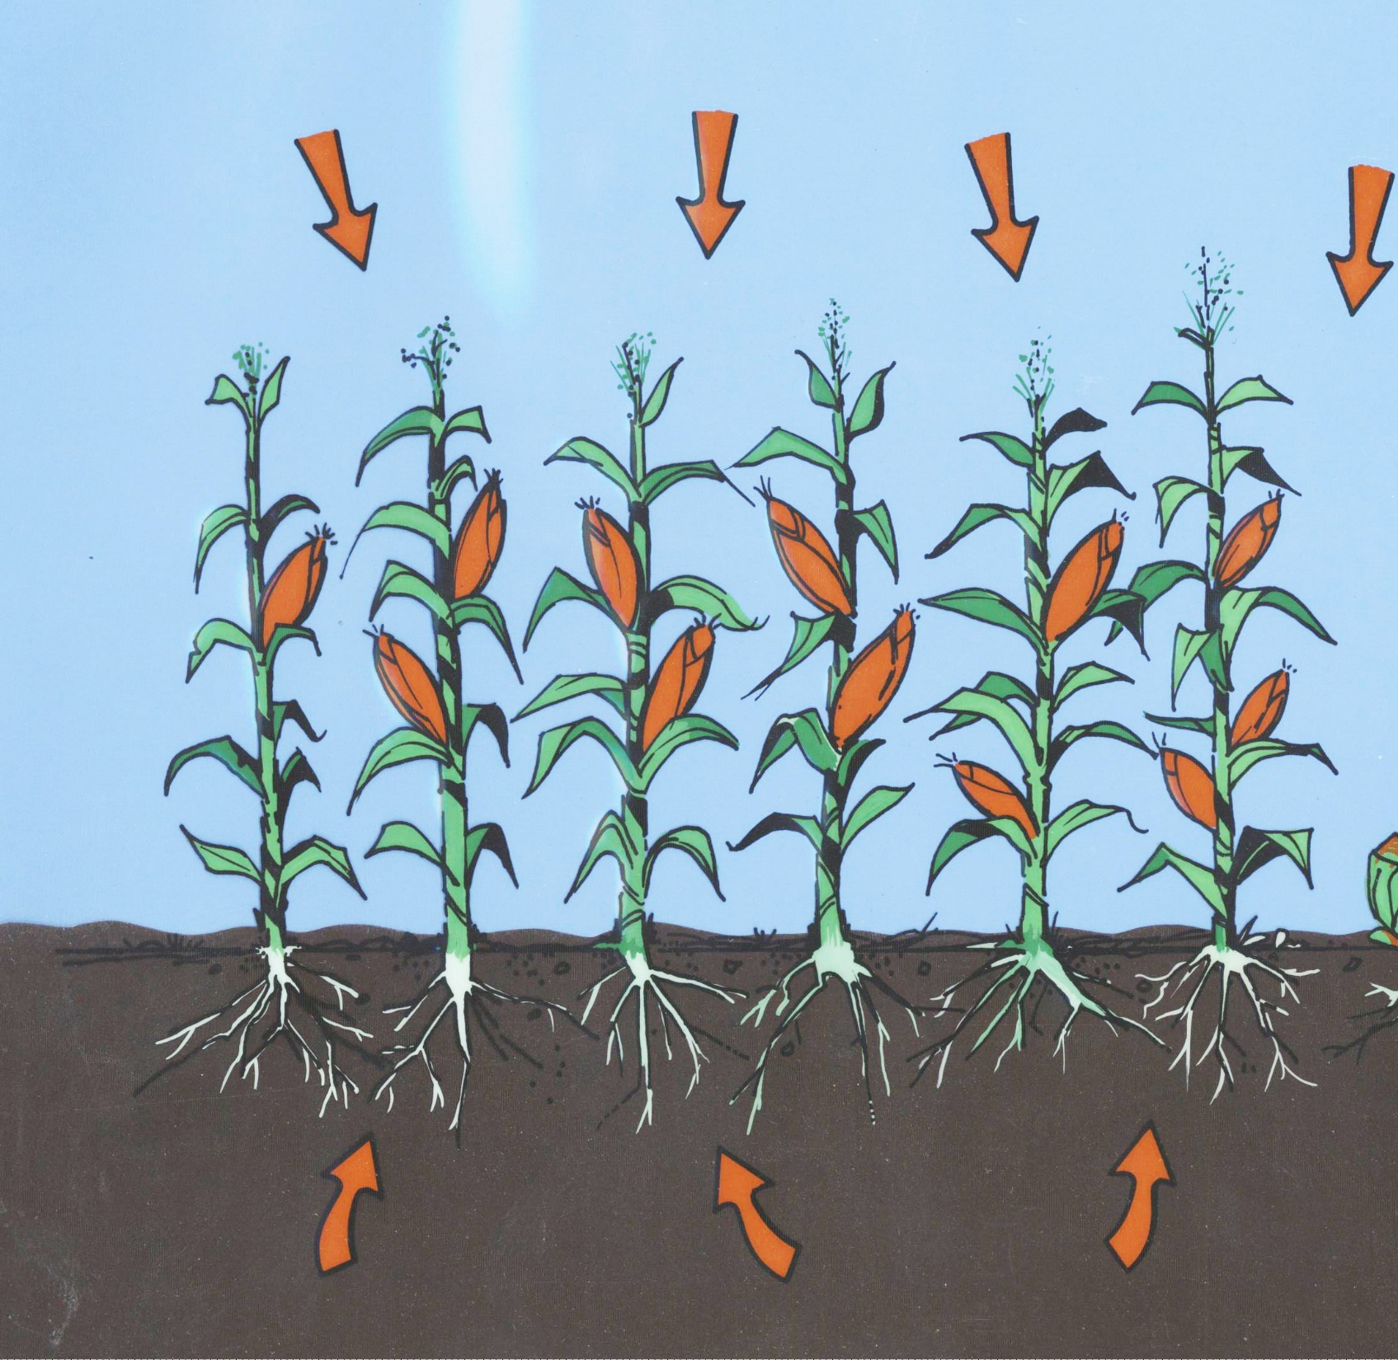
Biotic Transport and Exposure
Accumulation in plants and animals for both direct evaluation of environmental effects and human exposure

Slide 14
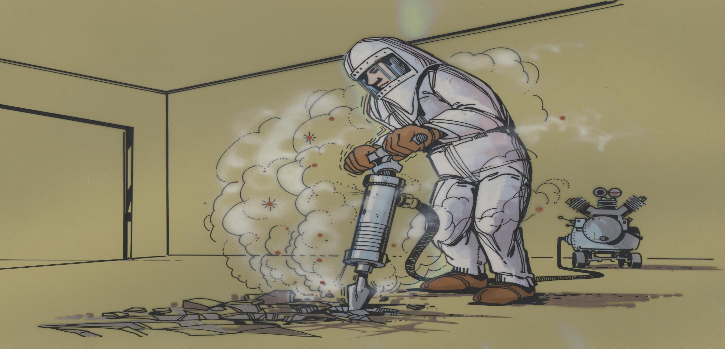
Human Intrusion
Models for evaluating transfer of buried waste to soil surface, resuspension; etc.

Slide 15
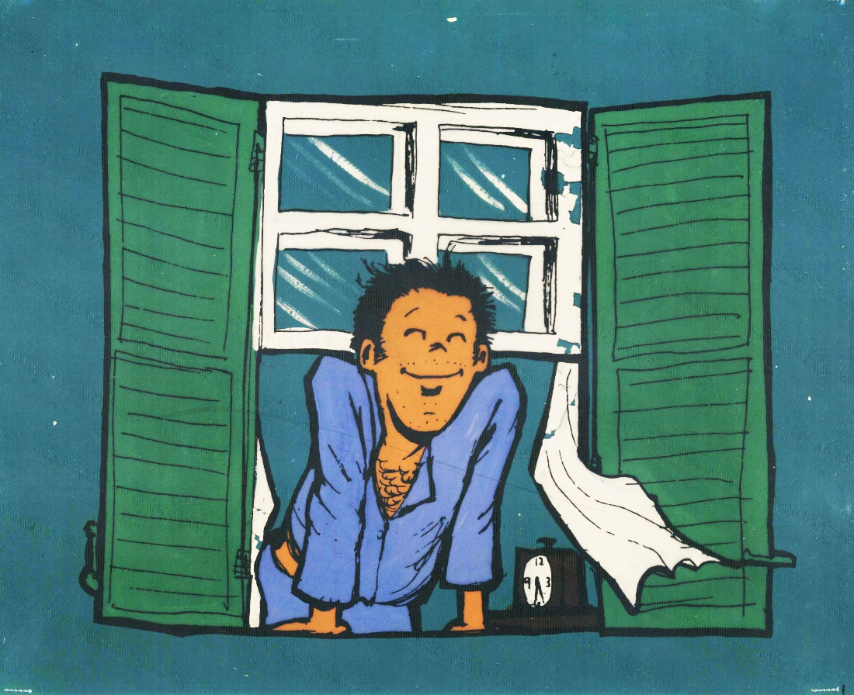
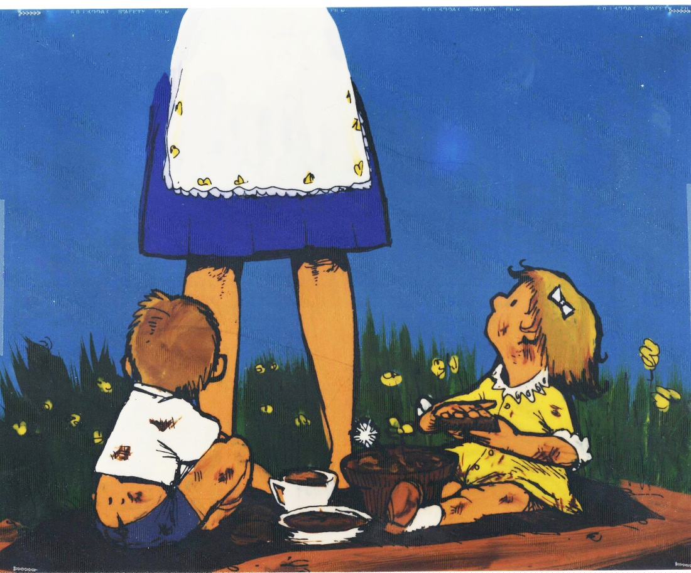
Human Exposure Pathways
External
  Transported air
  Soil
  Swimming
  Shoreline
Inhalation
  Transported air
  Resuspended soil
  Volatilized indoor air pollutants from water

Slide 16
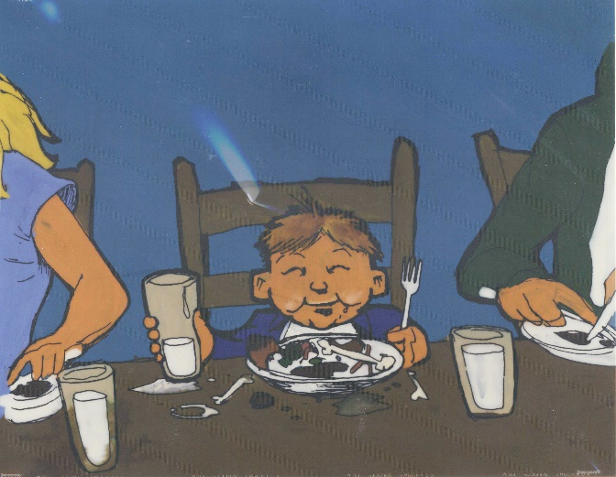
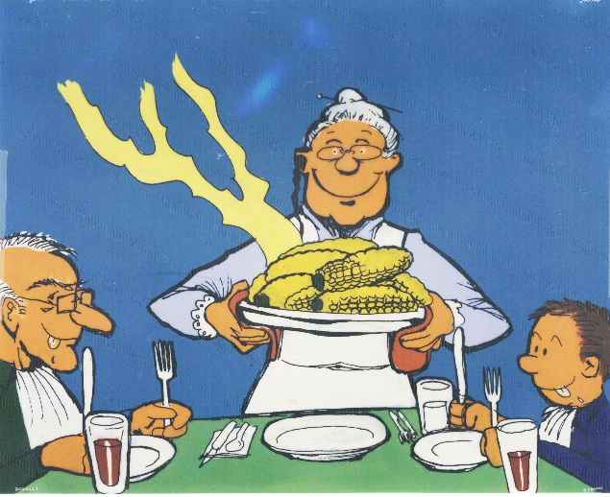
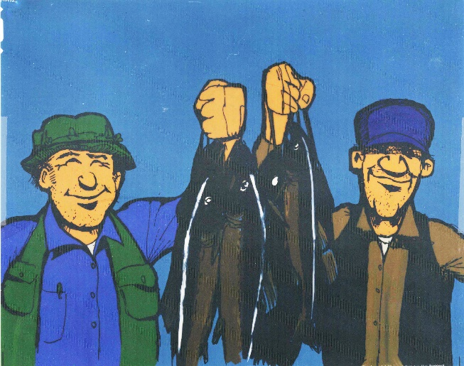
Human Exposure Pathways – Ingestion
Leafy vegetables
Other vegetables
Fruit
Grain
Meat
Milk
Poultry
Eggs
Fish
Crustaceans
Mollusks
Water plants
Drinking water
Shower water
Swimming water
Soil

Slide 17
Acute-Deposition Food Pathways
GENII V.2 presents results for 4 seasons (Winter/spring/summer/autumn)
“Seasons” are surrogates for complex sets of underlying assumptions about plant growth, weathering, uptake, and time-to-harvest
Selection of season depends on meteorological input (this is related to the uncertainty capability)
Seasons below the equator are reversed! A minor change in an external file to adjust…

Slide 18
Human Exposure
Up to 6 age groups allowed, following ICRP-56,67,69 (International Commission on Radiological Protection)
ICRP Age Group | GENII Age Range
3 months | 0-1 year
1 year | 1-2 years
5 years | 2-7 years
10 years | 8-12 years
15 years | 13-17 years
20+ years | 17-110 years

Slide 19
External Exposure – Doses
Dose rate conversion factors from Federal Guidance Report (FGR) 12, provided by Keith Eckerman, ORNL
  Air Submersion
  Water Immersion
  Soil Plane
  Soil Volume
  Eckerman, K. F. and J. C. Ryman. 1993. Federal Guidance Report No. 12: External Exposure to Radionuclides in Air, Water, and Soil, Oak Ridge National Laboratory. FGR 12.

Slide 20
Internal Exposure - Doses
Effective dose equivalent: ICRP-30
  Adult only
Effective dose: ICRP-72
  6 age groups
  24 organs/tissues
  Inhalation classes F, M, S

Slide 21
Risk Calculations – FGR 13
US Federal Guidance Report 13 provides coefficients for 15 cancer sites
  Inhalation (risk/Bq)
    Inhalation classes F, M, S
  Ingestion (risk/Bq)
    Accounts for different consumption patterns with age
      Drinking water
      Food crops
  Eckerman, K.F., Legget, R.W., Nelson, C.B., Puskin, J.S., Richardson, A.C.B. 1999. Federal Guidance Report No. 13: Cancer Risk Coefficients for Environmental Exposure to Radionuclides. EPA 402-R-99-001.

Slide 22
Uncertainty Analysis
Parameter uncertainty and sensitivity may be addressed using the SUM³ processor in FRAMES.
All non-control parameters are allowed to be varied, using description files to define ‘available’ parameters.
Acute atmospheric releases are an important subset. SUM³ is used to vary start times, creating distribution functions of dose.

Slide 23
Legacy Site Scenario
Hanford BC Controlled Area
In the mid-1950s, Hanford retrieved uranium from the oldest tanks of high-level waste remaining from the original Bismuth Phosphate reprocessing process
The uranium recovery worked, but generated nearly twice as much waste as originally produced
The wastes were processed to “scavenge” Cs137 and Sr90 to reduce the activities, and then the supernatant liquids were discharged to surface soils in a series of covered “specific retention trenches”
  155,000,000 liters (40,000,000 gallons)
Historical Site Assessment of the Surface Radioactive Contamination of the BC Controlled Area; WMP-18647

Slide 24
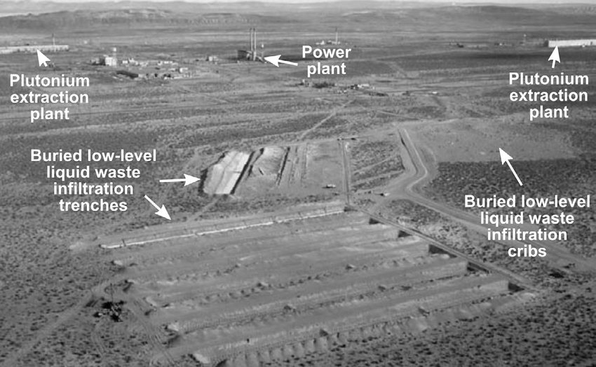
The Specific Retention Trenches

Slide 25
Contamination Events
The trenches were covered with soil, but initially, burrowing native animals intruded into the trenches and used the waste as a “salt lick”
  Badgers, rodents, primarily jackrabbits
  The animals defecated and urinated in the vicinity
  Predators (coyotes) also ate the rabbits and further spread scat and urine
  Also, deep-rooted tumbleweeds and subsequent grasses added to the distribution
This was discovered in 1958-1960; the holes were filled in 1965 and the trenches covered with asphalt. Additional gravel was added in 1969
A total of ~10 km² (4 square miles) was directly impacted
Historical Site Assessment of the Surface Radioactive Contamination of the BC Controlled Area; WMP-18647

Slide 26
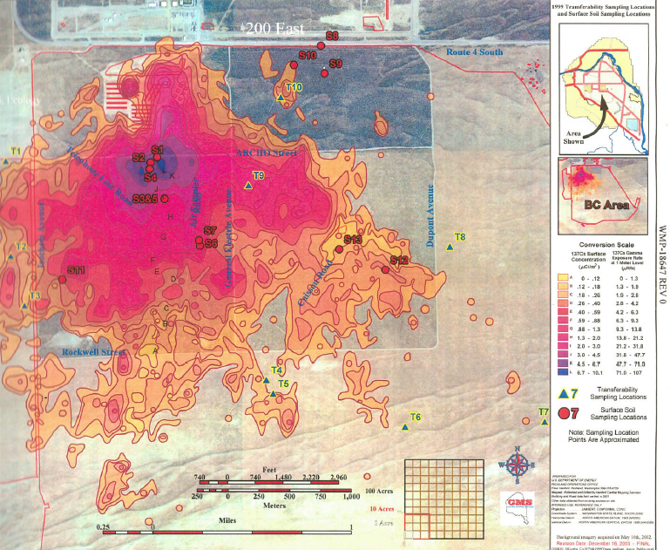
The Extent of the Contamination
The original trenches
Historical Site Assessment of the Surface Radioactive Contamination of the BC Controlled Area;
WMP-18647

Slide 27
Contamination Levels (Aerial Survey ~1978)
Soil concentration is quite variable
  Cs-137 0.01 – 110 Bq/g 0.2 – 3,000 pCi/g
  Sr-90 0.03 – 150 Bq/g 0.1 – 4,000pCi/g
  Pu-239/240 0.0004 – 0.07 Bq/g 0.01 – 2 pCi/g
Because of the nature of the deposition(s), the bulk of the contamination is in the upper 15 – 23 cm (6 – 9 inches)
For the example calculations, the large ‘red’ area on the preceding map is 1 µCi/m² Cs137 (with substantial variability), or about:
  0.2 Bq/g Cs-137
  0.3 Bq/g Sr-90
  0.01 Bq/g Pu-239/240
Historical Site Assessment of the Surface Radioactive Contamination of the BC Controlled Area; WMP-18647

Slide 28
GENII Legacy Site Scenarios
Based on the Hanford BC Cribs historical data, we will demonstrate two different legacy site modelling scenarios in GENII (Heavy Equipment Operator, Agricultural Resident Scenario)
*All examples are demonstrations of how to develop scenarios in GENII based on a contaminated site.
** Any results presented in this presentation are strictly a demonstration of the GENII code and may use assumptions or data that are not applicable to the site. Results should not be interpreted as actual analysis related to the Hanford Site.

Slide 29
Heavy Equipment Operator
FOR DEMONSTRATION PURPOSES ONLY
Exposures that may occur for an individual whose job involves working outdoors on the site in activities that intentionally disturb the surface soils (e.g., grader cutting or maintaining fire lines, front loader scooping loose surface soils)
Based on the DOE Hanford Site Risk Assessment Methodology for an Industrial Scenario (DOE 1995)
No contact with groundwater or surface water
Primary Exposure Pathways
  Incidental ingestion of contaminated soils
  External exposure of radionuclides in the soil
  Inhalation of fugitive dust

Slide 30
Heavy Equipment Operator
FOR DEMONSTRATION PURPOSES ONLY
Assumptions for GENII Model
  30 days/year of heavy equipment operations for a 20 year employment period
  Entire working activity outside (shielding factor 1.0)
  Breathing rate 1.3 m³/hour (no indoor reduction factor)
  Contaminants in the air is assumed to be higher than ambient air due to active disruption of the soil
  Inadvertent ingestion of soil is increased due to working in a potentially dusty environment

Slide 31
Agricultural Resident Scenario
FOR DEMONSTRATION PURPOSES ONLY
Exposure based on consumption of locally produced food and animal products in addition to external exposure, inhalation, and soil ingestion
Based on the DOE Hanford Site Risk Assessment Methodology for an Agricultural Resident Scenario (DOE 1995) and the Washington State Department of Health (DOH 1997) input parameters
Primary Exposure Pathways
  Ingestion of crops and animal products raised on the contaminated location
  Incidental ingestion of contaminated soils
  External exposure of radionuclides in the soil
  Inhalation of resuspended soils

Slide 32
Agricultural Resident Scenario
FOR DEMONSTRATION PURPOSES ONLY
Assumptions for GENII Model
  Living, growing food, and raising animals at the site
  Breathing rate - 20 m³/day
  Atmospheric mass loading – 50 micrograms/m³
  30 year model assuming exposure 7010 hours per year
  60% of time spent inside, 20% of time spent outside, 20% of time away from location
  Shielding Factor - 0.8
  Dust filtration factor – 0.4
  Inadvertent soil ingestion rate 36.5 g/year
  Ingestion by food type (leafy vegetables, other vegetables, fruit, grain, milk, meat, fowl, eggs)

Slide 33
Questions?
Thank you!
Bruce Napier
bruce.napier@pnnl.gov
Caitlin Condon
caitlin.condon@pnnl.gov

