Slide 1

RAMP Code Consolidation
October 27th, 2022
Caitlin Condon
Julia Flaherty
Pacific Northwest National Laboratory
PNNL-SA-179075

Slide 2
Outline
History and Motivation for RAMP Code Consolidation
RAMP Code Consolidation (SIERRA)
Atmospheric Engine Code Consolidation Efforts
Next Steps

Slide 3
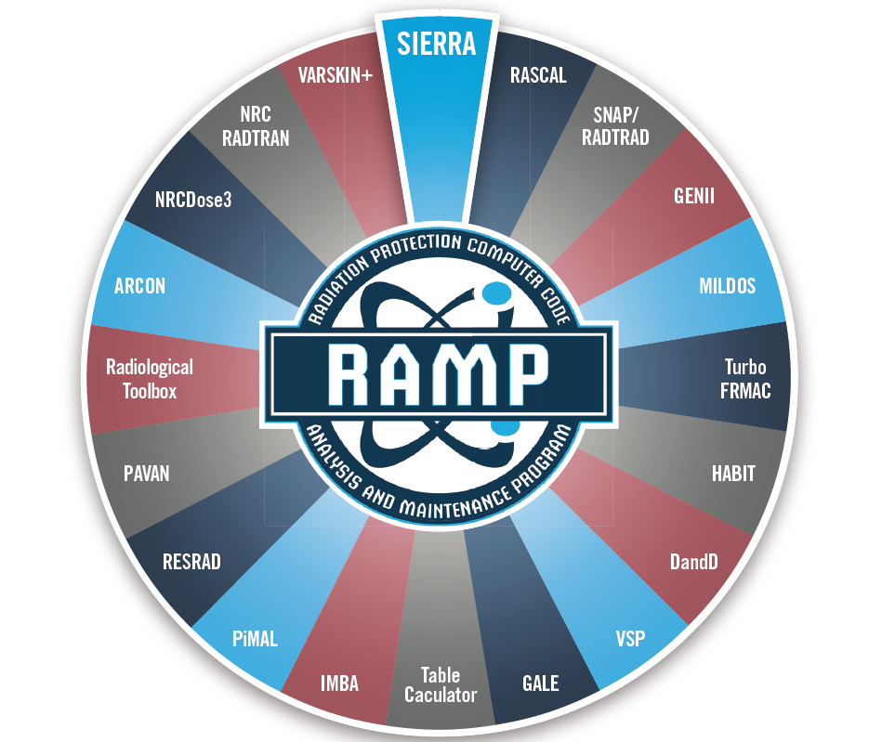
RAMP Codes

Slide 4
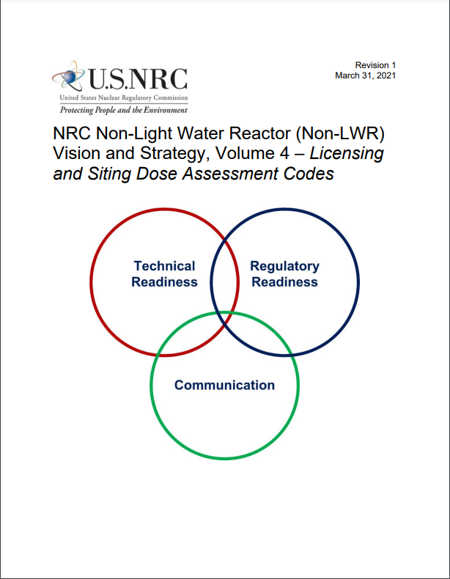
NRC Need
NRC Non-Light Water Reactor (Non-LWR) Vision and Strategy, Volume 4 –– Licensing and Siting Dose Assessment Codes (RAMP)
  describes the computer codes in RAMP and how they would be applied to each of the principal non-LWR design types, and summarizes the tasks necessary to resolve “gaps” in the capability to model and simulate those designs with the accuracy required by the regulator
Code consolidation can help resolve the identified gaps in the RAMP suite of codes

Slide 5
Code Functions and Data Flow
R
Source Term
What radionuclides to consider for potential release to the environment?
Source Term Data
Input to RAMP Codes
Release Conditions
How they are released, e.g., chemistry, particle size, buoyancy, building size, stack height?
RAMP Codes
Releases
Environmental Dispersion
Where does it go…how much, how far, how fast?
Environmental Fate
Met
Data
Environmental Consequences
What is the dose?
Report Out
Data

Slide 6

Legacy Issues Facing RAMP Codes
Incompatible with non-LWRs
Ownership issues
Lack of standardized code development
Lack of maintenance
Dated science
Lack of standardized quality assurances
Functional redundancy/data transfer
Inefficiency

Slide 7

What is the broader challenge?
Prepare for Non-LWRs
Modernize
Consolidate

Slide 8
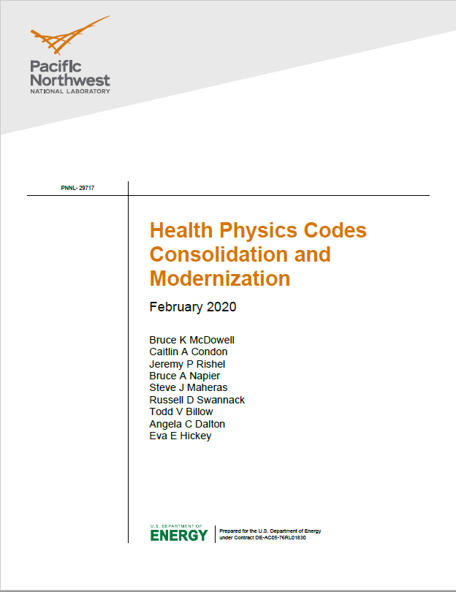
Options Paper for RAMP Code Modernization and Consolidation
Thesis Statement
The computer codes in the RAMP program have been developed since the 1970’s to address specific regulatory needs.
These codes today have numerous current and legacy issues that reduce the efficiency of operation and maintenance of the codes and increase cost. In their current state, these codes are also unable to fully assess radiological doses from advanced non-light water reactor designs.
These current and legacy issues could be addressed by transforming the current suite of single-purpose radiation protection and dose assessment computer codes to a consolidated functional and modern suite of codes that is modular, flexible, efficient and user-friendly.

Slide 9
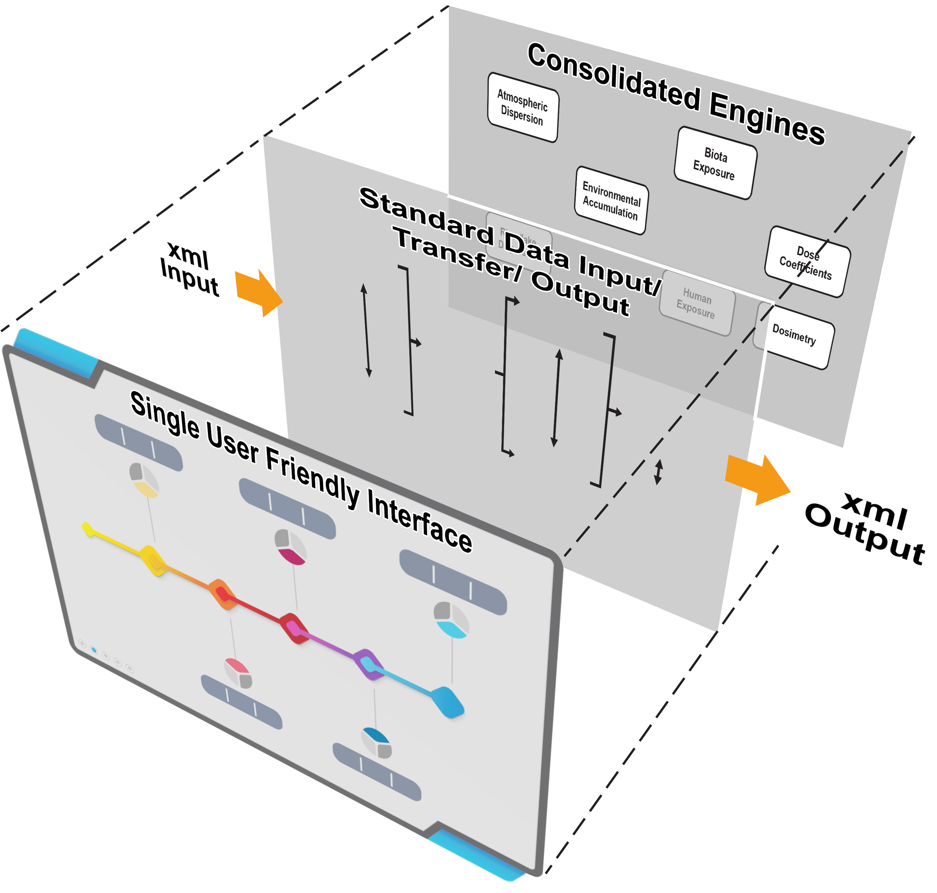
RAMP Codes Consolidation and Modernization
Three Concept “Pillars:”
Consolidate Current Code Capabilities functional “Engines”
Develop Standardized Data Transfer Schema
Build a Single and Separate User Interface (UI)

Slide 10
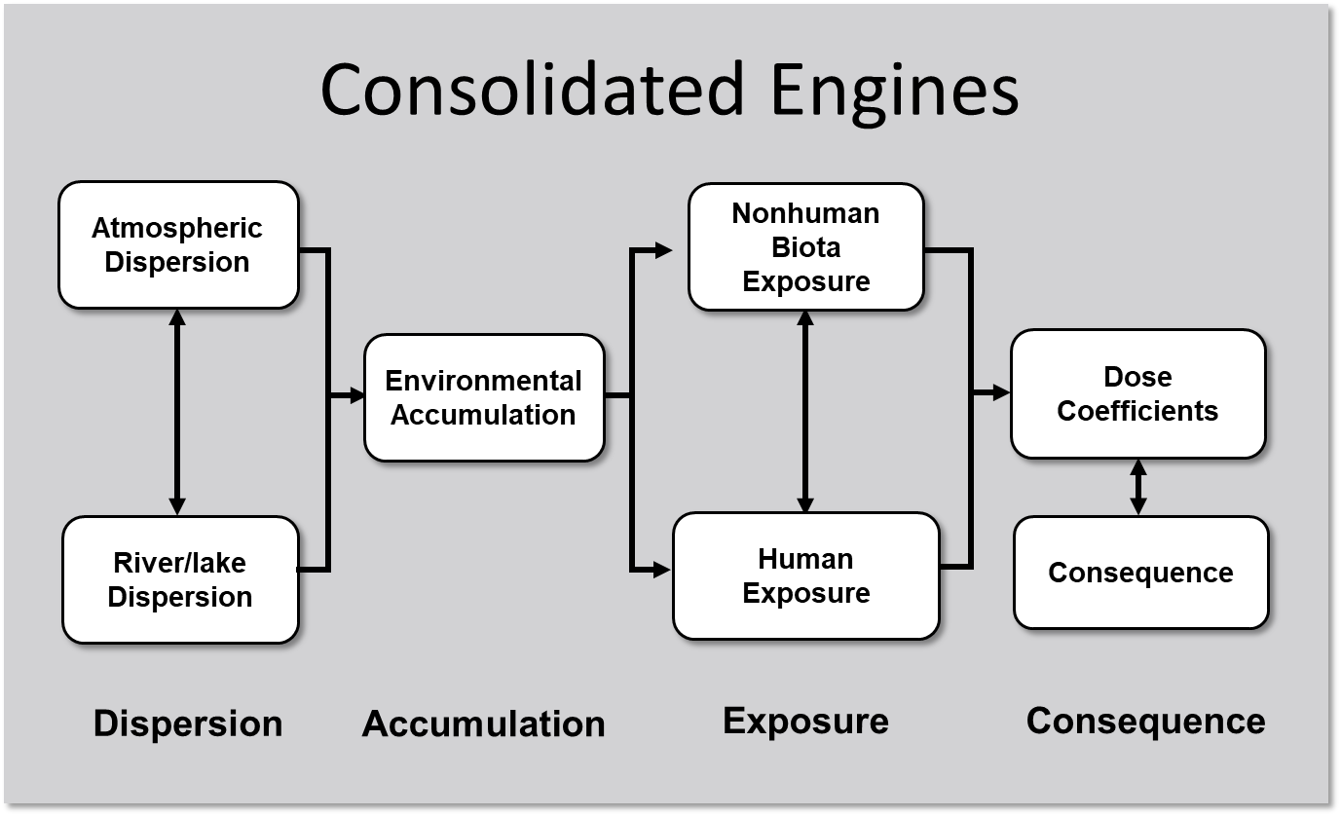
Pillar 1: Proposed Functional “Engines” will standardize input/output
Consolidated Engines would perform calculations for dispersion and consequence analysis:
  Dispersion
  Accumulation
  Exposure
  Consequence

Slide 11
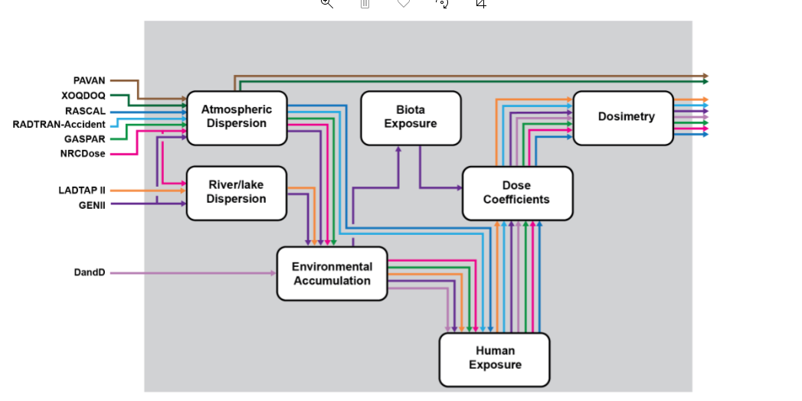
Overlapping Capabilities in Current RAMP Codes

Slide 12
Code Functional Capability Examples
PAVAN
Atmospheric Dispersion
Biota Exposure
Dosimetry
River/Lake Dispersion
Dose Coefficients
Environmental Accumulation
Human Exposure

Slide 13
Code Functional Capability Examples
Atmospheric Dispersion
Biota Exposure
Dosimetry
GENII Biota
River/Lake Dispersion
Dose Coefficients
Environmental Accumulation
Human Exposure

Slide 14
Code Functional Capability Examples
Atmospheric Dispersion
Biota Exposure
Dosimetry
GASPAR II
River/Lake Dispersion
Dose Coefficients
Environmental Accumulation
Human Exposure

Slide 15
Pillar 2: Develop Standardized Data Transfer Schema
JSON Input
JSON Output

Slide 16
Pillar 2: Develop Standardized Data Transfer Schema
A JSON schema for the RAMP suite of codes will be
  Flexible
    Will allow additions of new variables yet unknown for advanced reactor designs
    Variable data will not need to appear in the data transfer file in a particle order, will only need to be in the json format and have the associated keyword
  Standardized
    All data transfer into the code, between functional engines, and out to the user will be in the same standard format
  Modern
    Widely used format

Slide 17
Pillar 3: A Single Modern Use Interface
Improved UI will provide a modern user experience
User interface will be separate from the functional engines
  Updating or changing the user interface will not inadvertently affect the quality of the functional capabilities
  Allows for the possibility of developing a web-based user experience or mobile application
User interface will require updates and maintenance
  Will only have one user interface to maintain

Slide 18

What are the Benefits of the Approach?
Accommodates anticipated needs for non-LWR Designs
Modernizes code languages and user experience
Reduces number of codes to upgrade and maintain
Standardizes Inputs and Outputs
Flexible design for future expansion or updates

Slide 19


Slide 20

Code Consolidation Methodology
Establishing requirements in a “Requirements Document”
Establishing quality assurance protocols
  A software Quality Assurance Plan (SQAP) was established for the entire development project
Flexibility and anticipation of growth and change

Slide 21
SIERRA User Interface Development
SIERRA provides a user interface which can be used to define the type of simulation that is to be run
Using a defined directory structure, SIERRA controls the execution and data transport of modules during a simulation
Modules are independent applications and are not directly integrated into the SIERRA application
Modules are considered “Black Box” and are executed as synchronous child processes by the SIERRA application
While SIERRA was developed using the C# programming language, modules can be developed using any programming language that produces an executable file
Module executables are required to accept input and output paths as command line arguments
Modules provide their own interfaces and post processing functionality
SIERRA is intended to allow for the addition of modules without requiring code changes to UI

Slide 22
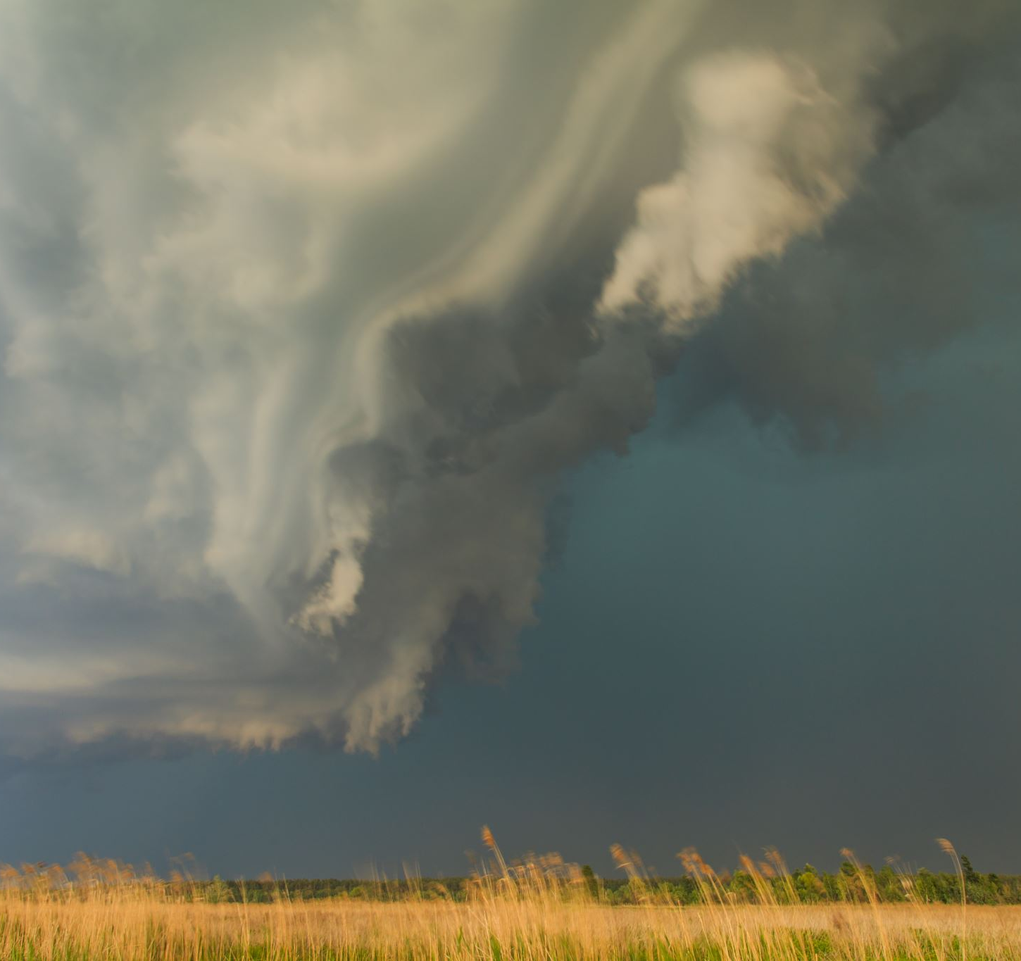
Atmospheric Dispersion Module Development
Julia Flaherty, PNNL

Slide 23
Current Efforts in Code Consolidation
Prototype Development
  Atmospheric Dispersion Module
    JSON Schema for variables of interest
  Functional User Interface
Testing Activities
  Usability testing of the User Interface
  Functional testing of code
    Verify data transfer
    Evaluate code accuracy and consistency with ARCON, PAVAN, and XOQDOQ results
Quality Assurance (QA)
  Software QA Plan defines QA approach to provide adequate confidence that
    Software development process is controlled
    Software products meet established requirements

Slide 24
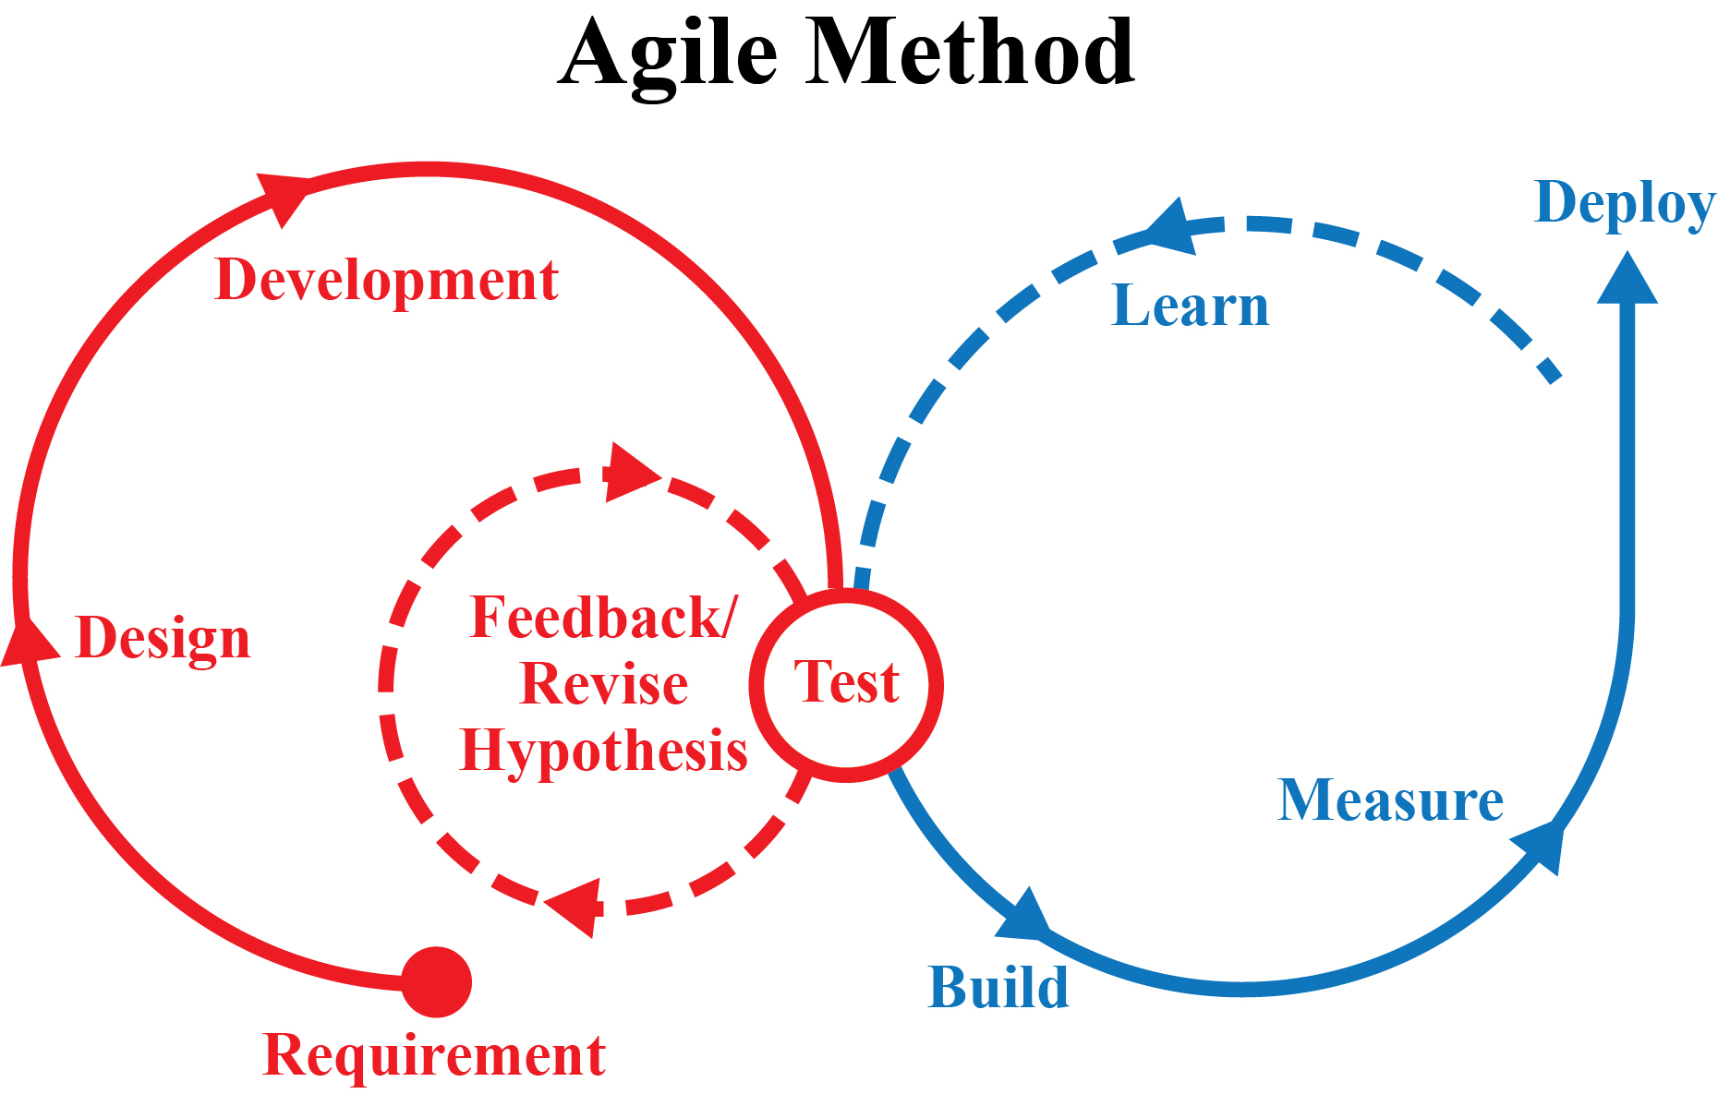
Agile Software Development

Slide 25
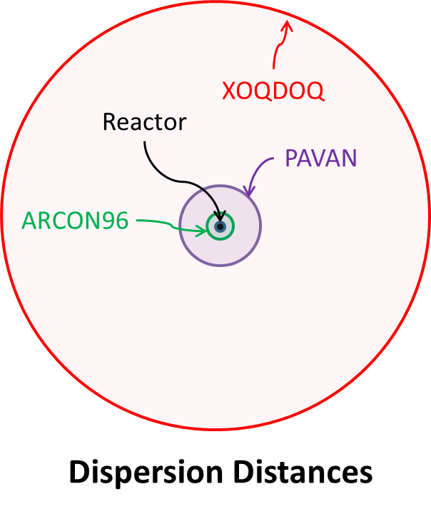
Prototype Development: Consolidating Current Atmospheric Dispersion Codes
Code | Description
ARCON | Used to calculate relative air concentrations (χ/Qs) in support of control room habitability assessments required by general design criteria (GDC) 19 of 10 CFR Part 50 Appendix A and RG 1.194.
PAVAN | Used to estimate relative ground-level air concentrations (χ/Q s) resulting from radioactive material releases from design-basis accidents at NPPs following the methodology in RG 1.145.
NRCDose | Software suite that integrates the functionality of three individual Fortran codes: LADTAP II, GASPAR II, and XOQDOQ, which were developed by the NRC and have been in use by NPP licensees and the NRC staff for assessments of liquid radioactive releases and offsite doses, gaseous radioactive effluents and offsite doses, and meteorological transport and dispersion, respectively. XOQDOQ implements the atmospheric dispersion modeling described in RG 1.111.
Near Field: ~100s of meters
Mid-Field: ~10 km
Far Field: Up to ~80 km

Slide 26
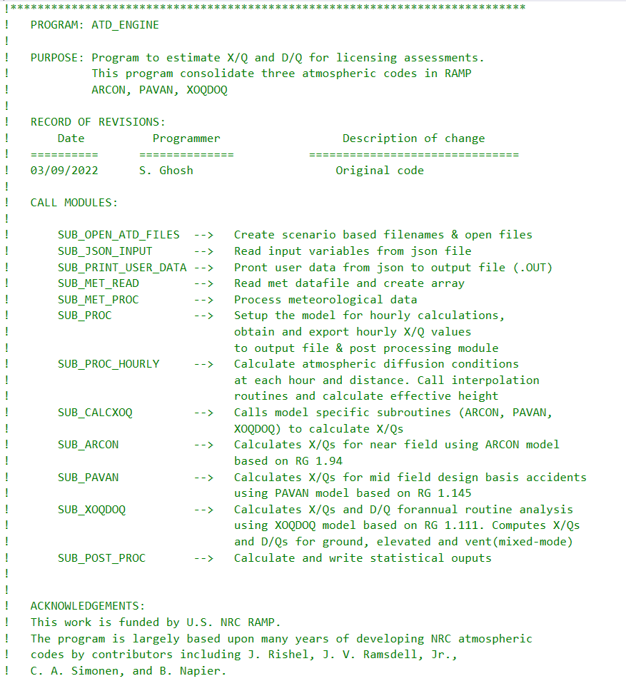
Atmospheric Dispersion Engine Working Prototype
Functional Engine within the larger Consolidated Engine Framework

Slide 27

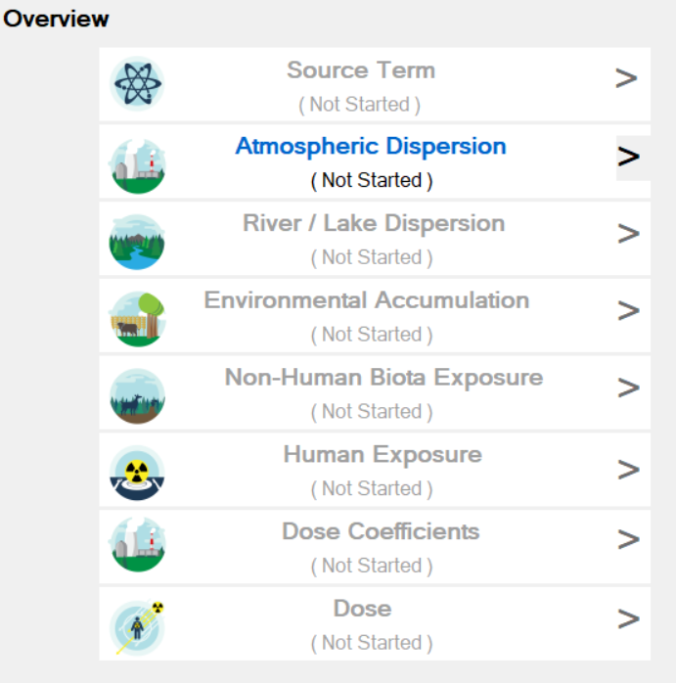
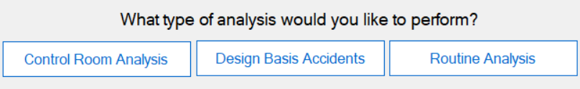
SIERRA Prototype Overview
Regulatory vs Research
Analysis Types:
  Control Room Analysis
  Design Basis Accidents
  Routine Analysis
Module Selection:
  Atmospheric Dispersion

Slide 28
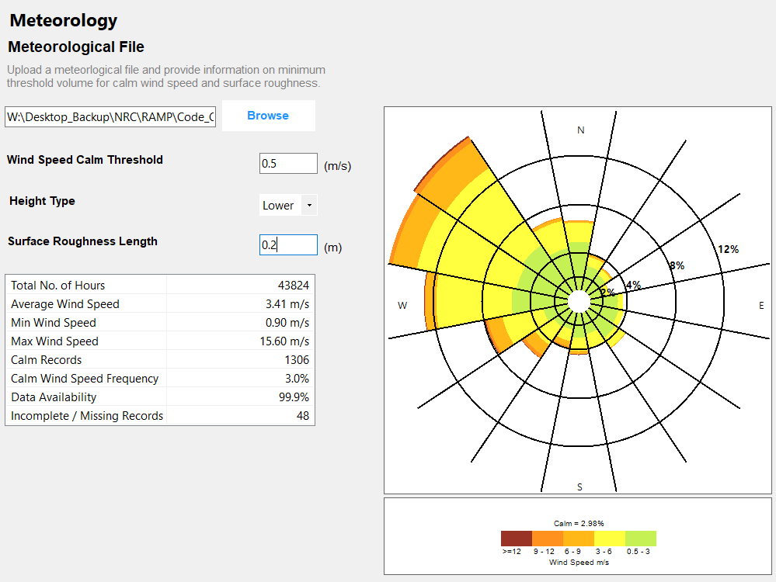
Common Input Needs / User Interface Panels
Source
Receptor (Control Room, Routine Analysis)
Terrain (Design Basis, Routine Analysis)
Meteorology
  All models use hourly data per RG1.23
Output
Notes:
Met panel: Control Room Habitability includes roughness length; DBA, Routine Analysis omits roughness length

Slide 29
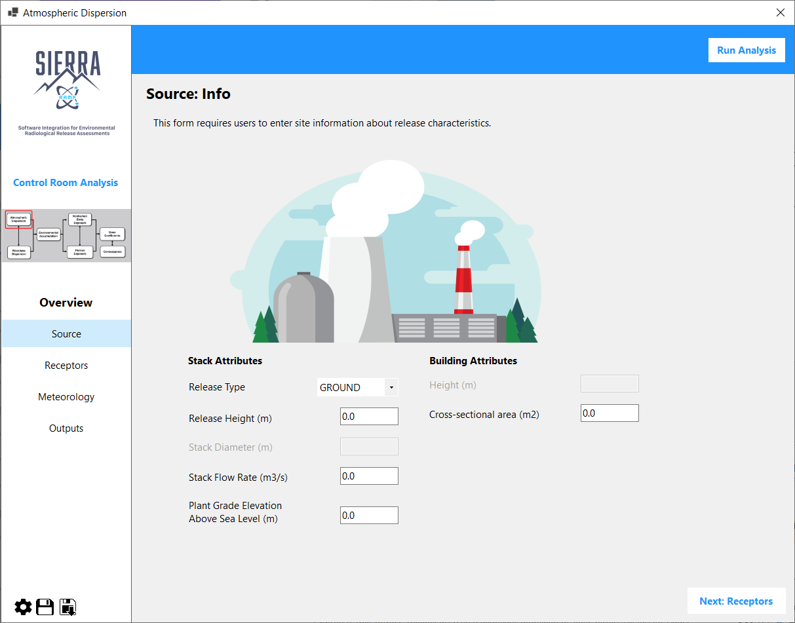
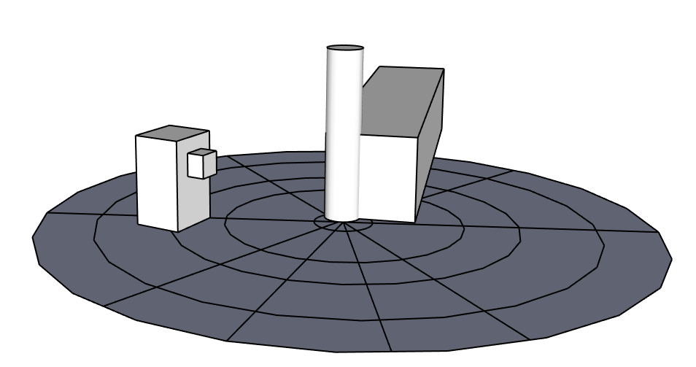
Control Room Habitability Assessment (ARCON)
Release Height
10 m
45 m
Receptor Distance
Building Area
Intake Height
1900 m²
15 m
Direction to Source
230 degrees
Source
Receptors
Meteorology
Output

Slide 30
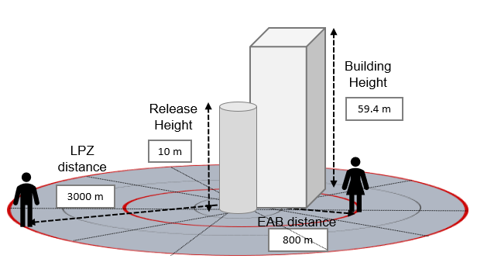
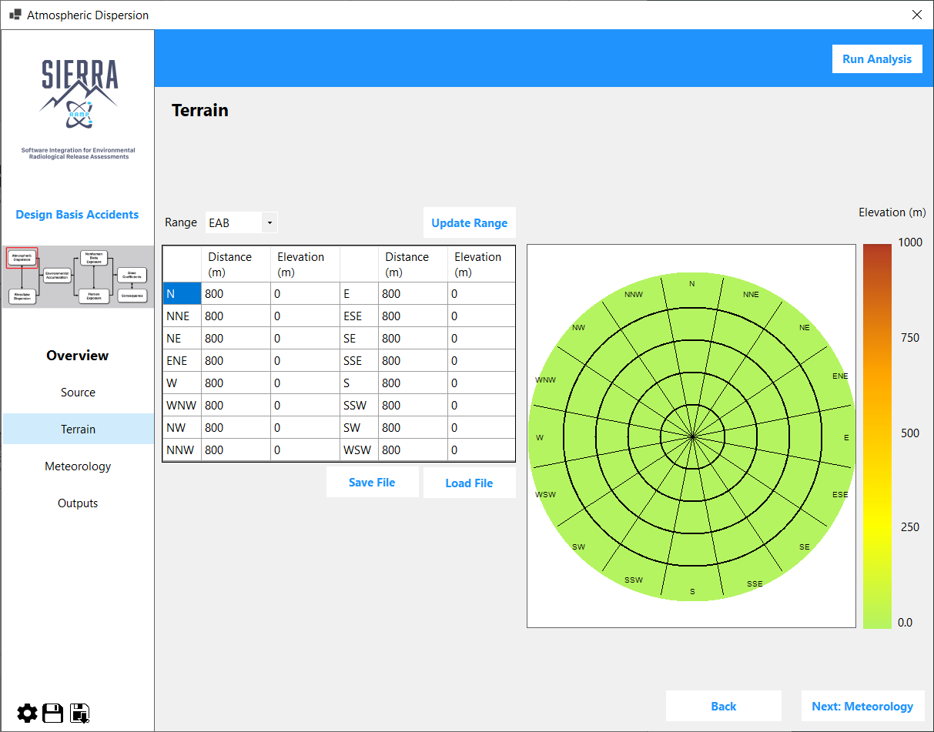
Design Basis Analysis (PAVAN)
Source
Terrain
Meteorology
Output

Slide 31
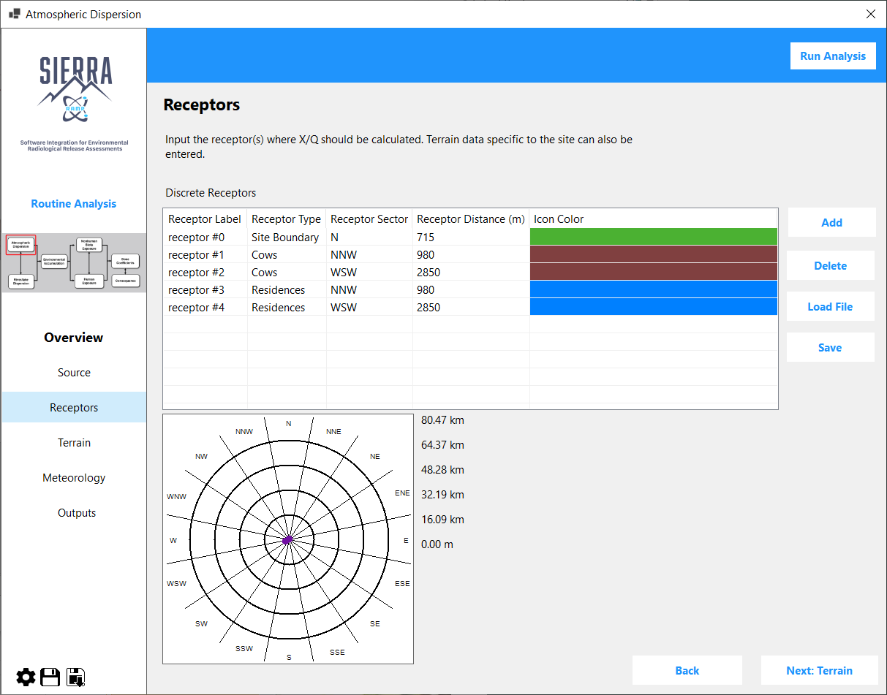


Routine Analysis (XOQDOQ)
Release Height
45 m
distance
980 m
Site boundary distance
715 m
distance
2850 m
Source
Receptors
Terrain
Meteorology
Output

Slide 32
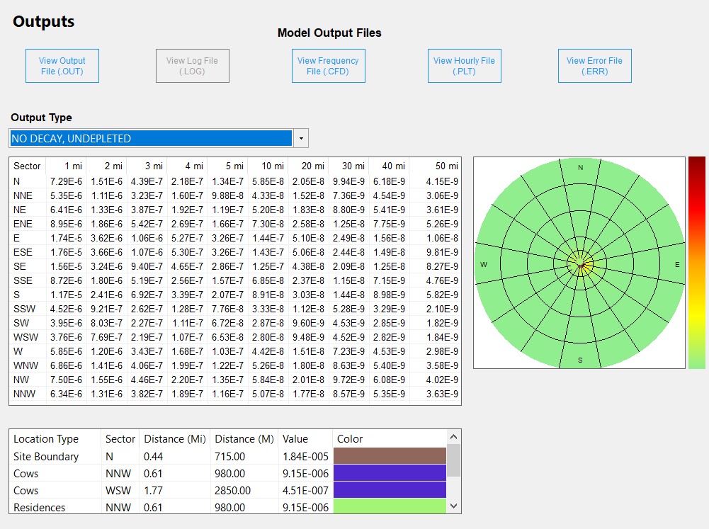
Example Output Panel
Routine Analysis
Two areas in the panel:
  Output Files
  Output Viewer

Slide 33
Next Steps
In Progress:
SIERRA User Interface
Atmospheric Dispersion Module
Source Term Module
Upcoming:
River/Lake Dispersion Module
Environmental Accumulation
Human Exposure
Dose Coefficients
Dose/Consequences
Non-Human Biota exposure

