Slide 1
Nuclear Emergency Response –An Overview
John Crapo, CHP
REAC/TS Health Physicist
John.Crapo@orau.org
865-576-3131
24 Hour Emergency: 202-586-8100

Slide 2
Disclaimers
REAC/TS is operated by Oak Ridge Associated Universities under a contract with the Department of Energy.
I do not speak for or on behalf of any Federal government department or agency
Any products mentioned or included in a graphic is done so for illustrative purposes only and should not be construed as an endorsement of that product by me or ORISE
All materials contained herein are unclassified/open source
Notes:
Commercial Interest - The ACCME defines a “commercial interest” as any entity producing, marketing, re-selling, or distributing health care goods or services, used on, or consumed by, patients. The ACCME does not consider providers of clinical service directly to patients to be commercial interests - unless the provider of clinical service is owned, or controlled by, an ACCME-defined commercial interest.
Financial relationships - Financial relationships are those relationships in which the individual benefits by receiving a salary, royalty, intellectual property rights, consulting fee, honoraria, ownership interest (e.g., stocks, stock options or other ownership interest, excluding diversified mutual funds), or other financial benefit. Financial benefits are usually associated with roles such as employment, management position, independent contractor (including contracted research), consulting, speaking and teaching, membership on advisory committees or review panels, board membership, and other activities from which remuneration is received, or expected. ACCME considers relationships of the person involved in the CME activity to include financial relationships of a spouse or partner.
Relevant financial relationships - ACCME focuses on financial relationships with commercial interests in the 12-month period preceding the time that the individual is being asked to assume a role controlling content of the CME activity. ACCME has not set a minimal dollar amount for relationships to be significant. Inherent in any amount is the incentive to maintain or increase the value of the relationship. The ACCME defines “’relevant’ financial relationships” as financial relationships in any amount occurring within the past 12 months that create a conflict of interest.

Slide 3
Learning Objectives
Basic understanding of the US Government’s role in response to a nuclear or radiological emergency
Basic understanding of resources available for response to a nuclear or radiological emergency
Notes:
We can work safely with and around radioactive materials if we understand the relative risk and keep in mind some general safety principles.

Slide 4
Response to Domestic Incidents
First principle - all incidents are managed locally
Local capability and capacity to manage incidents varies with location and extent and magnitude of the incident
HSPD-5 (2003), Management of Domestic Incidents, identified steps for improved coordination in response to incidents.
HSPD-8 (2003), National Preparedness, directed DHS to lead a national initiative to develop a National Preparedness System—a common, unified approach to “strengthen the preparedness of the United States to prevent and respond to threatened or actual domestic terrorist attacks, major disasters, and other emergencies.”
PPD-8 (2011), National Preparedness, describes the Nation's approach to preparedness-one that involves the whole community, including individuals, businesses, community- and faith-based organizations, schools, tribes, and all levels of government (Federal, State, local, tribal and territorial).

Slide 5
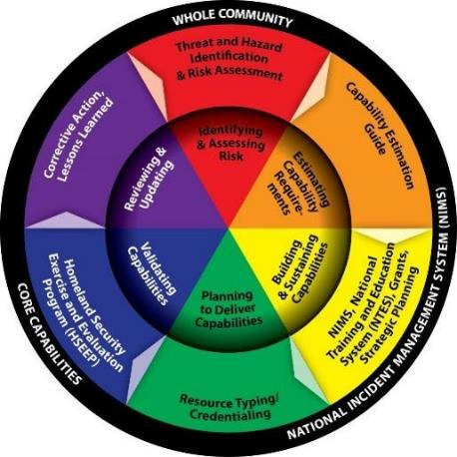
National Preparedness System
National Preparedness Goal: “A secure and resilient nation with the capabilities required across the whole community to prevent, protect against, mitigate, respond to, and recover from the threats and hazards that pose the greatest risk.”

Slide 6
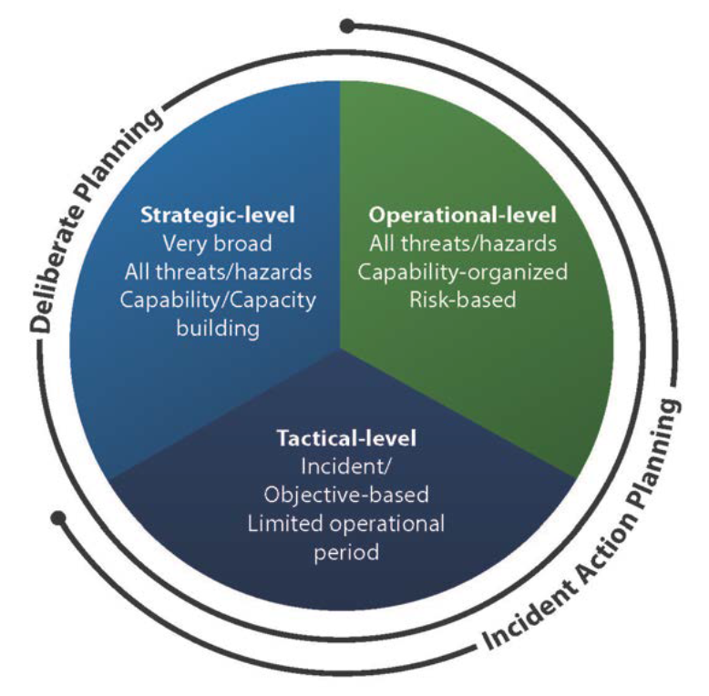
National Planning System
Strategic Planning
  National Incident Management System (NIMS)
  National Response Framework (NRF)
Operational-level planning
  Federal Interagency Operational Plan (FIOP) for each mission area
Tactical Level Planning
  Pre-positioning plans
  Incident Action Plans
Hazard-specific supplemental information
  Nuclear/Radiological Incident Annex to the Response & Recovery FIOPs
  Planning Guidance for Response to a Nuclear Detonation, 3rd Edition
Notes:
provides a unified approach and common terminology to plan for all-threats and hazards and across all mission areas of Prevention, Protection, Mitigation, Response, and Recovery
a shared understanding of the types and levels of planning will enable the whole community to think through potential crises, determine capability requirements and address the collective risk identified during the risk assessment process.

Slide 7
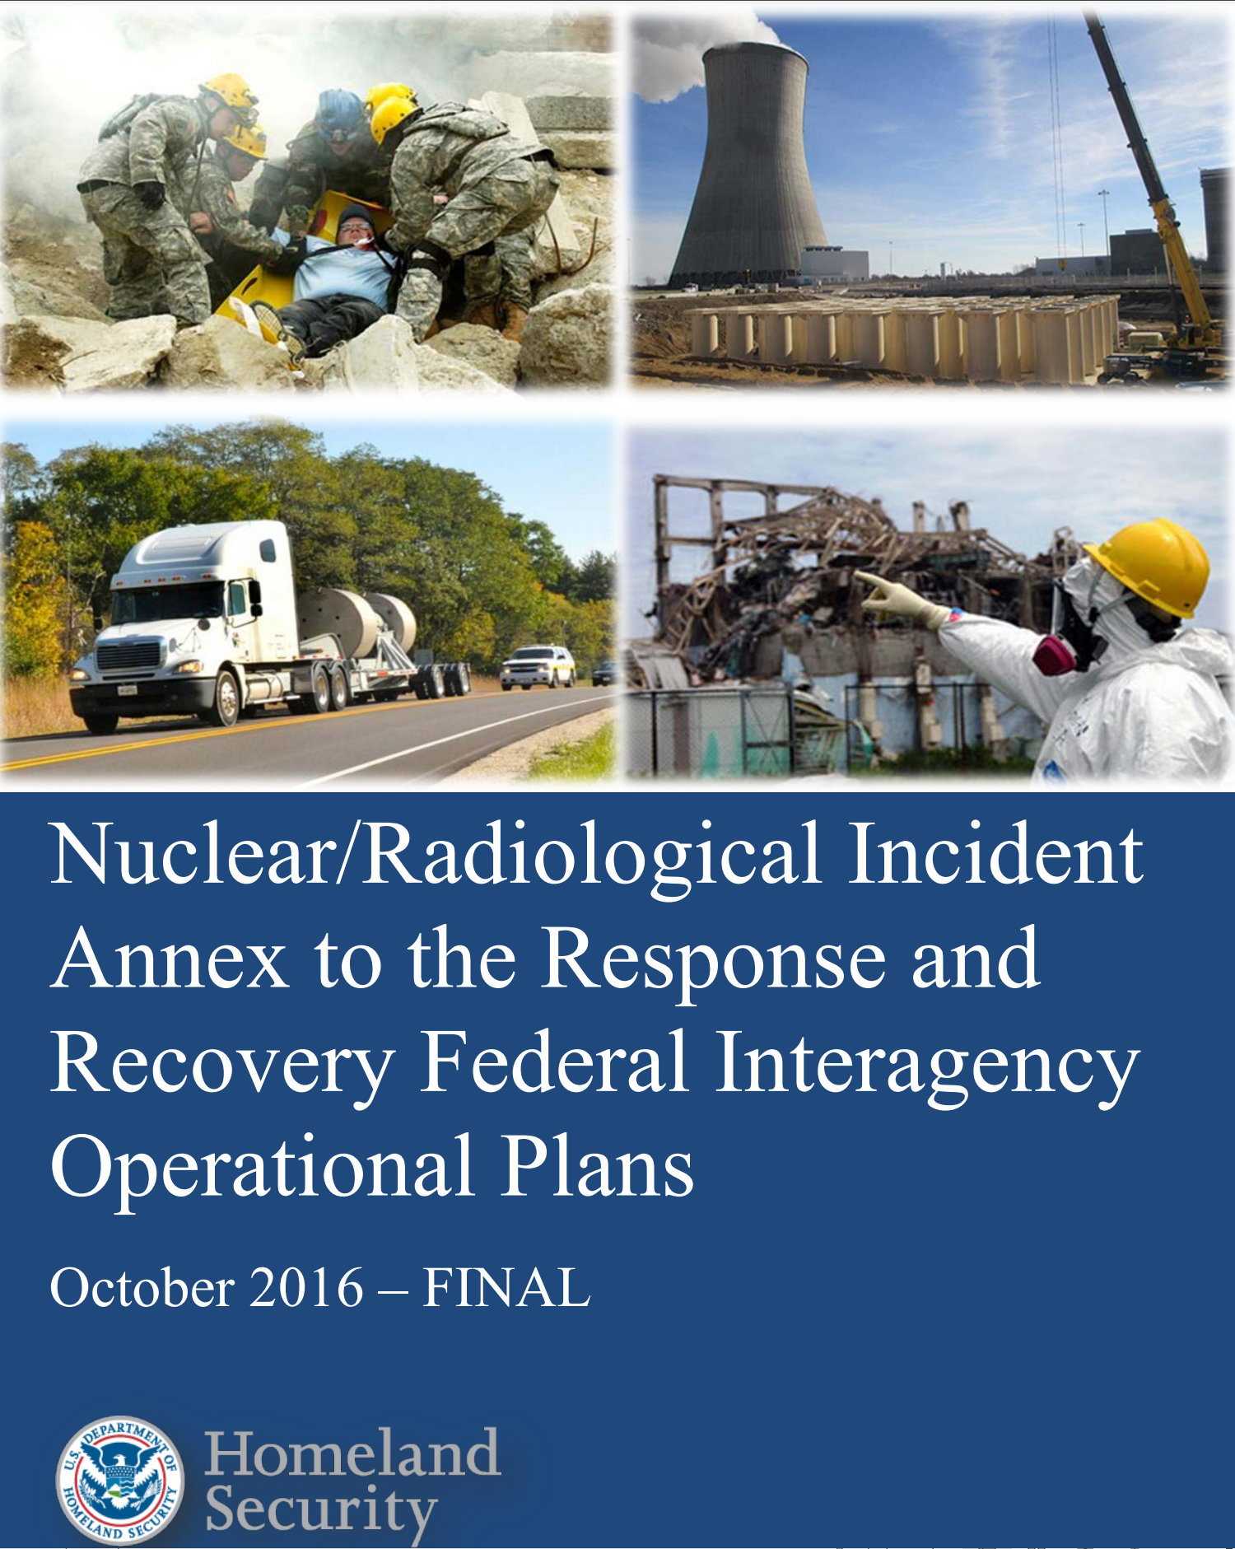
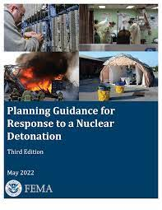
Hazard-specific supplemental plans

Slide 8
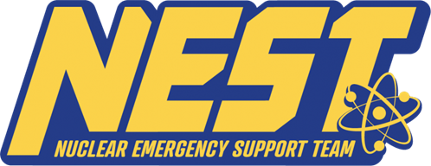
Department of Energy (DOE) Response to Nuclear/Radiological Incidents
Falls within the counterterrorism and counterproliferation mission of the National Nuclear Security Administration NNSA), a semi-autonomous agency with the Department
Nuclear Emergency Support Team (NEST)
  Multi-mission nuclear emergency response capability
  Leverages the technical expertise organic to the DOE enterprise
  Umbrella designation that encompasses all DOE/NNSA radiological and emergency response functions
  Flexible, scalable and interdisciplinary

Slide 9
NEST mission spaces and expertise
Mission Space
Expertise
  Countering weapons of mass destruction (WMD) operations
    Includes preventive radiological/nuclear detection operations and threat-based search)
  Public health and safety/radiological consequence management
  Response to U.S. nuclear weapon accidents and incidents
spectroscopy
radiography
device assessment
atmospheric modeling
radiological environmental monitoring
dose assessment
medical effects of radiation
technical nuclear forensics

Slide 10
NEST Assets
Accident Response Group (ARG)
Aerial Measuring System (AMS)
Consequence Management Response Team (CMRT)
Disposition and Forensic Evidence Analysis Team (DFEAT)
DOE Forensics Operations (DFO)
Joint Technical Operations Team (JTOT)
National Atmospheric Release Advisory Center (NARAC)
National Search Team (NST)
Radiation Emergency Assistance Center/Training Site (REAC/TS)
Radiological Assistance Program (RAP)
Notes:
If energy circumstances are favorable, a given radionuclide may undergo many competing types of decay, with some atoms decaying by one route, and others decaying by another.
In many cases, the result of radioactive decay (the decay product) IS STABLE and will not undergo any more transformations.
For example, Co-60 atoms decay to Ni-60 atoms –

Slide 11
Nuclear Incident Response Team (NIRT)
Not a “response team” per se
Collection of specialized federal teams and equipment from DOE/NNSA and the EPA that provide a rapid response capability to nuclear accidents or incidents
Pursuant to the Homeland Security Act of 2002, as amended, the Federal Emergency Management Agency (FEMA) has the authority to activate NIRT assets in connection with an actual or threatened terrorist attack, major disaster, or other emergency in the United States.
When activated under FEMA authorities, NIRT assets shall operate as an organization unit and under the direction and control of FEMA.
  For Stafford Act responses, that direction is expected to be provided through the normal mission assignment process

Slide 12
Radiation Emergency Assistance Center/Training Site (REAC/TS)
Radiation Medicine Mission
  Provide response, advice, and consultation on diagnosis and management of ionizing radiation-related injuries
    One deployable team comprised of a physician, registered nurse-paramedic, and health physicist on-call 24/7
      Deployment authorized by the DOE Emergency Response Officer (202-586-8100)
      Pre-scripted mission assignment coordinated with FEMA for Stafford Act declarations
    Technical reachback available 24/7
  Only Pan Americal Health Organization (PAHO)/World Health Organization (WHO) Collaborating Center for radiation emergency management in the U.S.
  Coordinates U.S. participation in WHO’s Radiation Emergency Medical Preparedness and Assistance Network (REMPAN)
  Registered medical support capability within the International Atomic Energy Agency (IAEA) Radiation Assistance Network (RANET)

Slide 13
REAC/TS Mission (cont’d)
Education and Expertise
  Provide state-of-the-science educational opportunities for emergency preparedness and response community world-wide
    Radiation Emergency Medicine, Advanced Radiation Medicine, and Health Physics in Radiation Emergencies presented annually at the REAC/TS facility
    Exportable, customized courses available upon request
  Provide support to exercise scenario development to Federal, State, local and private response entities
  Sponsor international symposia on management of radiation injury
Radiation Dose Assessment
  Provide timely dose estimation for external exposures or internal contamination

Slide 14
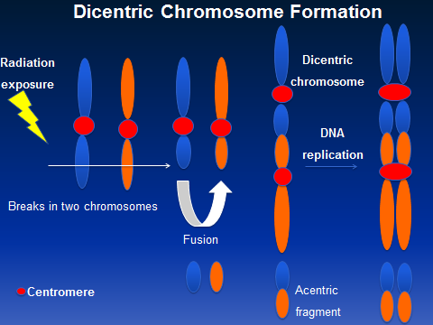
Cytogenetics Biodosimetry Laboratory (CBL)
Performs the individualized radiation dose assessment using the “gold standard” dicentric chromosome assay.
Only federally funded facility certified by Clinical Laboratory Improvement Amendments (CLIA)
Recently initiated the development of high throughput platforms for many of the cytogenetic applications and novel biomarkers, which will enable rapid dose assessment of individuals in case of mass casualty incidents.
  Capacity – 150 cases/week
  Lower limit of detection – 0.1 Gy

Slide 15
REAC/TS Resources for Medical Professionals
Patient treatment references & job aids
Dose estimation resources
Videos
  Just-in-time training
  Understanding radiation
  Ground and air transport of radiologically contaminated patients
Guidance for radiation accident management
Guidance for radiation countermeasures
Published research
REAC/TS RadMed App

Slide 16
Department of Veterans Affairs Medical Emergency Response Team (MERRT)
Deployable teams VA physicians, health physicists, and Area Emergency Managers that
  Assess the radiological impact on human health
  Provide medical consultation and services on the treatment of people exposed to or contaminated by radioactive materials
  Manage & consult on radiation protection issues

Slide 17
Armed Forces Radiobiology Research Institute (AFRRI)
Medical Radiobiology Advisory Team (MRAT)
  Deployable team responsible for providing expert advice to incident commanders and staff during a radiological incident.
  Two-person team, usually consisting of 1 health physicist and 1 physician, specializing in the health effects of radiation, biodosimetry, and treatment of radiation casualties.
  Available for reachback support

Slide 18
Advisory Team for Environment, Food, & Health (Advisory Team)
Federal interagency group of radiation experts whose mission is to provide radiation safety recommendations to decision-makers at all levels of government following a radioactive release.
  Food & Drug Administration (FDA)
  Centers for Disease Control and Prevention (CDC)
  Environmental Protection Agency (EPA)
  U.S. Department of Agriculture (USDA)
Works closely with the Federal Radiological Monitoring and Assessment Center (FRMAC), ensuring that the Team has access to incident data as theyare collected.

Slide 19
Department of Health and Human Services
Office of the Administration for Strategic Preparedness and Response
  Biomedical Advanced Research & Development Authority (BARDA) provides an integrated, systematic approach to the development of the necessary vaccines, drugs, therapies, and diagnostic tools for public health medical emergencies such as chemical, biological, radiological, and nuclear (CBRN) accidents, incidents and attacks
  Strategic National Stockpile (SNS) supplements medical countermeasures needed by states, tribal nations, territories and the largest metropolitan areas during public health emergencies.
  National Disaster Management System - A coordinated network of 4,600 authorized intermittent federal employees organized into teams and trained to deploy in the event of a natural or manmade disaster, including mass casualty or loss of healthcare infrastructure, a disease outbreak, and during large public scale events

Slide 20
Radiation Injury Treatment Network (RITN)
The Radiation Injury Treatment Network® (RITN) is a national network of medical centers with expertise in the management of bone marrow failure and works with partners from other medical specialties to assist with managing acute radiation syndrome (ARS) and its health-related consequences.
The mission of the RITN is to maximize health-related outcomes among casualties with ARS following a mass casualty disaster involving radiological, nuclear, or chemical agents with marrow toxicity.

Slide 21
RITN concept of operations

Slide 22
Other Useful Resources
Radiation Emergency Medical Management (REMM) (https://remm.hhs.gov)
Centers for Disease Control and Prevention (CDC) (https://www.cdc.gov/nceh/radiation/emergencies/index.htm)
U.S. Food & Drug Administration (FDA) (https://www.fda.gov/drugs/bioterrorism-and-drug-preparedness/radiation-emergencies)
National Alliance for Radiation Readiness (NARR) (https://www.radiationready.org)

Slide 23
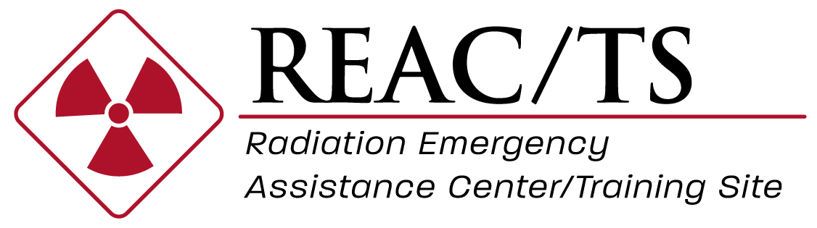
Thank You!

