Slide 1
Emergency Response Under War Conditions
October 25, 2022
Yurii Kyrylenko
SSTC NRS
Notes:
About the Image: A Glass From the Past
While taking a closer look at ancient glass to better understand how it changed over time, Pacific Northwest National Laboratory scientists made an unexpected discovery-the remains of bacteria that once lived on the surface. PNNL researchers and collaborators are delving into the past to further their knowledge about the stability of glass that will be used to safely store low-activity nuclear waste at the Hanford Site. With support from the Department of Energy's Office of Environmental Management, International Programs through the Office of River Protection, they are analyzing this glass found in Swedish hillforts that predates the Vikings because it has a chemical composition similar to what will be produced at Hanford's Waste Treatment and Vitrification Plant and has been "stored" in a known environment for more than 1,500 years.
Research team: David Peeler, Bruce W. Arey, Carolyn I. Pearce, Tamas Varga, Micah D. Miller, Michele Conroy and Michael J. Schweiger (all of PNNL); John S. McCloy (Washington State University); Jamie L. Weaver (National Institute of Standards and Technology); Edward Vicenzi and Thomas Lam (Smithsonian Institution's Museum Conservation Institute); Rolf Sjoblom (Tekedo AB); Eva Hjarthner-Holdar and Erik Ogenhall (Arkeologerna); and Albert A. Kruger (Department of Energy Office of River Protection). The image was colorized by Nathan Johnson (PNNL).
Instrument: Scanning electron microscope and focus ion beam hybrid
https://www.flickr.com/photos/pnnl/24220123368/in/photolist-fqwiqF-aBF44N-fqwj9R-aEuQHd-CUfsRW-pZVLNL-aPjNkZ-fxBosi-aErWsK-aBCnZk-ECMqka-aEr4hT-6yL625-6xvZrp-6xh38v-6xmeiY-VNqjUa-CJUXKp-CPUyAo-25kubq5-BUPMLB-211nysv-Chikdn-Cq6fRm-BscBWe-CnhkRJ-CiHawx-CPUwEu-BUGK7J-CiHawn-BUPKMg-CGEBLY-BUGHTw-CJV1jx-CPUxnw-CSdgpF-CSdj4D-CJUWi6-CPUwFm-BXsubh-CPUxJd-CiHdVB-BUGG5b-BUGHYm-22DixCm-243ex8R-Cq6jHQ-CGEzzy-PEd3HJ-P9S5sd

Slide 2
Content
Emergency Response in the War Context
Calculation Toolkit
Challenges for Emergency Response
Conclusions

Slide 3
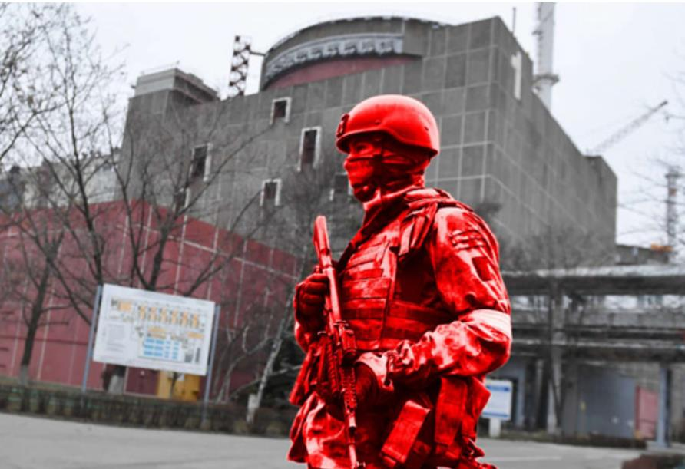
1. Emergency Response in the War context
https://www.pravda.com.ua/eng/news/2022/10/12/7371580/

Slide 4
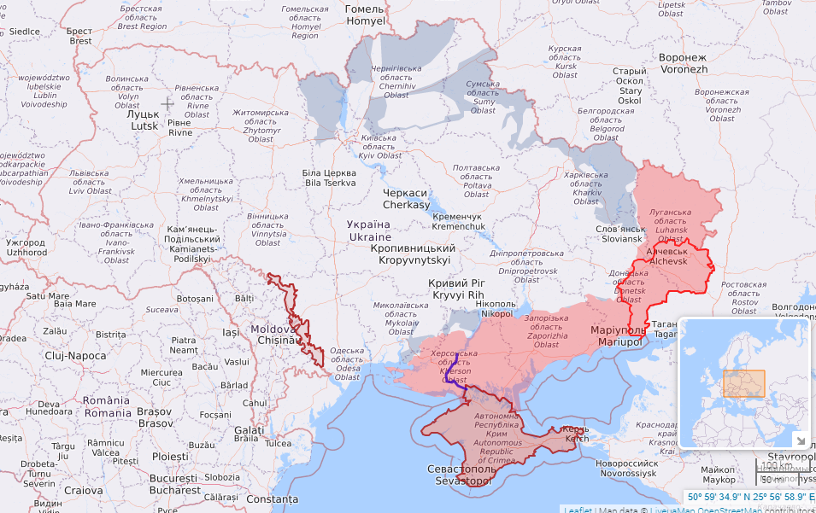
Facilities at risk
Since the full-scale russian invasion (February 24, 2022) Ukrainian facilities of IAEA EPR category I have been at risk:
ZNPP 6 units WWER-1000 (+ SFDS)
SUNPP 3 units WWER-1000
KhNPP 2 units WWER-1000
RNPP 2 units WWER-440 and 2 units WWER-1000
The main task for IEC Experts:
Real-time assessment on recommended protective actions (for the territories controlled by Ukrainian government as well as for the territories temporary occupied by russia)
Rivne NPP
Chornobyl NPP
Khmelnytskyi NPP
South-Ukraine NPP
Zaporizhzhia NPP
Situation on October 14, 2022 https://liveuamap.com/en

Slide 5
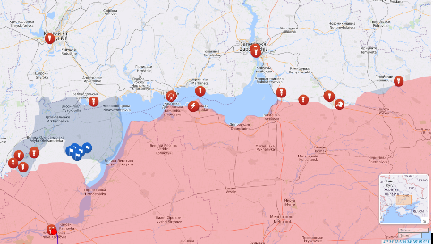
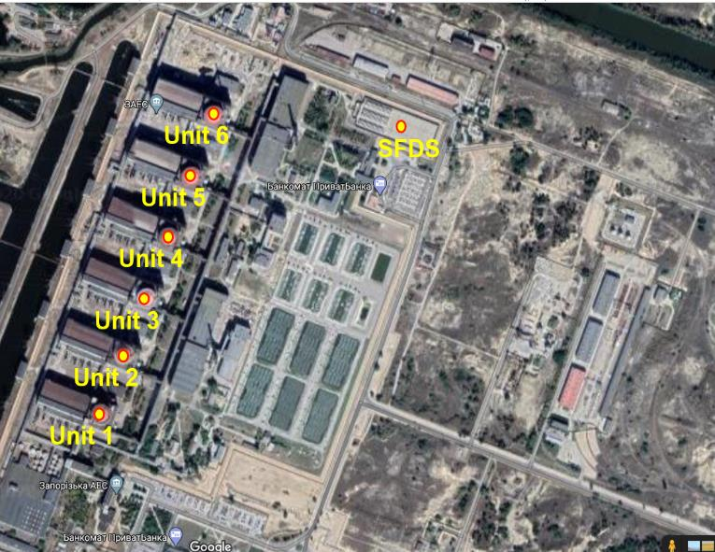
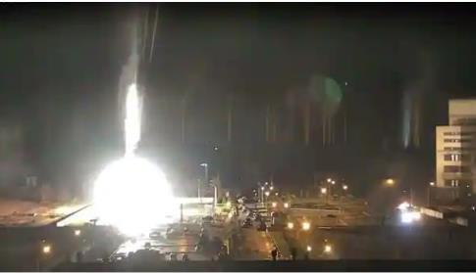

Zaporizhzhia NPP site
Zaporizhzhia NPP
Front line on October 10, 2022 liveuamap.com/en
Zaporizhzhia NPP site: russian attack, March 04, 2022
Zaporizhzhia NPP site contains
6 power units (WWER-1000/V-320 type)
SFDS (VSC-24 type, 5 years in storage)

Slide 6
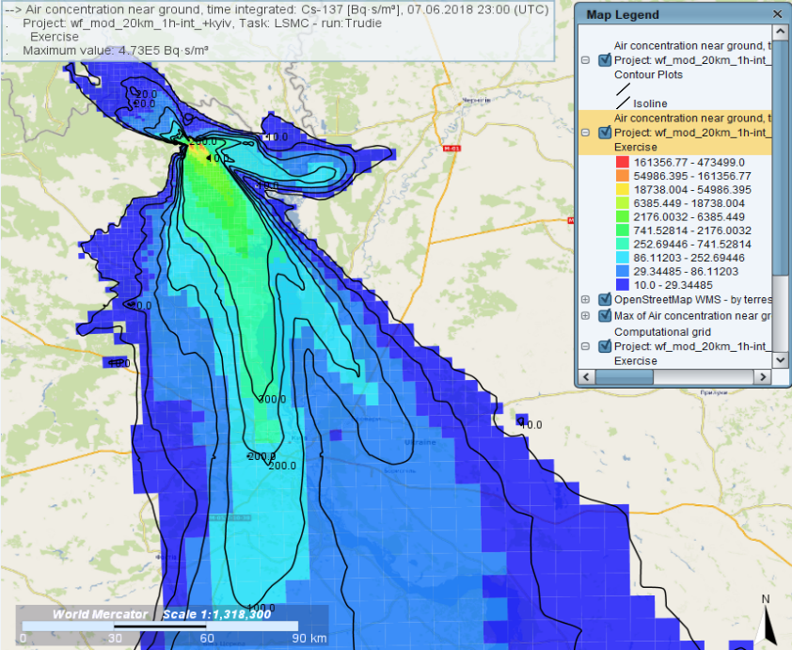
2. Calculation Toolkit

Slide 7
IEC Fast Running Tools
Software | HotSpot | InterRAS/RASCAL | JRODOS
Dispersion Model | Gaussian plume | Gaussian plume Gaussian puff | Gaussian puff (RIMPUFF), Lagrangian particle (DIPCOT, LASAT), Eulerian (MATCH)
Range limit | up to 50 km | up to 80 km / 160 km | More than 3000 km (MATCH model)
Meteorology | User defined | User defined (NWP – N/A for Ukraine) | User input / real-time NWP data for 96 h
Unit status as input data | No | Yes | No
Exposure Pathways | Inhalation, Cloudshine, Groundshine + Res. | Inhalation, Cloudshine, Groundshine + Res., Ingestion | Inhalation, Cloudshine, Groundshine+ Res., Ingestion, Skin exposure
Organ Doses | Effective, Thyroid, Bone, Colon, Lungs + 20 others | Effective, Thyroid, Bone, Colon, Lungs | Effective, Thyroid, Skin, Bone, Colon, Lungs + 8 others
Recommended Protective Actions | No, but does indicate when doses exceed user input levels | No, but does indicate when doses exceed Preventative Action Guidelines | Evacuation, Sheltering, ITB, Food screening (according to selected country)
Minimum Run Information | Source term, stable meteorology | Source term, Meteorological data | Source term, Meteorological data, Release location, Area of interest
Run Time | <1-2 minutes | <1-2 minutes | From 5 to 20 minutes (depends on chosen ADM, time-step, operating system efficiency)

Slide 8
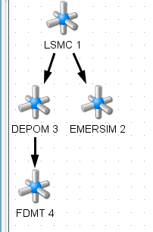
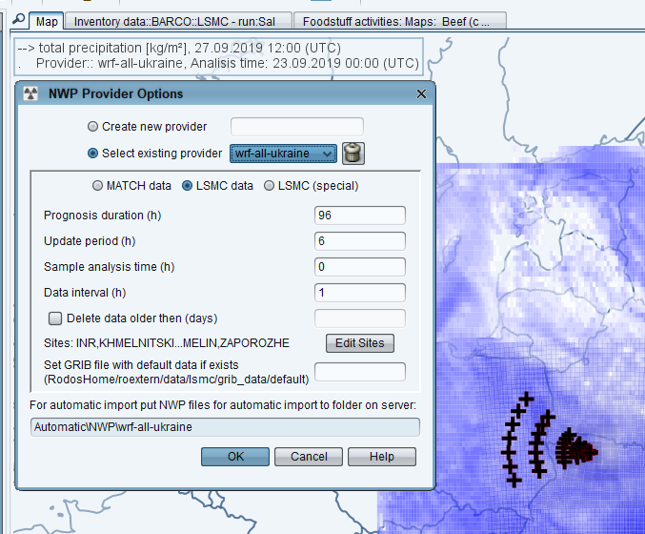
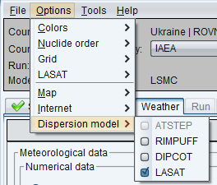
JRODOS system
The integrated and comprehensive Java-based Real-time On-line DecisiOn Support system, JRODOS, for the off-site emergency management of nuclear accidents was developed with support of the European Commission and the German Ministry of Environment
European DSS JRODOS (Karlsruhe Institute of Technology - KIT)

Slide 9
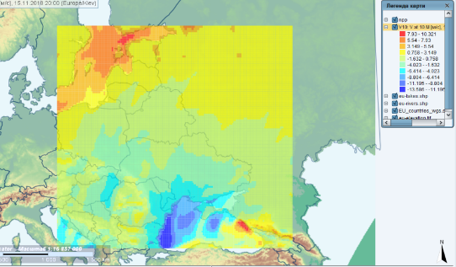
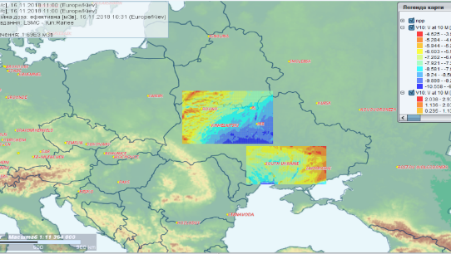
Meteorology
JRodos-DataSupplier as an application to JRODOS system is installed for an automatic receipt of the latest numerical weather predictions for all the territory of Ukraine, parts of adjacent countries and for some territories around Ukrainian facilities – WRF results (0.15º and 0.05º)
SSTC NRS experts have an access to SFTP-server with numerical weather predictions data
Global NOAA NOMADS GRIB2 0.5º/0.25º can be downloaded
Some additional weather information or extended numerical weather data can be required from Ukrainian Hydro-meteorological Center (UHMC).
Domain D01 WRF 0.15 Deg. Grid – All Ukraine
Domains D02, D03 WRF 0.05 Deg. Grid – ZNPP+SUNPP and RNPP+KhNPP+ChEZ

Slide 10
Reference source terms
ST no | Scenario | Release pathway | Modelling approach | INES level | Duration of the release, hr(s) | JRODOS ST type
1 | Total station blackout without containment localization | ZNPP Unit, reactor building vent stack | MELCOR v. 2.1 model for WWER-1000/V-320 unit | 7 | 24 | F1
2 | Total station blackout with activating containment venting system (no filtration) | ZNPP Unit, containment leakage + reactor building vent stack | MELCOR v. 2.1 model for WWER-1000/V-320 unit | 7 | 24 | F1
3 | Mechanical destruction of VSC-24 cask at spent fuel dry storage (SFDS) | 1 SF cask containing 24 assemblies (5 years in storage) | RASCAL 4.3.4 Inventory for VSC-24, 100% gas gap release | 6 | 0,5 | F6
4 | Total station blackout with activating filtered containment venting system (FCVS) | ZNPP Unit, containment leakage + FCVS scrubber stack | MELCOR v. 2.1 model for WWER-1000/V-320 unit | 5 | 24 | F1

Slide 11
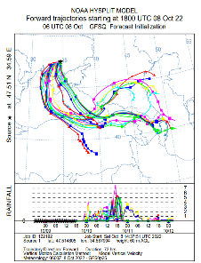
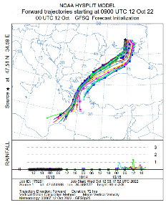
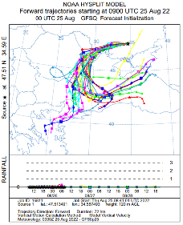
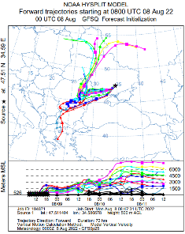
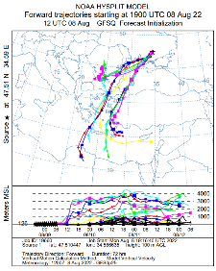
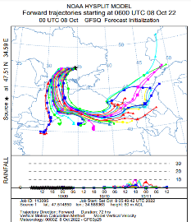
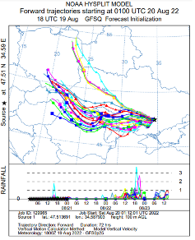
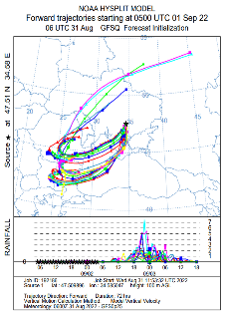
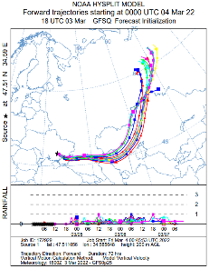
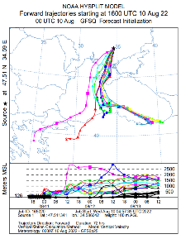
NOAA HYSPLIT trajectories - examples
Ex.1
Ex.2
Ex.3
Ex.4
Ex.5
Ex.6
Ex.7
Ex.8
Ex.9
Ex.9
Stein, A.F., Draxler, R.R, Rolph, G.D., Stunder, B.J.B., Cohen, M.D., and Ngan, F., (2015). NOAA's HYSPLIT atmospheric transport and dispersion modeling system, Bull. Amer. Meteor. Soc., 96, 2059-2077, http://dx.doi.org/10.1175/BAMS-D-14-00110.1
Rolph, G., Stein, A., and Stunder, B., (2017). Real-time Environmental Applications and Display sYstem: READY. Environmental Modelling & Software, 95, 210-228, https://doi.org/10.1016/j.envsoft.2017.06.025 . ( http://www.sciencedirect.com/science/article/pii/S1364815217302360)
The authors gratefully acknowledge the NOAA Air Resources Laboratory (ARL) for the provision of the HYSPLIT transport and dispersion model and/or READY website (https://www.ready.noaa.gov) used in this publication.

Slide 12
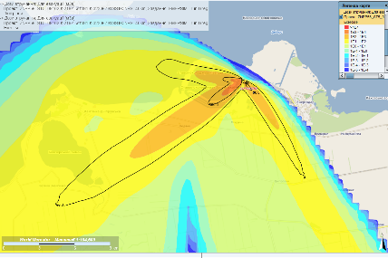
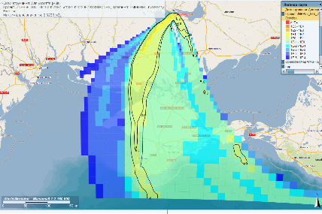
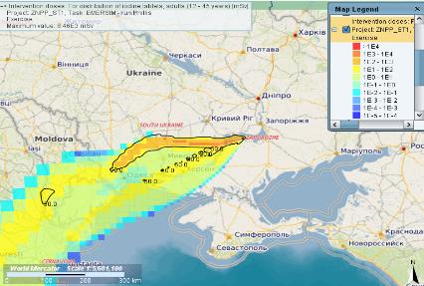
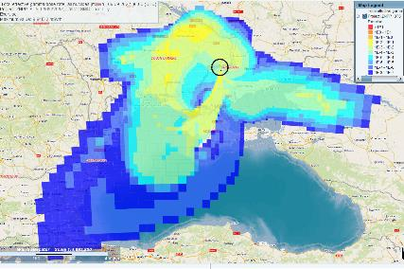
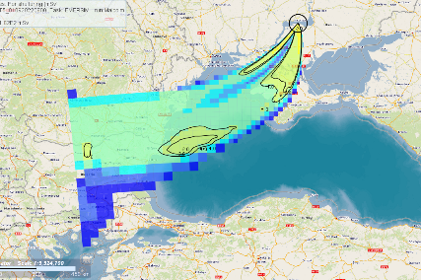
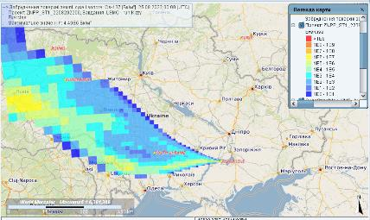
Atmospheric dispersion and dose projection – examples (1)
Intervention doses for evacuation (JRODOS, October 08, 2022)
Intervention doses for sheltering (JRODOS, October 08, 2022)
Intervention doses for ITB (JRODOS, August 09, 2022)
Total effective gamma dose rate (JRODOS, September 09, 2022)
Intervention doses for sheltering (JRODOS, September 01, 2022)
Cs-137 ground deposition (JRODOS, September 01, 2022)

Slide 13
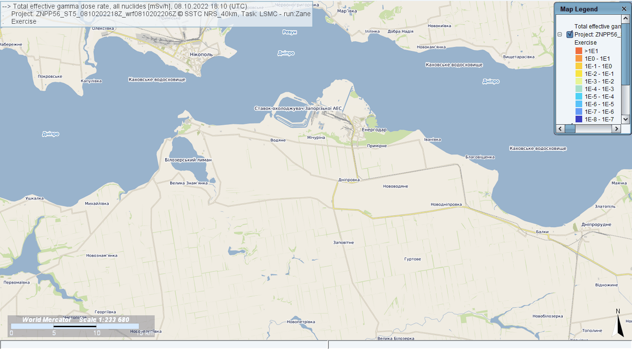
Atmospheric dispersion and dose projection - examples (2)
JRODOS Modelling Results (ADM LASAT): Total Effective Gamma Dose Rate up to 40 km, mSv/h – October 08, 2022

Slide 14
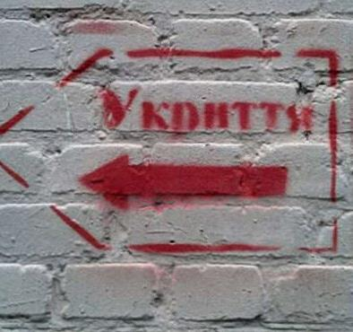
3. Challenges for Response

Slide 15
Challenges for IEC experts
Absence of a safe working place for the expert during hostilities
Breakdown of information chains and communications with some experts of the emergency center
Unavailability of the tools needed for the calculations in the shelters (work with phone/paper materials)
Problems with electricity and Internet connection (work in a stand-alone mode, inability to download NWP, to load maps, to transmit data, etc.)
Unreliability of data, transmitted from a captured facility (false output data, uncertainties, failures, including unavailability of radiation monitoring data around the site, technological parameters, etc.)

Slide 16
Possible solutions
Organizing a safe working place for the expert (sheltering) equipped with necessary tools;
Development of a protected virtual platform for communication of the IEC experts;
Development of a library of the reference source terms for the expected range of threats for all possible installation conditions (at the stage of preparedness);
Use a secure server (clouds) to transfer large files;
Maximum diversification and independence of data transmission channels (satellite technologies);
Automatic distribution of data to mail/messenger/widget of the expert in order to save current meteorological data, information on the weather forecast, and, if possible, technological parameters of the object;
Regular training on calculation procedures in various conditions, at any time of the day, and in conditions of missing data or obtaining unreliable data.

Slide 17
Conclusions
Response procedures analysis related to the aggression of russian federation is ongoing, experience is being built up with every day of the war in Ukraine;
TSBO proved to be one of the critical scenarios for the power units of ZNPP, the source for which was used as a reference source term;
Scenarios involving DSSNF at ZNPP require additional research from the point of view of military influence (shells of different types and calibres);
Preparedness to an emergency resulting from the military attacks at NPP requires more information/knowledge about the potential military threats.

