Slide 1
Puget Sound Maritime Small Vessel Preventive Radiological / Nuclear Detection Program
Melanie Godinez
Pacific Northwest National Laboratory
Notes:
Image: Security Composite Illustration

Slide 2
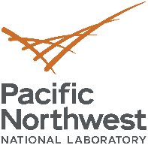



Funding Model
Port Security Grant-Funded (FEMA)
Lead Agency: Seattle Fire Department
Administrators: Pacific Northwest National Laboratory

Slide 3
Mission and Goal
Mission Statement: Design and implement a maritime-oriented architecture for coordinated and integrated detection and interdiction of illicit radiological/nuclear materials that may be used to develop a weapon (RDD/IND) within the Puget Sound region.
Overarching Goal: To prevent a radiological/nuclear attack on the United States by enhancing the Puget Sound’s maritime small vessel capabilities to detect, identify, and interdict illicit radioactive materials.

Slide 4
Goals and Objectives
Support the Department of Homeland Security Small Vessel Security Strategy:
  Develop a robust layered defense by expanding and enhancing maritime radiological/nuclear detection capabilities for federal, state, local, tribal, and private stakeholders
  Leverage technology to enhance the ability to detect, determine intent, and when necessary, interdict small vessels
  Improve coordinated small vessel interdiction capabilities and operations.
  Prevent illicit radiological/nuclear weapons or materials from entering the Puget Sound maritime region
  Interdict any such weapons or materials as far away as possible from critical infrastructure and populated areas
  Evaluate radiation detection sensors and operational protocols for the Puget Sound’s maritime environment
  Ensure minimal impact on the law-abiding boating community and small vessel operators

Slide 5
Approach
Combination of defense-in-depth layered system of radiological/nuclear sensors and Law Enforcement Tactics, Techniques, and Procedures:
  Consistent detection operations involving a mix of sensors
  Leverage current maritime training and operations
  Develop and implement new tactics, techniques, procedures, or operations to address identified gaps
  Enhance Maritime Domain Awareness

Slide 6
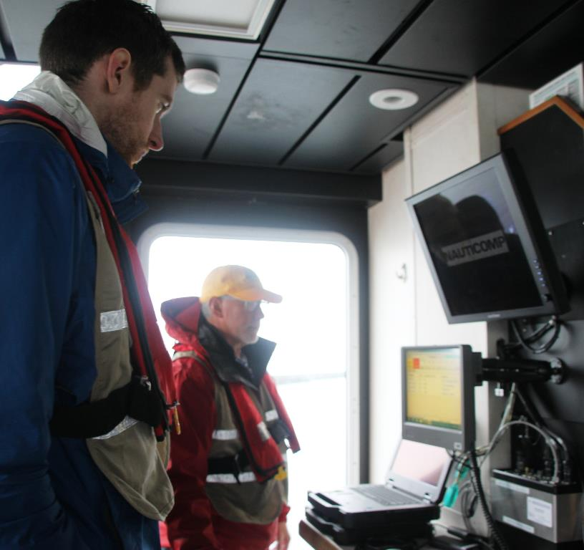
Organization
15 state and local agencies participating
10 police departments
11 additional Fire agencies affiliated through HAZMAT response network
12 federal agencies participating outside of the Port Security Grant
Sector Puget Sound Joint Harbor Operations Center is the central reporting point
Cross-agency collaboration

Slide 7
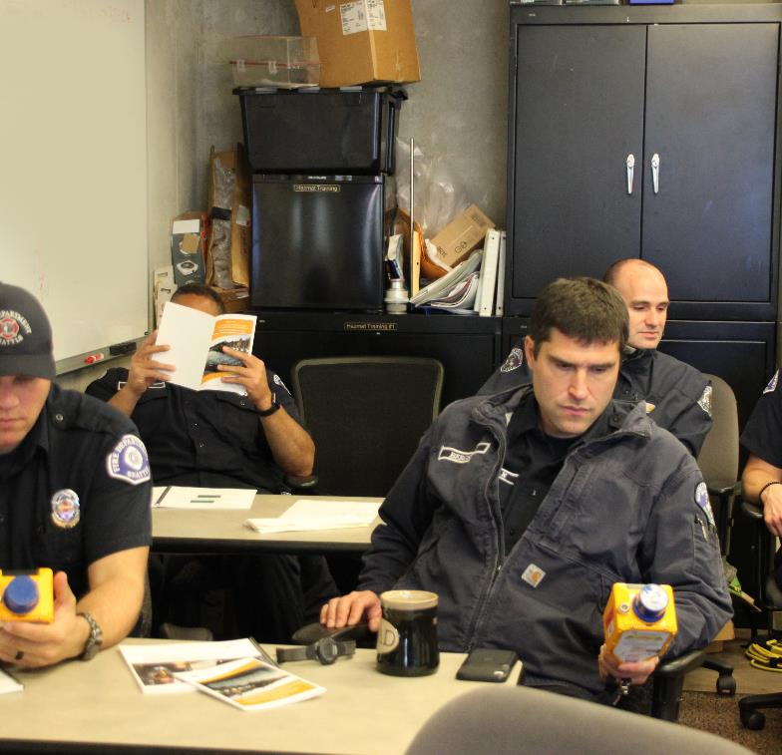
Annual Trainings
Initial qualification training held for newly assigned officers/responders
Dockside drills
Annual agency-specific refresher training
Bi-annual dockside drills

Slide 8
Lessons Learned
Require initial classroom training on agency human-portable and/or boat-mounted detection equipment.
Continue “Buttonology” training focused on small groups at the agency level and specific to equipment held by each agency.
Execute monthly training using the Quick Reference Guide at the individual agency level.
Continue semi-annual drill training to sustain skillsets.
Ongoing funding requirements to purchase new and maintain existing equipment.

Slide 9

Next Steps
Sector Puget Sound review/approve updated Standard Operating Procedures for Rad/Nuc Detection Program
Continued Training in 2023
Tentative TTX with Senior Leadership
Tentative Full-Scale Exercise

Slide 10
Questions?
Points of contact
PNNL:
  Melanie Godinez
    Melanie.Godinez@pnnl.gov
    206-528-3427

