Slide 1

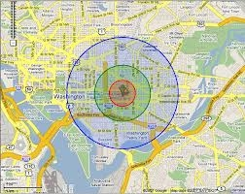
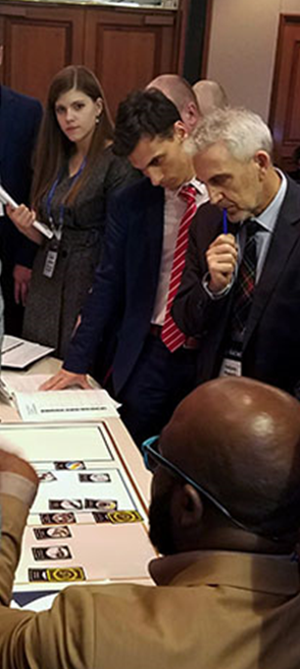

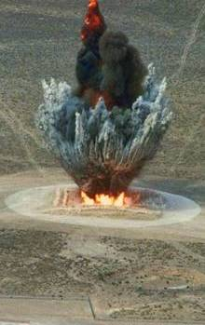
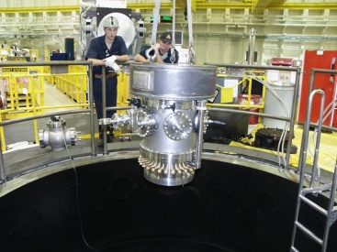
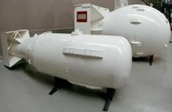
Office of Nuclear Forensics
RAMP Users’ Meeting
October 24, 2022

Slide 2
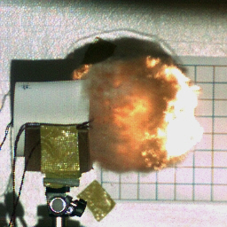
CTCP / NA-80 Mission
CTCP is responsible for countering nuclear terrorism and nuclear proliferation and responding to nuclear incidents and accidents domestically and overseas. CTCP missions include both national security and public health and safety disciplines.
Mission Pillars
Provide scientific understanding of nuclear threat devices and potential terrorist and proliferant state nuclear capabilities.
Inform U.S. policies, regulations, and interagency and international partners on terrorist and proliferant state nuclear threats and related planning.
Sustain Nuclear Emergency Support Team (NEST) readiness to respond to nuclear & radiological incidents and accidents at home and overseas.
Provide targeted training to domestic and international partners on nuclear and radiological emergency preparedness and response.

Slide 3
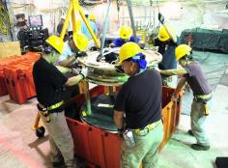


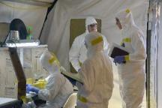
Office of Nuclear Forensics
Maintains a technical and operational forensics response capability in support of pre-detonation/interdicted nuclear materials, pre-detonation device assessment, and post-detonation debris collections & device assessment
Pre-detonation Material Analysis
  Laboratory analysis providing highly sophisticated and reliable chemical & physical measurements of nuclear materials
  Archive and characterize important nuclear materials
  Perform signature characterization and validation of measurement techniques
Pre-detonation Device Assessment
  Expertise for disassembly and disposition of nuclear weapons, INDs, or RDDs
  Support FBI forensics mission and assessment of device
Post-detonation Analysis
  Deployable assets support collection of nuclear debris
  Assessment of device for design characteristics

Slide 4
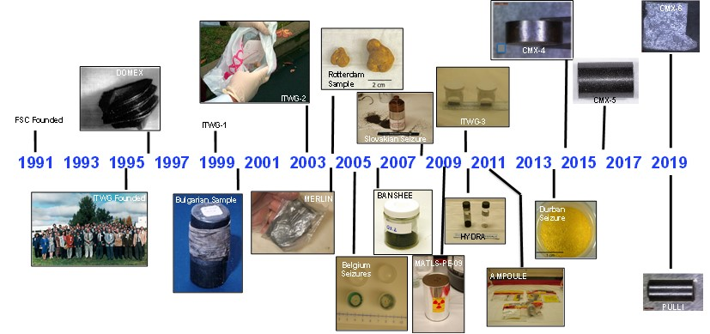
Pre-Detonation Material Analysis
Bulk SNM Analysis Program (BSAP)
  Laboratory capability to characterize material with the needed confidence for attribution.
  A national program: DOE/NNSA, FBI, & DHS committed to assuring a system capable of sophisticated chemical and isotopic measurements of pre-det materials.
  NNSA supports two designated laboratories, Los Alamos & Lawrence Livermore, to maintain and enhance measurement capabilities.
Pu Oxide
National Nuclear Material Archive
  Definitively answer the questions, “Was it ours?” “What part of the fuel cycle is it from?” “Is it exotic?”
  Characterize and retain historic DOE nuclear operations materials that have critical forensics value.

Slide 5
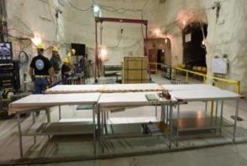
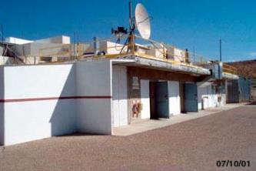
Pre-Detonation Device Assessment
Disposition and Forensic Evidence Analysis Team (DFEAT)
  Comprised of national laboratories and Nevada National Security Site (NNSS) in cooperation with law enforcement
Safe Disassembly of an Improvised Nuclear Device (or Radiological Dispersal Device)
  Preserve and collect evidence
  Package components for shipment
  Place components into three categories for additional forensic analysis: Special Nuclear Material (SNM), High Explosives (HE), other
Operations parallel to / following disassembly
  Support FBI examinations
    Traditional forensics: fingerprints, tool marks, DNA, markings, etc.
  Device Assessment
    Analyze device performance
  Nuclear Material Analysis to support attribution
    Sub-sampling and analysis of SNM, HE

Slide 6
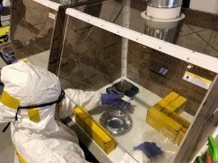

Post-Detonation Analysis
DOE Forensics Operations (DFO)
  24-person team that deploys within 8 hours of nuclear detonation detection (NUDET) to staff Ground Collection Task Force (FBI; DoD; DOE)
  Identify collection sites
  Minimize risk to DoD personnel
  Quality Assurance / Quality Control samples against dose, volume, fissions, and volatility requirements
  Process samples for shipment to DOE labs
Device Assessment
  Debris Diagnostics – measure and evaluate ground & air samples to characterize the detonation
    Fuel type and mass
    Efficiency of the detonation
    Fission and activation product isotopics
  Device reconstruction – “Unbake the cake”
Data Evaluation Supercomputer - Modeling

Slide 7
Questions?

Slide 8
Backup Slides

Slide 9
Legislation and Policy
Nuclear Forensics and Attribution Act (P.L. 111-140; Feb 2010)
  Statutorily authorized and codified the National Technical Nuclear Forensics Center (NTNFC) in DHS/DNDO.
National Security Presidential Directive (NSPD)-17 / Homeland Security Presidential Directive (HSPD)-4, Annex IV (Jul 2007)
  Formalized the TNF mission to develop, maintain, and advance capabilities across the spectrum of collection, analysis, and evaluation for radiological/nuclear events.
  Assigned TNF responsibilities to DHS/DNDO, DOE/NNSA, DoD, DOJ, DOS, and ODNI, including the establishment of the National Technical Nuclear Forensics Center (NTNFC) in DHS.
Presidential Policy Directive (PPD)-42 “Preventing and Countering Weapons of Mass Destruction Proliferation, Terrorism, and Use”
National Security Presidential Memorandum (NSPM)-35 “National Technical Nuclear Forensics”
  First Presidential Policy addressing Nuclear Forensics policy in its entirety.
  Endorses transition of forensics leadership from DHS to NNSA.
The United States will identify and hold fully accountable any state, terrorist group, or other non-state actor that supports or enables terrorist efforts to obtain or employ nuclear devices, materials, technologies, or designs.
The United States will maintain and advance a robust nuclear forensics capability to support the attribution of the source of an actual or attempted nuclear or radiological attack, or of interdicted or confiscated nuclear or radiological materials or devices.
Notes:
These foundational documents (NSPD 17/HSPD 4, Annex IX and NFAA) established NTNFC in DHS with three distinct missions:
An overarching USG-wide mission of NTNF program stewardship, including integration and readiness of the various departments and agencies with nuclear forensics roles.
A technical mission for developing the capability to perform nuclear forensics on pre-detonated nuclear materials.
A human capital mission for developing and sustaining a nuclear forensics expertise pipeline.

Slide 10
Nuclear Forensics Expertise Development Plan
To fulfill the mission of the National Nuclear Forensics Expertise Development Program, NNSA will develop and sustain the next generation of technical nuclear forensics expertise within the USG by expanding NNSA’s Defense Nuclear Nonproliferation (DNN) university program to include a university consortium dedicated to technical nuclear forensics.
This approach has a highly effective, decade-long track record of supporting university R&D addressing basic research shortfalls while developing the next generation of experts needed to support NNSA’s missions.
  Awarded over 500 degrees to date, including 177 PhDs, resulting in more than 140 new career placements across the nuclear security enterprise—primarily at the DOE/NNSA National Laboratories.
  University PIs, students, and postdocs partner with laboratory researchers to address mission-relevant research gaps.
  Consortia structure encourages direct engagement of university students in critical disciplines at DOE/NNSA laboratories for graduate research, thus strengthening likelihood of follow-on employment and thereby establishing a “pipeline” of talent.
DNN FY22 budget request includes $5M to establish a forensics consortium.
  Funding included in the FY 2022 House and Senate Energy and Water Development Appropriations bill.
  Funding included in the FY 2022 House and Senate National Defense Authorization Act (NDAA).

Slide 11
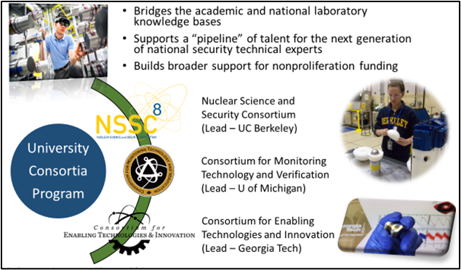
DNN R&D’s University Program
The DNN R&D university program and its new forensics consortium are implemented under existing statutory authority: Section 313, Omnibus Appropriations Act, 2009 (42 U.S.C. 16274a), as amended by section 2003(e) of the Energy Act of 2020 (P.L. 116-260).
Each consortium, consisting of ~10 universities in collaboration with DOE/NNSA National Laboratories, is awarded $25M over 5 years and is re-competed every 5 years.
Program authorized and first funded by Congress in 2009 and first consortia established in 2011.
A Funding Opportunity Announcement could be issued in early 2022 with selection by year’s end.

