Slide 1

Nonradiological Health Consequences from Evacuation and Relocation (NUREG/CR-7285)
Amy Sharp
October 24, 2022

Slide 2
Project Background
Evacuation and relocation are key protective actions recommended in a radiological release
  PAGs are intended to weigh the risk of radiation against the risk of the protective action
Despite being protective of the hazard, evacuation and relocation have inherent risks associated with them
  The holistic risk has not been fully quantified, making it difficult for emergency managers to thoughtfully weigh the risks
This project seeks to quantitatively and qualitatively evaluate the risks associated with evacuation and relocation

Slide 3
Definitions and Scope
Two groups examined:
  Displaced populations
    Evacuated populations typically return within 1 year
    Relocated populations remained displaced for greater than 1 year
  Nondisplaced populations
Response to a range of emergency events, excluding:
  Terrorism
    Designed to create out-sized fear and anxiety in the population
  Displacements due to armed conflict where populations were not evacuated to truly safe areas
    During typical evacuations, populations are brought to safe areas
    Populations still at risk complicates interpretation of findings

Slide 4
Literature Review
Non-Radiological Health Consequences from Evacuation and Relocation

Slide 5
Literature Review Methodology
Collected papers covering a multitude of events and health outcomes
Filtered based on:
  Relevancy
  Redundancy
  Reliability
  Newcastle-Ottawa Scale
Excluded from meta-analysis if populations were conflated or ambiguous
1,210 Unique papers collected
235 Papers analyzed
209 Extracted quantitative information
Checked title and abstract for relevancy
82 papers used in meta-analysis
Checked for relevancy and redundancy
Checked for usable data for meta-analysis

Slide 6
Human Health Effects
Fourteen different health effects were identified across all the studies from the literature review
Broad effects | # of papers in meta-analysis
General Health Effects | 18
Healthcare Accessibility | 5
Other miscellaneous effects | 8
Psychological Distress | 23
Substance Abuse | 11
Specific effects | # of papers in meta-analysis
Anxiety | 10
Depression | 17
PTSD | 32
Diabetes | 10
Heart Disease | 12
Mortality | 8
Weight Problems | 6
Respiratory | 5
Sleep Problems | 4

Slide 7
Emergency Events
Nine different emergency event types were included in the dataset
  Most nuclear power plant data from the Fukushima nuclear accident
Event | # of papers in meta-analysis
Hurricanes/Cyclones | 19
Wildfires | 6
Non-disaster relocation events | 2
Nuclear power plant accidents | 32
Earthquakes | 9
Floods | 6
Explosions | 3
Earthquakes and Tsunamis | 3
War | 3

Slide 8
Statistical Methodology
Non-Radiological Health Consequences from Evacuation and Relocation

Slide 9
Overview of Statistical Method
Meta-analysis – combining data from multiple papers
  Most papers describe one health effect observed at a single event
  To understand effect across all health effects and all disasters, results must be combined
  Meta-analytical methods were used to combine study data and account for intra-study and inter-study variance
Meta-regression – understanding how different factors affect the health effects measured
  For the same health effect, different variables could influence the outcome
    Event type, time between event and data collection, age of population, etc.
  Meta-regression provides a tool to examine how different event characteristics influence the measured odds ratio

Slide 10





Meta-Analysis of Effect Sizes
Effect size
  Quantitative measure of a health effect for a general population under a given condition
Meta-analysis estimates an average effect size across multiple studies
  Using different studies increases statistical power and robustness of estimate
  Combined evidence gets closer to some underlying “truth”
  Identifies sources of disagreement between studies of different types
Between-study variance
Underlying effects per population, observed with sampling error

Slide 11
Random Effects (RE) Modeling
Effect size
  Population proportion or odds ratio
Random Effects Model
  RE models are used to combine individual study effect sizes into an average effect size
  Accounts for differences between studies with different population demographics and emergency event type
Between-study variance
Underlying effects per population, observed with sampling error
Combined using RE model
Estimated average effect

Slide 12
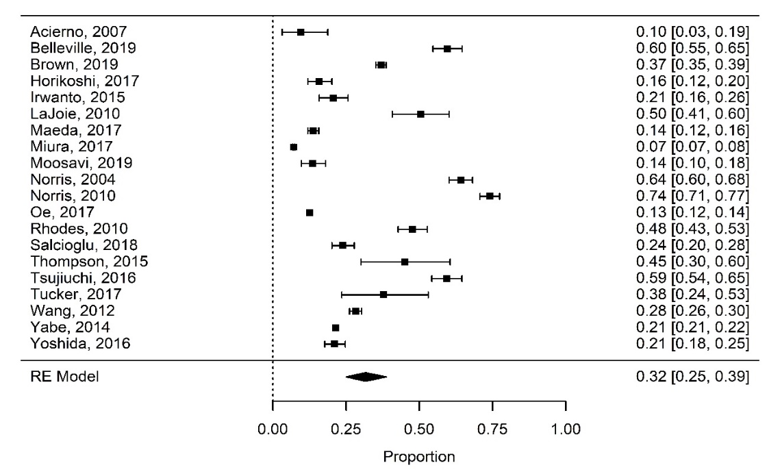
Meta-Analysis of Proportions
Study focused on estimating a proportion of the displaced and nondisplaced populations affected by each health condition following emergency events
  Estimates a weighted average of the proportion in each population
Proportions are visualized using a forest plot
  Shows individual effect sizes
  Individual-level variance of each study
  Final pooled estimate and 95% confidence interval
  Example: Aggregated effect size for PTSD in evacuated or relocated groups following an emergency, $\hat{p}=0.32 (0.25, 0.39)$

Slide 13
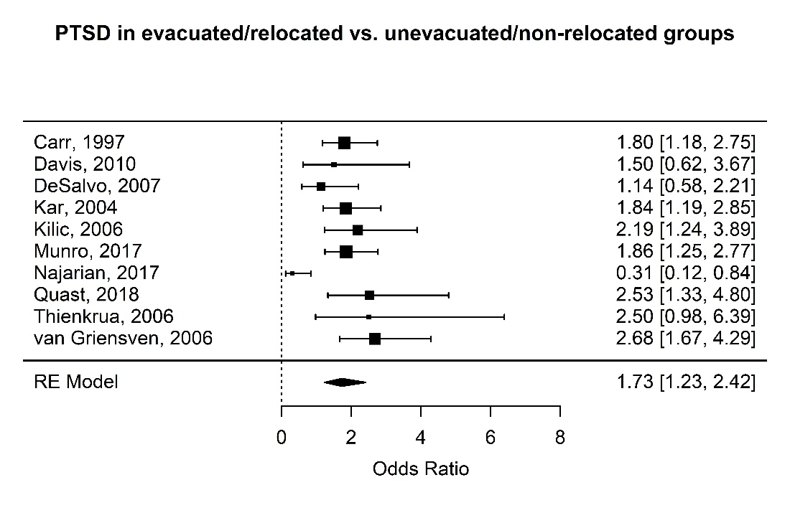

Meta-Analysis of Odds Ratio
Study focused on estimating the odds that individuals may experience a health condition if displaced, compared to the odds if non-displaced, following an emergency event
  Estimates are a weighted average of the odds ratio
  Allows for an examination of the association between negative health outcomes (e.g., experiencing PTSD) and displacement
Visualized using a forest plot
  Shows individual effect sizes
  Individual-level variance of each study
  Final pooled estimate and 95% confidence interval
  Example: Comparative effect size for PTSD in evacuated or relocated groups following an emergency, $\hat{OR}=1.73 (1.23, 2.42)$

Slide 14



Interpretation of Odds Ratios
For displaced populations, there is a greater likelihood of experiencing a negative health outcome
Displacement following an emergency has no statistical association with an increased likelihood of experiencing a particular health outcome
For non-displaced populations, there is a greater likelihood of experiencing a negative health outcome
$$\hat{OR}>1$$
$$\hat{OR}=1$$
$$\hat{OR}<1$$

Slide 15
Meta-Regression of Emergency Factors
Examined the individual study and emergency event characteristics that are associated with greater or lesser pooled effect sizes across each health outcome
Variable Short Name | Type of Variable | Variable Values
data_source | Categorical | Physician-diagnosed (reference), self-reported, test
group | Categorical | Both evacuated and relocated (reference), evacuated, relocated
NOS | Numeric | Ordinal NOS score values 2-8
time_between_event | Numeric | Years between event and effect measurement
type_CycHurr | Binary | Cyclone or hurricane emergency indicator
type_EqTsu | Binary | Earthquake or tsunami emergency indicator
type_Flo | Binary | Flood emergency indicator
type_Fire | Binary | Fire emergency indicator
type_NPP | Binary | Nuclear power plant emergency indicator

Slide 16
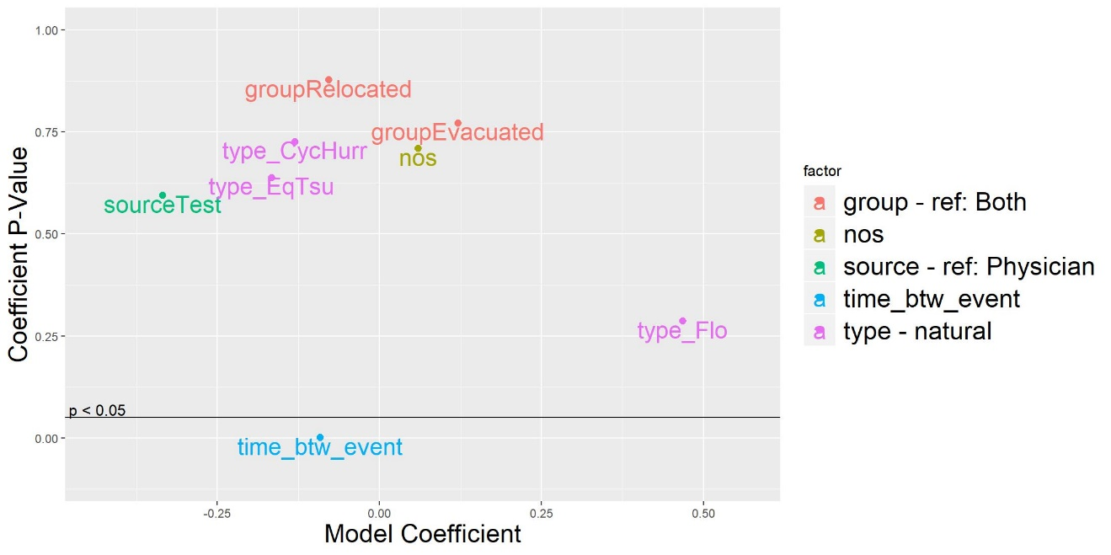
Meta-Regression of Emergency Factors
The study characteristics were evaluated in individual models and results were aggregated across the health outcome to compare model coefficients and p-values
P-value less than p=0.05 indicates “statistical significance”, or strong evidence that the model coefficient is different from zero
Model coefficients less than zero indicate a negative association with effect size
Model coefficients greater than zero indicate a positive relationship with effect size

Slide 17
Results and Findings
Non-Radiological Health Consequences from Evacuation and Relocation

Slide 18
Summary of Odds Ratio Findings
Displaced individuals more likely to suffer from negative health effects
“All Health Effects” is estimated at OR=1.49
  Study aggregate across all disaster and health effect types
  Evacuation and relocation are related to a greater likelihood of experiencing a negative health outcome
Outcome | Odds Ratio | Confidence Interval | Significant (95% level)
Anxiety | 1.29 | (0.84, 1.97)
Depression | 2.50 | (1.87, 3.35) | Yes
Diabetes | 1.19 | (1.08, 1.32) | Yes
General Health Effects | 1.94 | (1.14, 3.30) | Yes
Healthcare Accessibility Problems | 2.04 | (0.81, 5.18)
Heart Disease | 1.07 | (0.88, 1.31)
Mortality | 1.76 | (1.49, 2.09) | Yes
PTSD | 1.73 | (1.23, 2.42) | Yes
Psychological Distress | 1.68 | (1.19, 2.38) | Yes
Respiratory Problems | 1.48 | (0.96, 2.30)
Sleep Problems | 1.63 | (1.53, 1.74) | Yes
Substance Abuse | 1.11 | (0.97, 1.27)
Weight Problems | 1.43 | (1.17, 1.75) | Yes
Other Effects | 2.86 | (1.81, 4.52) | Yes
All Health Effects | 1.49 | (1.24, 1.79) | Yes

Slide 19

PTSD Meta-analysis
Displaced individuals were more likely to experience PTSD, with an overall average odds ratio of 1.73
Reflected in a large disparity in the overall prevalence of PTSD in the displaced (right) and nondisplaced populations (p=0.15, not pictured)
However, PTSD prevalence is high in both groups
PTSD is nearly inevitable among a population following man-made or natural emergencies whether or not there was an evacuation event (Neria, 2008)

Slide 20
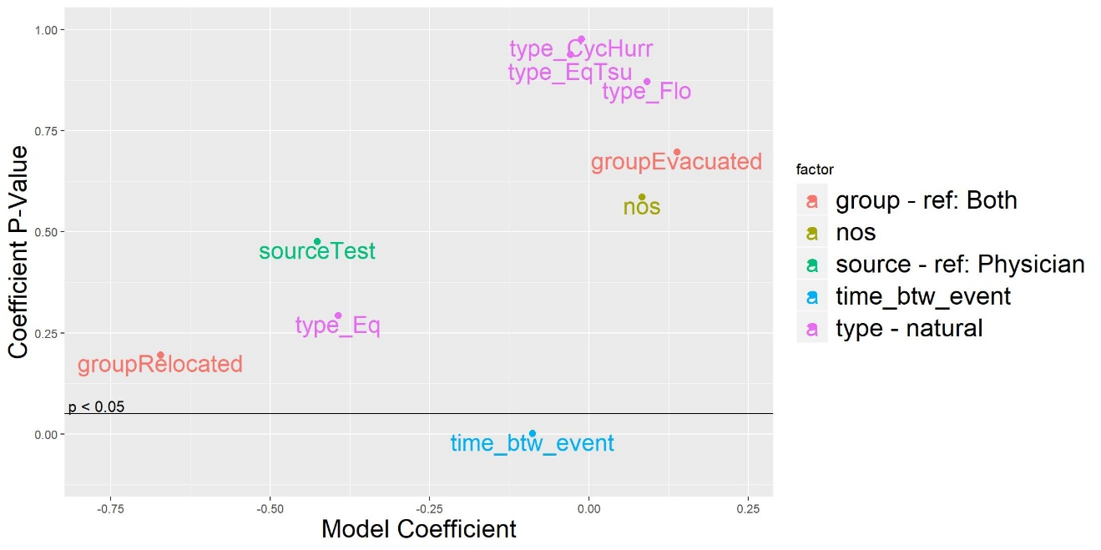
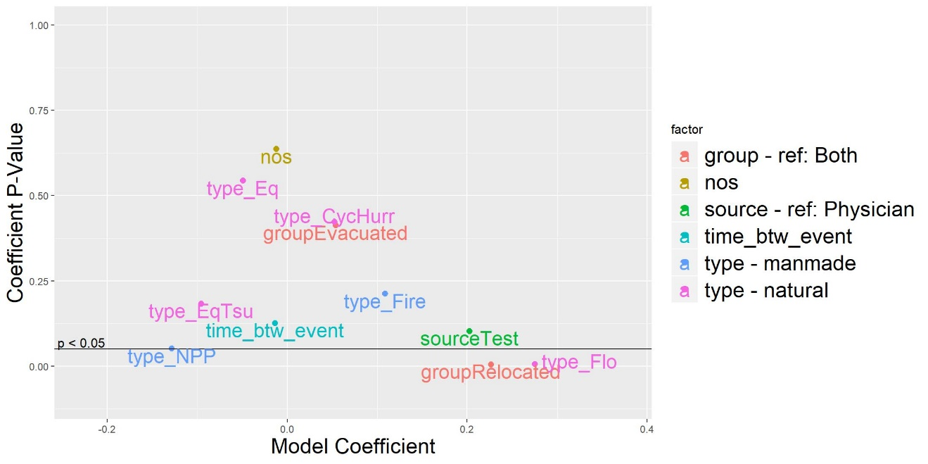
PTSD Meta-regression
Only one statistically significant variable was identified in the odds ratio analysis
Time between the emergency event and the data collection
Displaced population only―
Relocation and flood events both associated with higher prevalence of PTSD
Nuclear power plant accidents were not significant at the p<0.05 level but were associated with lower prevalence of PTSD

Slide 21
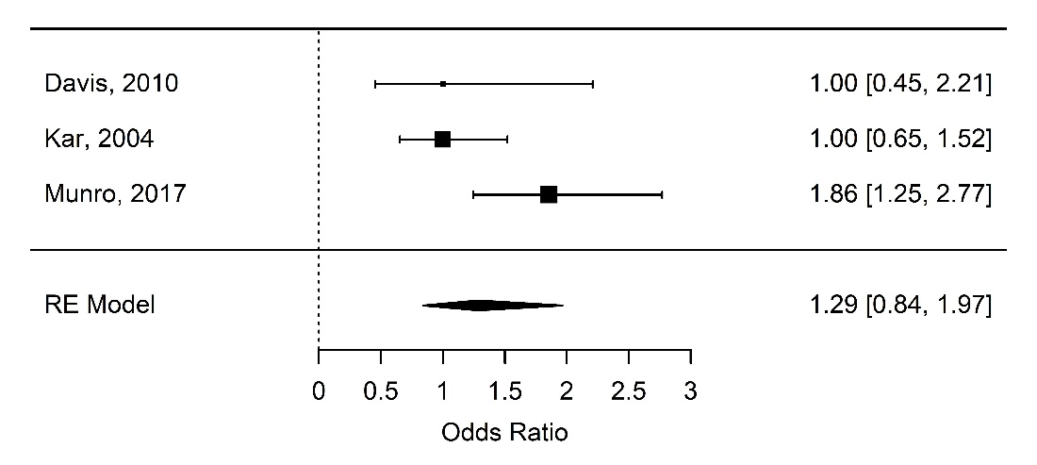
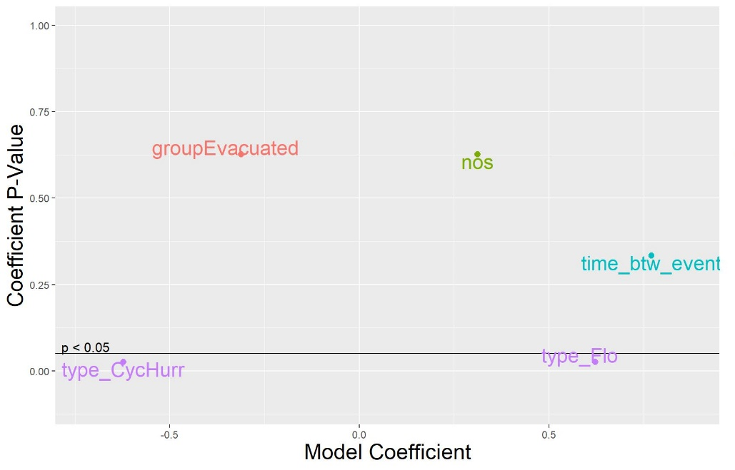
Anxiety Results
Small number of studies directly compared displaced and non-displaced individuals with anxiety
Displaced individuals were more likely to experience anxiety
Not statistically significant
Emergency event type was significantly association with the anxiety outcome
Floods associated with higher anxiety
Hurricanes associated with lower
Anxiety following emergency events is mediated primarily by exposure to the traumatic event itself, rather than to factors related to evacuation (Davis, 2010)

Slide 22
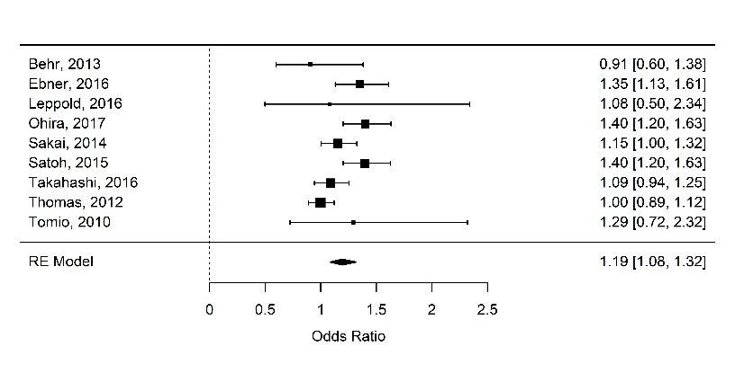
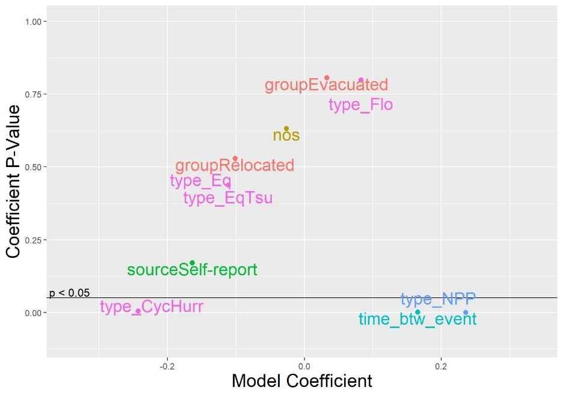
Diabetes Results
Small but statistically significant result
Displaced populations more likely to suffer diabetes after a disaster
Studies did not necessarily distinguish new cases of diabetes from diabetes that pre-dated the emergency event
A higher odds ratio was associated with two factors:
Greater times between the event and when the data was collected
Nuclear power plant disasters
Nuclear power plant disaster data came from 2011 Fukushima incident
Increased incidence of diabetes in evacuated groups could be caused by changes in diet and lifestyle that accompanies prolonged displacement

Slide 23
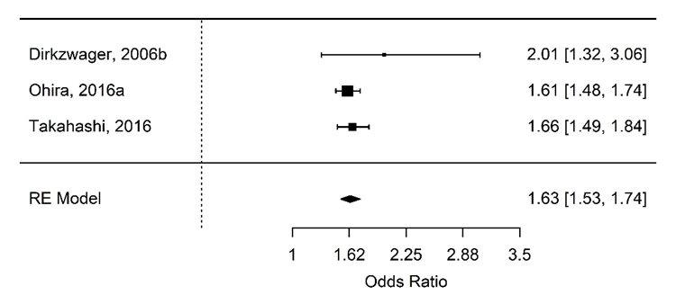
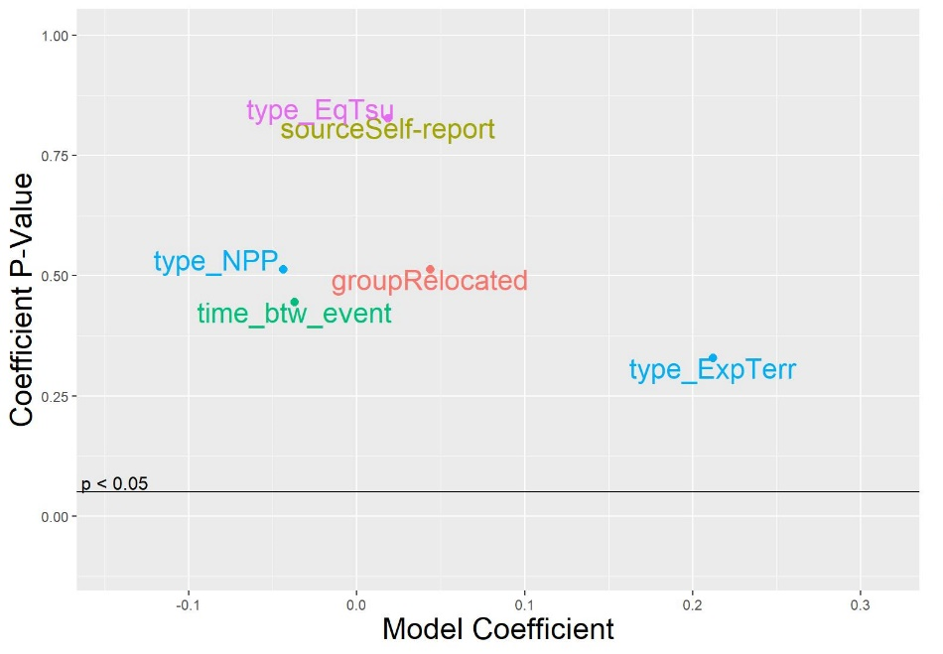
Sleep Problems
Displaced populations reported more sleep problems
Likely a causal relationship between displacement and sleep problems as evacuees cope with the stress reactions and are anxious to return home
No individual variables were significantly associated with observed sleep problems
Several at-risk groups or other potential factors that could be driving sleep problems
Children between 4 and 12 had the largest increase in sleep problems
Analysis of sleep problems difficult because people cannot reliably report the quality of their sleep

Slide 24
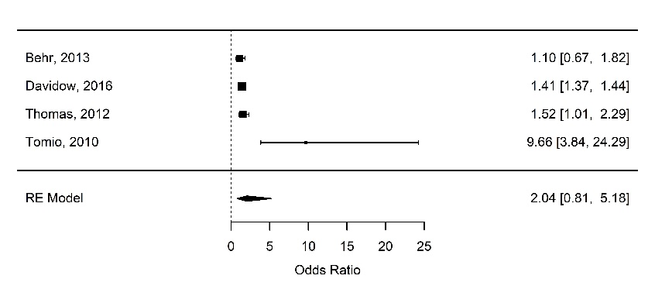
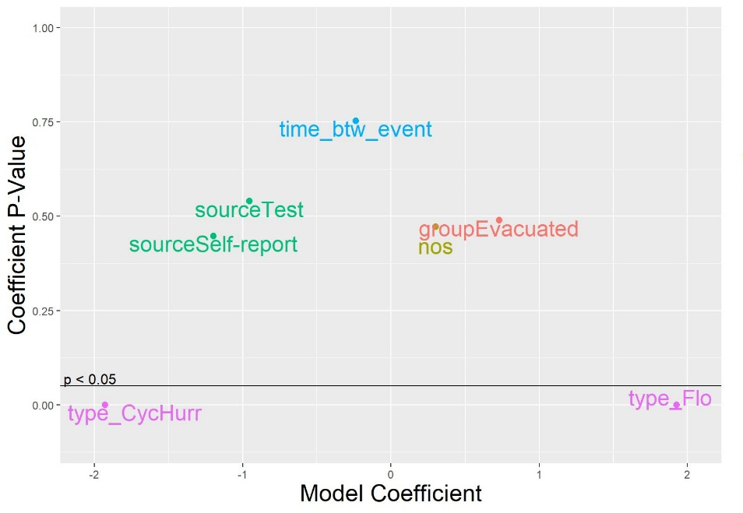
Healthcare Accessibility Results
Odds ratio > 2 but not statistically significant
Displaced populations suffer from significant accessibility problems
General awareness about this issue may lead to mitigation efforts
Both displaced and non-displaced populations struggled with healthcare accessibility after major emergency events
Floods were associated with higher odds ratios while hurricanes and cyclones were associated with lower odds ratios
Result fairly expected as hurricanes typically have longer notice periods, giving emergency managers time to prepare
Floods are typically no-notice or short-notice events, may not see same effect

Slide 25
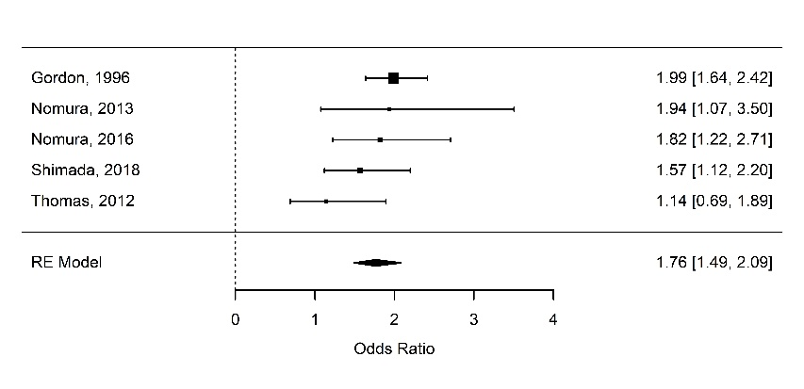
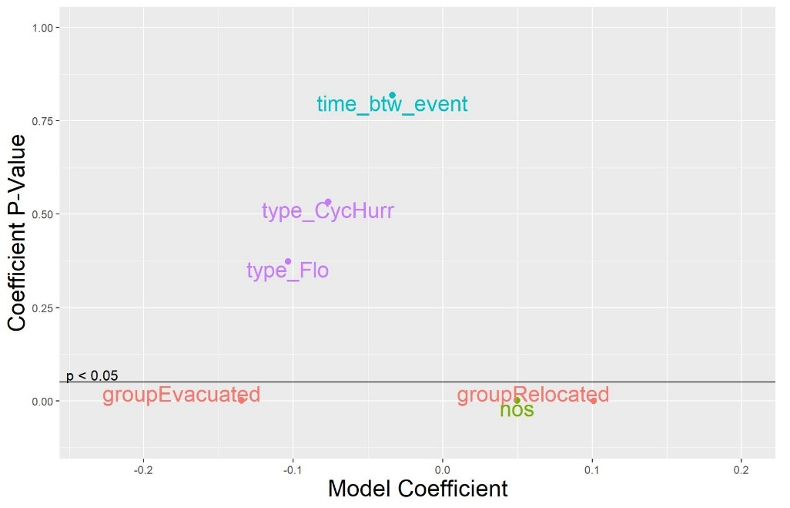
Mortality Results
Displaced populations suffered higher mortality, particularly in the first 60-90 days after displacement
Data includes deaths during evacuation of hospitals, elderly care or nursing facilities, and at admittees at a hospital
Meta-regression of the odds ratio effect size found no significant factors associated with mortality
Meta-regression of the prevalence effect size:
Evacuation score associated with slightly lower mortality
Relocation associated with slightly higher mortality
* Meta-regression on the prevalence of mortality

Slide 26
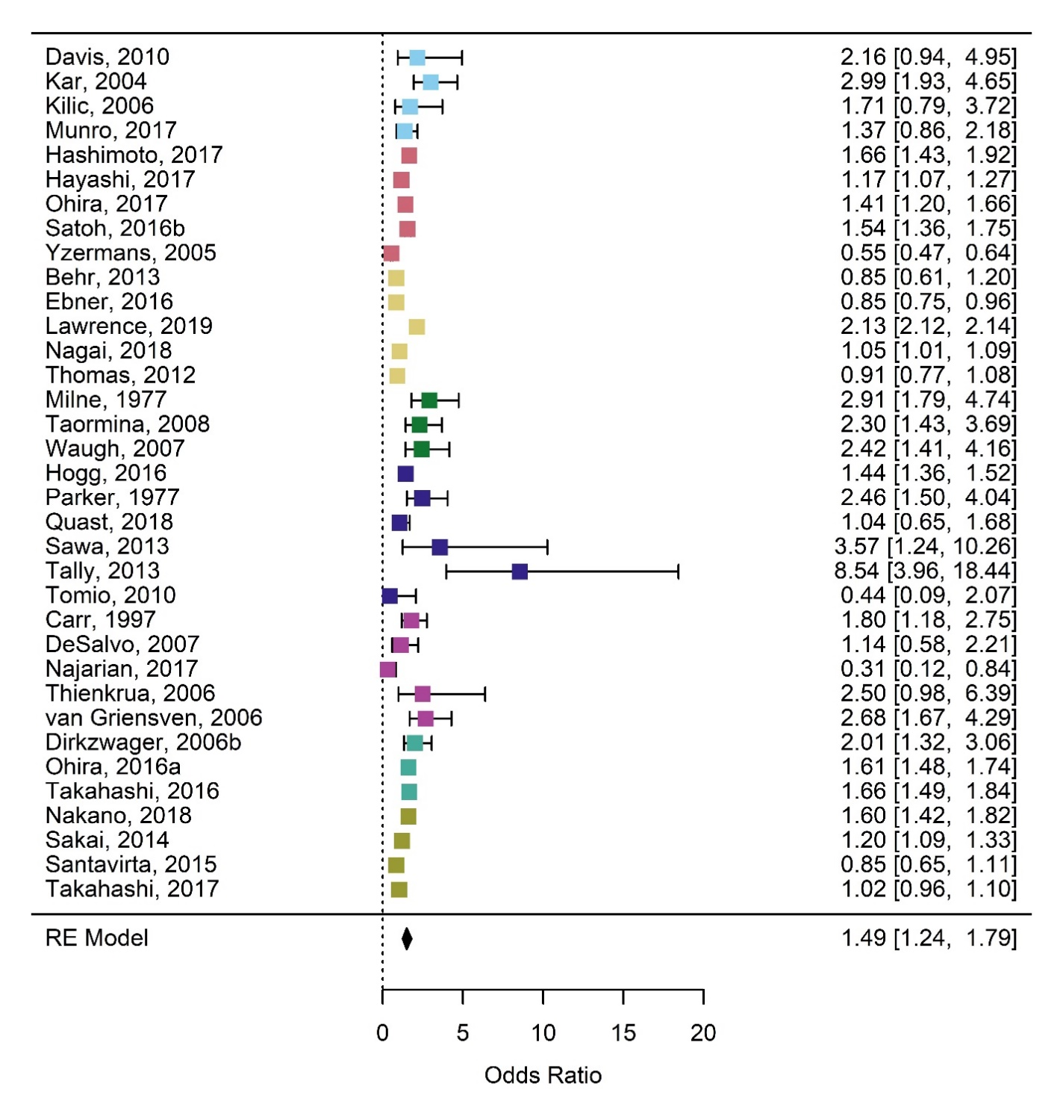
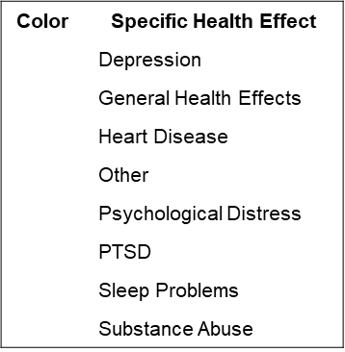
Overall Health Effects

Slide 27
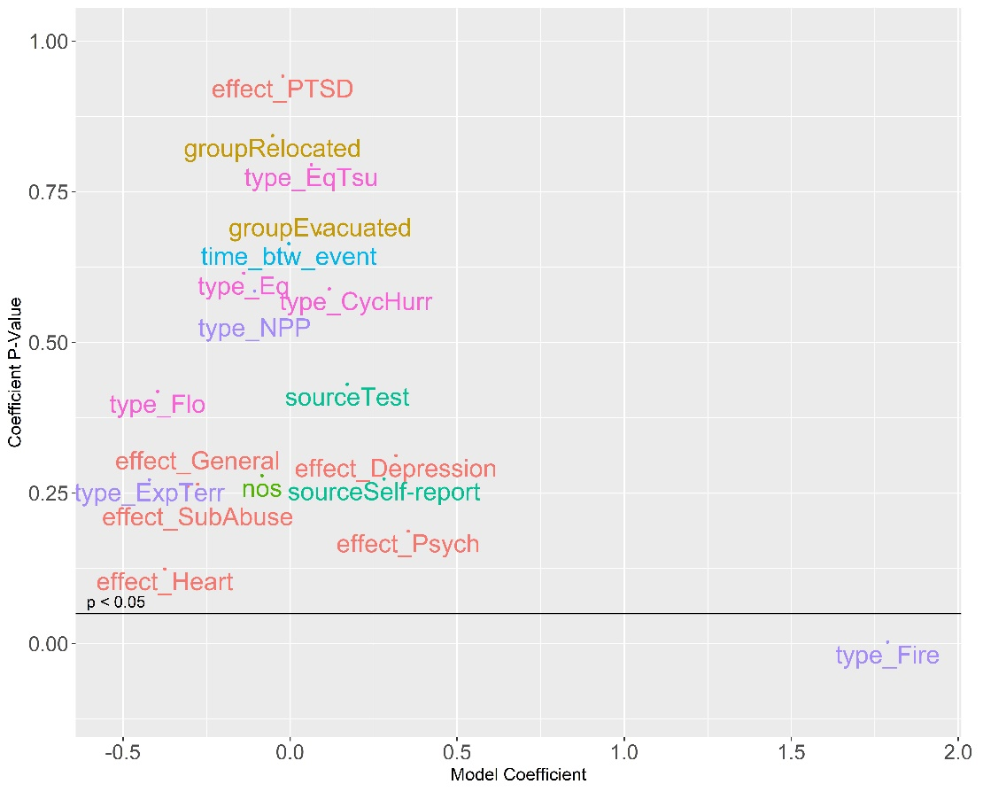
Overall Health Effects Meta-Regression
Meta-regression analysis includes meta-analysis health effects and event factors
Fire emergency events associated with higher odds ratio
  Includes psychological distress health effect
  Similar association not found for radiological events
Shows relative association by health effect type
  Greater than zero: depression and psychological distress
  Less than zero: general health effects, substance abuse, heart disease

Slide 28
Analysis of Estimated Magnitude of Effect
There are limitations to the real magnitude of each health effect –
  Directly comparing odds ratios tells us little about the total number of people who might be adversely affected by an ordered evacuation
  A risk difference analysis was performed to examine and compare the magnitude of the aggregate effect sizes across all the different health outcomes
Use estimated effect sizes to solve for estimated number of individuals reporting the health effect after displacement
Estimate difference between displaced and nondisplaced affected individuals

Slide 29
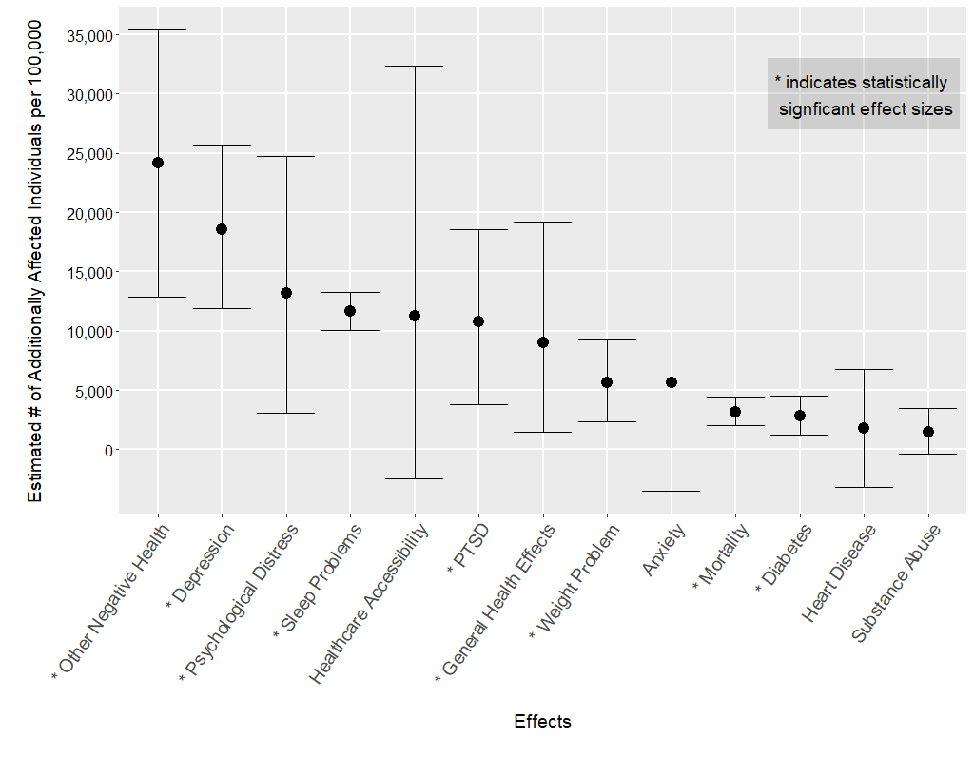
Analysis of Estimated Magnitude of Effect

Slide 30
Conclusions
Non-Radiological Health Consequences from Evacuation and Relocation

Slide 31
Major Conclusions
Data demonstrates a clear relationship between evacuation/relocation and an increase in expected deleterious health effects
  Both physical and behavioral/psychosocial
  Correlated, but causation has not been established for all effects
Nearly 25,000 additional people per 100,000 displaced suffer from ‘other health effects’
  Disruption of social support networks, increase in domestic abuse, memory problems in children, etc.
Evacuation and relocation results in substantial and statistically significant increases in PTSD, depression, psychological distress, sleep problems, and mortality.
  All health effects showed an increase among displaced populations, and most were statistically significant

Slide 32
Application of Findings
Estimated magnitudes cannot be used to directly estimate harm to individuals
  Many persons may be suffering more than one health effect
  Nearly all datasets incorporate at least some special population
Estimated magnitudes can risk-inform protective action decision-making to balance the radiological risk
Health Outcome (Odds Ratio) | Percentage of Studies with Special Populations | Special Populations Included
Anxiety | 0%
Depression | 29% | Children
Diabetes | 11% | Elderly
General Health Effects | 18% | Elderly, Males
Healthcare Accessibility | 25% | Elderly
Heart Disease | 22% | Elderly
Mortality | 80% | Hospital Patients, Nursing Home Residents
Other | 25% | Low-educated Mothers
Psychological Distress | 20% | Children, Hospitalized Patients
PTSD | 30% | University Students, Children
Respiratory Problem | 25% | Elderly
Sleep Problems | 0%
Substance Abuse | 13% | Children
Weight Problem | 0%

Slide 33

Questions
Acknowledgement
Nonradiological Health Consequences from Evacuation and Relocation
Gryphon Scientific
T. Adams, L. MacMillan, R. Casagrande, M. Osborne
Public Health Consultant
L. Huff
Amy Sharp
amy.sharp@nrc.gov
(301) 415-0960

