Slide 1
Origin of Accident Source Terms used in SNAP/RADTRAD for Light Water Reactors
November 3, 2022
Michael Salay
Nuclear Regulatory Commission
Notes:
About the Image: A Glass From the Past
While taking a closer look at ancient glass to better understand how it changed over time, Pacific Northwest National Laboratory scientists made an unexpected discovery-the remains of bacteria that once lived on the surface. PNNL researchers and collaborators are delving into the past to further their knowledge about the stability of glass that will be used to safely store low-activity nuclear waste at the Hanford Site. With support from the Department of Energy's Office of Environmental Management, International Programs through the Office of River Protection, they are analyzing this glass found in Swedish hillforts that predates the Vikings because it has a chemical composition similar to what will be produced at Hanford's Waste Treatment and Vitrification Plant and has been "stored" in a known environment for more than 1,500 years.
Research team: David Peeler, Bruce W. Arey, Carolyn I. Pearce, Tamas Varga, Micah D. Miller, Michele Conroy and Michael J. Schweiger (all of PNNL); John S. McCloy (Washington State University); Jamie L. Weaver (National Institute of Standards and Technology); Edward Vicenzi and Thomas Lam (Smithsonian Institution's Museum Conservation Institute); Rolf Sjoblom (Tekedo AB); Eva Hjarthner-Holdar and Erik Ogenhall (Arkeologerna); and Albert A. Kruger (Department of Energy Office of River Protection). The image was colorized by Nathan Johnson (PNNL).
Instrument: Scanning electron microscope and focus ion beam hybrid
https://www.flickr.com/photos/pnnl/24220123368/in/photolist-fqwiqF-aBF44N-fqwj9R-aEuQHd-CUfsRW-pZVLNL-aPjNkZ-fxBosi-aErWsK-aBCnZk-ECMqka-aEr4hT-6yL625-6xvZrp-6xh38v-6xmeiY-VNqjUa-CJUXKp-CPUyAo-25kubq5-BUPMLB-211nysv-Chikdn-Cq6fRm-BscBWe-CnhkRJ-CiHawx-CPUwEu-BUGK7J-CiHawn-BUPKMg-CGEBLY-BUGHTw-CJV1jx-CPUxnw-CSdgpF-CSdj4D-CJUWi6-CPUwFm-BXsubh-CPUxJd-CiHdVB-BUGG5b-BUGHYm-22DixCm-243ex8R-Cq6jHQ-CGEzzy-PEd3HJ-P9S5sd

Slide 2
Regulatory Guide 1.183
NRC staff developed RG 1.183 Rev. 0 (July 2000) to support implementation of 10 CFR 50.67, “Accident source term”
  RG 1.183 Rev. 0 identified the significant attributes of an acceptable accident AST based on NUREG-1465, “Accident Source Terms for Light Water Reactors”
  Replaces older TID-14844
Footnote to 10 CFR 100.11(a)) Reactor Siting
  A performance-based rule to evaluate the defense-in-depth provided by the containment
This presentation provides some of the background and evolution of the Containment Source Term

Slide 3
Definitions of the Source Term
Release of radionuclides to the environment
  Important for the analysis of risk and emergency preparedness
  Considered in the SOARCA project & Site Level 3 study
Release of radionuclides to the reactor containment
  Used in the licensing process
    Site suitability
    Control room habitability
    Equipment qualification

Slide 4
Regulatory Requirements
Hypothesize significant radionuclide release to containment (10CFR50.67)
  Consistent with substantial core melting
Defense-in-depth measure to assess containment, engineered safety features and siting
  Applicant or licensee assesses doses to site boundary, control room, etc.
Notes:
Part 50.67
(i) An individual located at any point on the boundary of the exclusion area for any 2-hour period following the onset of the postulated fission product release, would not receive a radiation dose in excess of 0.25 Sv (25 rem)² total effective dose equivalent (TEDE).
(ii) An individual located at any point on the outer boundary of the low population zone, who is exposed to the radioactive cloud resulting from the postulated fission product release (during the entire period of its passage), would not receive a radiation dose in excess of 0.25 Sv (25 rem) total effective dose equivalent (TEDE).
(iii) Adequate radiation protection is provided to permit access to and occupancy of the control room under accident conditions without personnel receiving radiation exposures in excess of 0.05 Sv (5 rem) total effective dose equivalent (TEDE) for the duration of the accident.

Slide 5
Source Term History
Release to the containment
TID-14844 (same for PWR & BWR) 1962
  Derived from heating irradiated fuel in a furnace
  Physical categorization of radionuclides releases
    Noble gases
    Gaseous iodine
    Particles (aerosols)
  Promptly available in containment
Reactor Safety Study (WASH 1400)
NUREG-1465 (alternative source term)
Notes:
Most of the currently operating power reactors in the USA were designed and licensed based on the so-called “TID-14844 source term”[1].
This source term was based on results of experiments involving the heatup of irradiated fuel fragments in a furnace. Releases to the containment prescribed by the TID-14844 source term are as shown
Radioactive Element Percent of initial core inventory released to the containment Physical form of the released material
Noble gases (Xe, Kr) 100 % gas
Iodine 50 % gas
All others 1 % aerosol particles
- The source term was assumed to be instantly available in the containment.
Half the iodine was assumed to deposit in route to the containment.
The source to the environment was found assuming the design basis leakage rate for the containment and attenuation of the radioactive material available for release by engineered safety features (sprays, suppression pools, ice beds, etc.) of the plant.

Slide 6
Source Term History
Release to the containment
TID-14844 (same for PWR & BWR)
Reactor Safety Study (WASH-1400) 1975
  First systematic attempts at defining a mechanistic source term dependent on accident conditions
  Not used in the regulatory process
  MARCH computer code
NUREG-1465 (alternative source term)

Slide 7
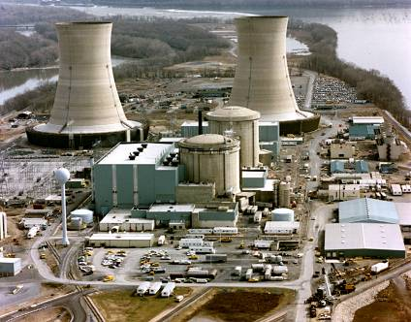
Source Term History
(continued)
The accident at TMI (1979) changed perceptions
  Severe accident possible
  Source term different
Nuclear Regulatory Commission asked for a better, more realistic source term
NRC Research initiated a major initiative to develop a mechanistic source term
  Tie to risk important accidents – not DBAs
  Eventually more than $500 million spent
Notes:
Following the accident at Three Mile Island, it was evident that radionuclide release did not closely follow the pattern that might be expected based on the TID-14844 source term.
Pressure arose from the nuclear industry for a more realistic source term.
The Commission asked the Office of Regulatory Research if it could define a more realistic source term and if that source term would be smaller than that used for reactor licensing.
The Office of Regulatory Research reply [2] was that insufficient data were available for defining a more realistic source term, but that it was possible to obtain the needed data and provide such a definition.
The Office was directed by the Commission to undertake the required research.

Slide 8
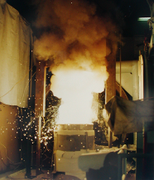
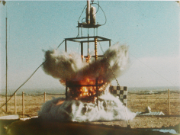
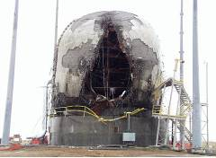
NRC Severe Accident Source Term Research
Massive undertaking to understand
  Accident progression within RCS
    In-pile tests (PBF, ACRR, DF, FLHT, etc.)
  Ex-vessel phenomena
    Melt-concrete interactions
    Steam explosions
    Hydrogen combustion
  Fission product chemistry
    Deposition in RCS
    Aerosol physics
  Containment integrity
Notes:
Examples of SA out-of-pile and in-pile research undertaken by NRC Research
Accident Progression: PBF – INEEL, Idaho; ACRR – Sandia; DF – Sandia, FLHT –
MCCI – SNL, ANL
Steam explosion – SNL, Univ. of Wisconsin,
Hydrogen – BNL
DCH – SNL, ANL, Purdue University
FP chemistry: ACRS ST (SNL), HI-VI (ORNL)
Containment integrity: SNL

Slide 9
Culminated in
Alternate Source Term for licensing
  NUREG-1465
NUREG-1150 Level III risk analysis of five representative US nuclear power plants
  3 PWRs
  2 BWRs
Integrated, systems-level, accident analysis computer code to preserve understanding
  Initially, Source Term Code Package
  Later MELCOR
Notes:
The research on the reactor accident source term led to the development of the STCP. This was a suite of “stand-alone” computer codes linked together to mechanistically predict for a variety of accidents the source term to the reactor containment and the attenuation of the inventory of radionuclides in the containment as a result of natural and engineered processes.
This first phase of the NRC’s study of mechanistic reactor accident source terms culminated in the publication of improved source terms for use in regulatory processes (NUREG-1465) and publication of level III analysis of accident risks at representative US nuclear power plants (NUREG-1150).
TMI-2 accident >> 1979
NUREG-1150 >> published in 1990
NUREG-1465 >> published in 1995

Slide 10
Source Term History
Release to the containment
TID-14844 (same for both PWR & BWR)
Reactor Safety Study (WASH-1400)
NUREG-1465 (alternative source term)
  Based on NUREG-1150 and research done following Three Mile Island accident
  Distinct releases for PWRs and BWRs
  Chemical categorization of radionuclides
  Four phases of release and release timing
  Source Term Code Package
  First two phases used for AST and the regulatory process

Slide 11
Alternate Source Term
Timing based on four accident phases in BWRs and PWRs separately:
  Gap release (clad ballooning and rupture)
  In-vessel release (core degradation)
  Ex-vessel release (melt/concrete etc.)
  Late in-vessel release (revaporization)
Release magnitudes based on mechanistic analysis of important accident sequences for many plants
  8 chemical groups of fission products
  Most aerosol
  5% of released iodine gaseous
Notes:
NUREG-1465 is used for Design Based source term evaluation of

Slide 12
NUREG-1465 Source Term
Phases of release
  Starts 30 to 45 seconds after accident initiation
  Gap release – associated with venting the inventory from the fuel/cladding gap
  In-vessel release – associated with core degradation
  Ex-vessel release - follows vessel penetration by reactor core debris
  Late In-vessel release – revaporization of deposited radionuclides

Slide 13
NUREG-1465 Source Term
Chemical Groups
  Noble gases
  Halogens
    Predominantly metal halide particles (CsI, CdI₂, AgI, etc.)
    5% gaseous iodine (I₂ or volatile organic iodide = RI)
  Alkali metals
  Tellurium Group
  Alkaline earths (Ba/Sr group)
  Refractory metals (Ru, Mo, Pd, etc.)
  Lanthanides
  Actinides (Cerium group)

Slide 14
Alternate Source Term for Licensing PWRs
Fission Product class | Gap 0.5 hr | In-vessel 1.3 hr | Ex-vessel 2 hr | Late 10 hr
Noble Gases | 5% | 95% | ~0 | ~0
Iodine, bromine | 5% | 35% | 25% | 1%
Cesium | 5% | 25% | 35% | 1%
Tellurium | ~0 | 5% | 25% | 0.5%
Ba, Sr | ~0 | 2% | 10% | ~0
Ru, Mo, Pd, etc. | ~0 | 0.25% | 0.25% | ~0
Lanthanides | ~0 | 0.02% | 0.5% | ~0
Cerium group | ~0 | 0.05% | 0.5% | ~0
Notes:
An example of NUREG-1465 ST shown for PWR.
Source terms for use in the regulatory process were developed for generic pressurized water reactors and boiling water reactors.
In both, it is recognized that the release of radioactivity progressed in time.
Accidents are divided into four phases: gap release, in-vessel release, ex-vessel release, and late in-vessel release. The fourth of these phases accounts for the revaporization of radionuclides deposited within the reactor during early phases of an accident.
Release fractions of eight radionuclide groups are prescribed for each of these accident phases.
With the exception of noble gases and iodine, all releases are presumed to be in the form of aerosol particles.
Most of the iodine is presumed to be released to the containment as particulate, but 5% is taken to be gaseous and a fraction of this gaseous iodine is taken to be a volatile organic iodide.

Slide 15
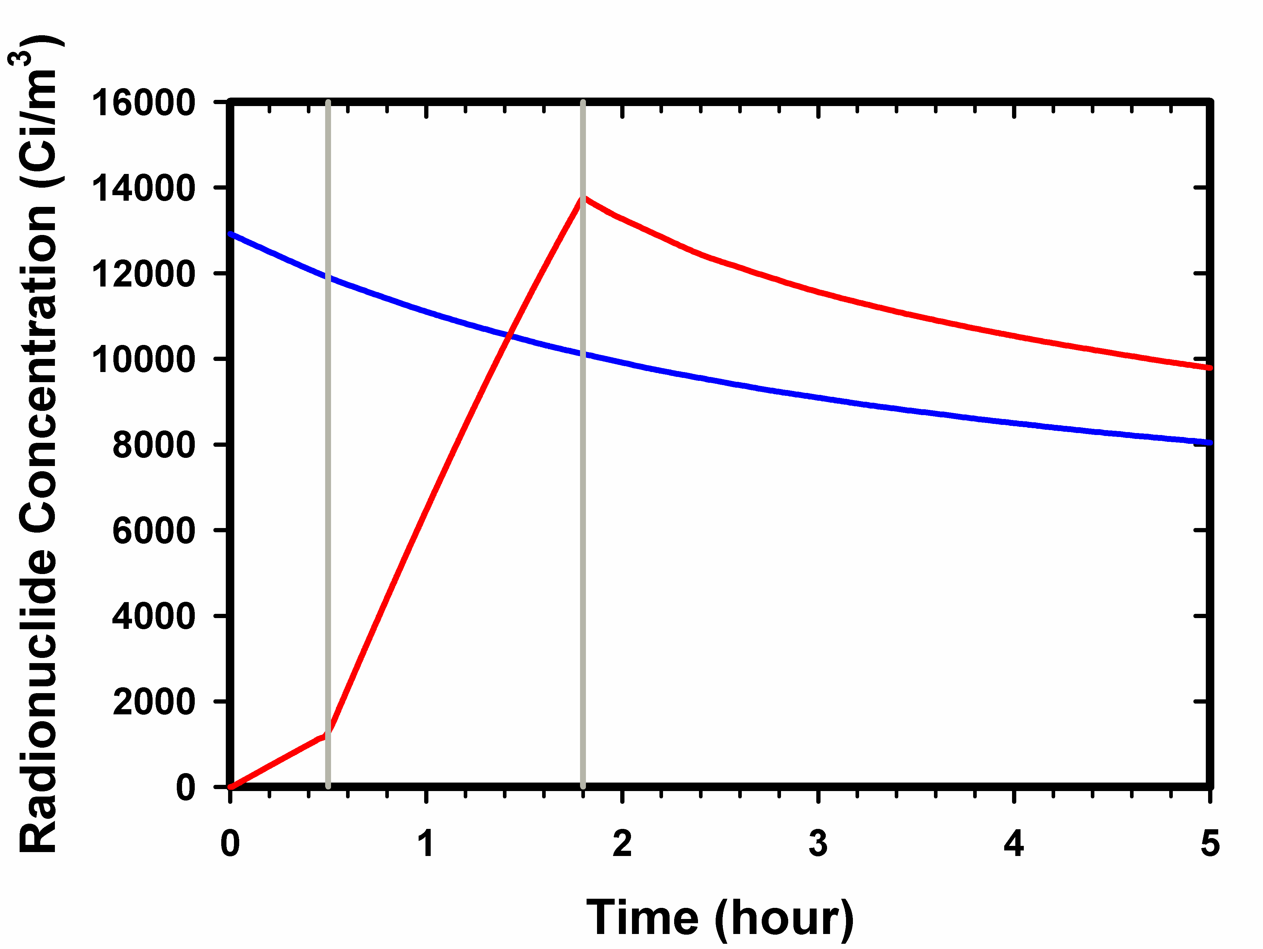
Comparison of
TID-14844 and NUREG-1465
Alternative source
term
Gap Release
TID-14844
In-vessel
Release

Slide 16
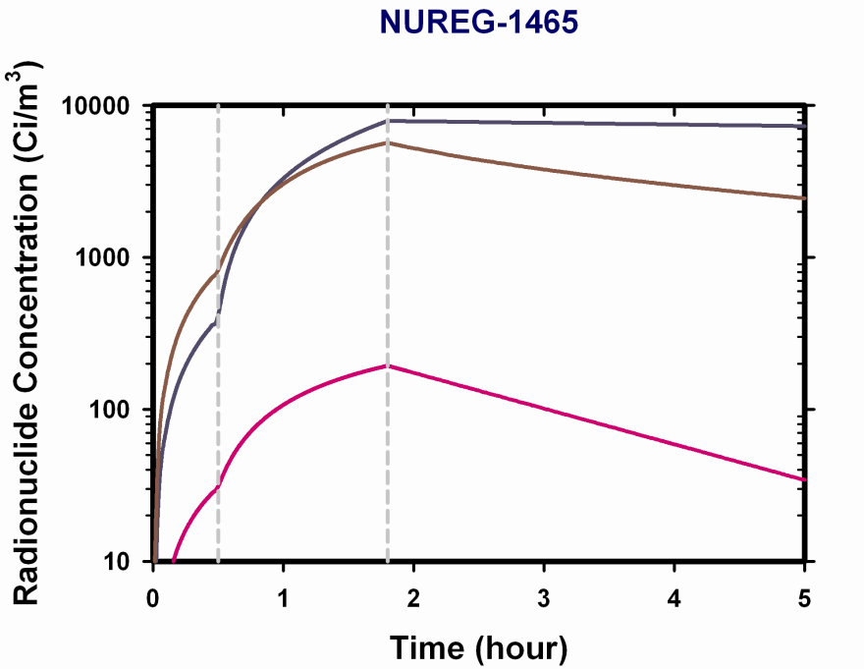
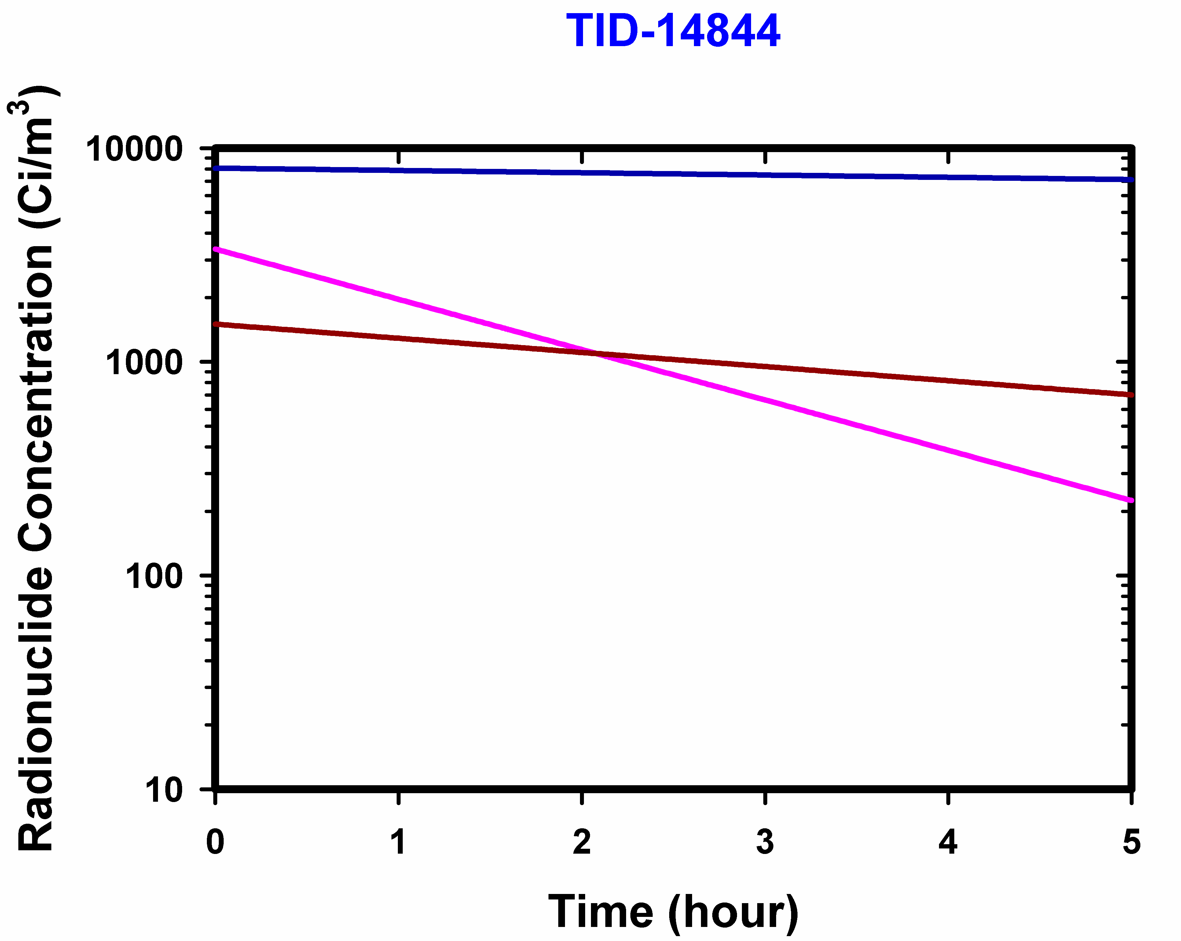
Composition Comparison
Noble Gas
particles
particles
Gaseous Iodine

Slide 17
A Research Climax but not a Conclusion
NUREG-1150 made clear many uncertainties remained
  Estimated release fractions to environment could vary by factors of 10 to 1000
  Source terms adequate for regulatory needs of the time
  As use of PRA and more advanced reactors developed, better source term understanding needed
Notes:
In the intervening years (1979 TMI-2 accident to NUREG-1150 publication in 1989), knowledge on SA and ST increase dramatically (compare to TID-14844)
ST is based on understanding SA phenomenology
Further understanding: PBF, XR, FLHT are expensive integral experiments,
:separate effective experiments to study chemical interactions of different species (Cs, H2O, I, ) in the presence of surfaces (SS, inconel);
combinations are too large to study >>> constantly modifying TRAPMELT
: VICTORIA code: too many chemical species and too many possibilities.
Move from a two-tiers code strategy to a single tier (system level code)
NEED GUIDANCE on what are the KEY CHEMICAL SPECIES that we should model

Slide 18
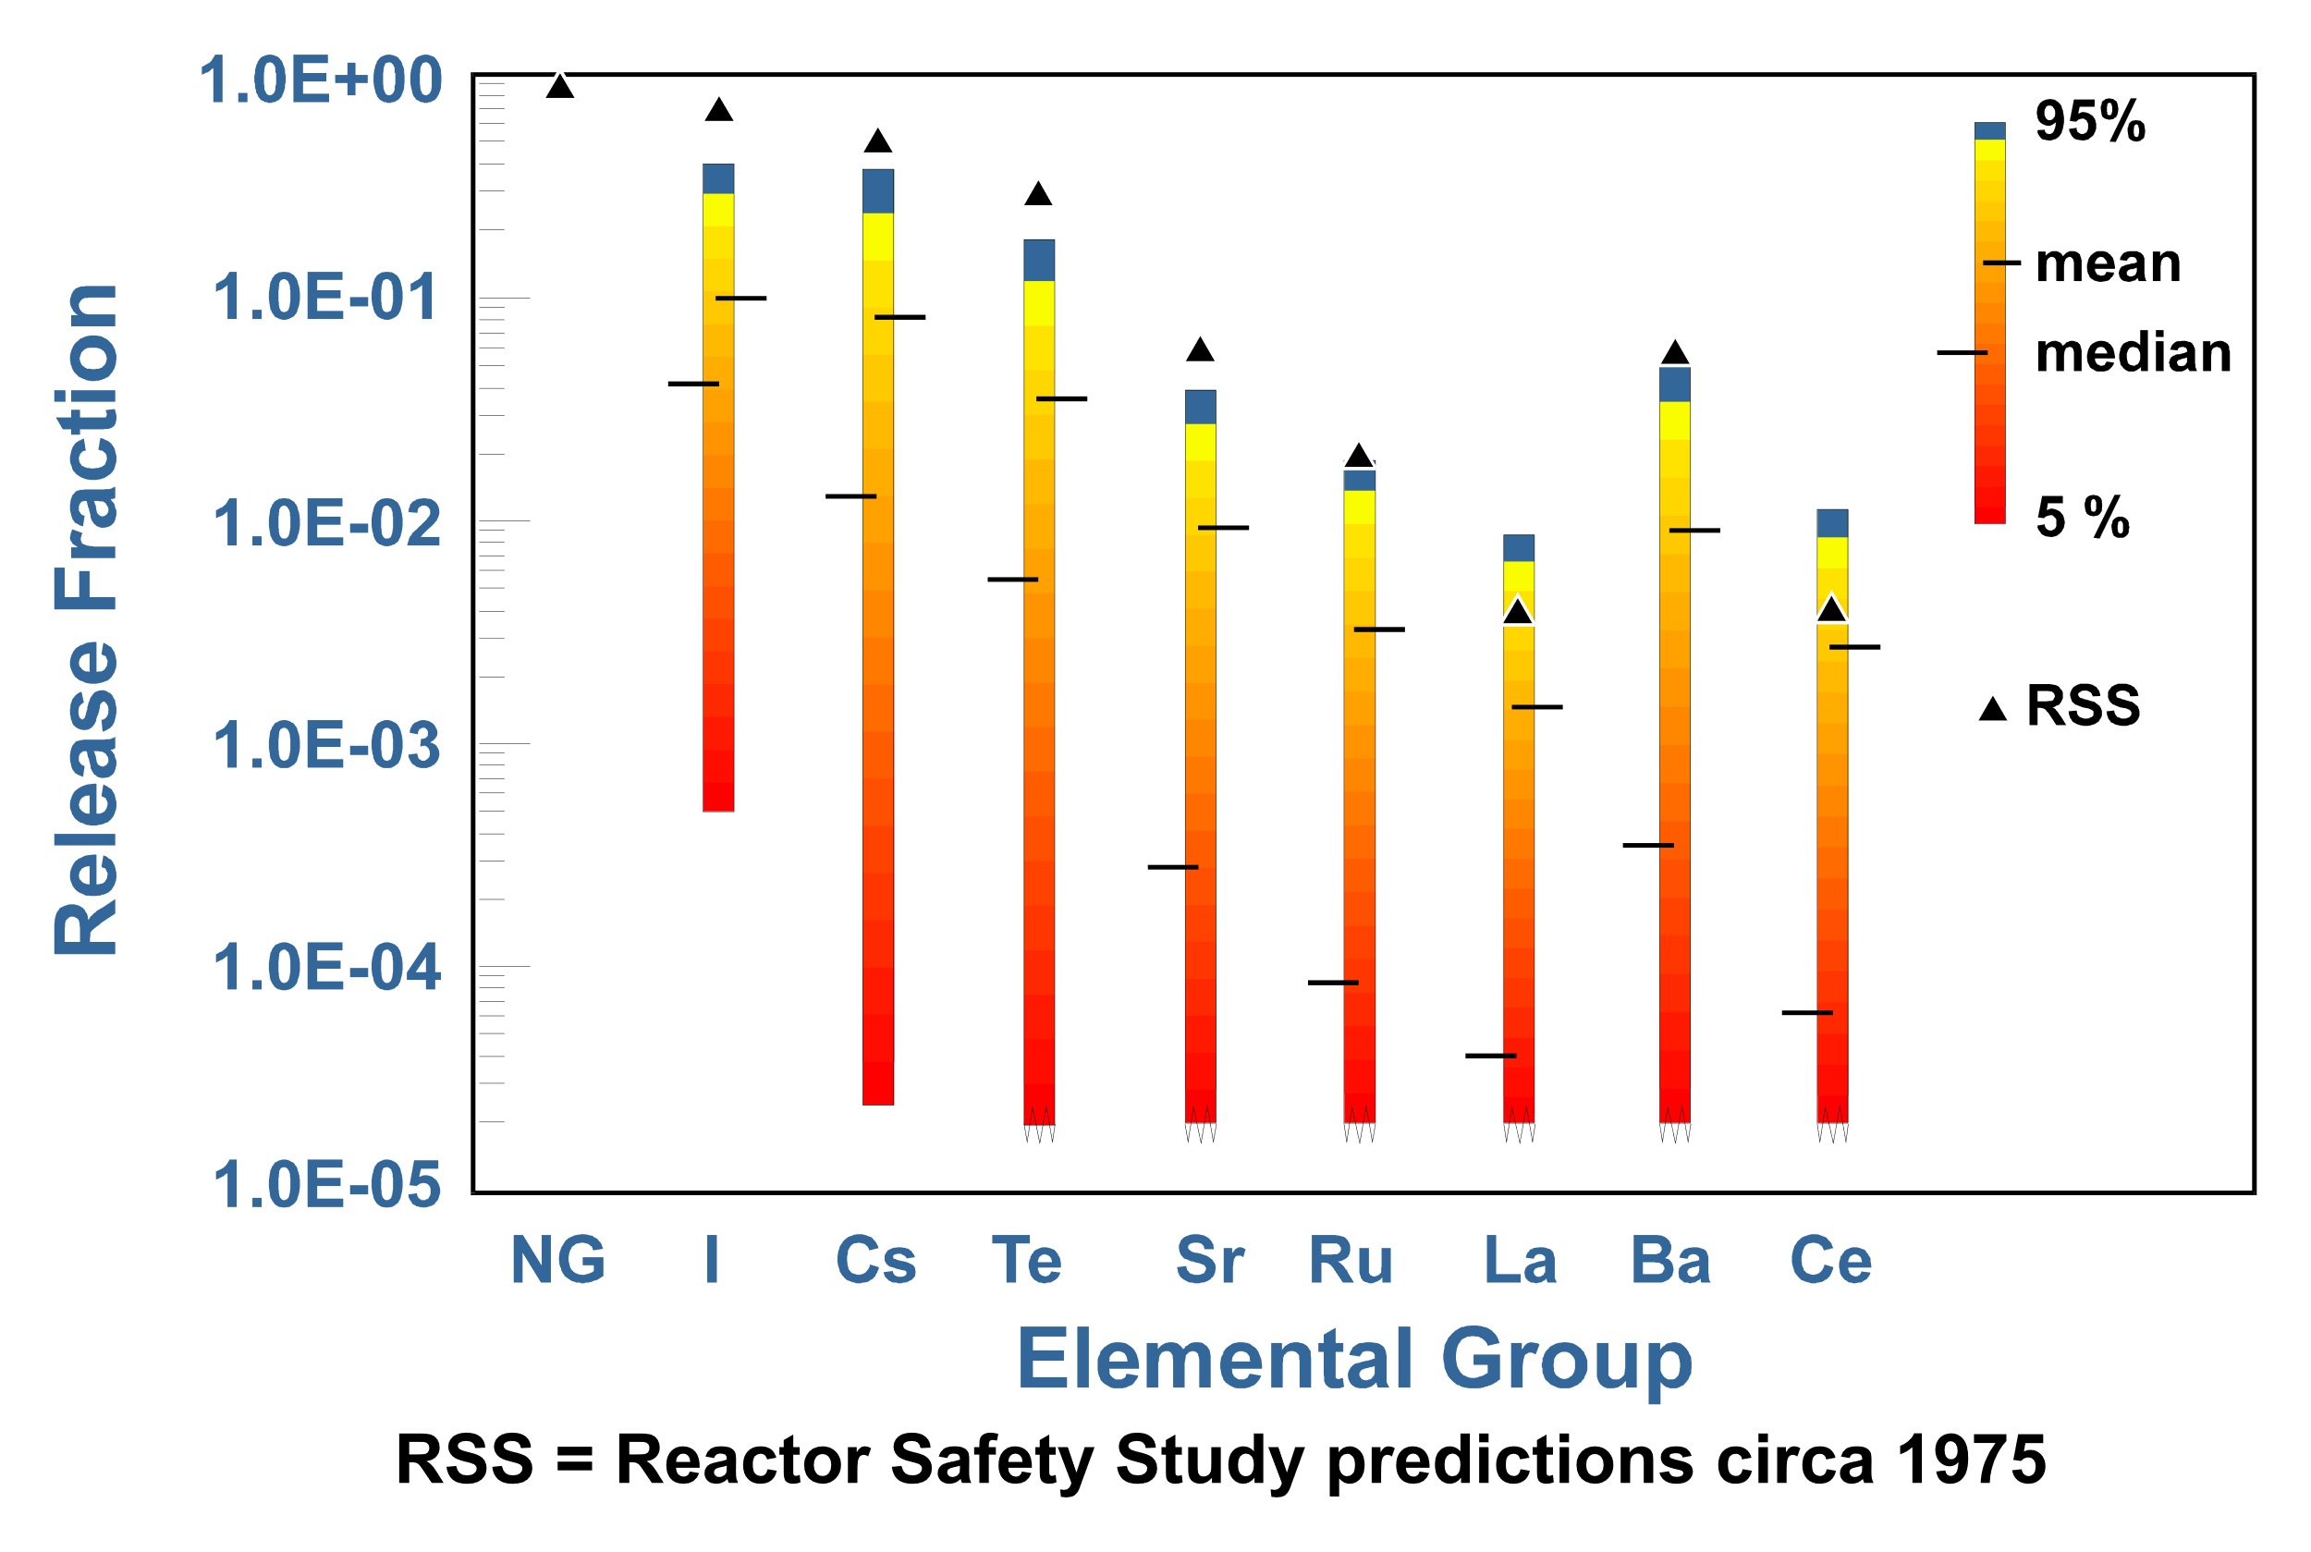
Examples of Radionuclide Release Uncertainties from NUREG-1150
Notes:
In general, WASH-1400 envelop NUREG-1150 95%
(when I changed the yellow text to blue, the top fractile bins also changed to blue since it used the same color)

Slide 19
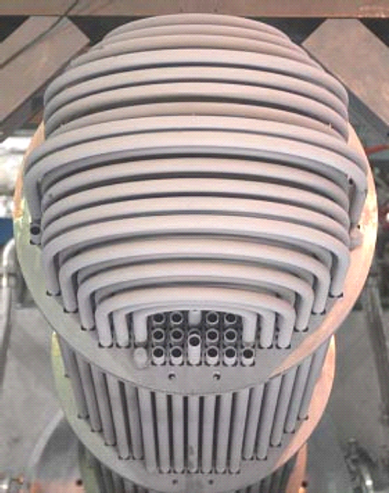
Collaborative Experimental
Research
PHEBUS-FP: realistic FP chemistry in RCS and containment
ARTIST: mitigation of risk dominant accident for PWRs
RASPLAV/MASCA: feasibility of in-vessel retention and FP release in late-stage degradation
Many others: iodine, revaporization, ATF
PreTest
Post Test
Notes:
Phebus-FP: provide guidance on realistic ST (especially on chemical forms) that code should model
ARTIST: Do we get additional attenuation of aerosols in the steam generator secondary side under dry conditions (consideration for SA induced steam generator tube ruptures)
RASPLAV, MASCA: Address in-vessel molten material behavior (and address the question on melt retention)
MCCI: ex-vessel molten melt cooling and attenuation of ST with water.

Slide 20
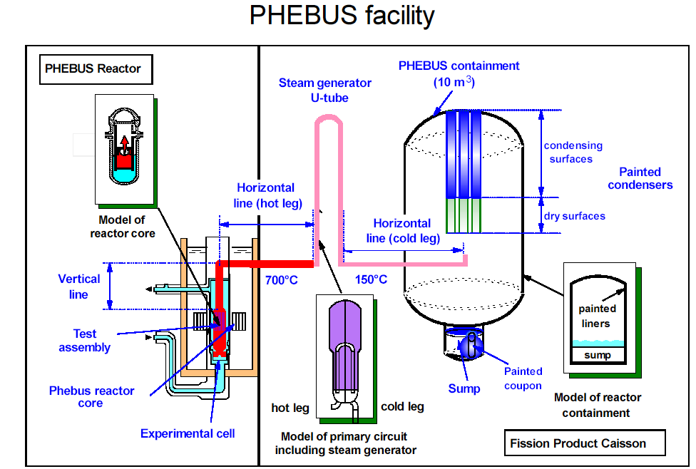
Facility Scaled 1:5000 from a French 900 MW_{e} PWR
Notes:
1/5000 scale >> initial bundle inventory; circuit conc., containment conc.
Containment vessel volume: 10 m3 (353 ft3); surface = 25 m2;
Condenser surface = 1.1 m2/each; (0.78m2 wet, 0.34m2 dry) >>>> simulate cold surfaces of a reactor containment
Sump (120 liter >> 100 liter vol. and 20 liter in the loop)
temp. control (organic liquid loop) >> (1) control vertical wall & ellipical cont. wall (2) condenser and (3) sump wall
Ripolin epoxy paint (EdF)

Slide 21
Comparison of Alternative MELCOR Models
of Cesium Release to Data from PHEBUS test
Validation of the Alternate Source Term for reactor licensing
Notes:
MELCOR different models’ predictions of Cesium release data from Phebus FPT-1 test.

Slide 22
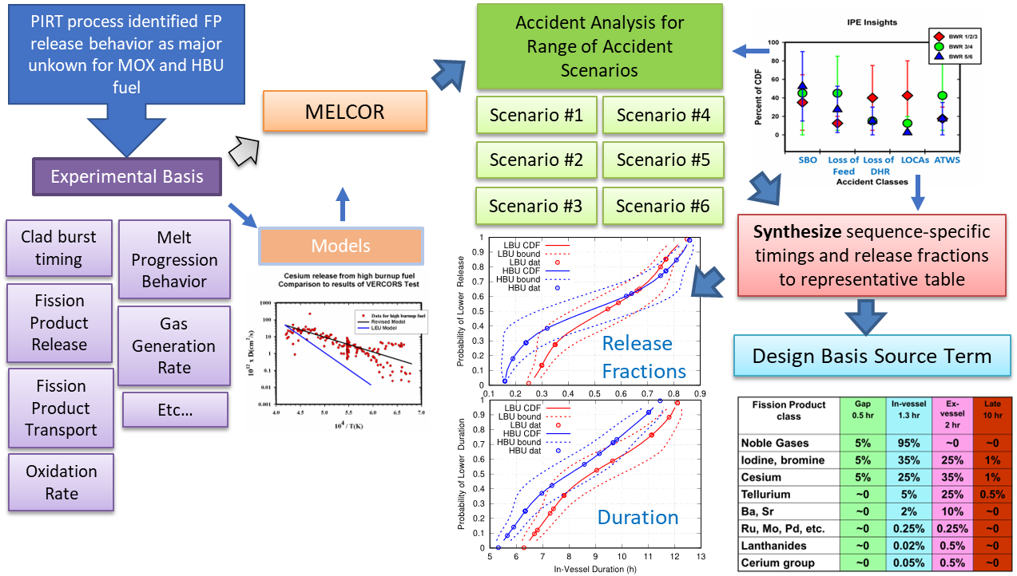
Containment Source Term Development Process

Slide 23
Containment Source Term Use
Licensing calculations typically performed in RADTRAD
  Representative single source term analysis
    Design basis leak rate
    Integrated radioactive decay/activity calculation
  Involves simplified containment decontamination/transport models
    Based on uncertainty analyses with mechanistic codes /models in both sequence and parameters
      Scaled by most influential parameters so that results are facility-specific
      conservative decontamination
    Conservative atmospheric dispersion
    Nominal breathing rates and dose conversion factors
    Liquid
  Facility/license-specific inventories and crediting of SSCs
BWR RADTRAD Model

Slide 24
Final remarks
Update of NUREG-1465 Source Term for High Burnup Fuel
SOARCA, Site Level 3 & Fukushima provide additional insights on release to environment
Other Source Term Challenges being addressed for advanced reactors & new cladding/fuel
  High temperature gas reactor, sodium-cooled fast reactor, molten salt reactor
  Different claddings (FeCrAl, Silicon Carbide) & fuel form (U₃Si₂ ,metallic HEU Zr-U)

