Slide 1

Welcome to the RAMP 2023 Fall User Meeting
'ahlaan bik
Ласкаво просимоs
Welkom
欢迎
Witamy
ברוך הבא
Bienvenidas
benvenuto
어서 오십시오
bienvenu
բարի գալուստ
Benjamin Kellogg
Health Physicist
2023 Fall RAMP Users’ Group Meeting
October 23–27, 2023
Rockville, MD
Notes:
Good morning, good afternoon and good evening,
My name is Benjamin Kellogg. I am the RAMP Program Manager and Welcome to the 2023 Fall RAMP Meeting.
I am here to both welcome you and go over a few housekeeping issues.
Next slide please
20 sec

Slide 2
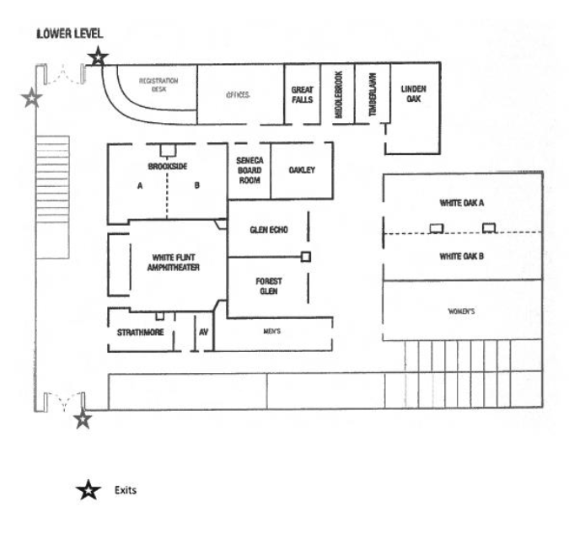
White Flint Amphitheater
In case of Emergency
Notes:
For those of you that are in-house, your safety is paramount.
Please see the four conference rooms that will be utilized through-out the week.
20 sec

Slide 3
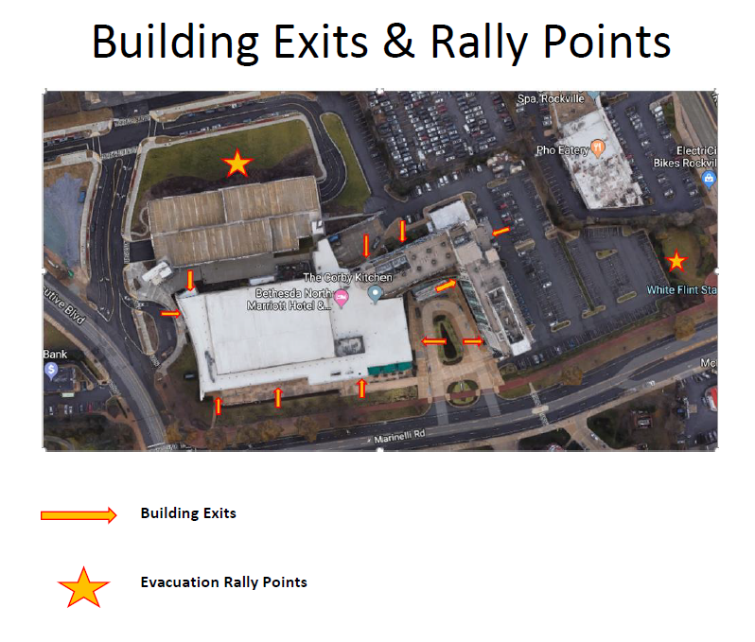
Evacuation Rally Points
In case of emergency
Notes:
Once you are out of the building, the evacuation rally points are here behind the conference hall, and on the opposite side of the parking lot near the main road.
20 sec

Slide 4
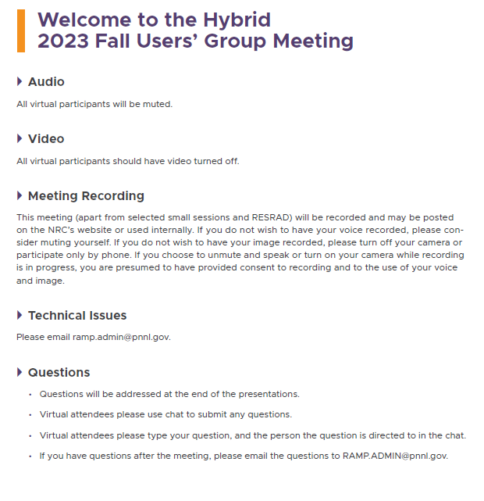
Hybrid Meeting
Notes:
Additionally, this is a hybrid meeting. We have both in-house participants and people attending via Teams
All virtual participants will be muted unless you are presenting, we encourage virtual participants to use the chat function to ask questions during the sessions.
45 sec

Slide 5
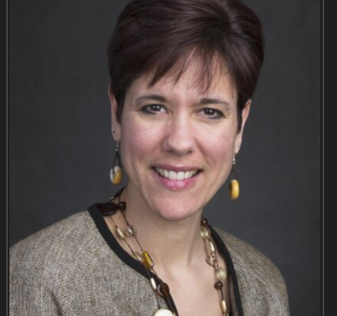
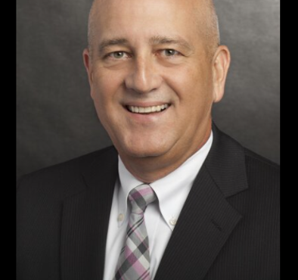
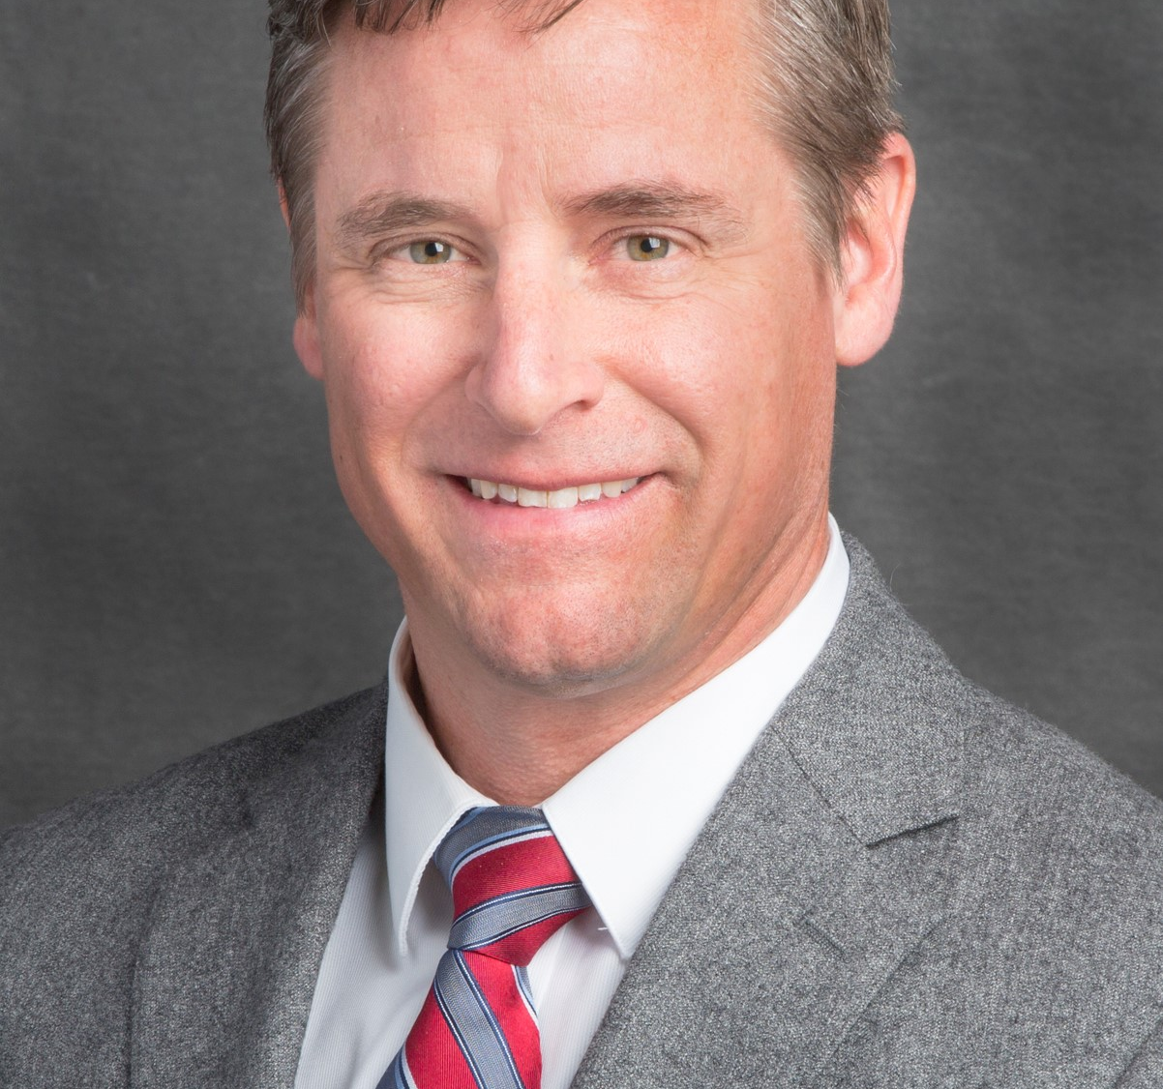
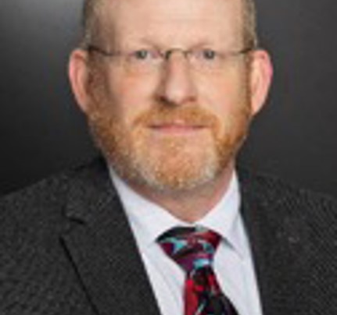
Speakers
Andrea Kock, Deputy Office Director, NRR
John Lubinski, Director, NMSS
Andrea Kock
John Lubinski
Todd Smith
John Tomon
Todd Smith, Ph. D. Senior Level Advisor, NSIR
John Tomon, CHP
Branch Chief, RES
Notes:
Traditionally, each RAMP meeting there is a theme and we solicit a keynote speaker that highlights that theme. This year, we are highlighting work at the NRC and our focus on the safe and secure use of nuclear technology to be environmentally responsible.
Andrea L. Kock is the Deputy Office Director for Engineering, Office of Nuclear Reactor Regulation (NRR).
And
John W. Lubinski is the Director of the Office of Nuclear Material Safety and Safeguards (NMSS).
He will give an overview of their offices programs
Todd Smith, Ph.D. is the Level Advisor for Emergency Preparedness and Incident Response/
His talk will center around Emergency Preparedness both domestically and internationally.
John Tomon, Chief of the Radiation Protection Branch will give an overview of the RAMP program.
After those talks members of the RAMP team will discuss the week long program and we will have question and answers, but first

Slide 6
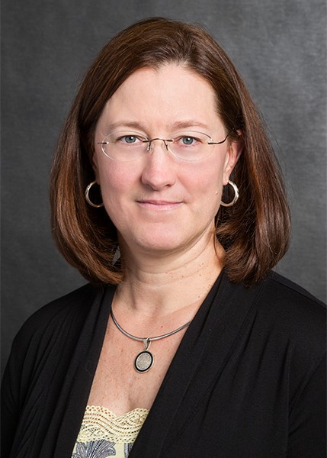
Kimberly Webber, Division Director,
Office of Nuclear Regulatory Research
Notes:
I would like to introduce Dr. Kimberly Webber to give the official welcome. She is the Director of the Division of System Analysis in the Office of Nuclear Regulatory Research. She is also the NRC Management Executive over the RAMP Program.
Kim, its all yours.
20 sec

