Slide 1
RAMP Overview
John Tomon, CHP
Chief, Radiation Protection Branch
2023 Fall RAMP Users’ Group Meeting
October 23–27, 2023
Rockville, MD

Slide 2

Welcome RAMP Partners
Over 3000 registered RAMP Users
Over 200 participants at this RAMP Meeting
  Representatives from 15 Countries
    Australia, Canada, Ghana, Finland, Italy, Mexico, Nigeria, South Africa, South Korea, Spain, Taiwan, Ukraine, United Arab Emirates, United States, United Kingdom
  Federal Agencies:
    EPA, NIST, FEMA, NIH, NRC, DOE, Army, Navy, DOT
  States: Nebraska, Virginia, Arkansas, Connecticut, New Jersey, Texas, Alabama, Florda,
  National Labs: PNNL, ANL, ORNL, INL, Sandia, LANL, BNL
  Licensees/Applicants: Duke Energy, X-energy, Westinghouse, Entergy, Holtec
  Universities, Medical Facilities

Slide 3
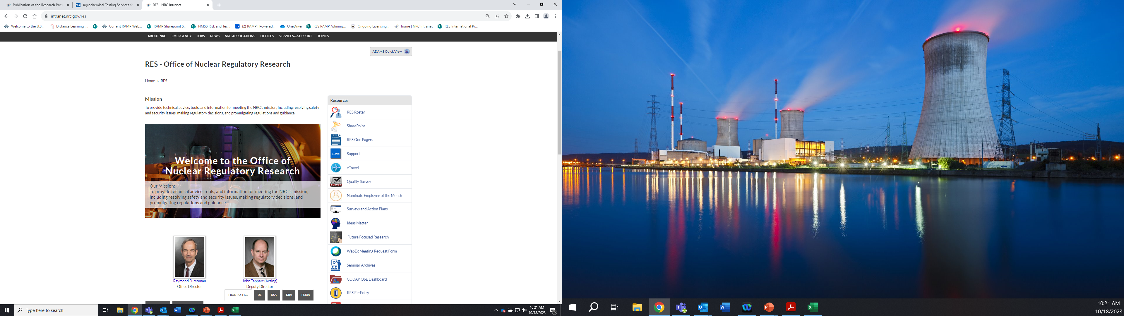
Nuclear Regulatory Research

Slide 4
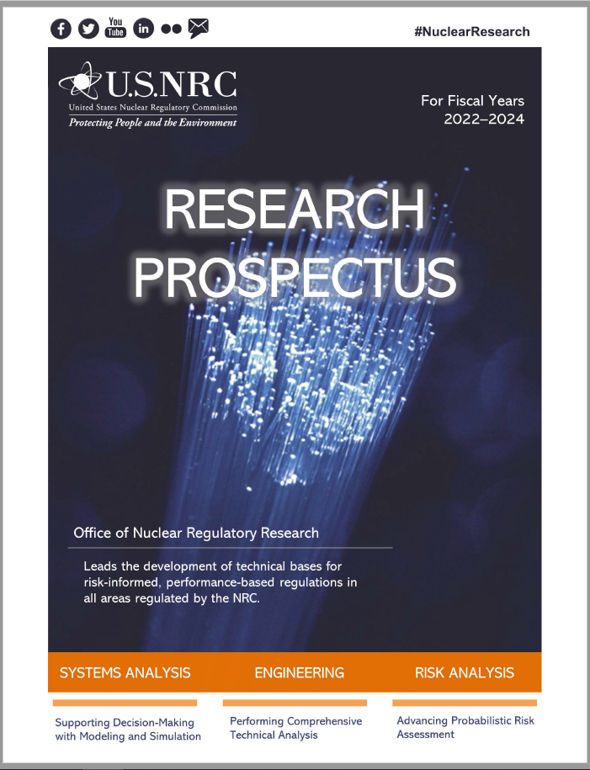
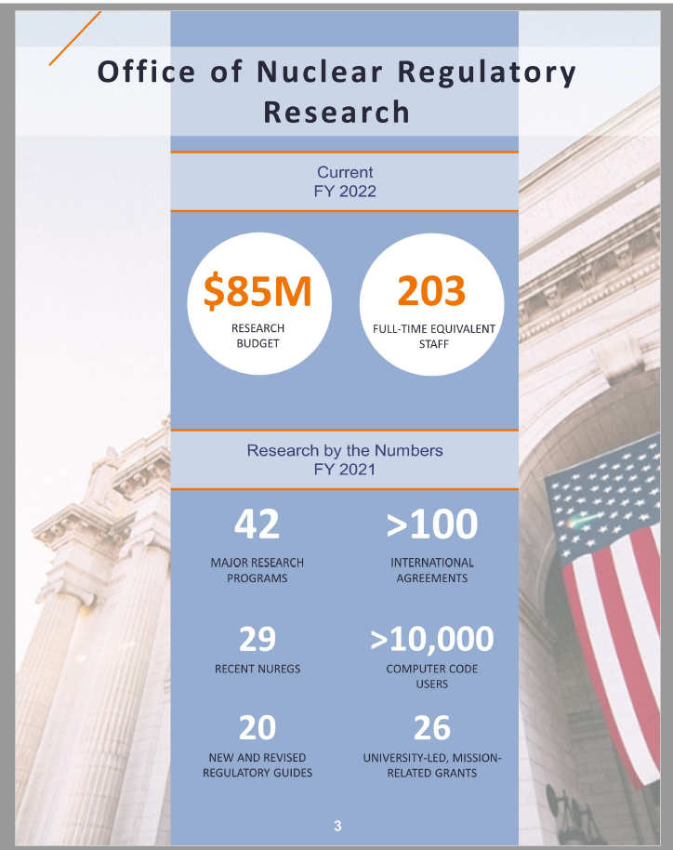
Research Prospectus 2022-2024
https://www.nrc.gov/docs/ML2223/ML22235A651.pdf

Slide 5
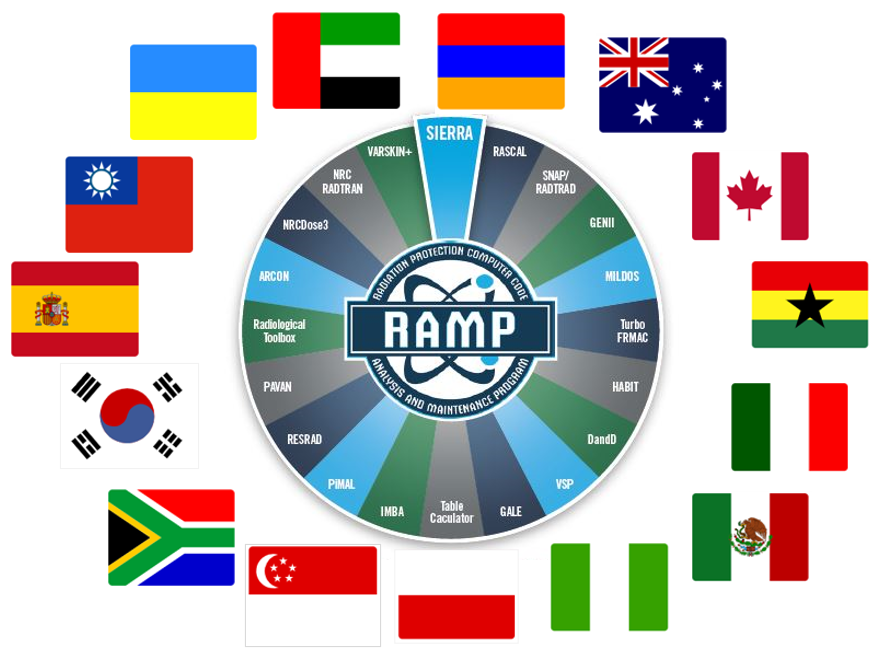
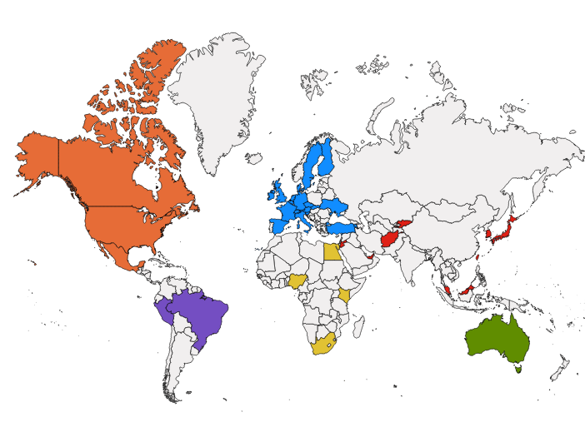
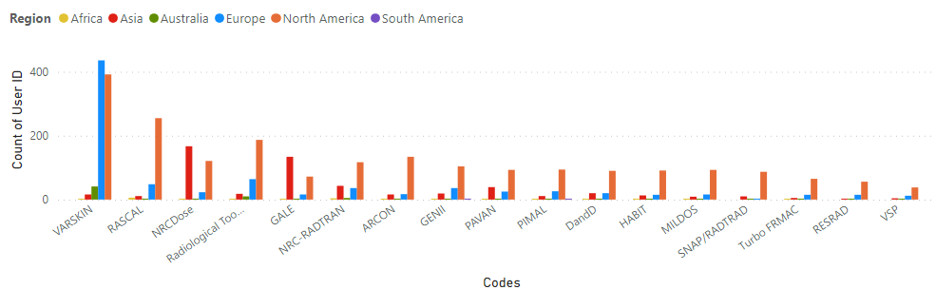
International Collaboration
Strong international cooperation
100+ bilateral or multilateral agreements
with over 20 countries (15 Agreements for RAMP)
  Cooperative Research Programs
Shared insights and resources
Cooperative Research Programs in DSA
  RAMP
  CAMP
  CSARP
Notes:
RAMP: Radiation Protection Code Analysis and Maintenance Program to exchange information on radiation protection and dose assessment codes.
CSARP: Cooperative Severe Accident Research Program to exchange information on severe accident safety issues related to reactor, spent fuel pool, and plant systems.
CAMP: Code Applications and Maintenance Program to exchange information on thermal-hydraulic safety issues related to reactor and plant systems.

Slide 6
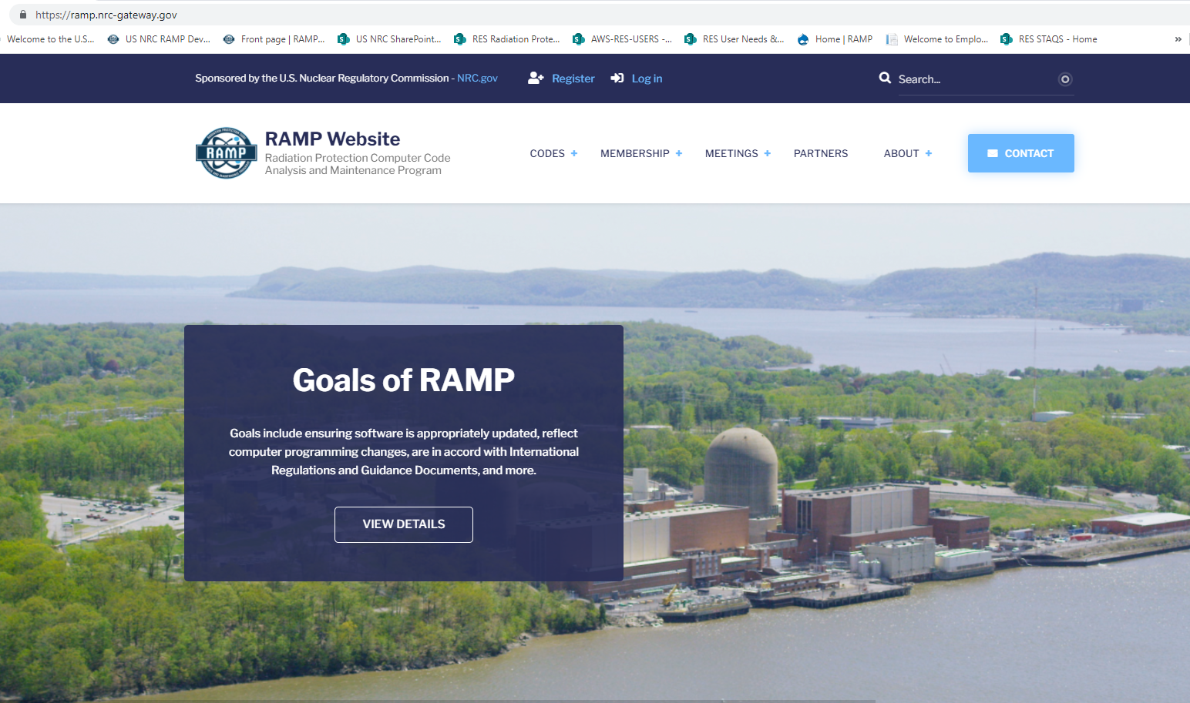
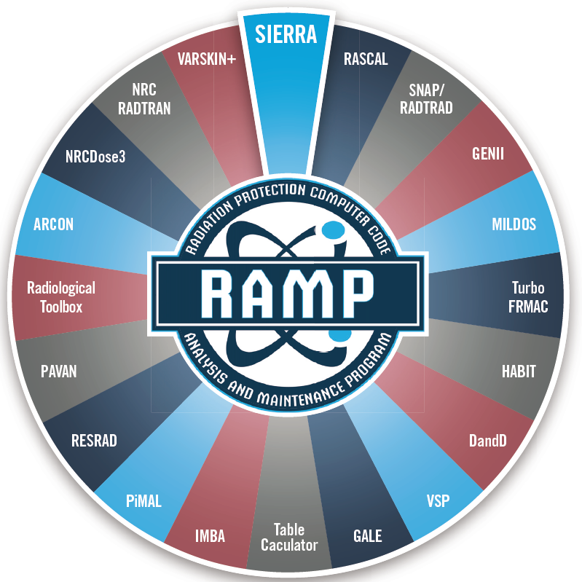
RAMP
https://ramp.nrc-gateway.gov/

Slide 7
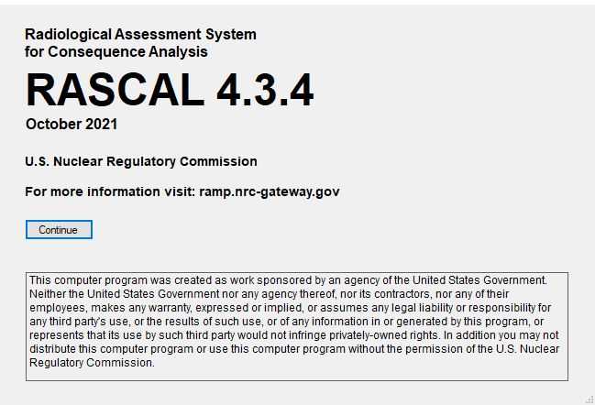
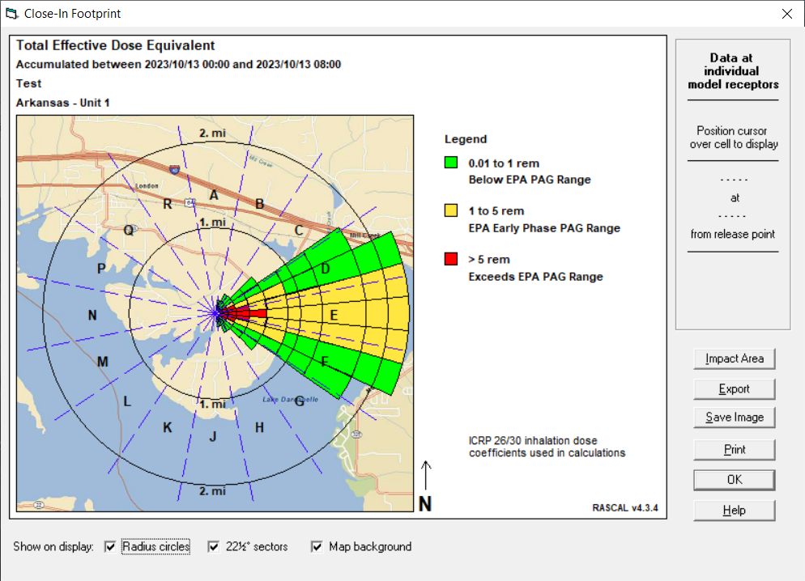
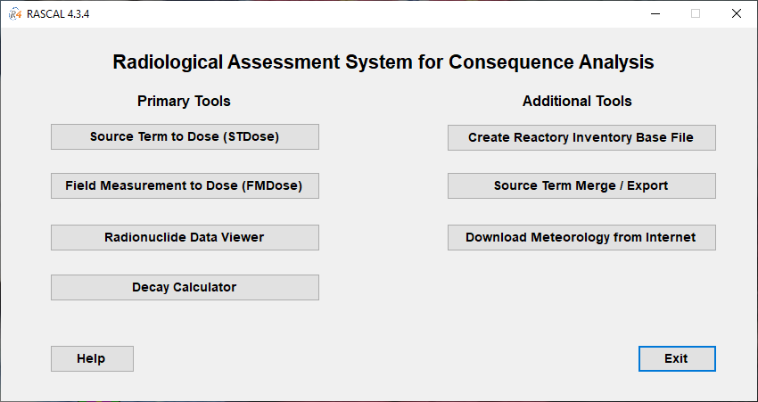
Emergency Response Codes
RASCAL
Radiological Assessment System for Consequence Analysis
Fast-running software used for beyond-design-basis radiological incidents to assess off-site dose consequences and to help inform or evaluate protective actions.
Current Activities:
  RASCAL v4.3.5 release date in early 2024.
  Beginning RASCAL 5.0 Development with PNNL.

Slide 8
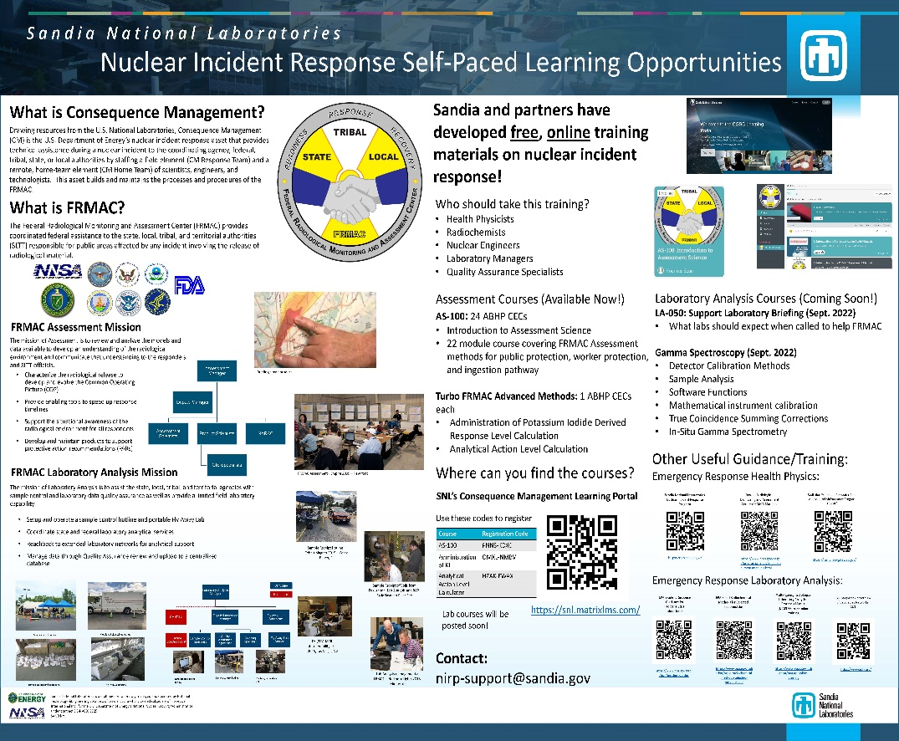
Emergency Response Codes
Turbo FRMAC
Turbo FRMAC performs complex calculations to quickly evaluate radiological hazards during an emergency response by assessing impacts to the public, workers, and the food supply.
Sandia National Laboratories maintains distribution of Turbo FRMAC, but RAMP users have access to code discussions, training, and technical support.
Web-based training that will be available on demand is in development.
If you need technical support for Turbo FRMAC please email: nirp-support-fogbugs@sandia.gov
https://nirp.sandia.gov/Software/TurboFRMAC/TurboFRMAC.aspx

Slide 9
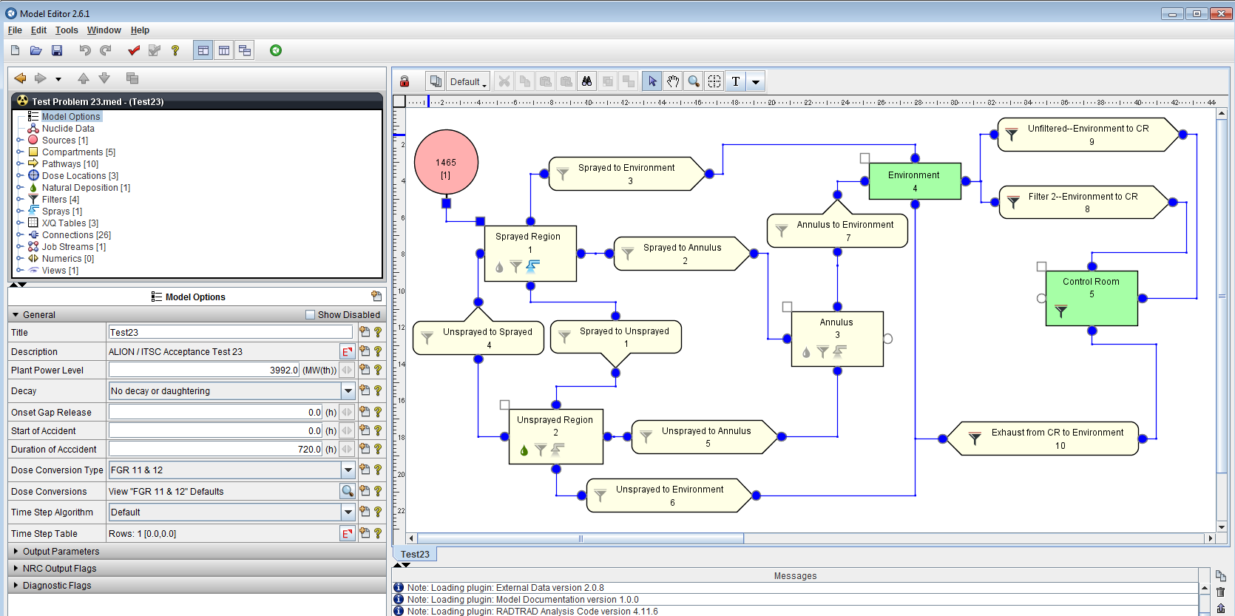
Licensing Support Codes
SNAP/RADTRAD
Symbolic Nuclear Analysis Package/RADionuclide Transport Removal And Dose Evaluation
Performs dose calculations for design-basis accidents at the exclusion area boundary, low population zone, and control room.
NRC staff uses to perform licensing confirmatory analyses of the plant’s design and the licensee’s offsite and control room dose calculations following a design basis accident.
Current Activities:
  RADTRAD-AC v5.1 – release in November/December 2023.

Slide 10
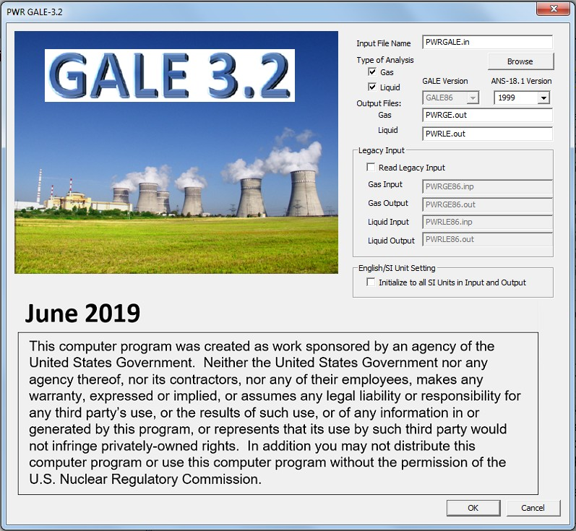
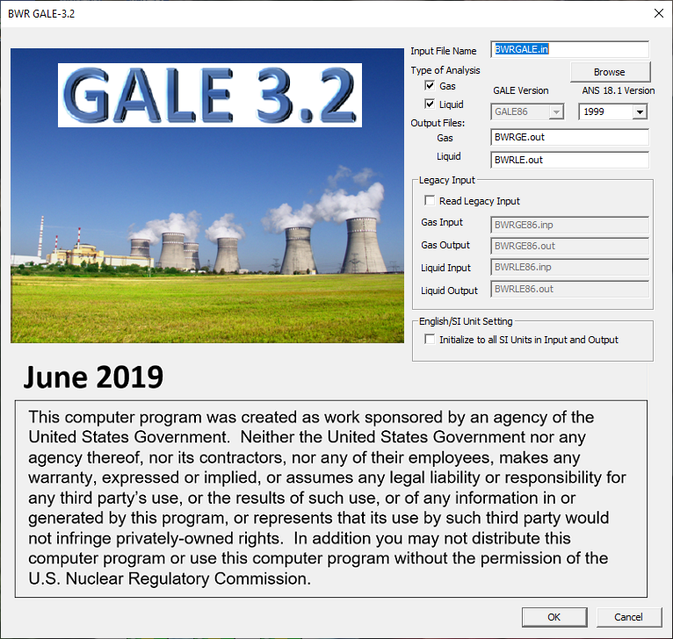
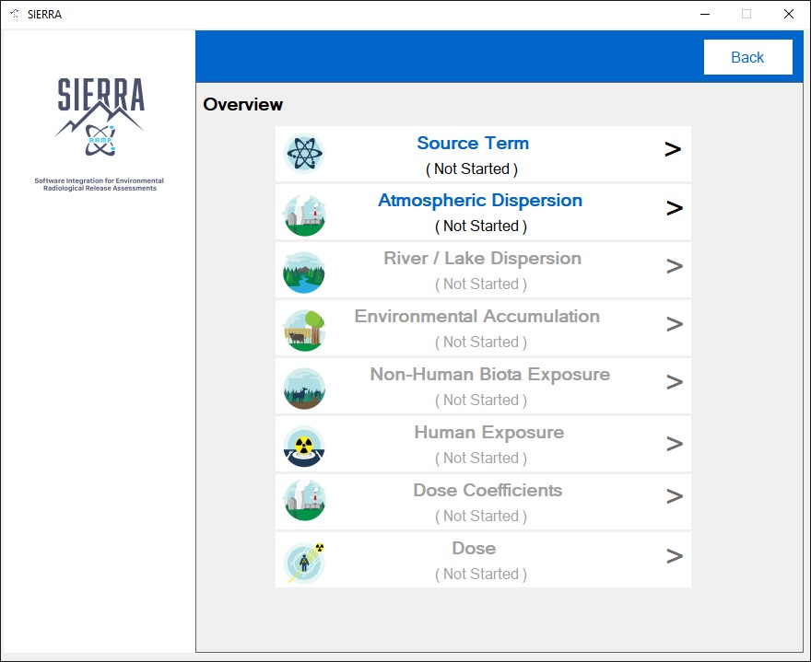
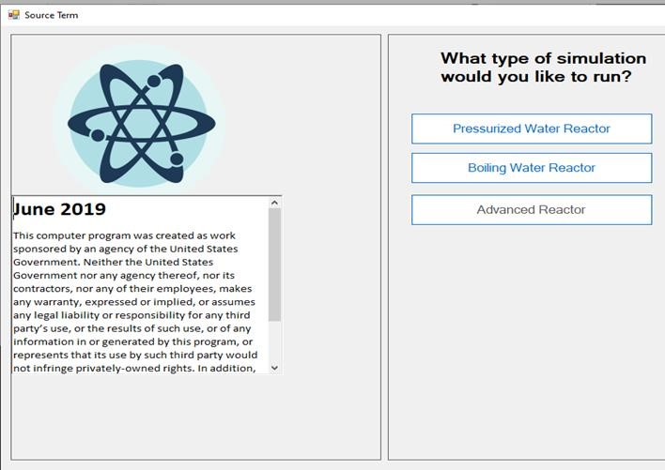
Licensing Support Codes
GALE
Gaseous And Liquid Effluents
Calculates the gaseous and liquid effluents from routine releases (normal source term) from light water reactors. Aids in determination of compliance with the requirements of Appendix I to 10 CFR Part 50.
Code Distributed in two interfaces:
  Pressurized Water Reactor (PWR)
  Boiling Water Reactor (BWR)
Current Activities:
  Code Consolidation – PNNL is incorporating the four GALE Fortran codes the Software Integration for Environmental Radiological Release Assessments (SIERRA) code with completion in the winter 2024.

Slide 11
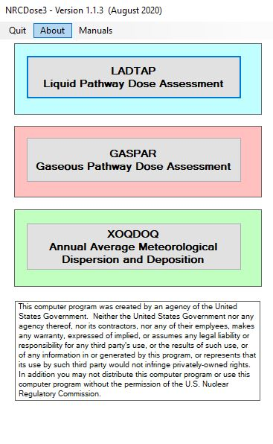
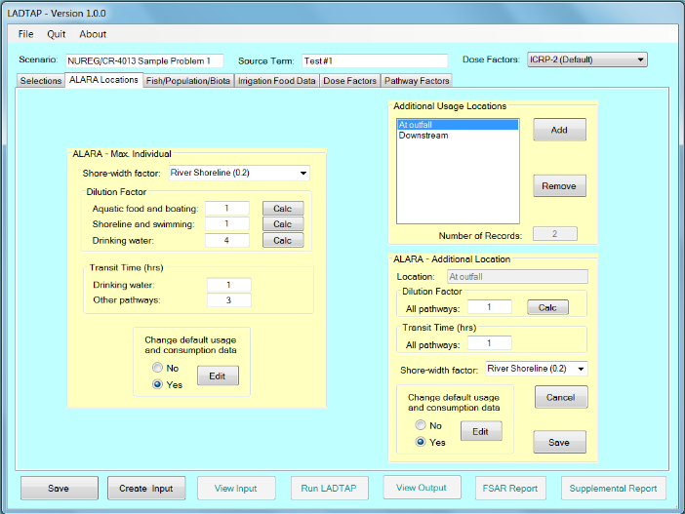
Licensing Support Codes
NRCDose3
GUI for the LADTAP II, GASPAR II, and XOQDOQ Fortran codes that implement NRC’s current requirements for As Low As is Reasonably Achievable for radioactive effluents from NPP.
Current Activities:
  NRCDose3 v1.1.4 – released in late 2023.
  Publish NUREG: User Guide and Technical Manual
  Code Consolidation into SIERRA anticipated in FY 2026.

Slide 12
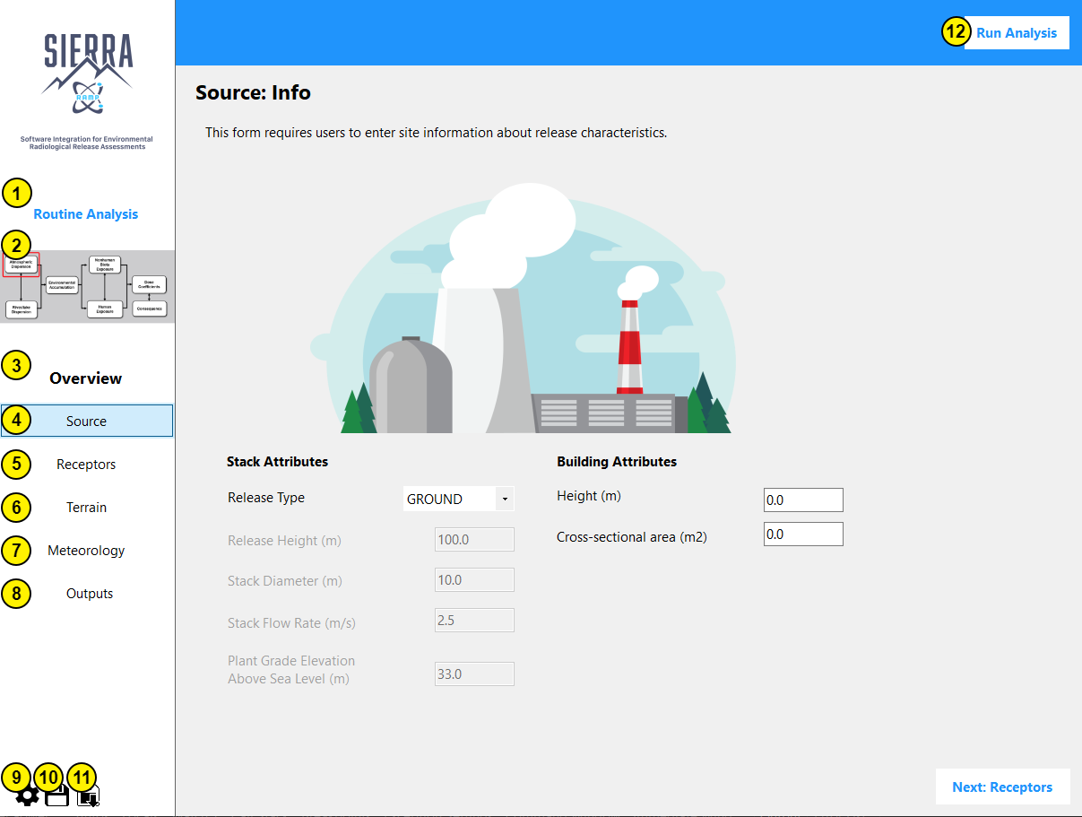
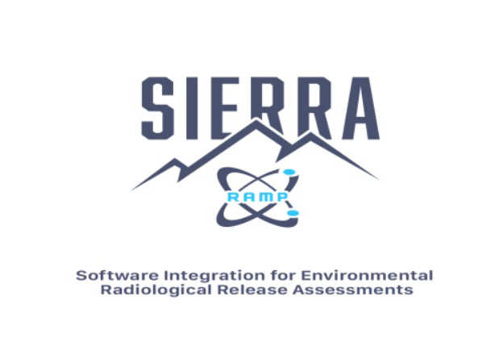
Code Consolidation
SIERRA
Software Integration for Environmental Radiological Release Assessments
Software under active development which aims to combine multiple RAMP codes into one easy to use package.
Currently have two efforts underway for SIERRA.
  Atmospheric Dispersion Models:
    ARCON
    PAVAN
    XOQDOQ
  Source Term
    GALE
    NRCDose3
    Advanced reactors

Slide 13
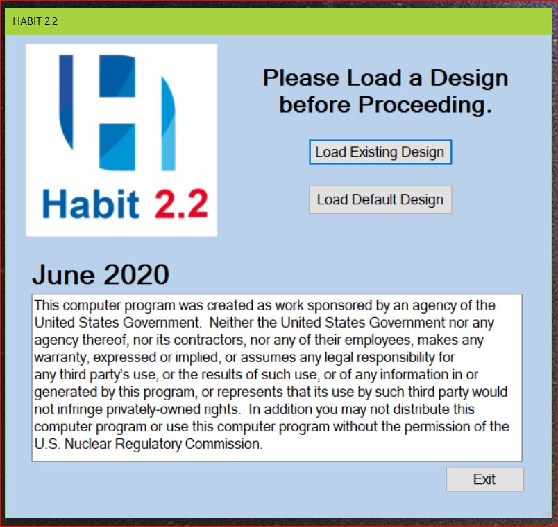
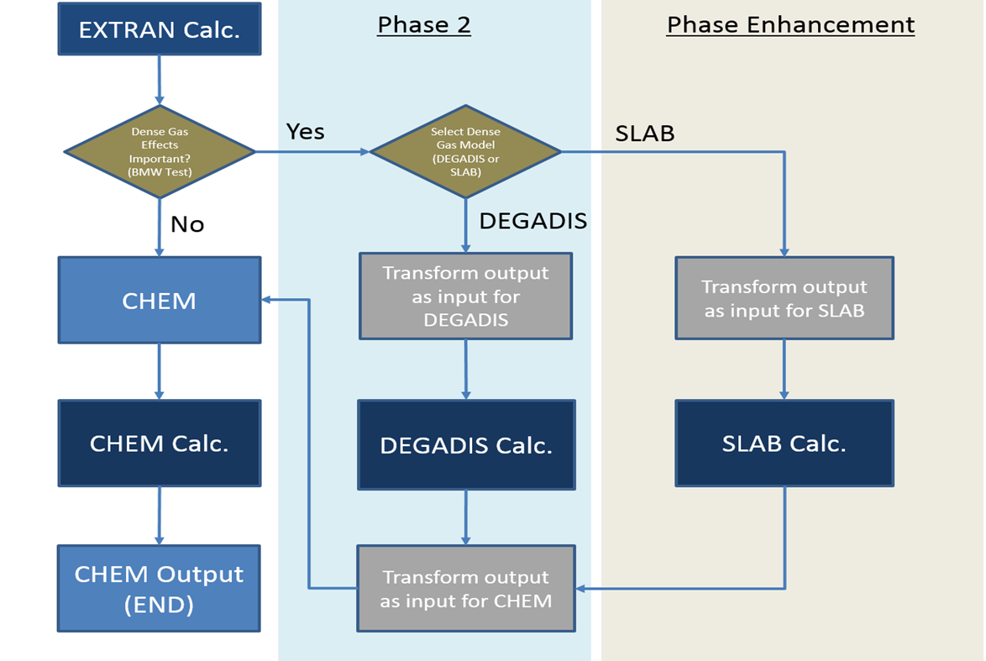
Licensing Support Codes
HABIT
A suite of computer codes to assist in evaluating LWR control room habitability in the event of accidental spills of toxic chemicals.
Current Activities:
  Version 2.2 released in June 2020.
    Scalable screen and enhanced GUI plotting utilities.
    Backward compatibility to intake and run old case files.
    Integrated both the EPA’s Dense Gas Model (DEGADIS) and LLNL’s Denser than Air Model (SLAB).
  Possible future code consolidation into SNAP with a plugin like SNAP/RADTRAD – FY 2027.

Slide 14
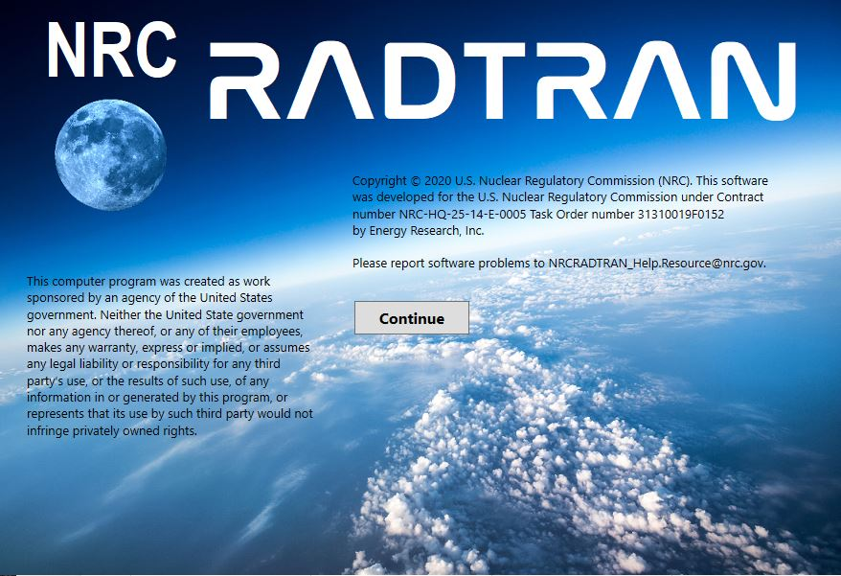
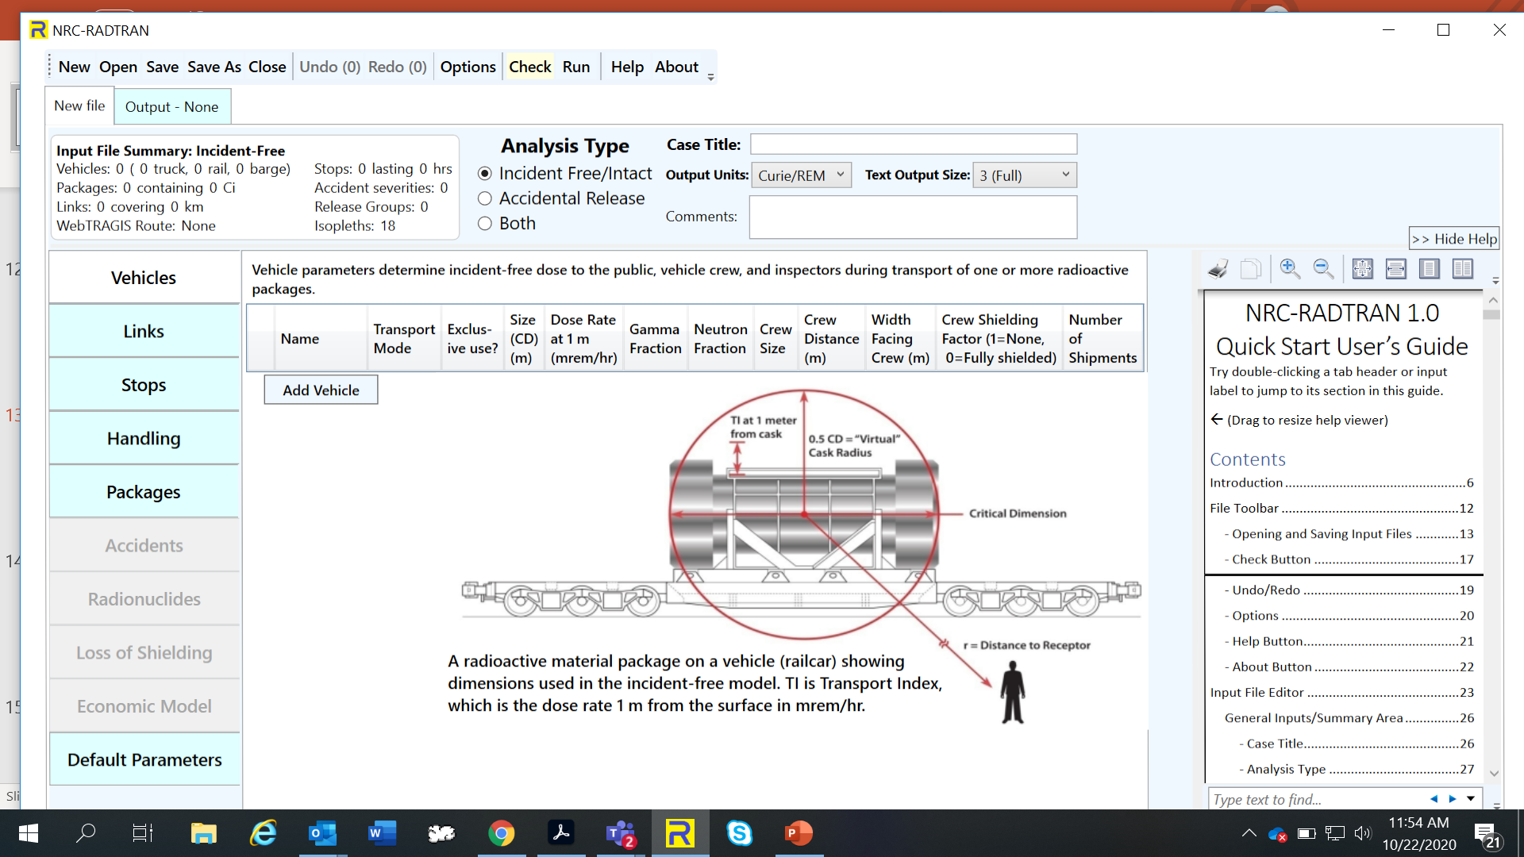
Licensing Support Codes
NRC-RADTRAN
Radioactive Material Transport
Code for risk and consequence analysis of radioactive material transportation.
Current Activities:
  Updated Code ‒ NRC-RADTRAN v1.1 in FY 2025, to include:
    Fix KML file errors for speed and population densities.
    Develop WebTRAGIS alternatives.
    Sum population risk across all transportation links and fix errors while using >9 links.
    Implement coding changes to display default values in NRC-RADTRAN.,
    Implement GUI changes to include air cargo, air passenger, and other rail options, and
    Investigate and correct hard coded conversion factors.

Slide 15
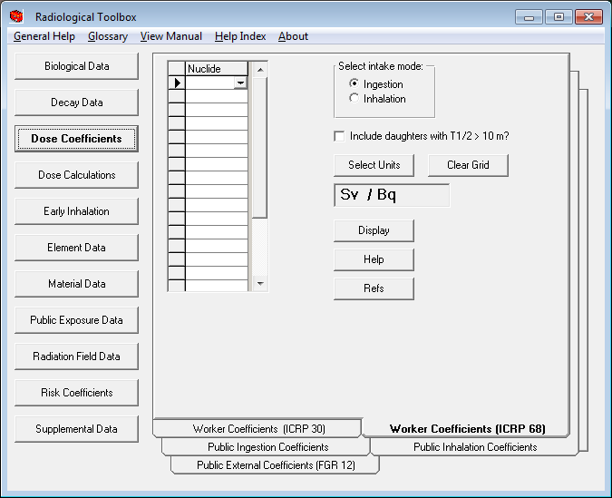
Dosimetry Codes
Radiological Toolbox
Electronic handbook containing
  Biological Data
  Decay Data
  Dose Coefficients
  Element and Material Data
  Risk Coefficients
Current Activities:
  Code consolidation of Radiological Toolbox by combining with VARSKIN+ – FY 2024.
  Updated Dose Coefficients

Slide 16
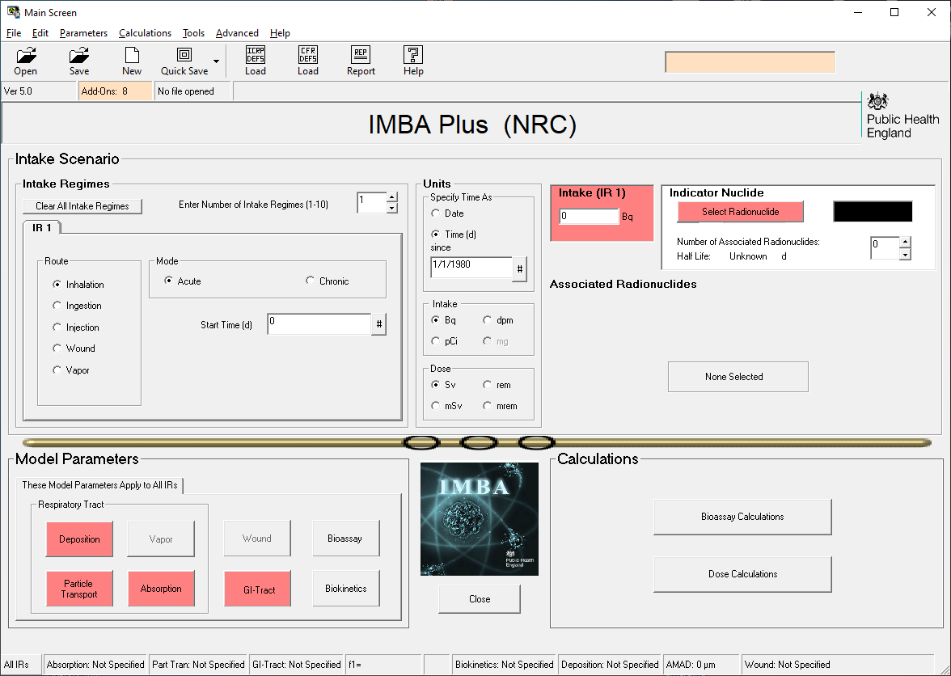
Dosimetry Codes
IMBA
Integrated Modules for Bioassay Analysis
A suite of modules for internal dosimetry that implements respiratory tract, GI-tract, tissue dosimetry, biokinetic, and bioassay models as recommended by the International Commission on Radiological Protection.
IMBA modules can estimate single or multiple intakes of different radionuclides and calculate resulting doses based on ICRP 68 and US 10 CFR 835.

Slide 17
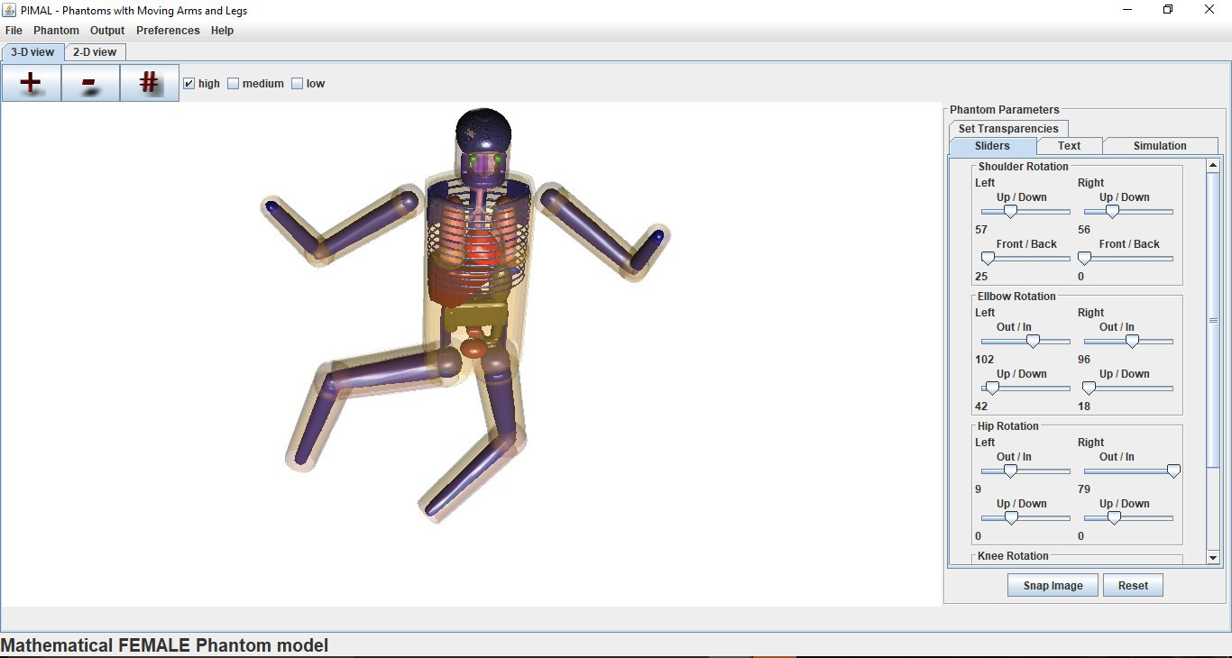
Dosimetry Codes
PiMAL
Phantom with Moving Arms and Legs
Graphical User Interface which assists users in developing Monte Carlo N-Particle (MCNP) geometry input decks.
PiMAL allows for manipulation of the phantom within the GUI and will then provide the input deck to be utilized in MCNP.
  Includes 23 organs
Current Activities:
  Incorporation of three animal phantoms due to increasing frequency of radiological veterinary treatments
    Equine
    Canine
    Feline

Slide 18
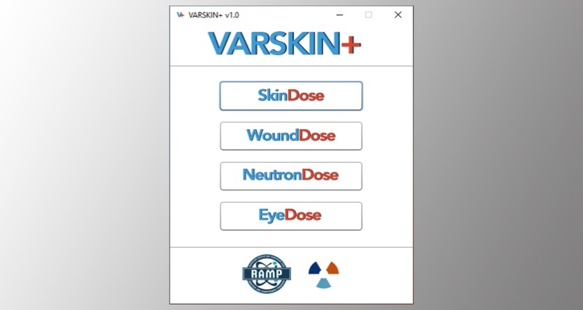
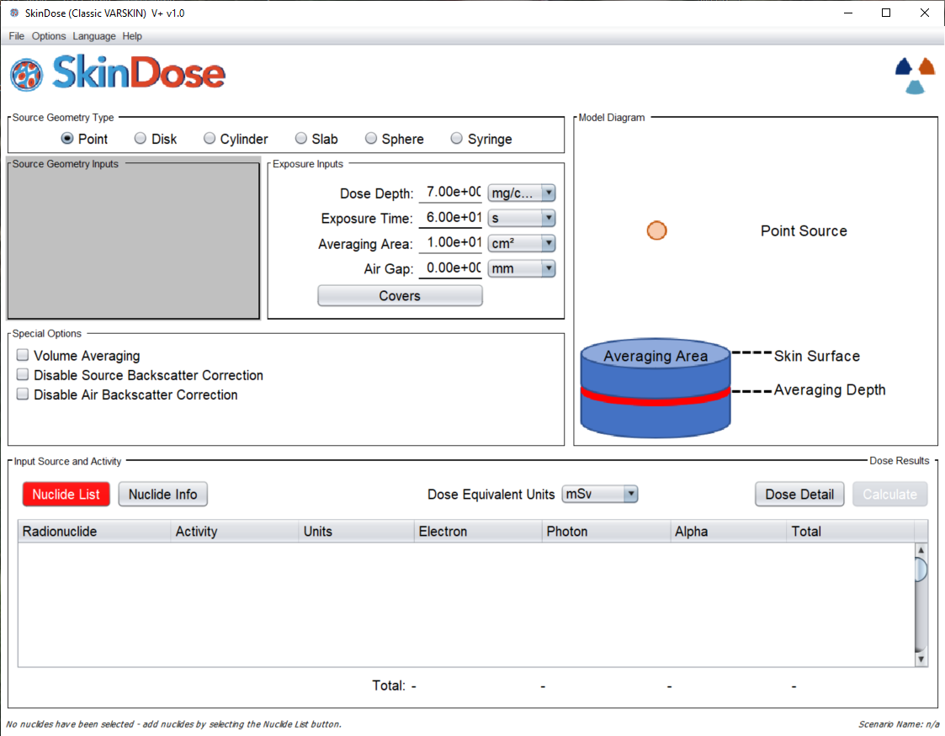
Dosimetry Codes
VARSKIN+
Used to calculate occupational dose to the skin resulting from exposure to radiation emitted from contamination on or near skin.
Current Activities:
  Release of VARSKIN+ v1.2 in Aug 2023.
    Improved Alpha Dosimetry.
    Improved Ingrown Decay Progeny Calculation.
    Neutron Energy Degradation Model.
  Release of Extravasation Dose Module in FY24/25

Slide 19
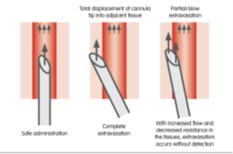
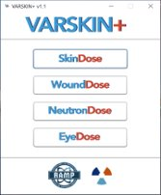
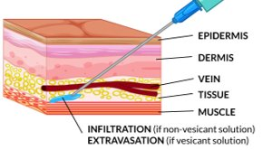
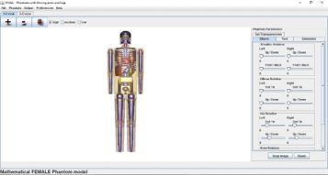
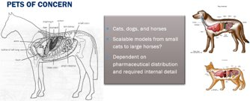
Rulemaking Support ‒ RAMP
VARSKIN+
Nuclear Medicine Injection Extravasations Rulemaking
Source: Managing chemotherapy extravasations in practice, Helen Roe MSc, www.hospitalpharmacyeurope.com
PiMAL
Regulatory Guidance Development Support for Veterinarian Release

Slide 20
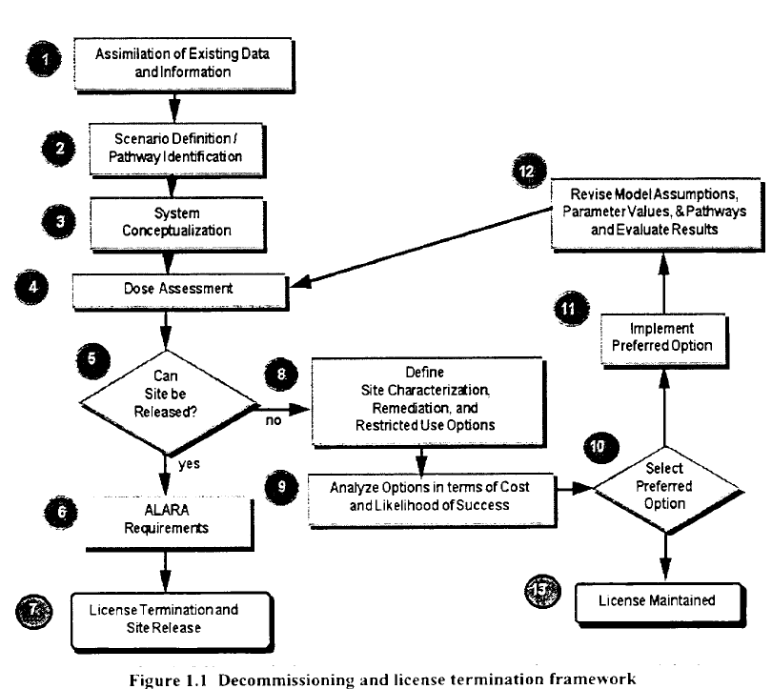
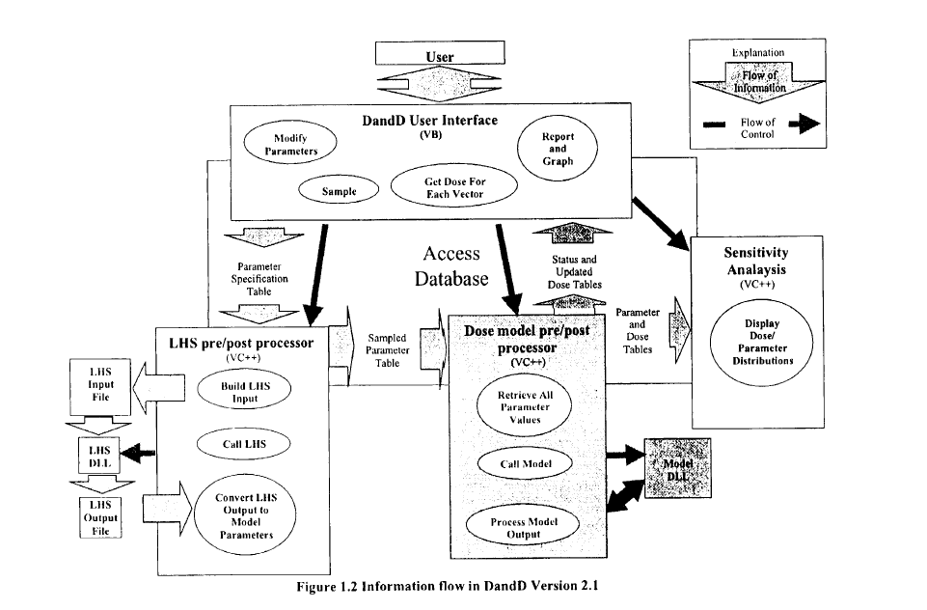
Decommissioning & Environmental Assessment
DandD
Decontamination and Decommissioning
Software package developed by the NRC to assess compliance with the dose criteria of 10 CFR Part 20, Subpart E.
DandD utilizes soil and building surface screening samples to estimate the annual dose from residual radioactivity.
Current Activities:
  Current version 2.1.

Slide 21
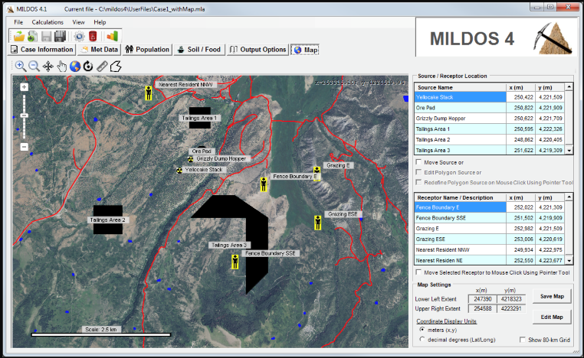
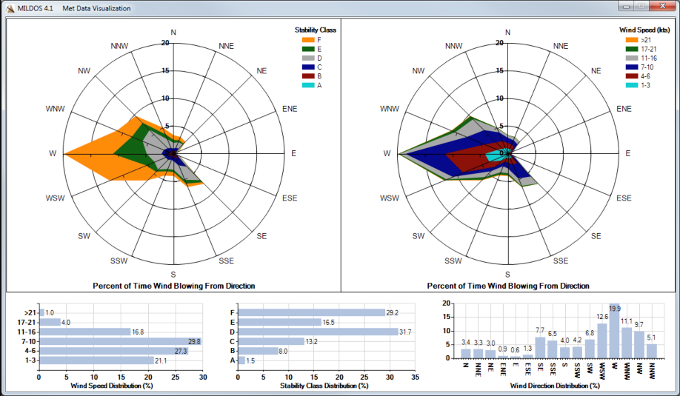
Decommissioning & Environmental Assessment
MILDOS
Assists in evaluating the radiation protection compliance at uranium recovery facilities, both ore mining and the associated on-site milling facilities.
Calculates the radiological dose commitments received by individuals and the general population with an 80-kilometer radius of operating uranium recovery facility.
Estimates air and ground concentrations of radionuclides for individual locations as well as for a generalized population grid.
  Extra-regional population doses resulting from transport of radon and export of agricultural products are also estimated.
Current Activities:
  Current version 4.21.

Slide 22
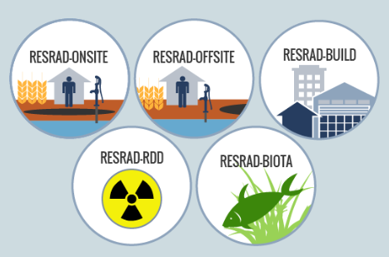
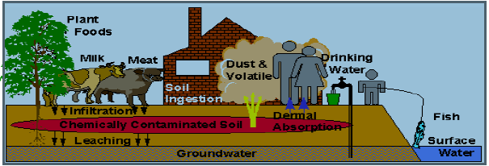
Decommissioning & Environmental Assessment
RESRAD
Residual Radioactivity
Family of codes used to analyze human and biota radiation exposures from environmental contamination of residual radioactive materials.
Uses pathway analysis to evaluate exposure and associated risks, which then informs cleanup criteria and authorized limits.
Current Activities:
  RESRAD ONSITE v8.0 FGR-15 DCFs.

Slide 23
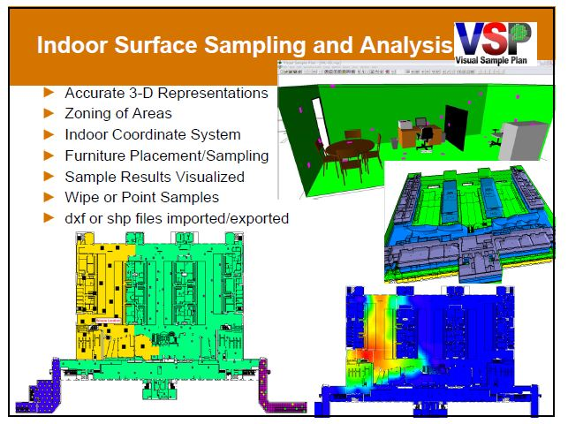
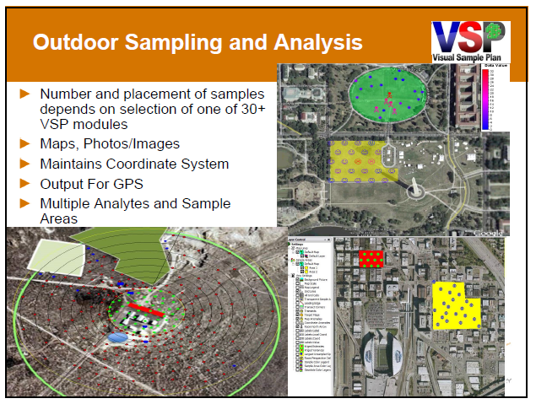
Decommissioning & Environmental Assessment
VSP
Visual Sample Plan
VSP is a software tool that assists in creating a defensible sampling plan based upon statistical sampling theory and the analysis of sample results.
Ensures the right type, quality, location, and quantity of data are gathered for statistical evaluations for regulatory decision making (decommissioning).
Distributed by Pacific Northwest National Laboratory.
Current Activities:
  improvement of VSP subsurface radiological survey design.
  visualization and analysis tools
  improvement of continuously collected data visualization
  and analysis tools
  beta version of the Spatial Analysis and Decision Assistance
  (SADA) code

Slide 24
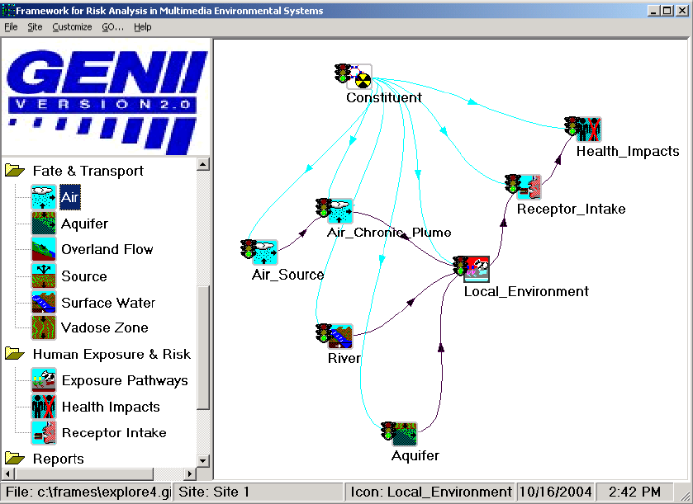

Decommissioning & Environmental Assessment
GENII
GENII is an environmental assessment code for estimating radionuclide concentrations in the environment from acute and chronic radiological releases
Dose to humans and biota from acute and chronic radiological releases.
Supported radionuclide transport options include:
  Air
  Water
  Biological Activity

Slide 25
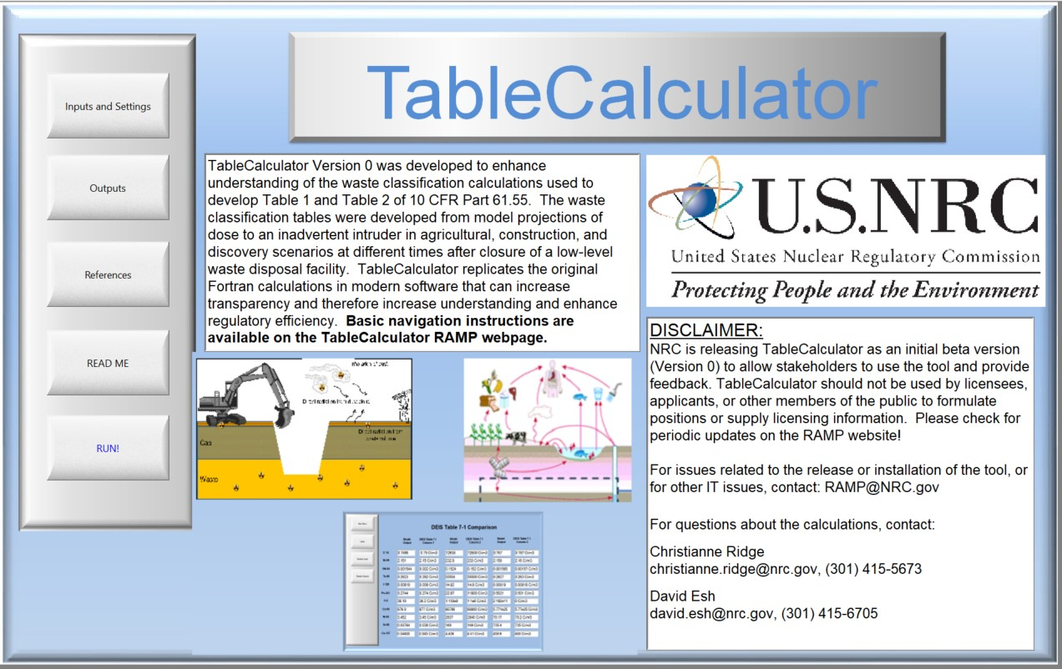
Decommissioning & Environmental Assessment
TableCalculator
User-friendly tool to facilitate comprehensive understanding of calculations used to develop the low-level radioactive waste (LLRW) classification tables 10 CFR Part 61.55.
Also provides users access to intermediate results, such as individual exposure pathway contributions that were not provided as outputs from the original code.

Slide 26
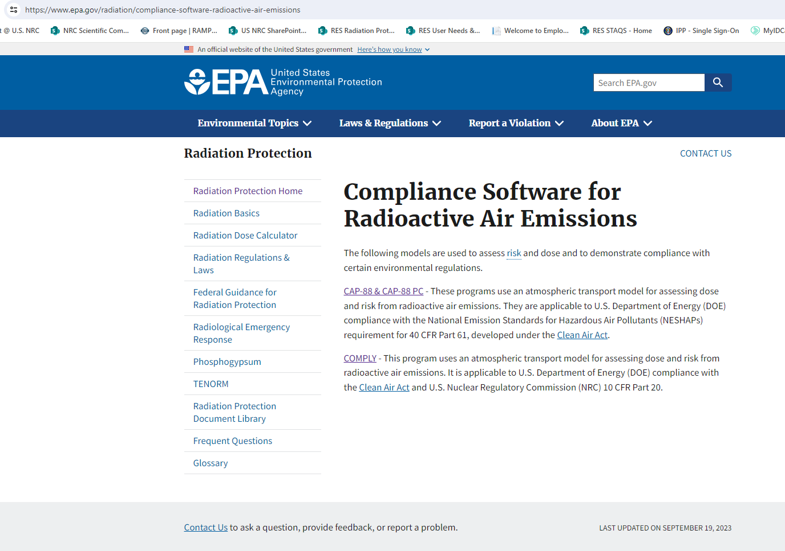
Recent RAMP Happenings
Memorandum of Understanding (MOU) with US Environmental Agency (EPA) regarding RAMP and the development of dose coefficients.
Computer Codes:
  CAP–88 and CAP–88 PC (v4.1.1)
  COMPLY (v1.7.1)
  DC_PAK (3.02)
https://www.epa.gov/radiation/compliance-software-radioactive-air-emissions

Slide 27
Your Role in the Meeting
Thank you for coming!
Participate actively
Share your insights
Work together for safety
Build networks
Strengthen collaboration
Enjoy Washington DC

Slide 29
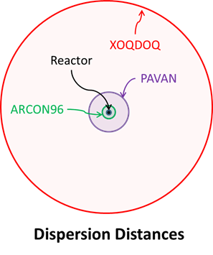
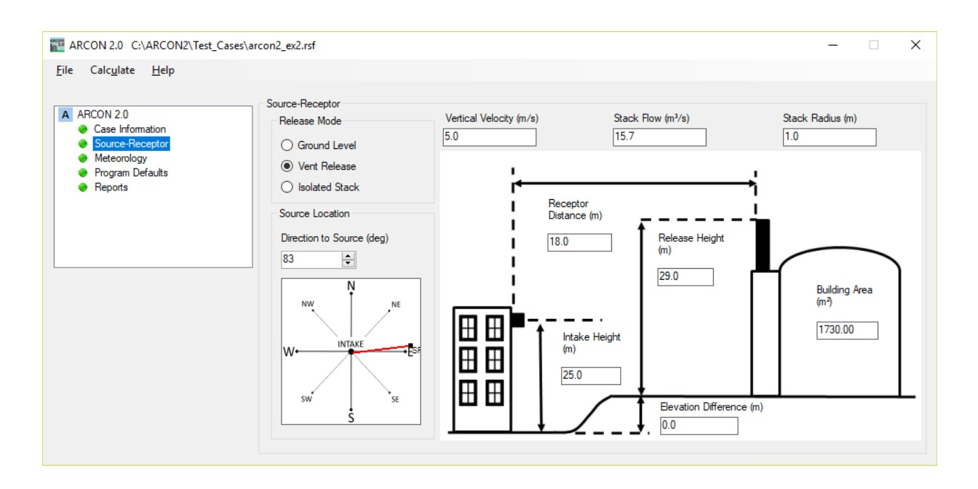
Licensing Support Codes
ARCON & PAVAN
ARCON 2.0 (2019)
Calculates χ/Q in the near field (~100 meters) for design basis accidents in the control room and technical support centers.
PAVAN
Calculates χ/Q in the mid-field (~10 km) for design basis accidents in the exclusion area boundary and low population zone.
Current Activities
  Code Consolidation – ATD module for the SIERRA code to include ARCON, PAVAN and XOQDOQ. Currently with a release date of September 2024.

