Slide 1

Welcome to the RAMP 2023 Fall User Meeting
Rigel Flora
Health Physicist
United States Nuclear Regulatory Commission
2023 Fall RAMP Users’ Group Meeting
October 23–27, 2023
Rockville, MD
Notes:
Hello, my name is Rigel Flora
I am a Health Physicist and the RAMP Program Manger.
This presentation is to give each of you a snap shot of the rest of the User Meeting.
Next slide please.
20s

Slide 2
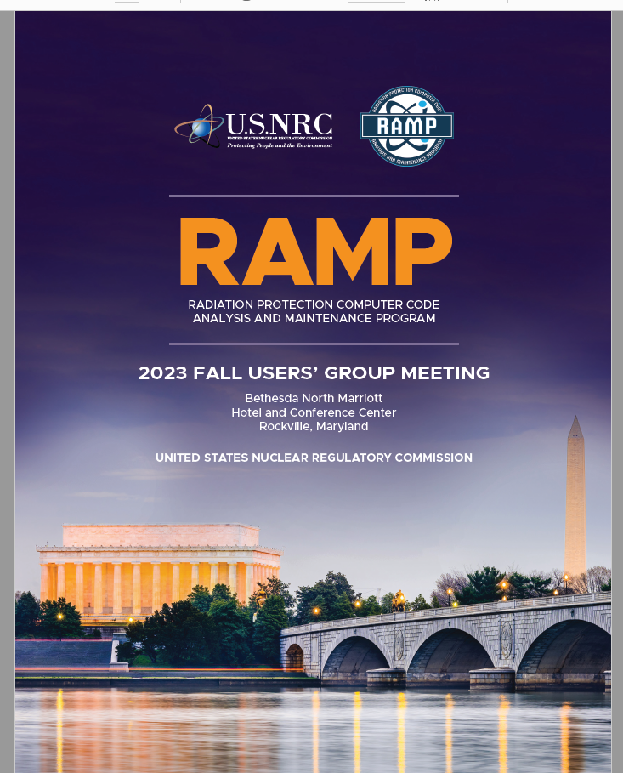
Five Days of:
Presentations
Training
Beginner/Advanced Classes
Tours
Social Hour
Networking
CHP Credit
Notes:
You should have both this booklet and the RAMP newsletter in your folder if you are in house.
If you are virtual, you should have received the RAMP Program Booklet via email.
Everything you need to know if contained in this booklet.
However, if you did not, I am here to tell you about the full five days of presentations, training, code discussions and tours.
As John said earlier, we manage about 18 codes and its not possible to give attention to each code each year.
As such, we alternate what we present, but it is based on the popularity of the code, if a new version was developed during that year and other factors.
As Kim said in her opening talk, this year we concentrate on RASCAL and RESRAD
.and an Internal and External Dosimetry Meeting.
Make sure you mention the CHP credit
Next slide please.

Slide 3
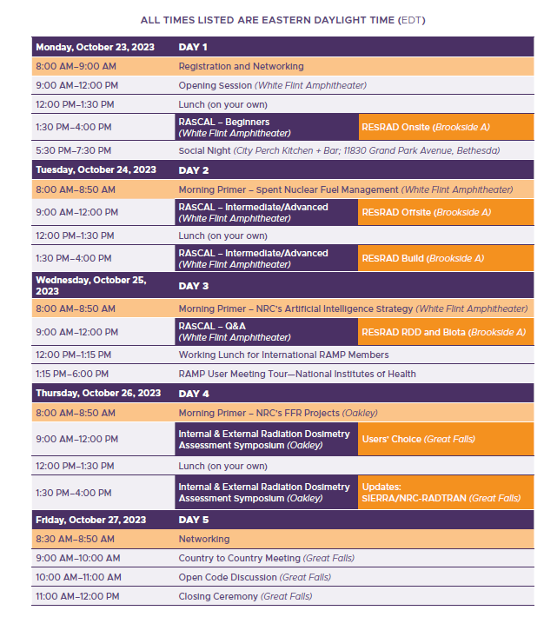
Overall Agenda
Notes:
This is the five days in a quick overview. It also includes what room the training and symposiums are in, again this is in your booklet. Benjamin showed you a map of the building, but the rooms are here and around the counter.
Also, this slide is busy, but I will explain each day.

Slide 4
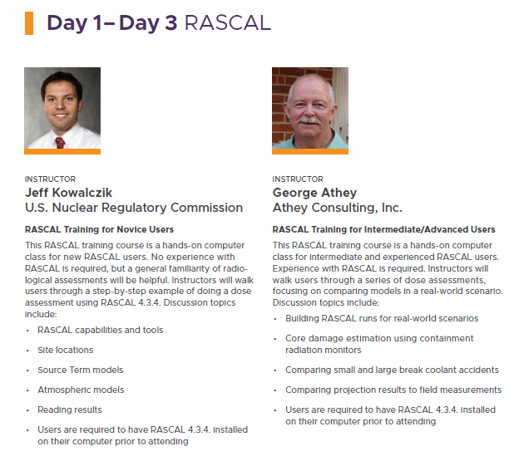
RASCAL
Monday Afternoon
Tuesday
Wednesday Morning
Notes:
This afternoon is RASCAL, all day Tuesday and Wednesday morning. Its right here in the White Flint Amphitheater.
The instructors are Jeff Kowalczik and George Athey. There are four modules….
Make sure you have RASCAL 4.3.4 on your computer.
In the afternoon, breaks start 2:30

Slide 5
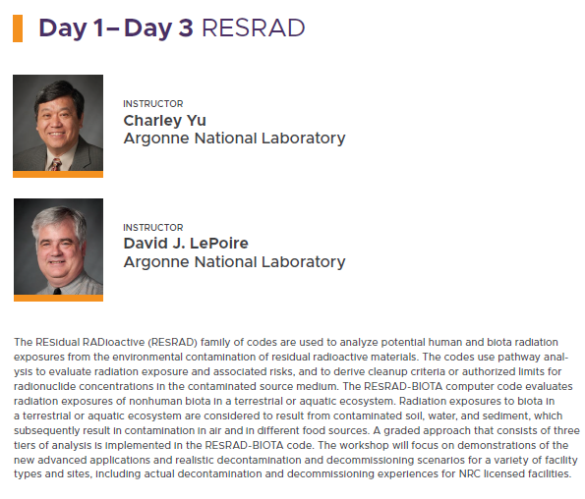
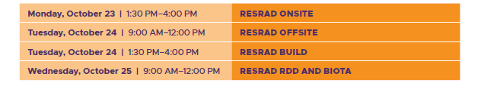
RESRAD
Monday Afternoon
Tuesday
Wednesday Morning
Notes:
RESRAD is in Brookside A, right around the corner.
Dr. Charley Yu and Dr. David LePoire of Argonne National Lab will deliver the training.
Just a reminder that this is an overview of the training. RESRAD Onsite, Offsite, Build, RDD and Biota are week long classes.
Remember that breaks start at 2:30 in the afternoon. So remind your trainers.

Slide 6
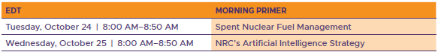




Primers
RAMP Social Night
Network with RAMP administrators, code developers, and other RAMP members Heavy Hors D’oeuvres & Cocktails
City Perch Kitchen + Bar, 11830 Grand Park Avenue, Bethesda
Monday, October 23rd | 5:30 – 7:30 pm
Notes:
. We can't forget about the primers. Primers are very short sessions that are less than 1 hour, presented at the beginning of each day.
Tuesday is an overview of Spent Fuel Management and Wednesday is NRCs Artificial Intelligence Strategy.
They are meant to be an introduction to the meeting where a participate can just listen, while settling down with a good cup of coffee to get ready for a good day of the RAMP User meeting.
They are all here in the White Flint Amphitheater.
Also, everyone is invited to the social hour today 5:30 to 7:30. Directions are at the registration desk.

Slide 7

Tour:
Operations Center
Registration Sheet
Tuesday for International Attendees
Notes:
Will meet here at the White Flint Amphitheater at 12 noon on Tuesday.
Please sign the sign in sheet
Requesting that all International Attendees tour on Tuesday due to the International Luncheon on Wednesday

Slide 8
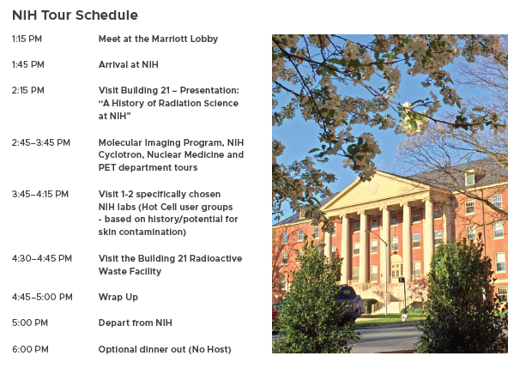
Tour:
National Institute of Health
Registration Sheet
Wednesday, October 25th
Closed-toe shoes required
Notes:
Wednesday is the Tour at the National Institute of Health. Please sign in on the sign in sheet.
Meet at Marriott at 1:15…[read the tours]
Note that close toe shoes are required.
Please bring your passport if you are an international attendee.

Slide 9
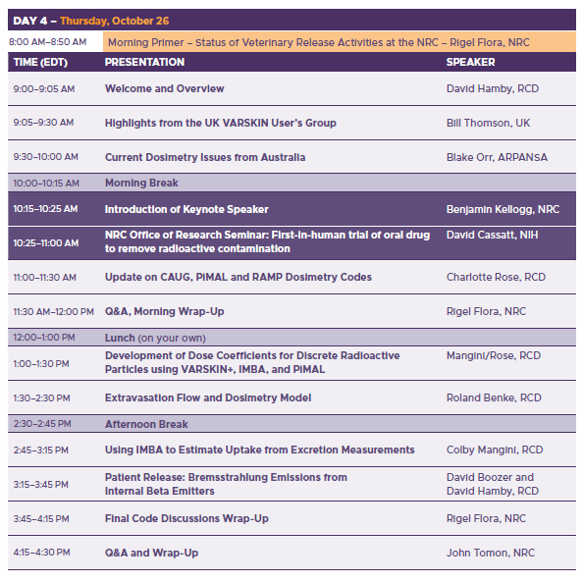
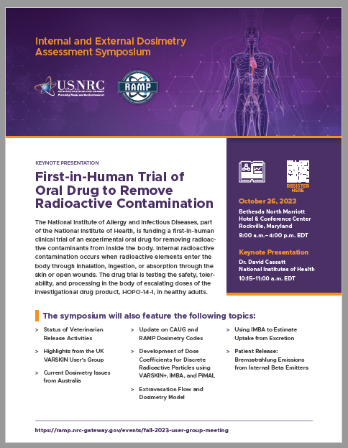
Notes:
Thursday
Highlights are VARSKIN from UK, Current Dosimetry Issues from Australia and the Keynote Presentation
The afternoon is devoted to work funded by the NRC by RCD.
We will change rooms on Thursday. The symposium will be in Oakley.

Slide 10
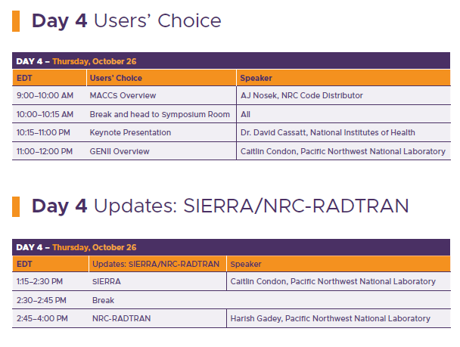
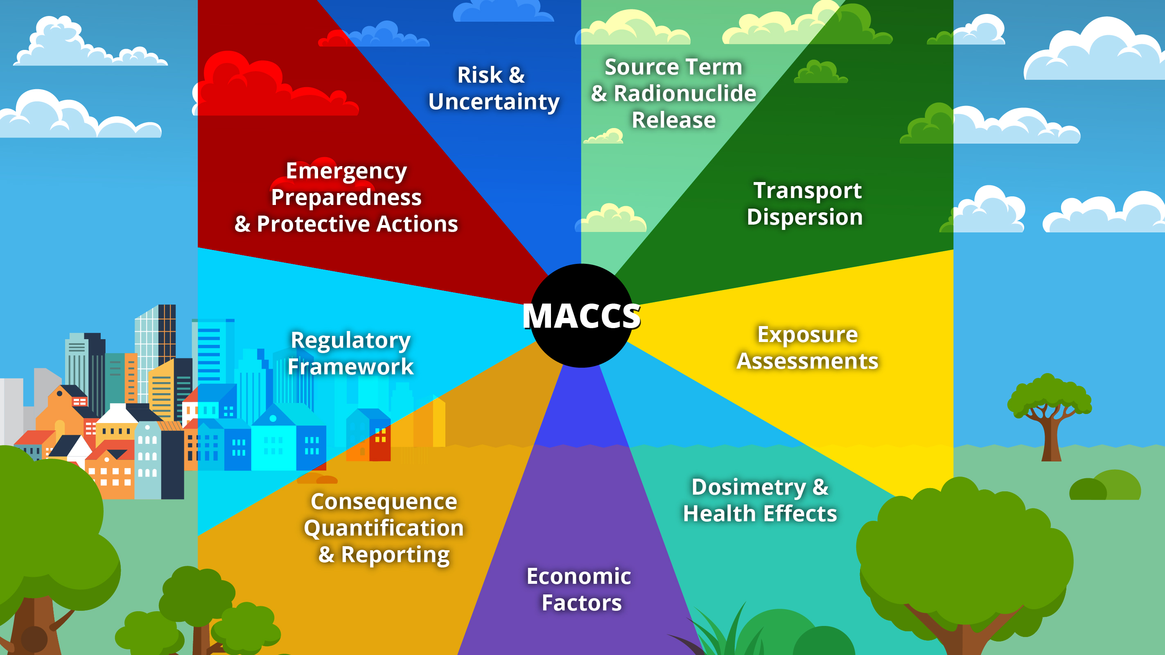

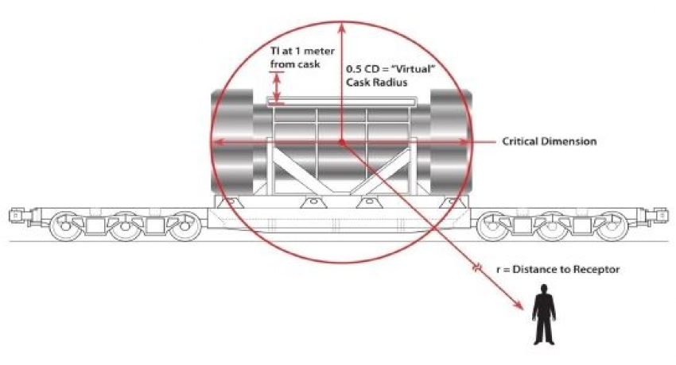
There’s more on day four!
Notes:
Day 4 is also User’s Choice. During registration, User’s had the option to choose certain topics and MACCS Overview and GENII were the top two choices.
Also of note: at 10:00, there will be a break for those in this session to attend the Symposium keynote.
These presentations will be in Great Falls. Its also right around the corner.
In the afternoon, we have a status and update on SIERRA and NRC RADTRAN.

Slide 11
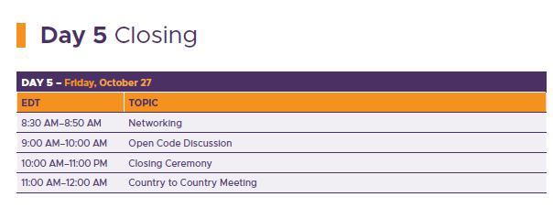
Sad to see you go…
Notes:
During the week, we will gauge how Friday will go.
The RAMP team is always here., we will be in Great Falls.
However, some trainers may be with us via Teams.
We will also have certificates for those that stay and can email certificate to those on the Teams call.
And of course we will have cake.

Slide 12


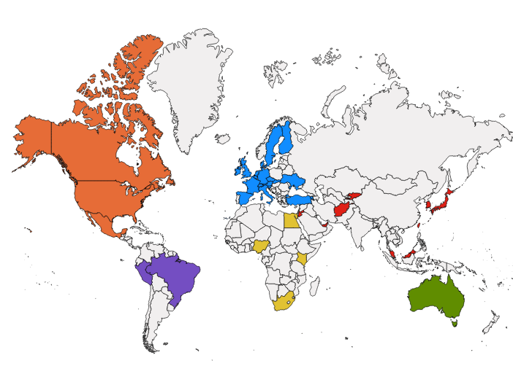
Roll Call
A special welcome to our international partners
Australia, Canada, Ghana, Finland, Italy, Mexico, Nigeria, South Africa, South Korea, Spain, Taiwan, Ukraine, United Arab Emirates, United States, United Kingdom
Notes:
A special welcome to Canada, Ghana, South Korea and Taiwan.. We had discussions over the year and will meet with each of you separately during the week.

Slide 13









Welcome Federal Partners
Notes:
As John said, there are over 200 participants during the week of the RAMP meeting.
Including our Federal Partners, EPA, NIST, FEMA, NIH, DOE, Army, Navy and DOT.

Slide 14







National Laboratories
Notes:
Welcome to the National Labs of Pacific Northwest National Lab, Argonne National Lab, Oak Ridge National Lab, Idaho National Lab, Sandia, Los Alamos Natioinal Lab and Brookhaven.
Also welcome to our licenses, applicants, universities and medical centers.

Slide 15









Welcome State Partners
Notes:
Welcome to our State Participants in Nebraska, Virginia, Arkansas, Connecticut, New Jersey, Texas, Alabama, Florida and West Virginia

Slide 16
Your Role in the Meeting
Participate actively
Share your insights
Work together for safety
Build networks
Strengthen collaboration
Enjoy Washington DC
Notes:
To reiterate John’s last email, your role is to x, y, z.
..and we hope you have time to enjoy Washington D.C.

Slide 17
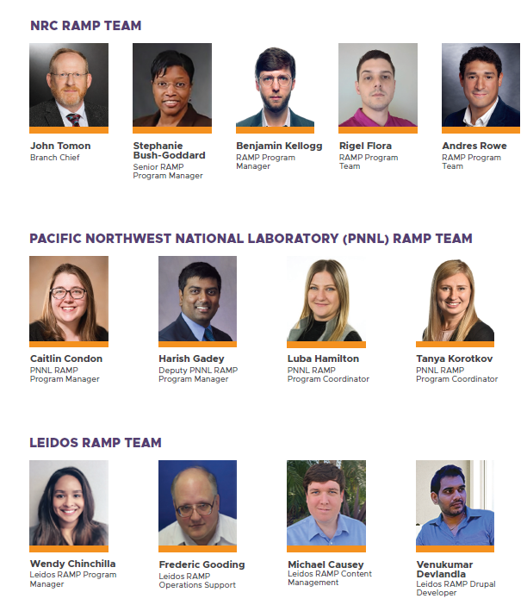
Notes:
Thank you from the RAMP Team. I want to recognize both PNNL and Leidos. They are instrumental in making this program work, and they work very hard during the year to ensure the website site and codes and distributed and maintain.

