Slide 1
Day-2 Primer: Spent Nuclear Fuel Management
Harish Gadey and Caitlin Condon
Pacific Northwest National Laboratory
2023 Fall RAMP Users’ Group Meeting
October 23–27, 2023
Rockville, MD
Notes:
About the Image: A Glass From the Past
While taking a closer look at ancient glass to better understand how it changed over time, Pacific Northwest National Laboratory scientists made an unexpected discovery-the remains of bacteria that once lived on the surface. PNNL researchers and collaborators are delving into the past to further their knowledge about the stability of glass that will be used to safely store low-activity nuclear waste at the Hanford Site. With support from the Department of Energy's Office of Environmental Management, International Programs through the Office of River Protection, they are analyzing this glass found in Swedish hillforts that predates the Vikings because it has a chemical composition similar to what will be produced at Hanford's Waste Treatment and Vitrification Plant and has been "stored" in a known environment for more than 1,500 years.
Research team: David Peeler, Bruce W. Arey, Carolyn I. Pearce, Tamas Varga, Micah D. Miller, Michele Conroy and Michael J. Schweiger (all of PNNL); John S. McCloy (Washington State University); Jamie L. Weaver (National Institute of Standards and Technology); Edward Vicenzi and Thomas Lam (Smithsonian Institution's Museum Conservation Institute); Rolf Sjoblom (Tekedo AB); Eva Hjarthner-Holdar and Erik Ogenhall (Arkeologerna); and Albert A. Kruger (Department of Energy Office of River Protection). The image was colorized by Nathan Johnson (PNNL).
Instrument: Scanning electron microscope and focus ion beam hybrid
https://www.flickr.com/photos/pnnl/24220123368/in/photolist-fqwiqF-aBF44N-fqwj9R-aEuQHd-CUfsRW-pZVLNL-aPjNkZ-fxBosi-aErWsK-aBCnZk-ECMqka-aEr4hT-6yL625-6xvZrp-6xh38v-6xmeiY-VNqjUa-CJUXKp-CPUyAo-25kubq5-BUPMLB-211nysv-Chikdn-Cq6fRm-BscBWe-CnhkRJ-CiHawx-CPUwEu-BUGK7J-CiHawn-BUPKMg-CGEBLY-BUGHTw-CJV1jx-CPUxnw-CSdgpF-CSdj4D-CJUWi6-CPUwFm-BXsubh-CPUxJd-CiHdVB-BUGG5b-BUGHYm-22DixCm-243ex8R-Cq6jHQ-CGEzzy-PEd3HJ-P9S5sd

Slide 2
Disclaimer
This is a technical presentation that does not take into account contractual limitations or obligations under the Standard Contract for Disposal of Spent Nuclear Fuel and/or High-Level Radioactive Waste (Standard Contract) (10 CFR Part 961). To the extent discussions or recommendations in this presentation conflict with the provisions of the Standard Contract, the Standard Contract governs the obligations of the parties, and this report in no manner supersedes, overrides, or amends the Standard Contract.
This presentation reflects technical work which could support future decision making by DOE. No inferences should be drawn from this presentation regarding future actions by DOE, which are limited both by the terms of the Standard Contract and Congressional appropriations for the Department to fulfill its obligations under the Nuclear Waste Policy Act including licensing and construction of a spent nuclear fuel repository.
This information was prepared as an account of work sponsored by an agency of the U.S. Government. Neither the U.S. Government nor any agency thereof, nor any of their employees, makes any warranty, expressed or implied, or assumes any legal liability or responsibility for the accuracy, completeness, or usefulness, of any information, apparatus, product, or process disclosed, or represents that its use would not infringe privately owned rights. References herein to any specific commercial product, process, or service by trade name, trademark, manufacturer, or otherwise, does not necessarily constitute or imply its endorsement, recommendation, or favoring by the U.S. Government or any agency thereof. The views and opinions of authors expressed herein do not necessarily state or reflect those of the U.S. Government or any agency thereof.

Slide 3
Outline
Introduction
Next Generation System Analysis Model (NGSAM)
Stakeholder Tool for Assessing Radioactive Transportation (START)
Conclusions

Slide 4
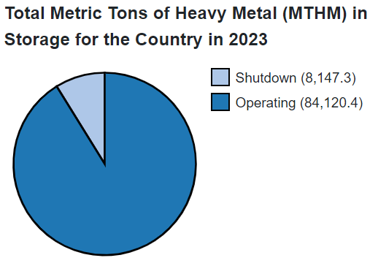
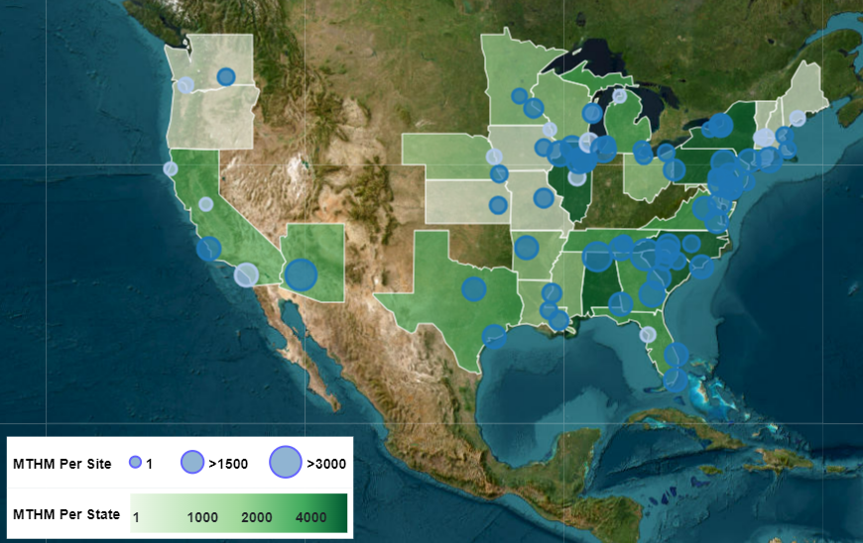
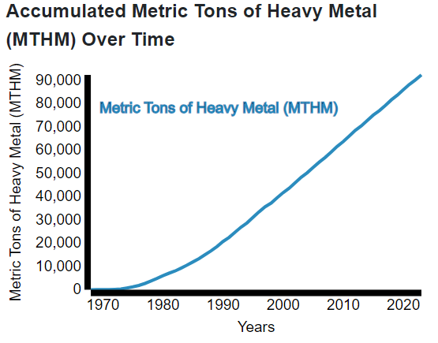
Introduction
>92,000 MTHM (projected) SNF is stored in the United States as of 2023
https://curie.pnnl.gov/map

Slide 5

Next Generation Systems Analysis Model
Next Generation System Analysis Model (NGSAM):
  Agent-based toolkit
  Answer “What if ?” scenarios
  Collaborative effort (ANL, INL, ORNL, PNNL, SNL)
System analyst goals include:
  Information regarding various alternatives
  Understanding system requirements, performance, inter-dependencies, and sensitivities
  Generate cost estimates for scenarios
Origin
Storage
Transportation
Disposal

Slide 6
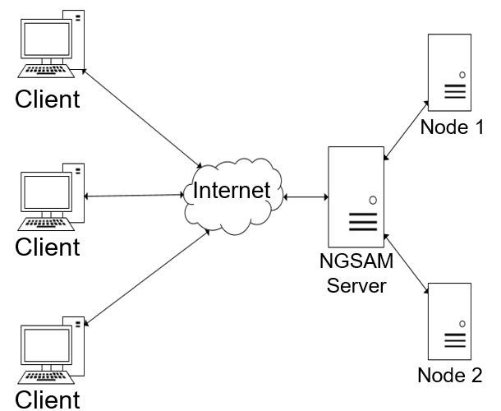
NGSAM (cont.)
Data for NGSAM analysis:
  Unified Database (UDB)
  Transportation routing information from the Stakeholder Tool for Assessing Radioactive Transportation (START)
  Scenario specific data (facility capacities, receipt rates, etc.)
Backend of NGSAM:
  Java Transportation Operations Model (JTOM)
  Transportation scheduler (movement of SNF from sites)

Slide 7
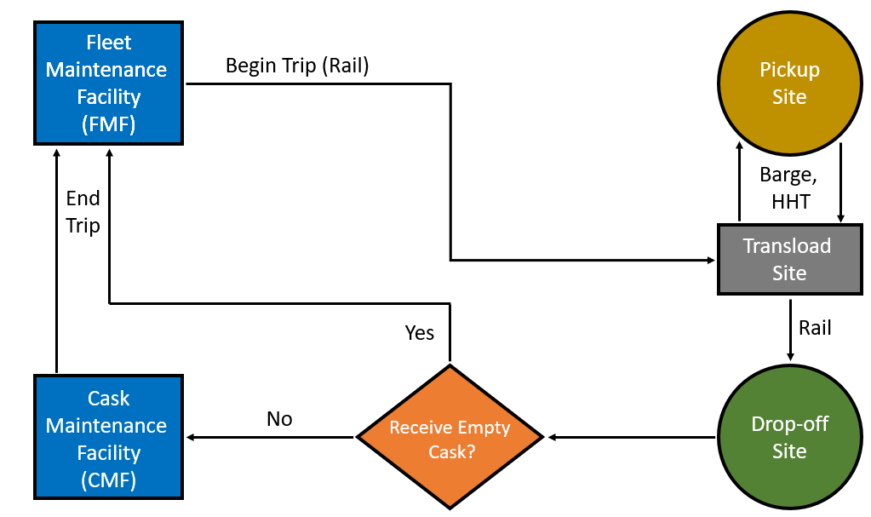
NGSAM (cont.)
Barges accommodate a similar or greater number of casks than rail
Rail – Preferred mode of transportation:
  Rail connects more geographical regions vs navigable waters
Operable rail infrastructure not available at all sites
Barge or heavy haul truck (HHT) can be used for transport to transload site

Slide 8
NGSAM (cont.)
Three transload options:
  Barge to transload site
  Barge to transload site via short distance HHT
  HHT to transload site
Factor in information from DOE documents and site-specific de-inventory reports
Assumptions:
  Five casks per shipment
  Site Transporter and staging area availability
  24-hour fuel loading operation in spent fuel pool

Slide 9
NGSAM (cont.)
Assumption on Durations (current values):
  16 hours to load from ISFSI
  4-5 hours for site transfer time
  Between 3 to 5 hours for mode transfer time
JTOM methods: Java based methods for executing tasks (fuel loading in cask, cask loading on rail, transportation, etc.)
Data stored within NGSAM or CSV files

Slide 10
NGSAM (cont.)
Process steps developed and time estimated between:
  railcar arrival (with empty casks) at transload site; and
  railcar departure (with loaded casks) from transload site
Process steps mapped to JTOM methods
Identified steps with no defined JTOM methods
Exchange of loaded casks for empty casks at transload site was beyond the scope of this study
SNF Transfer Assumptions | Total Time (days)*
From BWR pool | 33.5 to 40.5
From PWR pool | 31.5 to 38.5
From ISFSI | 18 to 20
*from railcar arrival at transload site
to railcar departure from transload site

Slide 11
NGSAM (cont.)
Proposed Times
Cask loading times:
  BWR pool: 105 hours
  PWR pool: 95 hours
  ISFSI: 16 hours
Site Transfer time: 4 to 5 hours
Mode transfer time: 2 to 10 hours
Identical times considered for transfer between modes (for example, barge to rail and rail to barge)

Slide 12
Stakeholder Tool for Assessing
Radioactive Transportation (START)

Slide 13

Integrated Waste Management
The Department of Energy (DOE) is planning for an integrated waste management system to transport, store, and dispose of the nation's spent nuclear fuel (SNF) and high-level radioactive waste (HLW).
An integrated waste management system consists of siting facilities and other key infrastructure needed to safely manage SNF and HLW from commercial electricity generation, as well as national defense activities.
Notes:
https://www.energy.gov/ne/integrated-waste-management

Slide 14

U.S. Congress provides funding and directs DOE to move forward with interim storage to support near-term action in managing the nation’s SNF and is an important component of an integrated waste management system.
Interim storage of SNF would allow DOE to begin removing fuel from shutdown reactor sites in the near term.
Interim Storage

Slide 15
START Features & Functions
Feature/Function | START
Program Access & Protection | Yes
User Guide & Feedback Mechanism | Yes
Geographic Coverage | Continental U.S.
Transport Modes | Highway, Rail, Waterway, Intermodal
Base Maps | 36 options
Data Layers & Attributes | 58 layers Attributes Included Within Each Layer
Origin/Destination Selection | Drop-Down Menus, User-Defined
Routing Criteria | Distance, Travel Time, Population Exposure
Routing Constraints | Ability to Avoid Locations Ability to Require Shipment to Pass Through Locations
Feature/Function | START
Buffer Zones | 800 Meters, 2500 Meters
Route Analysis Outputs | Summary, Detailed
Batch Processing | Yes
Reporting Formats | Total Route, State, Tribal Land, County, Congressional District, Military Bases, State Legislative Districts
Export Capability | Reports, Shapefile, csv, kml
Smart Mapping | Spatial Statistics, Filtering, Thematic
Route Sharing | Yes
Photographic Features | Yes
Measurement Tools | Area, Distance, Map Coordinates, Elevation
Radiological Exposure | Incident-Free Dose from SNF Transport

Slide 16
START GIS Data Layers
Shipment origin and transfer points:
Potential transload sites, Nuclear reactors, Shutdown sites, DOE and other facilities
Emergency response assets:
Fire departments, TEPP trained personnel, Police, Hospitals, State EOCs, Advance notification designees
Mass gathering places:
Theme parks and zoos, Casinos, Performing arts centers, Stadiums and arenas, Malls, National monuments/icons, Places of worship, Airports
Educational and elderly care facilities:
Schools, Colleges/Universities, Day care centers, Nursing homes
Transportation infrastructure and operations:
Rail network, freight stations, junctions, crossings, yards, bridges, tunnels
Highway: network, bridges
Navigable waterway network, locks/dams, water terminals, Coast Guard Districts, Captain of Port Zones
Existing Routes:
Highway Hazmat Route Registry
DOE WIPP Highway Routes
U.S. Navy Spent Fuel Rail Routes
Environmental land uses:
Parks, National forests, Federal lands, Military bases, Hazard threat urban areas, Surface water
Political jurisdictions:
Tribal lands, Congressional Districts, States, State legislative districts, Counties, City limits, Urban areas
Other:
Social vulnerability index, Transportation infrastructure photos
The availability and utilization of such an extensive array of geospatial information provides a rich platform for assessment and communication.

Slide 17
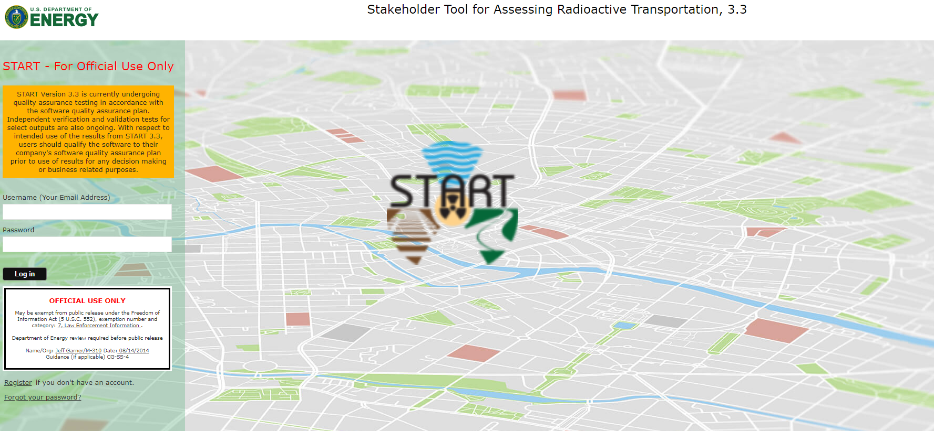
start.energy.gov

Slide 18
Features and Functions
START supports many aspects of the Integrated Waste Managements (IWM) program, including:
Serving as a communications tool for conveying geospatial data and information.
An options analysis tool for exploring potential transport modes and routes.
An emergency response planning tool for States and Tribes to identify training needs along potential transport corridors.
An environmental analysis tool for estimating potential radiation dose exposure from incident-free conditions.
A systems analysis support tool for providing route-related inputs for throughput analysis.

Slide 19
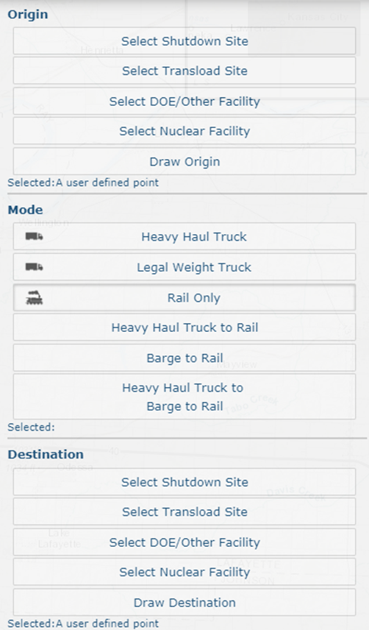
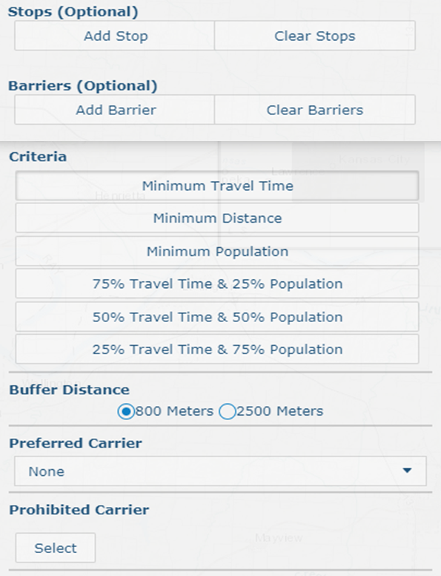
Routing Options

Slide 20
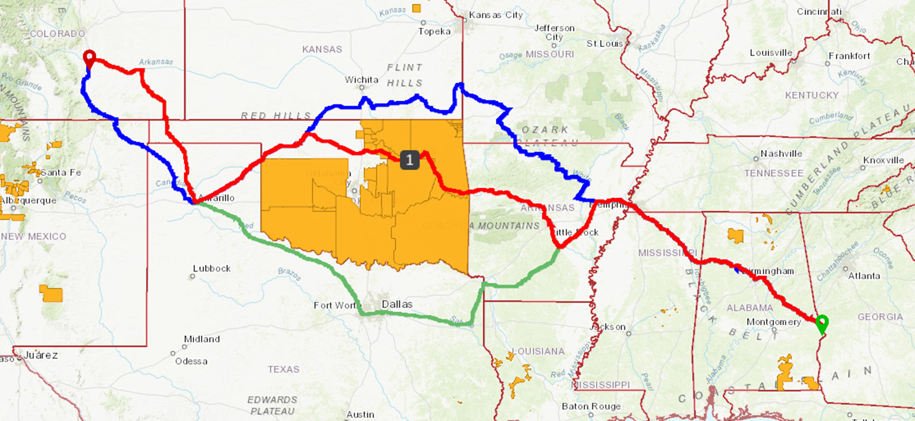
Routing Examples*
* Example routes are for illustrative purposes only and do not reflect a selected destination site.

Slide 21
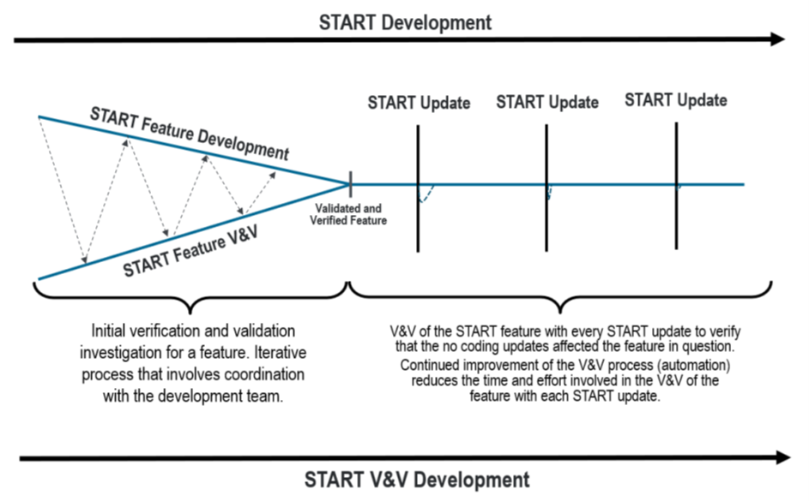
Verification and Validation (V&V)
The development team provides new and updated features implemented with each new version of START.
Updated features are subsequently evaluated by the V&V Team.
The V&V team then provides feedback and suggestions for further updates and development of future versions.

Slide 22
Verification and Validation (V&V)
The independent V&V of START began in 2020.
V&V of START is conducted continuously as START is developed and new data features are added or updated.
As START implements updates, output data that is considered crucial is validated against the previous version’s data as well as any updated data layers and new features are evaluated for accuracy.

Slide 23
Population Data Verification
Population within the buffer zone was identified as a crucial output of START that could be used in an impact evaluation.
When generating a route, START calculates population data using a designated buffer zone along the route and determines the geographic overlay with a population raster data set.
Using the same method, test routes were imported into QGIS and ArcMap where a buffer zone was created and overlayed with a population raster data set.
The average population extracted from QGIS and ArcMap were then compared to the START results as part of the V&V process.

Slide 24
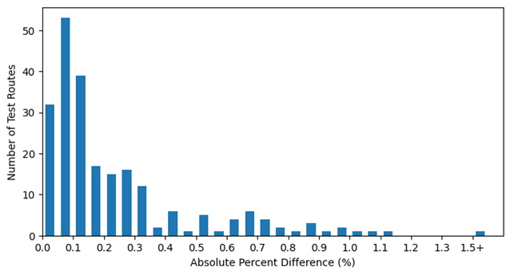
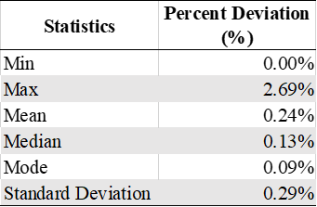
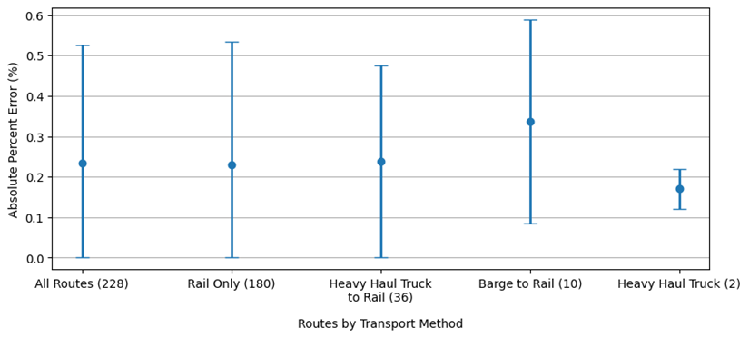
Population Data Results
Strong agreement was observed between the START results and the QGIS, ArcMap data
START Population Data Comparison to Calculated Population Data using latest LandScan data inputs
START Population Data Comparison by Transport Method

Slide 25
Route Length Data Verification
Route length was identified as a crucial output of START that would be used in an impact evaluation.
The route distance was verified and validated using the QGIS software using the KML file of the route downloaded from START.
The route must be reprojected from the native ESPG:4326 projection into ESPG:3857 or web Mercator in order to calculate the route distance in QGIS.
The route distance V&V was conducted in QGIS because it is fully independent of START. In addition, START utilizes the ArcMap Network Analyst tool for this calculation.
Automated python scripts were developed in QGIS and used to calculate the route length.

Slide 26
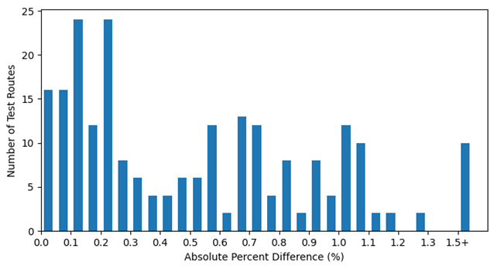
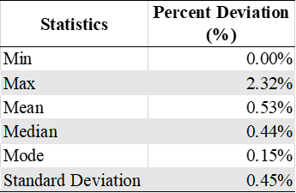
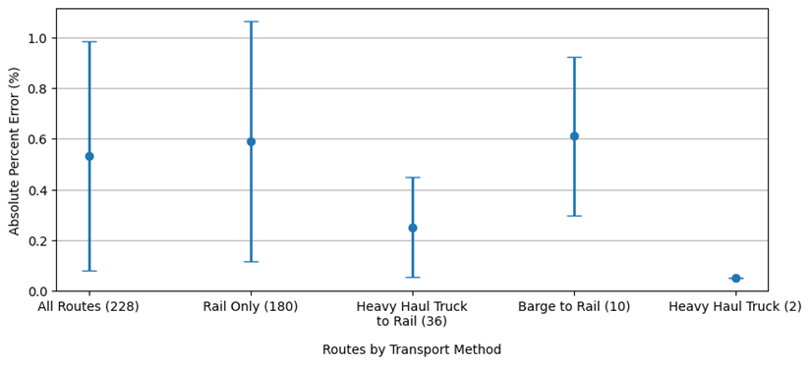
Route Length Data Results
The results showed overall good agreement with an average difference of 0.53% (SD 0.45%).
START Length Data Comparison as Calculated in QGIS
START Length Data Comparison by Transportation Method

Slide 27
Future START Tasks and Results
As DOE continues to plan for the eventual transportation, storage, and disposal of SNF and HLW from nuclear power plants and DOE sites, tools assisting in decision making and risk assessment will be needed.
START provides a tool that provides stakeholders with the ability to compare route attributes such as accident likelihood, expected population dose, and route length among others.
With each update, START data is verified by an independent V&V team.
With the update of START to v.3.2.2, the V&V team verified length and population using independent data. The population data was verified using the latest LandScan data in QGIS and show good agreement with an average difference of 0.24% (SD 0.29%). The length data was compared to data generated in QGIS and showed good agreement with an average difference of 0.53% (SD 0.45%).

Slide 28
Conclusion
Projected SNF inventory (2023)
Back-end SNF process flow and transload operations (NGSAM)
SNF routing and GIS analysis tool – Routing and V&V
Functionality and data cross-feed of two SNF management tools – NGSAM and START discussed

