Slide 1


NRC
Artificial Intelligence
Strategic Plan
RAMP User’s Group Meeting
October 25, 2023
Matt Dennis
Data Scientist
Office of Nuclear Regulatory Research
U.S. Nuclear Regulatory Commission

Slide 2


Outline
Intro to AI
U.S. Nuclear AI Landscape
NRC AI Strategic Plan
AI Partnerships, International Engagement and Standards
Considerations and Executing the NRC AI Strategic Plan

Slide 3


CONSIDERING SAFE ARTIFICIAL INTELLIGENCE (AI) AND MACHINE LEARNING (ML) ADOPTION
https://safeautonomy.blogspot.com/2023/01/the-tesla-autopilot-crashes-just-keep.html

Slide 4


DEVELOPING A CONSISTENT UNDERSTANDING
Artificial Intelligence
  A machine-based system that can go beyond defined results and scenarios and has the ability to emulate human-like perception, cognition, planning, learning, communication, or physical action. For a given set of human-defined objectives, AI can make predictions, recommendations, or decisions influencing real or virtual environments. These systems use machine- and human-based inputs to perceive real and virtual environments, abstract such perceptions into models through analysis in an automated manner, and use model inference to formulate options for information or action.¹
Machine Learning
  An application of artificial intelligence that is characterized by providing systems the ability to automatically learn and improve on the basis of data or experience, without being explicitly programmed.¹
¹National Defense Authorization Act (2021)

Slide 5



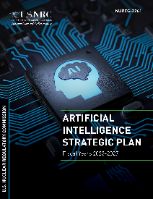




AI LANDSCAPE AND THE NRC
NUCLEAR INDUSTRY
(EXTERNAL)
OTHER CONSIDERATIONS
AND OPPORTUNITIES
(EXTERNAL)
INTERNAL TO THE NRC
Federal actions for accelerating the use of AI in government operations
NRC Evidence Building
Priority Questions
Industry wants to use AI
Internal interest in researching
AI-based tools ranging from AI-embedded in commercial applications to custom programming
ACTIVITIES
AI Strategic Plan
to prepare staff to review AI
Wide range of AI meetings, conferences, and activities

Slide 6









NUCLEAR INDUSTRY AI SURVEY
In April 2021, NRC issued a Federal Register Notice (FRN) soliciting feedback on the nuclear industry’s AI readiness and applications
FRN responses indicated
  Benefits are great, but cost of developing and implementing AI is a challenge
  Concerns about data security, including cyber intrusions, proprietary information leakage, and loss of export control
  Developers are particularly interested in using NLP, neural networks, and clustering algorithms

Slide 7
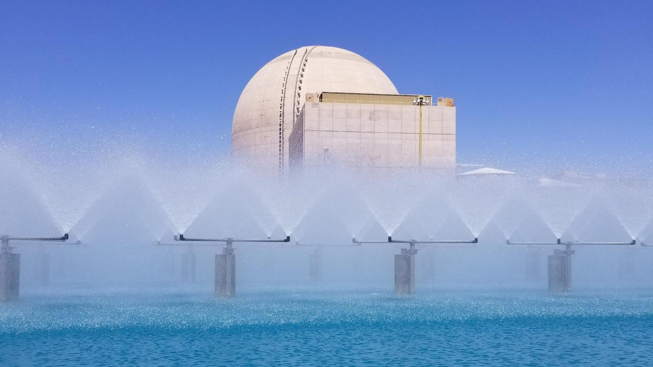
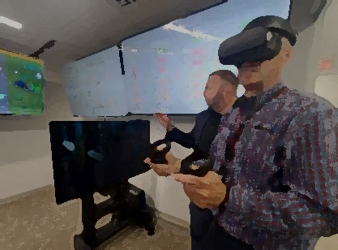
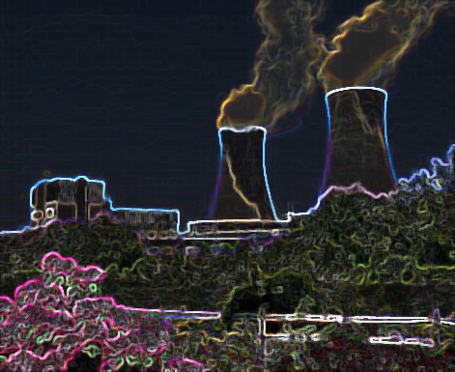

NUCLEAR INDUSTRY AI LANDSCAPE
Industry Project Categories
  Increasing existing economic efficiency
  Plant condition monitoring
  Process improvement and cost reduction
  Plant automation
  Sensor-enabled degradation assessment
Example Operating Reactor Application Areas
  Non-destructive examination
  Advanced remote monitoring
  Corrective action process automation
  Core design optimization
  Generative document preparation
  Physics-informed surrogate models
Example Advanced Reactor Application Areas
  AI/ML-enabled digital twins
  Autonomous operation of backend processes
  Design optimization
Example Radiation Protection Application Areas
  Medical image recognition, radiotherapy treatment preparation, radiobiology, dosimetry

Slide 8


Workshops Objectives and Findings
Foundational Knowledge
Collaboration Opportunities
Data Sharing
Current Projects
Future Activities
Workshop series has discussed Intro to AI, Current Topics, Future Focused Initiatives and AI Characteristics for Regulatory Consideration
Observations
  Industry interest in regulatory guidance
  Nuclear-specific data sharing would benefit development of data hungry AI applications
  As of 2021, potential AI application deployment in 1-2 years and regulated applications in 3-5 years
  Encouragement to engage collaboratively to pursue potential pilot studies and proofs of concept to serve as a foundation for reviewing
  the use of AI in NRC-regulated activities

Slide 9


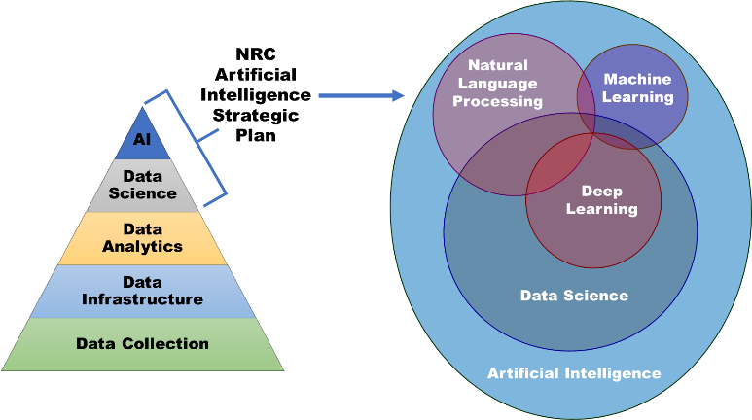

AI STRATEGIC PLAN SCOPE

Slide 10
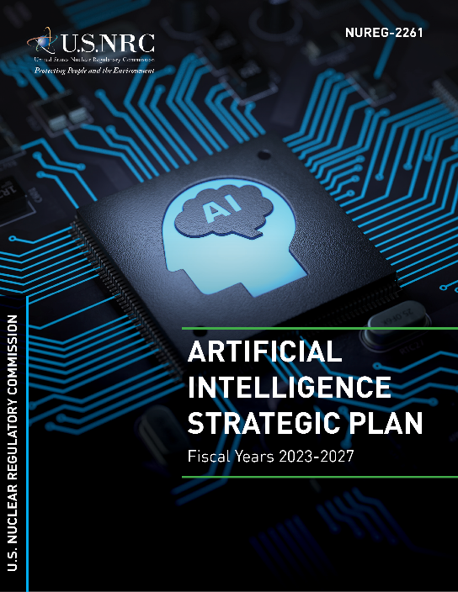
ARTIFICIAL INTELLIGENCE STRATEGIC PLAN
OVERVIEW
Vision and Outcomes
Continue to keep pace with technological innovations to ensure the safe and secure use of AI in NRC-regulated activities
Establish an AI framework and cultivate a skilled workforce to review and evaluate the use of AI in NRC-regulated activities
The AI Strategic Plan consists of five strategic goals:
Goal 1: Ensure NRC Readiness for Regulatory Decisionmaking
Goal 2: Establish an Organizational Framework to Review AI Applications
Goal 3: Strengthen and Expand AI Partnerships
Goal 4: Cultivate an AI-Proficient Workforce
Goal 5: Pursue Use Cases to Build an AI Foundation Across the NRC
Draft Available at ML22175A206
Final available at ML23132A305

Slide 11
NOTIONAL AI AND AUTONOMY LEVELS IN COMMERCIAL NUCLEAR ACTIVITIES
Level | Notional AI and Autonomy Levels | Potential Uses of AI and Autonomy in Commercial Nuclear Activities
Level 0 | AI Not Used | No AI or autonomy integration in systems or processes
Level 1 | Insight Human decision-making assisted by a machine | AI integration in systems is used for optimization, operational guidance, or business process automation that would not affect plant safety/security and control
Level 2 | Collaboration Human decision-making augmented by a machine | AI integration in systems where algorithms make recommendations that could affect plant safety/security and control are vetted and carried out by a human decisionmaker
Level 3 | Operation Machine decision-making supervised by a human | AI and autonomy integration in systems where algorithms make decisions and conduct operations with human oversight that could affect plant safety/security and control
Level 4 | Fully Autonomous Machine decision-making with no human intervention | Fully autonomous AI in systems where the algorithm is responsible for operation, control, and intelligent adaptation without reliance on human intervention or oversight that could affect plant safety/security and control
Human
Involvement
Machine
Independence
Common Understanding of the Level Key for Regulatory Readiness

Slide 12
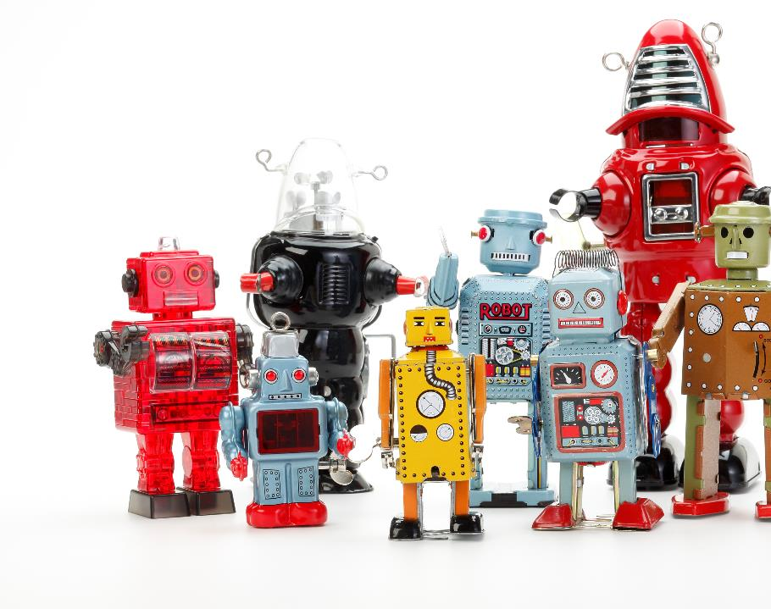








STRENGTHENING AND EXPANDING AI PARTNERSHIPS
Leveraging MOUs
New Data Science and AI Addendum
Operating Experience and Data Analytics
Enhancing and leveraging existing Memoranda of Understanding (MOU)
Participating in federal AI working groups and maintaining awareness of other AI regulatory activities
Engaged with international counterparts interested in AI for nuclear
Maintaining continual engagement on state-of-the-art research
Maintaining Federal Awareness
International Collaboration

Slide 13


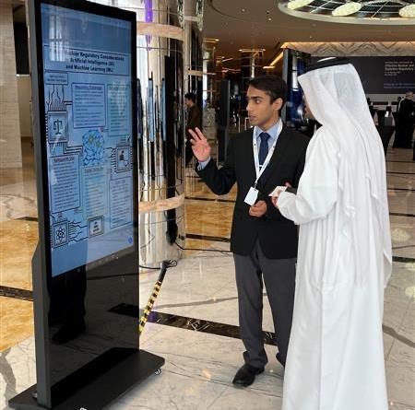

AI INTERNATIONAL COLLABORATION
CANUKUS quarterly trilateral meetings on AI and innovation
CANUKUS AI Principles Paper
IAEA AI Activities
  Safety Implications of the Use of AI in Nuclear Power Plants
  Artificial Intelligence and its Recent and Near-Term Deployment in Operating Nuclear Power Plants

Slide 14



AI STANDARDS ENGAGEMENT
IEC/SC 45A - Instrumentation, control and electric power systems of nuclear facilities
  WGA 12 – AI for nuclear facilities
  Initiated August 2023
  35-member multi-disciplinary international team
  (4 NRC staff)
WGA 12 anticipated document products
  Level 2 cross-cutting areas (e.g., trustworthiness, testing and V&V, etc.)
  Level 3 nuclear-specific AI applications (e.g., virtual sensors, anomaly detection)
  Technical reports supporting Level 2/3 standards

Slide 15

NRC AI CONSIDERATIONS
Current
Future
Regulatory Guidance and Decision-Making Development
Differentiating AI Usage for Modeling/Design vs. Autonomous Control
Explainable AI and Trustworthy AI – Reliability and Assurance
Internal AI Budget Predicated on Emergent Industry Applications
Workforce Training
Traceable and Auditable Evaluation Methodologies
Internal Challenges: AI Uses for Agency Business Processes
External Challenges: Understanding Licensee and Applicant AI Usage

Slide 16

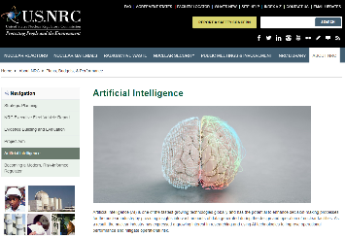
EXECUTING THE AI STRATEGIC PLAN
AI Research Priorities
Regulatory framework applicability assessment
Survey AI tools and methods for safety evaluation
AI use cases for regulatory framework
AI standards identification
AI partnerships
AI Regulatory Workshops
Scoping AI characteristics and regulatory considerations (September 19, 2023)
Regulatory gaps and considerations (2024)
AI Organizational Framework
Internal NRC AI Steering Committee
Internal NRC AI Community of Practice
NRC AI Webpage

Slide 17


MOVING FORWARD AND STAKEHOLDER ENGAGEMENT
Continued safety and security in the nuclear industry is paramount
Embrace new and innovative ways to meet NRC’s mission
Maintain strong partnerships with domestic and international counterparts
Engage with the NRC early and often on plans and operating experience
Future Activities
Advisory Committee on Reactor Safeguards subcommittee meeting on AI (November 15, 2023)
Regulatory framework applicability assessment of artificial intelligence in nuclear applications (Summer 2023 Spring 2024)

Slide 18

Contact Us
Matt Dennis
Data Scientist
Office of Nuclear Regulatory Research
matthew.dennis@nrc.gov
Luis Betancourt, P.E.
  Chief, Accident Analysis Branch
  Division of Systems Analysis
  Office of Nuclear Regulatory Research
  luis.betancourt@nrc.gov
Victor Hall
  Deputy Division Director
  Division of Systems Analysis
  Office of Nuclear Regulatory Research
  victor.hall@nrc.gov

Slide 19
ABBREVIATIONS
ADAMS –Agencywide Documents Access and Management System
AI – Artificial Intelligence
AICoP – Artificial Intelligence Community of Practice
AISC – Artificial Intelligence Steering Committee
CNSC – Canadian Nuclear Safety Commission
DOE – U.S. Department of Energy
EO – Executive Order
EPRI – Electric Power Research Institute
FDA – U.S. Food and Drug Administration
FRN – Federal Register Notice
FY – Fiscal Year
GAO – U.S. Government Accountability Office
GSA – U.S. General Services Administration
IAEA – International Atomic Energy Agency
IEC – International Electrotechnical Commission
ML – Machine Learning
MOU – Memorandum of Understanding
NLP – Natural Language Processing
NRC – U.S. Nuclear Regulatory Commission
OMB – U.S. Office of Management and Budget
ONR – U.K. Office for Nuclear Regulation
NEI – Nuclear Energy Institute
NIST – National Institute of Standards and Technology
XAI – Explainable Artificial Intelligence

Slide 20
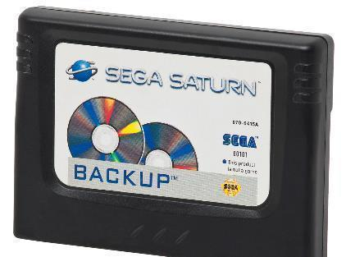

BACKUP SLIDES

Slide 21


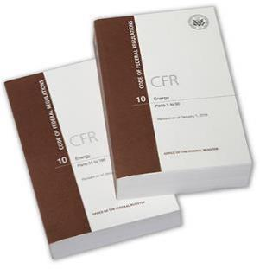



NRC REGULATORY FOCUS AREAS
Operation and Oversight
Tests and Regulatory Engagement
Licensing Process Steps
NRC Focus Areas
Regulatory Framework
Final Safety Analysis Report
Design Certification
Operating/Combined License
Inspections, Tests, Analyses, and Acceptance Criteria
Pre-Application Interactions
Conceptual Design
Preliminary Safety Evaluation Report
Topical Reports
Industry Guidance Documents
Consensus Codes and Standards
Regulatory Review, Inspections and Tests

