Slide 1
ALARA in Diagnostic Imaging
Charlotte Rose MS (RHP)

Slide 2
Welcome and Introductions
Hello everyone and welcome to the afternoon of day 2! I am so grateful to be here talking with you IN PERSON today, after 3 years of COVID, it is nice to be doing conferences in person.
I feel very lucky to have been welcomed here by the Ghana Nuclear Regulatory Authority, and by the USNRC. So thank you! It is lovely to meet you all.
Back home, in Oregon, I have a 13-year old boy who I am missing greatly right now! Being here with you was an opportunity I was very happy to take. And I think he’s probably happy that his mom isn’t around to bug him about doing his homework!

Slide 3
My role at RCD
Research Scientist
  MCNP User
  Whitepaper writer
  Validation and verification of dose codes like Varskin
  Science research and support for Reg guide: release of patients after administration of radiopharmaceuticals
    Groundwork for veterinary guide of same theme
  Support for other dose assessments
  First Job at RCD; translator

Slide 4
As a student
Graduated with a Bachelor of Science in Radiation Health Physics
  Science of radiation interaction with matter
  Doses to environment and people
  Interactions with detectors, shielding
Graduate degree (MS) in same with minor in Statistics
  US NRC Fellowship for my first year as a graduate student
  Compliment to the analytical work
  Monte Carlo method
  Validation and verification of models and methods

Slide 5
Previous to work as a Scientist
Worked as a medical radiation technologist from 1997 through 2011
  General duty
  Portable radiography in operating room and intensive care units
  Fluoroscopy
  Computed tomography (2004-2011)
Patient care, image quality hinged on radiation protection
  Worked primarily nights (midnight-8am) so always on own, primary contact with patients, physicians, nurses, accessory hospital staff, families and emergency workers (firemen, police etc)
  Lots of questions about radiation protection; unknowns and fears

Slide 6
Working as a medical radiation technologist
From 1997 through 2011 lots of changes were happening
  Analogue film screen combinations to
  Digital radiography
  Changes to equipment and room layouts; the realization that techs/management/radiation safety officers/design engineers/engineering analysts (radiological engineers) don’t have the same vision in mind, so I challenge you to take in the discussion and see things from a different perspective. – I also work as a radiological engineer where I do dose analysis for components and people in radiation environments, so I see the license from both the perspective of the regulator AND the designer.
  This is important!!

Slide 7
One other thing to mention
The work I did as a technologist was in my home country, Canada.
I understand cultural differences and how they impact how we learn and work
Canada is a bilingual country, and science is conducted in both official languages, so I understand that language barriers exist: please DO NOT hesitate to ask me to slow down in explaining things during discussions. I can sometimes get excited talking about analysis and if I speed up, I may need to be reminded to slow down! I will not be offended ☺

Slide 8
Introductory information
During the presentations, I invite you to ask questions and share experiences – How would this information serve you?
Tomorrow I will be conducting a session on how to use PIMAL, from installation to an example problem. Think of ways that you could use the codes and bring questions and feedback to the presentations!
Notes:
21 minutes to this point. Allow 15 minutes for audience introductions. If it runs less, ask questions like “have you had experience with yourself or a loved one in a diagnostic imaging exam? Did you knowabout radiaiotn? Was the person you were with scared or concerned? Did you wish that you had more information from the hospital worker? Etc.

Slide 9
Agenda for this talk
1st half (90 min)
  ALARA details / a day in the life of an imaging tech 1:00-2:30
2nd half (60 min)
  ALARA modeling with RAMP (PIMAL examples)
  VARSKIN capabilities with wound dose
  Work with extravasation
  2:45-3:45
Questions
  3:45-4:00

Slide 10
ALARA – the NRC, IAEA, WHO
NRC – “ALARA is an acronym for “as low as is reasonably achievable” which means making every reasonable effort to maintain exposure to ionizing radiation as far below the dose limits as is practical, consistent with the purpose for which the licensed activity is undertaken, taking into account the state of technology, the economics of improvements in relation to state of technology, the economics of improvements in relation to benefits to the public health and safety, and other societal and socioeconomic considerations, and in relation to utilization fo nuclear energy and licensed materials in the public interest”
IAEA – uses the term “optimization”
WHO – Bonn call to action: joint position statement between the IAEA and WHO identifying and addressing issues arising in radiation protection in medicine. The actions to improve radiation protection in Medicine in the next decade all have ALARA at heart; focusing on the role of the manufacturer, health professional, educators and doctors to optimize, justify, and prevent exposure to patients. Additionally, to promote safety culture in medicine and improve benefit-risk dialogues all with global medicine in mind.

Slide 11
Occupational Dose limits (US NRC)
50 mSv
150 mSv to eye
500 mSv to shallow dose of skin
But ALARA isn’t about dose limits! It is about keeping doses low regardless of the limit.

Slide 12
LNT
Basic theory behind ALARA is that there is no threshold under which radiation damage could occur.
Weather or not this is true is hotly debated, but a concept I think is important to maintain regardless, and I am going to share why.
As you work with and gain more familiarity with hazards, their threat becomes less and less to you. It is easy to forget that others do not share the same level of comfort as you do with said hazard. But also, think of a new parent (or at least in north America parents act like this) as a baby is new, there is much caution taken o keep them from getting sick. But as the baby gets older, or more siblings are had, the less caution you take. Lets be honest, we are human and can work on autopilot, so if we act with intention, and always have the goal of ALARA at the front of our mind, we will never have to question that we did the right thing!

Slide 13
Stakeholders
3 stakeholders in ALARA:
  Patient
  Regulated worker
    Nuclear medicine technologist
    Xray technologist
    Radiation therapist
  Caregivers/Family/The public
Each one of these groups of people have different regulations associated with exposure

Slide 14
Stakeholders: The patient
No dose limits – treatments and diagnoses are prescribed by a licensed physician
ALARA is followed by reducing repeat examinations, collimating, keeping exposure factors low (using relevant film screen combinations, finding exposure factors for digital imaging that optimize image detail with lower dose exposures.

Slide 15
Stakeholders: The Regulated Worker
Specific limits set by regulator
Monitored with detection equipment (TLD, OLD)
Most exposed person – 2022 hours in a full time work year

Slide 16
Stakeholders - The Public
Specific regulated limits
May be exposed to higher doses (while with patient in an exam room, for example, or caring for a patient after a procedure)
  Not likely to repeat that dose often
  If a person is likely to exceed 1/10th of an occupational exposure, for example, in the US they are required to be monitored by an OLD or TLD, for example.
  This person might be an imaging aide or a nurse working frequently with patients given radionuclides, or even an ICU nurse who is frequently present during mobile radiographic exams like daily chest xrays or mobile line insertions.

Slide 17
Next, lets talk about programmatic ways to maintain ALARA

Slide 18
Keeping doses low – 3 levels of controls
In planning exams using radiation, there are 3 levels of controlling the reduction of occupational exposure.
  Engineered controls
  Administrative controls
  Personal protective measures
Each control is used for a specific instance of design, with a hierarchy of importance.
We will see that each person – engineers, policy makers, managers, techs etc have a role to play in each one of the levels of control

Slide 19
Engineering Controls
These are controls designed into the equipment itself whose function is to reduce accidental exposure
  “dead man switch” in Xray
  Control panel being in separate room

Slide 20
Administrative Controls
When Engineered controls aren’t possible: Protocols in place at a programmatic level to reduce dose:
  Protocols keeping staff out of rooms, patients having only one caregiver in room and only if necessary
  Closing room doors for exams
  Keeping nuclear medicine tracers in shielded containers when not being administered

Slide 21
Protective equipment
When protocols cannot prevent the exposure of staff or public, protective measures are available
Personal Protective Equipment (PPE)
  Lead shields for people in room with patient
  Time, distance, shielding: reduce dose to patient (optimize exposure controls, use lowest activity for exams, etc)
    Reduce time and number of repeats
    Distance as much as possible between source and worker/caregiver
    Provide shielding like lead when and where possible; aprons, thyroid shields, lead glasses and even leaded gloves.

Slide 22
Next,
Lets talk about what an xray exam looks like!
  What normally happens?
  What if a patient can’t follow directions?
  What if a repeat needs to be done?
  What kinds of patients come in?
    Walking/talking
    In distress
    Anxiety
    Inebriation
    Incapacitation

Slide 23
Nuclear Medicine exam
Patients get injected with a radioactive tracer
Wait for a pre-determined amount of time for the target organ/system to uptake the tracer
Imaging consists of a detector measuring the output.
  Image resolution is low, but the result is metabolic, not anatomic

Slide 24
Scenarios that an Imaging technologist are in that address radiation protection
In the last few years, the NCPR came out with a report stating that gonadal shielding during abdominal and pelvic imaging procedures was unnecessary, and could lead to higher doses from repeats
This has cascaded to using less shielding as it generally puts patients more at ease
However, collimating, distance, communication and good techniques (in xray) are important to reduce dose
  2 factors: kV and mAs; on larger patients making sure kV is not increased as it will increase the scatter radiation.
  Communication to build trust and relay importance of holding still

Slide 25
Questions families and patients have about radiation protection.
Will my mom glow after this exam
  X rays do not make you radioactive!
  Nuclear medicine tracers are weak and clear from the body fast
Can I still have babies
  Radiation has not been shown to cause sterility in humans

Slide 26
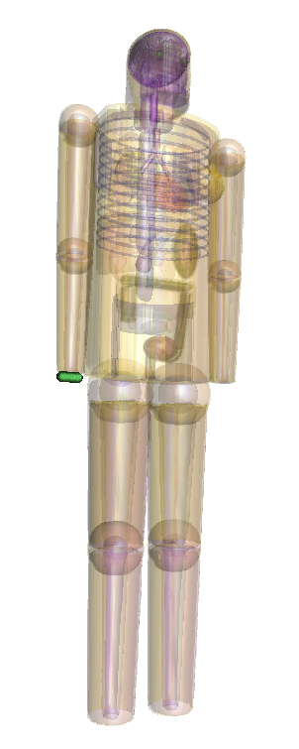
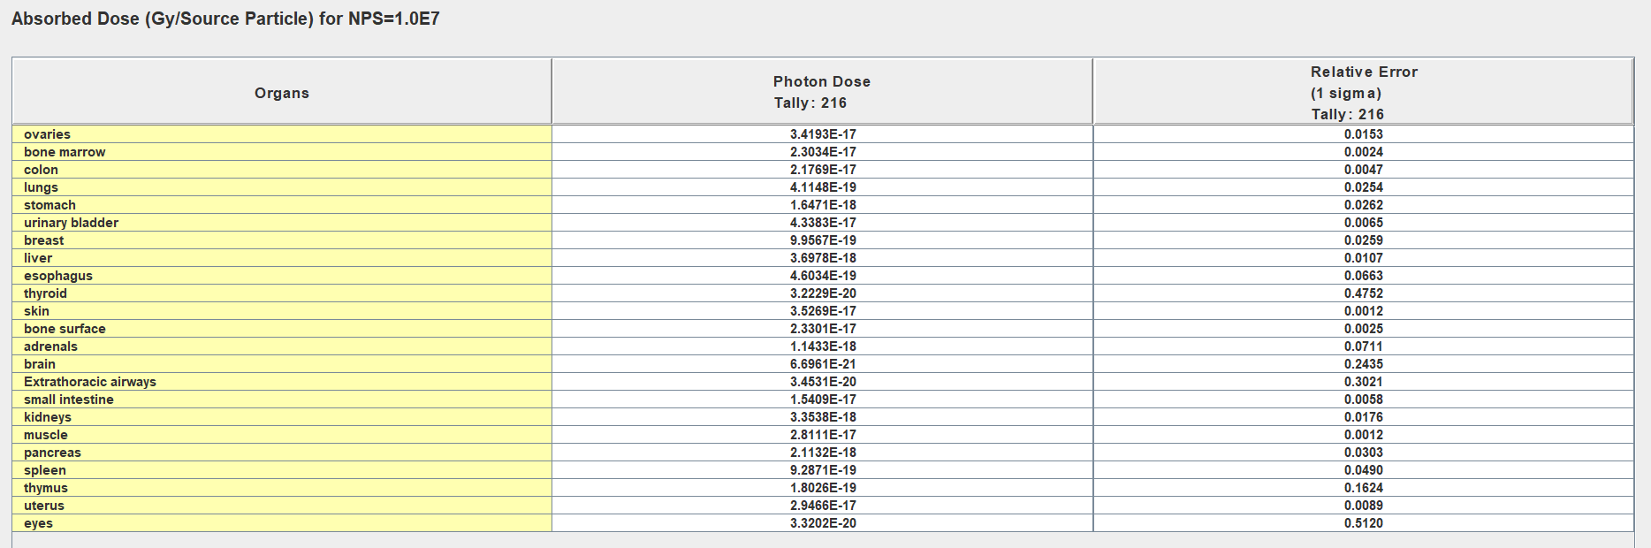
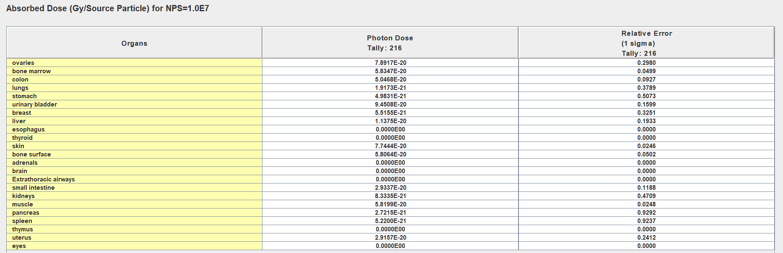
Shielded vs Unshielded Syringe – 0.21%

Slide 27
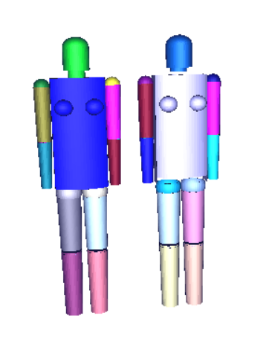
Distance increase from heart source

Slide 28
Energy Spectrum of 120 kVp x-ray

Slide 29
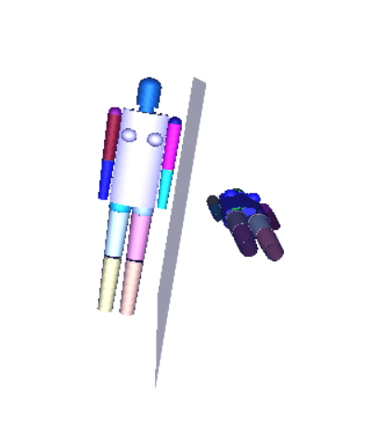
X ray scenario
Ratio:
0.57%

Slide 30
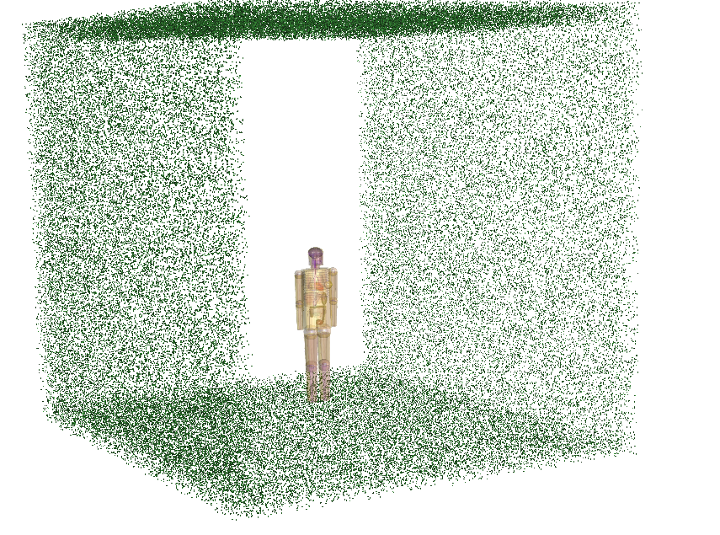
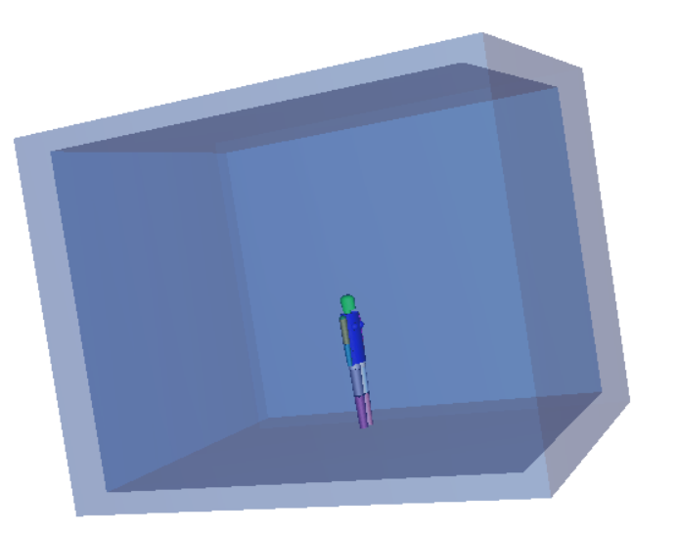
PIMAL phantom in room

