Slide 1
RASCAL Training
Day 1
Session start – 0900 EDT
Notes:
Dial (301) 715 8592
Enter meeting ID 975 8827 6497#
Enter # to skip participant ID
Enter password 544289#

Slide 2
RASCAL Trainers
George Athey
Athey Consulting
Jeff Kowalczik, CHP
US NRC
Office of Nuclear Security and Incident Response
Ed Harvey
US NRC
Office of Research

Slide 3
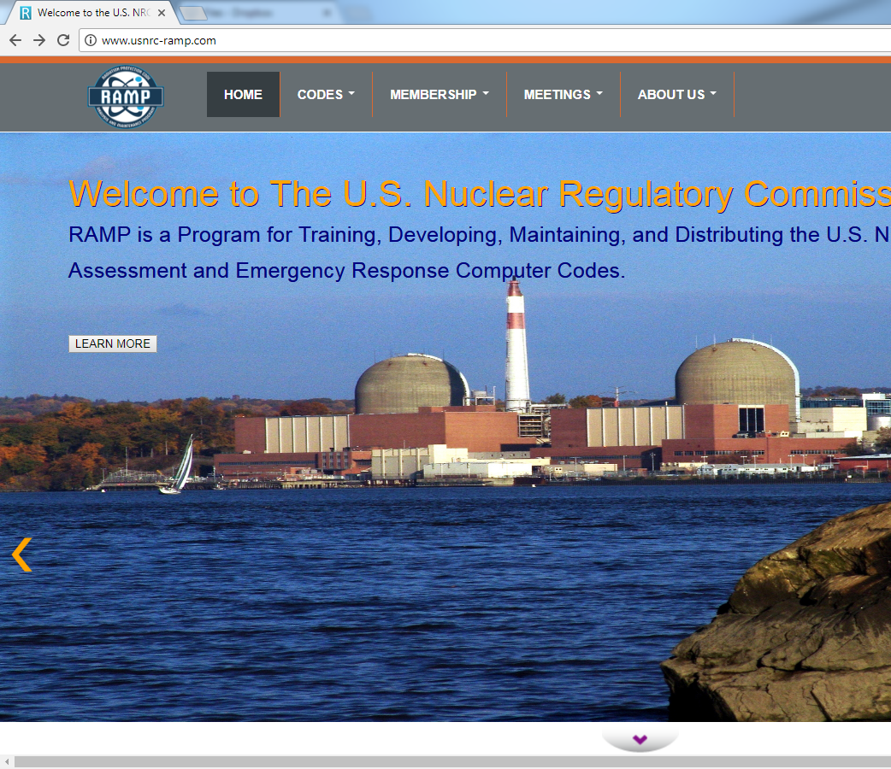
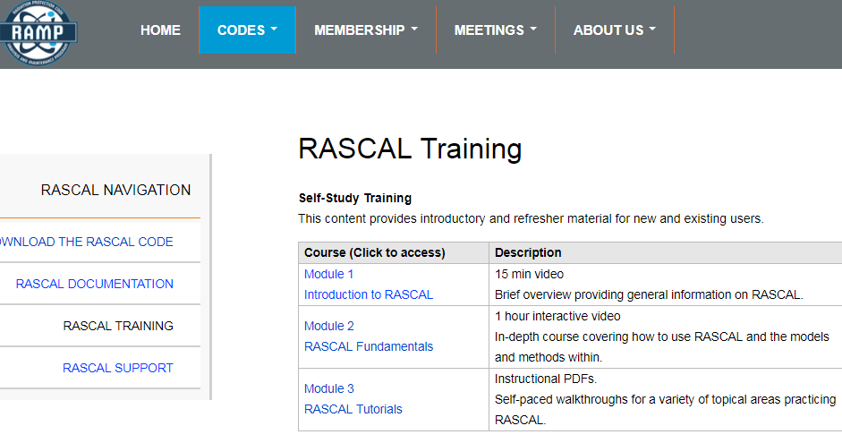
Training and support at ramp.nrc-gateway.gov
Need Account to Access
  Non-Disclosure Agreement (NDA)
  Fed/State/Local/International/Private
Code Distribution
Technical Support
  Technical
  documentation
  Training
  FAQs & Forums

Slide 4


RASCAL Slide
Every time we ask you to use RASCAL, you’ll see one of these blue slides.
It will include information needed to complete the steps.
Polls will be used to ask about the problem and make sure everyone is finished.
Notes:
You will be running RASCAL on your own computer at certain points during this class.
So when you see this blue screen that is an indication that you should be doing something with RASCAL.
Depending on how you are setup you may need to switch back and forth.
If you close the poll to be able to see something else you can redisplay the poll using the button on the Zoom control

Slide 5
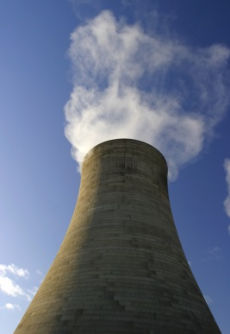
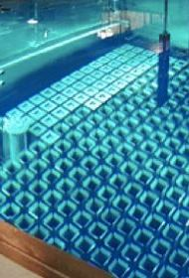
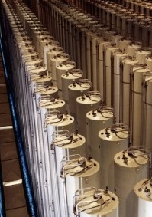
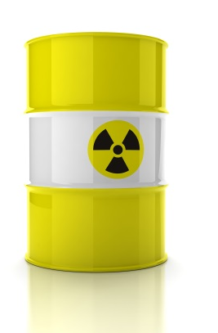
Technology Review
Nuclear Power
Plant
Spent Fuel
Fuel Cycle
Other Material

Slide 6
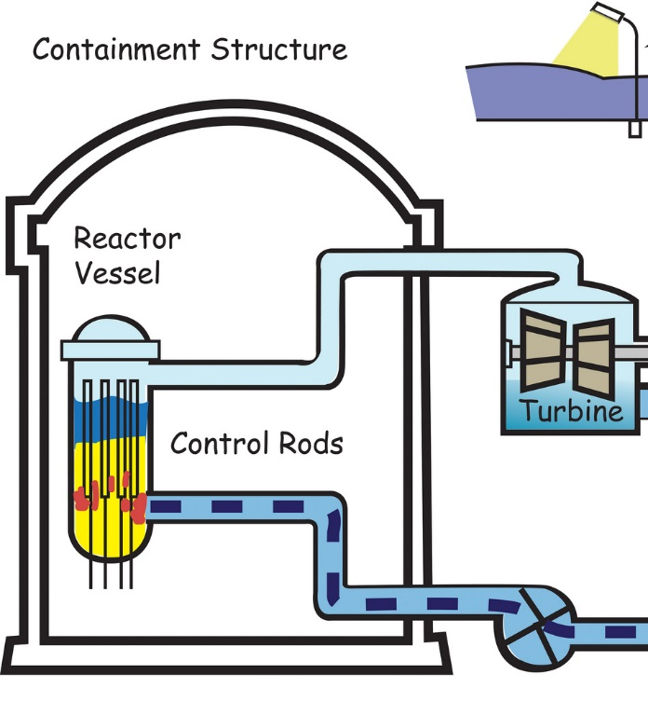
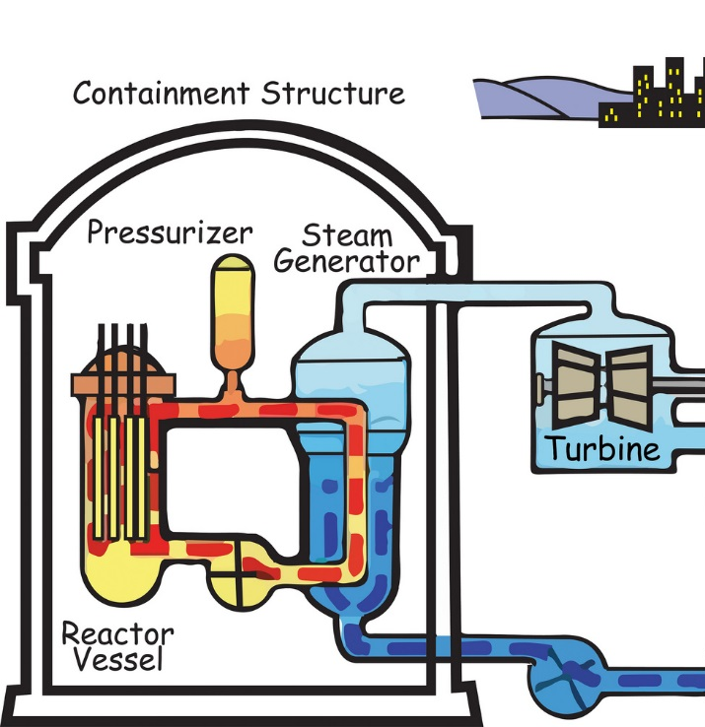
Reactor Types
Core inside reactor vessel creates heat, steam is created (main loop in BWR, secondary loop in PWR), steam turns turbine, which produces electricity
Boiling Water Reactor (BWR)
Pressurized Water Reactor (PWR)

Slide 7
Large releases will come from major fuel damage, only caused from lack of cooling
No heat removal leads to fuel cladding failure and fuel melt
Eventual RCS overpressure / leakage
Possible containment overpressure / leakage

Slide 8
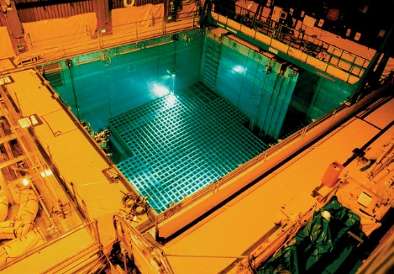
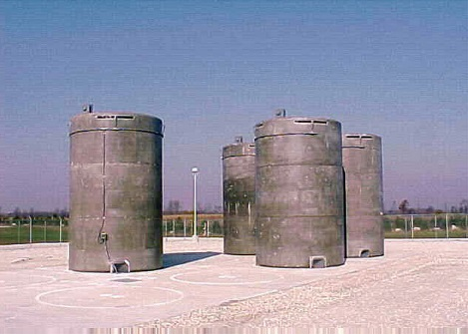
Spent Fuel
Every 12-24 months, a fraction of reactor core is replaced and moved to a pool to cool.
5-10 years later, cooler fuel moved to dry cask

Slide 9
Fuel Cycle
Fuel cycle facilities convert, enrich, and fabricate mined material into reactor fuel
RASCAL Supports these accident types:
  UF₆ Cylinders
  Criticality
  Fire/Explosions involving Uranium Oxide

Slide 10
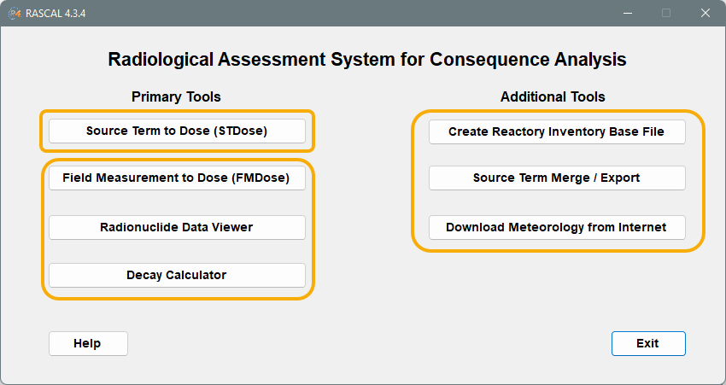
There are 4 primary tools and 3 additional tools on the RASCAL Home Page.
Notes:
When you start RASCAL, this is the main set of tools shown after the splash screen.
For this class we will focus only on Source Term to Dose. Goal is to take you through a calculation from beginning to end. Familiarity with the user interface and options such that when you see it next week you understand the basic parts and the button pushing.
Briefly talk about each of the other buttons.

Slide 11
Where does RASCAL fit in the phases of a radiological emergency?
Pre-release
Plume (early)
Intermediate
Ingestion
RASCAL (STDose)
RASCAL (FMDose)
Turbo FRMAC

Slide 12
Our Training Will Focus on STDose
Source Term to Dose module creates an atmospheric source term, processes weather data, and calculates doses
Wind
Atmospheric Source Term
Plume
Generation of Source Material
Dose/Concentration

Slide 13
RASCAL Defines Atmospheric Source Term
Determines radionuclides available for release
  May be single nuclide or complex core damage
  Time-dependent isotopes and activity
Source material may be filtered, reduced, or decayed
Wind
Atmospheric Source Term
Plume
Generation of Source Material
Dose/Concentration

Slide 14
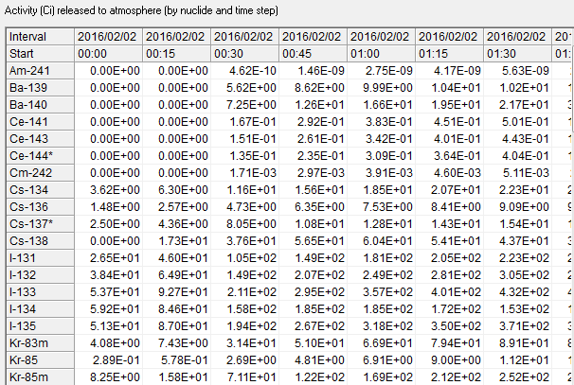
Result is Radionuclides Released to Environment Over Time (Atmospheric Source Term)
Isotopic activity over time (15 min)
Wind
Atmospheric Source Term
Plume
Generation of Source Material
Dose/Concentration

Slide 15
Atmospheric Source Term is Moved using ATD Models
Atmospheric Transport and Dispersion Models
  Transport material based on weather conditions
  Track material to where it falls/washes on ground
  Accounts for dry/wet processes and particle size
Wind
Atmospheric Source Term
Plume
Generation of Source Material
Dose/Concentration

Slide 16
Final Calculations Provide Doses and Concentrations over Calculation Area
Dose calculation accounts for multiple pathways
  External (Groundshine + cloudshine)
  Internal (Inhalation + ingestion)
Results includes other display/calculation options
Wind
Atmospheric Source Term
Plume
Generation of Source Material
Dose/Concentration
Notes:
Tee up the walkthrough

Slide 17
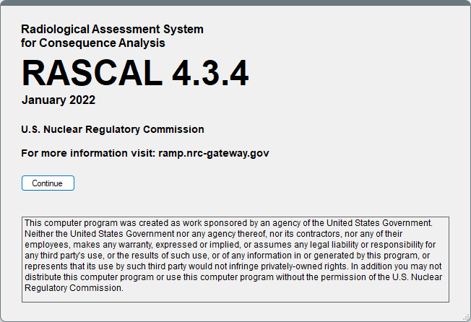
Walkthrough
Let’s step through a RASCAL run together
  Watch our discussion slides without using your RASCAL (screenshots may not match)
  At each blue slide, you will input information into RASCAL
Notes:
We show screenshots of RASCAL. Follow along and then we will have you do it.
Before we proceed any questions? Send a chat

Slide 18
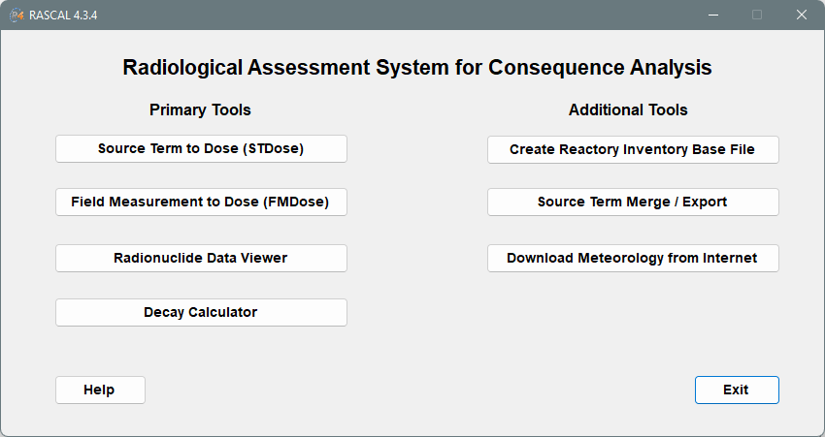
Select STDose
Most of what you will be using RASCAL for (dose assessment) will be done with Source Term to Dose (STDose).

Slide 19
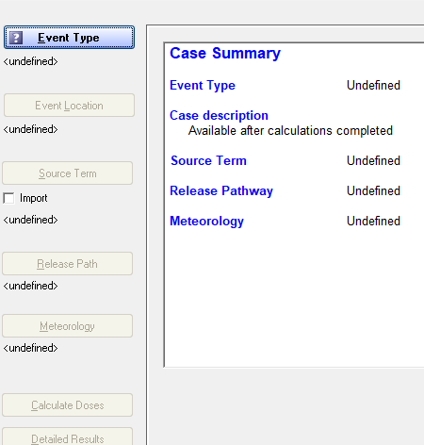
Using STDose
Input information on the buttons on left, from top to bottom
  Meteorology can be input once a location is selected
Translate available data into RASCAL inputs
  Some data is “static”; enter once
  Some data is “dynamic” and changes with time as more communications is established and as conditions evolve

Slide 20
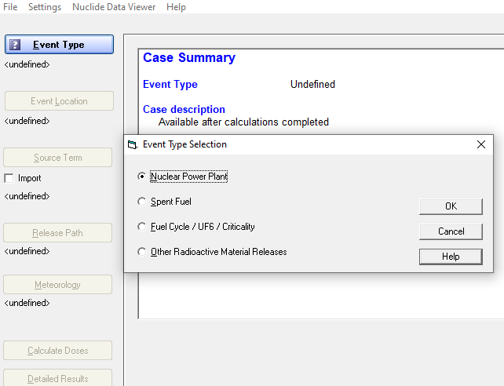
Start by Clicking Event Type
RASCAL breaks up locations and models into 4 types:
  NPP
  Spent Fuel
  Fuel Cycle
  Other/Materials

Slide 21
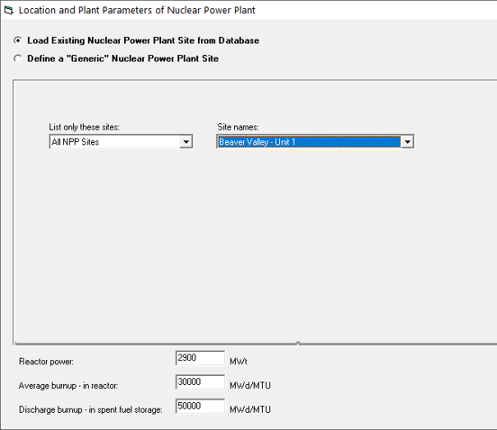
Next, Click Event Location
Select from a list of predefined sites
  All U.S. facilities (NPPs, Fuel Cycle, Materials)
  International NPPs including: Mexico, South Africa, Taiwan, and UAE
Or, define a custom site
  Need Latitude/Longitude coordinates
  Does not build in roughness or topography

Slide 22
At the Bottom of Location, Check Reactor Power
Units of megawatts thermal (MWt) and is a direct measure of the energy produced by fission. This number is used by the model to determine the fission product inventory in the core.
The facility database contains the power level at which the reactor is allowed to operate.
Since reactors generally try to operate at 100% power, this value should rarely be changed.

Slide 23
Also Check Burnup
Fuel burnup has units of megawatt-days per metric ton of uranium (MWd/MTU) and is a measure of how much fission energy has been produced by the fuel elements that are currently in the core.
RASCAL uses burnup to adjust core inventory for long-lived radionuclides in the core fuel. A mid-life core value is used as default instead of site-specific values
If you have a burnup value – use it, otherwise the default is OK.

Slide 24
Your Turn to Use RASCAL
Start the RASCAL program & select STDose
Click Event Type
  Select Nuclear Power Plant
  Click OK
Click Event Location
  Select Beaver Valley, Unit 1
  Click OK

Slide 25

Let’s walk through together
Notes:
Show RASCAL window on top of slide.

Slide 26
Knowledge Check
The RASCAL STDose model supports which of the following radiological emergency phases? [select all that apply]
  Pre-release
  Plume (early)
  Intermediate
  Ingestion
T or F, RASCAL can model releases from sites not in its facility database?
  True
  False
Notes:
The RASCAL STDose model supports which of the following radiological emergency phases? [select all that apply]
Pre-release (correct)
Plume (early) (correct)
Intermediate (correct)
Ingestion
T or F, RASCAL can model releases from sites not in its facility database?
True (correct)
False

Slide 27
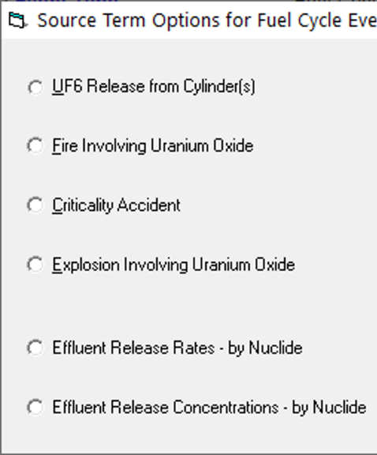
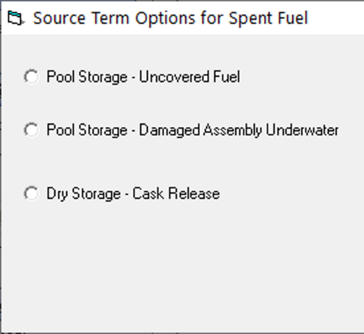
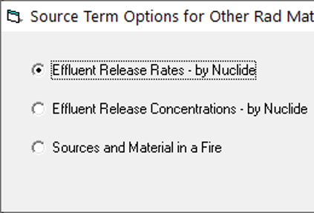
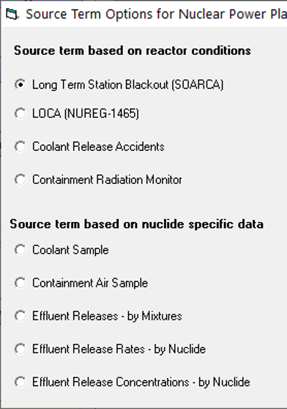
Source Term
Source term models calculate material that can be released
Pick the best model; may have multiple options
Available choices depend on Event Type
Nuclear Power Plant
Spent Fuel
Fuel Cycle
Other Materials
Notes:
Here is where we select which model RASCAL will use to calculate how much material can be released
We will need to pick the best model based on the information we have, and there may be multiple options
Remember we told you that these models depend on which event type was selected

Slide 28
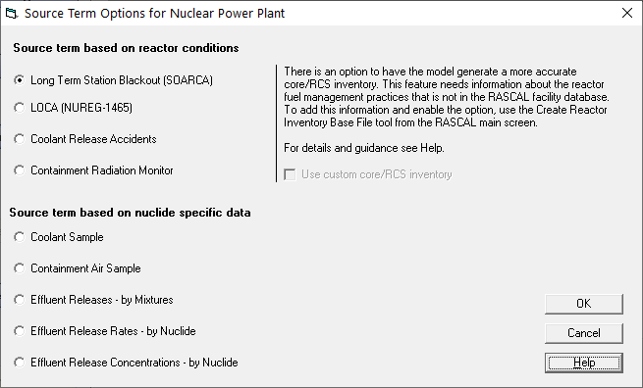
Nuclear Power Plant
RASCAL has 9 nuclear power plant source term options:
4 based on reactor condition models
5 based on nuclide measurements

Slide 29
Nuclear Power Plant
Long Term Station Blackout
Without onsite & offsite AC power and other cooling methods, could lead to core melt
User inputs event timing

Slide 30
Nuclear Power Plant
Loss of Coolant Accident (LOCA)
Loss of reactor coolant, leads to core uncovery and fuel melt
User inputs event timing
Notes:
Always core damage
30 min of gap release
Transition to core melt and ex vessel

Slide 31
Nuclear Power Plant
Coolant Release Accident
Loss of reactor coolant where only coolant is released, no core melt expected
Very small releases

Slide 32
Nuclear Power Plant
Containment Radiation Monitor
Estimates core damage based on containment rad monitor

Slide 33
Nuclear Power Plant
Coolant or Containment Air Sample
User inputs entire source term by nuclide
RASCAL does not extrapolate source term from subset of nuclides
Not expected to have data during event

Slide 34
Nuclear Power Plant
Effluent Releases - Mixtures
User inputs activity rates of:
  Noble Gas
  Iodines
  Particulates
RASCAL fractionates by nuclide based on core inventory
Often based on utility conversion or calculation

Slide 35
Nuclear Power Plant
Effluent Release Rates/Concentration
User inputs entire atmospheric source term by nuclide
RASCAL does not extrapolate source term from subset of nuclides
Can be used to manually define source term, including small/custom releases

Slide 36
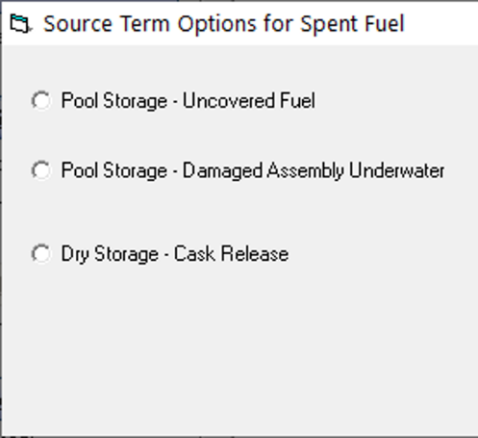
Source Term
Source term models calculate material that can be released
Pick the best model; may have multiple options
Available choices depend on Event Type
Nuclear Power Plant
Spent Fuel
Fuel Cycle
Other Materials
Notes:
Here is where we select which model RASCAL will use to calculate how much material can be released
We will need to pick the best model based on the information we have, and there may be multiple options
Remember we told you that these models depend on which event type was selected

Slide 37
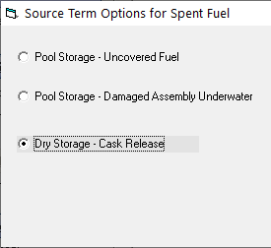
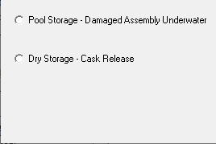
Spent Fuel
For Spent Fuel, RASCAL has 3 source term options
Includes both pool and dry storage
Sites are collocated with NPPs

Slide 38
Spent Fuel
Pool - Uncovered Fuel
Models clad/zirconium fire whether possible or not
User inputs fuel pool inventory and fire start/end times

Slide 39
Spent Fuel
Pool - Damaged Underwater
For fuel handling accidents
Very small releases
User inputs amount of fuel damaged

Slide 40
Spent Fuel
Dry - Cask Release
4 damage options
Small to zero release
User defines inventory of fuel and damage type

Slide 41
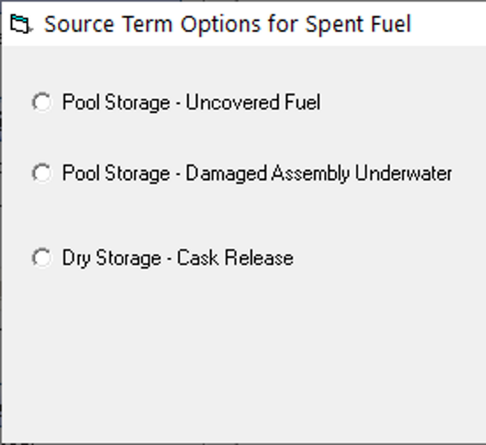
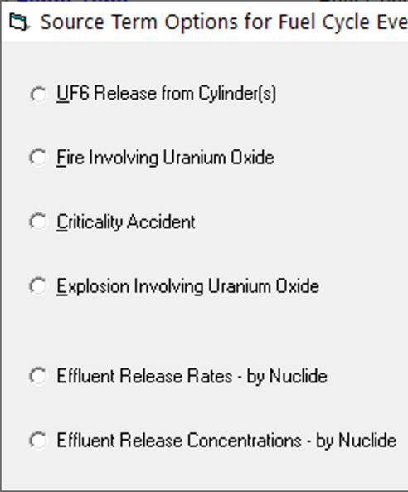
Source Term
Source term models calculate material that can be released
Pick the best model; may have multiple options
Available choices depend on Event Type
Nuclear Power Plant
Spent Fuel
Fuel Cycle
Other Materials
Notes:
Here is where we select which model RASCAL will use to calculate how much material can be released
We will need to pick the best model based on the information we have, and there may be multiple options
Remember we told you that these models depend on which event type was selected

Slide 42
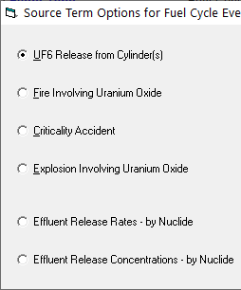
Fuel Cycle
RASCAL can model certain events from fuel fabrication facilities
  UF6 chemical models
  Criticality
  UO2 Fire/Explosion

Slide 43
Fuel Cycle
UF6 Release from Cylinder
Gaseous UF6 released
Special plume model with chemical conversion process
More chemically dangerous than radiological

Slide 44
Fuel Cycle
Fire or Explosion involving Uranium Oxide
Small amounts of material put into atmosphere from event
User inputs material at risk and release fractions / rates

Slide 45
Fuel Cycle
Criticality
Mainly focused on direct shine from criticality event
  Very small amount of activated material put into atmosphere

Slide 46
Fuel Cycle
Effluent Release Rates/Concentration
User inputs entire atmospheric source term by nuclide
RASCAL does not extrapolate source term from subset of nuclides
Can be used to manually define source term, including small/custom releases

Slide 47
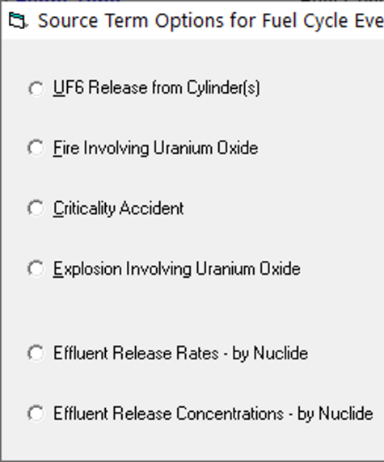
Source Term
Source term models calculate material that can be released
Pick the best model; may have multiple options
Available choices depend on Event Type
Nuclear Power Plant
Spent Fuel
Fuel Cycle
Other Materials
Notes:
Here is where we select which model RASCAL will use to calculate how much material can be released
We will need to pick the best model based on the information we have, and there may be multiple options
Remember we told you that these models depend on which event type was selected

Slide 48
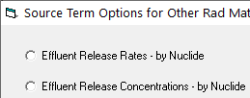
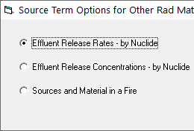
Other Materials Locations
RASCAL also has 3 “other” materials options
Useful for modeling transportation accidents, lab accidents, etc.
All models still focus on atmospheric releases
  Liquid releases (like spills and leaks) are not modeled in RASCAL

Slide 49
Other Materials Locations
Effluent Release Rates/Concentration
User inputs entire atmospheric source term by nuclide
RASCAL does not extrapolate source term from subset of nuclides
Can be used to manually define source term, including small/custom releases

Slide 50
Other Materials Locations
Sources and Material in a Fire
Small amounts of material put into atmosphere from a fire
User inputs material at risk and release fractions / rates

Slide 51
Source Term
Source term models calculate material that can be released
Pick the best model; may have multiple options
Available choices depend on Event Type
Nuclear Power Plant
Spent Fuel
Fuel Cycle
Other Materials
Notes:
Here is where we select which model RASCAL will use to calculate how much material can be released
We will need to pick the best model based on the information we have, and there may be multiple options
Remember we told you that these models depend on which event type was selected

Slide 52
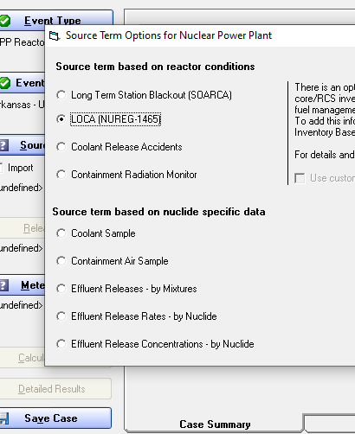
Pick a Source Term
For this scenario, the most appropriate model would be the LOCA model

Slide 53
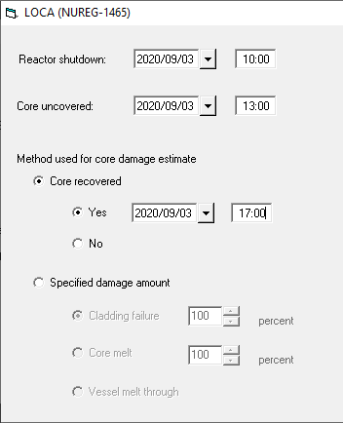
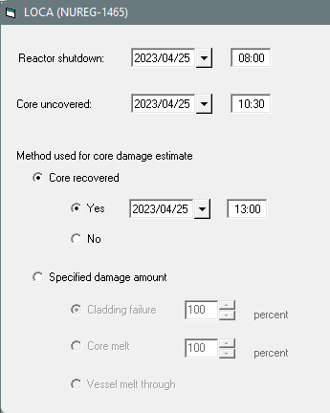
Enter Source Term Details
Each model requires additional details like timing or measurements
For the LOCA model:
  Time of reactor shutdown
    Starts the decay of all nuclides in the core (they’re in equilibrium before)
  Time core was uncovered
    When NUREG-1465 models start, starting with 30 min of gap activity, then fuel melt
  Is the core recovered?
    Additional material stops being generated after the core becomes recovered
All times entered with 24-hour clock
Notes:
Rx SD @ 8
Uncover @ 1030
Recover at 13

Slide 54

Your Turn to Use RASCAL
Click Source Term
Select Loss of Coolant Accident (LOCA)
  Click OK
Input timing sequence numbers
  Shutdown Time - 0800
  Time of Core Uncovery – 1030
  Select Yes for Core Recovered, Time – 1300
  Click OK

Slide 55
Let’s walk through together
Notes:
Show RASCAL window on top of slide.

Slide 56
Knowledge Check
Why is it important to enter the reactor shutdown time?
  That is when the radionuclide decay calculation starts
  That is when the release starts
  That is when the damage to the reactor fuel begins
If the core is recovered, will there still be a release to the atmosphere?
  Maybe, it depends on the release pathway and leak rate
  Yes, that just stops further damage to the core
  No
Notes:
Why is it important to enter the reactor shutdown time?
That is when the radionuclide decay calculation starts (correct)
That is when the release starts
That is when the damage to the reactor fuel begins
If the core is recovered, will there still be a release to the atmosphere?
Maybe, it depends on the release pathway and leak rate (correct)
Yes, that just stops further damage to the core
No

Slide 57
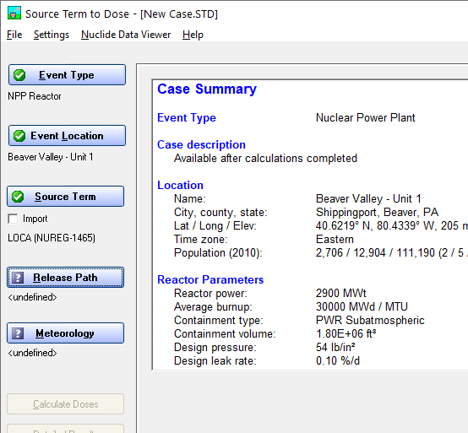
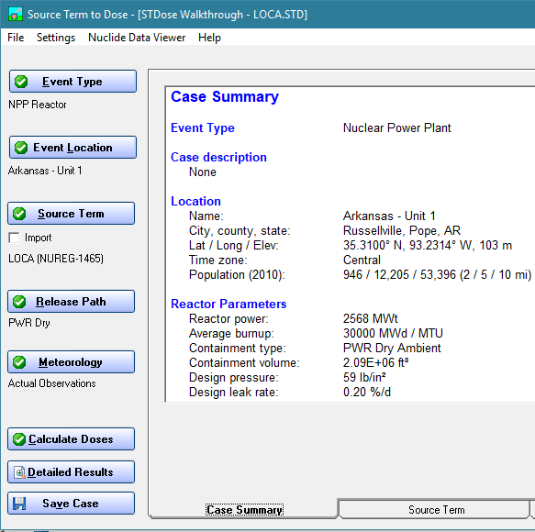
As you can see, the Case Summary tab updates as information is added
As each step is completed, the input information is added to the case summary displayed.
Notes:
Useful for reviewing inputs without having to go back into the screens.

Slide 58
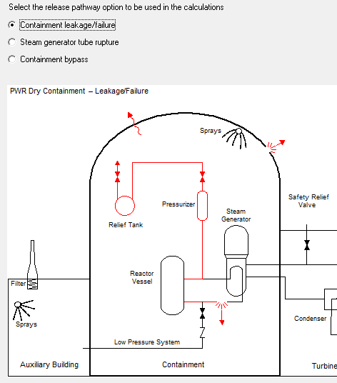
Now We’ll look at Release Pathway
RASCAL needs information on how generated material is released to the atmosphere
  Pathway
  Height
    Wind speeds change with height
  Reduction
    Amount of material reduced by decay, holdup, filter, sprays
  Timing
    Release rates, start
    and stop
We’ll start by selecting the Pathway
Notes:
Describe how each

Slide 59
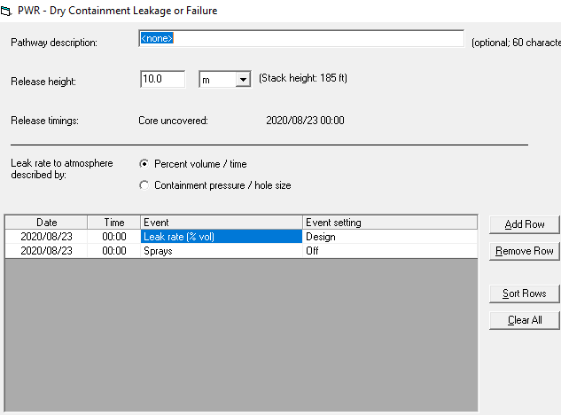
For this Release Pathway option, We’ll need to input:
Release Height
  10m is minimum height allowed (ground release)
Select leak rate type
  Percent Volume / Time (e.g., 3%/hour)
  Containment pressure / Hole Size (e.g., 30 psi/2 cm²)
Define release timeline
  Used for leak rate and additional conditions
  Need to review/set initial conditions, then can add rows as needed
Don’t copy this data. For discussion purposes only.
Notes:
Explain the event table at the bottom
Add row
Event type dropdown
Event setting choices – may see additional screen to make selection

Slide 60
Your Turn to Use RASCAL
Click Release Path
Select Containment leakage/failure, Click OK
Ensure release height is set to 10m
Change the initial leak rate (at 10:30) to 5% / day
Keep sprays off
Add row and enter
  Time: 18:00 Event Type = Leak rate Setting = 0.0 %/d
Click OK

Slide 61
Let’s walk through together
Notes:
Show RASCAL window on top of slide.

Slide 62
Knowledge Check
For a LOCA accident, RASCAL can model the release of material to the atmosphere through which of the following pathways? [select all that apply]
  Containment
  Steam generator
  Bypass of containment via other systems
  Direct from the reactor vessel
T or F, in RASCAL a release height of 10m is considered ground level?
  True
  False
Notes:
For a LOCA accident, RASCAL can model the release of material to the atmosphere through which of the following pathways (select all that apply)?
Containment (correct)
Steam generator (correct)
Bypass of containment via other systems (correct)
Direct from the reactor vessel
T or F, in RASCAL a release height of 10m is considered ground level?
True (correct)
False

Slide 63
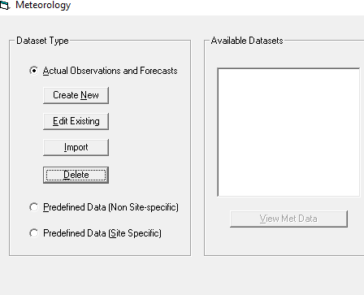
Moving onto Meteorology
Actual
  Enter station observations/forecasts
  Manual entry or internet download
Pre-defined (non site-specific)
  Simple static weather conditions
  Easy/fast if no meteorological data known, but doesn’t include topo/roughness
Predefined (site-specific)
  Allows custom creation of likely conditions

Slide 64
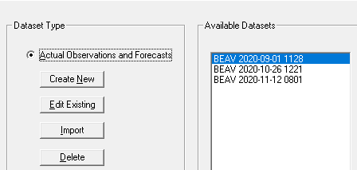
We’ll Mostly Use Actual for Exercises/Events
We won’t use pre-defined except in training
For actual conditions, weather data is managed as site-dependent files
  Create New / Edit
  View any previously saved weather files
  Usable as long as times support scenario
Notes:
Reminder to tell them about before/after screenshots, next step is click new/edit

Slide 65
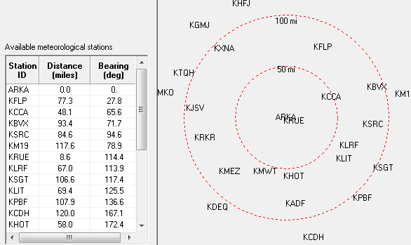
Each Site contains predefined weather stations
Table and map show site and surrounding weather stations
Select stations with plume direction in mind

Slide 66
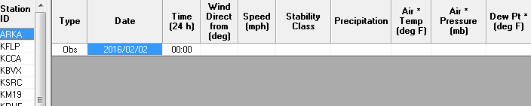
Inputting Weather Data
Select weather station on the left to input its data on the right:
  Type
  Date/Time
  Wind Direction/Speed
  Stability
  Precipitation
Notes:
Reminder to tee up the rules about weather inputs (on next slide)

Slide 67

RASCAL uses observed and/or forecast weather data
Current Time
Observations
Forecasts
Release 1
Release 2
Release 3
RASCAL can model releases in the past (all observations), in the future (all forecasts), or that span both.

Slide 68

RASCAL Can Run with a Single Weather Datapoint
2 hours
Release 1
Release 2
Release 3
However, the initial meteorological data must fall within 2 hours before the start of the release to the atmosphere. (Release starts at 10:30; must have some meteorology defined within the 8:30 to 10:30 window)

Slide 69
Although Single Datapoint Weather is possible, More Data is Preferred
Release 1
Release 2
Important when the release may start in the future or may continue for some period of time. You will likely need both observed and forecast data.
However, our scenario doesn’t have additional info like forecasts yet.

Slide 70
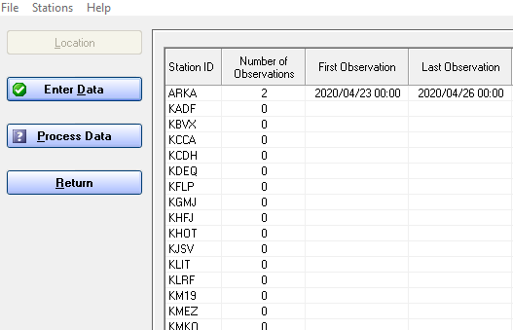
Process Data
Click Process Data to compile all the weather data into a form that the models can use.

Slide 71
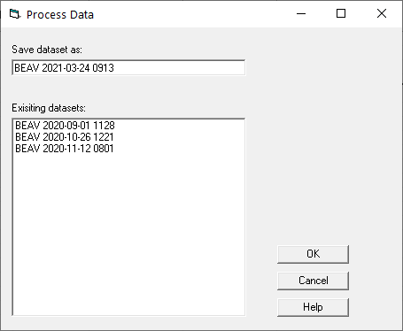
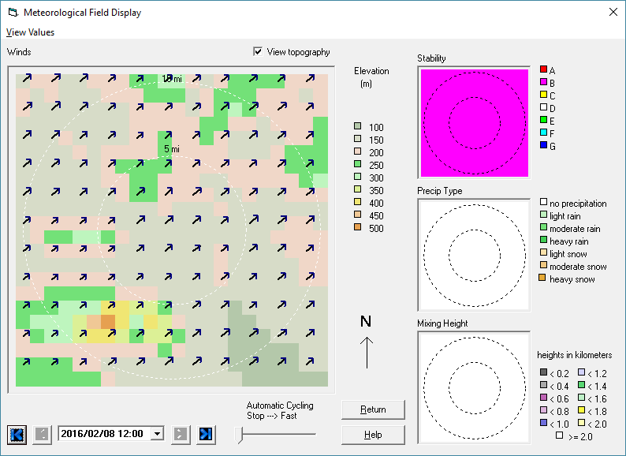
RASCAL processes all entered data into a merged gridded field that changes over time
This named file will show on the main met screen
Weather details can be viewed if needed (View dataset)

Slide 72
Finally, Select Which Weather File You Want RASCAL to Use
RASCAL will return to the main Meteorology screen
Highlight the desired weather data
  Likely the one at the top

Slide 73
Your Turn to Use RASCAL
Click Meteorology
Select option for Actual Observations and Forecasts
  Click Create New button
Click Enter Data button
For the BEAV station enter the following:
  Time = 10:00
  Winds = from 45 deg at 2 mph
  Stability class = B
  Precipitation = None
  Click OK
Click Process Data button then click OK
Click the Return button
Make sure your newly created file is selected in blue in the list of available datasets. Click OK

Slide 74
Let’s walk through together
Notes:
Show RASCAL window on top of slide.

Slide 75
Knowledge Check
T or F, pre-defined weather conditions are acceptable to use in a real event?
  True
  False
T or F, RASCAL requires at least some weather data to drive the ATD models?
  True
  False
T or F, RASCAL allows you to enter weather data that varies in both space and time?
  True
  False
T or F, RASCAL can model a release that may occur in the future?
  True
  False
Notes:
Poll 5
T or F, pre-defined weather conditions are acceptable to use in a real event?
True
False (correct)
T or F, RASCAL requires at least some weather data to drive the ATD models?
True (correct)
False
T or F, RASCAL allows you to enter weather data that varies in both space and time?
True (correct)
False
T or F, RASCAL can model a release that may occur in the future?
True (correct)
False

Slide 76
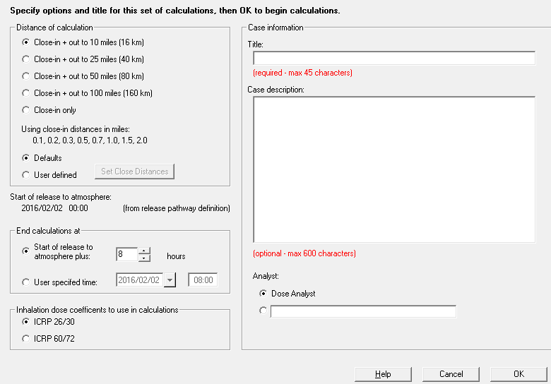
Calculate Doses
Nothing has been calculated at this point
With a few additional parameters, RASCAL will perform all its calculations

Slide 77
Pick a distance to set the calculation area
Shorter distances provide higher resolution
Rule of Thumb – start on the 10 mile distance. If doses are high at the 10 mile edge, go to 25 miles

Slide 78
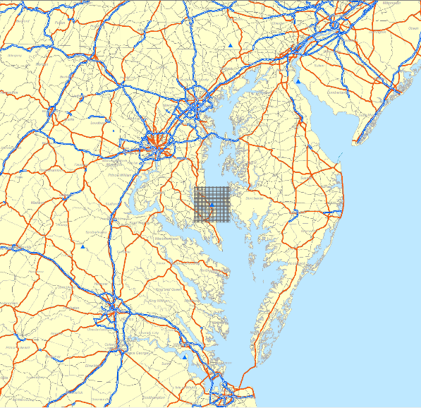
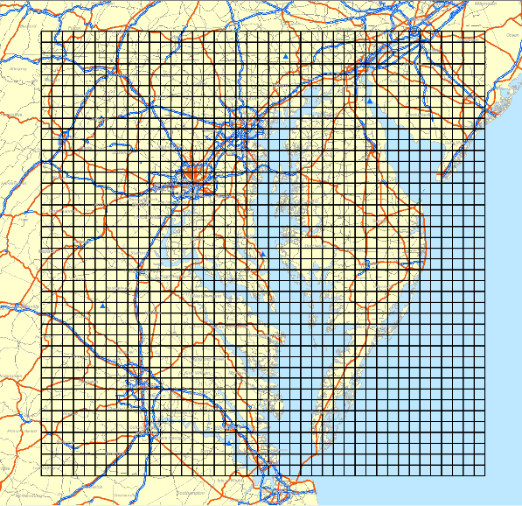
Closer calc distances provide better resolution if you don’t need to see further out
10 mile grid – cells are .5 mile wide
100 mile grid – cells are 5 miles wide

Slide 79
Define a Calculation Time
Duration after the first release to atmosphere that RASCAL terminates the release, plume movement and dose calculations
If time is set too short, dose may be missed; no disadvantage to going long (except runtime)

Slide 80
Set calculation duration to allow for trailing plume edge to reach set distance
Trailing edge, released at t=8.
Leading Edge, released at t=0.
10 mi
Wind speed determines when trailing edge reaches 10 miles
10 mi

Slide 81
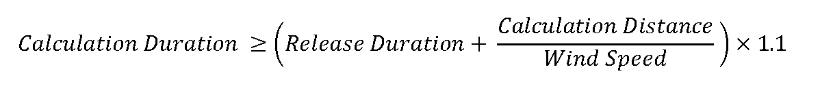
There is a rule-of-thumb for estimating the calculation duration
Calculation Distance
“Release Duration”
10 mi
For our problem, 7.5 hr release with 2 mph winds, calculate a duration for a 10-mile grid.
7.5 hours + (10 miles / 2 mph) = 12.5 hours
Add 10% to get 13.75, then round up to the nearest hour (14)

Slide 82
Select the inhalation dose coefficients to be used
ICRP 26/30 vs 60/72
Currently, NRC and most States use 26/30
New EPA PAG Manual uses 60/72
Differences are inclusion of child thyroid CEDE and some minor dose values changes

Slide 83
Enter the case information
RASCAL requires a case title
Description used for justification or special notes; don’t need to repeat case info
Select and/or define an analyst name

Slide 84
What happens when the OK button is clicked?
RASCAL calculates the atmospheric source term and runs the ATD models with the given weather
  You cannot interrupt the calculations
Once complete, view results tabs at the bottom
  Case Summary
  Source Term
  Maximum Dose Values

Slide 85
Your Turn to Use RASCAL
Click Calculate Doses
Leave Distance of Calculation at 10 miles
Set End Calculations at:
  Start of release to atmosphere plus: 14h
Click OK to start the calculations

Slide 86
Let’s walk through together
Notes:
Show RASCAL window on top of slide.

Slide 87
Knowledge Check
Which calculation grid has the better resolution?
  50-mile
  10-mile
  They have the same resolution
What would you set as the calculation duration with a 7-hour release with 5 mph winds on a 10-mile grid?
  8 hours (RASCAL default)
  9 hours
  10 hours or more
  96 hours (RASCAL max)
Notes:
Which calculation grid has the better resolution?
50-mile
10-mile (correct)
They have the same resolution
Using the formula shown on the blue screen, what would you set as the calculation duration with a 7-hour release with 5 mph winds on a 10-mile grid?
8 hours (RASCAL default)
9 hours
10 hours or more (correct)
96 hours (RASCAL max)

Slide 88
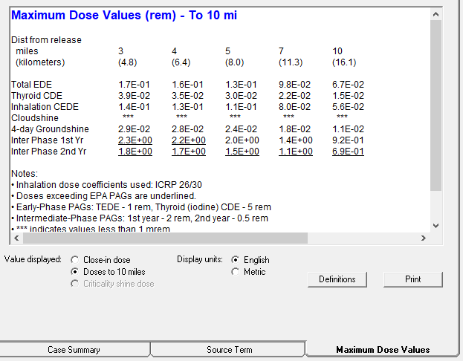
RASCAL Results
When RASCAL is finished calculating, it shows this screen, which is just 1 of 3 tabs at the bottom
They each contain different information and have a different purpose, let’s go through them
Your results will be different than screenshot. For discussion purposes only.

Slide 89

Case Summary Tab Shows Inputs
The Case Summary tab has been populating as we added info
You can use it as a great way to check your inputs all at once or compare inputs against other dose assessors
Your results will be different than screenshot. For discussion purposes only.

Slide 90

Source Term Tab Shows Details for Release to Atmosphere
Summary window
View Balance
  Where nuclides are at the end of the simulation
View Importance
  What nuclides are contributing the most to dose
Release vs. Time
  Displays amount of each nuclide released each 15 minute time step
  Can be exported
Your results will be different than screenshot. For discussion purposes only.

Slide 91
Max Values Table Shows dose snapshot
Summary window
  Doses important for protective actions (TEDE, Thyroid)
  Underlines doses exceeding PAGs
Select distance
  Close in vs selected “far out” model distance
Does not show direction
Your results will be different than screenshot. For discussion purposes only.

Slide 92

For Additional Result Information, Click Detailed Results
Provides additional graphical and tabular outputs
Result types at top
  Dose-related
  Deposition/Measurements
  Acute doses
Settings on the bottom
  Time - cumulative or rate
  Map/Table; Close-in or Further Out
  Units

Slide 93


Difference between Footprint and Table
Footprint provides celled results on map
Table provides numeric values
Both can be exported, map can be queried, table can be filtered
Footprint
Table

Slide 94


Difference between “close in” and “Far Out”
Two ATD models are used in the calculations
  Resolution advantages
  Overlap may not line up exactly
Plume Model
Puff Model

Slide 95
Your Turn to Use RASCAL
Examine the results
  Maximum Dose Values tab shows some doses at selected distances
  Source Term tab show details about the atmospheric release
  Click Details Results to see options for looking at dose on a map

Slide 96
Let’s walk through together
Notes:
Show RASCAL window on top of slide.

Slide 97
Knowledge Check
What is the projected TEDE (rem) at 5 miles?
  1.4E+00
  1.7E+00
  3.2E+01
  None of the above values
What percentage of the release to the atmosphere is iodines?
  0.6%
  12.9%
  16.4%
  None of the above values
What direction is the plume projected to travel?
  Northeast
  East
  Southeast
  Southwest
Notes:
What is the projected TEDE (rem) at 5 miles?
1.4E+00 (correct)
1.7E+00
3.2E+01
None of the above values
What percentage of the release to the atmosphere is iodines?
0.6%
9.7%
12.9%
16.4% (correct)
None of the above values
How much Xe-133 is projected to be released to the atmosphere?
1.4E+04
2.1E+06 (correct)
3.2E+06
None of the above values
What direction is the plume projected to travel?
Northeast
East
Southeast
Southwest (correct)
Northwest

Slide 98
This concludes our intro walkthrough
You should now be able to click through RASCAL start to finish.
Remember that resources & training can be found at:
https://ramp.nrc-gateway.gov/

Slide 99
Available topics for tomorrow (Poll)
Nuclear Power Plant Accidents
  Long-Term Station Blackout
  Monitored Effluent Mixtures
  Containment Rad Monitor
  Steam Generator Tube Rupture
Other Radiological Accidents
  Spent Fuel Pool
  Fuel Cycle
  Other Materials Accident
  Transportation Accident
RASCAL features
  Multi-Unit Assessment
  Comparing with Field Measurements
  Field Team Dosimetry & DRDs
  Download Met from Internet (MetFetch)
  Special Receptors

