Slide 1
PiMAL
2023 Ghana RAMP Meeting
Charlotte Rose MS (RHP)

Slide 2
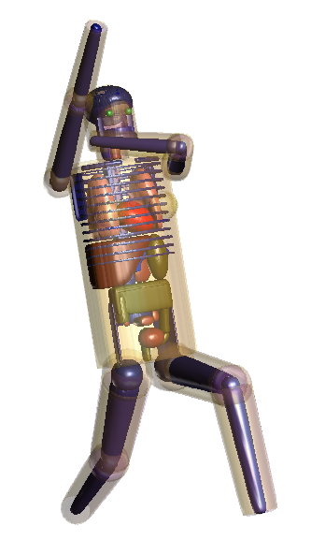
Welcome!
Introduction
Part 1: PiMAL
  Development/Basic Theory
  What it is/What it’s not
  PiMAL in literature
  Future goals
Part 2: Input Demonstration
Part 3: Output Demonstration
Notes:
During this slide, introduce myself, and if the group is small enough ask what people’s goals are for the presentation

Slide 3
Purpose
Develop an interface to assist the analyst in using an updated computational phantom model in dose assessment activities

Slide 4
GUI assists analyst with input preparation and output manipulation
Visualizes the positioning of arms and legs as the desired posture is achieved
MCNP input file is generated and called to run in the background to conduct the radiation transport simulation
Organ doses are extracted from the completed MCNP output file

Slide 5
PiMAL is a tool!
Based on parameters selected by the user with a stand alone GUI, it will create an MCNP input file and call MCNP to run it (given that it is installed)
No initial need to understand the use of input and output files of MCNP, but will be useful if changes need to be made.
In order to get the most out of PiMAL, some working knowledge of MCNP is best.
Simulations are only as useful as the set up!

Slide 6
PiMAL is not a stand alone code
PiMAL, on its own cannot perform radiation transport simulations
Needs a working executable path to MCNP
Some of the basic limitations and error traps will be discussed but it should not be assumed that this will provide a comprehensive list of items needing fixing. All o fyour results should be evaluated with your judgement and understanding of health physics.

Slide 7
PiMAL phantom
Built to add complexity to ORNL and MIRD phantoms which were limited by materials, organ locations, and body position.
Detailed anatomically correct organs as well as complex material compositions of those orvans are incorporated into the model.
Neutron transport, for example, benefits from a more detailed material composition.
23 organ specific materials and densities, based on ICRP 89 (2003), were incorporated (a departure from the 3 previous; bone, soft tissue and lung)

Slide 8
PiMAL in literature
What kind of problems can PiMAL solve?
  Internal exposure
  External exposure
  Dose rates from organ -> organ, whole body, outside sources, gender specific etc
  (organ tallies as-is are missing some examples; we will discuss how to add later)
Dose coefficients
Dose consequences to baby being breast fed
Dose consequences from companion animals after radiation treatments
Dewji, S., Reed, K.L. & Hiller, M. Comparison of photon organ and effective dose coefficients for PIMAL stylized phantom in bent positions in standard irradiation geometries. Radiat Environ Biophys 56, 277–291 (2017). https://doi.org/10.1007/s00411-017-0698-1
Foreman, C.; Dewji, S.1. Estimation of External Dose Rates to Hotel Workers from bed linens Contaminated by 131I Patients. Health Physics: June 2020 - Volume 118 - Issue 6 - p 615-622 doi: 10.1097/HP.0000000000001141

Slide 9
Recommendations for future development
Bug fixes are welcome!
New feature suggestions are welcome!
Weight scaling
Age scaling
Pregnant female model
Animals/pets
Source geometries
Alignment with ICRP 103 organs
Incorporation of dose conversion for 4 particles, organ weighting factors etc.

