Slide 1
RASCAL Training
Day 2
Session start – 0900 EDT
Notes:
Dial (301) 715 8592
Enter meeting ID 975 8827 6497#
Enter # to skip participant ID
Enter password 544289#

Slide 2
RASCAL Trainers
George Athey
Athey Consulting
Jeff Kowalczik, CHP
US NRC
Office of Nuclear Security and Incident Response
Ed Harvey
US NRC
Office of Research

Slide 3
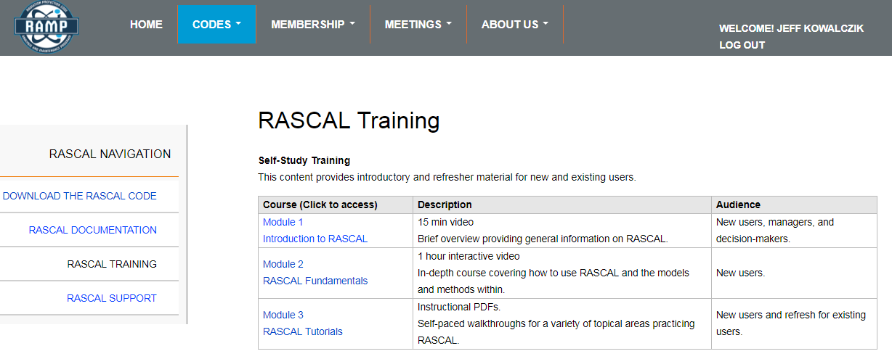
training modules are available online
ramp.nrc-gateway.gov

Slide 4
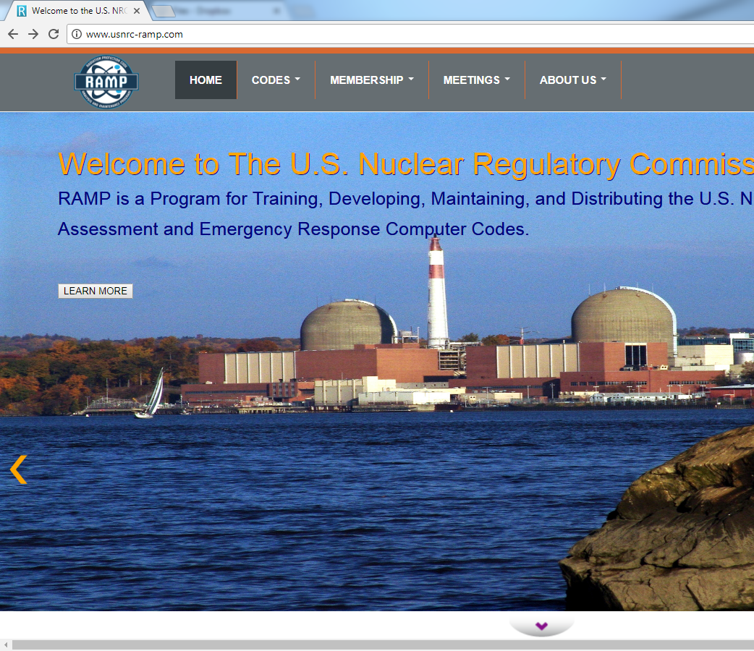
Training and support at ramp.nrc-gateway.gov
Need Account to Access
  Non-Disclosure Agreement (NDA)
  Fed/State/Local/International/Private
Code Distribution
Technical Support
  Technical
  documentation
  Training
  FAQs & Forums

Slide 5


RASCAL Slide
Every time we ask you to use RASCAL, you’ll see one of these blue slides.
It will include information needed to complete the steps.
Polls will be used to ask about the problem and make sure everyone is finished.
Notes:
You will be running RASCAL on your own computer at certain points during this class.
So when you see this blue screen that is an indication that you should be doing something with RASCAL.
Depending on how you are setup you may need to switch back and forth.
If you close the poll to be able to see something else you can redisplay the poll using the button on the Zoom control

Slide 6
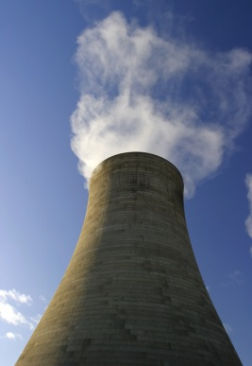
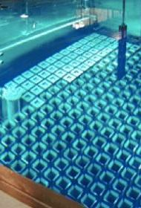
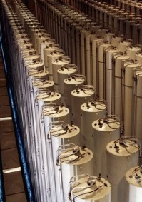
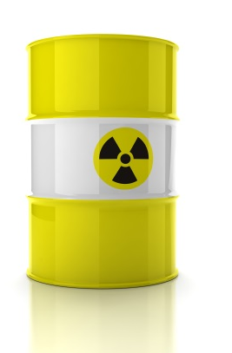
Technology Review
Nuclear Power
Plant
Spent Fuel
Fuel Cycle
Other Material

Slide 7
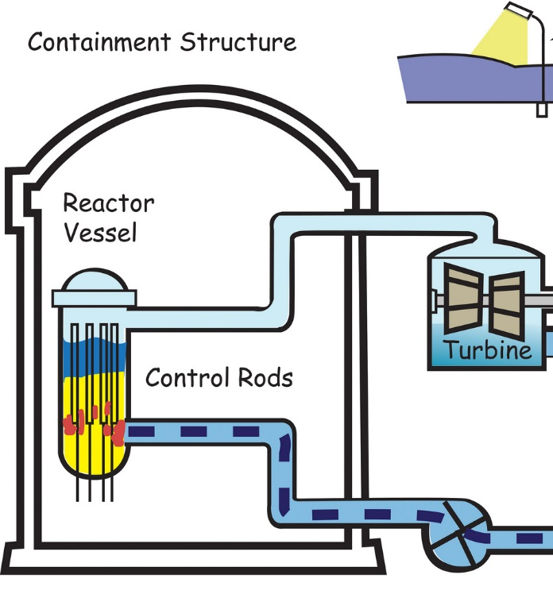
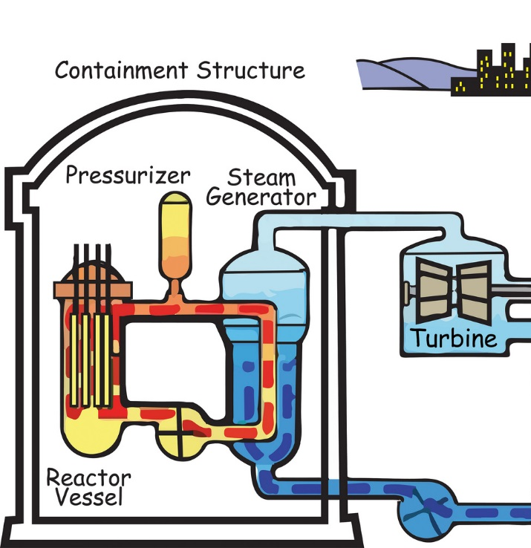
Reactor Types
Core inside reactor vessel creates heat, steam is created (main loop in BWR, secondary loop in PWR), steam turns turbine, which produces electricity
Boiling Water Reactor (BWR)
Pressurized Water Reactor (PWR)

Slide 8
Large releases will come from major fuel damage, only caused from lack of cooling
No heat removal leads to fuel cladding failure and fuel melt
Eventual RCS overpressure / leakage
Possible containment overpressure / leakage

Slide 9
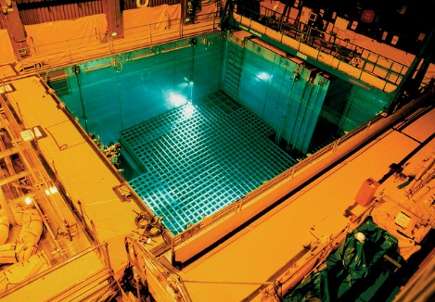
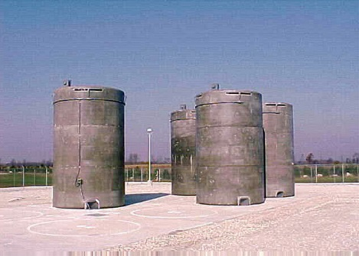
Spent Fuel
Every 12-24 months, a fraction of reactor core is replaced and moved to a pool to cool.
5-10 years later, cooler fuel moved to dry cask

Slide 10
Fuel Cycle
Fuel cycle facilities convert, enrich, and fabricate mined material into reactor fuel
RASCAL Supports these accident types:
  UF₆ Cylinders
  Criticality
  Fire/Explosions involving Uranium Oxide

Slide 11
Discussion Topics for Today
Nuclear Power Plant Accidents
  Long-Term Station Blackout
  Monitored Effluent Mixtures
  Containment Rad Monitor
  Steam Generator Tube Rupture
Other Radiological Accidents
  Spent Fuel Pool
  Fuel Cycle
  Other Materials Accident
  Transportation Accident
RASCAL features
  Multi-Unit Assessment
  Comparing with Field Measurements
  Field Team Dosimetry & DRDs
  Download Met from Internet (MetFetch)
  Special Receptors

Slide 12
This concludes our RASCAL Training
Remember that resources & training can be found at:
https://ramp.nrc-gateway.gov/

