Slide 1
Long-Term Station Blackout
Part of the RASCAL Instructor-led Training

Slide 2
LTSBO - Background
In a Long-Term Station Blackout, a facility will lose all offsite and onsite AC power. Cooling is initially maintained using diesel generators and batteries. However, after these are exhausted, water in the core will start to heat and eventually boil. RASCAL models this heatup time as 8 hours in a PWR and 6 hours in a BWR. After the core is fully uncovered, fission products begin to release.
The source term model for LTSBO in RASCAL is based on the State-of-the-Art Reactor Consequence Analysis (SOARCA) reports.

Slide 3
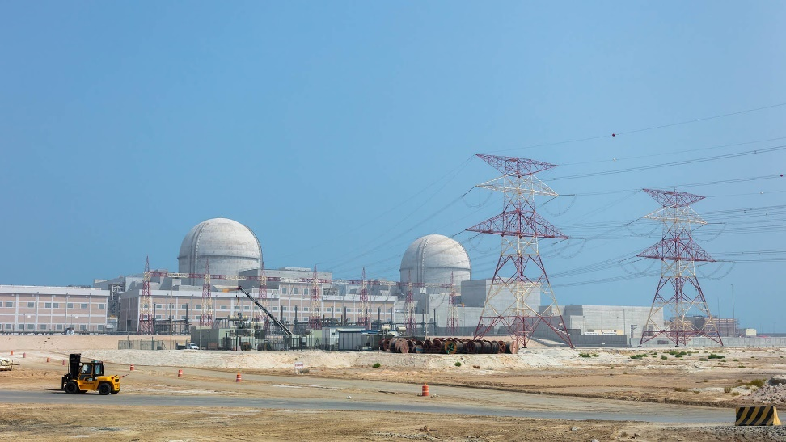
LTSBO - Scenario
Barakah Unit 2, was shutdown at the same time as Unit 1, 10:00, due to the event which caused the Unit 1 LOCA.
All offsite and onsite AC power was lost.

Slide 4
LTSBO - Scenario
Diesels initially provided power and cooling was maintained. However, 5 hours after the original event, further technical complications incapacitated the diesels. The batteries lasted six hours.
Fission products leak through a slightly damaged containment at 2.0 percent/d with no sprays available.
Finally, power is restored and the core is recovered at 10:00 on the next day. Containment pressure was reduced to atmosphere at noon.

Slide 5


Knowledge Check
Reactor shutdown at 1000. Diesels initially provided power and cooling was maintained. However, 5 hours after the original event, further technical complications incapacitated the diesels. The batteries lasted 6 hours.
Fission products leak through a slightly damaged containment at 2.0 percent/d with no sprays available. Finally, power is restored and the core is recovered at 10:00 on the next day. Containment pressure was reduced to atmosphere at noon.
Given the models in RASCAL, at what time does the core heat up to the point of damage/release?
  1500
  2100
  0500 next day
  1000 next day

Slide 6

Your Turn to Use RASCAL
Given the scenario excerpt below, start building a RASCAL case.
Barakah Unit 2 shutdown at 1000. Diesels initially provided power and cooling was maintained, but became incapacitated 5 hours later. The batteries lasted 6 hours. Fission products leak through a slightly damaged containment at 2.0 percent/d with no sprays available. Finally, power is restored and the core is recovered at 10:00 on the next day. Containment pressure was reduced to atmosphere at noon. Use the following weather data for the BK12 station
Type | Date | Time | Wind Dir (deg) | Wind spd (m/s) | Stability Class | Precip | Air Temp (Deg C)
Obs | Today | 12:00 | 210 | 3 | B | None | 11
Fcst | Today+1 | 00:00 | 210 | 3 | B | None | 11
Fcst | Today+1 | 04:00 | 340 | 2 | D | None | 9
Fcst | Today+1 | 08:00 | 350 | 3 | C | None | 10
Fcst | Today+1 | 12:00 | 0 | 4 | B | None | 19
Notes:
Give 5-10 min to complete problem. Next slide is walkthrough to catch up anyone who may need help.

Slide 7
Knowledge Check
There is a warning message you received when processing your weather data. What is this from?
  The large wind shift from 350 deg to 0 deg
  The change from observations to forecasts
  The large wind shift from 210 deg to 340 deg
  I did not get a warning message

Slide 8
Your Turn to Use RASCAL
Continue building and run your entire case in RASCAL.
Using IRCP 60/72, do an assessment of the Unit 2 LTSBO and record the TED and Child Thyroid CED at 0.8 and 8 km from the release.
Dose | Distance from the Site
 | 0.8 km | 8.0 km
TED (Sv)
Child Thyroid CED (Sv)
Notes:
Give 5-10 min to complete problem. Next slide is walkthrough to catch up anyone who may need help.

Slide 9
Let’s walk through the problem together
Notes:
Show RASCAL window on top of slide.

Slide 10
LTSBO - Results
Dose | Distance from the Site
 | 0.8 km | 8.0 km
TED (Sv) | 4.6E-01 | 1.6E-02
Child Thyroid CED (Sv) | 7.6E+00 | 3.2E-01
Conclusions?
  Release timing vs LOCA

