Slide 1
Using the MetFetch Tool
Part of the RASCAL Instructor-led Training

Slide 2
In the past, all the meteorological data retrieval and entry into RASCAL had to be done manually.
This meant:
  Identifying surrounding weather stations if the site was not in RASCAL
  Finding a source for the weather data, e.g. ERDS, NWS website
  Capturing the data for observations and forecasts; copying the numbers or printing
  Entering that data item by item into the RASCAL meteorological data processing program
  Periodically repeating the full process

Slide 3
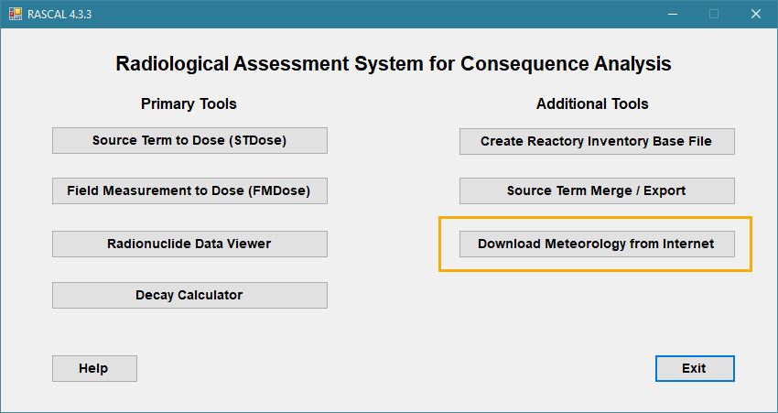
To partially automate this procedure RASCAL has a tool to Download Meteorology from Internet (MetFetch).

Slide 4
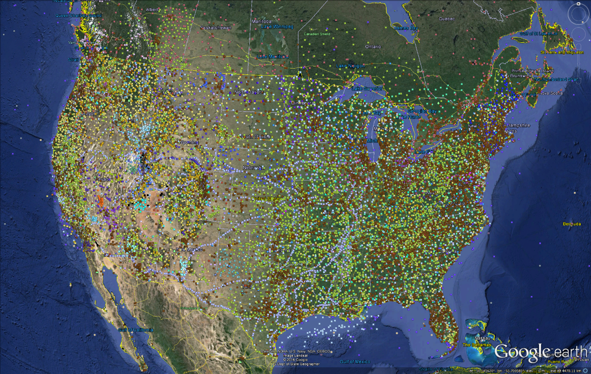
There are literally thousands of sources for observed weather data online.
We started with all the stations that are available from the MesoWest data source of observations.
MesoWest contains observations for a wide range of places besides NWS sites; national labs, highways, oil rigs, and so on. Not all the data has the same quality and availability.

Slide 5
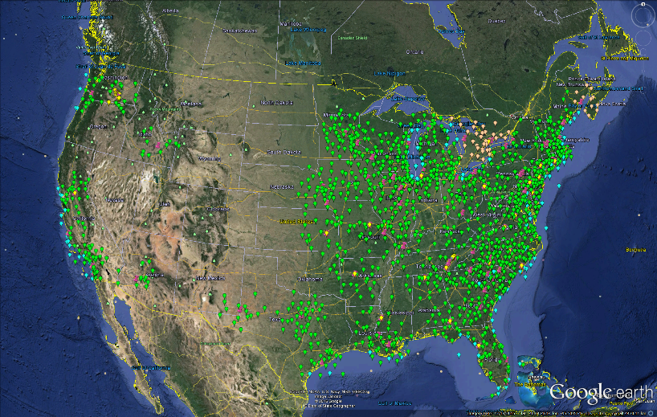
From the mesoWest stations, up to 40 were selected from the first order stations around all the sites in the RASCAL facility database.

Slide 6
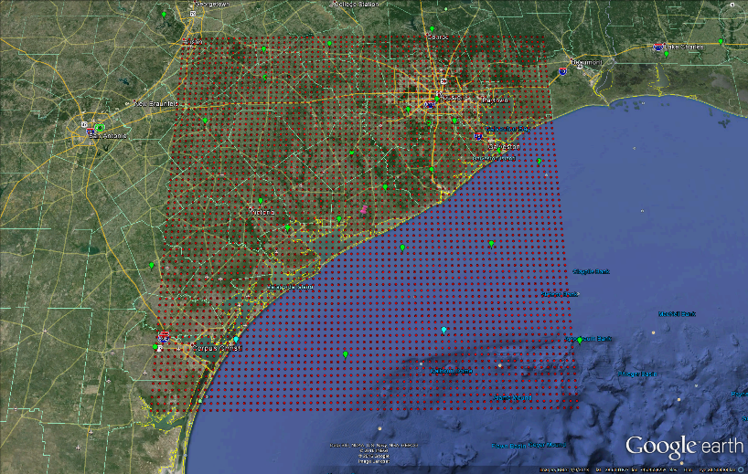
Observations are from weather stations, forecasts are from the closest forecast model point to the station.

Slide 7
RASCAL has a separate tool to handle the download of weather data from the internet.

Slide 8
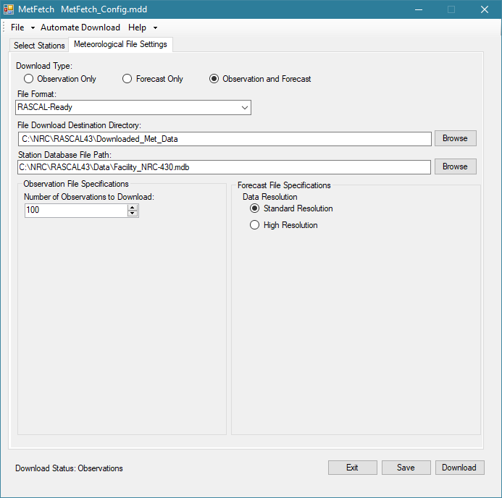
The first time you start up MetFetch, check all the settings.
Those setting shown here are those recommended for routine use of the MetFetch tool with the RASCAL STDose model.

Slide 9
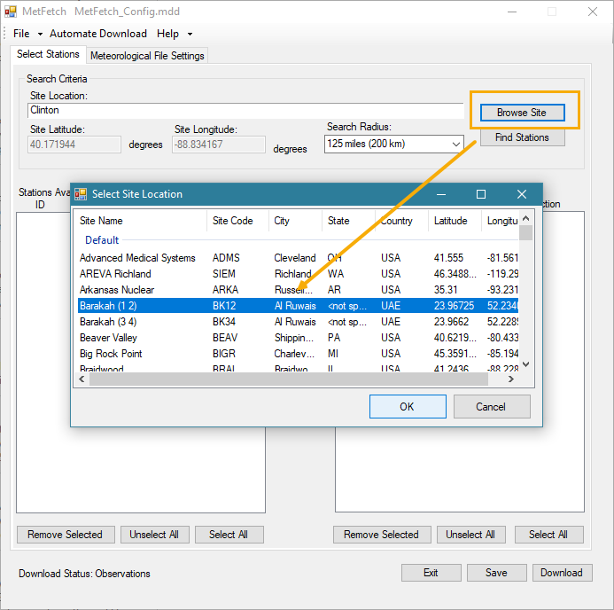
Begin by using the Browse Site button to see a list of all the facilities in the RASCAL database
Select the desired site.
That will load the site latitude and longitude.

Slide 10
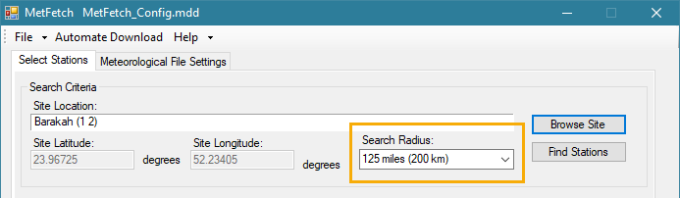
Next, set the Station Type and the Search Radius
Reducing the search radius is needed only in the U.S. for areas where there are many sources of observed weather data.

Slide 11
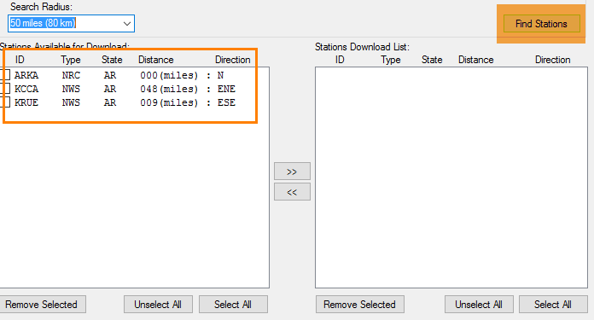
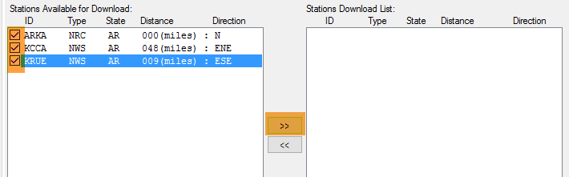
Click the Find Stations button
Set a checkmark for each station and then click the arrow to move them to the Stations Download List.

Slide 12
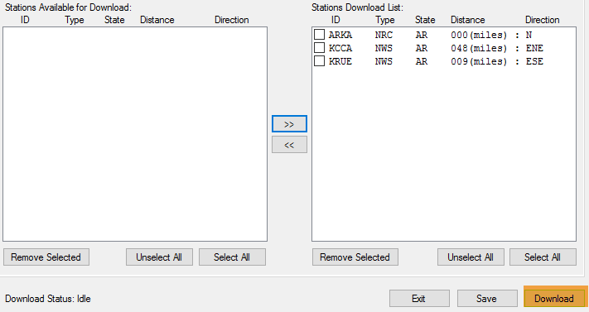
Finally, click the Download button

Slide 13
What happens during the download?
A warning will be displayed that MetFetch cannot download observations for the site station.
  That is normal – NPP sites do not provide their met data to NWS
  It is a reminder to you to manually get site observations
Observations are downloaded for the other stations
Forecasts are downloaded from the nearest point to each of the stations

Slide 14
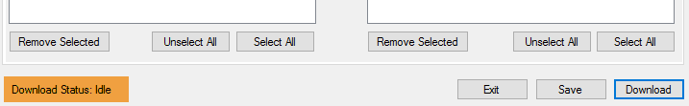
What do I do after the download?
The Download status: Idle indicates the process is complete.
You can leave the program open as you may come back to it later to get updated observations and forecasts.
The data has been downloaded to a location on your computer where the RASCAL STDose model can find it. But you need to go and retrieve it.

Slide 15
Next step is to get the downloaded data into the STDose model
Open a saved case or start running an STDose scenario that uses the same site as downloaded in MetFetch
For our example, let’s take a look at Cooper and some BWR specifics.

Slide 16
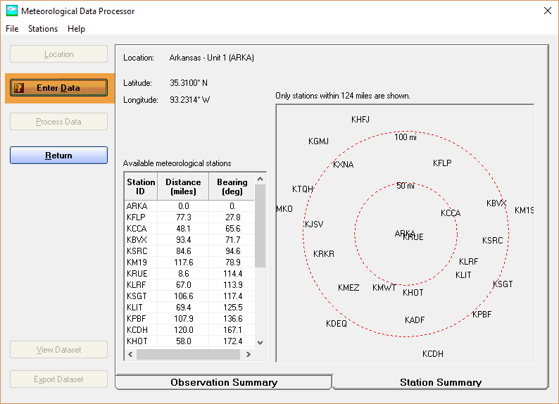
Click the Enter Data button

Slide 17
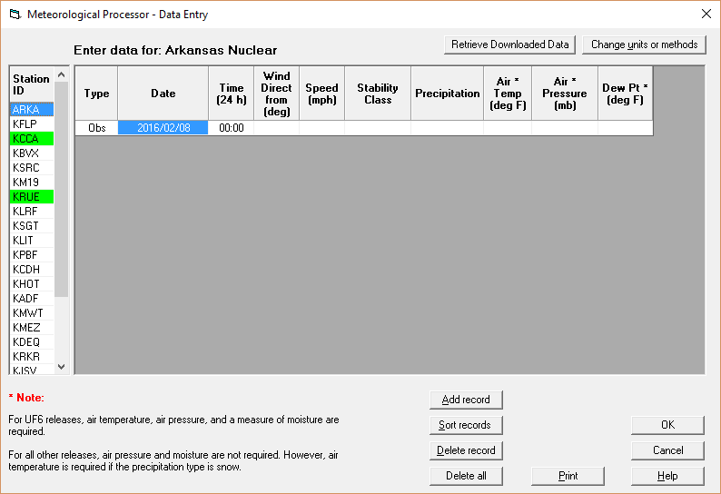
Note the green highlighting of the station IDs.
That indicates that there is downloaded weather data available for that station.
What it does not indicate is when that data was downloaded. That can be checked in the next step.

Slide 18
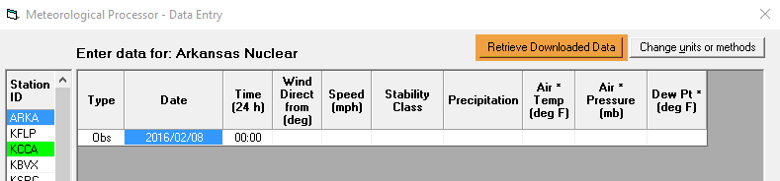
With the site selected in the Station ID list, click the Retrieve Downloaded Data button
Note: the site ID is actually colored green also. However, since it is currently selected the blue color hides the green.

Slide 19
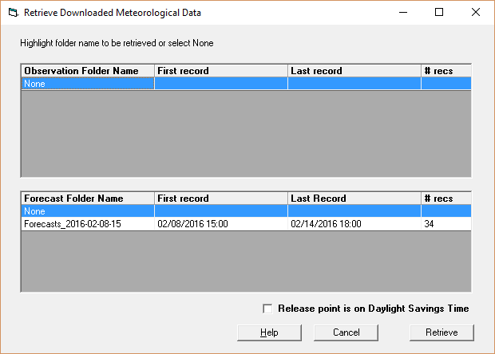
The Retrieve screen shows a folder with forecast data for the site but no folder for observed data.
That is correct as remember we mentioned earlier that MetFetch does not have access to observations made at the site.

Slide 20
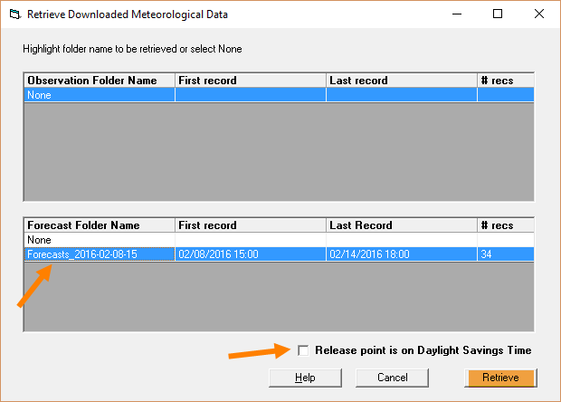
To complete the retrieval of the data for the site:
Click to select the available forecast data folder.
Leave the DST box unchecked; does not apply this time of year.
Click the Retrieve button.

Slide 21
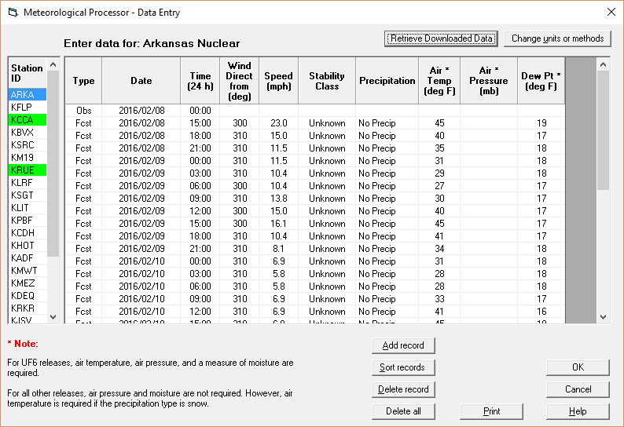
The forecast data that was downloaded is loaded into the grid for the site
Note, you still need to enter the observations manually.
See that stability class is Unknown. That is correct as stability is not forecast by NWS. That is OK, RASCAL will estimate it when needed.

Slide 22
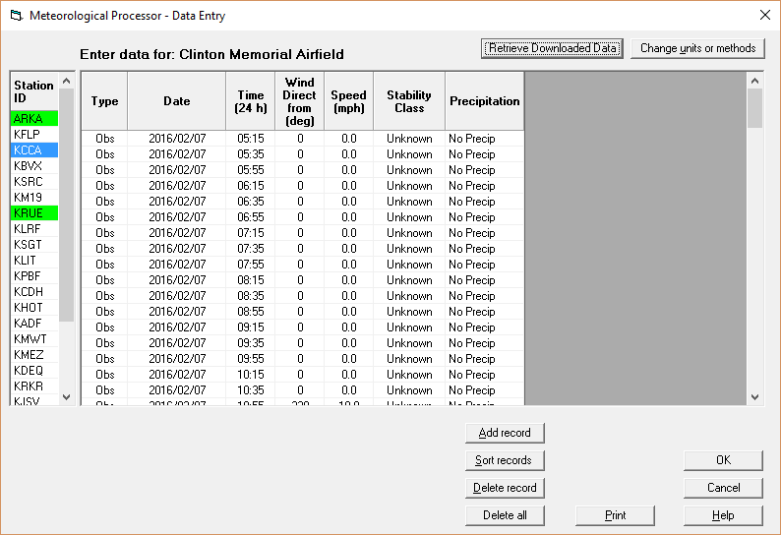
Repeat the process for other downloaded stations
Note
You will have to select folders for both observations and forecasts.
Always pick the most recent folder

Slide 23
After retrieving data for all stations
Click OK to return to the main screen
Note that all now we have a significant number of records for all stations.
Click the Process Data button to create a dataset usable by the STDose ATD models.

Slide 24
Conclusions
MetFetch makes it much easier to get both observed and forecast data for multiple sites.
Since it is automated it reduces errors
The entire download and retrieve process would be repeated at intervals
  NWS makes observations every hour
  Forecast are updated every 6-12 hours

Slide 25
Final word on MetFetch
At this time it works best for U.S. sites where it has access to many observation stations and the U.S. digital forecast data.
RASCAL 4.3.3 adds access to Aviation Weather for the world but coverage is less.
Future version of RASCAL may provide ways for countries to automatically retrieve their data.

