Slide 1
Environmental Reviews and Codes
Donald Palmrose, Ph.D.
Senior Reactor Engineer
Office of Nuclear Material Safety and Safeguards (NMSS)

Slide 2
Agenda
NEPA overview
Types of environmental reviews and process
Safety and environmental codes relationship
Codes applied in environmental reviews
  Hydrology
  Decommissioning
  Radiological liquid and gaseous effluent releases
  Postulated accidents
  Transportation of fuel and waste

Slide 3
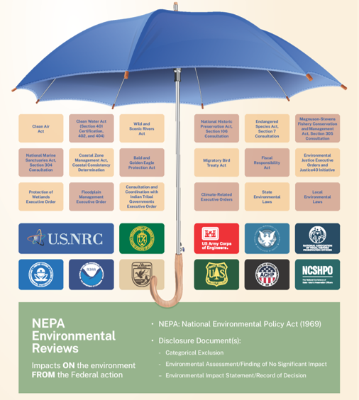
What is the National Environmental Policy Act?
Since 1970, NEPA requires federal agencies to assess environmental effects of proposed actions prior to a final decision. ​
Agencies follow NEPA in evaluating the environmental and related social and economic effects of proposed actions. ​
Federal agencies must produce detailed assessments for environmental impacts of, and alternatives to, major federal actions that could significantly affect the environment.
International RAMP and MACCS User Group Meeting, October 21, 2024

Slide 4

NEPA and the NRC
Informs Federal decision making
Public disclosure of environmental impacts and other considerations
NRC’s Environmental Regulations in 10 CFR Part 51
  Supported by guidance documents for submissions and the staff’s environmental review
Staff review is to determine if the environmental impacts of licensing action are so great that granting the action would be unreasonable

Slide 5
Types of Environmental Reviews
EIS: Prepared for "major Federal actions significantly affecting the quality of the human environment" or for proposed actions that the Commission, as a matter of discretion, determines should be covered by an EIS. The NRC's regulations at 10 CFR 51.20(b) identify categories of actions requiring preparation of an EIS. Findings are given as “SMALL,” “MODERATE,” or “LARGE.”
EA: Prepared for all licensing and regulatory actions except those identified as requiring an EIS per 10 CFR 51.20, those that do not meet the CATEX criteria at 10 CFR 51.22(c), and those identified in 10 CFR 51.22(d) for the Nuclear Waste Policy Act as other actions not requiring environmental review. The NRC determines, based on the EA, one of two ways to proceed:
  Preparation of a “finding of no significant impact” (FONSI): The NRC determined the action will not have a significant impact on the environment; or
  Preparation of an EIS: The NRC determined that the proposed action has the potential to significantly impact the environment.
CATEX : Certain NRC licensing, regulatory, and administrative actions, specified in 10 CFR 51.22, that the NRC has pre-determined do not individually or cumulatively have a significant environmental impact.

Slide 6
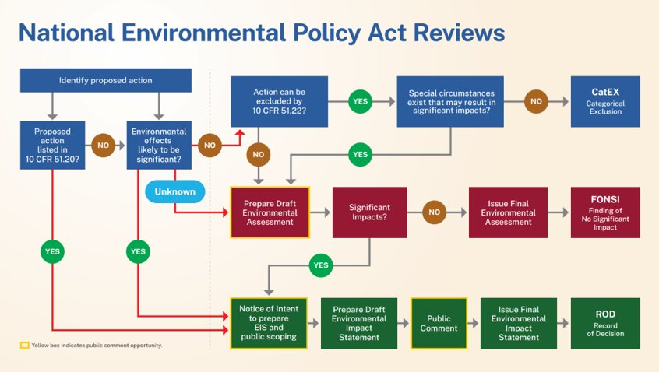
NRC’s Environmental Review Process​
The NEPA analysis is based on the significance of environmental effects from the proposed action.
NEPA encourages incorporation of material, such as planning studies, analyses, or other relevant information.
NEPA encourages public participation.

Slide 7
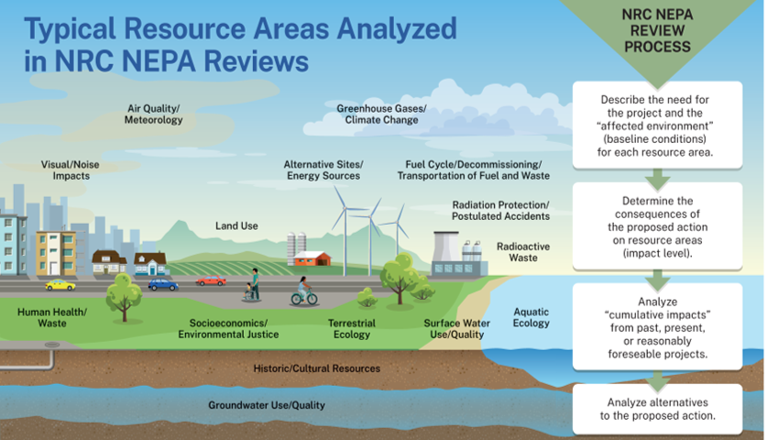
International RAMP and MACCS User Group Meeting, October 21, 2024

Slide 8
Codes Applied by Safety and Environmental Reviews
Safety review analyzing near-field individual exposures for satisfying requirements in NRC regulations
Environmental review utilizes information from the safety analysis for away-from-site impacts
Same codes for radiological effluent releases
MACCS traditionally used in the environmental evaluations of severe accidents and now may be applied for safety analysis/Emergency Planning Zone (EPZ) determinations
International RAMP and MACCS User Group Meeting, October 21, 2024

Slide 9
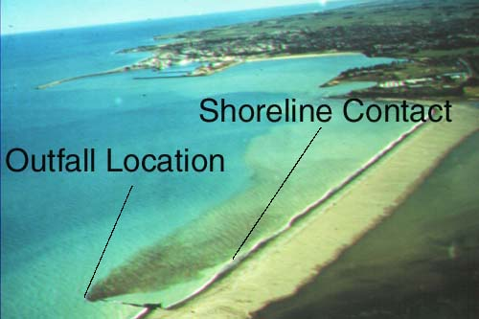
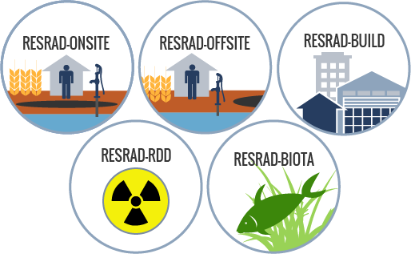
Hydrology and Decommissioning
Hydrology
  CORMIX [EPA]
  GUI for MODFLOW (GMS, Visual Modflow, Groundwater Vistas,) [USGS]
Decommissioning
  DandD [RAMP]
    Compliance with the dose criteria of 10 CFR Part 20, Subpart E
    Embodies NRC’s guidance on screening dose assessments
  RESRAD family of codes [RAMP/ANL]
    Regulatory tools for evaluating radiologically contaminated sites
  Visual Sample Plan [RAMP/PNNL]
  More decommissioning codes at https://ramp.nrc-gateway.gov/topic/environmental-assessment-codes
Source: http://www.cormix.info/index.php
Source: https://resrad.evs.anl.gov
International RAMP and MACCS User Group Meeting, October 21, 2024

Slide 10
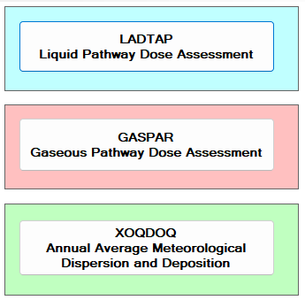
Radiological Liquid and Gaseous Effluent Releases
NRCDose3 and CAP 88-PC have been applied in both safety and environmental reviews
NRCDose3 [RAMP]
  Application in the safety analysis informs the environmental review
  Environmental calculation for the annual population dose to compare to natural background levels and for non-human biota exposures, especially if any endangered or threaten species could be affected
CAP 88-PC [RAMP/EPA]
  Estimates the dose and risk from emissions of radioactive material to the air
  A regulatory compliance tool under the National Emissions Standard for Hazardous Air Pollutants (NESHAPs)
Source: NRCDose3 opening window
Source: CAP 88-PCVersion 4.1 User Guide
International RAMP and MACCS User Group Meeting, October 21, 2024

Slide 11
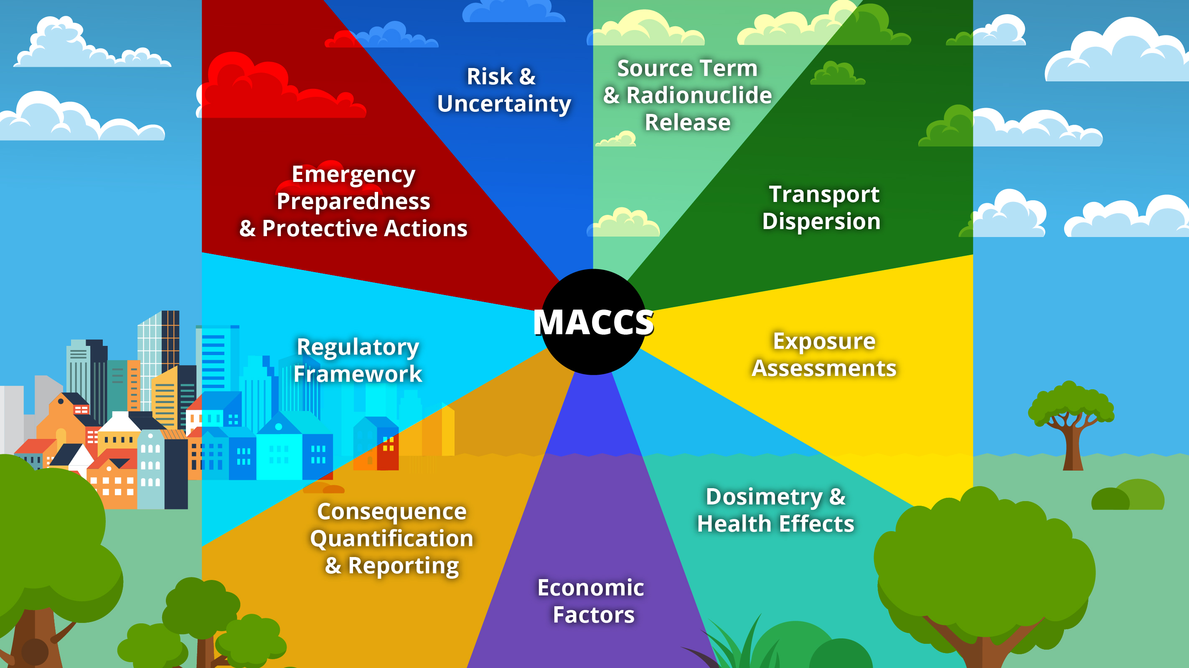
Postulated Accidents
MACCS [SNL]
  Applied in the environmental reviews and now may be applied for safety analysis under Licensing Modernization Program/Emergency Planning Zone (EPZ) determinations
  Input guidance provided in NUREG/CR-7270 (ML22294A091)
  Source term from MELCOR (Level 2 PRA results)
  Weather data is from the safety analysis
SecPop [SNL]
  Calculates population and economic data for a specific location in the continental United States based on its latitude and longitude
  Direct input into MACCS as a data file
  Applies US Census data
Source: https://maccs.sandia.gov/maccs.aspx
International RAMP and MACCS User Group Meeting, October 21, 2024

Slide 12



Transportation of Fuel and Waste
NRC-RADTRAN [RAMP] derived from RADTRAN code
WebTRAGIS [ORNL] is a geographic information system tool for modeling transportation routing
NRC transportation studies available on NRC-RADTRAN Technical Documents page
Applies a GUI to RADTRAN Version 6.02
RAMP Contractor, PNNL, addressing identified issues and future improvements
Access is available to Federal employees and others need a Federal sponsor for access
NRC-RADTRAN GUI capability to read WebTRAGIS kml file for routing data
NRC-RADTRAN User Guide site has clarification on an identified issue with reading kml files and adjusting the population data
Latest study is NUREG-2266 (ML24207A210) for Accident Tolerant Fuels (ATF)
Demonstrates continued use of Table S-4 under 10 CFR 51.52 for LWR ATF deployment and use with enrichment up to 8 wt% U-235 and burnup levels up to 80 GWd/MTU

Slide 13
For information on codes not available on RAMP
CORMIX: http://www.cormix.info/index.php
MODFLOW: https://www.usgs.gov/mission-areas/water-resources/science/modflow-and-related-programs#overview
MACCS and SecPop: https://maccs.sandia.gov/default.aspx
WebTRAGIS: https://webtragis.ornl.gov/login

Slide 14
Questions and Discussion

