Slide 1
Welcome and Overview of the RAMP/MACCS User Group Meeting
International RAMP and MACCS 2024 Fall User Group Meeting
Marcos Vicente
Health Physicist

Slide 2
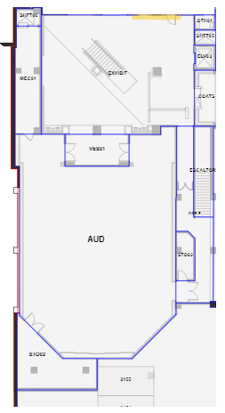
Auditorium and Evacuation Plan

Slide 3
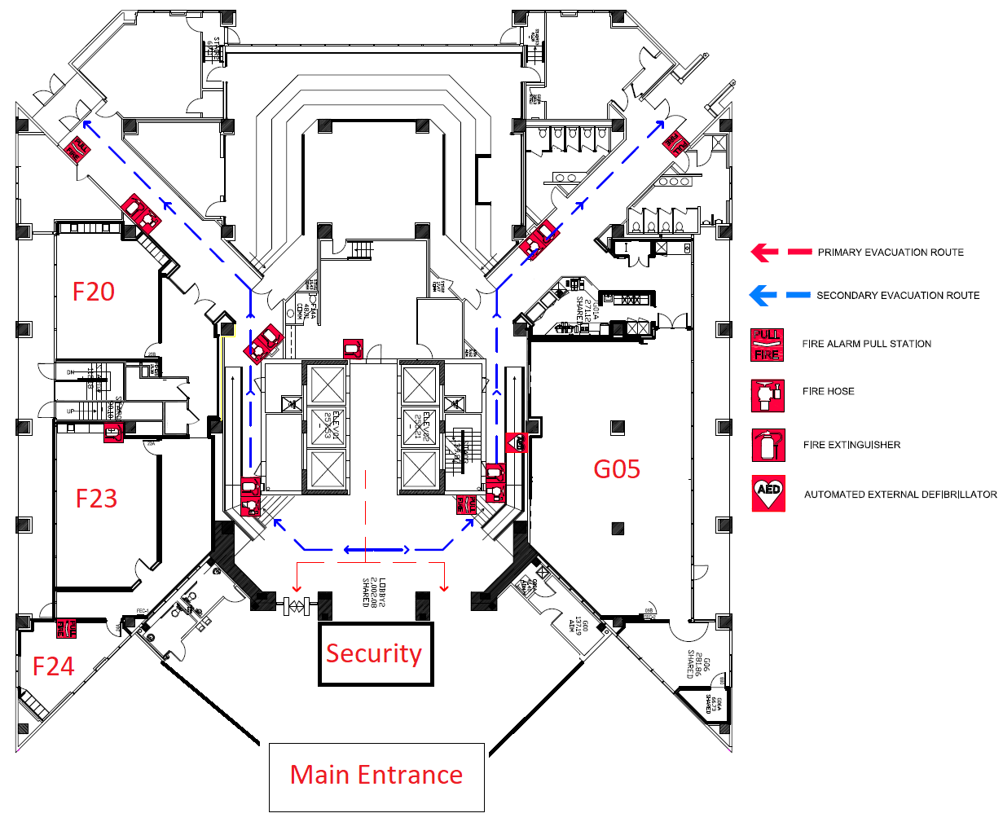



1st Floor Map and Evacuation Plan

Slide 4
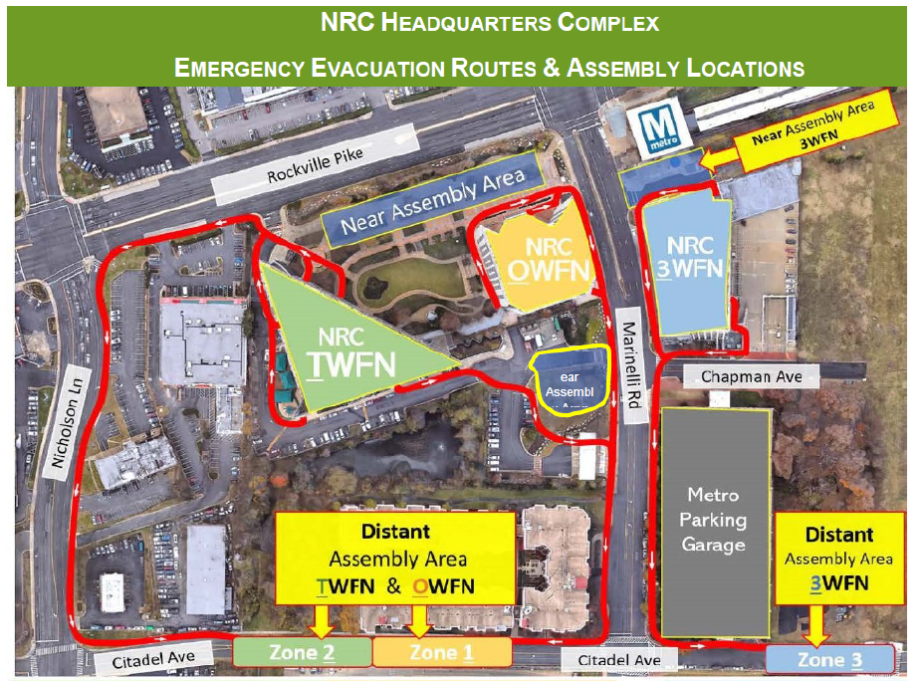
Emergency Evacuation Route and Assembly Location

Slide 5
Ground Rules for Visitors at the NRC
Must always wear visitor badge and ensure it is visible
Must be escorted to the auditorium
Not allowed access to elevators, stairwells, or non-public sections of NRC space
Allowed to move freely without an escort in public areas on the main level (i.e. main lobby, cafe, training session rooms)

Slide 6
Hybrid Sessions
Audio
  All virtual participants will be muted
Video
  All virtual participants should have video turned off
Meeting Recording
  This meeting (apart from selected small sessions) will be recorded and may be posted on the NRC’s website or used internally
  If you choose to unmute and speak or turn your camera while recording is in progress, you are presumed to have provided consent to recording and to the use of your voice and image
Technical Issues
  Please email ramp@nrc.gov
Questions
  Questions will be addressed at the end of the presentations
  Virtual attendees please use the chat to submit questions
  If you have questions after the meeting, please email the questions to ramp@nrc.gov

Slide 7

Program Booklet

Slide 8
Program Booklet Highlights
Map of the Main Floor of the NRC
Guest WiFi
Welcome Letter from the Acting Director of Nuclear Regulatory Research, John Tappert
NRC RAMP, NRC MACCS, PNNL, and LEDIOS Teams
Agenda for the week
RAMP/MACCS Code Presentation Descriptions
Description of Optional Tours
Social Night and No-Host Dinner
Nearby Dining
Things to do in the area

Slide 9
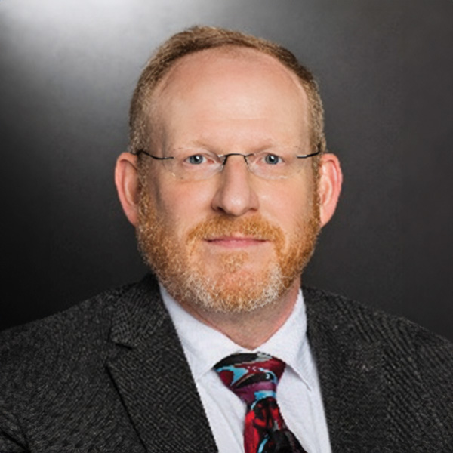
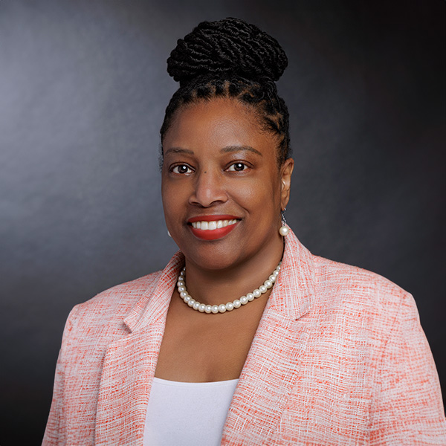
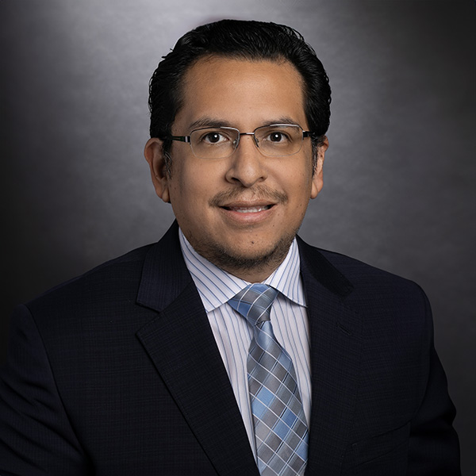
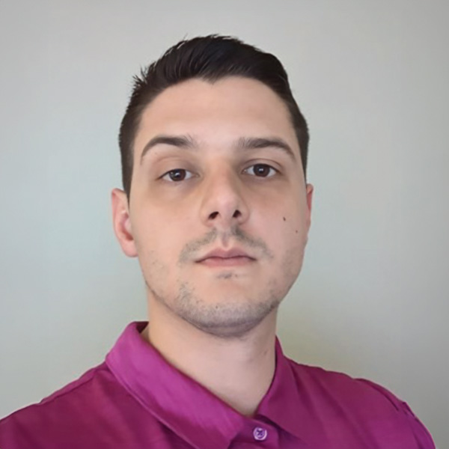
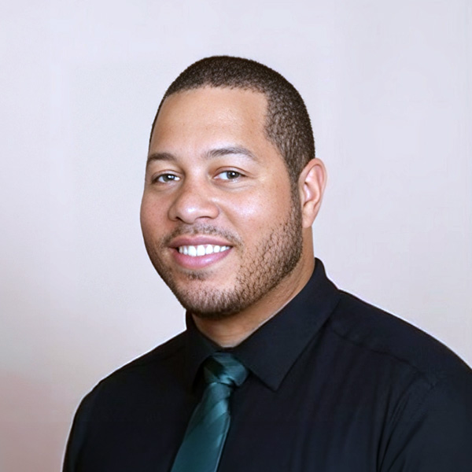
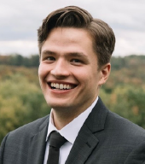
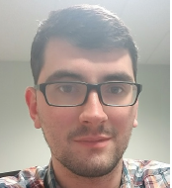
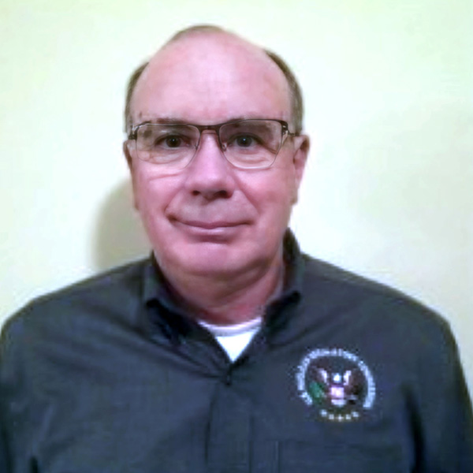
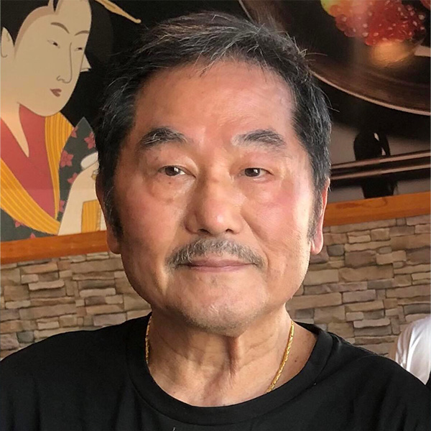

NRC RAMP Team
Dr. Stephanie
Bush-Goddard
Senior RAMP Manager
Marcos Vicente
RAMP Manager
Rigel Flora
RAMP Team
John Tomon
Branch Chief
Brian Allen
RAMP Team
Dr. Sam Hanson
RAMP Team
Sam Edwards
RAMP Team
Don Lowman
RAMP Team
Dr. Casper Sun
RAMP Team
Kerstun Norman
RAMP Team

Slide 10
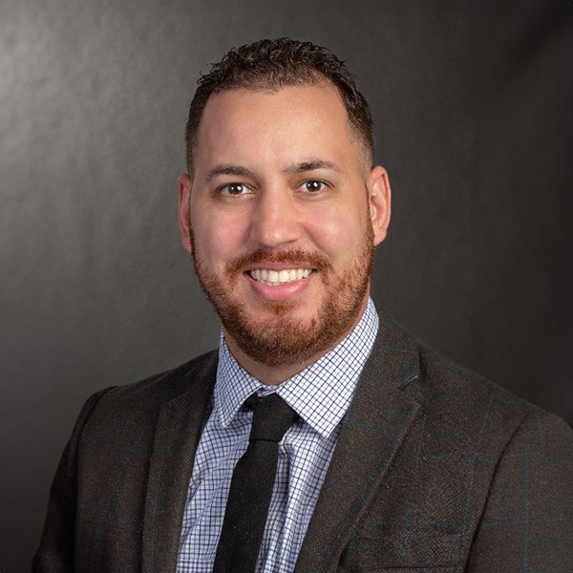
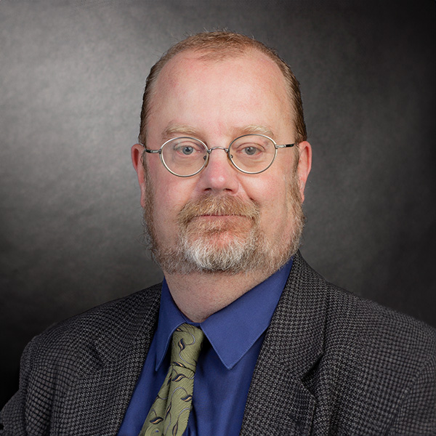
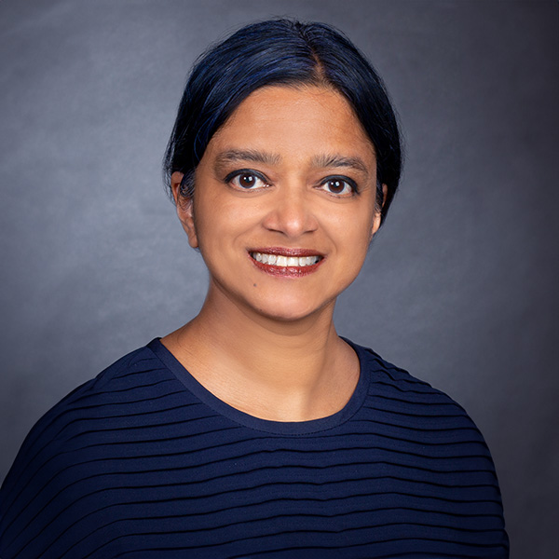
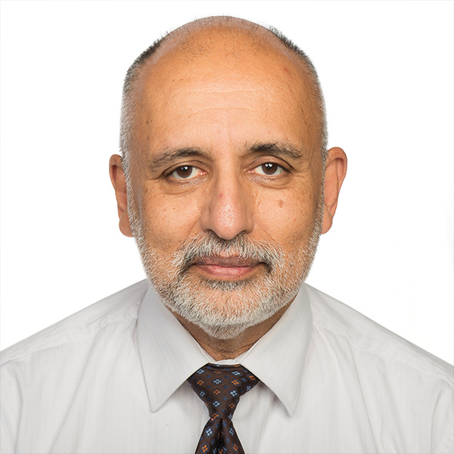
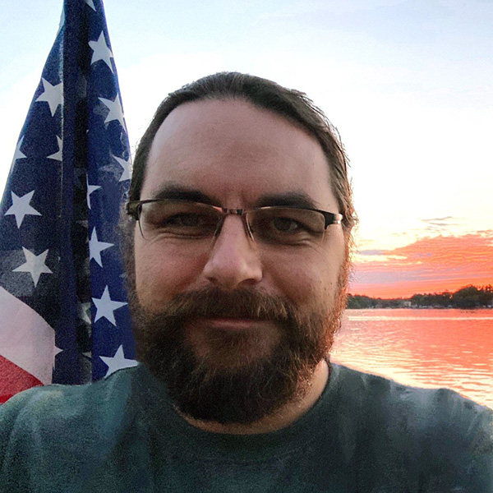
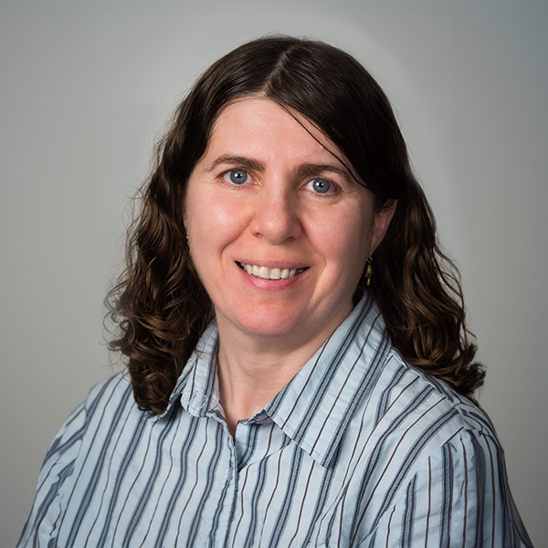
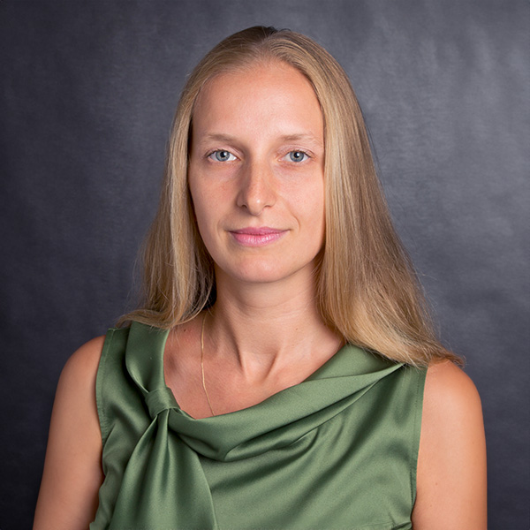
NRC MACCS Team
Luis Betancourt
Branch Chief
Dr. Keith Compton
MACCS Team
Dr. Tina Ghosh
MACCS Team
Dr. Salman Haq
MACCS Team
Dr. AJ Nosek
MACCS Team
Dr. Nazila Tehrani
MACCS Team
Dr. Elena Yegorova
RAMP Team
10

Slide 11
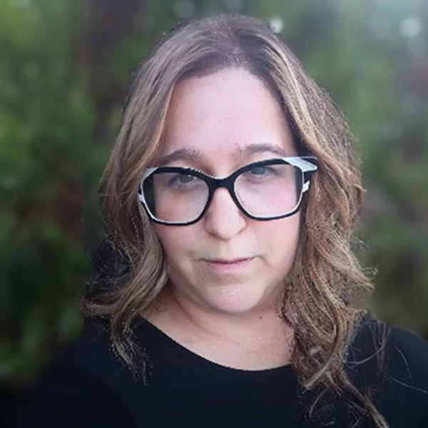
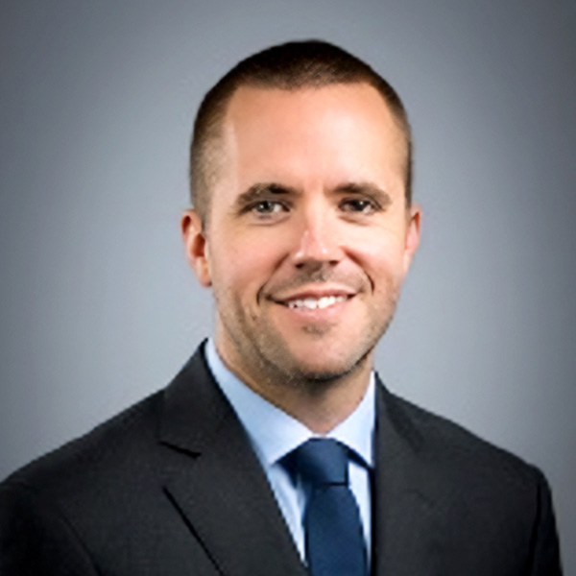
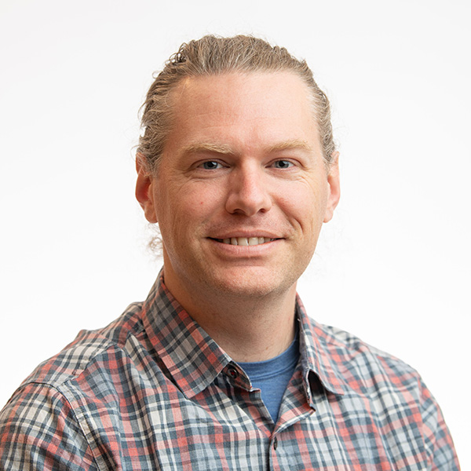
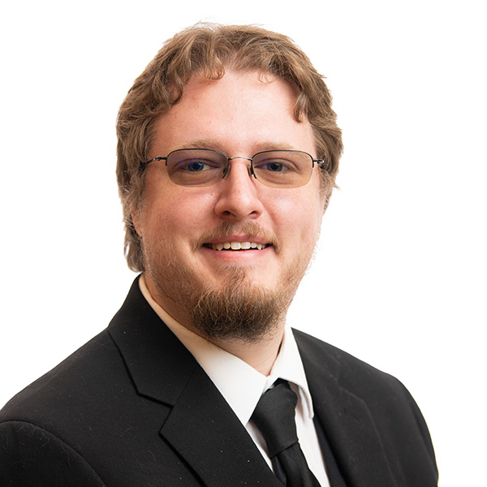
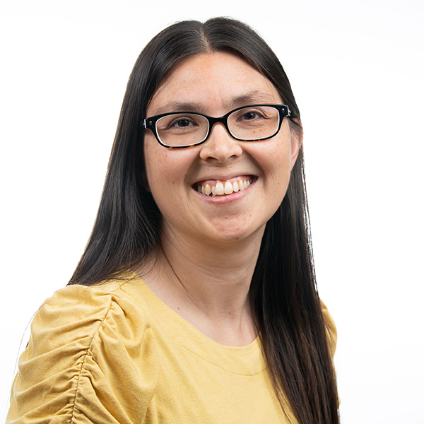
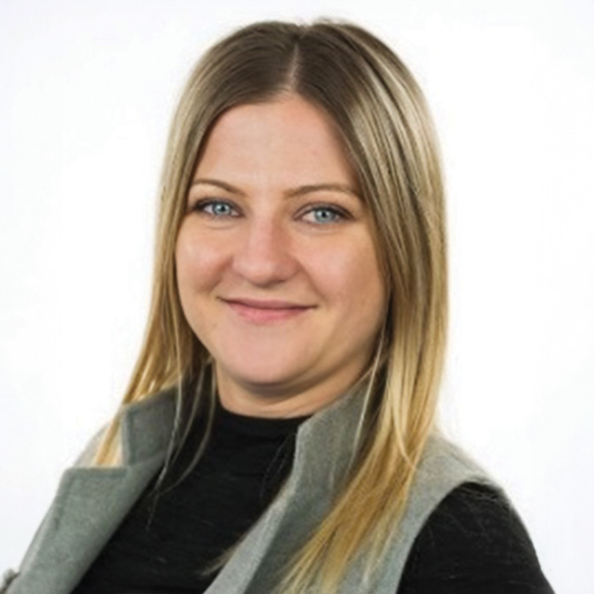
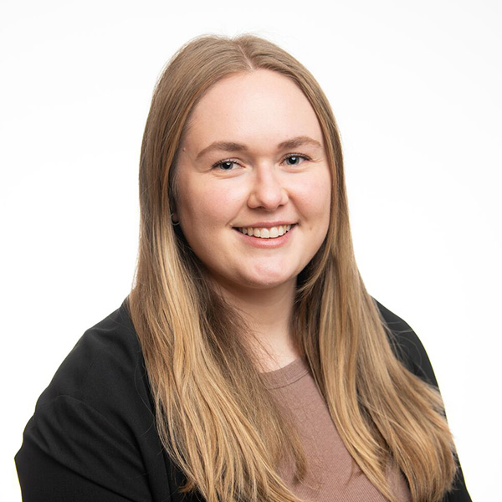
PNNL Team
Dr. Vered Shaffer
PNNL RAMP Program Manager
Dr. Colby Mangini
PNNL RAMP Team
Dr. Jon Napier
PNNL RAMP Team
Dr. Josh Hargraves
PNNL RAMP Team
Julia Flaherty
PNNL RAMP Team
Luba Hamilton
PNNL RAMP Team
Carli Ramos
PNNL RAMP Team
11

Slide 12
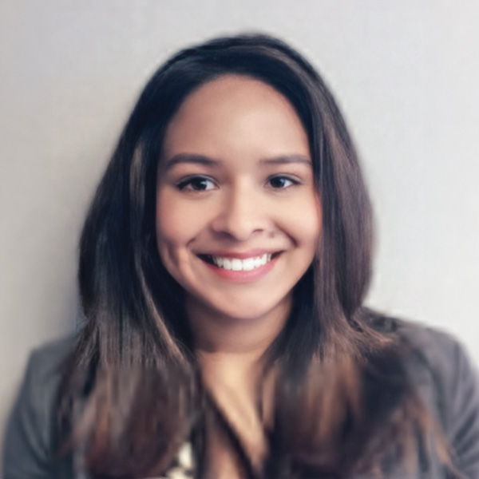
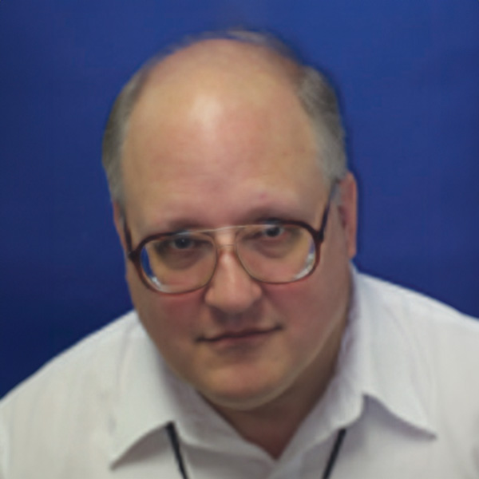
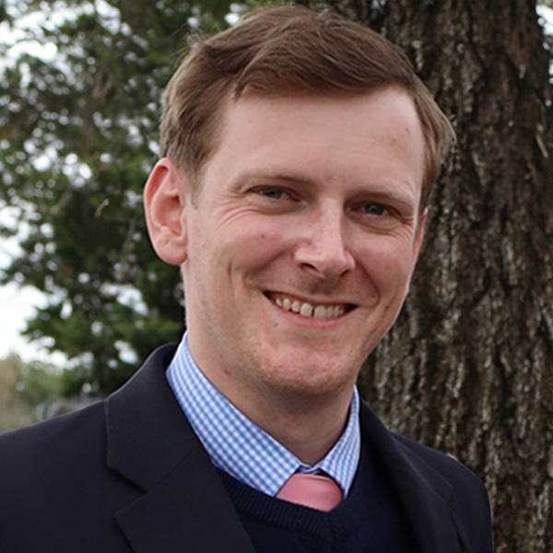
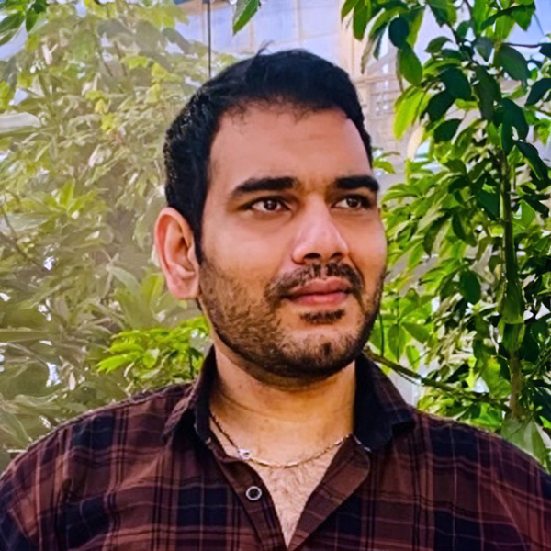
Leidos Team
Wendy Chinchilla
Leidos RAMP Manager
Frederic Gooding
Leidos RAMP Operations Support
Eric Zimmerman
Leidos RAMP Website Developer
Venukumar Devandla
Leidos RAMP Drupal Developer

Slide 13
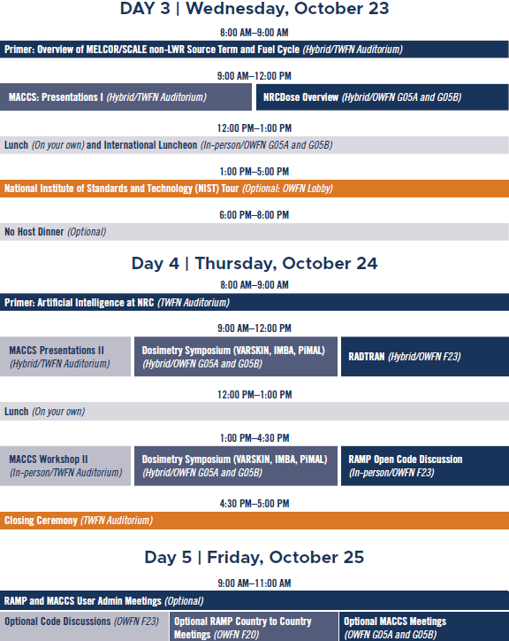
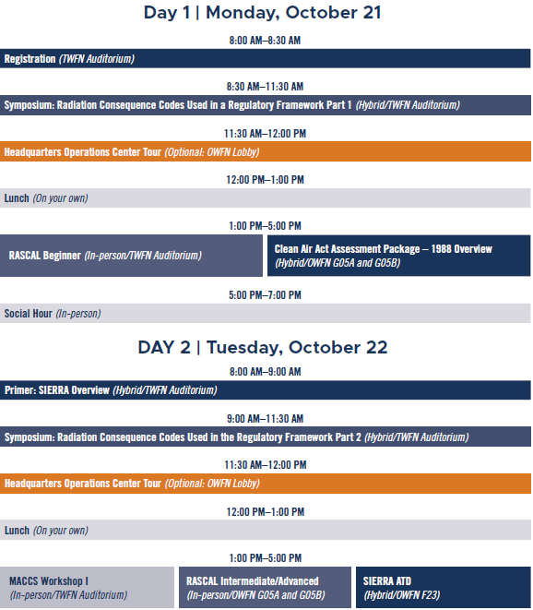
Schedule at a Glance

Slide 14
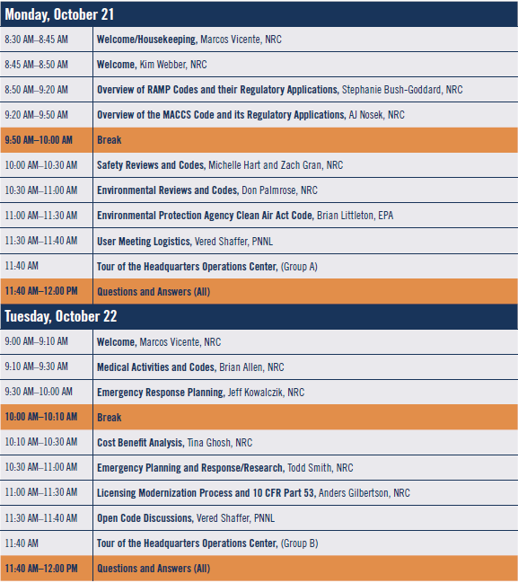
Agenda for Radiation Consequence Codes Used in a Regulatory Framework

Slide 15
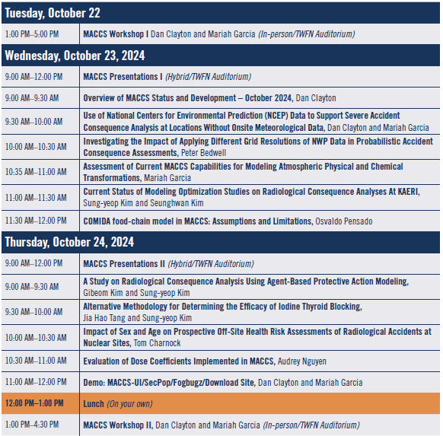
Agenda for MACCS Overview

Slide 16
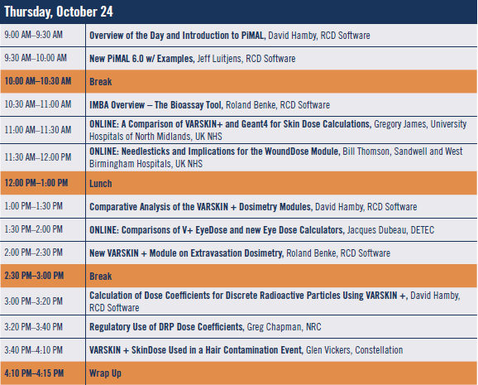
Agenda for RAMP Dosimetry Symposium

Slide 17
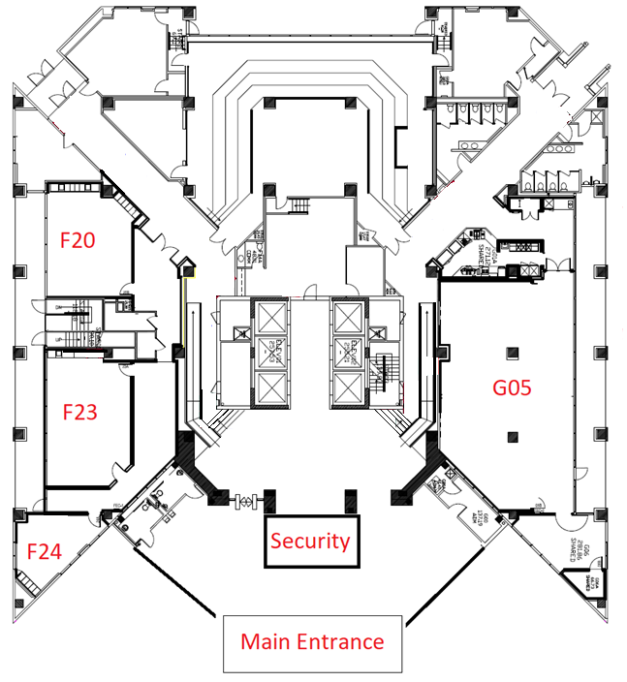

















1st Floor Map
Women’s Restroom
Men’s Restroom
Breakout
Sessions
Stairwell/Elevators/Walkway to Auditorium (must be escorted)

Slide 18
Program Overview
Dr. Stephanie-Bush Goddard
Senior RAMP Program Manager
Dr. AJ Nosek
MACCS Team

Slide 19
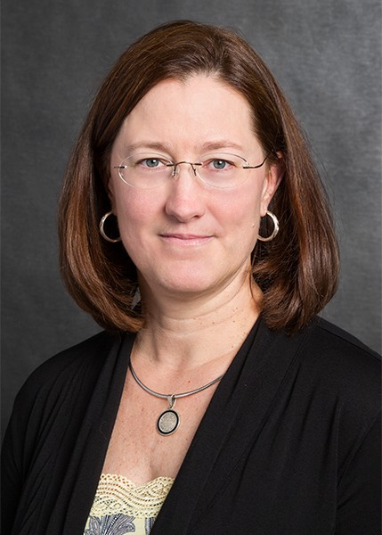
Kimberly Webber,
Division Director of Systems Analysis,
Office of Nuclear Regulatory Research

