Slide 1
Overview of the MACCS Code and Its Regulatory Applications,
Oct 2024
AJ Nosek, PhD
US Nuclear Regulatory Commission
2024 RAMP and MACCS Users Group Meeting

Slide 2
Outline
MACCS Overview
  Purpose of MACCS Code
  MACCS Code Distribution
  Phenomena Treated by MACCS
  MACCS / RASCAL Comparison
  MACCS Spatial Grid
  MACCS Time-Dependent Calculations
  Progression of a MACCS Calculation
  MACCS Code Modules
  MACCS Outputs
MACCS Outputs of Regulatory Interest
  Cost-Benefit Analyses
  Safety Goal Evaluations
  Environmental Reviews
  Emergency Preparedness
  Safety Reviews
  Research Studies

Slide 3
Purpose of MACCS Code
The purpose of MACCS is to simulate and understand the public consequences of severe nuclear accidents.
Created by Sandia National Laboratories to support NRC research and regulatory applications
  Origins go back to the mid-1970s
MACCS is typically used for prospective analyses
MACCS is very versatile with a large set of user inputs
MACCS can quickly run thousands of Monte Carlo simulations for PRA applications
  Large set of weather trials (hundreds or thousands)
  Significant set of source term categories (ten or twenty) plus additional sensitivity studies

Slide 4
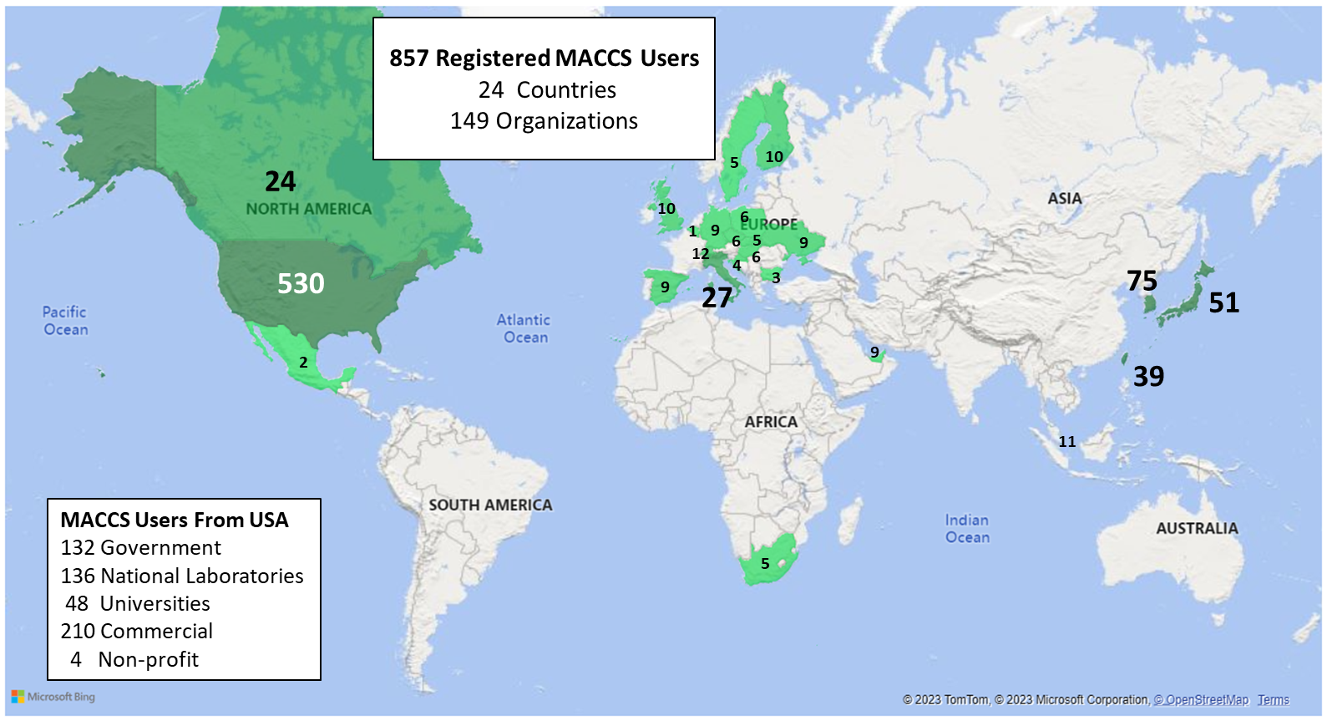
MACCS Code Distribution
NRC Cooperative Programs | Research Areas
Code Applications and Maintenance Program (CAMP) | Thermal Hydraulics
Cooperative Severe Accident Research Program (CSARP) | Severe Accidents
Radiation Protection Computer Code Analysis and Maintenance Program (RAMP) | Radiation Protection
MACCS belongs to the Cooperative Severe Accident Research Program (CSARP)
MACCS support codes include:
  MACCS-UI / WinMACCS
  MelMACCS
  SecPop (U.S. only)
  MACCS-HYSPLIT Tools
  AniMACCS
Instructions for requesting the MACCS code and MACCS-related documents can be found at: https://maccs.sandia.gov/
MACCS Users by Country

Slide 5
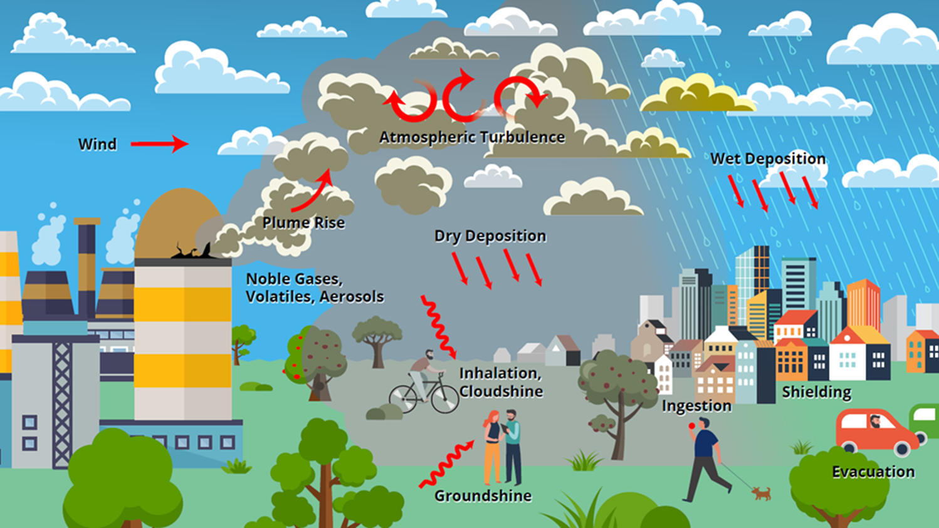
Phenomena Treated by MACCS
Emergency response
  Sheltering
  Evacuation
  Potassium iodide (KI) ingestion
  Relocation
Long-term protective actions
  Decontamination
  Temporary or permanent interdiction of property
  Crop disposal
Economic losses
  Evacuation and relocation per diem costs
  Long-term relocation cost
  Decontamination costs
  Loss of property use
  Depreciation during interdiction
  Property value for permanent interdiction
Radiogenic health effects
  Early health effects
  Cancer incidence / fatalities
Representation of source term
Atmospheric dispersion
  Statistical sampling of archived weather data
  Wet and dry deposition
Dose exposure pathways
  Inhalation
  Cloudshine
  Groundshine
  Resuspension
  Ingestion
  Skin deposition
Notes:
Source term – imported as a file from MELCOR or similar application, or input directly into MACCS itself by specifying the release characteristics. Magnitude and timing, to include buoyancy (heat), height, initial timing, release rate by radionuclide by chemical group, particle size distribution by chemical group…items like that to characterize your release.
Models Atmospheric transport and dispersion – weather is a key part of that – options for statistical sampling of your weather data
(120 hour, bin sampling)
Deposition – deposited on the ground, or washed out by interactions with clouds or rain.
Exposure pathways – and ultimately the biological impacts and resulting risks
Broken down into multiple time domains:
Emergency – sheltering, biological impacts and potential shielding effects
Evacuation – speed and timing of evacuation for example. You can also modify this for certain groups of people, or modify speeds (weather)
Potassium Iodine Ingestion –
Relocation
Long Term effects:
Impacts on the land – work associated with decontaminating land, possible interdition, and crop disposal
Economic Losses:
Mentioned biological impacts, but a key part of MACCS is also calculating economic impacts to have a full picture of the risk.

Slide 6
MACCS / RASCAL Comparison
 | MACCS | RASCAL
Inputs | Hundreds | <20
Input time | Hours to Days | <10 min
Run time | Minutes to Days | <5 min
Source Term | External Input | Included (Simplistic)
ATD Models | Y | Y
Weather | Sampled Historic Obs | Live Weather
Dose Calculations | Y | Y
Protective Actions | Credited | Not Credited
Health Effects | Y | N
Economic Effects | Y | N

Slide 7
MACCS Spatial Grid
Calculations are performed on a radial polar grid
The user specifies the number of compass sectors and radial intervals, and the outer distance of each radial interval
MACCS calculates results for each spatial element
Example of MACCS polar coordinate grid with 16 sectors and 3 radial divisions.
(reproduced from Fig. 2-1 of NUREG/CR-6613 Vol. 1

Slide 8
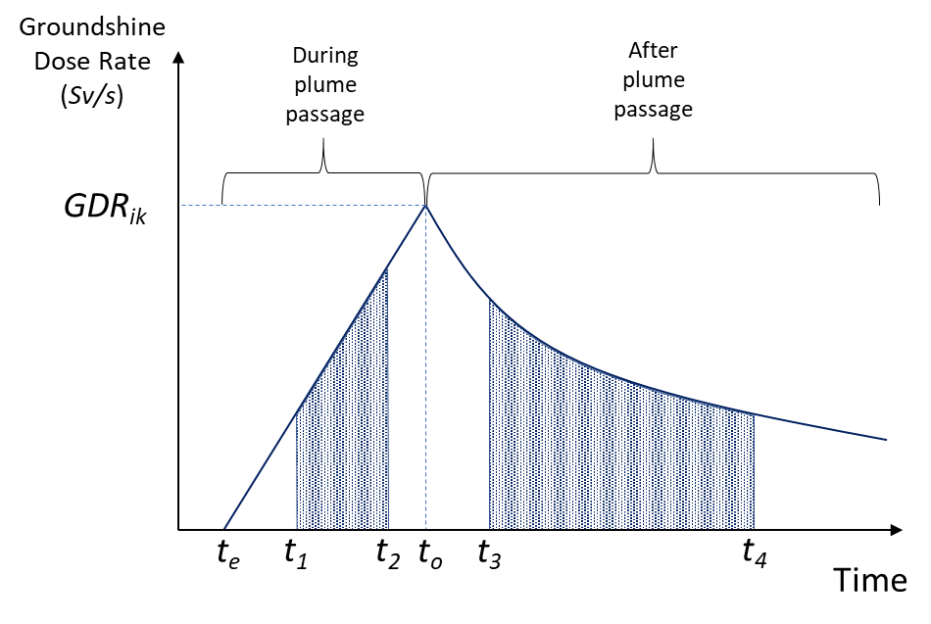
MACCS Time-Dependent Calculations
The timing of protective actions affects consequences
Example: Figure below shows groundshine dose accumulation during the emergency phase
Network evacuation scheme

Slide 9
Progression of a MACCS Calculation
ATMOS
EARLY / CHRONC
Dose
Coefficients
Source Terms
Plume Rise
Protective Actions
Dosimetry
Population
And Site Data
Weather Data
Transport and Diffusion
Health
Effects
EARLY
Data
Costs
CHRONC
Data
ATMOS Data
Deposition
Outputs
Notes:
ATMOS: Atmospheric transport in early phase
EARLY: Dosimetry, protective actions, and health effects from early phase.
- Early phase: Up to 40 days, usually one week.
CHRONC: Dosimetry, protective actions, and health effects from intermediate and long-term phases; Costs in all phases
- Intermediate phase: 0 to 30 years, usually zero or one year.
- Long-term phase: Exposure period depends on the pathway. EXPTIM up to 317 years, usually 30 or 50 years.

Slide 10
MACCS Code Modules
ATMOS
  Estimates transient air and ground concentrations
  Option for Gaussian Plume Segment or Lagrangian Particle models
EARLY
  Treats emergency phase (up to 40 days, usually one week)
  Estimates projected doses from plume passage and ground contamination
  Models cohort-specific emergency response actions
  Estimates accumulated doses and health effects to cohorts
CHRONC
  Treats intermediate phase (up to 30 years, usually zero or one year)
  Treats long-term phase (up to 300 years, usually 50 years)
  Estimates projected doses from ground contamination
  Models long-term protective actions (i.e., relocation / property interdiction, food interdiction, decontamination, and condemnation)
  Estimates accumulated doses and health effects
  Estimates economic losses, land contamination, displaced individuals, and other societal impacts.

Slide 11
MACCS Outputs
Output Name | ATMOS | EARLY | CHRONC
Type 0: Atmospheric Results for Specified Downwind Distances | X
Type 1: Health Effect Cases |  | X | X
Type 2: Early Fatality Distance |  | X
Type 3: Population Exceeding Early Dose Threshold |  | X
Type 4: Average Individual Risk |  | X | X
Type 5: Population Dose |  | X | X
Type 6: Centerline Dose |  | X | X
Type 7: Centerline Risk |  | X | X
Type 8: Population-Weighted Individual Risk |  | X | X
Type A: Peak Dose for Specified Distances |  | X | X
Type B: Peak Dose for Specified Spatial Elements |  | X | X
Type C: Land Area Exceeding Dose |  | X
Type D: Land Area Exceeding Concentration |  | X
Type E: Population Movement Across Radius |  | X
Type 9: Breakdown of Long-term Population Dose |  |  | X
Type 10: Economic Cost Measures |  |  | X
Type 11: Maximum Distance for Protective Actions |  |  | X
Type 12: Impacted Area / Population |  |  | X
Type 13: Maximum Annual Food Ingestion Dose |  |  | X
Type 14: Evacuated and Relocated Population |  |  | X
Output Category
Atmospheric
Health Effects
Dose
Socioeconomic
Notes:
If you don’t run CHRONC, the outputs only contain early phase results. Also, even when you do run CHRONC, certain outputs do not include food and water ingestion. To include all MACCS dose exposure pathways, use Type 1 and 5 outputs.

Slide 12
MACCS Outputs of Regulatory Interest
MACCS Outputs (truncated list)
Type 0: Atmospheric Results
Type 1: Health Effect Cases
Type 5: Population Dose
Type 8: Population-Weighted Individual Risk
Type A: Peak Dose for Specified Distances
Type 10: Economic Cost Measures
Type 12: Impacted Area / Population
Type 14: Evacuated and Relocated Population
Safety goal evaluation
  The safety goals are a level of protection from consequences of nuclear power plant operation at which members of the public bear no significant additional risk to life or health. (51 FR 30028)
The quantitative health objectives (QHOs)
  The QHOs are a measure of meeting the NRC safety goals.
  The QHO for early fatalities is ~ 5x10⁻⁷/year. (NRC’s subsidiary goal for the QHO for early fatalities, LERF is 1x10⁻⁵/year.)
  The QHO for latent fatalities is ~ 2x10⁻⁶/year. (NRC’s subsidiary goal for the QHO for latent fatalities, CDF, for operating and new reactors, is 1x10⁻⁴/year.)
A QHO safety goal evaluation is a comparison of the early and latent fatality risk against the QHOs
Safety goal evaluations are used to inform regulatory analysis / backfit analysis and other efforts.
Output Category
Atmospheric
Health Effects
Dose
Socioeconomic

Slide 13
MACCS Outputs of Regulatory Interest
MACCS Outputs (truncated list)
Type 0: Atmospheric Results
Type 1: Health Effect Cases
Type 5: Population Dose
Type 8: Population-Weighted Individual Risk
Type A: Peak Dose for Specified Distances
Type 10: Economic Cost Measures
Type 12: Impacted Area / Population
Type 14: Evacuated and Relocated Population
Cost-benefit analysis (CBA)
  CBA is a process used to measure the benefits of a decision or action minus its associated costs to determine whether it is worthwhile.
  NRC uses CBA to evaluate potential regulatory actions.
  MACCS provides the public health and economic costs from a nuclear facility accident as inputs to CBA.
NRC uses CBA in regulatory analyses (rulemaking).
NRC also uses CBA in environmental reviews.
Output Category
Atmospheric
Health Effects
Dose
Socioeconomic

Slide 14
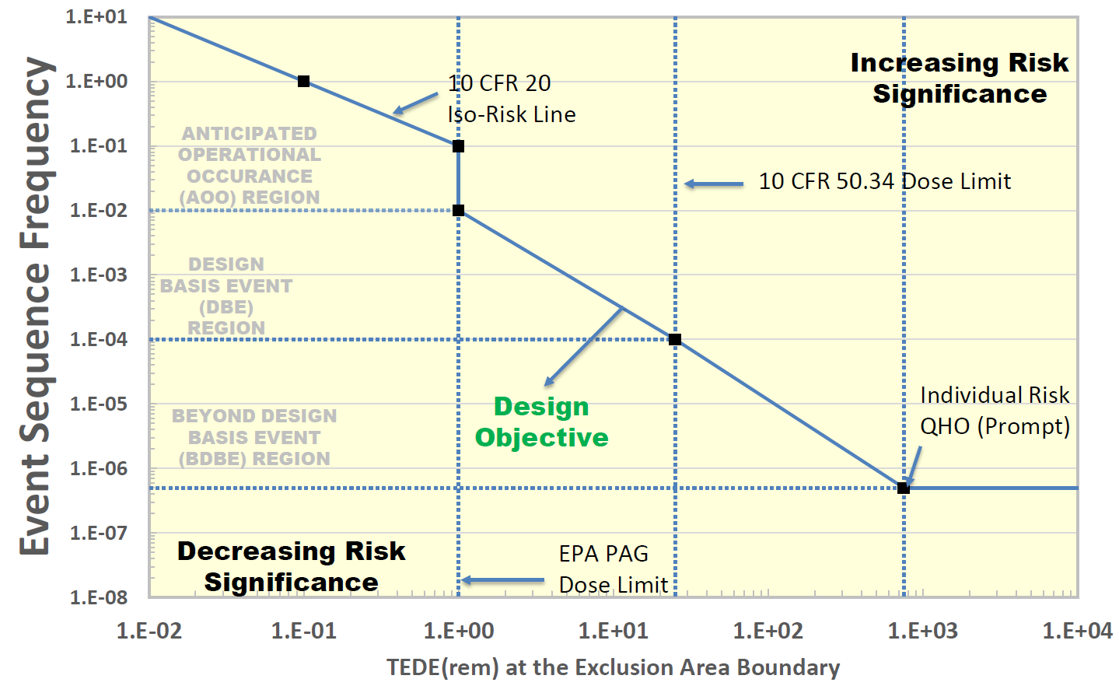
MACCS Outputs of Regulatory Interest
MACCS Outputs (truncated list)
Type 0: Atmospheric Results
Type 1: Health Effect Cases
Type 5: Population Dose
Type 8: Population-Weighted Individual Risk
Type A: Peak Dose for Specified Distances
Type 10: Economic Cost Measures
Type 12: Impacted Area / Population
Type 14: Evacuated and Relocated Population
Licensing modernization project (LMP)(NEI 18-04, Rev. 1)
  LMP is a licensing approach to support new and advanced reactor designs.
  LMP is technology-inclusive, risk-informed, and performance-based.
  LMP uses a frequency-consequence curve for portions of the licensing basis.
  LMP also requires assessments of cumulative risk (QHOs, public dose limits).
  While not required, NRC anticipates MACCS to be used to evaluate licensing basis events.
Output Category
Atmospheric
Health Effects
Dose
Socioeconomic
Notes:
In addition to the comparison to the frequency-consequence target (TEDE to individual at EAB from 30-day exposure, reported as 5th, mean, and 95th percentile dose) for the licensing basis events, there is also a comparison of the peak 95th individual dose to the offsite (siting) 25 rem TEDE dose criteria at the EAB (worst 2-hr exposure) and LPZ (30-day exposure) for DBAs, and an evaluation of cumulative risk (QHOs and probability of exceeding Part 20 public dose limit offsite).

Slide 15
MACCS Outputs of Regulatory Interest
MACCS Outputs (truncated list)
Type 0: Atmospheric Results
Type 1: Health Effect Cases
Type 5: Population Dose
Type 8: Population-Weighted Individual Risk
Type A: Peak Dose for Specified Distances
Type 10: Economic Cost Measures
Type 12: Impacted Area / Population
Type 14: Evacuated and Relocated Population
Safety reviews
  Applicants for reactor licenses can use the licensing framework from either 10 CFR Part 50 or Part 52.
    MACCS has generally not been used.
    Non-LWR applicants may choose to use LMP.
  NRC is drafting an alternative PRA-forward licensing analysis framework (Part 53).
    Applicants can use LMP in Part 53 as well.
  MACCS can support other license requirements, e.g.,
    A dose evaluation at the exclusion area boundary (worst 2-hour exposure)
    A dose evaluation for the low population zone (30-day exposure)
Output Category
Atmospheric
Health Effects
Dose
Socioeconomic
Notes:
In addition to the comparison to the frequency-consequence target (TEDE to individual at EAB from 30-day exposure, reported as 5th, mean, and 95th percentile dose) for the licensing basis events, there is also a comparison of the peak 95th individual dose to the offsite (siting) 25 rem TEDE dose criteria at the EAB (worst 2-hr exposure) and LPZ (30-day exposure) for DBAs, and an evaluation of cumulative risk (QHOs and probability of exceeding Part 20 public dose limit offsite).

Slide 16
MACCS Outputs of Regulatory Interest
MACCS Outputs (truncated list)
Type 0: Atmospheric Results
Type 1: Health Effect Cases
Type 5: Population Dose
Type 8: Population-Weighted Individual Risk
Type A: Peak Dose for Specified Distances
Type 10: Economic Cost Measures
Type 12: Impacted Area / Population
Type 14: Evacuated and Relocated Population
Environmental reviews
  National Environmental Policy Act (NEPA) requires an Environmental Impact Statement (EIS) for “major Federal actions,” as such reactor licensing for the NRC.
  The EIS reports environmental risks of accident release categories.
    The frequency and environmental release information (i.e., the Level 1 and Level 2 PRA) come from the safety analysis.
    The consequence values come from MACCS outputs, such as population dose, early and latent fatalities, cost, and land requiring decontamination.
  Environmental risk measures of population dose and cost risk are inputs to cost-benefit analyses (CBA)
    The CBA for reactor licensing is known as a severe accident mitigation design alternative (SAMDA) analysis
    The CBA for license renewal is known as a severe accident mitigation alternative (SAMA) analysis
Output Category
Atmospheric
Health Effects
Dose
Socioeconomic
Notes:
The SAMDA / SAMA analyses typically calculate a potential maximum benefit to screen out
SAMDA is a subset of SAMAs without consideration of procedures and training which have not been developed at the new reactor licensing stage.

Slide 17
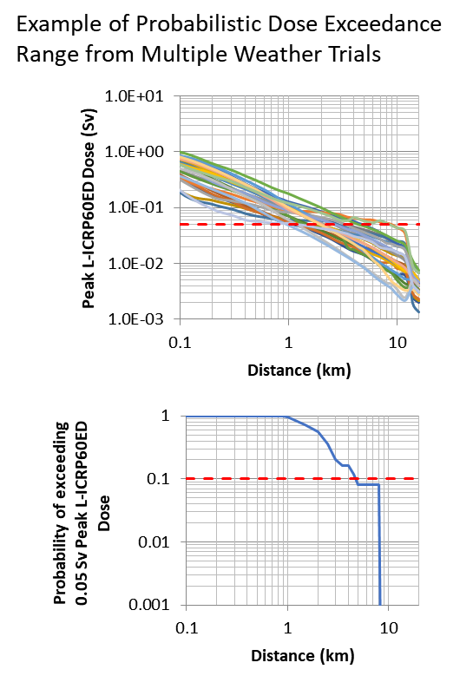
MACCS Outputs of Regulatory Interest
Emergency preparedness
  Emergency planning zones (EPZs)
    MACCS dose results can inform EPZ sizing
  Protective action strategies
    Response options include different types of evacuation and sheltering, and use of potassium iodide.
    MACCS outputs related to dose, health risk, and size of displaced population can help inform protective action strategies
Risk communication
Recovery preparedness
MACCS Outputs (truncated list)
Type 0: Atmospheric Results
Type 1: Health Effect Cases
Type 5: Population Dose
Type 8: Population-Weighted Individual Risk
Type A: Peak Dose for Specified Distances
Type 10: Economic Cost Measures
Type 12: Impacted Area / Population
Type 14: Evacuated and Relocated Population
Output Category
Atmospheric
Health Effects
Dose
Socioeconomic
Notes:
The protective action strategies that were identified and evaluated include:
Different types of evacuation (e.g., radial, lateral, staged)
Different types of sheltering (e.g., typical housing vs preferential shelters)
Various combinations of both sheltering and evacuation
Recovery planning

Slide 18
MACCS Outputs of Regulatory Interest
MACCS Outputs (truncated list)
Type 0: Atmospheric Results
Type 1: Health Effect Cases
Type 5: Population Dose
Type 8: Population-Weighted Individual Risk
Type A: Peak Dose for Specified Distances
Type 10: Economic Cost Measures
Type 12: Impacted Area / Population
Type 14: Evacuated and Relocated Population
Research Studies
  1975: WASH-1400, Reactor Safety Study
  1982: NUREG/CR-2239, Sandia Siting Study
  1990: NUREG-1150, “Severe Accident Risks: An Assessment for Five U.S. Nuclear Power Plants”
  2005: Security studies for 6 nuclear power plants
  2001: NUREG-1738, “Technical Study of Spent Fuel Pool Accident Risk at Decommissioning Nuclear Power Plants”
  2007: NUREG/CR-6953, Protective Action Recommendation Study
  2012-2013: NUREG-1935, NUREG/CR-7110 Vol. 1 & 2, State-of-the-Art Reactor Consequence Analyses (SOARCA)
  2013: NUREG-2161, Spent Fuel Pool Study
  2015: NUREG-2206, Containment Protection and Release Reduction
  2019: NUREG/CR-7245, SOARCA Sequoyah
  2016-2022: NUREG/CR-7155, NUREG/CR-7262, NUREG-2254, SOARCA Uncertainty Analyses
  2024+: NRC’s Level 3 PRA Project
Output Category
Atmospheric
Health Effects
Dose
Socioeconomic
Notes:
This hasn’t been a complete list,
There are a number of other uses:
The atmospheric results in MACCS could be used in control room habitability and exclusion area boundary and siting calculations, but these are generally done with RAMP codes.
There is new guidance for how close new and advanced reactors can be sited near population centers (similar to EPZ sizing)
Another example is that new reactor designs have to address large aircraft impact, but there are exclusions for RTRs.

Slide 19
Any Questions?
Instructions for requesting the MACCS code and MACCS-related documents can be found at: https://maccs.sandia.gov/

Slide 20
Backup Slides

Slide 21
Outline
MACCS Calculational Models
  Atmospheric Dispersion
  Dosimetry
  Protective Actions
  Social and Economic Impacts
  Radiogenic Health Effects
Software Components of the MACCS Code Suite
Architecture of WinMACCS Components
Auxiliary and Supporting Files
Recent MACCS Developments

Slide 22
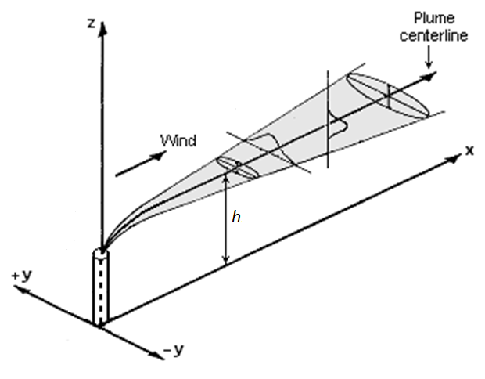
Atmospheric Dispersion
Gaussian approach:
  Gaussian plume equations with dispersion parameters
  Plume nearfield effects (building wake and meander)
  Boundary layer constraint
  Wet and dry deposition
  Off-centerline correction factors
MACCS / HYSPLIT approach:
  HYSPLIT (HYbrid Single-Particle Lagrangian Integrated Trajectory) is a code for computing complex dispersion and deposition simulations
  HYSPLIT is executed independently of MACCS
  HyGridConvert is used to convert air and ground concentrations from HYSPLIT to MACCS spatial grid
Factors common to both:
  Weather sampling routine
  Plume rise height calculation
  Radioactive decay and ingrowth
Figure from HYSPLIT User’s Guide (2022, p. 110)
Notes:
ATD to calculate air and ground concentrations

Slide 23
Atmospheric Dispersion:
Gaussian Transport Model
Gaussian Plume Segments
The plume segment direction is based on observed wind direction at time of release.​
After release, plume segments do not change direction.​
After release, plume segment dispersion changes with observed changes in weather​
  Plume speed changes with windspeed​
  Plume diffusion rate changes with stability class​
  Wet deposition rate changes with rain rate​

Slide 24
Atmospheric Dispersion:
Gaussian Transport Model
Ground Deposition

Slide 25
Atmospheric Dispersion:
MACCS / HYSPLIT Model
Ground Deposition
Notes:
Not a sample problem – but a animation for Fukushima using MACCS coupled with HYSPLIT
Also ground concentration, also Cs-137, map legend and units are different.

Slide 26
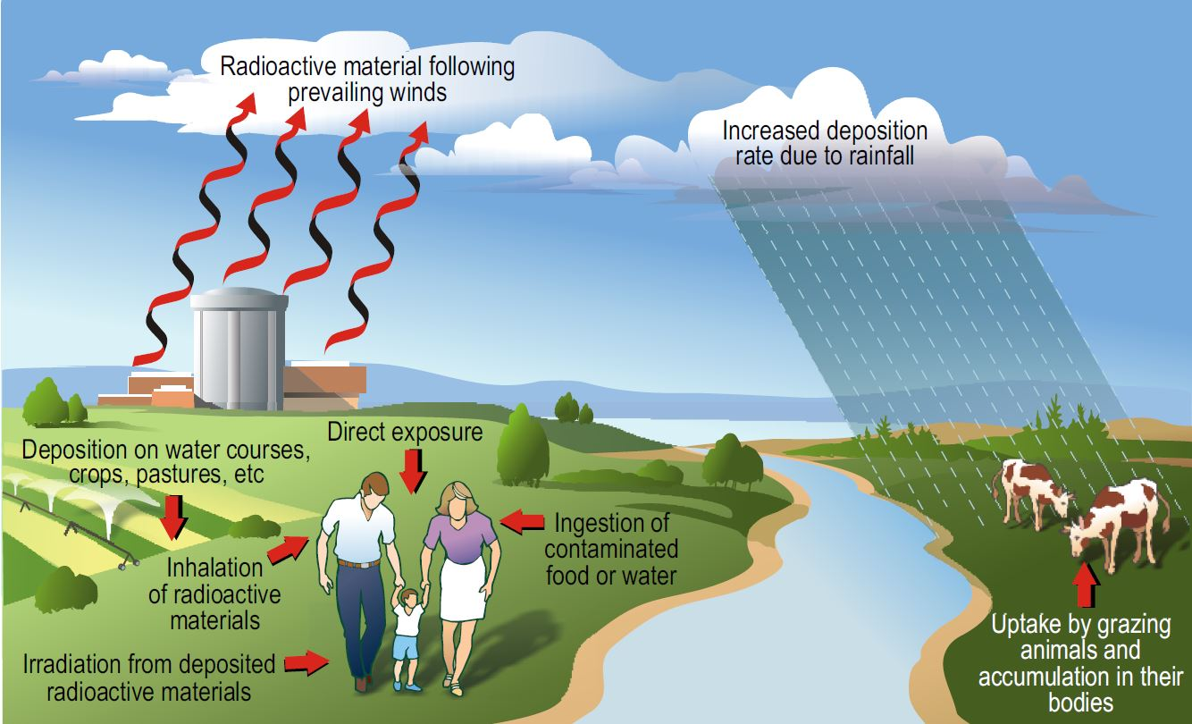
Dosimetry: Exposure Pathways
Early Doses
  Cloudshine
  Groundshine
  Direct inhalation
  Resuspension inhalation
  Skin deposition
Late Doses
  Groundshine
  Resuspension inhalation
  Food ingestion
  Water ingestion
Notes:
MACCS does not model incidental soil ingestion, ingestion of food that comes from gardens or foraged in non-farm areas, or ingestion of fish or other aquatic food.
If users are interested in all calculated pathways, they first need to run both EARLY and CHRONC. Additionally, users need to consider the correct MACCS outputs.
Individual dose and cancer risk outputs do not include ingestion doses.
Population dose and health effect cases) provide are more complete measures of accident consequence.
Depends on your analysis. Late doses are not relevant to early health effects, for instance.

Slide 27
Dosimetry: Dose Coefficients
The dose models use dose coefficients to convert from time-integrated air concentrations or ground concentrations to dose.
External pathways use a dose rate coefficient (e.g., Sv/s per Bq/m²)
Internal pathways (inhalation and ingestion) use an intake-to-dose coefficient (Sv/Bq)
Separate internal dose coefficients are provided for acute, lifetime, and annual doses

Slide 28
Dosimetry:
Types of Calculated Doses
Acute dose
  The portion of the dose that contributes to early health effects (i.e., accounts for the sparing effect)
  Includes only early-phase contributions to dose
  Uses a weighting factor (<1.0) to account for reduced risk associated with protracted internal doses from inhalation
Lifetime dose
  The dose that contributes to stochastic health effects (e.g., cancer)
  Includes both early-phase and late-phase contributions to dose
Annual dose
  The same as the lifetime dose, except annual doses are discretized into annual periods
  Includes both early-phase and late-phase contributions to dose

Slide 29
Protective Actions
Protective actions reduce radiation exposures.
Protective actions are a tradeoff: They reduce radiogenic health effects but at a cost of other types of societal and economic impacts.
Many protective actions are dose-dependent
  If a projected dose exceeds a dose criterion during a specified exposure period, it triggers a protective action.
Notes:
Projected dose: a dose assuming no protective actions
Certain portions of the population (e.g., outdoor workers) tend to have much less shielding than an average individual. To conservatively ensure that everyone is protected, protective action guides commonly use simplifying assumptions regarding shielding, such as assuming people are unprotected. Users should recognize that because of this, actual decisions for protective actions may be more extensive than what MACCS predicts.
Protective actions based on a dose rate (mSv/hr) rather than a projected dose (Sv) is not supported.

Slide 30
Protective Actions
Early phase
  Evacuation and sheltering model
  Early relocation
  Potassium iodide ingestion
Intermediate phase
  Intermediate-phase relocation
Long-term phase
  Decontamination
  Non-farm areas: temporary and permanent relocation
  Farm areas: farming restrictions

Slide 31
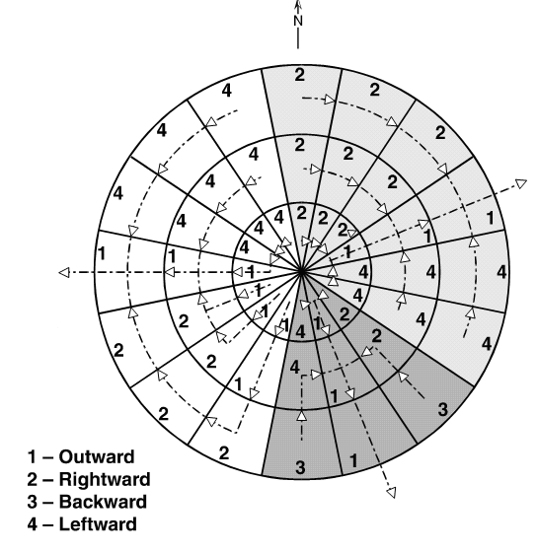
Protective Actions:
Evacuation Transit and Routing
Two evacuation routing options
  Radial evacuation: Evacuees travel radially outward
  Network evacuation: Evacuees travel along user-specified grid
During transit, MACCS models evacuees as moving from spatial grid midpoint to midpoint in a stepwise fashion until they reach the travel boundary
Network evacuation direction with corresponding IDIREC values on a spatial grid.
Notes:
Dosimetry uses a simplified tophat profile of the plume. Spatial element midpoints are inside the plume or they are not.
3 Travel phases: initial, middle, and late

Slide 32
Protective Actions:
Population Cohorts
User can divide the regional population into population cohorts that have similar characteristics during an emergency response
  Cohorts can have different protection factors, breathing rates, evacuation timelines, evacuation regions, and other factors.
  In the intermediate and long-term phases, MACCS treats all survivors as a single population cohort.
For each cohort, MACCS runs a separate simulation
Many outputs report both summary results from all cohorts and cohort-specific results
Notes:
Cohorts can represent populations that:
evacuate early,
evacuate late,
refuse to evacuate,
those who evacuate from areas not under an evacuation order (i.e., a shadow evacuation), or
those who represent special groups such as schools, hospitals, or other institutions that may respond differently than the general public

Slide 33
Protective Actions: Early Relocation
Early relocation is a dose-dependent response that occurs outside the evacuation and sheltering boundary.
The projected relocation dose can be based on either the “TOTAL” or “AVOID” option. (New in MACCS v4.2)
  "TOTAL" evaluates the total dose from all air and ground concentrations and
  "AVOID" evaluates the avoidable dose from ground pathways.
  These new options are intended to mirror how decision-makers would evaluate doses during a radiological emergency using Turbo-FRMAC.
Early relocation has two areas, hotspot and normal relocation, and can have separate relocation times and dose criteria.
Once relocation occurs, displaced individuals receive no dose for the remainder of the early phase.
Notes:
Early relocation, which can be thought of as a deferred evacuation, is an emergency response to displace individuals from at-risk areas outside the evacuation and sheltering boundary (NUMEVA).
Limitations:
Early relocation does not consider doses that may occur after the projection period.
The projection period assumes perfect knowledge of future plume segments

Slide 34
Protective Actions:
Long-term Phase
Land divided into farm and non-farm areas
Non-farm areas:
  Relocation occurs when projected dose exceeds any relocation criteria. (New in MACCS v4.2)
  Return / reoccupation occurs when decontamination is complete (if applicable).
  Condemnation occurs when decontamination is not feasible or cost effective.
Farm areas:
  Farming restrictions occur in farm areas when food ingestion doses exceed farmability criteria. (The farmability criteria depend on which food chain model the user selects.)
  Farming restrictions also occur when farmland exceeds relocation criteria, as MACCS assumes farmland is otherwise not farmable.
Decontamination:
  Decontamination occurs when projected dose exceeds relocation criteria (both farm and non-farm areas), but only when it can restore the area and is cost effective.
  A dose-dependent cleanup criterion allows users to model the acceptable cleanup level of contaminated areas. This allows users to model decontamination in lightly contaminated, habitable areas (non-farm area only). (New in MACCS v4.2)
Notes:
When habitation restrictions are in place, people receive no doses (apart from worker doses during decontamination) and interdiction costs occur
Farm areas: There are two food ingestion models, those being the original MACCS food-chain model and the COMIDA2 food-chain model. Protective actions in farm areas depend on food chain model

Slide 35
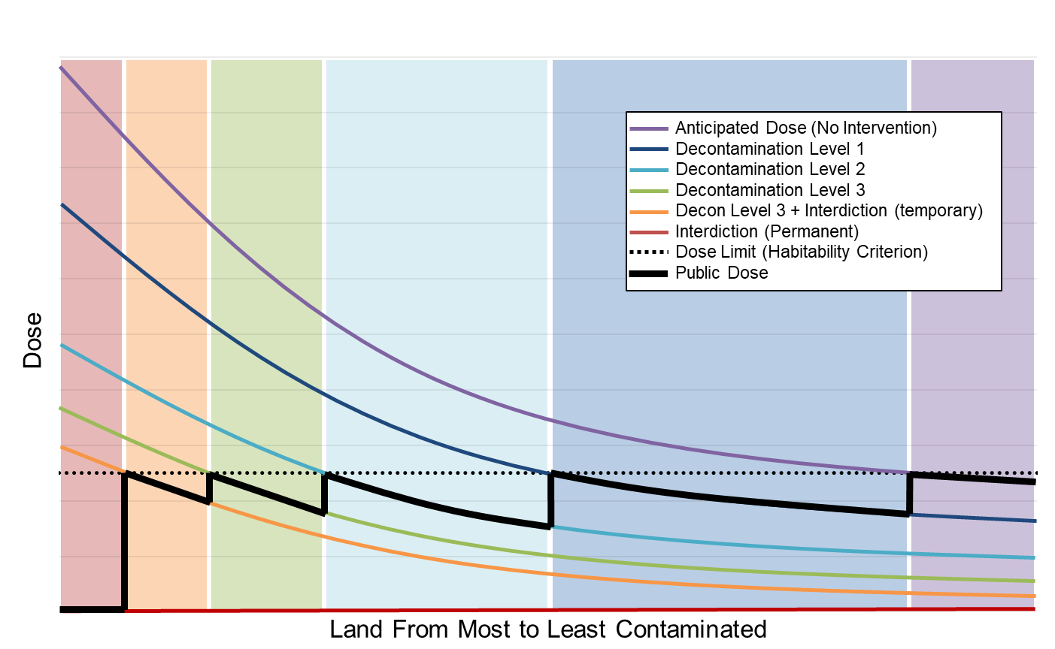
Protective Actions:
Long-term Non-farm Areas
Doses Received After Long-term Protective Actions
Notes:
Protective action levels for habitation restrictions can result in four possible outcomes:
land is immediately habitable, represented by the purple region,
land is habitable immediately after decontamination, represented by the blue and green regions,
land is habitable after decontamination and an additional period of interdiction, represented by the yellow region, and
land is condemned with removal and resettling of the population, represented by the red region.
Areas represented by the orange, green, and two blue areas can also become condemned if it is not cost effective to decontaminate. In this case, the dose in these areas is zero (the red line).

Slide 36
Social And Economic Impacts
Nuclear accident impacts can broadly be divided into two categories: market and non-market
Market impacts (sometimes called “financial impacts” or “special damages”) include:
  Onsite and offsite property damage
  Economic disruptions
  Accident-related expenditures
Non-market impacts (sometimes called “noneconomic impacts” or “general damages”) include:
  Health effects
  Societal disruptions
  Environmental damage
Notes:
Health effects fall into two categories: radiological and non-radiological health effects
Societal disruptions include:
Psychological distress – PTSD, depression, anxiety
Behavior and lifestyle changes – neglect for personal health, poor diet, and substance abuse
Loss of livelihood – displaced individuals lose their homes and jobs. Say they feel they have lost control of their lives, lose their sense of purpose
Dysfunction in families and communities – Displacement causes splits within families. Stigma towards evacuees. Disagreement about risk and compensation
Diminished standard of living - Displaced individuals tend to live in worse living conditions. In Japan, degraded living and social conditions from displacement created severe healthcare issues, particularly for the sick and elderly.
Environmental damage includes:
radiological effects
impacts from heavy decontamination / demolition

Slide 37
Social And Economic Impacts
Evacuation and early phase relocation costs
Intermediate phase relocation costs
Long-term costs in non-farm areas ($/capita) and farm areas ($/farm hectare)
  Milk and crop disposal (farm areas only)
  One-time relocation (non-farm areas only)
  Decontamination
  Property depreciation
  Lost income
Two methods to calculate lost income
  “Loss of use” approach treats property as an investment based on a rate of return.
  “GDP-based” approach using the Regional Disruption Economic Impact Model (RDEIM) input-output model to calculate direct, indirect, and induced losses; and recovery gains.
Cost models do not consider
  Onsite damages or disruptions
  Property losses due to housing market impacts
  Certain expenditures (e.g., removal of condemned structures, cost of litigation and a compensation system, medical expenses)
  Economic disruptions due to stigma effects (e.g., tourism, trade)
  Non-market impacts
Notes:
All modelled cost estimates are triggered based on a protective action.
MACCS does evaluate important metrics related to non-market impacts, including:
the number of cancer fatalities and other health effects
the number of displaced individuals
the amount of land contamination

Slide 38
Radiogenic Health Effects
Health effects from ionizing radiation are broadly categorized into two main categories:
  Stochastic effects, which include:
    Cancer incidence / fatality
    Heritable effects
  Tissue reactions (i.e., deterministic effects), which include:
    Early injury / fatality
    Degenerative conditions (i.e., cataracts, cardiovascular disease, and cerebrovascular disease).
MACCS analyses typically model cancer and early health effects.
Notes:
MACCS analyses do not typically model heritable effects, but MACCS is capable of modeling them assuming heritable risk coefficients are available.
Scientific understanding of how best to model late effects of tissue reactions is still developing.

Slide 39
Radiogenic Health Effects:
Early Health Effects
MACCS estimates risk of early health effects (injury or fatality) using a dose response model based on a Weibull distribution.
The early health effect estimates use acute doses, which account for the sparing effect.
Early fatalities are estimated using a “pooled” risk model (i.e., the early fatality hazards are summed together)
Hematopoietic Syndrome Mortality Risks for Minimal Treatment, Supportive Treatment, and Mixed Treatment - Central Estimates for Exposure at High Dose Rate.
(reproduced from Figure 3.1 of Evans 1989)
Notes:
Early health effects have a sparing effect when doses are protracted over time.

Slide 40
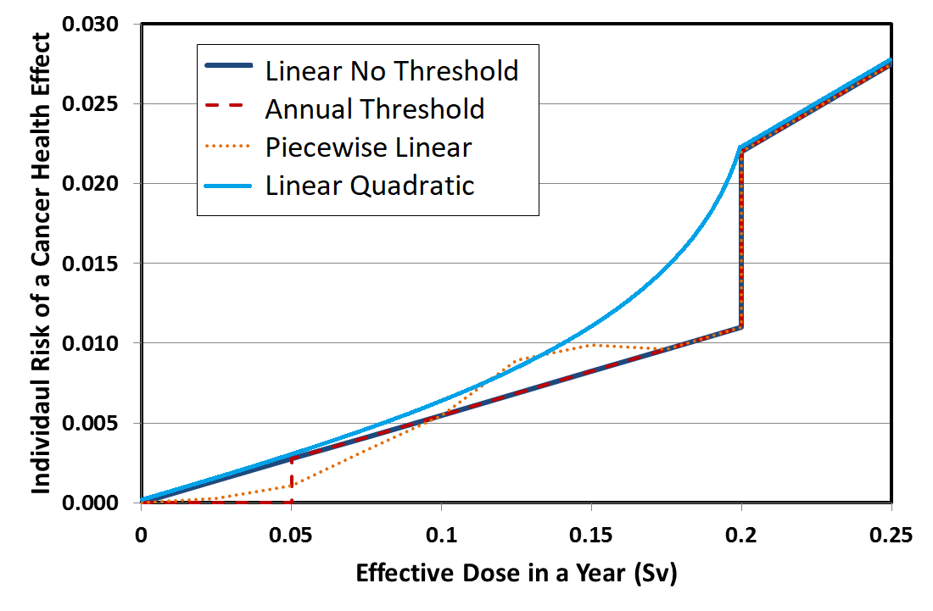
Radiogenic Health Effects:
Cancer Incidence / Fatality
Four dose-response models are available in MACCS to calculate cancer incidence and fatalities:
  Linear, no threshold (LNT) with a dose and dose rate effectiveness factor (DDREF)
  Linear quadratic
  Annual threshold
  Piecewise linear
The linear no-threshold and the linear-quadratic models use lifetime doses.
The annual-threshold and piecewise-linear models use annual doses that exceed specified thresholds.

Slide 41
Software Components of the MACCS Code Suite
MACCS:
  The main code of the MACCS code suite. MACCS assesses the public consequences associated with a hypothetical release of radioactive materials to the atmosphere, such as from a nuclear power plant accident.
  MACCS simulates the atmospheric dispersion, dosimetry, protective actions, health effects, and costs of a release.
  Current version is v4.2 (March 2023)
WinMACCS:
  The current graphical user interface for MACCS.
  Current version is v4.2 (March 2023)
MACCS-UI:
  A new graphical user interface that will replace WinMACCS.
  Planned release in 2024.

Slide 42
Software Components of the MACCS Code Suite (continued)
MelMACCS:
  An optional pre-processing code that reads a MELCOR output file and creates a MACCS input file that defines the atmospheric release (e.g., core inventory, release fractions, aerosol sizes, plume segment definitions).
  Current version is v4.0 (September 2022)
AniMACCS:
  An optional post-processing code that allows for certain MACCS output information to be visually displayed and animated onto a geospatial map background
  Current version is v1.3.1 (January 2022)
MACCS-HYSPLIT Tools:
  An optional set of tools to generate a meteorological input file and / or to use the HYSPLIT atmospheric dispersion code (available from the US National Oceanic and Atmospheric Administration [NOAA]) in place of the original MACCS straight-line gaussian plume model.
  MacMetGen reads NOAA meteorological datasets to generate MACCS meteorological files.
  GenHysplit calls on HYSPLIT to generate a set of output files of air and ground concentrations.
  HyGridConvert converts the HYSPLIT air and ground concentrations into MACCS input files.
  Current version of MACCS-HYSPLIT Tools is v1.2 (March 2023).

Slide 43
Software Components of the MACCS Code Suite (continued)
COMIDA2:
  An optional pre-preprocessing code that helps calculate anticipated food ingestion doses from farmland contamination via the food chain.
LHS:
  An optional pre-processing code to help model uncertain input parameters by running Monte Carlo simulations of MACCS.
SecPop (US only):
  An optional pre-processing code that creates a site file using US Census information.
  Current version is v4.3.1 (July 2020)
  Planning to update with new US census data in 2024
RDEIM (US only):
  An alternative economic consequence model that estimates the impact of a business disruption on the US gross domestic product considering interdependencies of US regional industries.

Slide 44
Architecture of WinMACCS Components

Slide 45
Auxiliary and Supporting Files
Dose coefficient (DCF) files for LNT and non-LNT applications
  FGR-13 (based on FGR-13 using standard radiation weighting factors)
  FGR-13 Gray Equivalent (Rev. A) (based on FGR-13 using relative biological effectiveness (RBE) factors consistent with FGR-13 cancer induction modeling and with all SOARCA analyses)
  Updated versions accompany MACCS 4.2
COMIDA2 files to go with each type of dose coefficient file
  Exposure duration (LASTACUM) set to 50 years
NRC and DOE sample problems
Tutorials based on NRC sample problems
Fogbugz used for problem reporting and corrective actions – https://ersdt.fogbugz.com/

Slide 46
Recent MACCS Developments
MACCS 4.0 was released in June 2020
  HYSPLIT capability added
  RDEIM economic model added
  AniMACCS capability added
  License keys now required (node-locked and time-limited)
MACCS 4.1 was released in July 2021
  Nearfield model updates
    New plume meander models added
    New plume entrainment model added
    New building wake model added
MelMACCS 4.0 was released September 2022
MACCS 4.2 was released March 2023
  Removal of node locking from license keys (still time-limited)
  RDIEM economic model updates
  Updates to dose-dependent protective actions
    Early phase calculations for avoidable and total dose added
    Long-term phase cleanup criterion added (allows for decontamination in habitable areas)
    Long-term phase dual dose criteria added
  Increase in maximum number of radionuclides
  Skin pathway standardization
MACCS modernization underway!

Slide 47
Any Questions?
Instructions for requesting the MACCS code and MACCS-related documents can be found at: https://maccs.sandia.gov/
Supporting documents
  WinMACCS & MACCS User Guides
    MACCS User’s Guide and Reference Manual Report (SAND2023-01315)
    MACCS Theory Manual (SAND2021-11535)
  Technical Bases for Consequence Analyses Using MACCS (NUREG/CR-7270)
  MACCS-HYSPLIT Tools documentation
  Benchmark, verification and validation reports
  Complete set of published SOARCA reports

Slide 48
References
CRAC / MACCS Research Projects:
  WASH-1400, NUREG-75/014, “An Assessment of Accident Risks in U. S. Commercial Nuclear Power plants,” U.S. Nuclear Regulatory Commission, Washington, DC, 1975.
  NUREG/CR-2239, “Technical Guidance for Siting Criteria Development,” U.S. Nuclear Regulatory Commission, Washington, DC, December 1981.
  NUREG-1150, Vol. 1, “Severe Accident Risks: An Assessment for Five U.S. Nuclear Power Plants,” U.S. Nuclear Regulatory Commission, Washington, DC, 1990.
  NUREG/CR-7110, Vol. 1, Rev. 1, “State-of-the-Art Reactor Consequence Analyses Project Volume 1: Peach Bottom Integrated Analysis,” U.S. Nuclear Regulatory Commission, Washington DC, 2013.
  NUREG/CR-7110, Vol. 2, Rev. 1, “State-of-the-Art Reactor Consequence Analyses Project Volume 2: Surry Integrated Analysis,” U.S. Nuclear Regulatory Commission, Washington DC, 2013.
  NUREG/CR-7245, “State-of-the-Art Reactor Consequence Analyses (SOARCA) Project Sequoyah Integrated Deterministic and Uncertainty Analyses,” U.S. Nuclear Regulatory Commission, Washington, DC, 2019.
  Draft NUREG, “U.S. NRC Level 3 Probabilistic Risk Assessment (PRA) Project, Volume 3d: Reactor, At-Power, Level 3 PRA for Internal Events and Floods, Draft for Comment,” U.S. Nuclear Regulatory Commission, Washington DC, 2022. ADAMS Accession No. ML22067A215.
MACCS Code Manuals:
  SAND2021-11535, “MACCS Theory Manual,” Sandia National Laboratories, Albuquerque, NM, 2021.
  SAND2023-01315, “MACCS User Guide – Version 4.2,” Sandia National Laboratories, Albuquerque, NM, 2023.

Slide 49
Backup Slides

Slide 50
MACCS Lineage
  Calculation of Reactor Accident Consequences (CRAC) Code (1975)
  Developed for the Reactor Safety Study (WASH-1400)
  CRAC2 (1982)
  Primarily used in 1982 siting study (NUREG/CR-2239)
  MACCS (MELCOR Accident Consequence Code System) (1990)
  Primarily used in NUREG-1150
  MACCS2 (1998)
  Developed to support DOE documented safety analyses of nuclear facilities
  WinMACCS/MACCS (2011)
  Enhance user friendliness
  Reduce likelihood of user errors
  Enable routine examination of uncertainty

Slide 51
MACCS 4.0 Improvements (06/2020)
Optional capability to perform high-fidelity atmospheric transport modeling with HYSPLIT (Lagrangian)
Optional state-of-practice, GDP-based model (RDEIM) to account for economic losses (database currently supports contiguous USA)
Support for special files needed by animation tool, AniMACCS
Limits extended on a large set of input parameters
Input parameters can be exported, including distribution definitions
Results for each weather trial are used to define quantile results

Slide 52
MACCS 4.1 Improvements (07/2021)
Near-field modeling improvements:
  Comparison of several near-field atmospheric transport and dispersion codes including QUIC, ARCON96, and AERMOD concluded MACCS provides a conservatively bounding assessment in the near-field
  MACCS v4.1 enhancements added for plume meander and trapping and downwash to simulate or bound near-field assessments of other codes
New projective peak dose output option
Documentation added to help menu in WinMACCS
Updates to the RDEIM economic model
Mixing layer information for each time period
Time synchronization between local time and UTC
Pop-up window for converting previous version
Linux version of MACCS 4.1

Slide 53
MACCS 4.0/4.1 Licensing Process
MACCS 4.0/4.1 contains new licensing features
  Software is locked to a specific computer
  Licenses are for one-year duration
Steps to activate license
  Run WinMACCS 4.X.0 Setup.exe (no installation key required)
  Open WinMACCS 4.X.0
    A popup screen briefly describes the licensing process
    Readme file provides more details on licensing process
  Run CreateLicenseRequestFile.exe in folder C:\Users\Public\WinMACCS to create license.request
  Send a copy of license.request to wg-maccs-entity@sandia.gov
  Once approved, Sandia sends product.key to user
  License key is linked to WinMACCS

Slide 54
MACCS 4.2 Improvements (03/2023)
Remove node locking from license
  Only time limit for licenses
  Removes three steps from process
  License included in 4.2 installer expires March 2024, new one to be issued before then
Up to 999 radionuclides
  Still limited to six member decay chain length
  Need dose coefficient data for radionuclides
Split indirect costs in economic model
Dual dose criteria
Relocation dose projection and timing
Decontamination in habitable areas
Skin pathway standardization

Slide 55
MACCS Modernization
Working collaboratively with the NRC to determine the future vision for MACCS
  Effectively tackle the consequence analysis challenges of the future
  Incorporate modern programming languages and techniques
  Be compatible with modern computing platforms
  Increased flexibly and modularity
  Support advanced reactor consequence analysis and future model updates
Divided into two main efforts
  User Interface (MACCS-UI)
  Analysis code (MACCS)

Slide 56
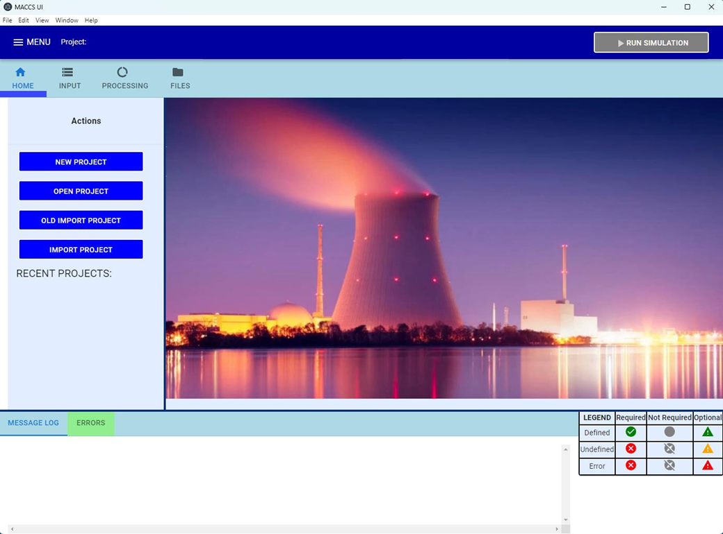
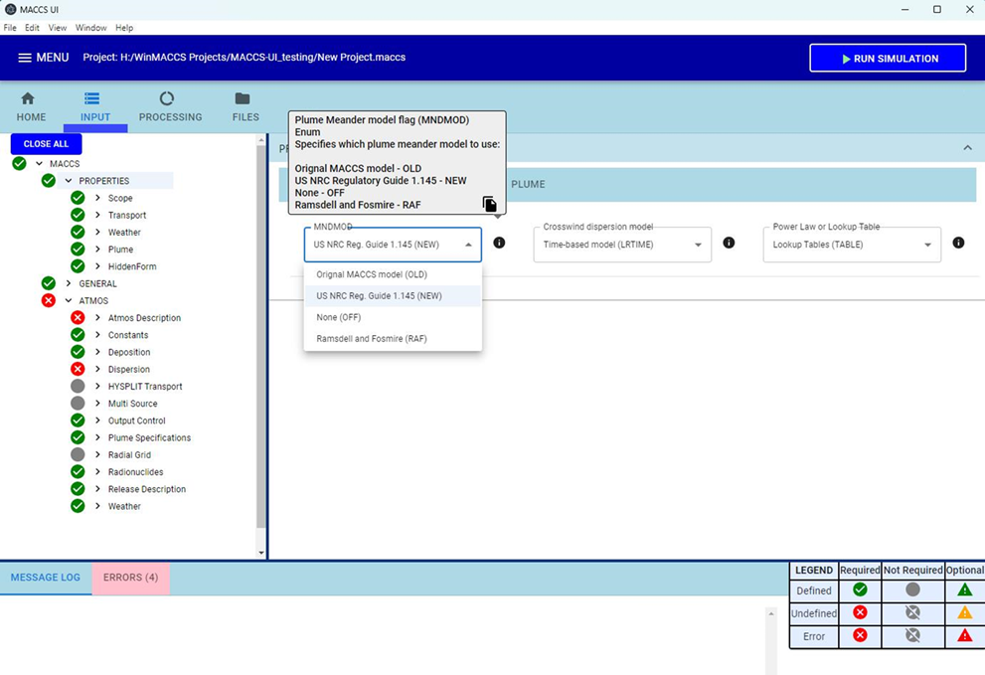
User Interface Modernization
Visual Basic 6 no longer supported
  Java, JavaScript and other modern tools
MACCS-UI to have the same functionality as current WinMACCS
  Ability to add more capabilities in the future
Same interface with MACCS
  Atmos.inp, Early.inp, Chronc.inp
  Model1.out, Model1.bin
  Import previous WinMACCS 4.x projects

Slide 57
Analysis Code Modernization
Goals and benefits
  Maintain backwards compatibility
  Compatible with what users currently use
    MACCS UI
    Command line
  Better readability and easier modification of code
  Improve and modify input functionality
  Increase output capabilities
  Work to support potential improvements and model capabilities
Modern programming practices will be used for enhanced readability and modification of MACCS code
  Convert mix of Fortran 77 & 90+ portions of code to modern Fortran
  Clean up memory use by using dynamic memory
  Modularize to facilitate adding or replacing models
Implement such that MACCS remains in a release-ready state

