Slide 1
Safety Reviews and Codes
Michelle Hart and Zach Gran
Senior Reactor Engineer and Reactor Scientist

Slide 2
Overview
RAMP and related computer codes used in the licensing of new and advanced reactors:
  NRCDose3
  SNAP/RADTRAD
  MACCS
What are these codes?
What are these codes used for?

Slide 3
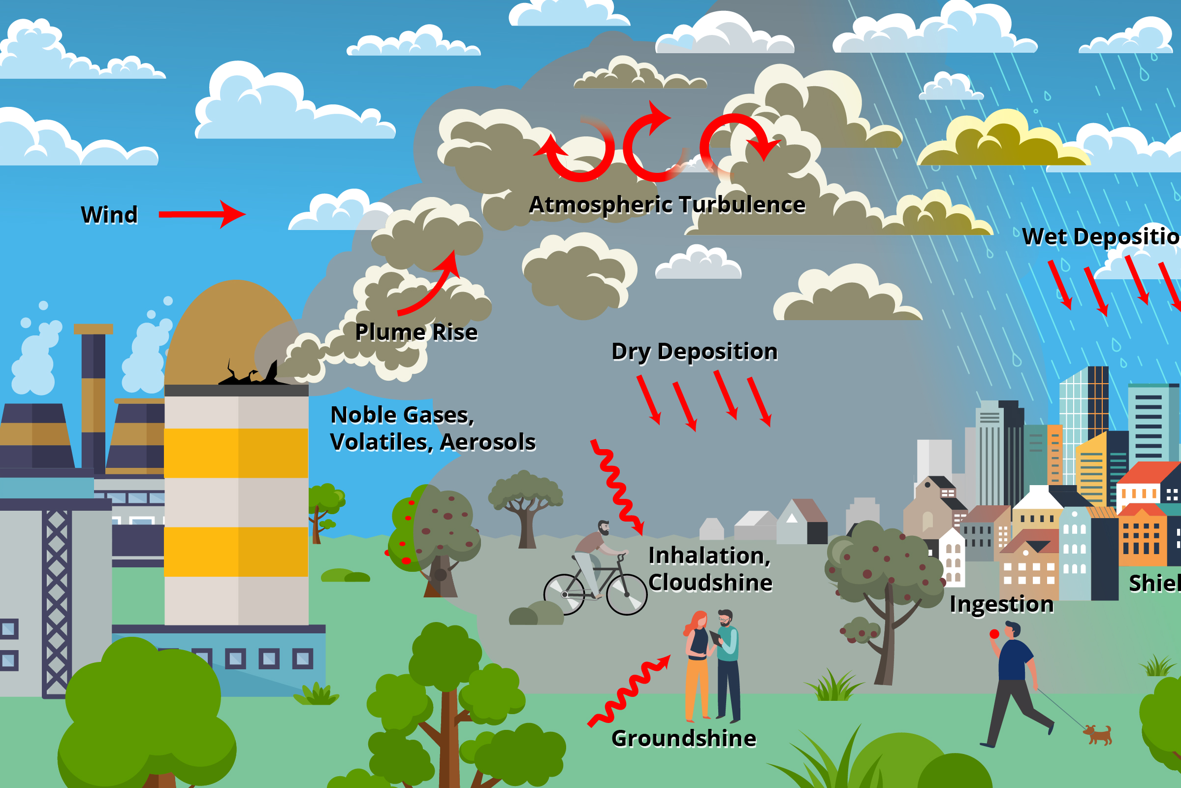
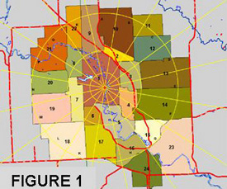
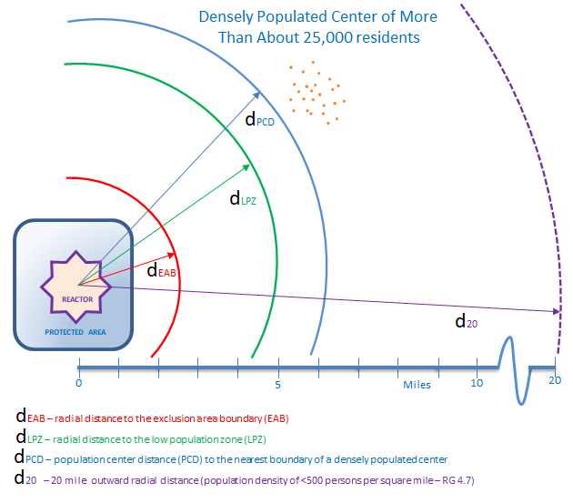
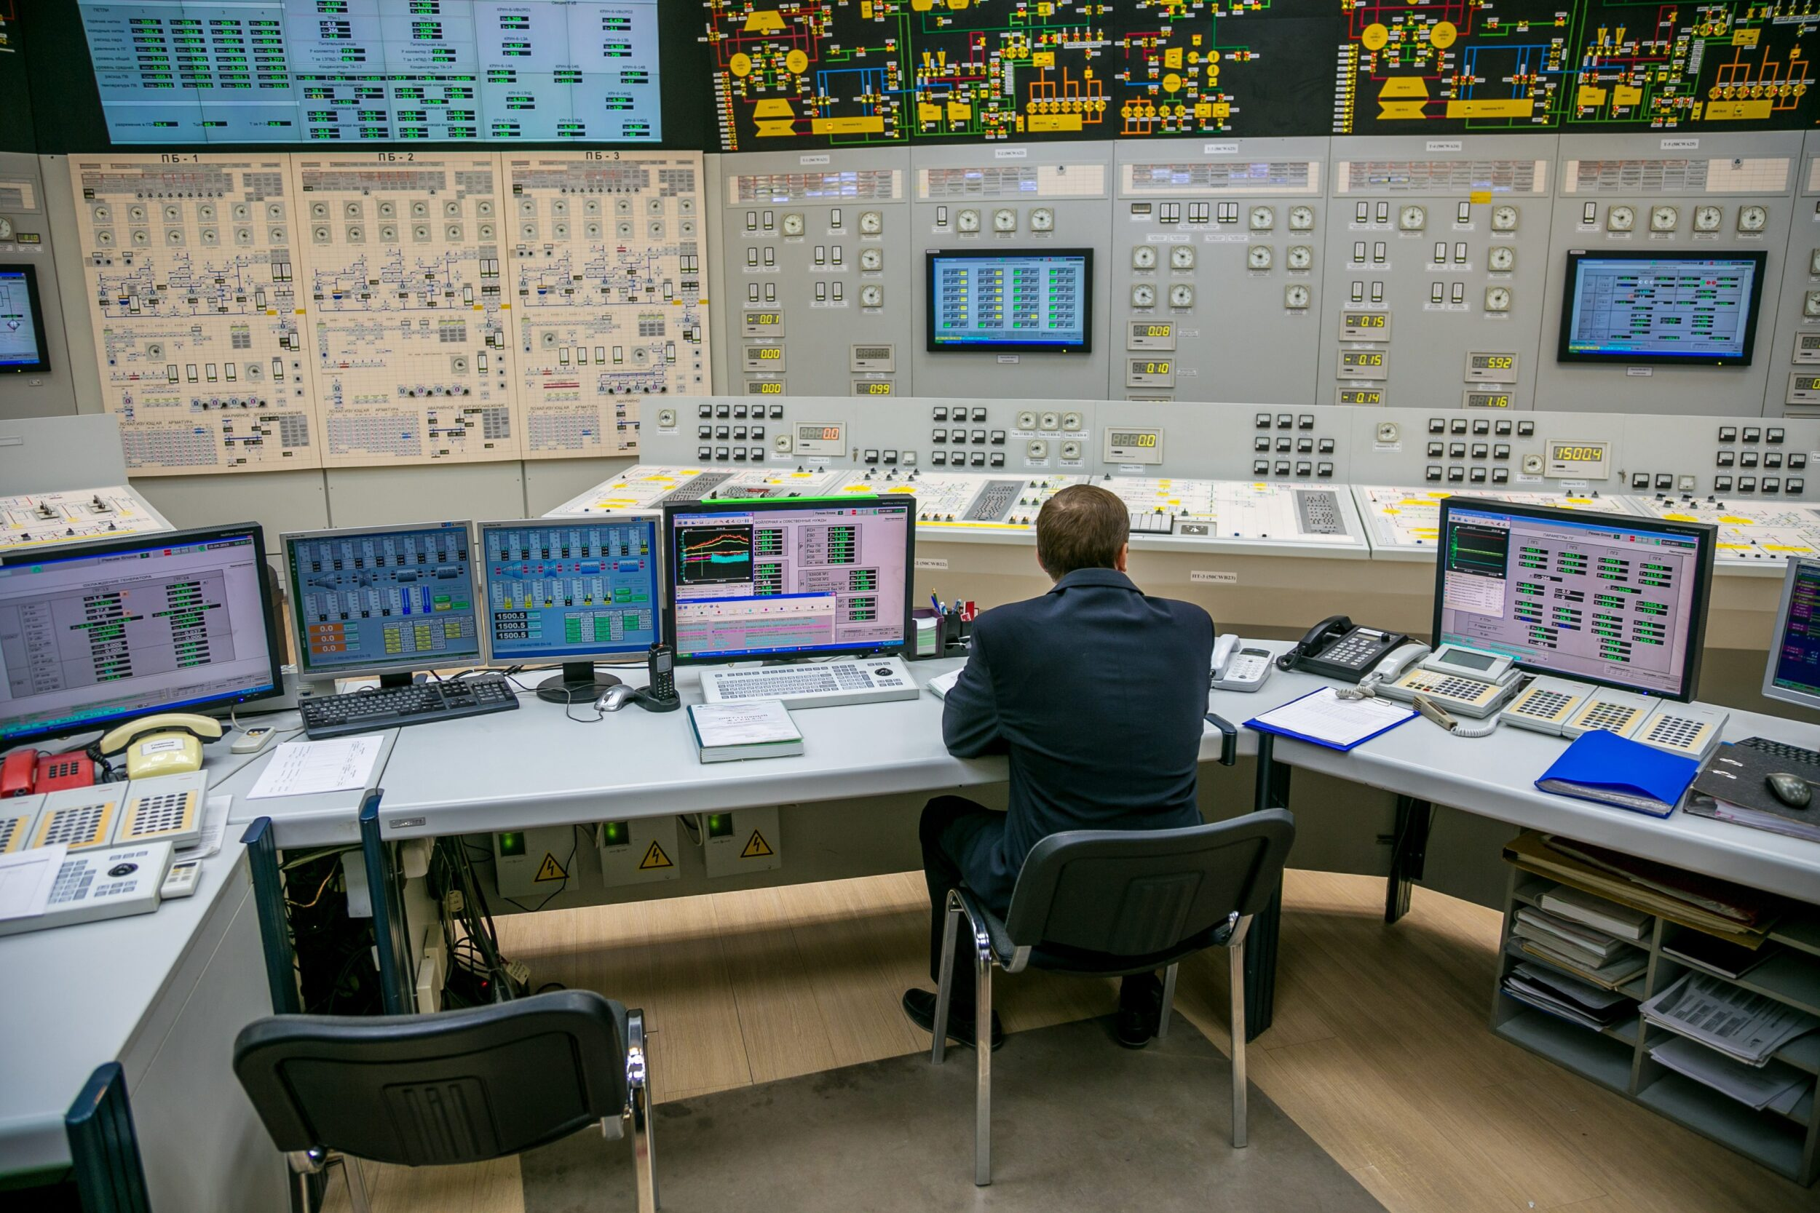
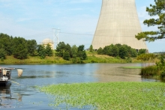
Radiological Release Consequence Analyses in Power Reactor Safety Reviews
Environmental consequences
Emergency planning zone sizing
LMP and risk analysis
Siting
Control room habitability
Effluent analysis
Notes:
Siting and safety analysis
Control room habitability design criterion
Environmental consequences of accidents
SAMA/SAMDA cost/benefit analysis
Probabilistic risk assessment (PRA)
Non-LWR PRA standard does not use risk surrogates like core damage frequency so calculate consequences
Risk-informed, performance-based methodology for non-LWR licensing basis development, a.k.a. Licensing Modernization Project (LMP)
RG 1.233 endorses NEI 18-04 approach to selecting licensing basis events, classifying structures systems and components and special treatment, and assessing defense-in-depth
Plume exposure pathway emergency planning zone size determination
Alternative security requirements – ongoing limited scope rulemaking
Consequence-based eligibility criterion
Part 53
Also used in regulatory analysis cost/benefit analysis

Slide 4
Radiological consequence analysis computer codes
Radiological release consequence codes developed for the NRC
  NRCDose3
  SNAP/RADTRAD
  MACCS
Other radiation analysis codes not discussed today
  Isotopic inventory
    SCALE, ORIGEN module for fission products
  Direct dose and shielding
    MCNP
    MicroShield
Used by NRC staff as confirmatory analysis tools to support review of power reactor license applications.

Slide 5
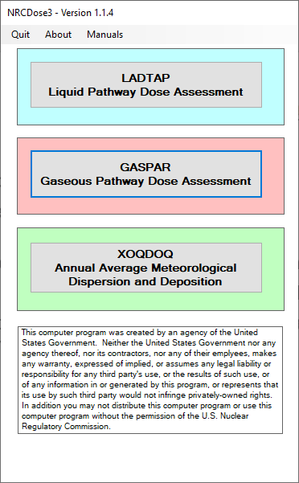
NRCDose3
Collection of the computer codes LADTAP II, GASPAR II, and XOQDOQ.
Used to calculate the doses from effluent releases to show how the 10 CFR Part 50 Appendix I dose objectives are met.
LADTAP II is used to determine dose from liquid effluent releases.
GASPAR II is used to determine dose from gaseous effluent releases.
XOQDOQ is used to determine the annual average relative dispersion (X/Q) and deposition (D/Q) values at user specified locations.
NRCDose3 Startup Screen

Slide 6
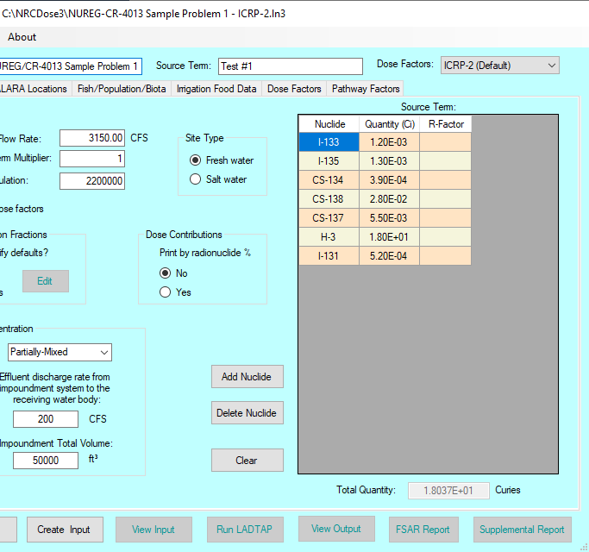
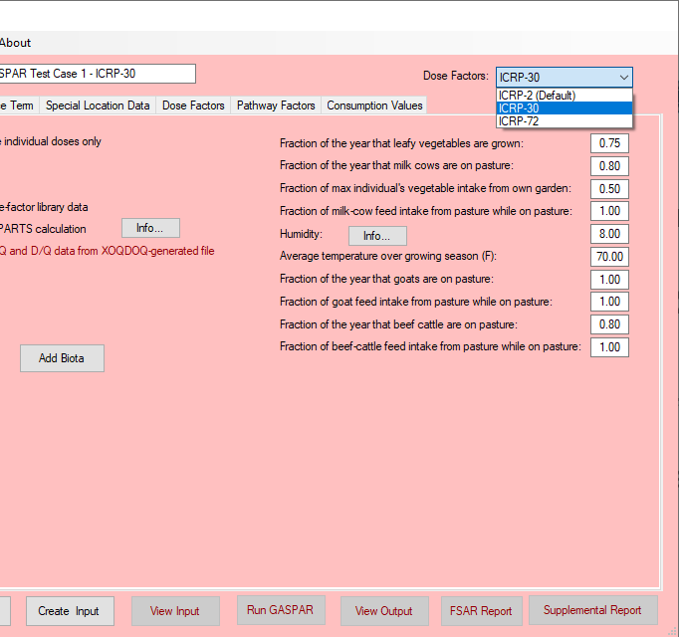
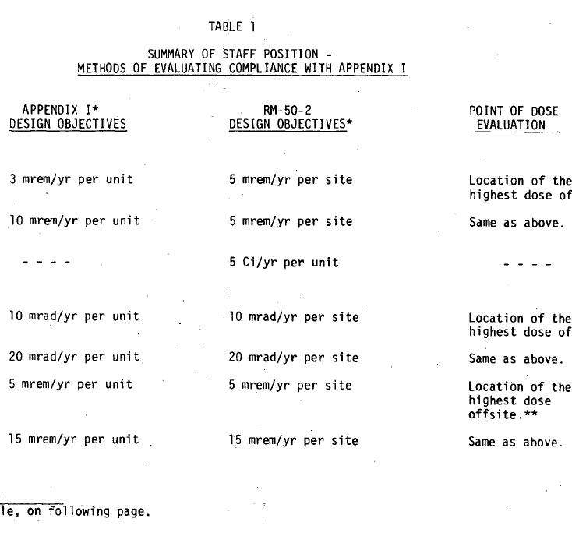


Using NRCDose3
LADTAP
GASPAR
The use of LADTAP II and GASPAR II is based on the types of effluent releases specified at a facility.
Requires source term inputs, XOQDOQ data, and other site-specific inputs.
NRCDose3 allows for the calculation of dose in ICRP 2, ICRP 30, and ICRP 72 methodologies.
Table 1 of RG 1.109 describes the methods of evaluating compliance with 10 CFR Part 50 Appendix I dose objectives.
Dose Factor Selection
Table 1 of RG 1.109

Slide 7
NRCDose3 in Licensing Activities
For licensing reviews LADTAP II and GASPAR II are used as a confirmatory analysis tool.
For licensing applications that also use LADTAP II and GASPAR II the NRC Staff can quickly perform confirmatory analysis to verify reported releases.
For licensing applications that choose to use another method to determine effluent doses, NRCDose3 can still be used with requests for certain details like X/Q and D/Q data, Ci/yr releases, and using RG defaults to verify dose estimates provided by these other methods.
  New Reactor Applications have used LADTAP II and GASPAR II.
  Research and Test Reactors tend to use other codes to approximate their gaseous releases. (CAP88 or GENII as examples)

Slide 8
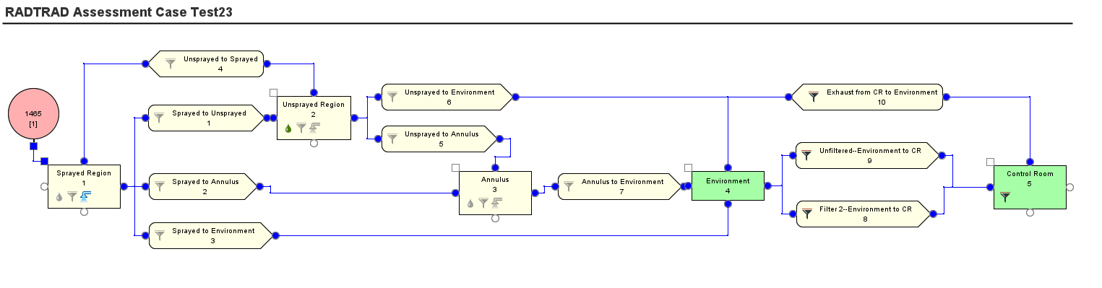
SNAP/RADTRAD
RADTRAD is one of the applications contained within the Symbolic Nuclear Analysis Package (SNAP).
RADTRAD estimates doses to an individual at the Exclusion Area Boundary (EAB), the Low Population Zone (LPZ), the Control Room, and other locations as defined.
RADTRAD Control Room Dose Model

Slide 9
RADTRAD in Licensing Activities
The RADionuclide, Transport, Removal, and Dose Estimation (RADTRAD) code is used to perform design basis accident (DBA) radiological consequence analyses for power reactor licensing siting and safety analysis.
  Uses a combination of tables and numerical models of source term reduction phenomena to determine the time-dependent dose at the EAB, LPZ, and in the control room
  Confirmatory analysis tool for NRC review staff
Component and pathway model - flexible to model specific facility and postulated DBAs
RADTRAD includes preset model inputs that can be selected consistent with guidance, or the user can define.
  Light water reactor (LWR) DBA source terms and consequence analysis guidance is given in Regulatory Guide (RG) 1.183 or RG 1.195.

Slide 10
Using RADTRAD for License Application Safety Analysis
Radionuclide inventory
  Select defaults for LWR (Ci/MWt) or user input total activity per radionuclide.
  User developed core inventories should use appropriate methods (e.g., SCALE/ORIGEN production and depletion code) – see RG 1.183 discussion.
  Coolant inventories or other non-core sources can be defined as user input.
Source term – fractional release of inventory over time interval
  Can choose LWR DBA source term models.
Compartments
  Source(s) connect to compartment.
  Radionuclide removal - natural deposition, filters, sprays
    Choose LWR correlations (as justified) or user input based on approved methodology for safety-related structures, systems, and components (SSCs).
  Environment and control room dose location compartments.

Slide 11
Using RADTRAD for License Application Safety Analysis
Pathways
  Filtered pathway, piping, air leakage
  User defined based on safety-related SSCs design information
Atmospheric dispersion
  X/Qs are user input.
  Use site characteristic values – PAVAN and ARCON codes can calculate using meteorological data.
Other inputs per guidance
  Use FGR 11 and 12 dose conversion factors to give total effective dose equivalent (TEDE).
  Breathing rates defaults are given consistent with guidance.
  Control room occupancy factors defaults are given.

Slide 12
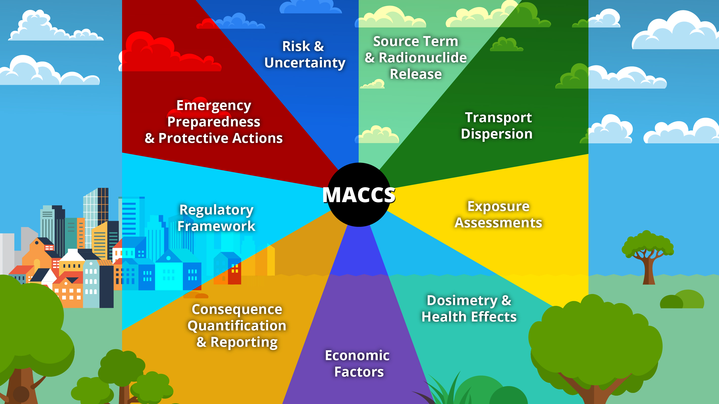
MACCS
MACCS is a fully integrated, engineering-level computer code developed at Sandia National Laboratories (SNL) for the NRC.
MACCS simulates the impact of severe accidents at nuclear power plants (NPPs) and other nuclear facilities on the surrounding environment.
The only code used by the NRC to support Level-3 probabilistic risk assessments (PRAs).
https://maccs.sandia.gov/maccs.aspx
MELCOR Accident Consequence Code System (MACCS)
Notes:
Not part of RAMP.

Slide 13
MACCS in Licensing Activities
MACCS can use a site’s weather data to determine hypothetical land contamination levels, doses to individuals, health effects and risks on populations based on protective action recommendations, and economic losses resulting from a NPP accident.
As a PRA tool, will be used to calculate radiological consequences for use in the risk-informed performance-based Licensing Modernization Project (LMP) methodology described in NEI 18-04, as endorsed by RG 1.233.
Other uses in license applications may include determination of plume exposure pathway emergency planning zone (EPZ) size. See RG 1.242 for analysis guidance.

Slide 14
Using MACCS for License Applications
The non-LWR PRA standard provides considerations on what to include in a PRA consequence analysis.
The source term radiological release to environment is user input.
  MELCOR code output prepared for use in MACCS with MelMACCS source term preprocessor tool
Ensure dose grid is defined to give results at desired locations (e.g., at site boundary, within 1 mile, etc.)
Meteorological data is user input.
Choose appropriate dose conversion factors to give TEDE or support risk estimate, as needed for specific criterion or figure of merit.
Model emergency response actions according to specific criterion or figure of merit.
Notes:
If needed to support cost-benefit or risk analyses, the SecPop preprocessor tool can calculate estimated population and economic data around any point specified by latitude and longitude. Files include recent census, economic, and land use data around a prescribed site.
The NRC staff encourages pre-application interactions with reactor designers, vendors, or potential applicants that have questions about radiological release consequence analysis and use of these codes, or others, for their specific power reactor license application, as needed.

