Slide 1
SIERRA ATD
J. Flaherty
Oct. 22, 2024
PNNL-SA-204862

Slide 2
Outline
SIERRA ATD Preview/Overview
Legacy Codes
  NRC Guidance and Regulations
Model Technical Basis
Examples
  Control Room Analysis
  Design Basis Accidents Analysis
  Routine Analysis
Current and Future Development
Questions

Slide 3
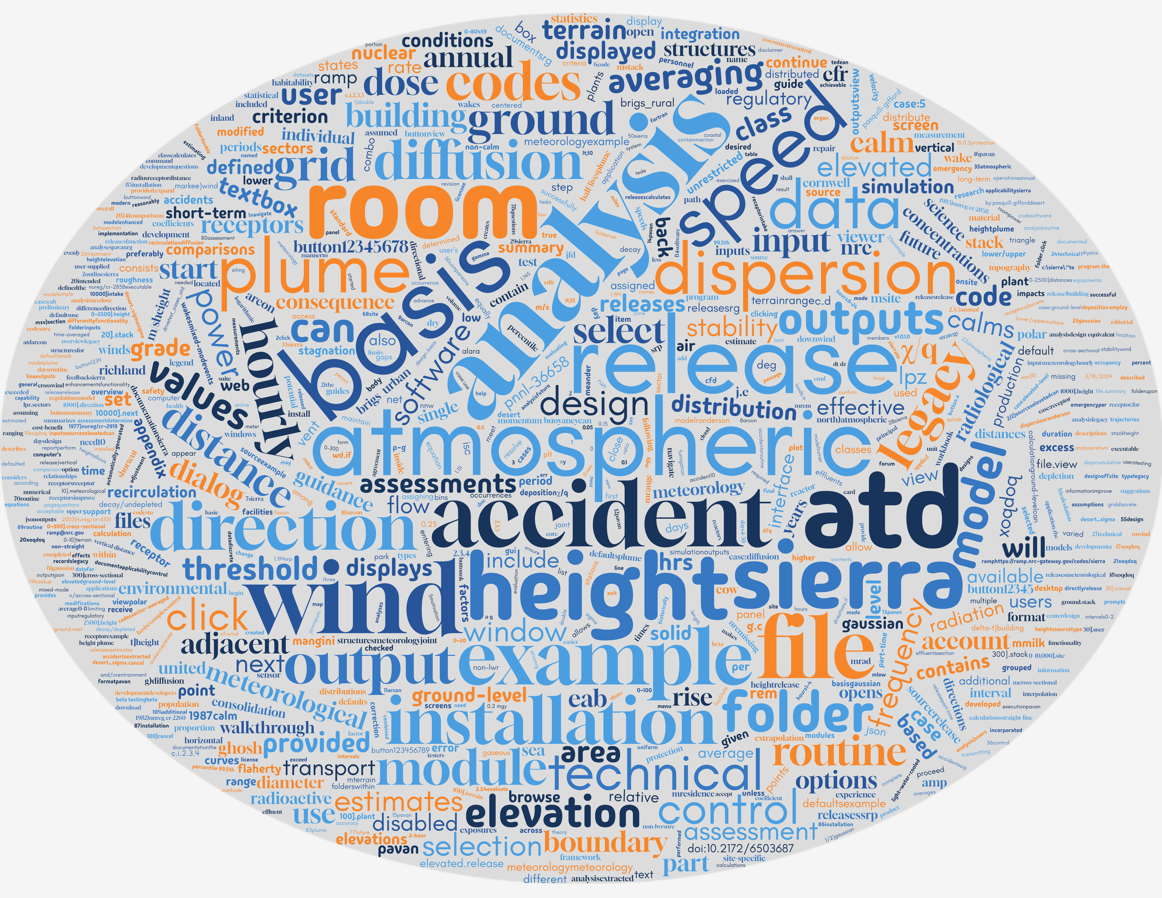
Getting to know our audience
Please navigate to the following to answer a few questions
  https://www.menti.com/bl1x2mi33zt3
Notes:
For IR Review: https://www.mentimeter.com/app/presentation/n/blnqo6yjhsrzwmoh8upab5kspxnw33zk/present

Slide 4
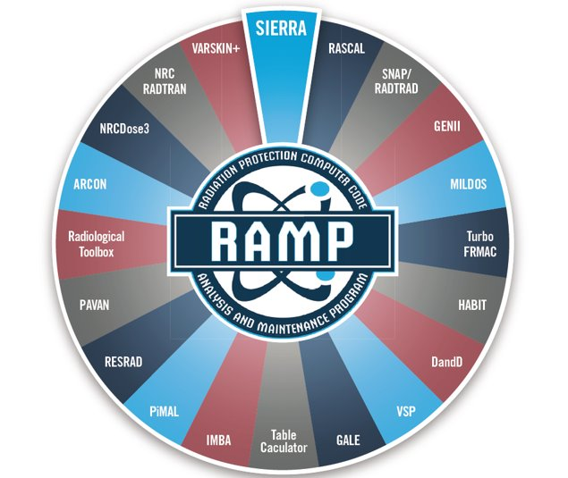
New RAMP Code
Software Integration for Environmental Radiological Release Assessments (SIERRA)

Slide 5
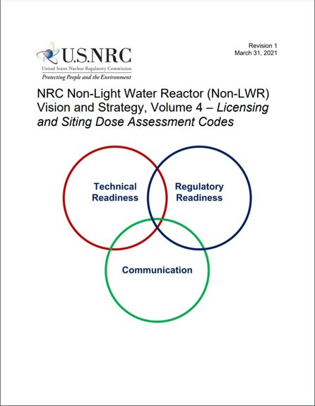
Motivation for Code Consolidation – Non-LWRs
NRC Non-Light Water Reactor (Non-LWR) Vision and Strategy, Volume 4 — Licensing and Siting Dose Assessment Codes ​
  Describes the computer codes in RAMP and how they would be applied to each of the principal non-LWR design types,
  Summarizes the tasks necessary to resolve “gaps” in the capability to model and simulate those designs with the accuracy required by the regulator. ​
Code consolidation can help resolve the identified gaps in the RAMP suite of codes

Slide 6
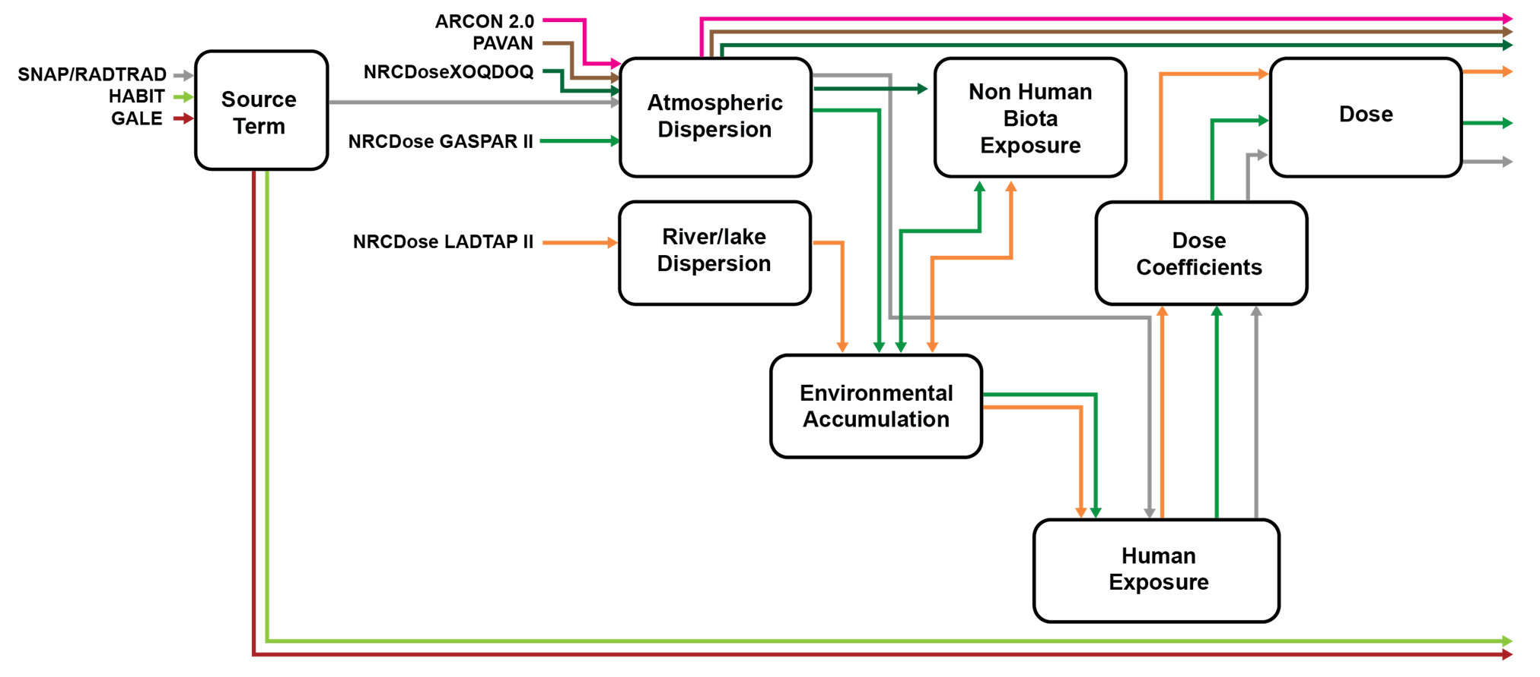
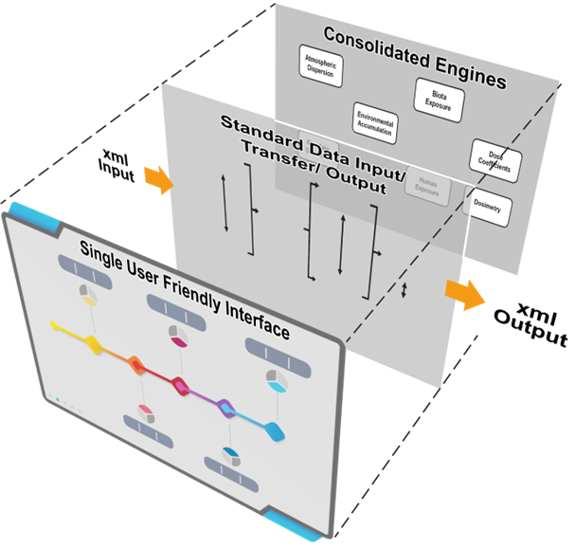
Code Consolidation – ATD Module
json
json

Slide 7
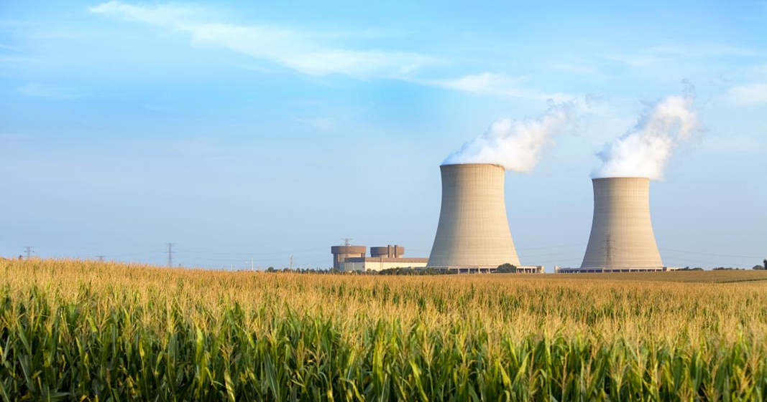
SIERRA ATD Software Development
A new atmospheric transport and diffusion (ATD) module was developed for SIERRA for the following reasons:
  To support a single user interface that allows users to access the functionality of each of the codes (ARCON, PAVAN, XOQDOQ) in a relatively uniform manner
  To facilitate future development to share data with other health physics codes in SIERRA
  To allow users to estimate relative
  concentrations based on hourly
  meteorological data for all three codes
  To employ a more modern FORTRAN
  code development practice, which makes
  the code easier to maintain in the future

Slide 8
ARCON - Regulatory Need
10 CFR Part 50, Appendix A, General Design Criterion 19 (GDC 19), Control Room (CR)
  Adequate radiation protection shall be provided to permit access and occupancy of the control room under accident conditions without personnel receiving radiation exposures in excess of 5 rem (0.05 Sv) whole body, or its equivalent to any part of the body, for the duration of the accident
10 CFR Part 50, Paragraph IV.E.8 of Appendix E, Emergency Facilities and Equipment
  A licensee onsite technical support center and emergency operation facility be provided, from which effective direction can be given and effective control can be exercised during an emergency
  Per SRP 15.0.3, the onsite Technical Support Center should provide the same level of protection against radiation that the control room provides
Notes:
TSC?

Slide 9
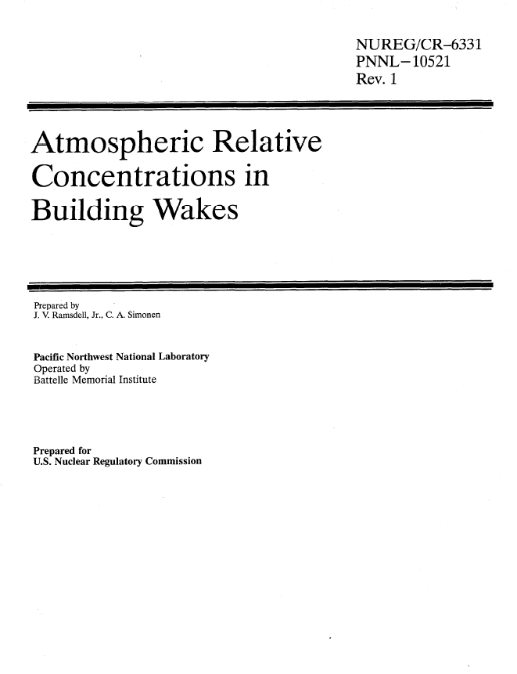
ARCON – Guidance Documents
RG 1.206, C.I.2.3.4: Short-Term Atmospheric Dispersion Estimates for Accident Releases
SRP 2.3.4: Short-Term Atmospheric Dispersion Estimates for Accident Releases
RG 1.194: Atmospheric Relative Concentrations for Control Room Radiological Habitability Assessments at Nuclear Power Plants (2003)
NUREG/CR-6331: Atmospheric Relative Concentrations in Building Wakes (1997)

Slide 10
ARCON – Technical Basis
Gaussian plume model
  Enhanced diffusion coefficients to account for dispersion under low wind speed conditions and building wakes
Meteorological input consists of hourly values of wind speed, wind direction, and atmospheric stability class
Calculates atmospheric dilution factors (hourly χ/Q values)
  Hourly χ/Q values are combined to estimate χ/Q’s ranging in duration from 2 hours to 30 days
  Cumulative frequency distributions are prepared from the average χ/Q values
  χ/Q values that are exceeded no more than 5 percent of the time for each averaging period are selected

Slide 11
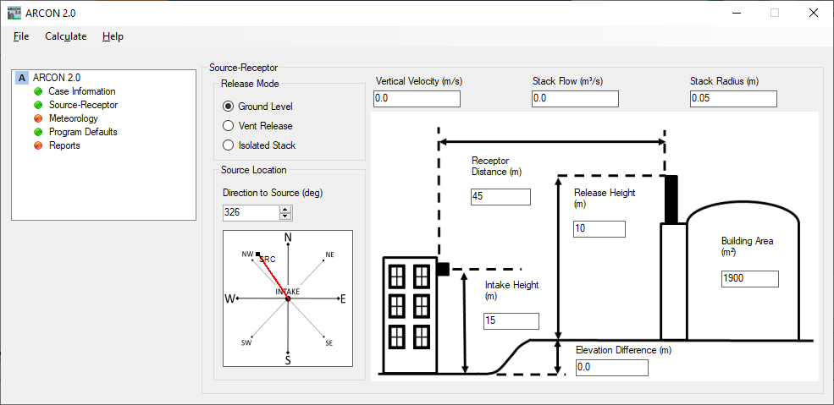
ARCON – Model Inputs
Meteorology
  Hourly file of wind speed, direction, stability
  Wind measurement heights
Source
  Type: ground, vent, or stack
  Height (vent or stack release)
  Building area (ground or vent release)
  Vertical velocity, stack flow, and radius
Receptor
  Distance to receptor
  Intake height
  Elevation difference
  Direction to source

Slide 12
PAVAN - Regulatory Need
10 CFR 52.79(a)(1)(vi), Contents of applications; technical information in final safety analysis report
  Perform an assessment assuming a fission product release from the core into the containment
    An individual located at any point on the boundary of the EAB for any 2-hour period would not receive a dose in excess of 25 rem (0.25 Sv) TEDE
    An individual located at any point on the outer boundary of the LPZ would not receive a dose in excess of 25 rem (0.25 Sv) TEDE during the entire period of the passage of the radioactive cloud

Slide 13
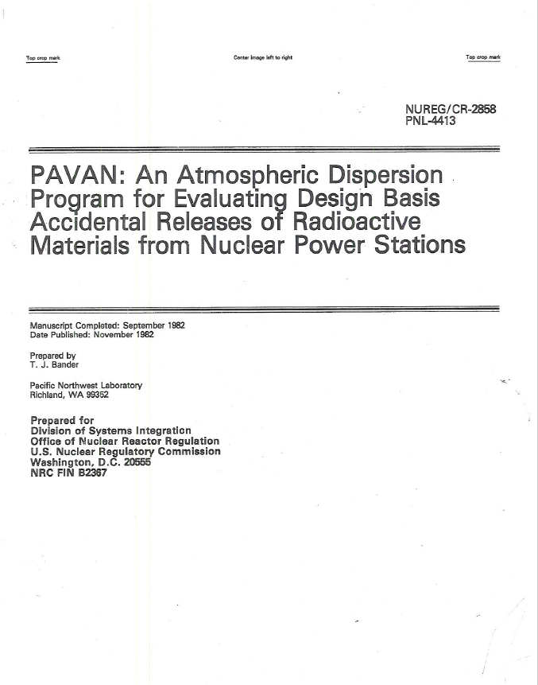
PAVAN – Guidance Documents
RG 1.206, C.I.2.3.4: Short-Term Atmospheric Dispersion Estimates for Accident Releases
SRP 2.3.4: Short-Term Atmospheric Dispersion Estimates for Accident Releases
RG 1.145: Atmospheric Dispersion Models for Potential Accident Consequence Assessments at Nuclear Power Plants (1983)
NUREG/CR-2858: PAVAN: An Atmospheric Dispersion Program for Evaluating Design-Basis Accident Releases of Radioactive Materials from Nuclear Power Stations (1982)
NUREG/CR-2260: Technical Basis for Regulatory Guide 1.145, “Atmospheric Dispersion Models for Potential Accident Consequence Assessments at Nuclear Power Plants” (1981)

Slide 14
PAVAN – Technical Basis
Gaussian plume model
  Simple modifications to diffusion coefficients to account for plume meander under low wind speed conditions and building wakes for ground-level releases
Meteorological input consists of a joint frequency distribution (JFD)
  Wind speed (calms defined as below sensor threshold, historically ~ 1 mph)
  Wind direction (16 directions, 22.5 deg sectors, centered on true north)
  Atmospheric stability class A-G (preferably based on delta-T)
Building wake impacts on release height
  Release point < 2.5 x the height of adjacent solid structures → ground-level release
  Release point > 2.5 x the height of adjacent solid structures → elevated release
Part-time fumigation conditions assumed for stack releases
Estimates χ/Q values for various time-averaged periods
  0-2 hrs and annual average
  0-8 hrs, 8-24 hrs, 1-4 days, 4-30 days are determined through logarithmic interpolation of the 0-2 hrs and annual average values

Slide 15
PAVAN – Model Inputs
The release mode can be ground-level or elevated
Ground-level releases can have additional dispersion due to:
  Plume meander, and/or
  Entrainment into the wake of building structures
For elevated releases, terrain height can be incorporated into a calculation of “effective plume height”
Plume diffusion can be described by:
  Pasquill-Gifford
  Desert curves (Markee)
Site-specific or default correction factors to account for non-straight trajectories may be used in the calculation of the annual average χ/Q values

Slide 16
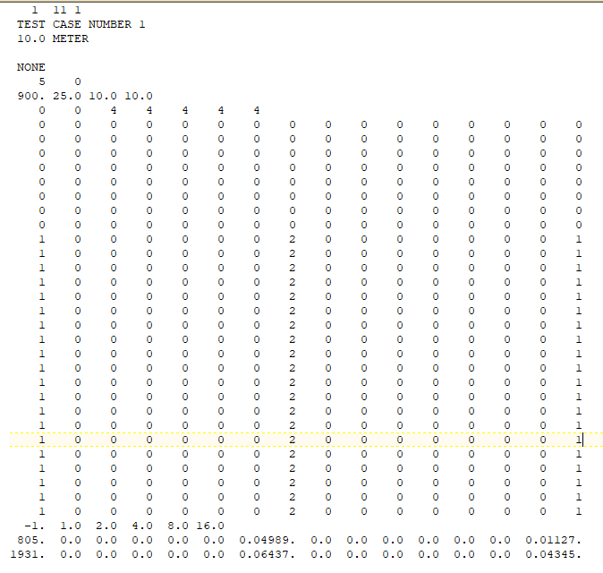
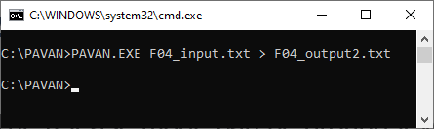
PAVAN – Model Input File and cmd Line Execution
PAVAN inputs are defined in a text file according to card descriptions in NUREG/CR-2858
Executable is run via command line
  PAVAN.exe input.txt > output.txt
Outputs are presented in a text file

Slide 17
XOQDOQ - Regulatory Need
10 CFR Part 20, Subpart D, Radiation Dose Limits for Individual Members of the Public
  The annual average concentrations of radioactive material released in gaseous effluents at the boundary of the unrestricted area do not exceed the values specified in Table 2 of Appendix B to Part 20
    Intended to result in doses below 0.05 rem (0.5 mSv)
10 CFR Part 50, Appendix I, Numerical Guides for Design Objectives and Limiting Conditions for Operation to Meet ALARA Criterion for Radioactive Material in Reactor Effluents
  Section II.B: Unrestricted annual air dose <10 mrad (0.1 mGy) gamma or 20 mrad (0.2 mGy) beta
  Section II.C: Unrestricted annual individual organ dose from all pathways of exposure <15 mrem (0.15 mSv)
  Section II.D: radwaste system cost-benefit analysis based on population dose out to 50 miles

Slide 18
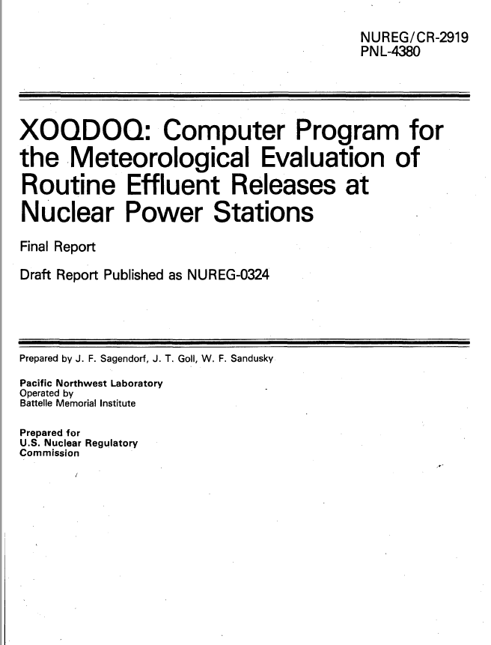
XOQDOQ – Guidance Documents
RG 1.206, C.I.2.3.5: Long-Term Atmospheric Dispersion Estimates for Routine Releases
SRP 2.3.5: Long-Term Atmospheric Dispersion Estimates for Routine Releases
RG 1.111: Methods for Estimating Atmospheric Transport and Dispersion of Gaseous Effluents in Routine Releases from Light-Water-Cooled Reactors (Revision 1, 1977)
NUREG/CR-2919: XOQDOQ Computer Program for the Meteorological Evaluation of Routine Effluent Releases at Nuclear Power Stations (1982)

Slide 19
XOQDOQ – Technical Basis (1/2)
Gaussian plume model
  Plume horizontal distribution is assumed to be evenly distributed within the 22.5 degree downwind sector (sector-averaging)
  For ground-level releases, plume vertical diffusion coefficient modified to account for building wake
Meteorological input consists of a JFD of hourly values of:
  Wind speed (calms defined as ½ sensor threshold)
  Wind direction (16 directions, 22.5 degree sectors, centered on true north)
  Atmospheric stability class (preferably based on delta-T)
Building wake impacts on release height
  Release points below adjacent solid structures → ground-level releases
  Release points at, or up to 2X higher than adjacent solid structures → mixed-mode (part-time ground, part-time elevated) releases
    Function of the ratio of plume vertical exit velocity to horizontal wind speed
  Release points higher than 2X adjacent solid structures → elevated releases
    Calculates effective plume height
Allows adjustment of χ/Q and D/Q values to account for the effects of local air recirculation or stagnation using default or user-supplied site-specific correction factors

Slide 20
XOQDOQ – Technical Basis (2/2)
Sources
  Elevated
    Can include plume rise from momentum/buoyancy
    Can include topography for use in “effective height” calculation
  Ground-level
    Can include additional dispersion from building wakes
  Mixed-mode
    Vents at or above height of adjacent structures
Meteorology
  Joint frequency distribution of wind direction (16 sectors), wind speed (up to 14 bins), stability class (7 classes, A through G)
  Diffusion: Pasquill-Gifford (P-G) or desert curves (Markee)
  Wind speed extrapolation to release height
Plume decay for varied half-lives
Plume depletion from dry deposition
χ/Q modified for recirculation or air stagnation

Slide 21
XOQDOQ – Model Inputs
Sources
  Elevated
    Can include plume rise from momentum/buoyancy
    Can include topography for use in “effective height” calculation
  Ground-level
    Can include additional dispersion from building wakes
  Mixed-mode
    Vents at or above height of adjacent structures
Meteorology
  Joint frequency distribution of wind direction (16 sectors), wind speed (up to 14 bins), stability class (7 classes, A through G)
  Diffusion: Pasquill-Gifford (P-G) or desert curves (Markee)
  Wind speed extrapolation to release height
Plume decay for varied half-lives
Plume depletion from dry deposition
χ/Q modified for recirculation or air stagnation

Slide 22
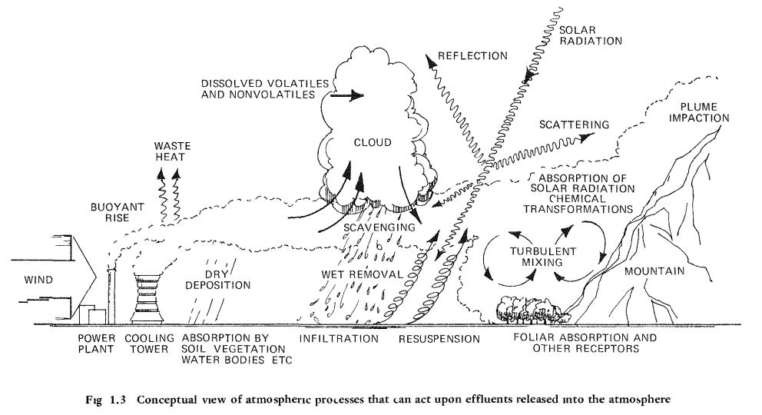
Atmospheric Processes Impacting Dispersion
Randerson, D. 1984. Atmospheric science and power production. United States. Web. doi:10.2172/6503687.

Slide 23
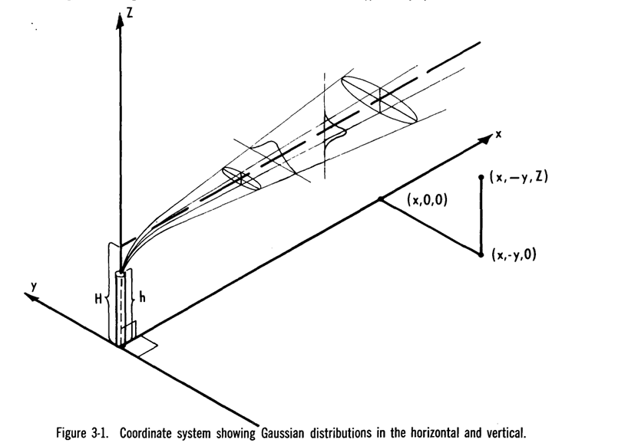
Gaussian Plume Model
$$\frac{χ}{Q}=\frac{1}{2πUσ_{y}σ_{z}}exp\left(−\frac{y^{2}}{{{2σ}_{y}}^{2}}\right)\left[exp\left(−\frac{{\left(z−H\right)}^{2}}{2{σ_{z}}^{2}}\right)+exp\left(−\frac{{\left(z+H\right)}^{2}}{2{σ_{z}}^{2}}\right)\right]$$
With simplifying assumptions, the basic form of the Gaussian plume model considers
  Wind speed (U)
  Horizontal and vertical diffusion (σ_{y}, σ_{z})
  Effective stack height (H)
Calculation at downwind distance x, crosswind distance y, and vertical distance z
Turner, B. 1970. Workbook of Atmospheric Dispersion Estimates. Research Triangle Park, NC.

Slide 24
Technical Basis - Meteorology
Meteorological data in hourly RG 1.23 format is used as input for ATD
  ARCON also uses hourly input, in ARCON format
  PAVAN and XOQDOQ use joint frequency distributions (JFDs)
Hourly atmospheric stability class is determined from hourly dT/dz records
  Legacy codes included stability classes directly
Release height wind speed is estimated from the measurement height via:
  Monin-Obukhov similarity theory for Control Room
  Power Law relationships for Design Basis Accident and Routine Analysis

Slide 25
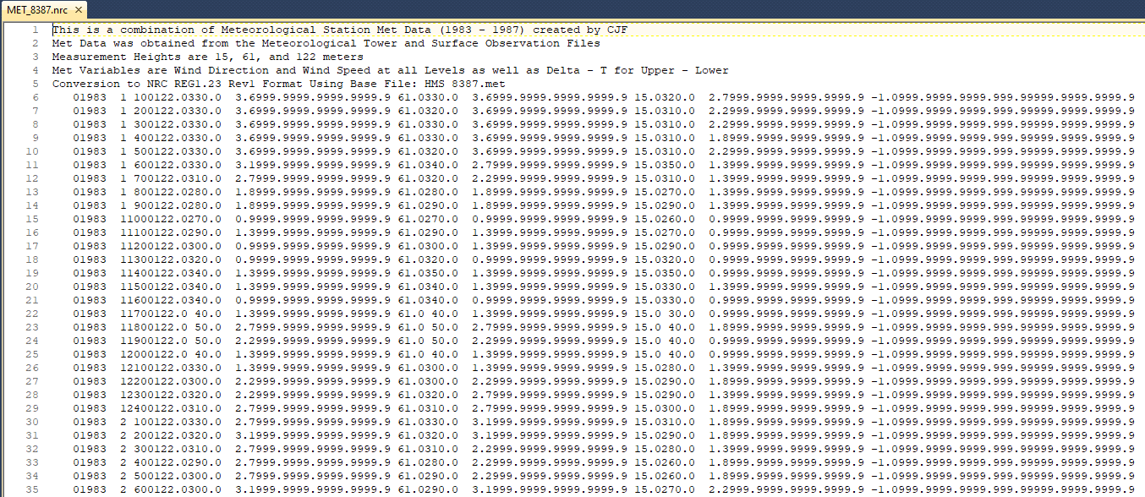
Example RG 1.23 Meteorological Data Format

Slide 26
Treatment of Calm Winds in ATD and Legacy codes
ATD | ARCON | PAVAN | XOQDOQ
For Control Room: All calms are assigned to the direction to the receptor. For Design Basis and Routine Analyses: All calms are distributed equally across all wind directions (WD). | All calms are assigned to the direction to the receptor. | If a WD is provided, use the given WD. If no WD is provided, distribute the calm occurrences by assigning them in proportion to the directional distribution of non-calm winds with speeds less than 1.5 m/s. If no WD is provided and there are no winds below 1.5 m/s, distribute the calms equally across all wind directions. | If a WD is provided, use the given WD. If no WD is provided, distribute the calm occurrences by assigning them in proportion to the directional distribution of the first non-calm wind speed class.

Slide 27
Technical Basis – Gaussian Plume. Statistical Calculations
Straight-line Gaussian plume equation implementation is identical to legacy codes
Sector-averaged Gaussian plume equation is slightly different for Design Basis Accident Analysis and Routine Analysis
  Legacy code equations included a factor for frequency of occurrence, which is not needed for the ATD model because of the hourly meteorological input
Regulatory Guides require different statistical outputs for different model assessments
  Control Room Analysis – 5% at receptor, at averaging times from 2 hrs to 30 days
  Design Basis Accident Analysis - 0.5% per sector, 5% overall site, at averaging times from 2 hrs to 30 days
  Routine Analysis - annual averages

Slide 28
SIERRA ATD Software Beta Testing
Beta Testing
  Provided SIERRA ATD v 0.3.0.0 to 22 beta testers from among RAMP users
  Testing performed from 3/18/2024 to 5/30/2024
  Example Feedback Provided:
    Expand the range of terrain input values
    Improve the user experience in entering receptors
    Improve the user experience in entering terrain information
    Improve the time to view hourly results
    Clarifying and editorial suggestions to the User’s Guide

Slide 29
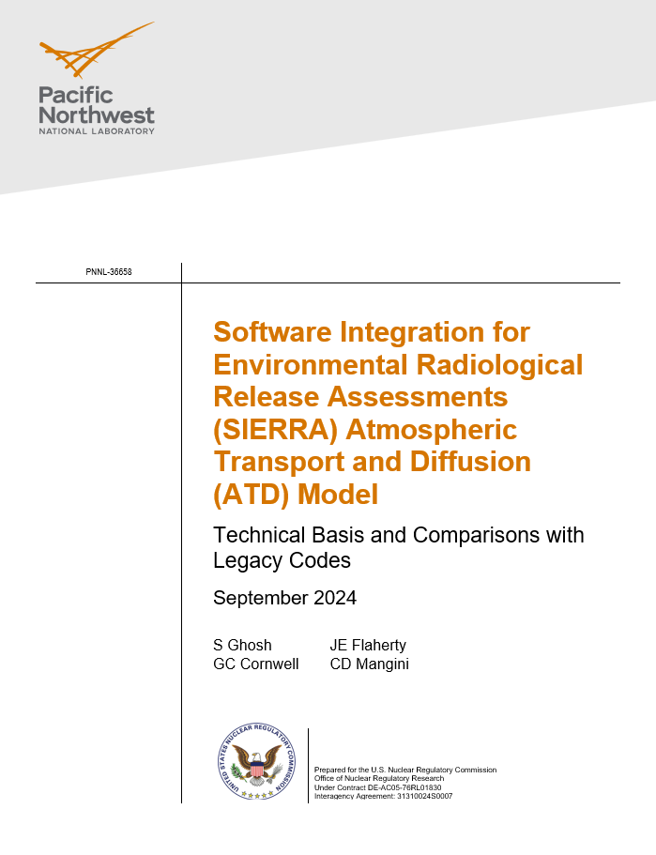
SIERRA ATD Technical Documentation
The SIERRA ATD technical basis and comparisons with legacy codes is documented in Ghosh et al. (2024)
  Document to be released publicly
  Comparisons were made with 22 site-specific meteorological datasets that contain 1-5 years of data
  For each legacy model, a ground (10 m) and elevated (60 m) release case was defined
  The PAVAN and XOQDOQ JFD files were defined such that the calm wind speeds were assigned a wind direction and distributed uniformly in the first wind speed class

Slide 30
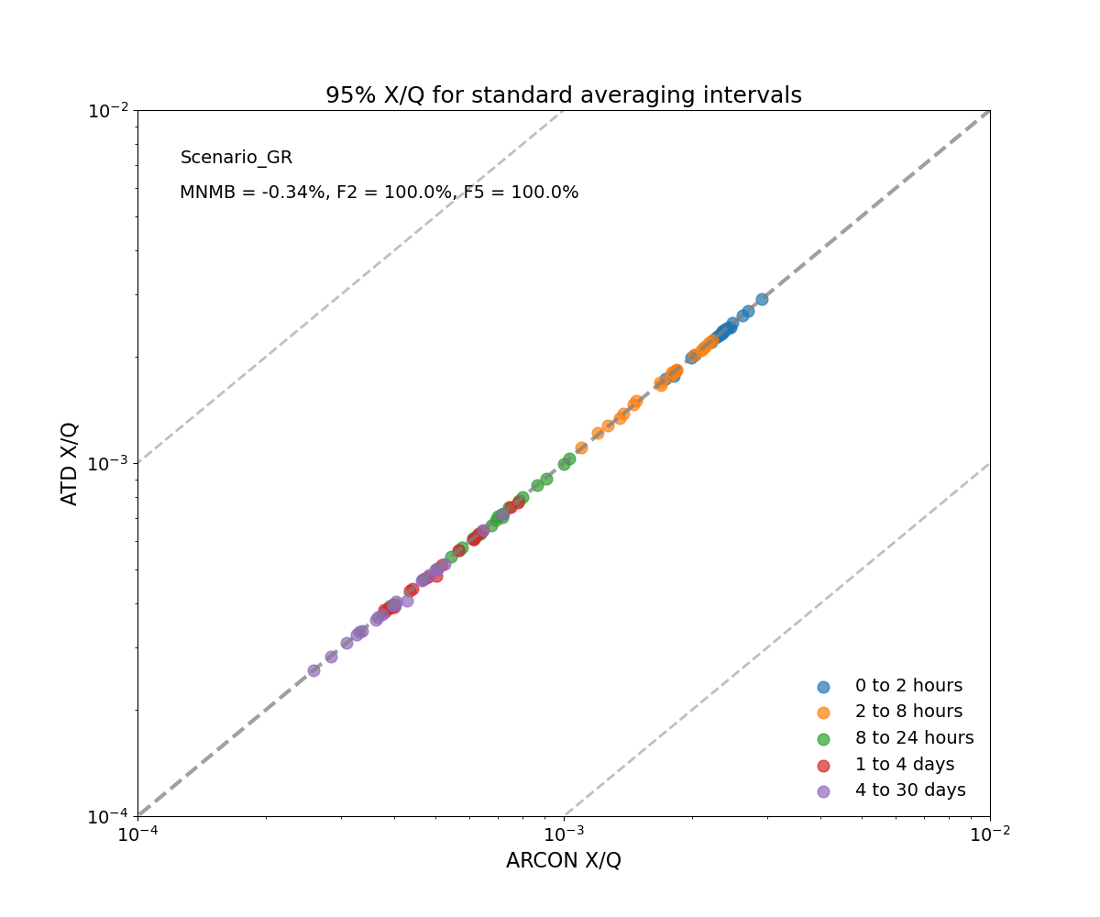
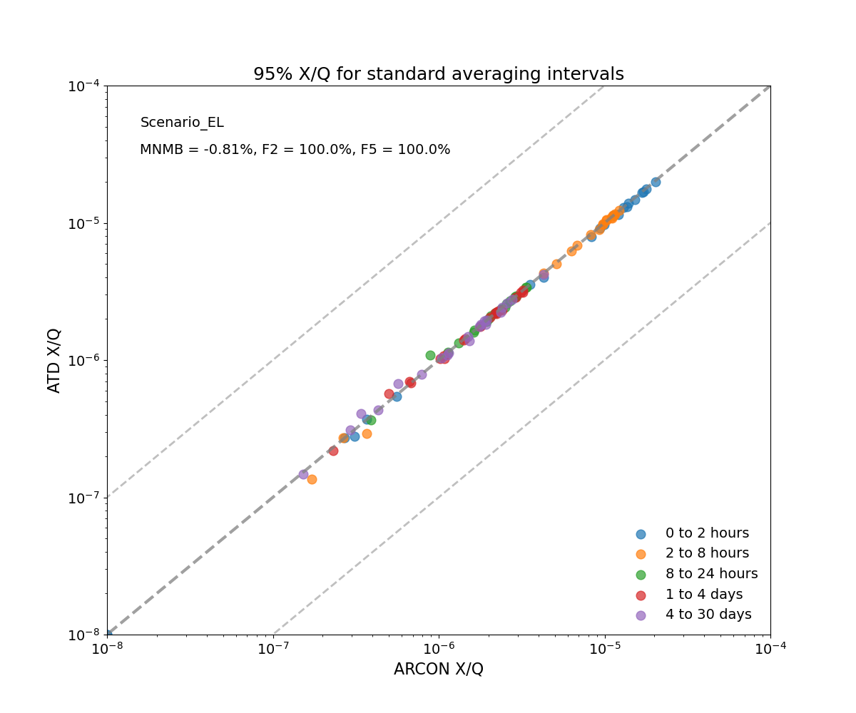
Comparisons with Legacy Codes – ARCON & ATD Control Room Analysis
Extracted from Ghosh, S., G.C. Cornwell, J.E. Flaherty, and C.D. Mangini. 2024. Software Integration for Environmental Radiological Release Assessments (SIERRA) Atmospheric Transport and Diffusion (ATD) Model: Technical Basis and Comparisons with Legacy Codes. PNNL-36658. Richland, WA.
Notes:
No text on the slide. Discuss the fact that ARCON and ATD both use hourly inputs, and they both use similar calms distributions. This is as close to an apples-to-apples comparison as possible. The ground case is presented in the left panel, while the elevated case is presented on the right. In both cases, there is a high level of agreement between the models.

Slide 31
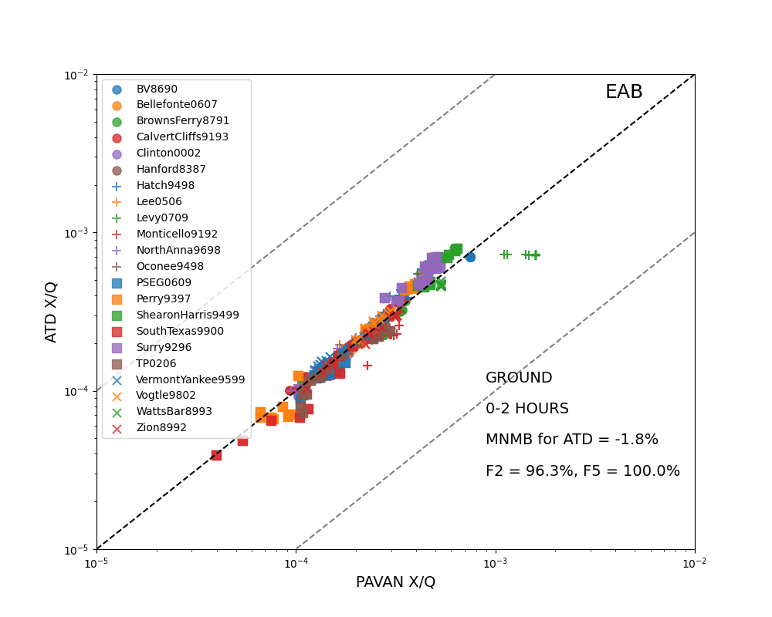
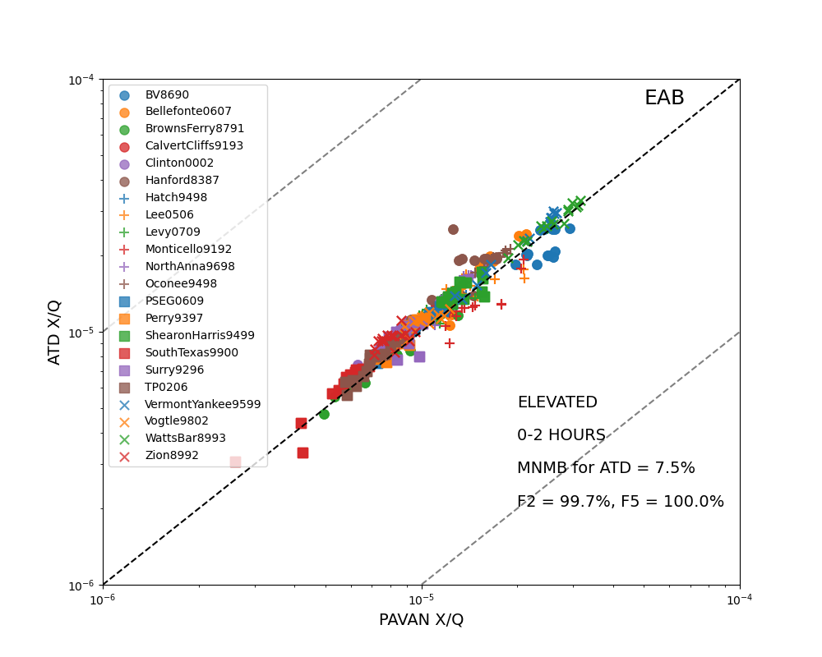
Comparisons with Legacy Codes – PAVAN & ATD Design Basis Accidents
Extracted from Ghosh, S., G.C. Cornwell, J.E. Flaherty, and C.D. Mangini. 2024. Software Integration for Environmental Radiological Release Assessments (SIERRA) Atmospheric Transport and Diffusion (ATD) Model: Technical Basis and Comparisons with Legacy Codes. PNNL-36658. Richland, WA.

Slide 32
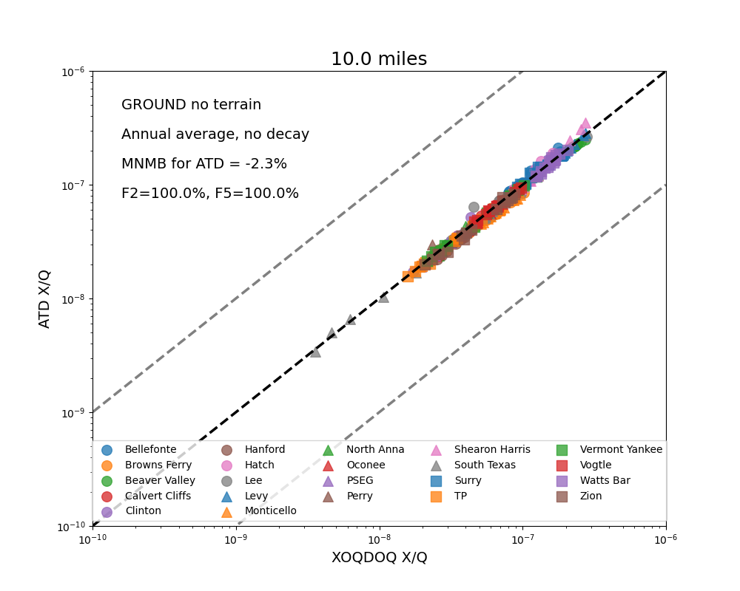
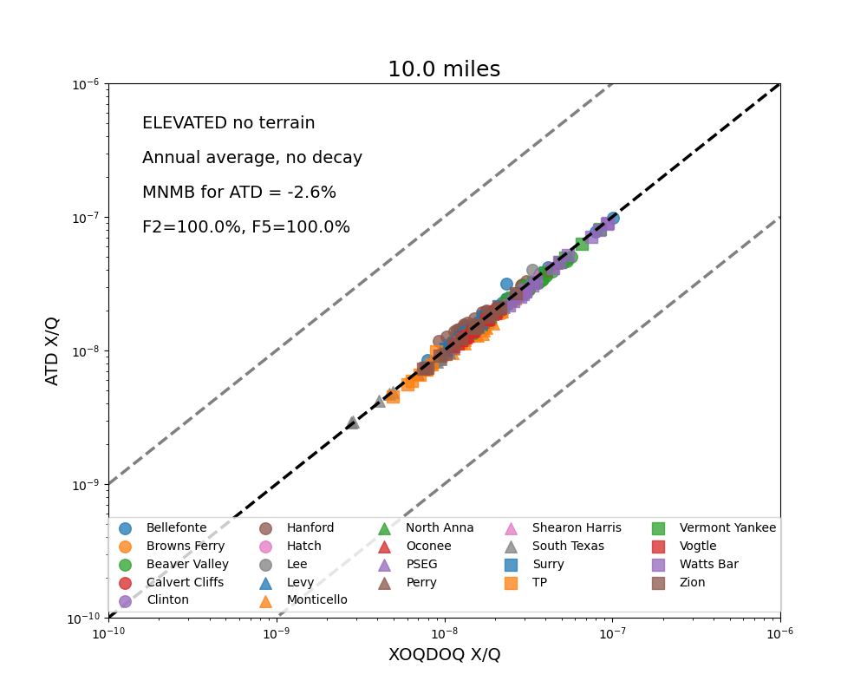
Comparisons with Legacy Codes – XOQDOQ & ATD Routine Analysis
Extracted from Ghosh, S., G.C. Cornwell, J.E. Flaherty, and C.D. Mangini. 2024. Software Integration for Environmental Radiological Release Assessments (SIERRA) Atmospheric Transport and Diffusion (ATD) Model: Technical Basis and Comparisons with Legacy Codes. PNNL-36658. Richland, WA.

Slide 33
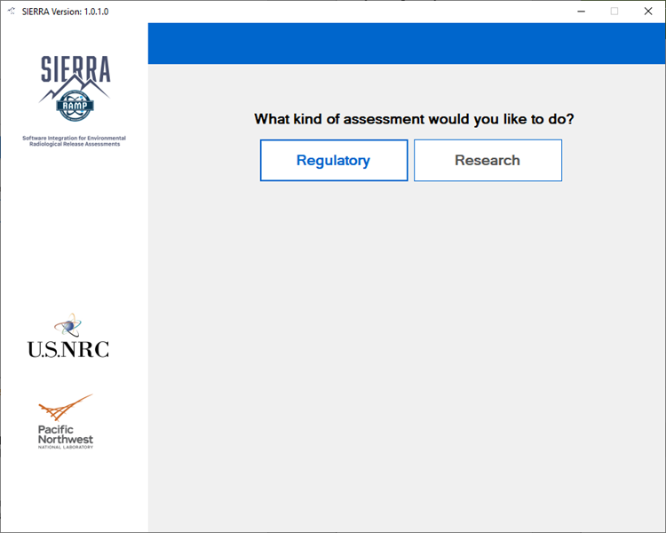
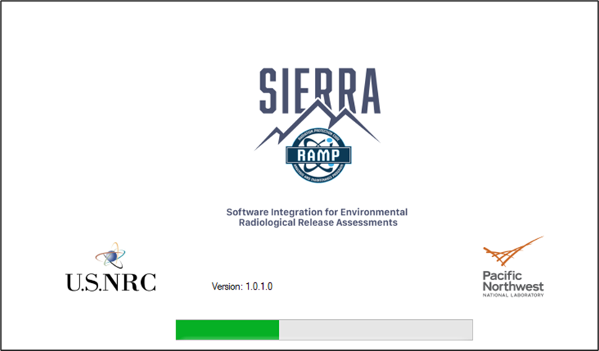
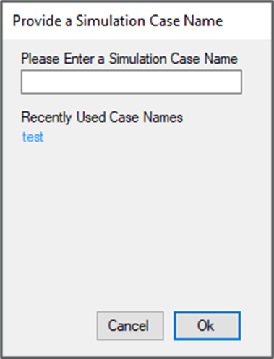
SIERRA GUI Screens (1)
Double-click the SIERRA desktop shortcut or single click the Windows Start Menu item to start the SIERRA application.
The SIERRA splash screen is displayed while the SIERRA application loads.
A disclaimer page will appear. Select the “Continue” button to proceed to the SIERRA application user interface.
The “Regulatory” option is the available assessment type.
A dialog window prompts user for the simulation name. Type the desired name into the dialog window text box and then click on the “Ok” button. (Or select from a list of recent names.)

Slide 34
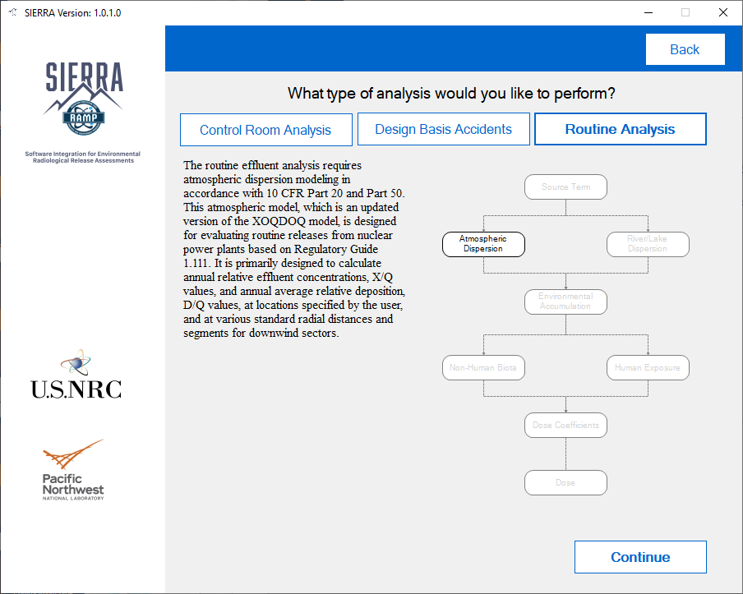
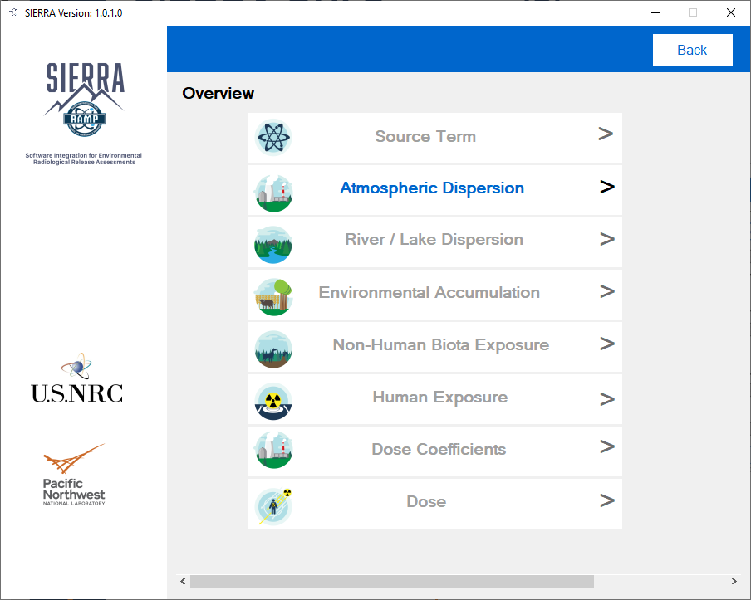
SIERRA GUI Screens (2)
The analysis type selection panel allows users to select from among “Control Room Analysis,” “Design Basis Accidents,” and “Routine Analysis.”
Click the “Continue” button to advance to the simulation “Overview” panel.
Click on the “Atmospheric Dispersion” button to start the atmospheric transport and diffusion (ATD) module interface.

Slide 35
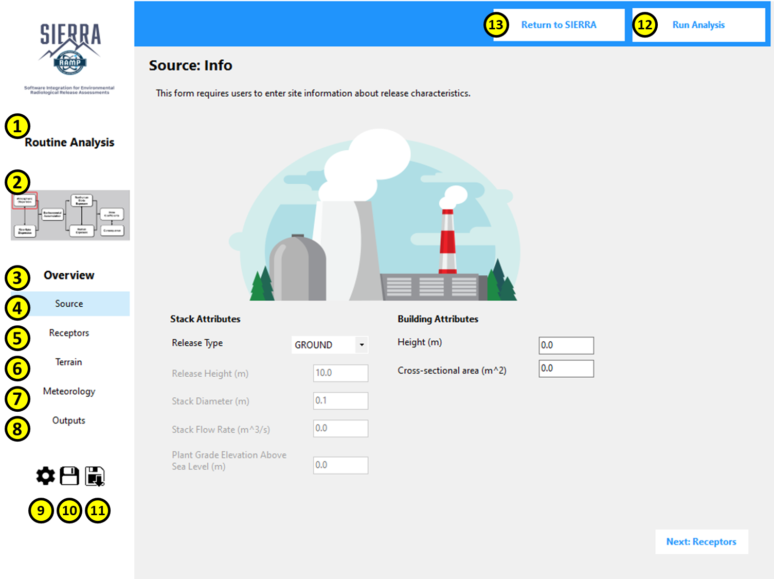
Atmospheric Dispersion Module Interface Walkthrough
Analysis Type
Module Map
Overview Section
Source
Receptor
Terrain
Meteorology
Outputs
Module Default Settings
Save Module Input
Load Module Input
Run Analysis
Return to SIERRA

Slide 36
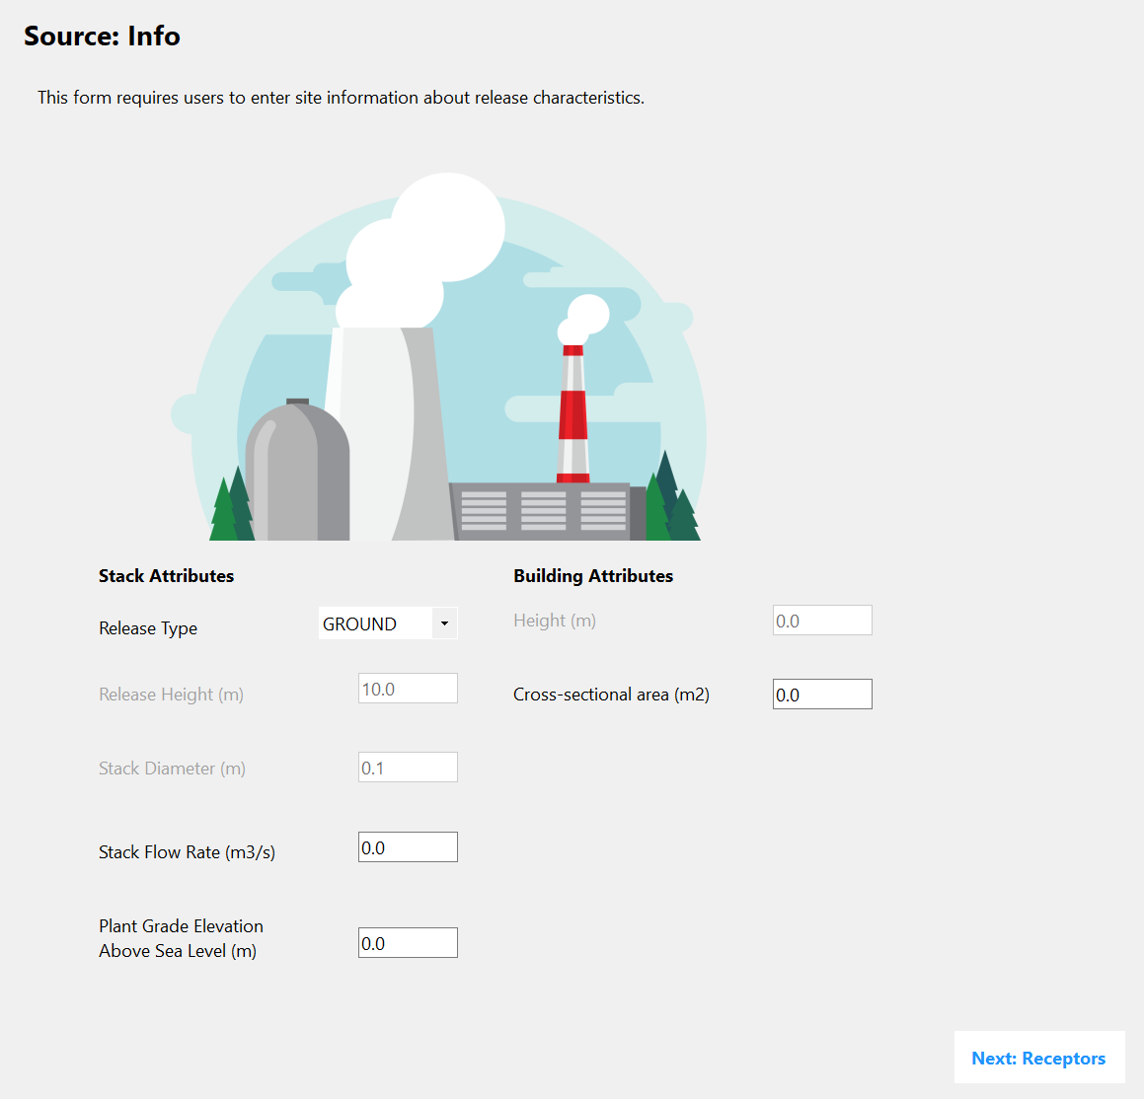
Control Room Type - Source
Release Type Selection – Options are GROUND, ELEVATED.
Release Height [10 - 300].
Stack Diameter [0.1 - 20].
Stack Flow Rate [0 – 100].
Plant Grade Elevation Above Sea Level [0 – 2500].
Height [0 – 300], N/A
Cross-sectional Area [0 - 10000].
Next: Receptors Button
1
6
2
7
3
4
5
8

Slide 37
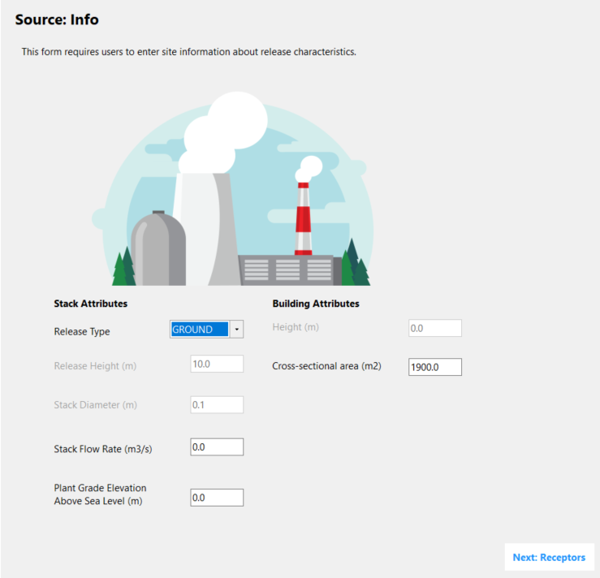
Control Room Type Example / Source
Example Case:
Ground-level release type
Release height of 10 m (default)
Stack flow rate of 0.0 m3/s
Plant Grade Elevation of 0.0 m
Building cross-sectional area of 1900 m2

Slide 38
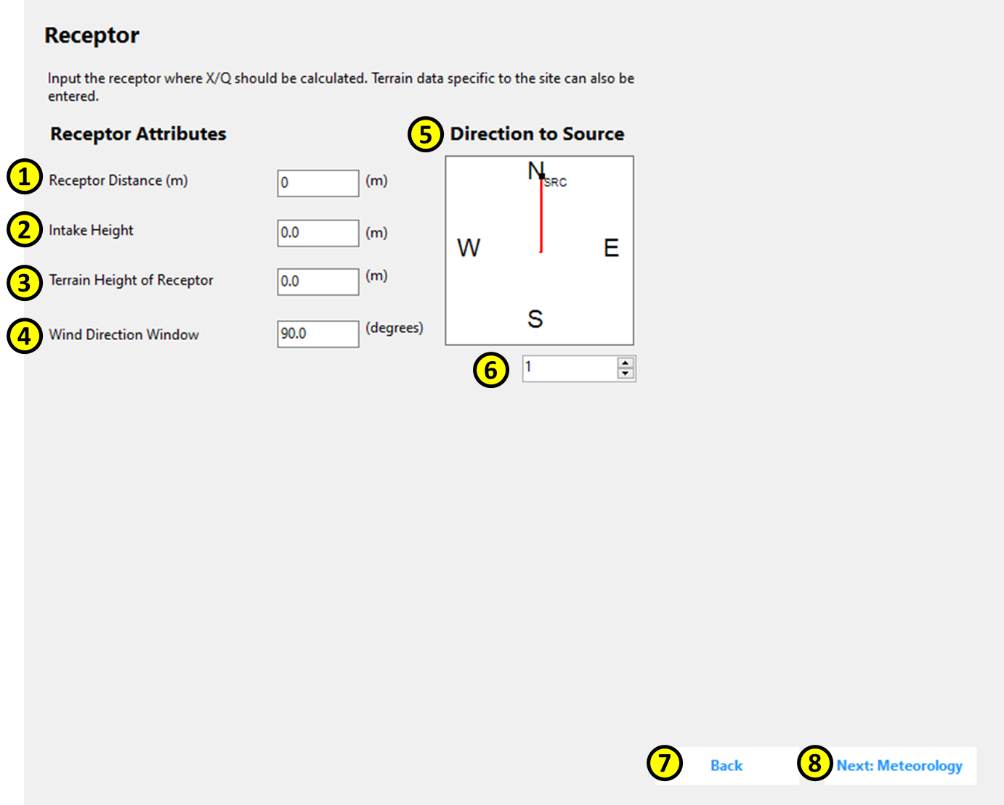
Control Room Type - Receptors
Receptor Distance [0 – 10000]
Intake Height [0 – 100].
Terrain Height of Receptor [0 – 2500].
Direction Window - Displays the direction to the source, based on the direction selected in the “Direction Select” portion of the panel.
Direction Select [1 – 360]
Back Button
Next: Meteorology Button

Slide 39
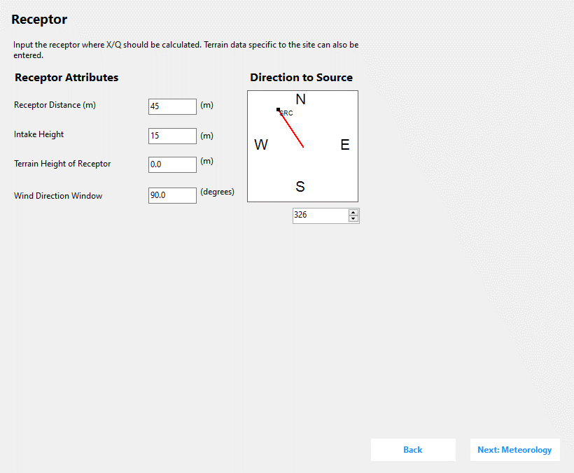
Control Room Type Example / Receptor
Example Case:
Receptor distance: 45 m from source
Intake height: 15 m
Terrain height: 0.0 m
Wind Direction Window 90°
Direction to source is 326°

Slide 40
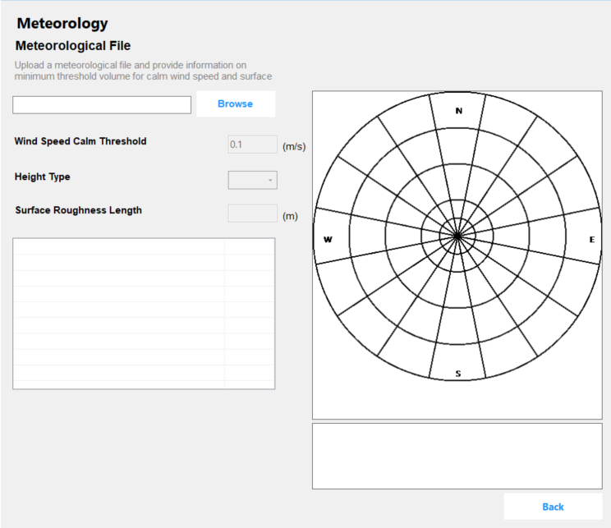
Control Room Type - Meteorology
Meteorology File Textbox
Browse Button
Wind Speed Calm Threshold Textbox [0 – 1]
Height Type Combo Box [Lower, Upper]
Surface Roughness Length Textbox - [0 – 10]
Meteorological Statistics View
Polar Grid Plot
Legend
Back Button
1
2
7
3
4
5
6
8
9

Slide 41
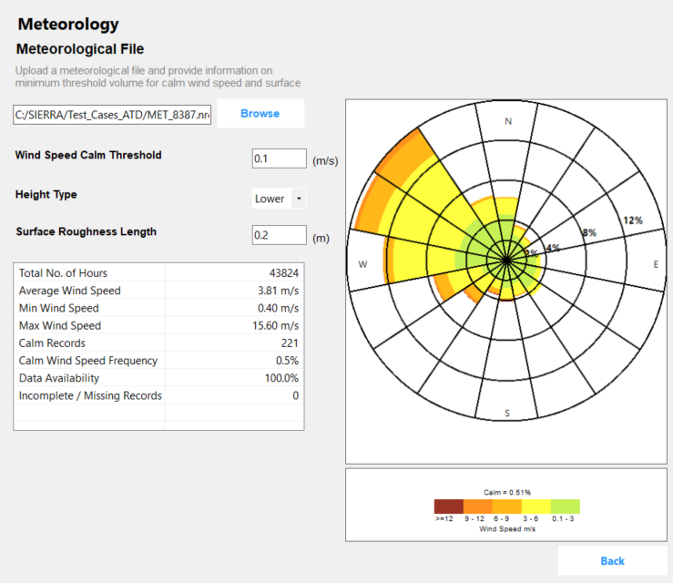
Control Room Type Example / Meteorology
Example Case:
5 years of data from 1983 through 1987
Calm wind speed threshold: 0.1 m/s
Height Type: Lower/Upper
Surface Roughness: 0.2 m

Slide 42
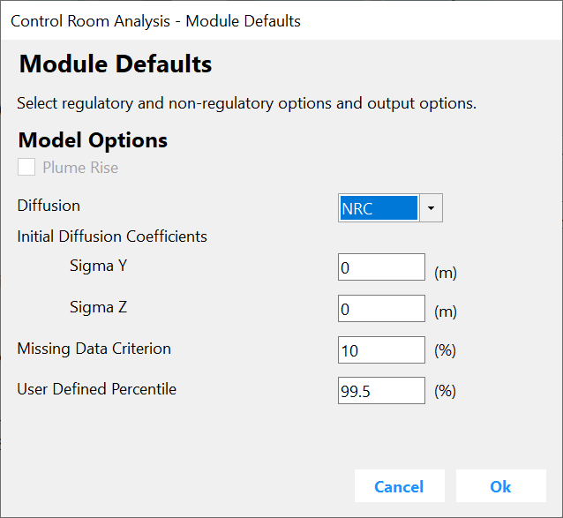
Control Room Type - Defaults
Plume Rise
Diffusion - Options are NRC, ISC, BRIGGS_RURAL, BRIGGS_URBAN, DESERT_SIGMA
Sigma Y
Sigma Z
Missing Data Criterion [0 – 30]
User Defined Percentile [0 – 100]
Cancel Button
Ok Button
1
2
3
4
5
6
7
8

Slide 43
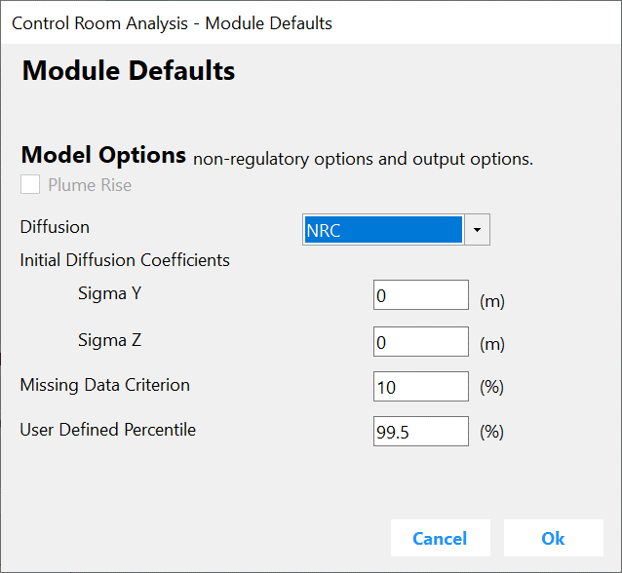
Control Room Type Example / Module Defaults
Example Case:
Diffusion NRC
Missing Data Criterion 10%
Additional 99.5th percentile calculations

Slide 44
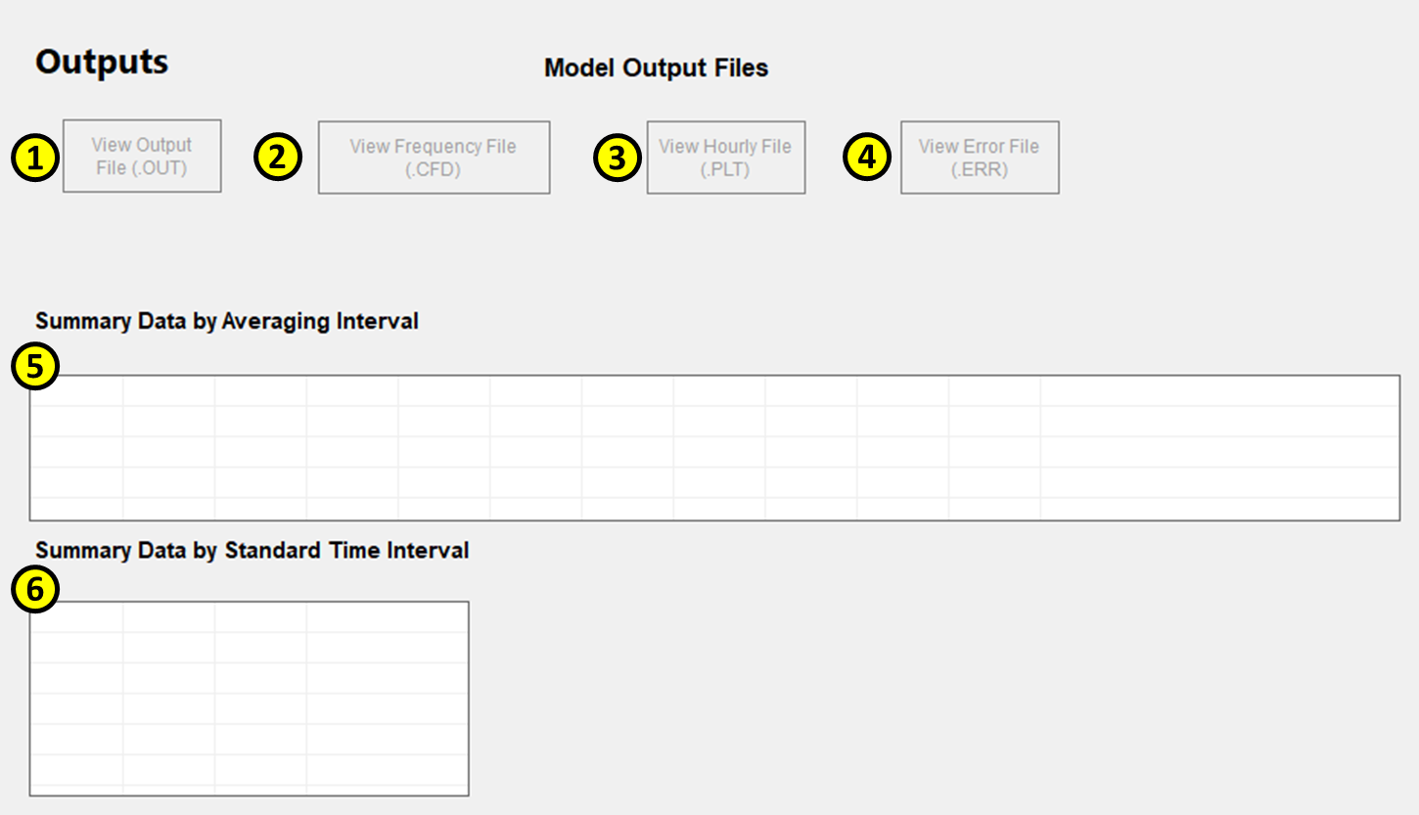
Control Room Type - Outputs
View Output File Button
View Frequency File Button
View Hourly File Button
View Error File Button
Summary Data by Averaging Interval Grid
Summary Data by Standard Time Interval Grid

Slide 45
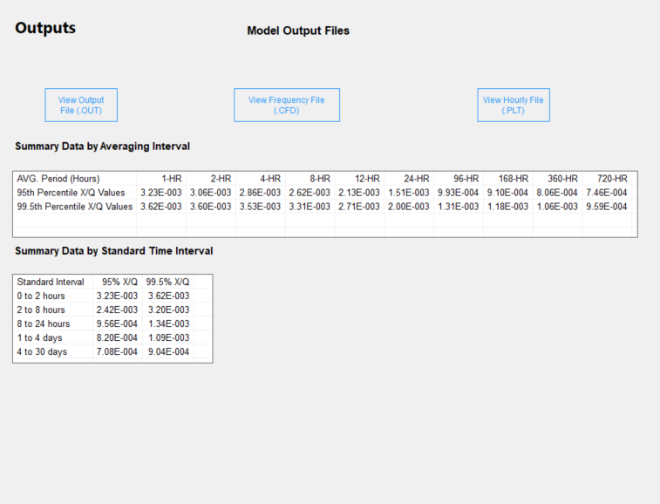
Control Room Type Example / Outputs

Slide 46
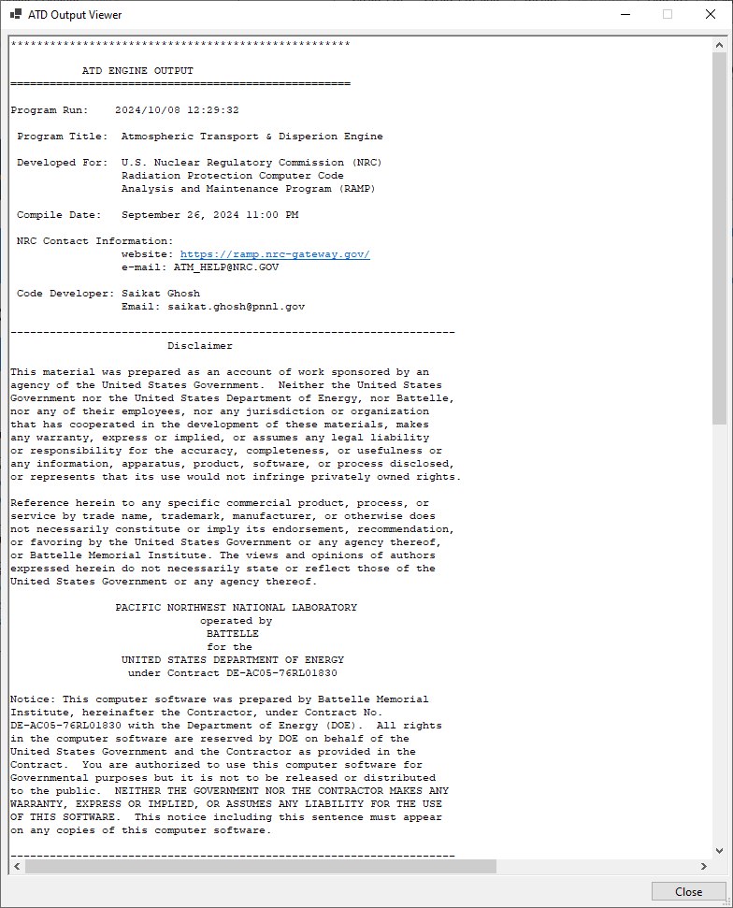
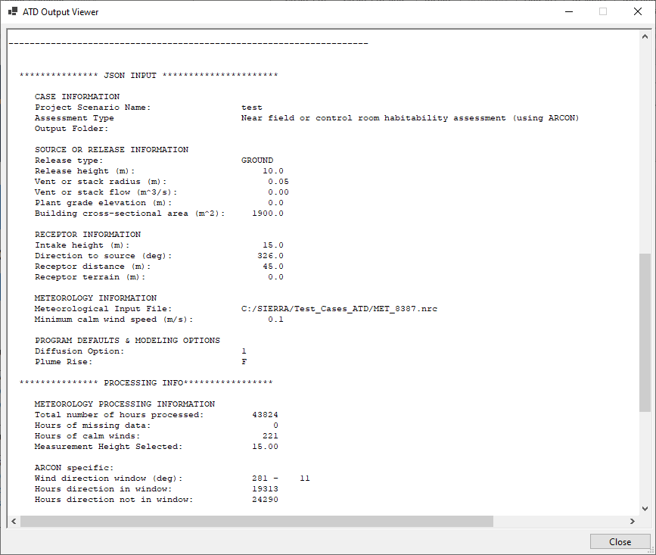
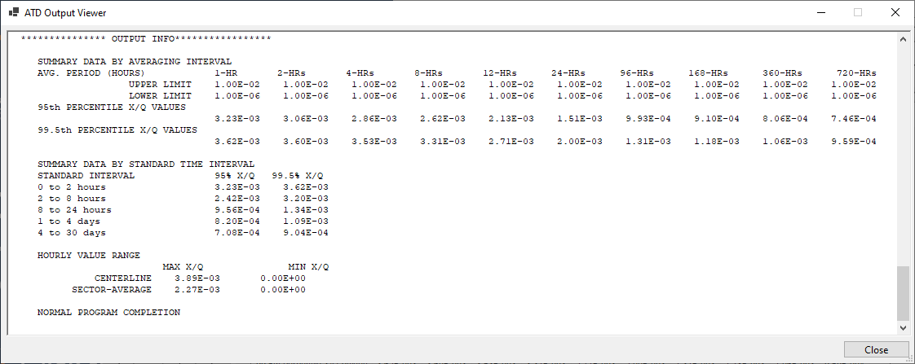
Control Room Type Example / Outputs .OUT

Slide 47
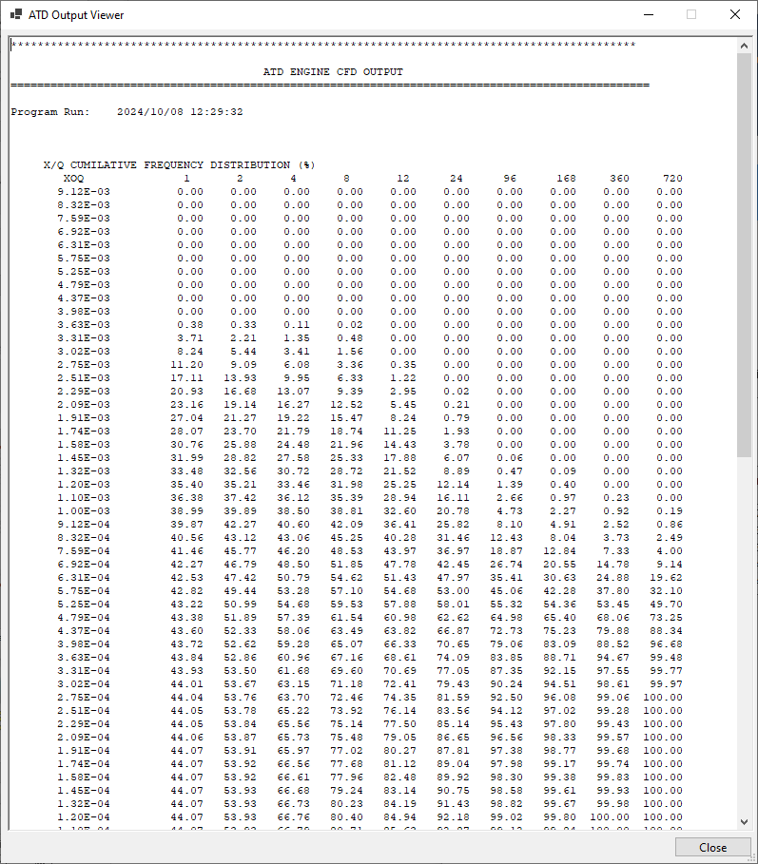
Control Room Type Example / Outputs .CFD

Slide 48
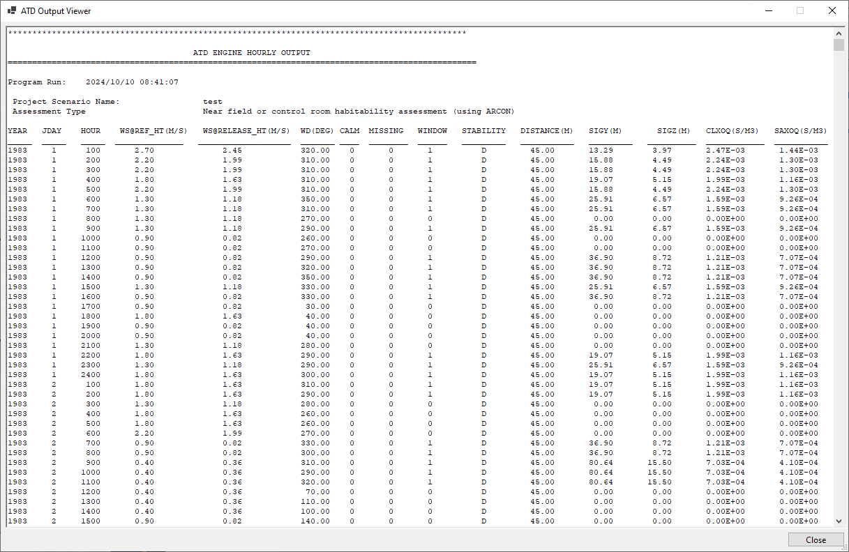
Control Room Type Example / Outputs .PLT

Slide 49
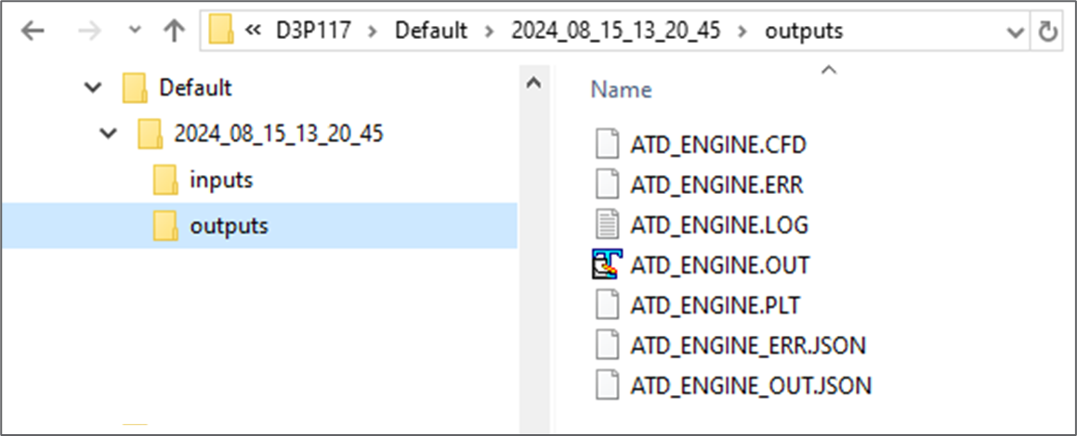
Control Room Type Example / Output Files
Each of the output files that are available from the Outputs panel in the UI are also available from the User folder for the simulation
Additionally, JSON format output is available for transmitting data to other SIERRA modules, to be developed in the future

Slide 50
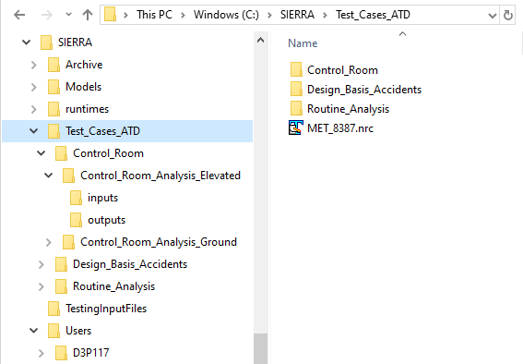
SIERRA Folder Structure
Default location for SIERRA folder is in the C: drive
  Test_Cases_ATD – contain test cases for each release type for each analysis type (i.e., Control Room Analysis, Design Basis Accidents Analysis, and Routine Analysis)
  Users – contain analysis data within Simulation Case folder

Slide 51
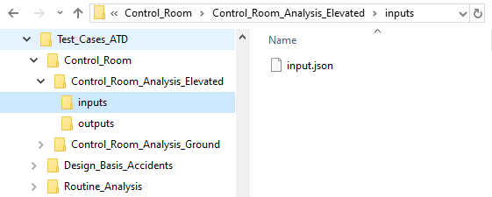
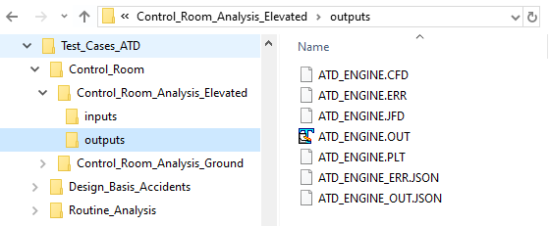
SIERRA ATD Test Cases Folders
Within each test case folder, there is an inputs folder and outputs folder
Inputs contains a single JSON file that can be loaded into a simulation
Outputs contains multiple output files:
  Standard outputs mirroring the legacy code outputs
  JSON outputs for future use with other SIERRA modules

Slide 52
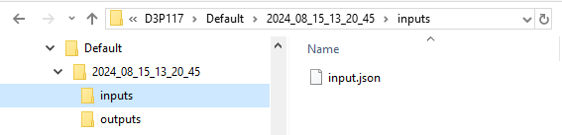
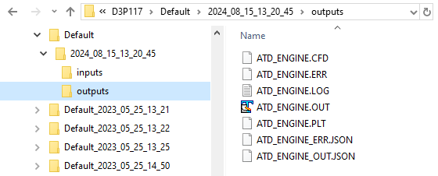
SIERRA ATD Simulation Case Folders
Within each Simulation Case folder there is an automatically-generated folder that contains an inputs folder and outputs folder
Run Analysis creates a folder named YYYY_MM_DD_hh_mm_ss

Slide 53
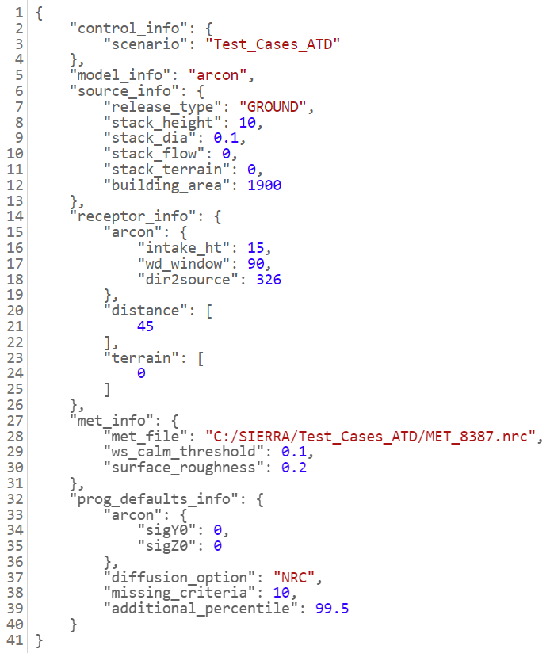
Example Input JSON
Inputs grouped by UI panel
  source_info
  receptor_info
  met_info
  prog_defaults_info
Notes:
Control Room Analysis – Ground Test Case

Slide 54


Example Output JSON
Outputs grouped by averaging period
  95th percentile
  99.5th percentile
Standard Intervals
  0-2 hours
  2-8 hours
  8-24 hours
  1-4 days
  4-30 days
Notes:
Control Room Analysis – Ground Test Case

Slide 55

Design Basis Accident Type - Source
Release Type Selection - GROUND or ELEVATED.
Release Height - [10–300]. Disabled when Release Type is set to GROUND.
Stack Diameter – [0.1–20]. Disabled when Release Type is set to GROUND. Also disabled when Release Type is set to ELEVATED unless Plume Rise is checked in the Module Defaults panel.
Stack Flow Rate - [0–100]. Disabled for GROUND. Also disabled when Release Type is set to ELEVATED unless Plume Rise is checked in the Module Defaults panel.
Plant Grade Elevation Above Sea Level – For ELEVATED release. [0–2500].
Height - For a GROUND release. [0–300].
Cross-sectional Area - For a GROUND release. [0–10,000].
Site Type Selection - Options are Inland and Coastal. Disabled when Release Type is set to GROUND.
Next: Terrain Button
1
6
2
7
3
8
4
5
9

Slide 56

Design Basis Accident Type Example / Source
Example Case:
Elevated-level release
Release height of 45.0 m
Plant Grade Elevation Above Sea Level of 0 m
Site Type of Inland

Slide 57

Design Basis Accident Type - Terrain
Range Selection - The user can select a range to edit. Range: EAB or LPZ
Sectors, Distances, and Elevations Grid - Distance [0–80459] and Elevation [0–2500]
Distances and Elevations Polar Grid Display
Back Button
Next: Meteorology Button
1
2
3
4
5

Slide 58

Design Basis Accident Type Example / Terrain
Example Case:
EAB distance at 800 m
Low population zone boundary (LPZ) distance at 3000 m
Terrain elevation 0.0 m

Slide 59

Design Basis Accident Type - Meteorology
Meteorology File Textbox
Browse Button
Wind Speed Calm Threshold Textbox [0 – 1]
Height Type Combo Box - Lower, Upper.
Meteorological Statistics View
Polar Grid Plot
Legend
Back Button

Slide 60

Design Basis Accident Type Example / Meteorology
Example Case:
5 years of data from 1983 through 1987
Calm wind speed threshold: 0.1 m/s
Height Type: Lower/Upper

Slide 61

Design Basis Accident Type - Defaults
Plume Rise
Diffusion - Options are NRC, ISC, BRIGGS_RURAL, BRIGGS_URBAN, DESERT_SIGMA.
Missing Criteria for Averaging Periods [0 – 30]
Cancel Button
Ok Button
1
2
3
4
5

Slide 62

Design Basis Accident Type Example Module Defaults
Example Case:
Diffusion: NRC
Missing Criteria for Averaging Periods: 10%

Slide 63


Design Basis Accident Type - Outputs
View Output File Button - Opens the ATD Output Viewer that displays the OUT file
View Frequency File Button - Opens the ATD Output Viewer that displays the CFD file
View Hourly File Button - Opens the ATD Output Viewer that displays the PLT file
View Error File Button - Opens the ATD Output Viewer that displays the ERR file
Summary Data by Averaging Interval Grid - Displays summary data for the averaging intervals generated by the analysis

Slide 64

Design Basis Accident Type Example / Outputs

Slide 65

Routine Analysis Type - Source
Release Type Selection - Options are GROUND, VENT, ELEVATED
Release Height [10 - 300]
Stack Diameter [0.1 - 20]
Stack Flow Rate [0 – 100]
Plant Grade Elevation Above Sea Level [0 – 2500]
Height [0 – 300]
Cross-sectional Area [0 - 10000]
Next: Receptors Button
1
6
2
7
3
4
5
8

Slide 66

Routine Analysis Type
Example / Source
Vent release
Release height: 10 m
Stack diameter: 2.0 m
Stack flow rate: 10.0 m/s
Plant Grade Elevation: 0.0 m
Building Height: 40.0 m
Cross-sectional area: 2000.0 m2

Slide 67

Routine Analysis Type - Receptors
Discrete Receptors Data
Discrete Receptors Polar Grid
Add Button
Back Button
Next: Terrain

Slide 68

Routine Analysis Type - Example / Receptors
site boundary / S / 805 m
site boundary / S / 966 m
site boundary / S / 1127 m
milk cow / S / 1931 m
milk cow / NNW / 4989 m
milk cow / SSE / 4345 m
Residence / S / 1931 m
Residence / NNW / 6437 m

Slide 69

Routine Analysis Type - Terrain
Range Selection [0–10]
Terrain Distances and Elevations Grid
Distances and Elevations Polar Grid Display
Back Button
Next: Meteorology Button
1
2
3
4
5

Slide 70

Routine Analysis Type
Example / Terrain
Range 0, Distance: 100 m / Elevation: 0 m
Range 1, Distance: 800 m / Elevation: 16 m
Range 2, Distance: 10000 m / Elevation: 200 m

Slide 71

Routine Analysis Type - Meteorology
Meteorology File Textbox
Browse Button
Wind Speed Calm Threshold Textbox [0 – 1]
Height Type Combo Box [Lower, Upper]
Meteorological Statistics View
Wind Rose Plot
Legend
Back Button
1
2
6
3
4
5
7
8

Slide 72

Routine Analysis Type
Example / Meteorology
Example Case:
5 years of data from 1983 through 1987
Calm wind speed threshold: 0.1 m/s
Height Type: Lower/Upper

Slide 73

Routine Analysis Type - Defaults
Use open terrain recirculation
Diffusion - Options are NRC, ISC, BRIGGS_RURAL, BRIGGS_URBAN, DESERT_SIGMA
Cancel Button
Ok Button
1
2
3
4

Slide 74

Routine Analysis Type
Example / Module Defaults
Example Case:
Use open terrain recirculation
Diffusion NRC

Slide 75

Routine Analysis Type - Outputs
View Output File Button
View Hourly File Button
View Error File Button
Output Type Selection - NO DECAY/UNDEPLETED, 2.260 DAY DECAY/UNDEPLETED, 8.000 DAY DECAY/DEPLETED, or RELATIVE DEPOSITION PER UNIT AREA (PER METER SQUARED)
Output Type Summary Data Grid
Discrete Receptors Summary Data Grid
Polar Grid Display
1
2
3
4
5
7
6

Slide 76

Routine Analysis Type
Example / Output

Slide 77

Future Development
Developers maintain a list for future enhancements
  Functionality to allow users to treat calms differently
  Functionality to allow users to select the height of measurements used in the simulation
User Feedback
  SIERRA ATD Forum on the RAMP page
  Questions to RAMP@NRC.gov

Slide 78
Questions?

Slide 79
Backup Slides

Slide 80
Assessment Types / Applicability
SIERRA Assessment Type | Legacy Model | NRC Guidance Document | Applicability
Control room habitability assessment | ARCON | RG 1.194 SRP 2.3.4 | Evaluate personnel exposures inside the control room during accidents
 |  | SRP 15.0.3 | Protection against radiation inside the onsite technical support center
Design basis accident analyses | PAVAN | RG 1.145 SRP2.3.4 | Offsite consequence at EAB and LPZ for plant design
 |  |  | Offsite consequence at EAB and LPZ for safety assessment
 |  |  | Determine acceptable EAB and LPZ for siting
 |  |  | Offsite consequence at EAB and LPZ for postulated accidents
Routine release analysis | NRCDose / XOQDOQ | RG 1.111 SRP 2.3.5 | Annual dose assessment to ensure below threshold limit during operations
 |  |  | Annual dose assessment to meet as low as is reasonably achievable (ALARA) criterion during preliminary plant design

Slide 81

Gaussian Plume Model
Randerson, D. 1984. Atmospheric science and power production. United States. Web. doi:10.2172/6503687.
Turner, B. 1970. Workbook of Atmospheric Dispersion Estimates. Research Triangle Park, NC.

Slide 82

Gaussian Plume Model
Randerson, D. 1984. Atmospheric science and power production. United States. Web. doi:10.2172/6503687.

Slide 83

Plume Rise
Randerson, D. 1984. Atmospheric science and power production. United States. Web. doi:10.2172/6503687.

Slide 84


Documentation
Documentation
  SIERRA ATD v1.0.1.0 User’s Guide (PNNL-36688)
  SIERRA ATD Technical Basis and Comparison with Legacy Code (PNNL-36658)

Slide 85



Installation Walkthrough – Step 1
Navigate to and open the “SIERRA_Install” folder
Double click on the SIERRA install executable (e.g., SIERRA_Install_V_1.exe) file in the folder
  Upon start up the installation software will display a license agreement display for installation of the .NET framework. Click on the “Accept” button.
A window to proceed with the .NET installation will appear. Click on the “Run” button.

Slide 86





Installation Walkthrough – Step 2
Click on the “Install” or “Repair” button to start the installation of the .NET framework.
Click on the “Yes” button when the “User Account Control” dialog window is displayed. The framework installation will begin, and a progress dialog will be displayed.
  An “Installation was successful” or “Repair Successfully Completed” dialog will be displayed.
  Click on the “Close” button to continue to the SIERRA installation.

Slide 87





Installation Walkthrough – Step 3
Click on the “Next” button on the SIERRA installation “Welcome” screen.
The “Select Installation Folder” screen is displayed with the folder path defaulted to “C:\SIERRA\.”
  To change the installation folder path, click on the “Browse” button and use the “Browse for Folder” dialog window to navigate to and select the desired installation folder.
Click on the “Next” button to continue the installation process.
When the “Confirm Installation” dialog window is displayed, click on the “Next” button to start the installation of the software.
Once the software is successfully installed, an “Installation Complete” screen will be displayed. Click the “Close” button to close the installation program.
The SIERRA software can then be started by double clicking the “SIERRA” shortcut that has been created on the computer’s desktop or by clicking on the “SIERRA” item in the Windows Start Menu.

