Slide 1
Risk-Informed, Performance-Based & Technology-Inclusive Reactor Licensing and Regulation
Anders Gilbertson (he/him/his)
Senior Project Manager
Office of Nuclear Reactor Regulation
October 22, 2024

Slide 2
Presentation Overview
An overview of the Licensing Modernization Project (LMP) methodology
Implementing LMP under Parts 50 and 52 – ARCAP & TICAP
An alternative licensing framework

Slide 3

An Overview of the LMP Methodology

Slide 4
Overview of LMP – General
The LMP methodology* is a probabilistic risk assessment (PRA)-led, risk-informed and performance-based approach for developing major portions of a licensing basis associated with off-normal operating conditions.
The LMP methodology consists of three interdependent and iterative processes –
1. Selection of licensing basis events
2. Classification of structures, systems, and components (SSCs)
3. Evaluation of a facility’s adequacy of defense in depth
The use of a PRA is a highly systematic means of –
• Identifying and analyzing a broad spectrum of event sequences
• Assessing risk-importance of design features
• Evaluating risk impacts of changes to facility design and operation
* See NEI 18-04, Revision 1, “Risk-Informed Performance-Based Technology Inclusive Guidance for Non-Light Water Reactor Licensing Basis Development” (ADAMS Accession No. ML19241A472)

Slide 5
Overview of LMP – Risk-Informed & Performance-Based
Decision-Making
Frequency-Consequence Target Curve informs –
LBE risk significance
SSC safety classification
DID adequacy evaluation
meeting the LMP design objective
Source: NEI 18-04, Revision 1

Slide 6
Overview of LMP – Wholistic Evaluation
Defense-in-depth adequacy evaluation –
Iterative process informed by PRA and deterministic inputs
Informs SSC safety classification and special treatments
Source: NEI 18-04, Revision 1

Slide 7
Overview of LMP –
Consideration of Consequences
LMP uses consequences in design and licensing to –
  compare 95th percentile to regulatory limits (e.g., 10 CFR 50.34)
  compare LBE mean values with the frequency-consequence target curve
  compare cumulative risk against Commission policy (e.g., Safety Goals)
    individual latent cancer fatality risk (ILCFR) < 2×10⁻⁶/year
    individual early fatality risk (IEFR) < 5×10⁻⁷/year
Use of LMP and consequence evaluations can help risk-inform –
  siting and safety analysis
  emergency preparedness
  emergency planning zone sizing (e.g., 10 CFR 50.160)
  environmental considerations
  severe accident mitigation design alternatives (SAMDAs)

Slide 8

Overview of LMP – Agency Approval
NEI 18-04 Revision 1, was endorsed by the staff in RG 1.233, Revision 0 (ML20091L698)
The LMP methodology was recommended by the ACRS to be adopted and was approved by the Commission
  ACRS letter dated March 19, 2019 (ML19078A240), recommends Commission adopt the proposed approach
  Commission approved SECY-19-0117 (ML18311A264) in SRM-SECY-19-0117 (ML20147A504)

Slide 9

LMP Under
Parts 50 and 52 – ARCAP & TICAP

Slide 10
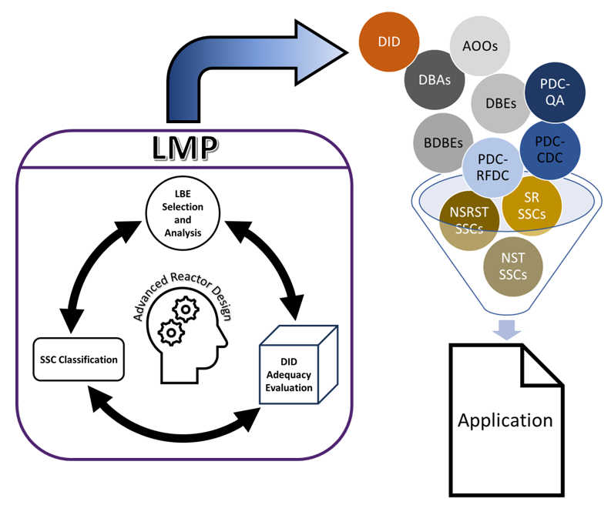
Advanced
Reactor
Content of
Application
Project
Technology-
Inclusive
Content of
Application
Project
Provides a standardized process that promotes uniformity among non-LWR applications and accommodates the flexibility of the LMP methodology
Applicable to LMP-based applications submitted under 10 CFR Parts 50 and 52
For more information, visit https://www.nrc.gov/reactors/new-reactors/advanced/modernizing/guidance/advanced-reactor-content-of-application-project.html

Slide 11
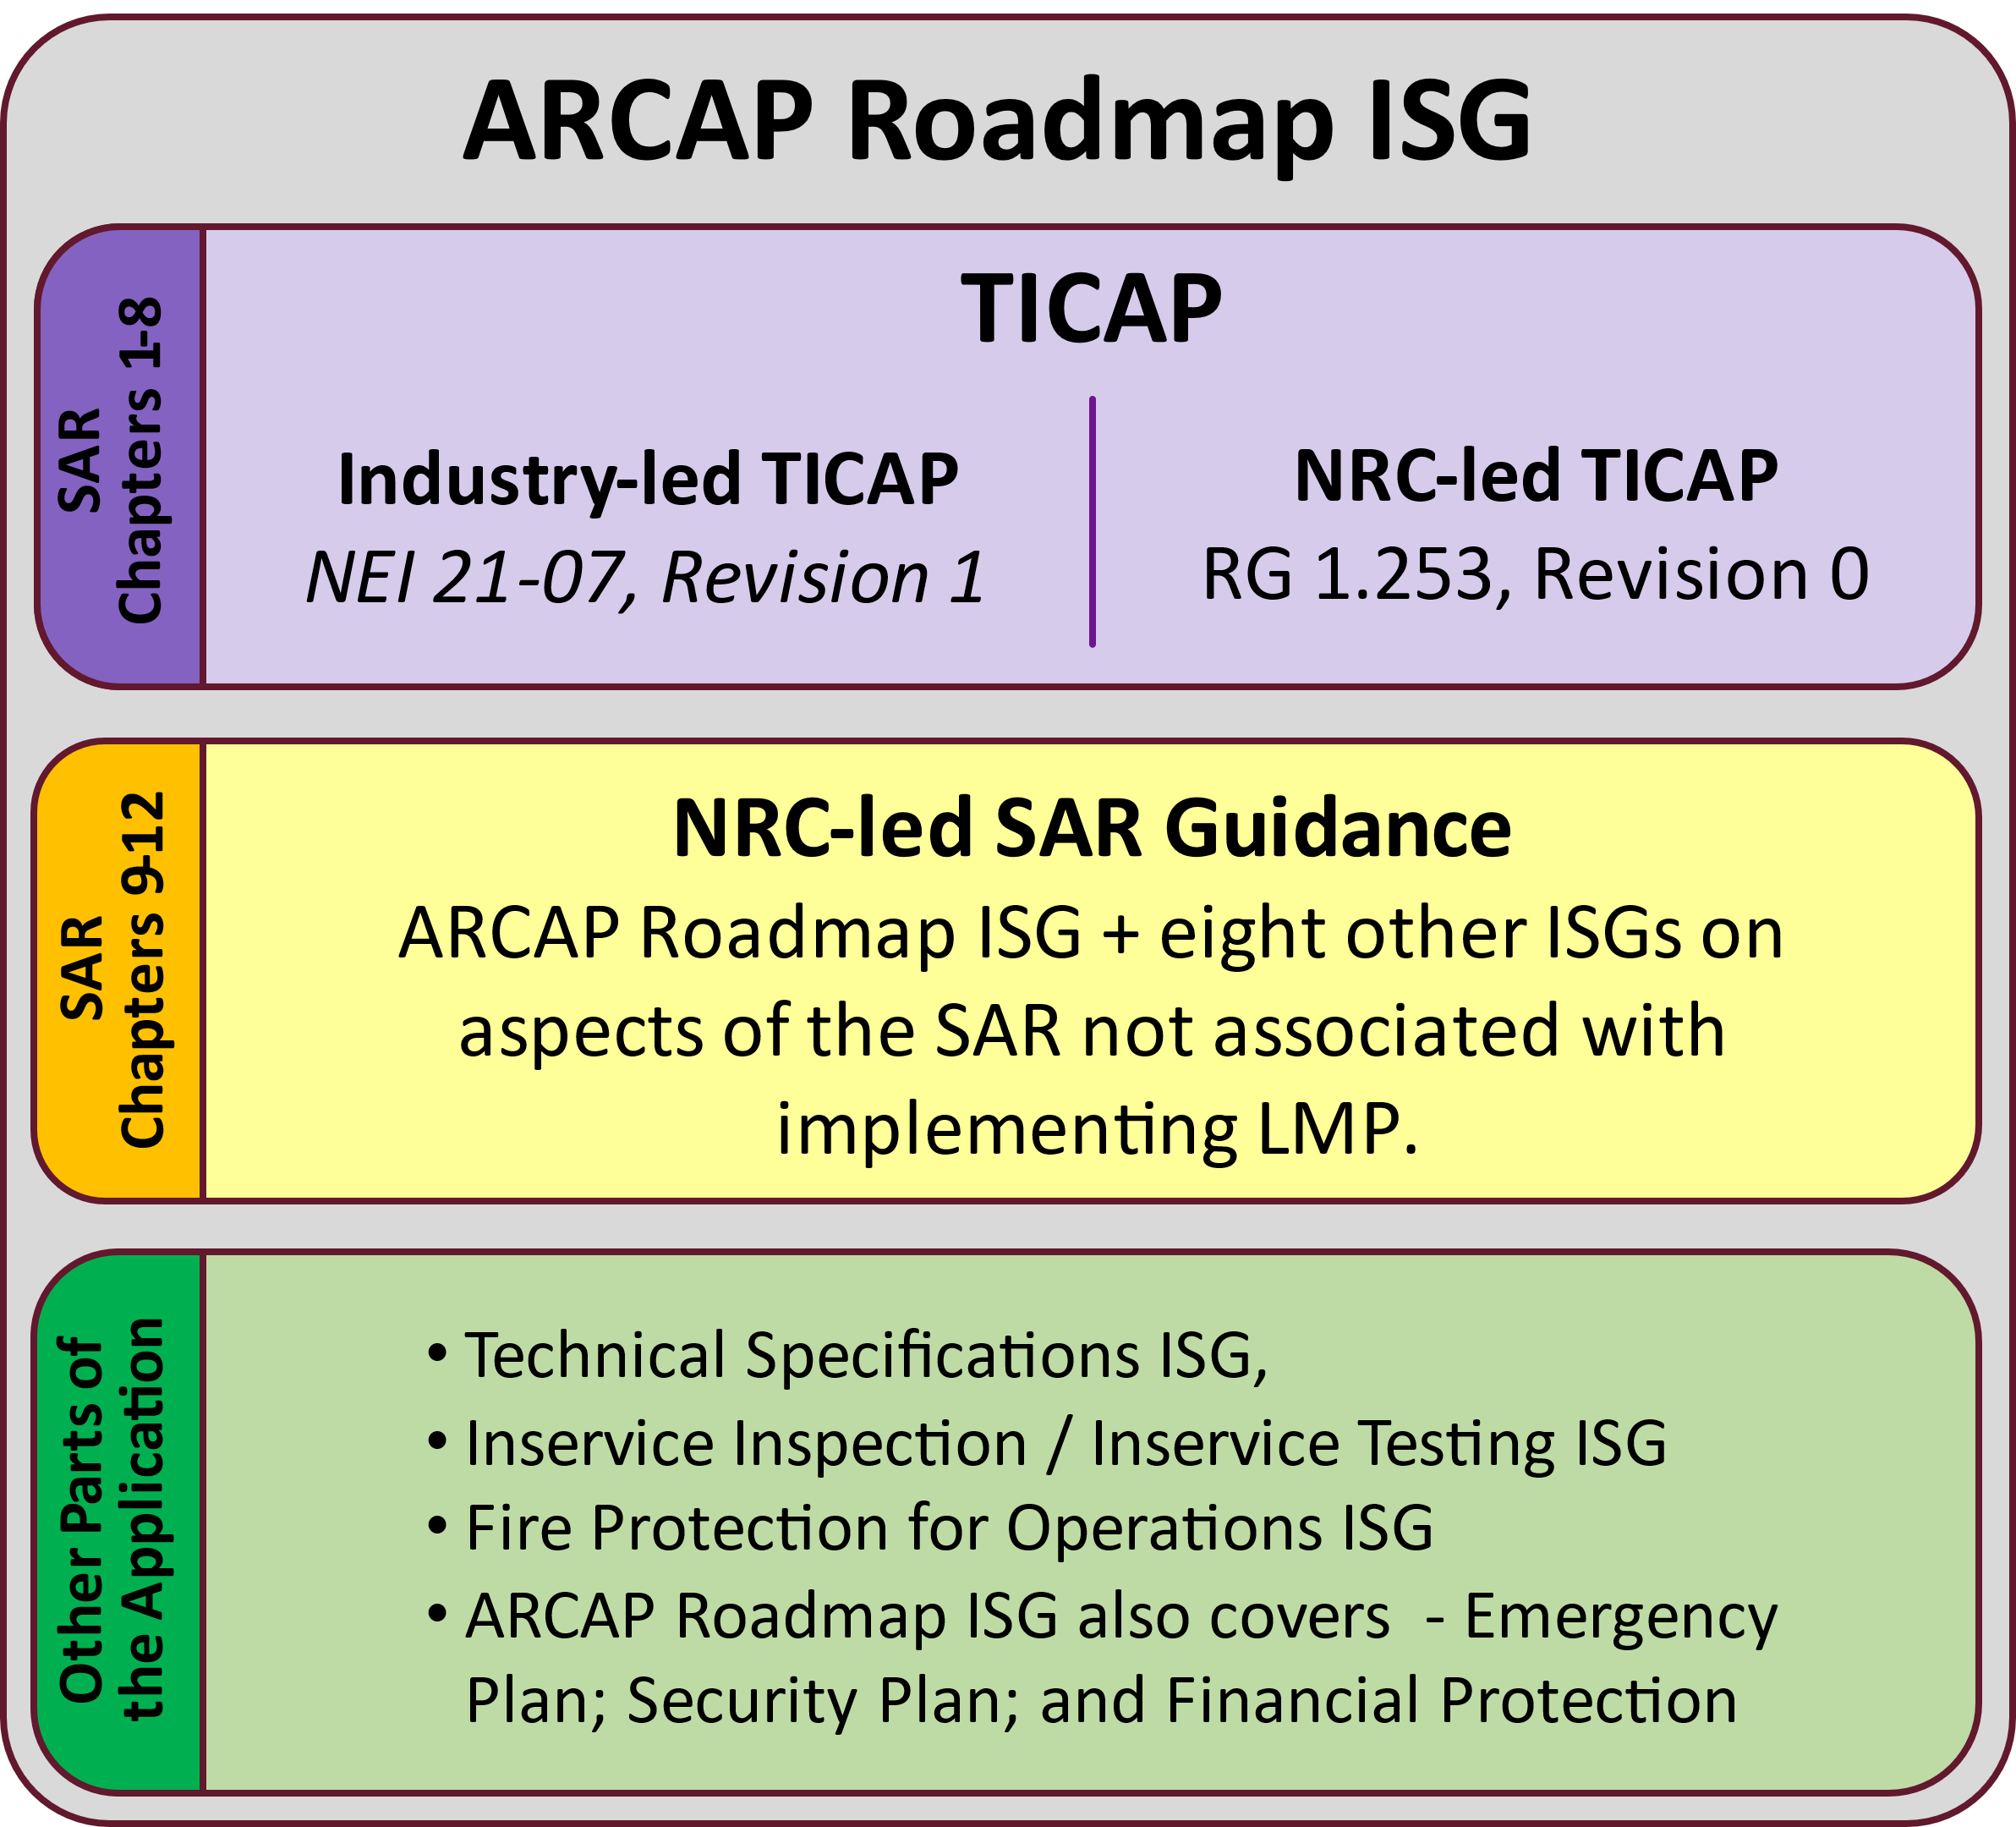
ARCAP-TICAP Relationship
ARCAP and TICAP are complementary
The ARCAP Roadmap ISG is overarching guidance for an entire application:
  12-Chapter SAR format
  SAR Chapters 1 through 8 address off-normal facility operation
  SAR Chapters 9-12 and other parts of an application address normal operations and other aspect of the licensing basis
For more information, visit https://www.nrc.gov/reactors/new-reactors/advanced/modernizing/guidance/advanced-reactor-content-of-application-project.html

Slide 12
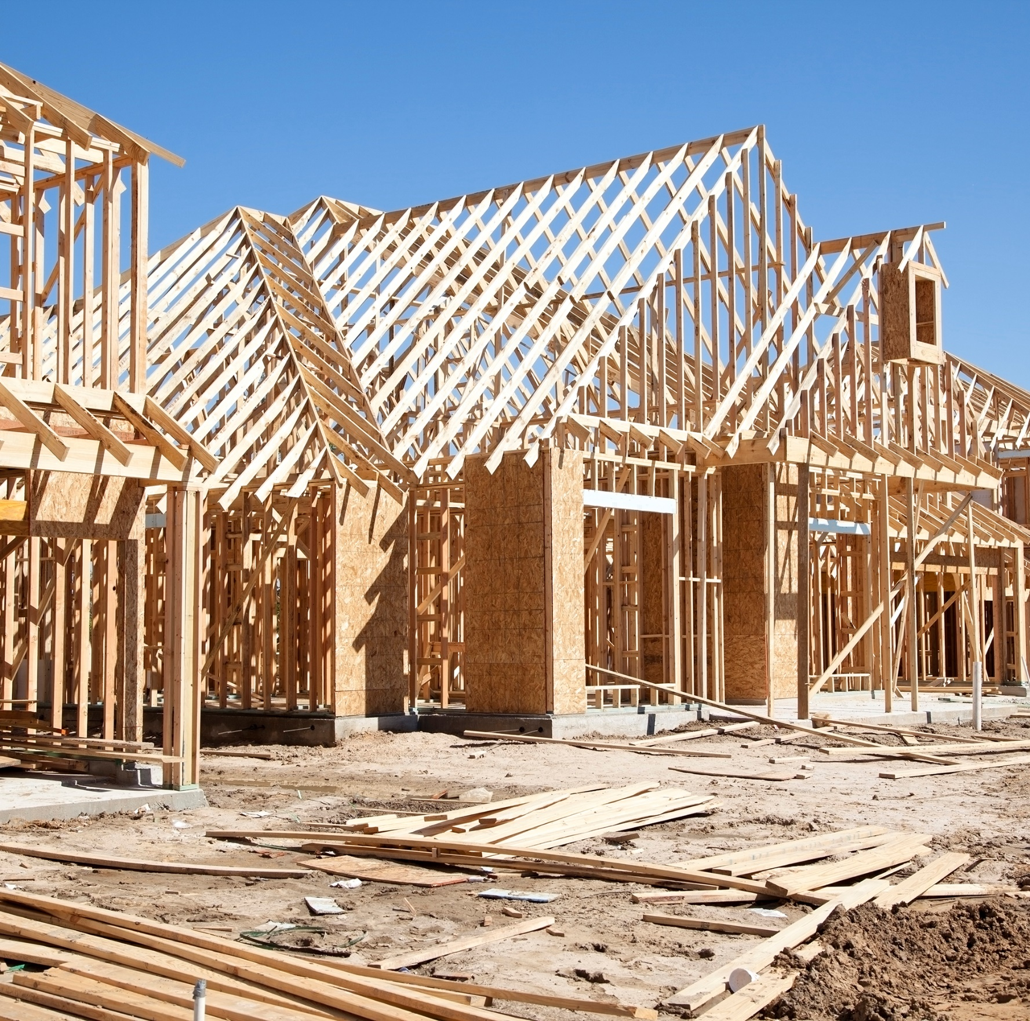
Part 53 Proposed Rule:
An Alternative, Technology-Inclusive Regulatory Framework

Slide 13
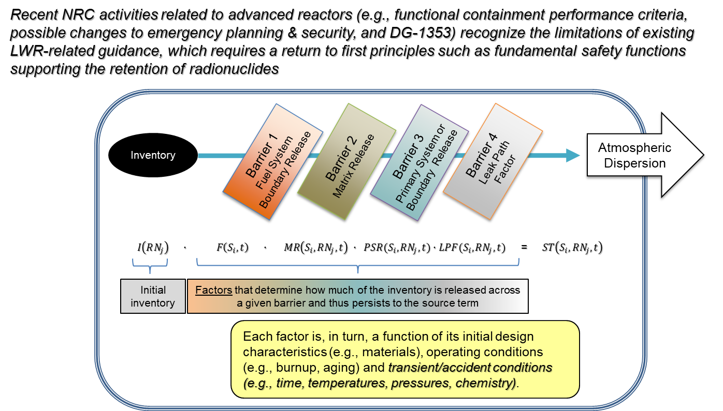
Part 53 Proposed Rule –
A Return to First Principles
See: SECY-18-0096, “Functional Containment Performance Criteria for Non-Light-Water-Reactors,” SECY-19-0117, “Technology-Inclusive .. Methodology to Inform the Licensing Basis..,” and INL/EXT-20-58717, “Technology-Inclusive Determination of Mechanistic Source Terms for Offsite Dose-Related Assessments for Advanced Nuclear Reactor Facilities”

Slide 14
Part 53 Proposed Rule –
General Attributes & Structure
Technology-Inclusive: Can be used for any new light-water reactor (e.g., small modular reactors) or non-light-water reactor technology
Risk-Informed: Requirements scaled to risk and consequences of the facility
Performance-Based: Establishes clear and objective criteria to assess performance
NEIMA due date for publishing
final rule is December 31, 2027
  Subpart A – General Provisions
  Subpart B – Safety Requirements
  Subpart C – Design and Analysis
  Subpart D – Siting
  Subpart E – Construction and Manufacturing
  Subpart F – Operations
  Subpart G – Decommissioning
  Subpart H – Licensing Processes
  Subpart I – License Maintenance
  Subpart J – Reporting
  Subpart M – Enforcement
List of Subparts

Slide 15
Part 53 Proposed Rule –
Foundations
Safety criteria for design-basis accidents (DBAs)
Safety criteria for licensing basis events (LBEs) other than DBAs
Safety functions
Normal operations
Protection of plant workers
Informed by key concepts of LMP:
  PRA-informed LBE selection and determining risk significance
  Safety classification of SSCs and Special Treatments
  Ensuring appropriate Defense in Depth
(B) Safety Criteria
What function(s) are needed to satisfy safety criteria (e.g., a barrier, cooling)?
(B) Safety Functions
What design features are provided to fulfill the safety function(s) (e.g., structures, systems, components)?
(C) Design Features
(and Human Actions)
What design criteria
are needed for design feature (e.g., leak rate, cooling capacity)?
(C) Functional Design Criteria
(Personnel; Concept of Operations)

Slide 16

A Look to the Future…
Ongoing license application reviews for advanced non-LWRs and LWRs
Ongoing interactions with designers and prospective applicants, including Advanced Reactor Demonstration Project Awardees
Many related activities are underway to support licensing and regulation of advanced reactors, such as:
  developing computer codes and analytical tools
  Generic Environmental Impact Statement (GEIS)
  guidance on fuel qualification
  ASME Section III Division 5 Standard (high temperature materials)
  ASME/ANS RA-S-1.4–2021, “Probabilistic Risk Assessment Standard for Advanced Non-Light Water Reactor Nuclear Power Plants” endorsed by RG 1.247
  coordinating with fuel cycle programs – high-assay low-enriched uranium (HALEU)
  revising requirements related to security and emergency planning
  international coordination
  developing approach for commercial fusion energy systems

Slide 18
Initialisms and Abbreviations
ACRS Advisory Committee on Reactor Safeguards
ADAMS Agencywide Document Accession and Management System
AOO abnormal operating occurrence
ARCAP Advanced Reactor Content of Applications
BDBE beyond design-basis event
CFR Code of Federal Regulations
DBA design-basis accident
DBE design-basis event
DG draft regulatory guide
DID defense in depth
EAB exclusion area boundary
EPA Environmental Protection Agency
F-C frequency-consequence
IEFR individual early fatality risk
ILCFR individual latent cancer fatality risk
ISG Interim Staff Guidance
LBE licensing basis event
LMP Licensing Modernization Project
NEI Nuclear Energy Institute
non-LWR non-light-water reactor
NRC Nuclear Regulatory Commission
NSRST non-safety-related with special treatments
NST non-safety-related with no special treatments
PAG protective action guidelines
PDC-CDC principal design criteria, complementary design criteria
PDC-QA principal design criteria, quality assurance
PDC-RFDC principal design criteria, required functional design criteria
PRA probabilistic risk assessment
QHO quantitative health objective
REM roentgen-equivalent man
RG Regulatory Guide
SAMDA severe accident mitigation design alternative
SAR safety analysis report
SR safety-related
SSC structure, system, and component
TICAP Technology-Inclusive Content of Application Project

