Slide 1
RASCAL Training
Unit 2 – Models Overview
RAMP 2024 Users Meeting

Slide 2
Unit 2 Outline
Discussion of all the RASCAL models
  What they are, how to use them, and when to use them
  Specific model details not covered today, see NUREG 1940
    Questions on technical details can be covered on Day 4
Source Term Models
  NPP
  Spent Fuel
  Fuel Cycle
  Materials
Atmospheric Models
Dose Models
  Not covered today, as there are no user settable parameters (except dose coeff)
Break in the middle of the session

Slide 3
Source Term to Dose processes
You’ve likely seen this graphic or concept before, but today we are going to focus on models in each part.
Atmospheric Models
Source
Term
Models
Dose Models

Slide 4
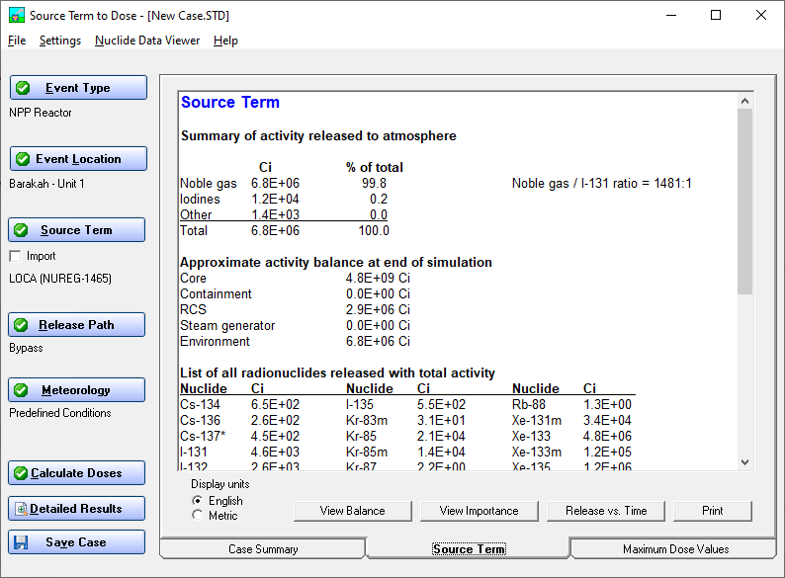
Generic Model Descriptions
INPUTS
OUTPUTS
Inventory
Release Fractions
Reductions
SOURCE TERM MODELS
x
Atmospheric Source Term
→
→
x
Atmospheric
Source Term
Weather
Concentrations
&
Depositions
→
ATD
MODELS
→
&
Concentrations /
Depositions
DOSE
MODELS
→
→
Dose Projections
&
Dose Coefficients
Notes:
Mention ORIGEN run and ANSI 18.1 for inventory

Slide 5
Generic Model Descriptions
INPUTS
OUTPUTS
Inventory
Release Fractions
Reductions
SOURCE TERM MODELS
x
Atmospheric Source Term
→
→
x
Atmospheric
Source Term
Weather
Concentrations
&
Depositions
→
ATD
MODELS
→
&
Concentrations
Deposition
DOSE
MODELS
→
→
Dose Projections
&
Dose Coefficients
Notes:
Mention ORIGEN run and ANSI 18.1 for inventory

Slide 6
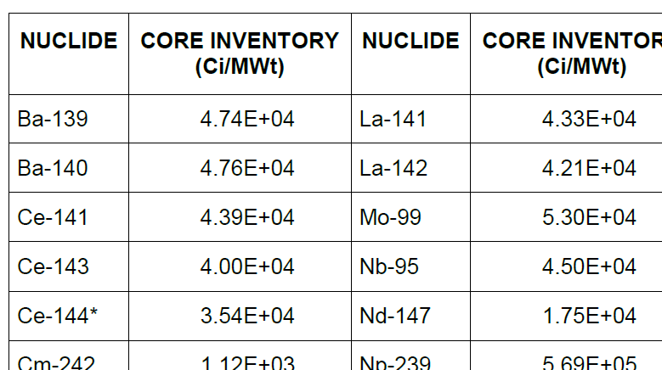
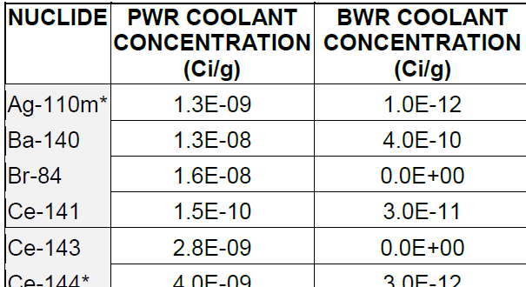
Inventory used in calculations
Inventory x Release Fractions x Reductions x Leakage or Flow = Atmospheric Source Term
Nuclear Power Plant
  Core inventory (scaled by power/burnup)
  Coolant inventory
Spent Fuel
  Core inventory from above (scaled to material at risk)
Fuel Cycle & Other Materials
  Define material at risk
NUREG 1940 Tables 1-1 and 1-2

Slide 7
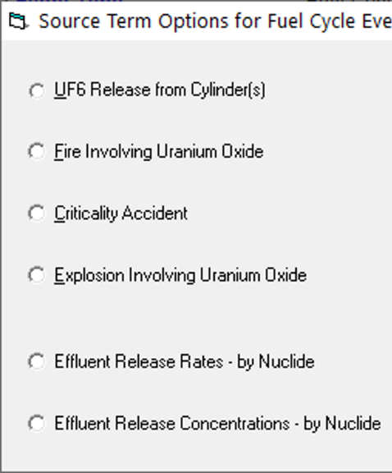
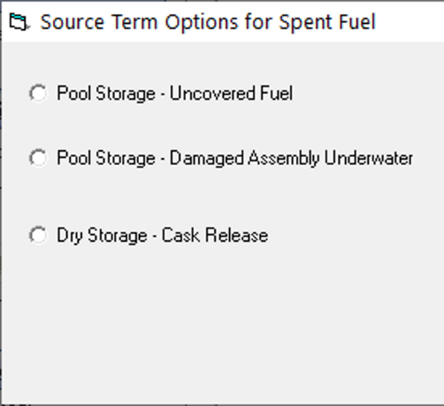
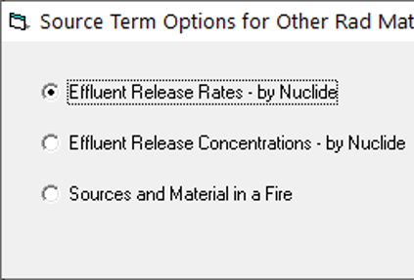
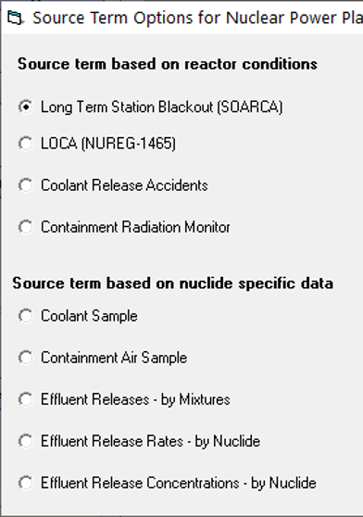
Source Terms
Source term models calculate material that can be released
Pick the best model; may have multiple options
Available choices depend on Event Type
Nuclear Power Plant
Spent Fuel
Fuel Cycle
Other Materials
Notes:
Here is where we select which model RASCAL will use to calculate how much material can be released
We will need to pick the best model based on the information we have, and there may be multiple options
Remember we told you that these models depend on which event type was selected

Slide 8
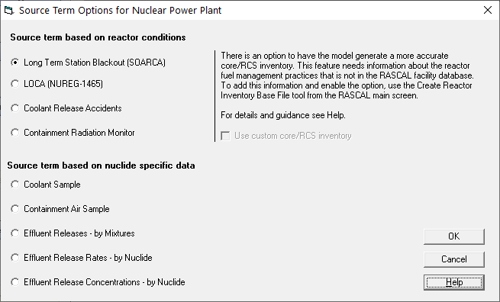
Nuclear Power Plant
RASCAL has 9 nuclear power plant source term options:
4 based on reactor condition models
5 based on nuclide measurements
This source term screen can be seen when you:
Select Event Type, set to Nuclear Power Plant
Select Event Location, select any NPP location
Select Source Term

Slide 9
Nuclear Power Plant → Long-Term Station Blackout
In an LTSBO, a facility will lose all offsite and onsite AC power. Cooling is initially maintained using diesel generators and batteries. However, after these are exhausted, water in the core will start to heat and eventually boil. After the core is fully uncovered, fission products begin to release.
Use this for LTSBO (and Short-Term Station Black Out) scenarios where RASCAL can help determine when the core may be uncovered

Slide 10
Nuclear Power Plant → Long Term Station Blackout
How this model works in RASCAL:
Based on the State-of-the-Art Reactor Consequence Analysis (SOARCA) reports.
Time of Core Damage = Shutdown Time + Cooling + Heatup
  Models determine when core becomes uncovered
  Cooling delays time of core damage; requires diesels or batteries
  Models automatically add heatup time
    8 hours for PWRs, 6 hours for BWRs

Slide 11
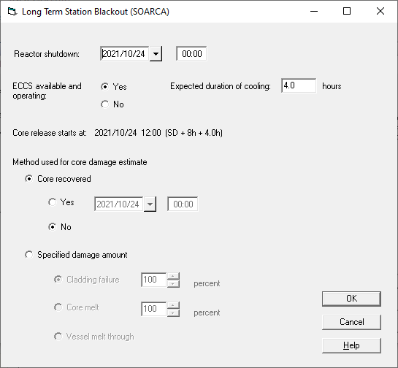
Nuclear Power Plant → Long Term Station Blackout
Shutdown time
  Used to decay correct all the isotopes in the core
Cooling
  Set duration of cooling if available
Reactor recovery time
  Used to stop additional nuclides from contributing to the source term

Slide 12


Your Turn to Use RASCAL
Given the scenario excerpt below, run the entire case in RASCAL.
Location: Arkansas - Unit 1
Source Term: LTSBO
Reactor shutdown at 1000. Batteries and diesels initially provided power but became incapacitated 11 hours later. Power is restored (and core recovered) at 1000 the next day.
Release Path: Defaults (Containment, 10m height, Design leak rate, Sprays off)
Weather: Predefined -> Standard Met
Settings: ICRP 26/30
Notes:
Give 5-10 min to complete problem. Next slide is walkthrough to catch up anyone who may need help.

Slide 13

Let’s walk through the problem together

Slide 14

Knowledge Check
Given the models in RASCAL, at what time does the core heat up to the point of damage/release?
  1500
  2100
  0500 next day
  1000 next day

Slide 15
Knowledge Check
T or F, the LTSBO model is appropriate anytime there is a loss of offsite power?
  True
  False
A loss of offsite power does not necessarily result in a station blackout, and RASCAL may not be needed at all. The LTSBO model should be used for station blackouts where it is projected that operators cannot keep the core cool.

Slide 16
Nuclear Power Plant → Loss of Coolant Accident (LOCA)
Large loss of reactor coolant, leads to core uncovery and fuel melt
Use for core damage accidents
  Similar release fractions to LTSBO events

Slide 17
Nuclear Power Plant → Loss of Coolant Accident (LOCA)
How this model works in RASCAL:
Based on NUREG-1465
Assumes that a core not covered by water is unable to remove enough heat and starts to heat to the point of fuel melt.
After the reactor is uncovered, the model will release fractions of the core inventory based on these phases:
30 minutes of cladding failure/gap release
80-90 minutes of core melt
2-3 hours of vessel melt-through

Slide 18
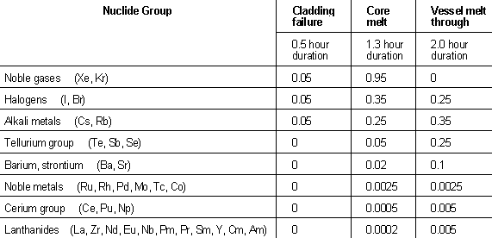
Nuclear Power Plant → Loss of Coolant Accident (LOCA)
Inventory x Release Fractions x Reductions x Leakage or Flow = Atmospheric Source Term

Slide 19
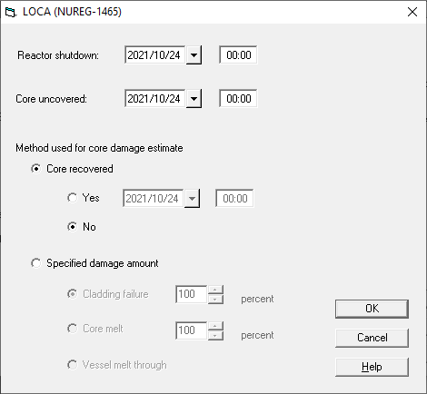
Nuclear Power Plant → Loss of Coolant Accident (LOCA)
Shutdown time
  Used to decay correct all the isotopes in the core
Core uncovered time
  Used to start the timing sequences in NUREG 1465
Reactor recovery time
  Used to stop additional nuclides from contributing to the source term

Slide 20
Your Turn to Use RASCAL
Given the scenario excerpt below, run the entire case in RASCAL.
Location: Arkansas - Unit 1
Source Term: LOCA
Reactor shutdown at 1000. Core uncovered at 0500 next day. Core recovered 5 hours later.
Release Path: Defaults (Containment, 10m height, Design leak rate, Sprays off)
Weather: Predefined -> Standard Met
Settings: ICRP 26/30
Notes:
Give 5-10 min to complete problem. Next slide is walkthrough to catch up anyone who may need help.

Slide 21
Let’s walk through the problem together
*Given similar timelines, did anyone notice dose/source term differences between LOCA and LTSBO models?

Slide 22
Knowledge Check
A NPP utility reports a major loss of coolant due to an earthquake, which also causes a loss of offsite power. Which source term model would be best to use?
  LTSBO
  LOCA
We would expect the core to become uncovered (and damaged) sooner due to water loss than due to heatup associated with a blackout.

Slide 23
Nuclear Power Plant → Coolant Release Accidents
Loss of reactor coolant where only coolant is released, no core melt expected
Very small releases
Use this when no fuel melt is expected

Slide 24
Nuclear Power Plant → Coolant Release Accidents
How this model works in RASCAL:
All reactor system pipe breaks can be modeled 2 ways depending on volume of coolant leak:
  LOCA (large or unrecoverable break, core melt)
  Coolant Release (smaller break, no core melt)
For coolant release models (simple SGTRs or small bypass LOCAs with no degrading conditions):
  Database has information about nuclides that would be in normal coolant
  Coolant spiking

Slide 25
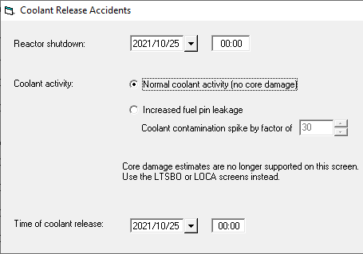
Nuclear Power Plant → Coolant Release Accidents
Shutdown time
  Used to decay correct all the isotopes in the core
Coolant Activity
  Pin leakage increases concentration of certain isotopes
Time of coolant release

Slide 26
Your Turn to Use RASCAL
Given the scenario excerpt below, run the entire case in RASCAL.
Location: Arkansas - Unit 1
Source Term: Coolant Release
Steam Generator Tube Rupture and immediate reactor trip at 00:36. No indications of spiked coolant.
Release Path: Defaults (SGTR, 10m height, Default SGTR table values)
Weather: Predefined -> Standard Met
Settings: ICRP 26/30
Notes:
Give 5-10 min to complete problem. Next slide is walkthrough to catch up anyone who may need help.

Slide 27
Let’s walk through the problem together
*How big is this release compared to our previous LOCA and LTSBO runs?

Slide 28
Knowledge Check
NPP operators report that there is a loss of coolant. What model would you use?
  LOCA
  Coolant Release
It depends.
If operators can add enough water to keep the core covered, then the accident will only include coolant water (Coolant Release model).
If operators are unable to keep the core covered, then the accident will include core damage (LOCA model).
If an accident progresses from Coolant Release to LOCA, we recommend ignoring the Coolant Release portion, as this is significantly smaller than any LOCA source term.

Slide 29
Nuclear Power Plant → Containment Radiation Monitor
Estimates core damage based on containment rad monitor
Use this when no additional data is available or as a backup method

Slide 30
Nuclear Power Plant → Containment Radiation Monitor
How this model works in RASCAL:
One or more instruments inside containment used to continuously survey the containment volume for radiation (generally R/h)
The model uses these tables to convert the reading into a damage amount. 2 additional factors are considered
  Time since reactor shutdown
  Whether sprays are on or off.

Slide 31
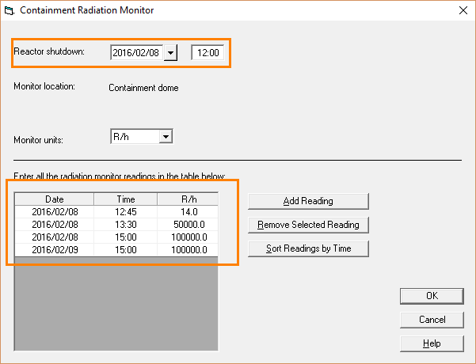
Nuclear Power Plant → Containment Radiation Monitor
The only entries required are the shutdown time and the actual rad monitor readings.
This model is not predictive and persists damage amounts until it reaches a new entry.

Slide 32
Nuclear Power Plant → Coolant or Containment Air Sample
User inputs entire source term by nuclide
RASCAL does not extrapolate source term from subset of nuclides
Not expected to have data during event

Slide 33
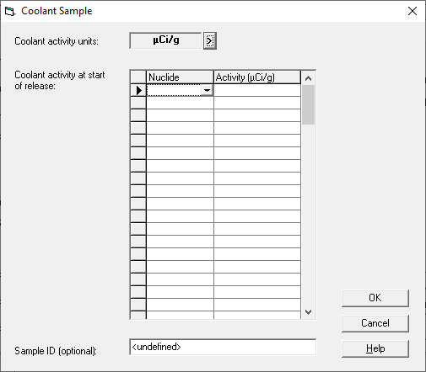
Nuclear Power Plant → Coolant or Containment Air Sample
Activity Units
Nuclide and Associated Activities
Does not allow for changes with time

Slide 34
Nuclear Power Plant → Effluent Releases - Mixtures
Monitored effluent pathways are useful indications but usually cannot identify specific radionuclides present
Effluent monitors provide detector count rates, which can be converted to release rates for noble gases, radioiodines, and sometimes particulates
Monitored releases will be filtered so they should be mostly noble gases but with a small proportion of iodines and particulates.

Slide 35
Nuclear Power Plant → Effluent Releases - Mixtures
How this model works in RASCAL:
RASCAL takes groupings of mixtures (NG, I, & P) and normalizes each nuclide within that mixtures according to reactor inventory. Example:
Core damage states are reflected in user inputs.
Usually requires coordination with utility calcs to convert from rates to activity/time.
Released Nuclides
1.1 Ci/s I-131
1.7 Ci/s I-132
2.3 Ci/s I-133
2.6 Ci/s I-134
2.3 Ci/s I-135
Input
10 Ci/s Total Iodines
→

Slide 36
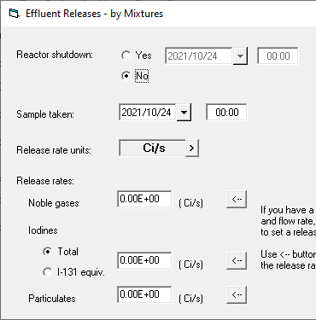
Nuclear Power Plant → Effluent Releases - Mixtures
Shutdown time
  Used to decay correct all the isotopes in the core
Sample Taken
Units
Release Rates
  Noble Gas
  Iodines
    Total vs I131 equivalent
  Particulates

Slide 37
Your Turn to Use RASCAL
Given the scenario excerpt below, run the entire case in RASCAL.
Location: Arkansas - Unit 1
Source Term: Effluent Releases – by Mixture
Shutdown at 15:50. 10 minutes later, release started and measured to be 950 Ci/s for noble gases, 12 Ci/s for iodine radioisotopes, and 0.3 Ci/s for particulates. Release lasted for 30 minutes.
Release Path: see above
Weather: Predefined -> Standard Met
Settings: ICRP 26/30
Notes:
Give 5-10 min to complete problem. Next slide is walkthrough to catch up anyone who may need help.

Slide 38
Let’s walk through the problem together

Slide 39
Knowledge Check
Plant data states that a monitored pathway detector is reading 100,000 cpm. How could you use this in RASCAL’s Effluent Releases – Mixture?
  Set NG, I, and P each to 33,000.
  Set NG to 100,000.
  Having already coordinated with NPP staff ahead of the accident, put in the corresponding activity rates using site-specific conversions.
  Use the LOCA, Coolant Release, or Containment Radiation Monitor models instead, depending on the accident conditions.

Slide 40
Nuclear Power Plant → Effluent Release Rates/Concentration
User inputs entire atmospheric source term by nuclide
RASCAL does not extrapolate source term from subset of nuclides
Can be used to manually define source term, including small/custom releases

Slide 41
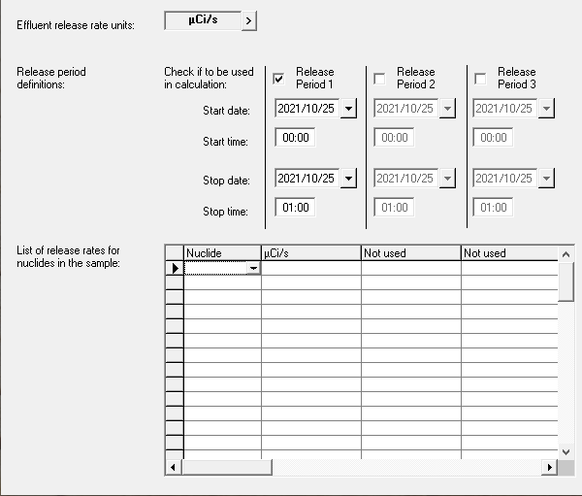
Nuclear Power Plant → Effluent Release Rates/Concentration
Units
Allows for Multiple Release Periods
  Up to 3
Start/Stop Time/Date
Nuclide and Associated Activity
Reminder, this defines the atmospheric source term (straight to atmosphere)

Slide 42
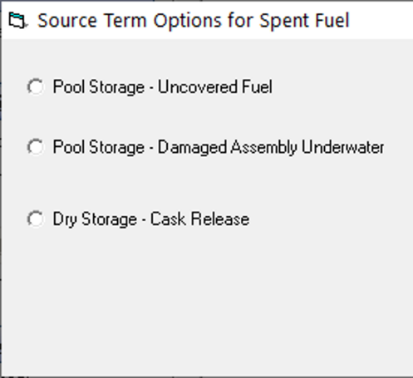
Source Terms
Source term models calculate material that can be released
Pick the best model; may have multiple options
Available choices depend on Event Type
Nuclear Power Plant
Spent Fuel
Fuel Cycle
Other Materials
Notes:
Here is where we select which model RASCAL will use to calculate how much material can be released
We will need to pick the best model based on the information we have, and there may be multiple options
Remember we told you that these models depend on which event type was selected

Slide 43
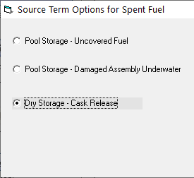
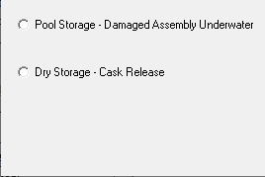
Spent Fuel
For Spent Fuel, RASCAL has 3 source term options
Includes both pool and dry storage
Sites are collocated with NPPs
This source term screen can be seen when you:
Select Event Type, set to Spent Fuel
Select Event Location, select any location
Select Source Term

Slide 44
Spent Fuel→ Pool - Uncovered Fuel
Models clad/zirconium fire for any fuel defined in the pool
Use this model when you expect to have a spent fuel fire, not if you need to determine whether there will be one

Slide 45
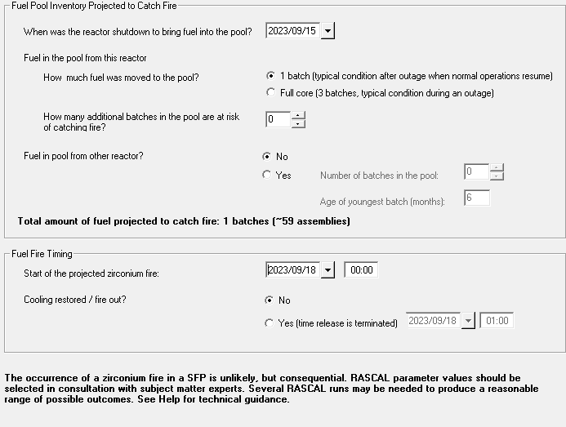
Spent Fuel→ Pool - Uncovered Fuel
Shutdown time
  Used to decay correct all the isotopes in the core
Inventory
  Can allow for core-offloads or shared pools
  Recommend only setting inventory to material at risk
Fire Start/Stop times

Slide 46
Knowledge Check
T or F, RASCAL will approximate when a spent fuel fire will start based on the last time that fuel was in the reactor?
  True
  False
HARD QUESTION! You just finished an assessment of a spent fuel fire in RASCAL. The fuel was last irradiated in the reactor 1 year ago, but still the thyroid dose PAGs were exceeded. Is Potassium Iodide (KI) recommended?
  Yes
  No
KI protects against thyroid cancer due to iodine uptake. While this accident would likely warrant some protective action, all the iodine has decayed away in the 1 year this fuel was in the pool. PAGs are exceeded due to thyroid dose from non-iodines.

Slide 47
Spent Fuel→ Pool - Damaged Underwater
Models cold gap releases from small amounts of fuel (e.g., several pins within an assembly)
Only releases gap activity isotopes and scrubbed by the pool
Very small releases
Use this for fuel handling accidents or mechanical fuel damage

Slide 48
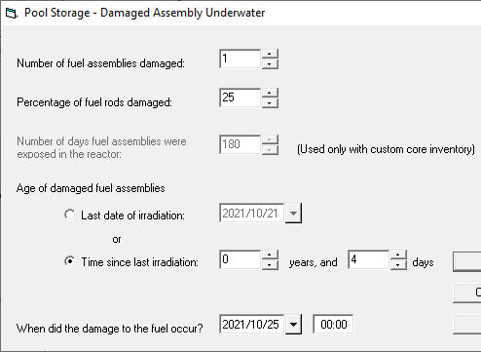
Spent Fuel→ Pool - Damaged Underwater
Inventory
  Number of assemblies and %
Age of assemblies
  Used to decay correct all the isotopes in the core
Damage time
  Starts the release

Slide 49
Spent Fuel→ Dry Storage - Cask Release
Models different damage types to dry cask storage of spent fuel
Expect small to no releases

Slide 50
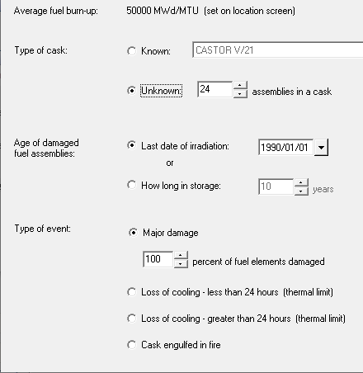
Spent Fuel→ Dry Storage - Cask Release
Cask Type
  Defines number of assemblies in cask
Age of assemblies
  Used to decay correct all the isotopes in the core
Damage type
  Sets release fractions and amounts
  Options 2 and 4 result in no release

Slide 51
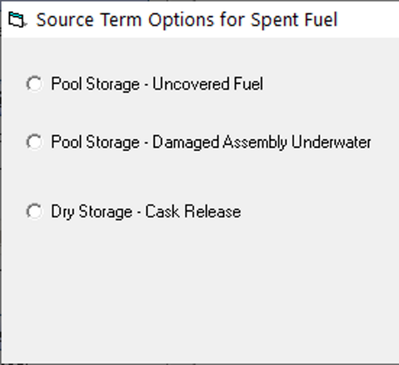
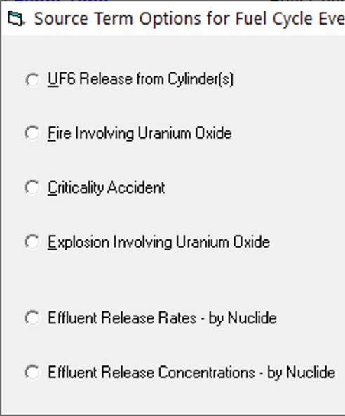
Source Terms
Source term models calculate material that can be released
Pick the best model; may have multiple options
Available choices depend on Event Type
Nuclear Power Plant
Spent Fuel
Fuel Cycle
Other Materials
Notes:
Here is where we select which model RASCAL will use to calculate how much material can be released
We will need to pick the best model based on the information we have, and there may be multiple options
Remember we told you that these models depend on which event type was selected

Slide 52
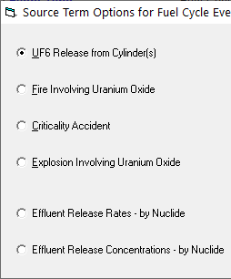
Fuel Cycle
RASCAL can model certain events from fuel fabrication facilities
For this section, we are only providing high-level model descriptions
  If you want additional information on fuel cycle models, stay after class and we can discuss
This source term screen can be seen when you:
Select Event Type, set to Fuel Cycle
Select Event Location, select any location
Select Source Term

Slide 53
Fuel Cycle → UF6 Release from Cylinder
Gaseous UF6 released
Special plume model with chemical conversion process
More chemically dangerous than radiological

Slide 54
Fuel Cycle → Fire or Explosion involving Uranium Oxide
Small amounts of material put into atmosphere from event
User inputs material at risk and release fractions / rates

Slide 55
Fuel Cycle → Criticality
Mainly focused on direct shine from criticality event
  Very small amount of activated material put into atmosphere

Slide 56
Fuel Cycle → Effluent Release Rates/Concentration
Identical to model we showed in NPP source terms

Slide 57
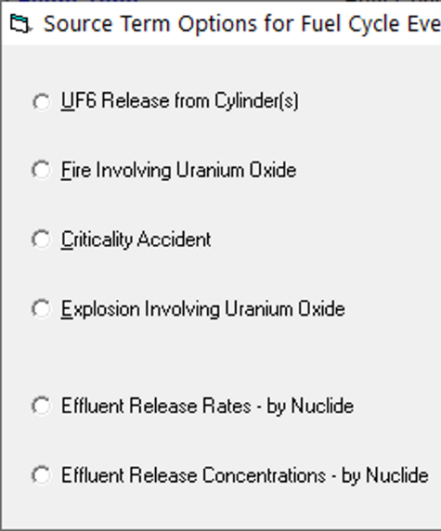
Source Terms
Source term models calculate material that can be released
Pick the best model; may have multiple options
Available choices depend on Event Type
Nuclear Power Plant
Spent Fuel
Fuel Cycle
Other Materials
Notes:
Here is where we select which model RASCAL will use to calculate how much material can be released
We will need to pick the best model based on the information we have, and there may be multiple options
Remember we told you that these models depend on which event type was selected

Slide 58
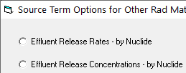
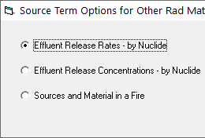
Other Materials
RASCAL also has 3 “other” materials options
Useful for modeling transportation accidents, lab accidents, etc.
All models still focus on atmospheric releases
  Liquid releases (like spills and leaks) are not modeled in RASCAL
This source term screen can be seen when you:
Select Event Type, set to Other Radioactive Materials
Select Event Location, select or define any location
Select Source Term

Slide 59
Other Materials → Effluent Release Rates/Concentration
Identical to model we showed in NPP source terms

Slide 60
Your Turn to Use RASCAL
Given the scenario excerpt below, run the entire case in RASCAL.
Event Type: Other Rad Matl Location: Advanced Medical Systems
Source Term: Effluent Releases Rates – by Nuclide
I-131 release from a building, estimated 10 Ci/min for 45 min
Release Path: see above
Weather: Predefined -> Standard Met
Settings: ICRP 26/30
Notes:
Give 5-10 min to complete problem. Next slide is walkthrough to catch up anyone who may need help.

Slide 61
Let’s walk through the problem together

Slide 62
Other Materials → Sources and Material in a Fire
Similar to effluent rates/concentrations, but you also need to input a release fraction
Release fraction guidance provided, but depends on material type (e.g., metal or volatile liquid)

Slide 63
Source Terms
Source term models calculate material that can be released
Pick the best model; may have multiple options
Available choices depend on Event Type
Nuclear Power Plant
Spent Fuel
Fuel Cycle
Other Materials
Notes:
Here is where we select which model RASCAL will use to calculate how much material can be released
We will need to pick the best model based on the information we have, and there may be multiple options
Remember we told you that these models depend on which event type was selected

Slide 64
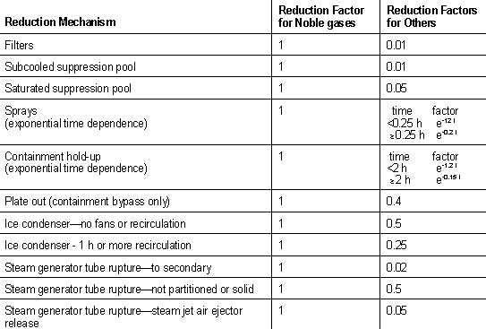
Release Path
Inventory x Release Fractions x Reductions x Leakage or Flow = Atmospheric Source Term
While our previous source term inputs define material that can be released, the release path determines what material enters the atmosphere
Reductions, release rates, leakage timing, etc.

Slide 65
Now We’ll look at Release Pathway
Pathway information is combined by the model with the source term details entered earlier to generate the atmospheric source term
RASCAL will only show pathways applicable to the defined source term type
For example
  Effluent release rates source terms are direct to atmosphere – no options to choose from
  LOCA source terms can release through containment leakage, steam generator, or containment bypass

Slide 66
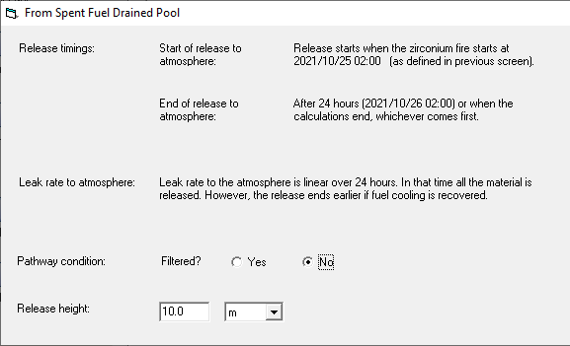
Release Path examples
Simple pathways

Slide 67
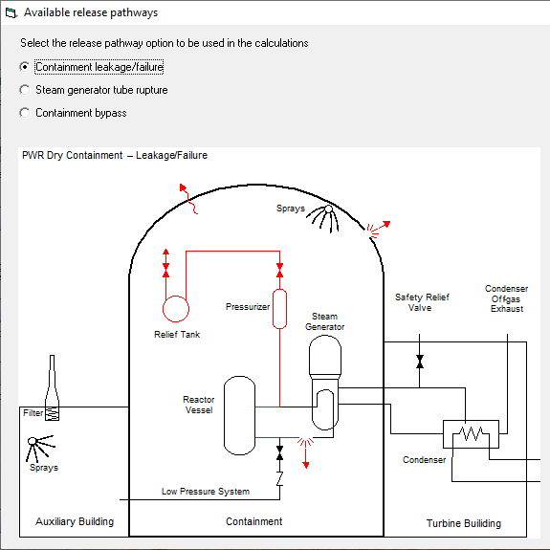
Release Path examples
PWR pathways

Slide 68
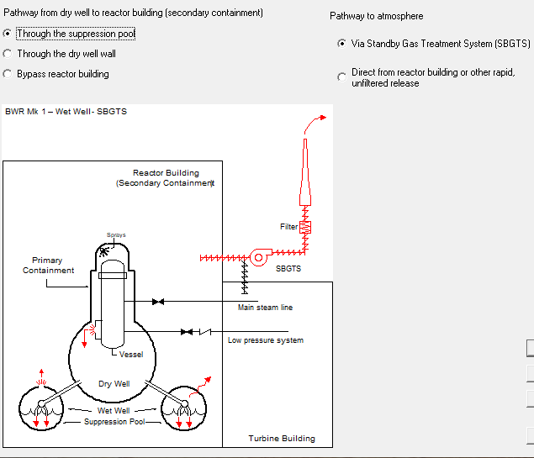
Release Path examples
BWR pathways

Slide 69
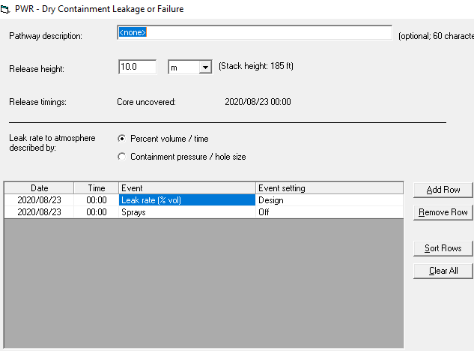
NPP release pathway screens have 3 main sections
Release height
Leak rate type
  Percent volume / time (e.g., 3%/hour)
  Containment pressure / hole size (e.g., 30 psi/2 cm²)
Release timeline
  Used for leak rate and additional conditions
  Need to review/set initial conditions, then can add rows as needed
Don’t copy this data. For discussion purposes only.

Slide 70
Release height
10 m minimum
Model scales winds to the release height
If there is a stack height in the facility database, the user interface echoes that value. However, if the release is via the stack you need to manually enter that number and set the units.
Do your best to characterize the release height but in many cases it will be unknown.
With elevated releases it takes some distance for the plume material to reach the ground. Thus, doses may be lower close to the release point and then increase with distance.
Notes:
NUREG-1940, Section 6.4.2

Slide 71
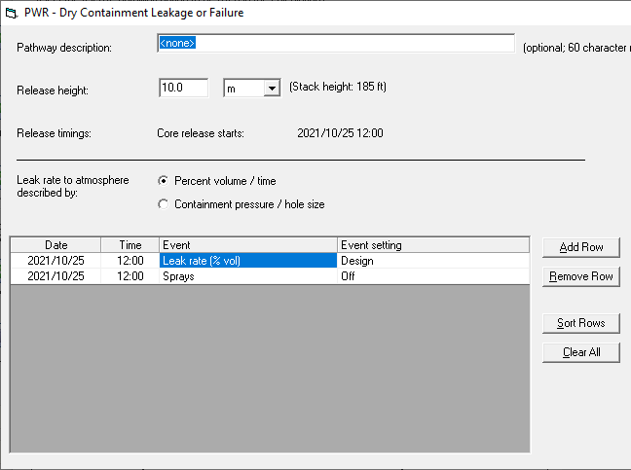
Release Path – Leak rate type
Percent volume / time (e.g., 3%/hour) or Containment pressure / hole size (e.g., 30 psi/2 cm²)
Design leak rate is the default initial value. Taken from FSAR.
Either type gets some initial conditions set that support the release start
Don’t copy this data. For discussion purposes only.

Slide 72
Release Path – Event timings
The initial set will show all the options available for the release pathway type
The initial conditions can be changed
Additional conditions can be added at later time to define time varying conditions
Don’t copy this data. For discussion purposes only.

Slide 73
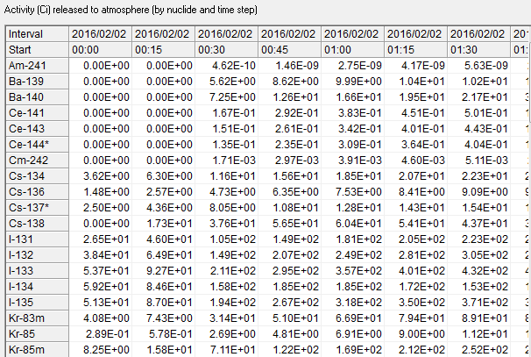
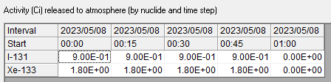
All Source Term & Release Path inputs -> Atmospheric Source Term
NPP Fuel Melt Source Term
2 isotope – 1 hour release

Slide 74
Generic Model Descriptions
INPUTS
OUTPUTS
Inventory
Release Fractions
Reductions
SOURCE TERM MODELS
x
Atmospheric Source Term
→
→
x
Atmospheric
Source Term
Weather
Concentrations
&
Depositions
→
ATD
MODELS
→
&
Concentrations
Deposition
DOSE
MODELS
→
→
Dose Projections
&
Dose Coefficients
Notes:
Mention ORIGEN run and ANSI 18.1 for inventory

Slide 75
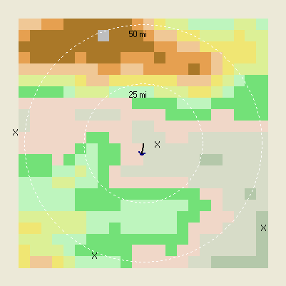
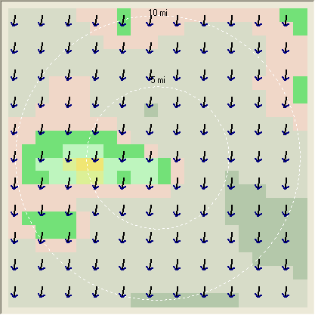
The meteorological data you enter for specific locations and times is processed to create a time series of gridded wind fields.
Points to gridded field
Times to 15 min steps

Slide 76
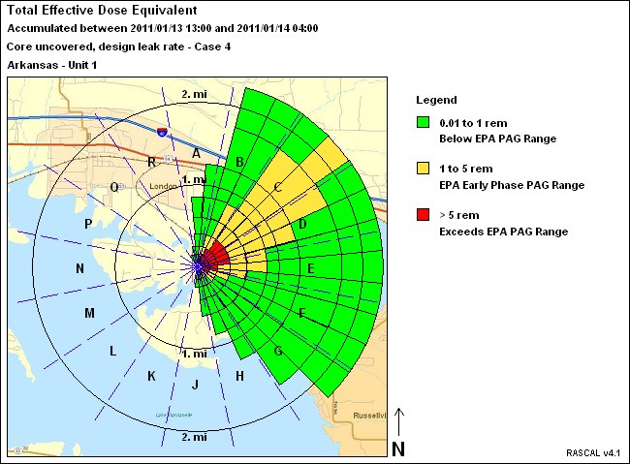
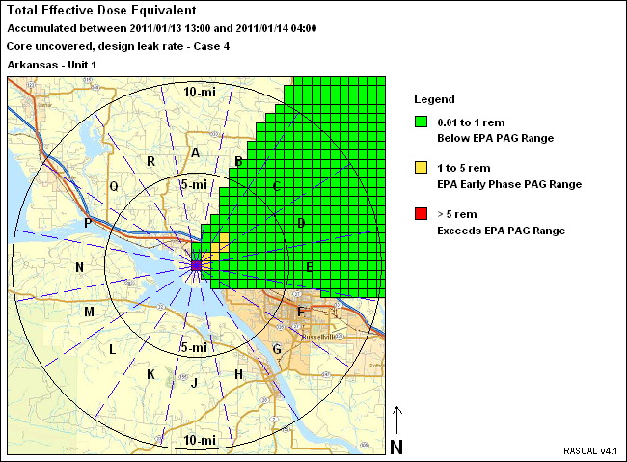
Two transport, diffusion, dose models are used in the STDose calculations
Plume Model
Puff Model

Slide 77
Plume vs Puff model comparison
 | Plume | Puff
What it is called in the UI | Close-in (~20% of puff) | To 10, 25, 50, 100-miles
Grid shape | Polar every 10 degrees With 8 concentric rings | Cartesian 41x41 with fixed distances
Always has a centerline | Yes, code rounds as needed to nearest 10 degrees | No
Wind data accounts for topography | No | Yes
Decay and ingrowth | Yes | Yes
Dry and wet deposition | Yes | Yes
Accounts for transit time | No (except when calm) | Yes
Useful to compare dose rates | No (steady state model) | Yes

Slide 78
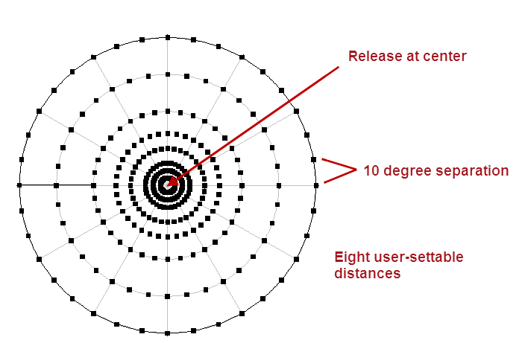
A straight-line Gaussian plume model on a polar grid is used to model distances close to the release point

Slide 79
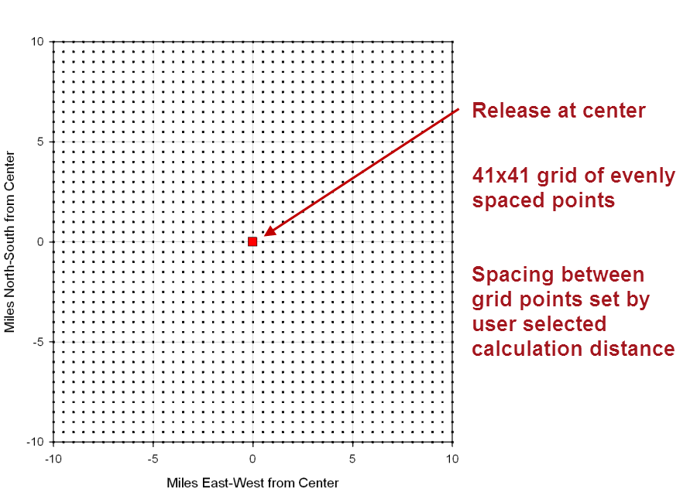
A puff model on a Cartesian grid is used to model at longer distances

Slide 80
A sequence of discrete puffs is used to model the plume
Puff centers move with the wind.
Puffs grow larger as time passes.
Each puff represents 5 minutes of release. That is, 12 puffs would be released each hour of the release.

Slide 81

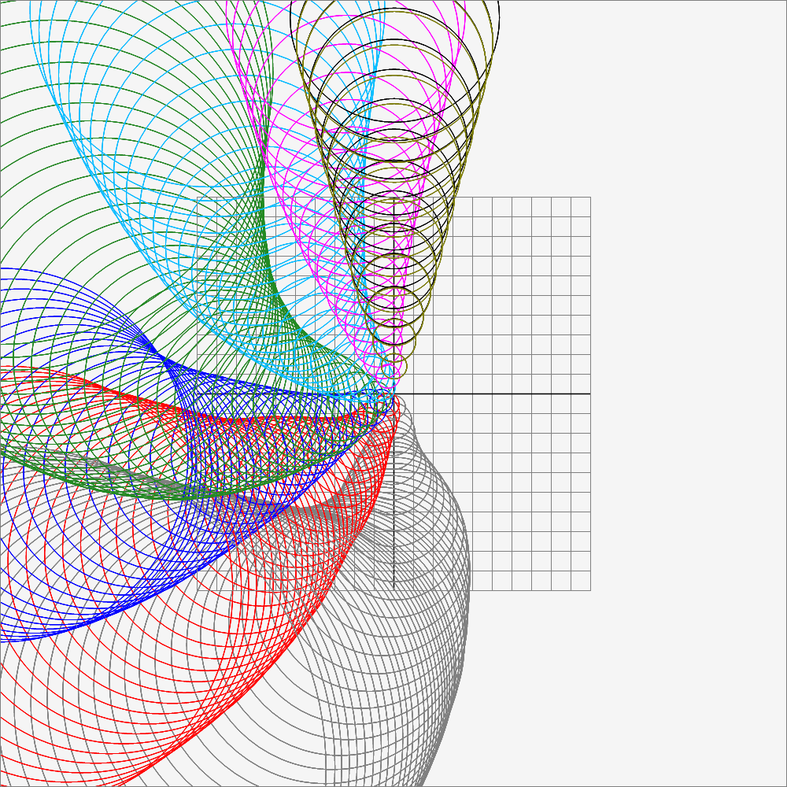
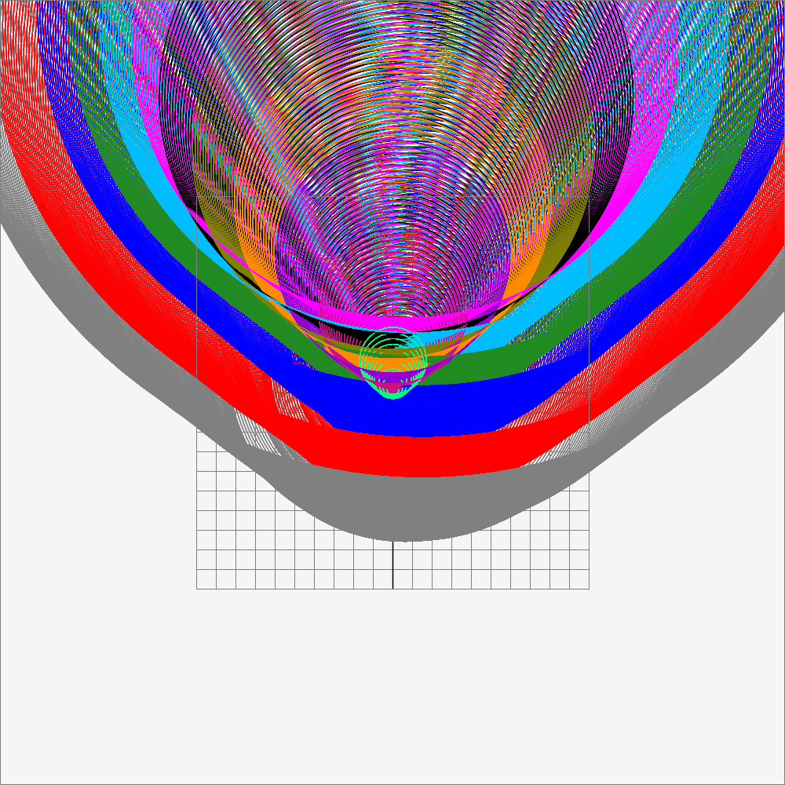
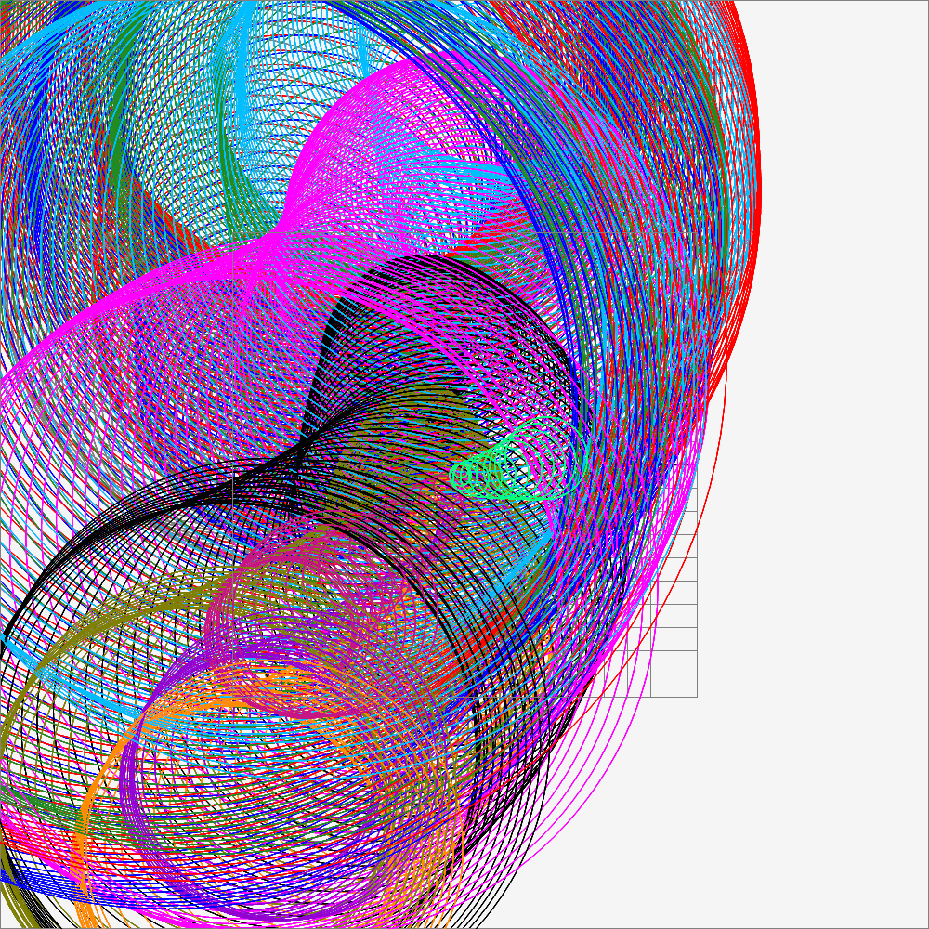
Visualizing puff movement and growth
Single Puff,
Simple Winds
Multiple puffs,
varying winds
Multiple Puffs,
Calm Winds
Multiple Puffs,
Actual Weather
Puff Visualization Videos

Slide 82
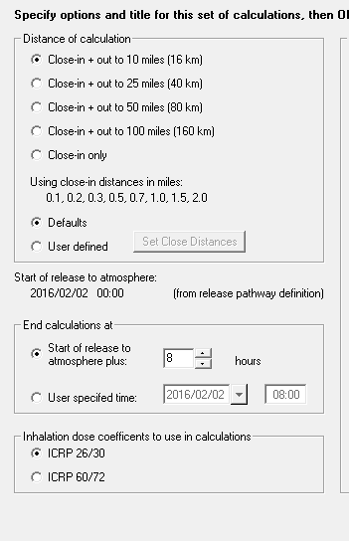
Atmospheric Models also need a few additional parameters
In the Calculation Settings:
  Calculation Distance
    Start with shorter distances; they provide higher resolution
  Calculation Duration
    Must be long enough to account for plume travel time

Slide 83
Generic Model Descriptions
INPUTS
OUTPUTS
Inventory
Release Fractions
Reductions
SOURCE TERM MODELS
x
Atmospheric Source Term
→
→
x
Atmospheric
Source Term
Weather
Concentrations
&
Depositions
→
ATD
MODELS
→
&
Concentrations
Deposition
DOSE
MODELS
→
→
Dose Projections
&
Dose Coefficients

Slide 84
Dose Models only take 1 user input
In the Calculation Settings there are options for the dose coefficients to be used by dose models:
    ICRP 23/30 or IRCP 60/72

Slide 85
Dose model details
Based on ICRP methods
  TEDE = cloudshine + inhalation + 4-day groundshine
  Reference man standing outside unshielded for 4 days
  Remainder of RASCAL calc duration counts out to 4 days
    No difference in results if plume has already passed
PAG assumptions
  Avoidable dose
Intermediate phase based on projected ground deposition
  If you have field measurement data, use that instead
RASCAL does not account for background

Slide 86
Set calculation duration to allow for trailing plume edge to reach set distance
Trailing edge, released at t=8.
Leading Edge, released at t=0.
10 mi
Wind speed determines when trailing edge reaches 10 miles
10 mi
Notes:
Review

Slide 87
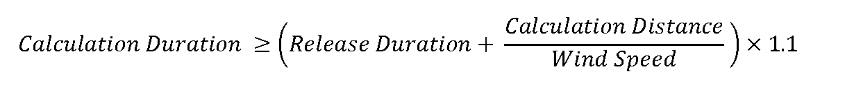
There is a rule-of-thumb for estimating the calculation duration
Calculation Distance
“Release Duration”
10 mi
For a 7.5 hour release with 2 mph winds, calculate a duration for a 10 mile grid.
7.5 hours + (10 miles / 2 mph) = 12.5 hours
Add 10% to get 13.75, then round up to the nearest hour (14)
Notes:
Review

Slide 88
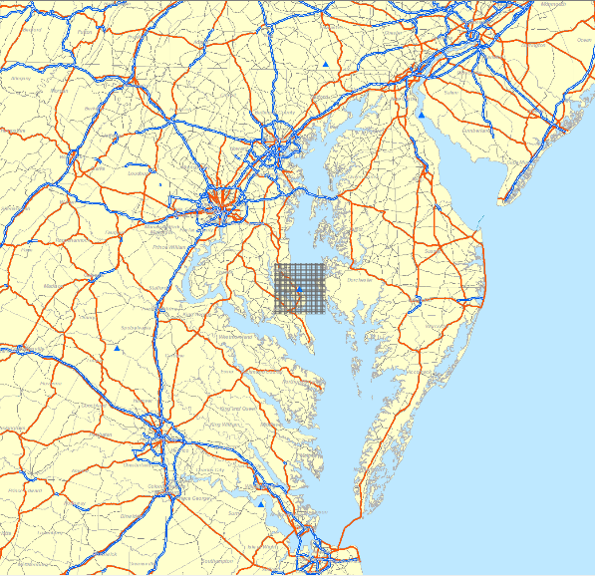
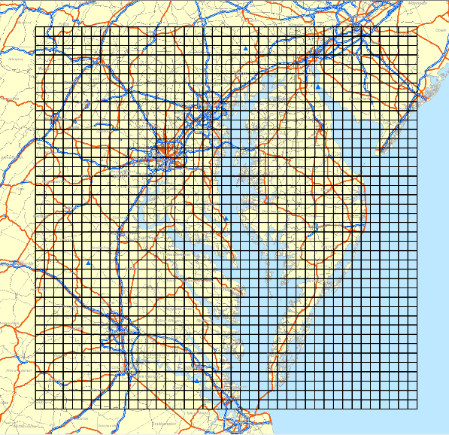
Review - Closer calc distances provide better resolution if you don’t need to see further out
10 mile grid – cells are .5 mile wide
100 mile grid – cells are 5 miles wide

Slide 89
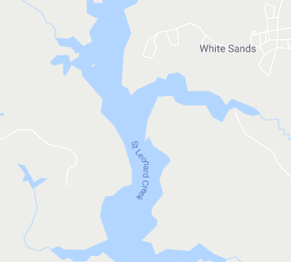
Let’s look a bit closer at one of these cells
Results calculated for cell center point
May not be exactly the value near the cell edge
Could be up to 5 miles wide

Slide 90
Generic Model Descriptions
INPUTS
OUTPUTS
Inventory
Release Fractions
Reductions
SOURCE TERM MODELS
x
Atmospheric Source Term
→
→
x
Atmospheric
Source Term
Weather
Concentrations
&
Depositions
→
ATD
MODELS
→
&
Concentrations
Deposition
DOSE
MODELS
→
→
Dose Projections
&
Dose Coefficients

Slide 91
This concludes our Models Overview unit
Remember that resources & training can be found at:
https://ramp.nrc-gateway.gov/

