Slide 1
User Meeting Logistics
Vered Anzenberg Shaffer, Ph.D.
PNNL RAMP Program Manager

Slide 2




Slide 3
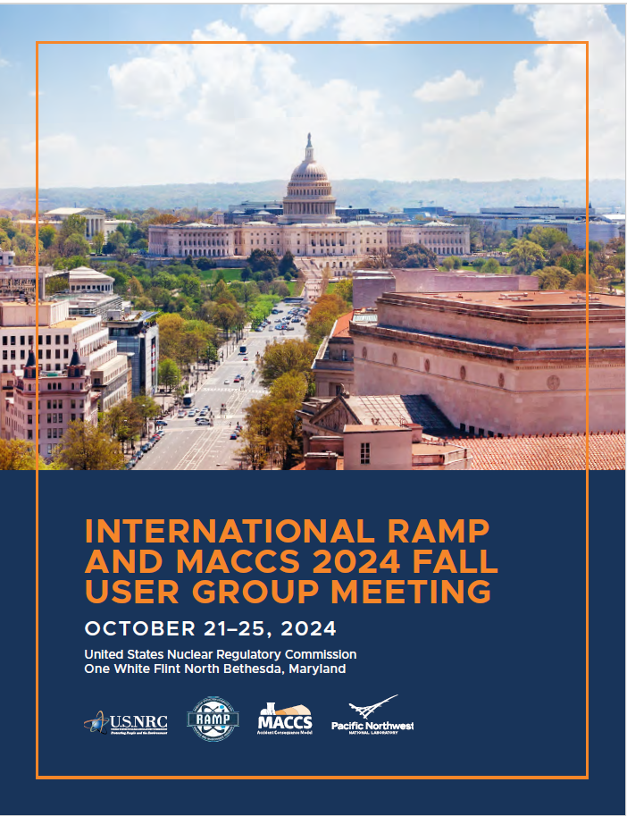

Everything you need is in your Program Booklet

Slide 4


Slide 5

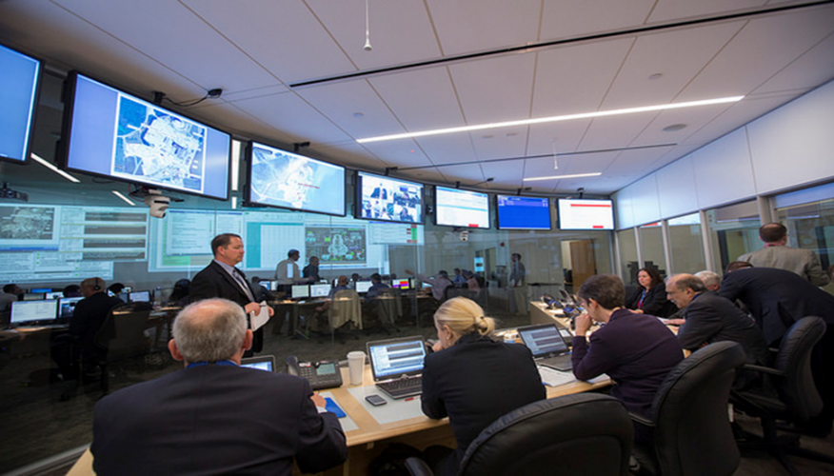
Tours of the NRC Operations Center
Monday, October 21 and October 22, 2024
11:30 AM – 12:00 PM

Slide 6


Boxed Lunch - Panera

Slide 7
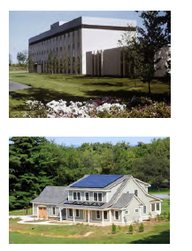

National Institute of Standard and Technology Tour
Wednesday, October 23rd. 1:00 – 5:00 PM

Slide 8
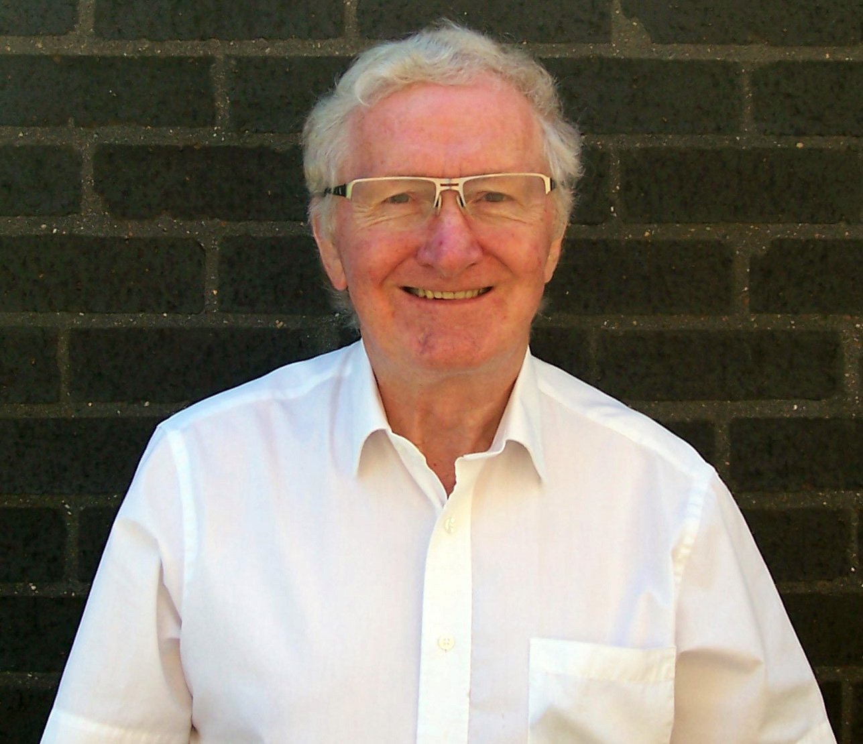
International Luncheon
Two White Flint North Auditorium
Wednesday, October 23rd 12:00 – 1:00 PM
Keynote speaker:
Dr. Bill Thomson
Consultant Physicist (retired)
City Hospital, Birmingham, UK
“Evolution of the UK VARSKIN User Group”

Slide 9
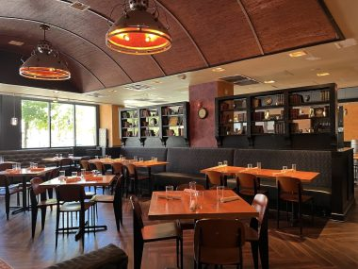

RAMP No-Host Dinner
Wednesday, October 23rd, 2024 6:00-8:00 PM
11820 Trade St, North Bethesda, MD 20852

Slide 10

Escorting
Reminder! You must be always escorted outside of the One White Flint North F23, and G05/07 rooms.
NRC staff will be going to the security area of One White Flint North in shifts to help with escorting.
Email ramp@nrc.gov with issues.

Slide 11

Final thoughts!
We are glad you are here!
Participate actively
  Ask as many questions as you want
Share your insights
  Share your experience of how you use the code
  Share your experience of how you want to use the code
  Share your thoughts on future code development.
Work together to enhance radiation protection and nuclear safety
Build networks
  After the meeting, email us, use the forums on the website
Strengthen collaboration
Relax and enjoy

Slide 12

Incidence Response Tour - Your time is up! Please head to the registration desk.
Others – questions?

