Slide 1

Emergency Planning and Response Research
Todd Smith, PhD
Senior Level Advisor for Emergency Preparedness and Incident Response

Slide 2
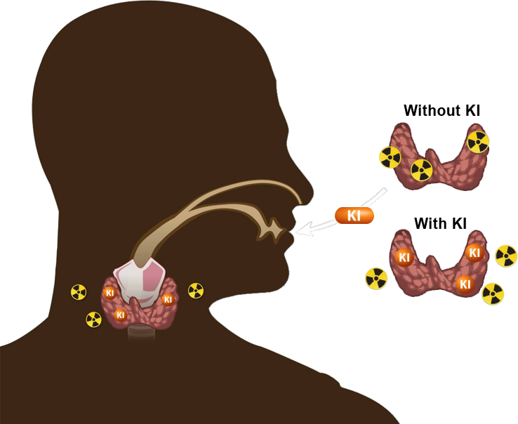
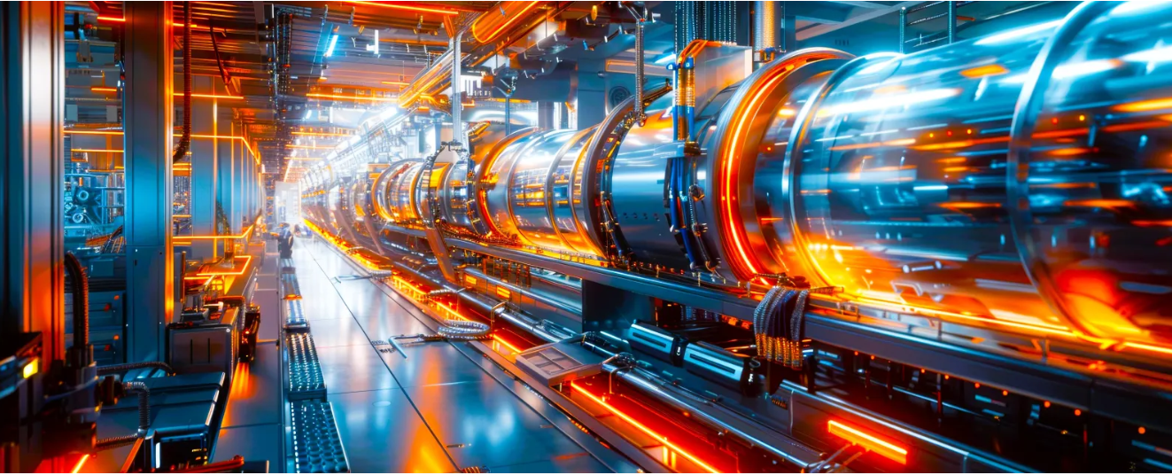
Emergency preparedness and incident response (EP/IR) assure public health and safety
The time to prepare for advanced nuclear is now
RAMP and MACCS are essential tools for advancing EP/IR
MACCS and RAMP can be used to inform potassium iodide (KI) use
EP/IR for advanced nuclear technologies is an opportunity

Slide 3
Potassium Iodide policy in the U.S.
NRC regulations require consideration of KI as a supplemental protective action
  regulations and guidance are specific to large light water reactors
“Federal Policy on Use of Potassium Iodide (KI),” 67 FR 1355, 2002
  KI should be stockpiled and distributed for emergency workers, institutionalized persons, and considered for the public within the 10-mile emergency planning zone
Bioterrorism Act of 2002
  requirement to distribute KI out to 20 miles around nuclear power plants; waived because more effective protective measures exist

Slide 4
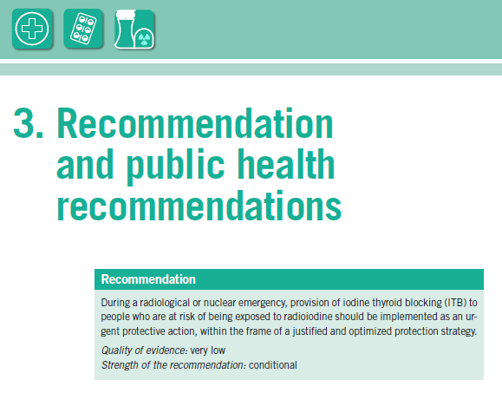
WHO recommends further KI research:
radioiodine biokinetics
optimal timing of intake
feasibility and acceptability
best practices for stockpiling or pre-distribution
World Health Organization, “Iodine thyroid blocking: Guidelines for use in planning and responding to radiological and nuclear emergencies,” WHO 2017. https://www.who.int/publications/i/item/9789241550185

Slide 5
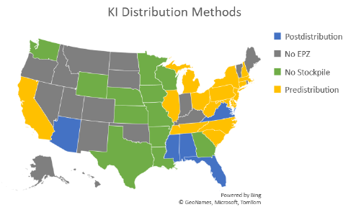
U.S. KI policy is evidence-based
Efficacy and efficiency of KI implementation could benefit from modernization
KI Subcommittee within the Federal Radiological Preparedness Coordinating Committee (FRPCC) has been reinstated to assess need for guidance
KI guidance can benefit from:
  insights on radioiodine release from state-of-the-art consequence analyses
  lessons from Chernobyl, Fukushima and Ukraine
  adequacy of dietary iodine sufficiency and daily iodine intake
  understanding of advances in nuclear technologies
  best practices
Stricker, Adam. Potassium Iodide Versus N95 Masks: An Effectiveness Comparison, Oregon State University, 2023.

Slide 6
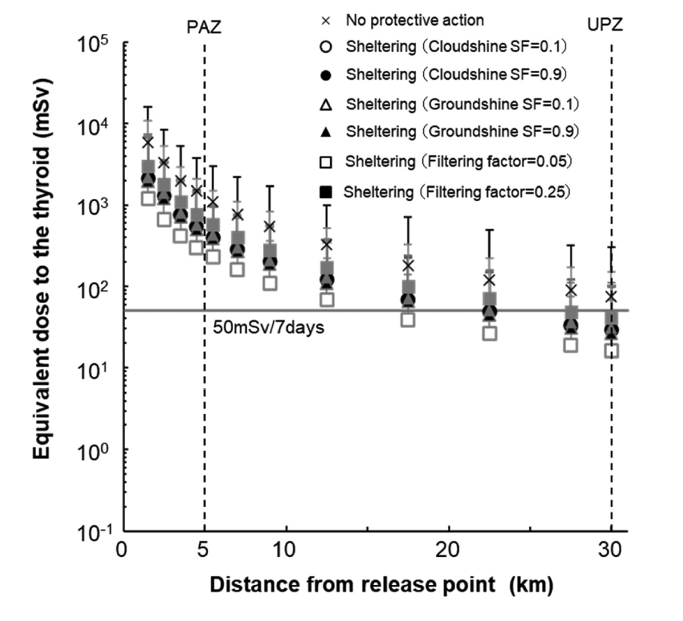
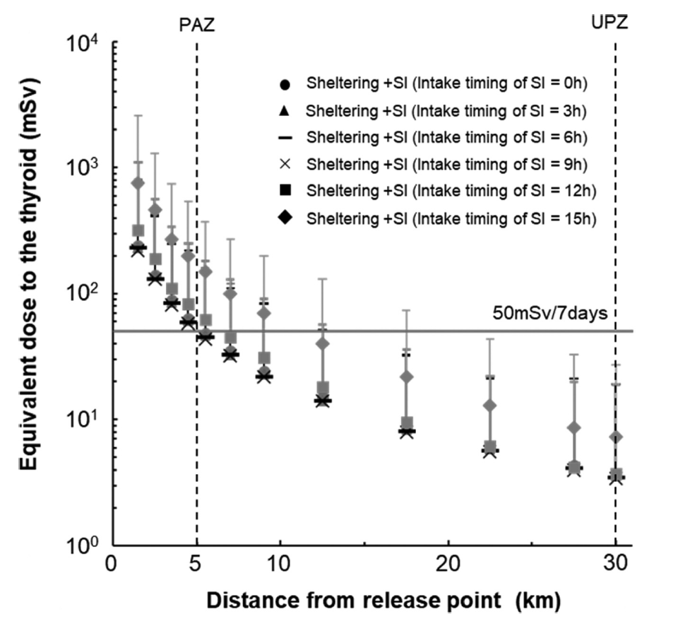
KI effectiveness can be modeled
SI: stable iodine
Kimura, M., Oguri, T., Ishikawa, J., & Munakata, M. (2020). Development of an evaluation method for planning of urgent protection strategies in a nuclear emergency using a level 3 probabilistic risk assessment. Journal of Nuclear Science and Technology, 58(3), 278–291. https://doi.org/10.1080/00223131.2020.1820914

Slide 7

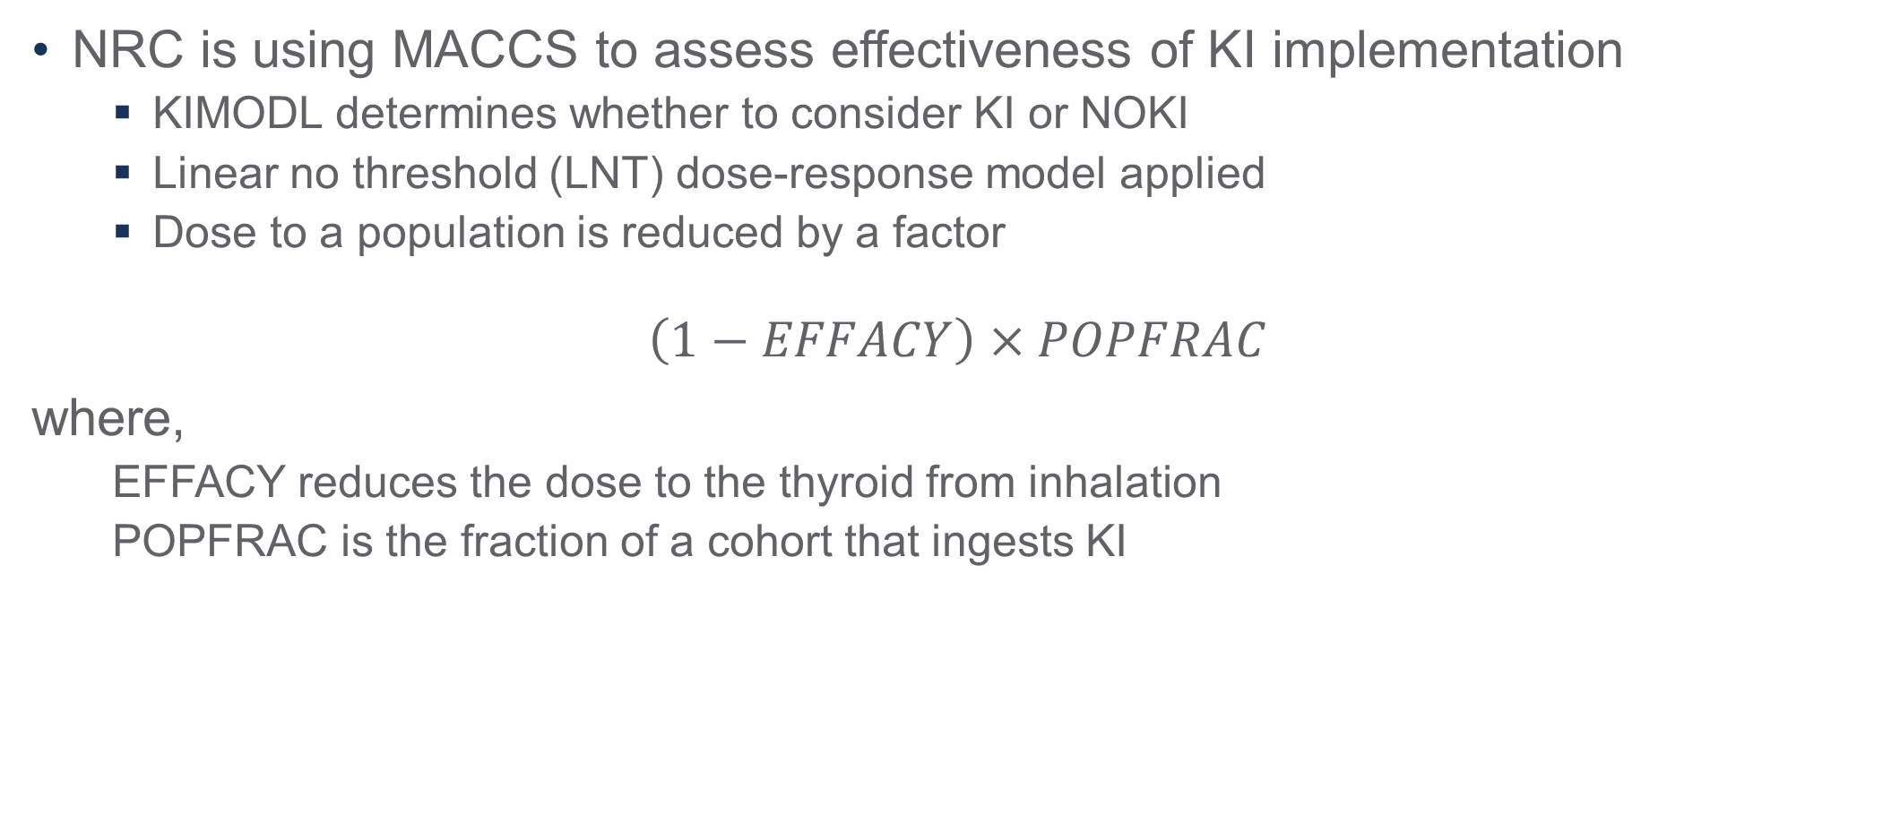
MACCS can inform KI strategies
NRC is using MACCS to assess effectiveness of KI implementation
  KIMODL determines whether to consider KI or NOKI
  Linear no threshold (LNT) dose-response model applied
  Dose to a population is reduced by a factor
$$\left(1−EFFACY\right)×POPFRAC$$
where,
  EFFACY reduces the dose to the thyroid from inhalation
  POPFRAC is the fraction of a cohort that ingests KI
MACCS User Guide – Version 4.2. SAND2023-01315, March 2023

Slide 8
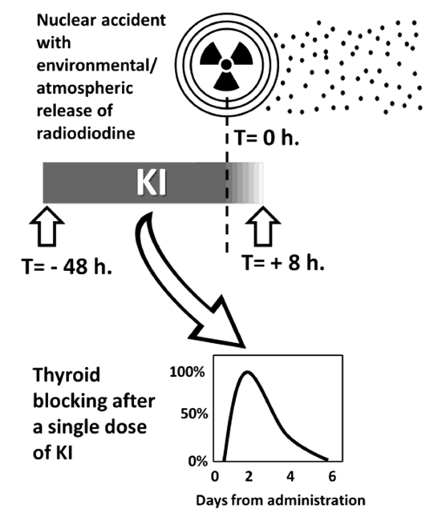
KI effectiveness is factor dependent
To be effective against inhalation exposure, KI must be administered within a specific window of opportunity
  < 12-24 hours before exposure ~90% to 70% effective
  < 1-3 hours after exposure ~85% to 50% effective
  > 6 hour after exposure has negligible protective effect
Modeling can provide useful insights for informing KI implementation. Factors include:
  source term (optimal timing and radioiodine form)
  KI time dependency (biokinetics)
  iodine sufficiency (biokinetics)
  distribution strategy (feasibility)
  human factors (acceptability)
  state of practice (best practice)
Ioannis Ilias, Manfredi Rizzo, Georgios Meristoudis. Potassium Iodide in Nuclear Accidents: Give it Timely, Swiftly and Judiciously, Endocrine, Metabolic & Immune Disorders - Drug Targets; Volume 23, Issue 6, Year 2023, e141022210042. DOI: 10.2174/1871530323666221014150729

Slide 9
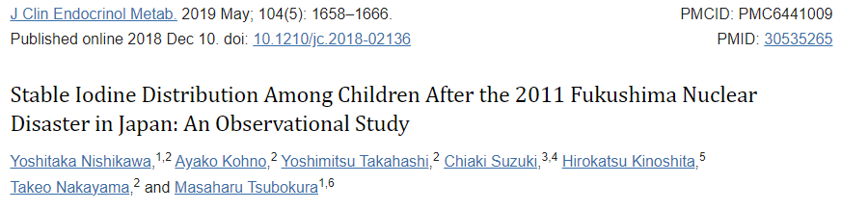
Data can inform MACCS parameters
The rate of distribution was 94.9%, but the intake rate was only 63.5%. Intake was lower in those aged 0 to 2 years compared with those aged ≥3 years (OR, 0.21; 95% CI, 0.11 to 0.36). Parents’ intake was positively associated with their children’s intake (OR, 61.0; 95% CI, 37.9 to 102.9). The variance partition coefficient for regions was 0.021, suggesting that the intake of stable iodine was more likely affected by individual than by regional factors. Closed-ended questions showed that the main reason for avoiding intake was concern about safety. Open-ended questions for other reasons revealed issues related to the distribution method, information about the effects and adverse effects of iodine, and instructions for iodine intake. There were no symptomatic adverse effects claimed to the town.

Slide 10
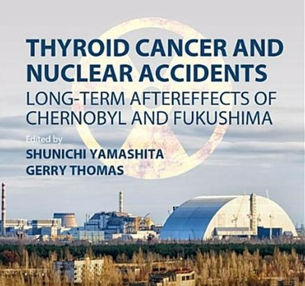
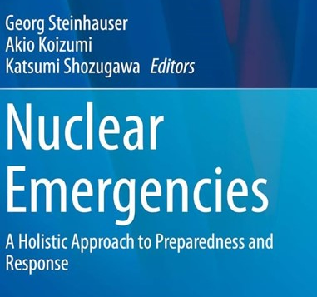
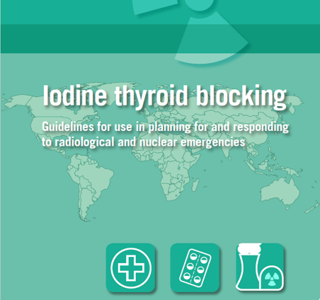
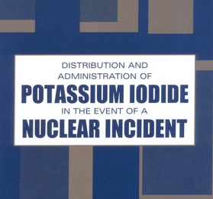
Real events provide insights on KI use and best practices
Regarding radioiodine:
  children are most at-risk
  ingestion pathway is important
  KI intake is not 100%
  thyroid screening resulted in overdiagnosis and anxiety
Nonradiological health effects can outweigh radiological risks

Slide 11
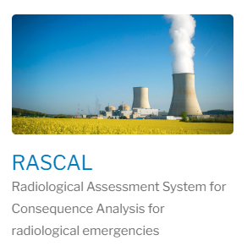
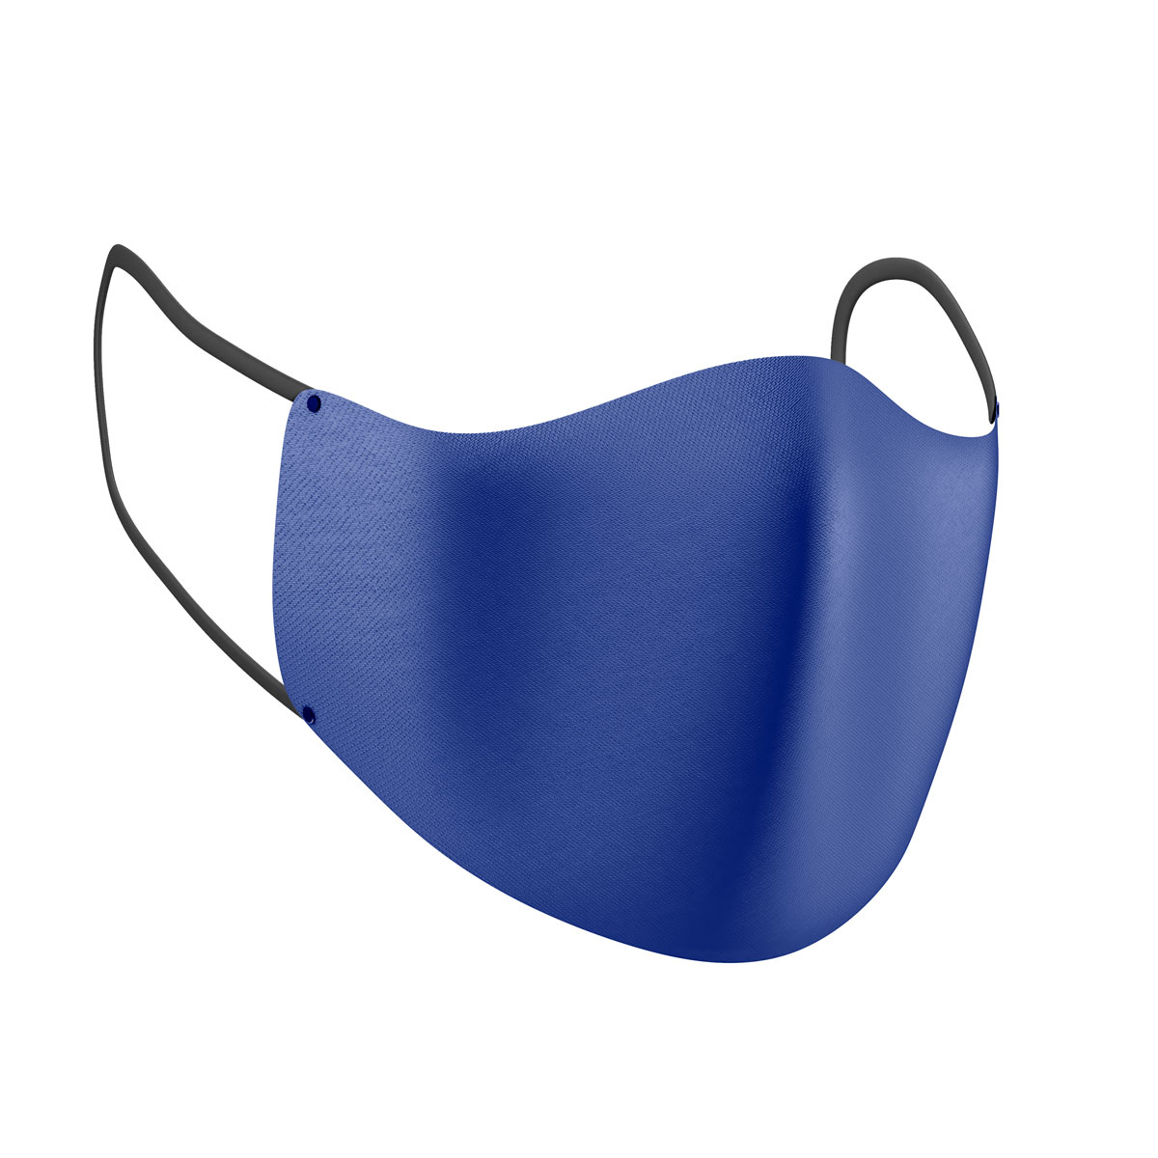
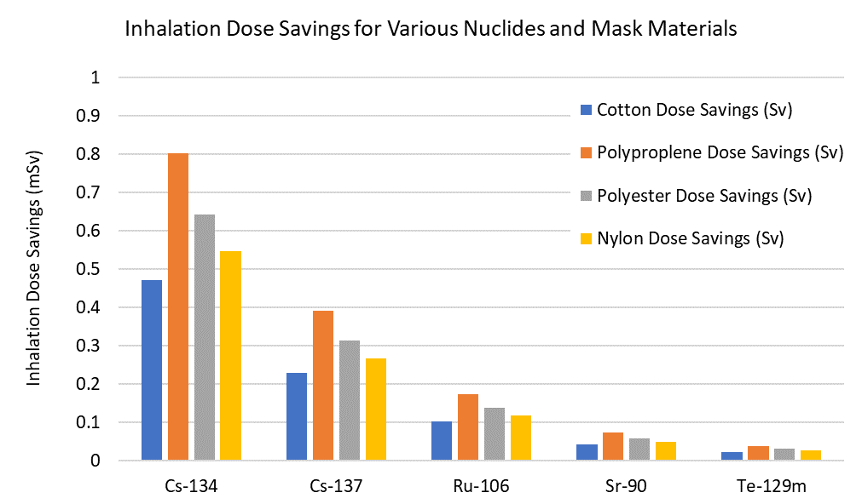

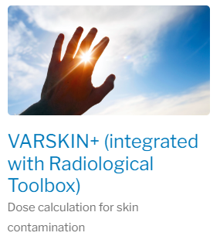
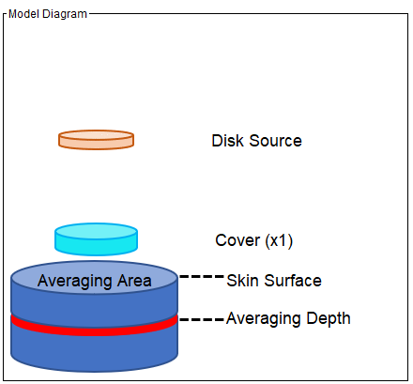
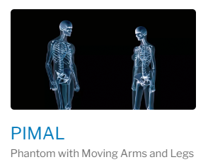
RAMP informs use of other measures

Slide 12
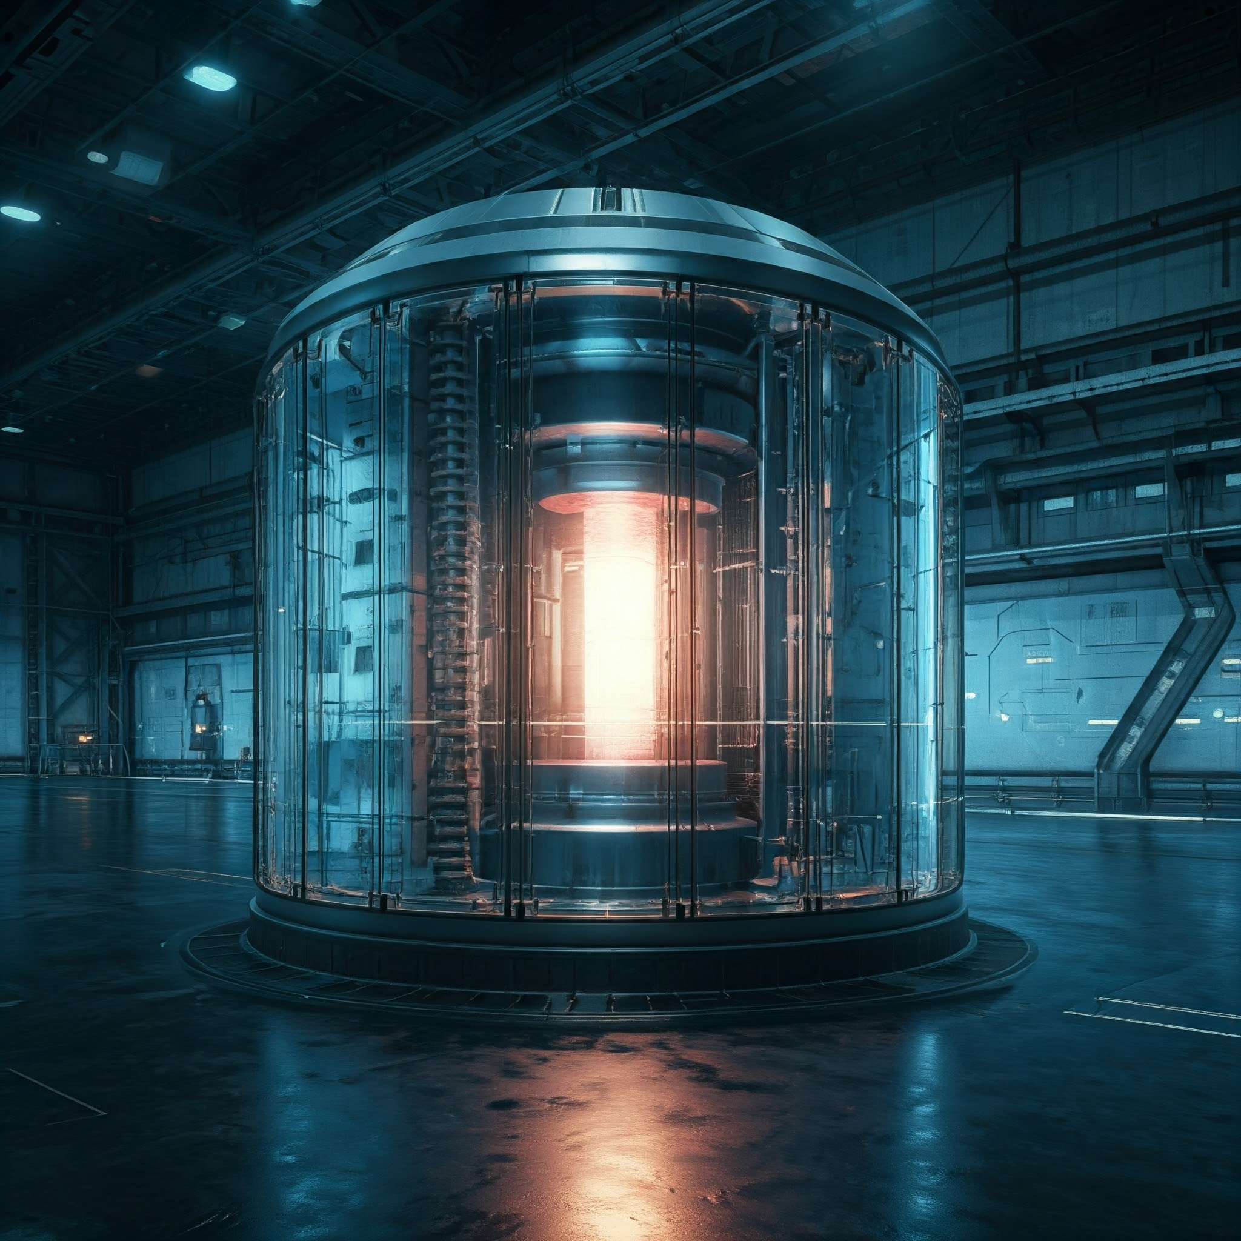
The time to prepare for advanced nuclear is now
assessment capabilities
use of artificial intelligence and machine learning
support NRC operations

Slide 13
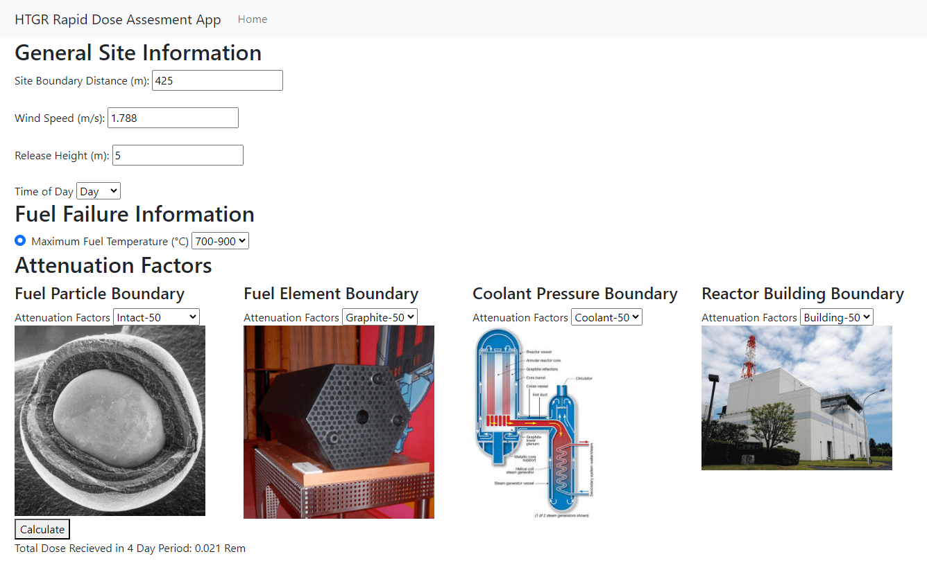
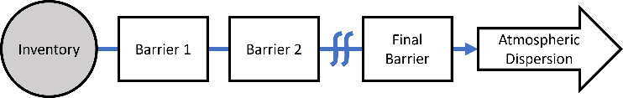
Accident assessment informs response
Assessment tools are needed for advanced nuclear technologies
NRC led a Purdue student team to explore Design of a Technology Inclusive Rapid Dose Assessment
  generalized barrier-out approach
  release fractions and attenuation factors
  Gaussian plume model
  web-based application with simple GUI
Example rapid dose assessment tool for HTGR reactor
2024 ANS Winter Meeting, Education Training, and Workforce Development: General
Wednesday, November 20, 2024
Design of a Technology Inclusive Rapid Dose Assessment Tool
Jonah Lau, Evan M. Frishholz, Andrew Romes, Joseph Powell (Purdue Univ.)

Slide 14
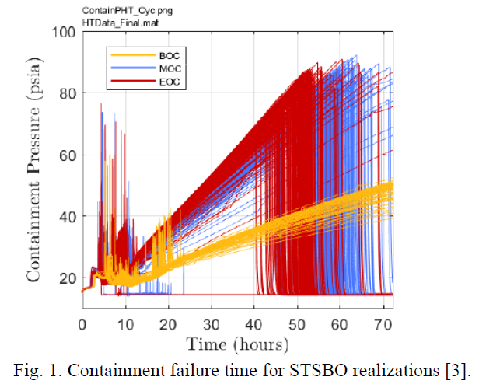
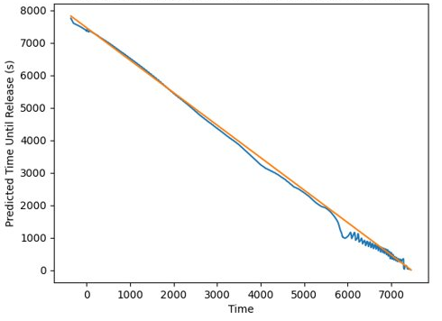

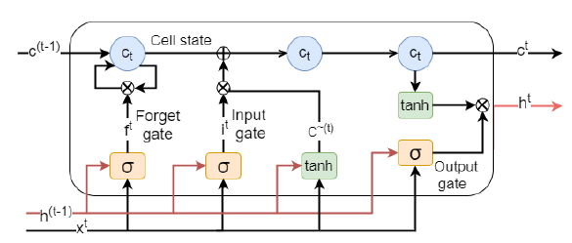
AI can leverage RAMP/MACCS results
RAMP/MACCS codes can provide data for use in AI applications
NRC led a Purdue student team to explore Use of Machine Learning for Predictive Emergency Response
Long short-term memory (LSTM) network
AI prediction of release time into containment
Zachery Dahm, Sarah McCauley Kannapell, William Kelly. Design of a Machine Learning Tool for Predictive Emergency Response, ANS, Transactions of the ANS Winter Meeting 2022, Nov 13-17, 2022. doi.org/10.13182/T127-39694

Slide 15
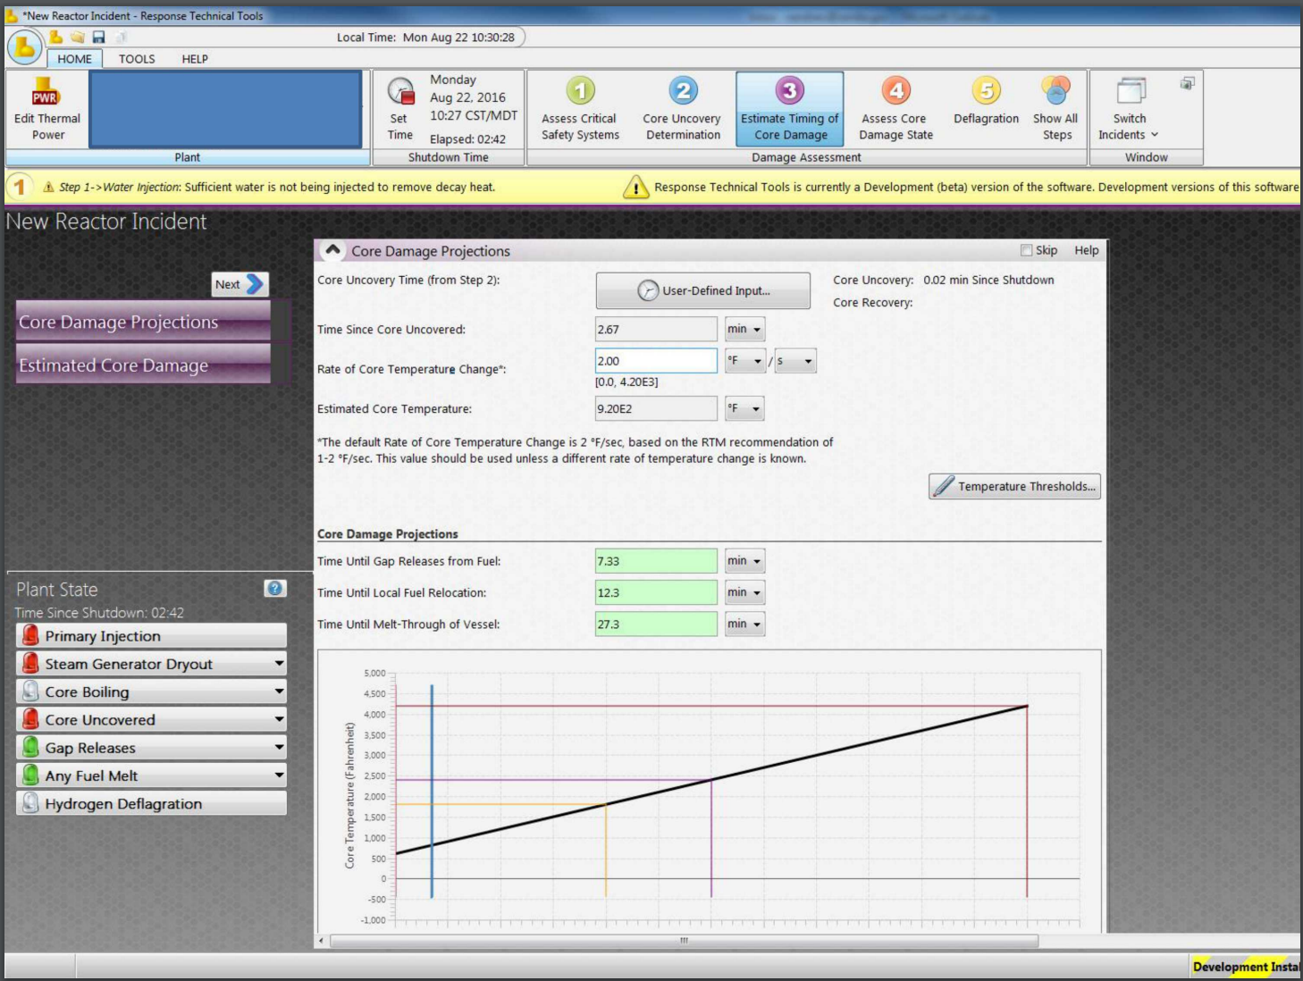
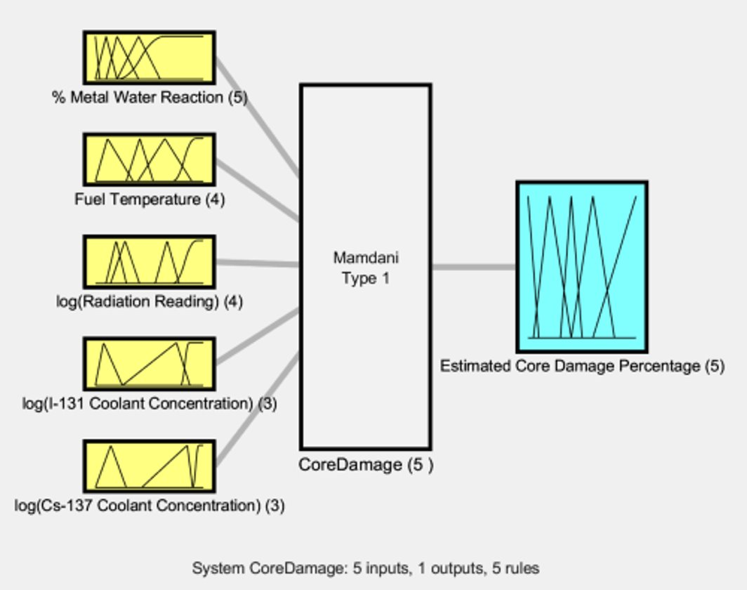
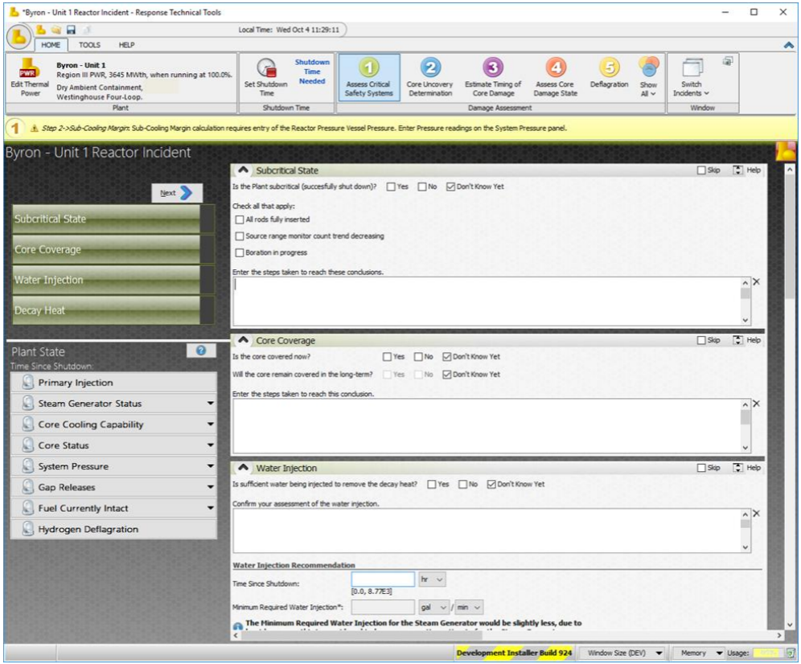
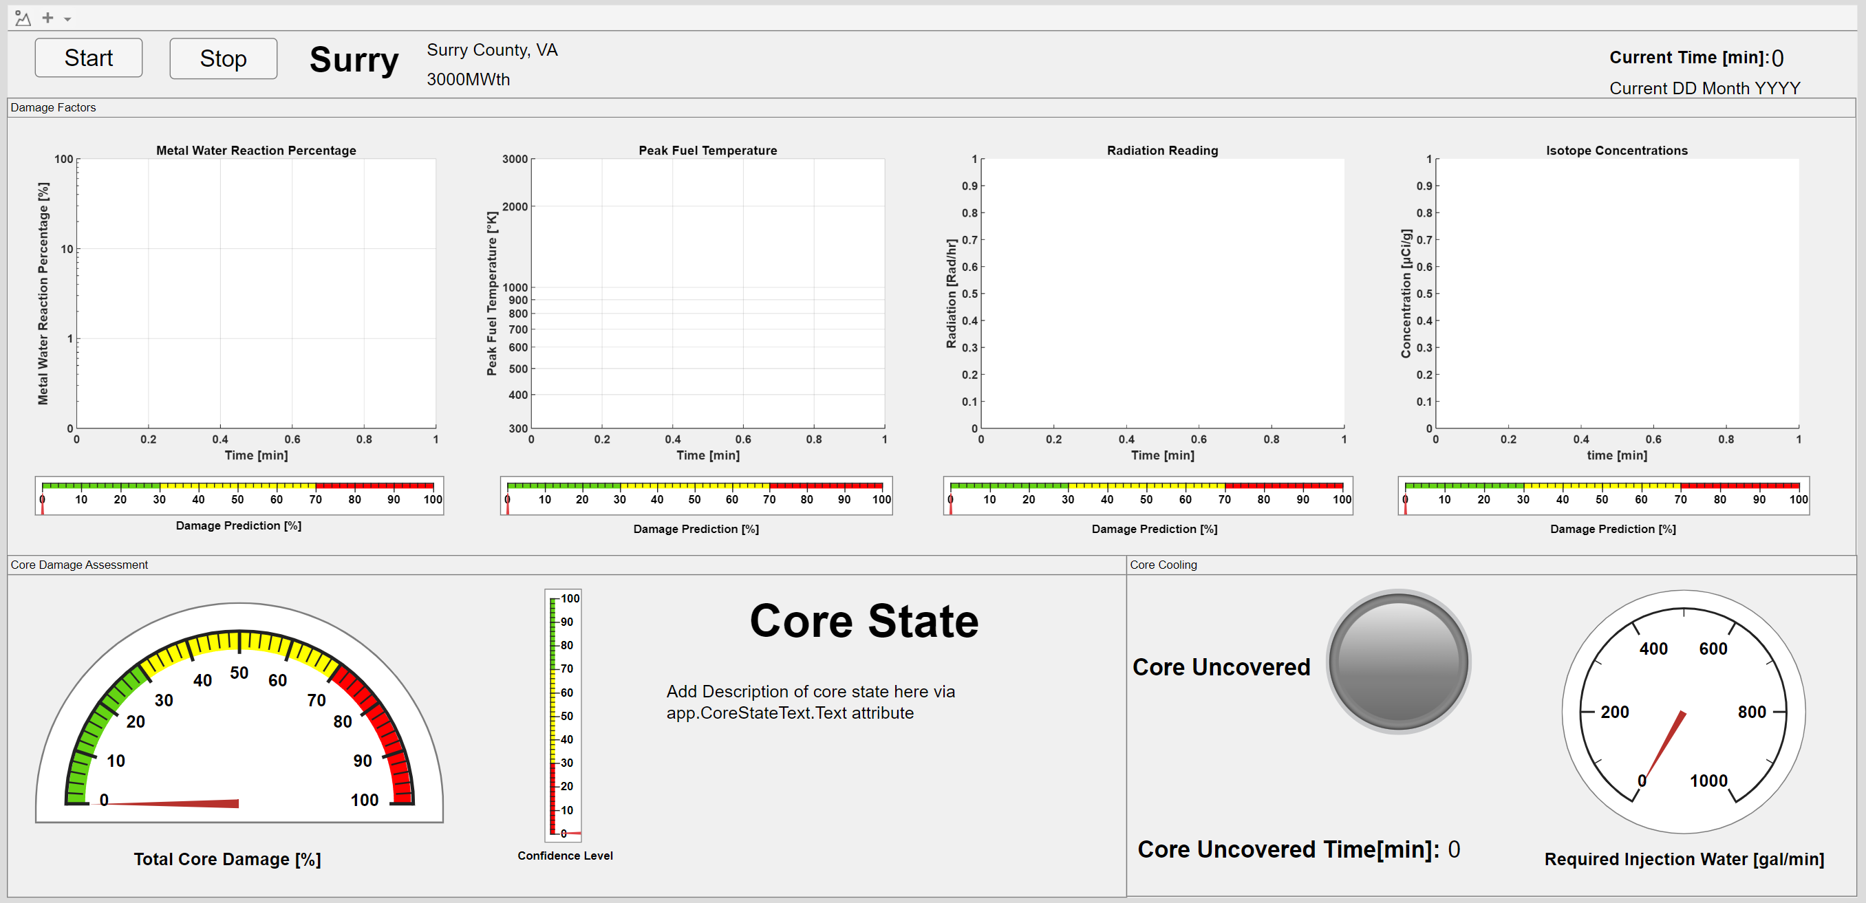
AI enables response technology
NRC led a Purdue student team to explore Design and Application of Digital Twins to Emergency Response
Response Technical Manual
(RTM)
Response Technical Tool
(RTT)
Response Digital Twin using Fuzzy Logic
(RDT)
RTM Models

Slide 16

RAMP and MACCS advance EP/IR

