Slide 1
Comparative Analysis of V+ Dosimetry Models
David M. Hamby, PhD
david.hamby@rcdsoftware.com

Slide 2
The premise …
You’ll see dose (β & γ) comparisons between V+ v1.3 and similar tools
It’s not my intention to specify the ‘correct’ answer!
Generally pulling Monte Carlo results from the literature and trying to apply V+ to a ‘similar’ scenario
My interpretation may not be correct; a true comparison may not be possible; etc.
Looking for patterns to see where we might focus resources

Slide 3
More on that …
The purpose of V+ is to provide a simple-to-use deterministic tool for skin dosimetry without the rigor and ‘expense’ of a probabilistic method
We’re not looking at absolute comparisons
  the dose units are not significant
The importance lies in the relative comparison
I’m not including the paper we just saw by Gregory James and the upcoming paper by Jacques Dubeau
And, I’m assuming you have some background with V+

Slide 4
Comparative Literature
Delacroix et al. 2002 is the earliest; vast majority within the past 5 years
Those using MC methods: GEANT, MCNP, FLUKA, Penelope
Skin contamination; source on clothing; source detached but nearby; handling a syringe; wound dose; droplet on a gloved hand; nuclear medicine needlestick; etc.
Including different nuclides, but it’s the scenario that’s important
  various nuclides just expand the energy over which comparisons are made
There are some papers relying totally on V+ results
  instilling confidence in V+ is important
  within its capability

Slide 5
Grouping of Three Authors
Small datasets from three papers
O’Doherty et al. 2021 – used Penelope and analytical methods (i.e., dose factors) to estimate skin dose from nasal administration of PET agents (C-11 & F-18)
Albiniak and Wrzesien 2020 – used GEANT4 to calculate SDE during handling of F-18 in syringe
Xu 2005 – used MCNP for 1 cm skin dose (10 energies)

Slide 6
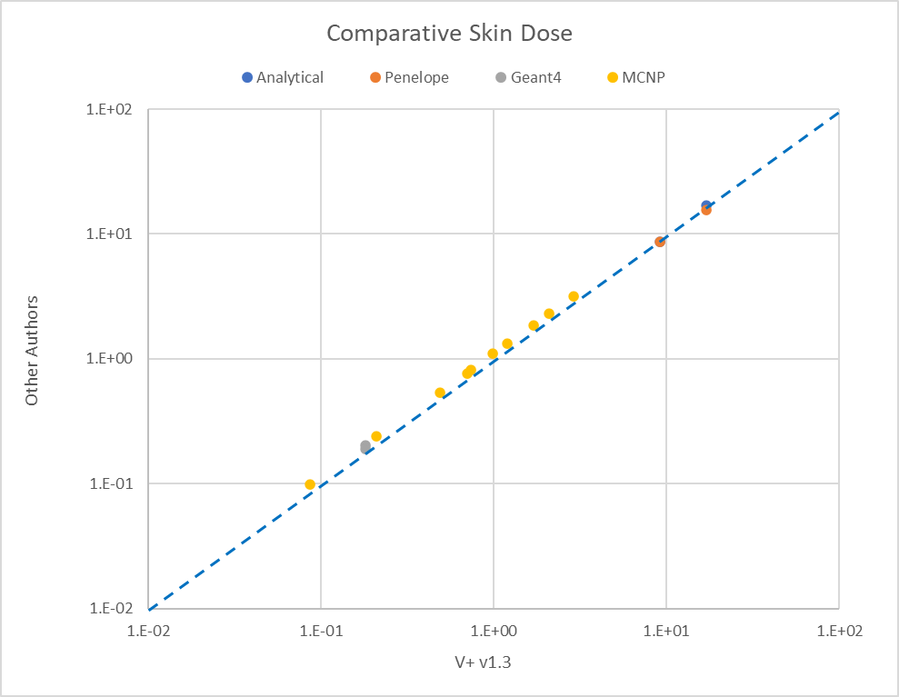
x1.5
x10
x2

Slide 7
Dubeau et al. 2018
Used MCNP5 to calculate electron skin dose for point sources
Six nuclides: Cl-36, Co-60, Rh-106, Cs-137, Tl-204, Pa-234m
With 13 combinations of fabric cover and air gap
Covers: 0, 15, 29, 43 mg/cm²
Air gaps: 0, 2, 5, 10 mm

Slide 8
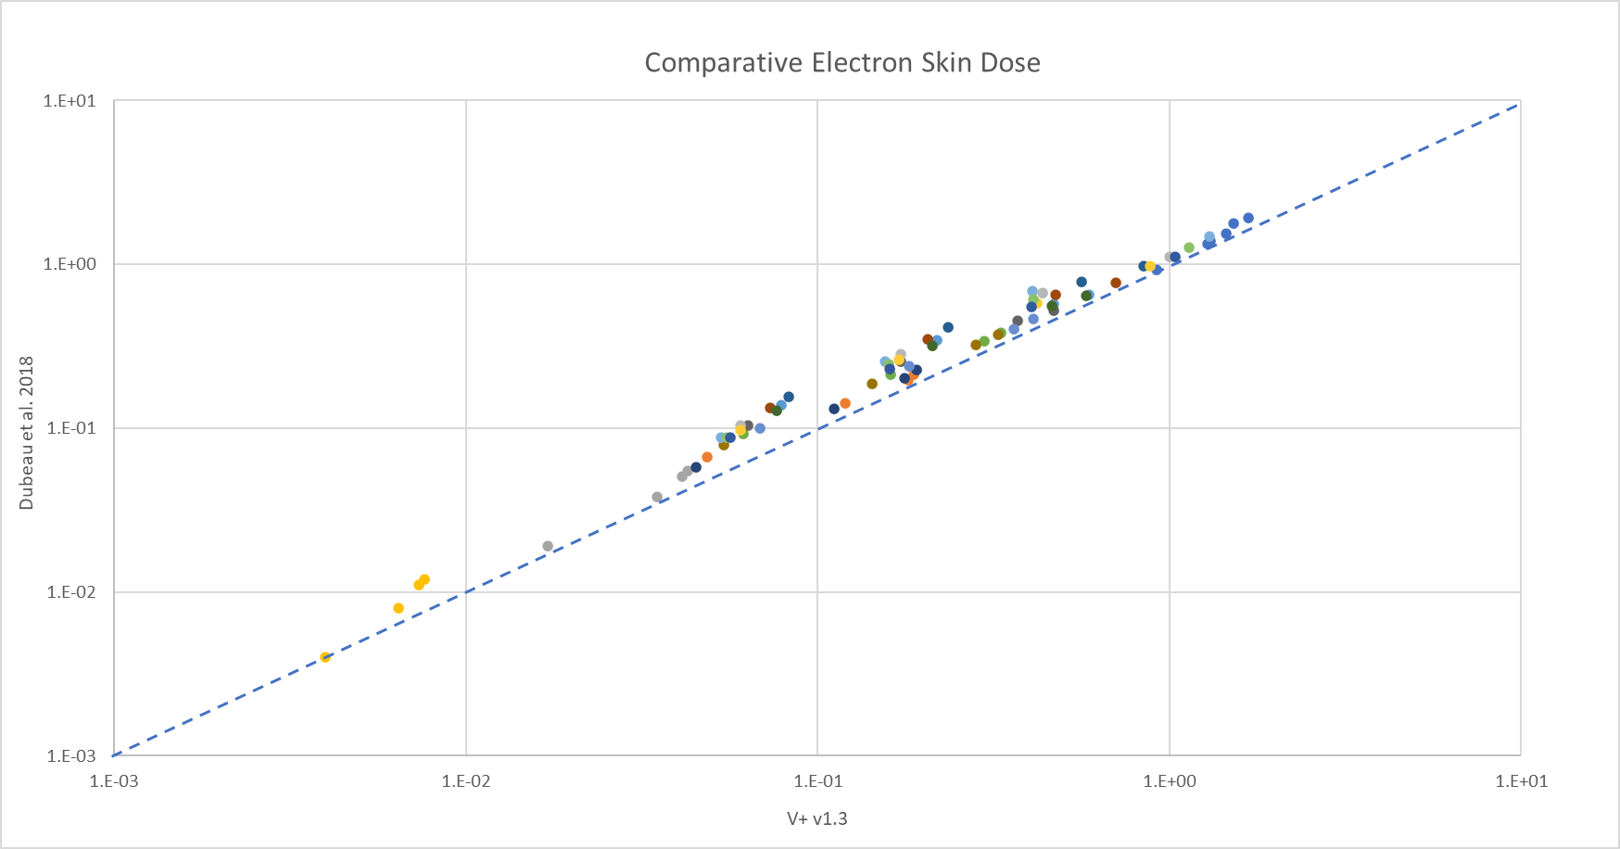
Each color grouping represents the
four air gaps for a given nuclide
and fabric thickness
Generally
2 mm air gaps
These all have a 10 mm air gap
with dose generally increasing as
fabric thickness decreases
These have no cover
and no air gap
Generally
5 mm air gaps
Co-60: fabric thickness of 43 mg/cm²
and air gaps of 10, 5, 2, and 0 mm
Co-60: fabric thickness of 29 mg/cm²
and air gaps of 10, 5, 2, and 0 mm

Slide 9
Dubeau et al. 2023
Count-rate measurements of skin contamination combined with subsequent skin dose assessments
Computer application was developed, and results compared with available data in the literature
Cl-36, K-40, Co-60, Sr-90D, Tc-99m, Pm-147

Slide 10
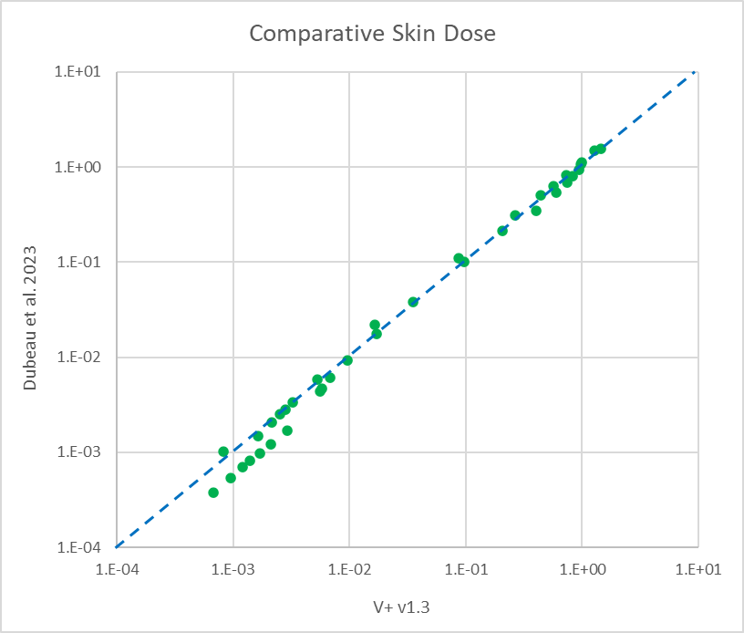
Sr-90(D) w/ seven absorber thicknesses
and a source area of 1,000 cm²

Slide 11
Frosio et al. 2019 & 2021
Frosio, FLUKA, and GRS in 2019
  1 cm² disk source; shallow dose equivalent
FLUKA, GEANT4, and MCNP in 2021
  38.5 cm² disk source; 50-100 mm volume averaging
Comparing with V+ v1.3 SkinDose

Slide 12
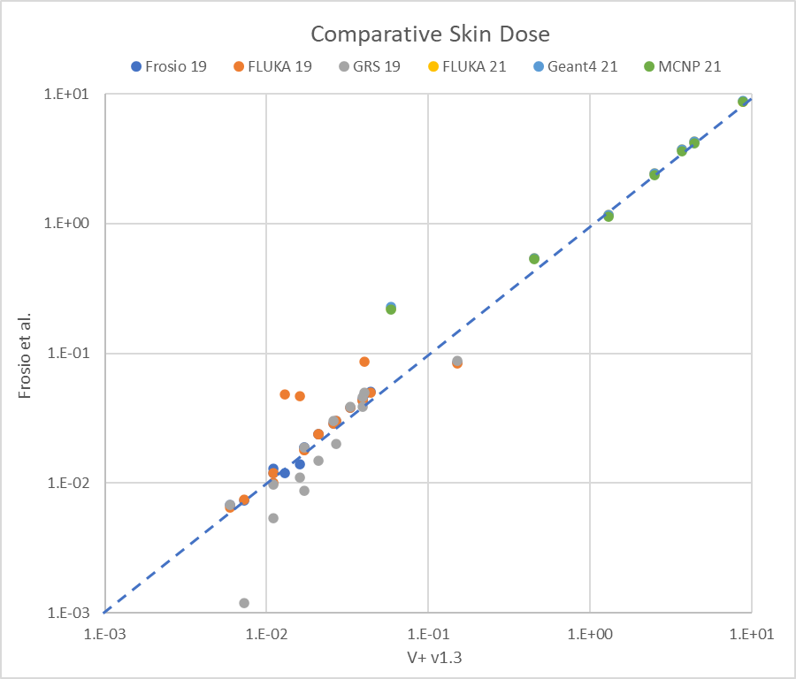
U-238(3)
electrons
Bi-213D
Tm-166
Yb-166D
Ca-47D(3)
Tb-152
Co-58

Slide 13
Galipeau et al. 2023
Using V+ v1.3 WoundDose
Calculating the “local” dose coefficient with MCNP
For 38 different radionuclides (I’ve chosen 9)
Affected tissue based on CSDA particle range
Injection:
  isotropic point source
  tissue sphere of 0.25, 0.5, and 1 cm radii
Laceration:
  horizontal line source
  tissue cube of 1 cm side lengths
Burn/Abrasion:
  skin surface area source
  tissue cube of 1 cm side lengths
WoundDose uses point and line sources (r = 0.620 cm)
Laceration Model

Slide 14
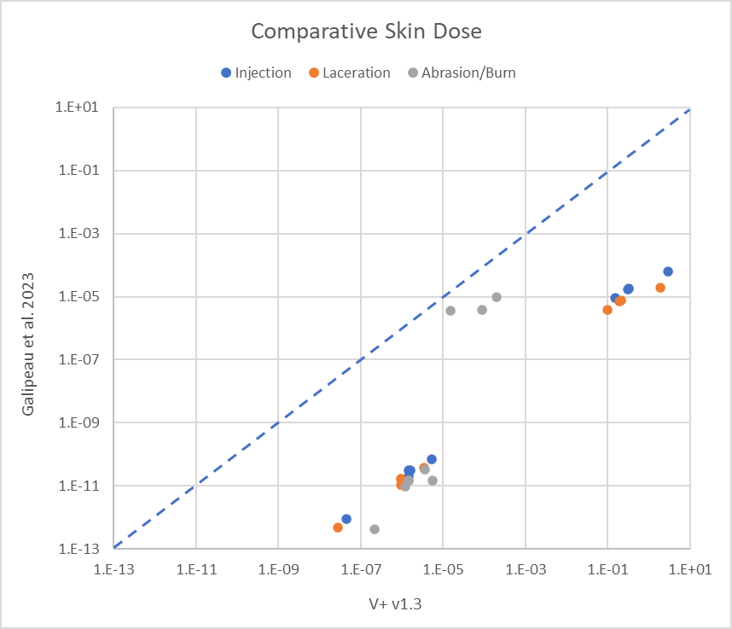
H-3
P-32
Sr-90D
I-131
Cs-137D
Po-210
U-235
Pu-239
Am-241

Slide 15
Delacroix et al. 2002
Very popular document (Rad. Prot. Dosimetry)
  especially in Europe
  still referenced today
Originally based on a 1994 French laboratory guide
  … with an update in 1998
Electron doses were calculated using Varskin Mod 2 (1992)
Photon doses estimated with MicroShield v4.10 (1996)
RadDecay v1.13 (1996) used for decay chains

Slide 16
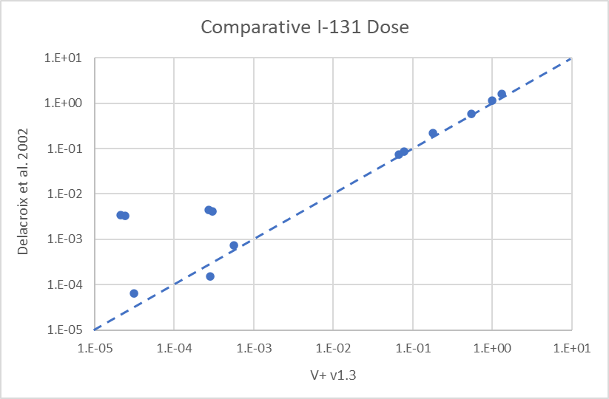
Delacroix et al. 2002
Planar photon sources

Slide 17
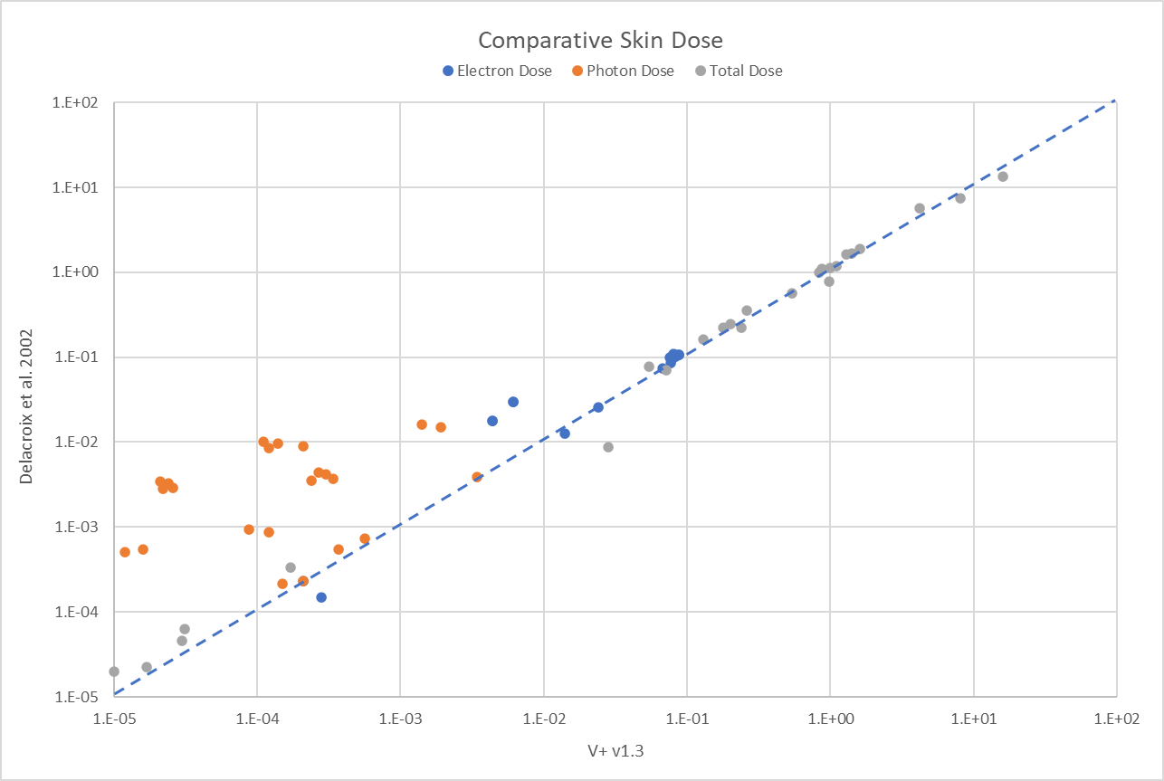
Delacroix et al. 2002 (5 nuclides x 13 doses)
K-40
Co-60
I-131
Mo99/Tc99m
Tc99m
droplet
Distant planar sources

Slide 18
Craig et al. 2023
Remember “telephone”?
This demonstrates Craig’s interpretation of Delacroix (as well as mine!)
Dose determination for:
  Tc-99m, I-131, Lu-177, and Ra-223
  electron and photon point sources at 30 cm
  contact with a 5 mL syringe
  skin contamination

Slide 19
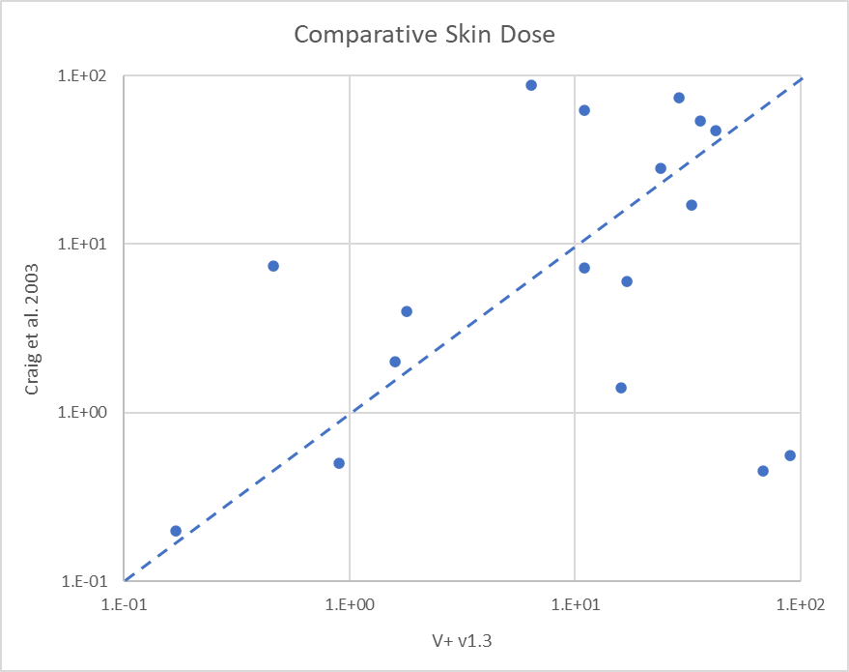
syringe
geometry
electrons & photons
@ 30 cm
skin
contact

Slide 20
Where we need work …
All-in-all good comparisons, but a few systematic differences revealed
Scenario similarity is probably of most importance
Inclusion of the same emissions by nuclide (& progeny)
Electron energy loss
  in air (airgap model)
  in clothing (cover model)
We are planning an international blind comparison to see how V+ is being used for controlled scenarios
  if you’d like to participate, please contact me: david.hamby@rcdsoftware.com

Slide 21
So, which estimate is correct?
What is the exposure scenario?
How is the problem interpreted?
What is modeled?
What is the model based upon?
How are the results interpreted?
… and many other questions
Looking at a problem with different models and from different viewpoints is likely the best approach to encircling the dosimetric truth

Slide 22

david.hamby@rcdsoftware.com

