Slide 1


An independent comparison of VARSKIN v1.2 and Geant4 Monte Carlo code for skin dose calculations
Gregory James
Head of Nuclear Medicine Physics
Royal Stoke University Hospital
United Kingdom (NHS)

Slide 2
Aim
VARSKIN is becoming more commonplace for skin dose calculations in nuclear medicine departments in the UK.
However, assumptions and approximations made in the software may cause inaccuracies (e.g. cylinders used for droplet shapes).
The aim of this project was to independently compare the VARSKIN (v1.2) skin dose module against Geant4 Monte Carlo code for typical skin contamination scenarios.

Slide 3
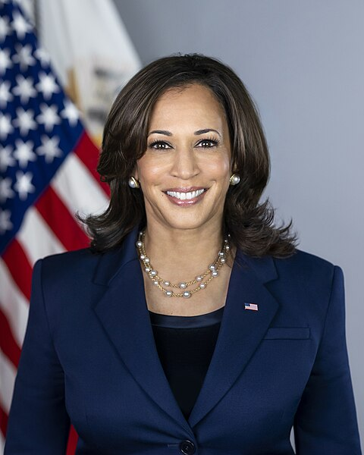

vs.

Slide 4
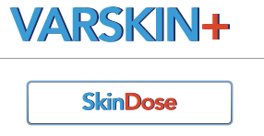


Slide 5

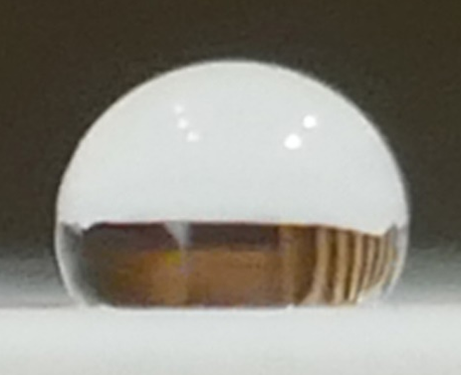
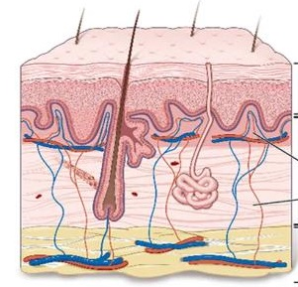
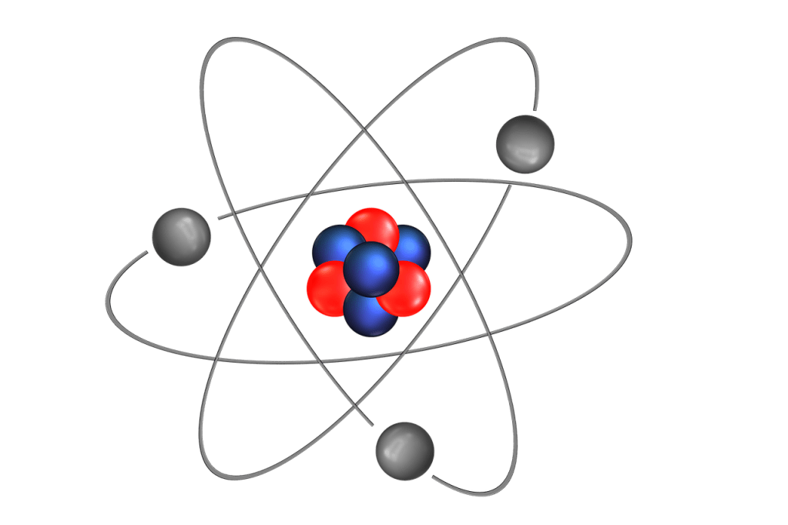
Method – Geometry Considerations
Four geometries:
Disk model
10 µl droplet
30 µl droplet
50 µl droplet
James et al. NMC 2023
Three glove layers:
No gloves
0.1mm thickness
0.2mm thickness
Density, ρ = 0.92 g/cm³
Four basal depths:
70 µm
140 µm
220 µm
370 µm
Covens et al. JRP 2013
28 radionuclides:
^{99m}Tc
¹⁸F
⁹⁰Y
¹³¹I
and 24 others!

Slide 6
Geant4 Geometry
Target: >10,000 hits to achieve <1% random error
Droplet
(10, 30, 50 μl)
Glove
Layer
0 mm
0.1 mm
0.2 mm
Sensitive
Volume
A = 1 cm²
Skin Surface
70 μm
140 μm
220 μm
370 μm
2 cm
Skin (ICRP)
ρ = 1.1 g/cm³
10 μm
4 cm

Slide 7
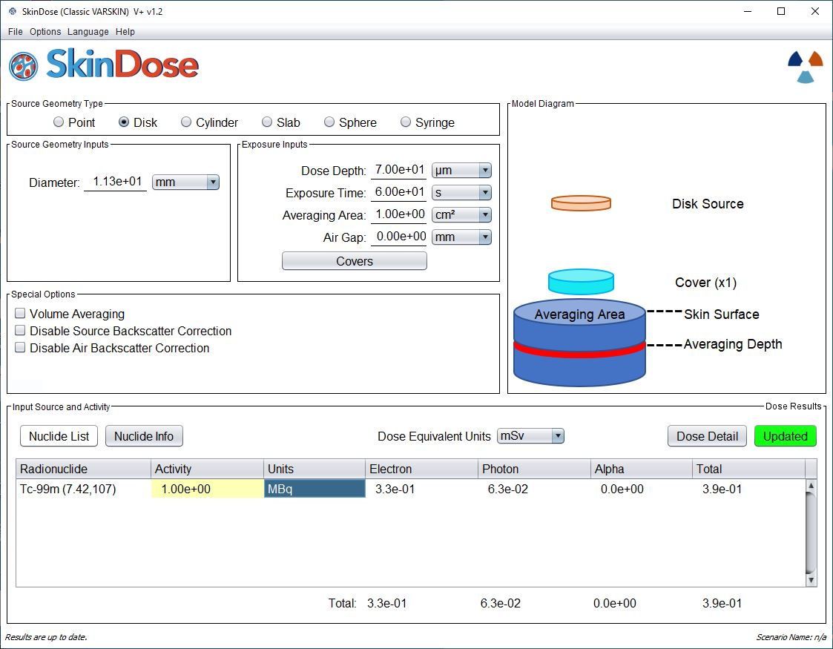
VARSKIN
Geometry
Diameter set to 11.28 mm for 1 cm²
Dose averaging area set to 1 cm²
Activity set to 1 MBq to derive instantaneous dose rate constant [mSv/MBq/hr]

Slide 8
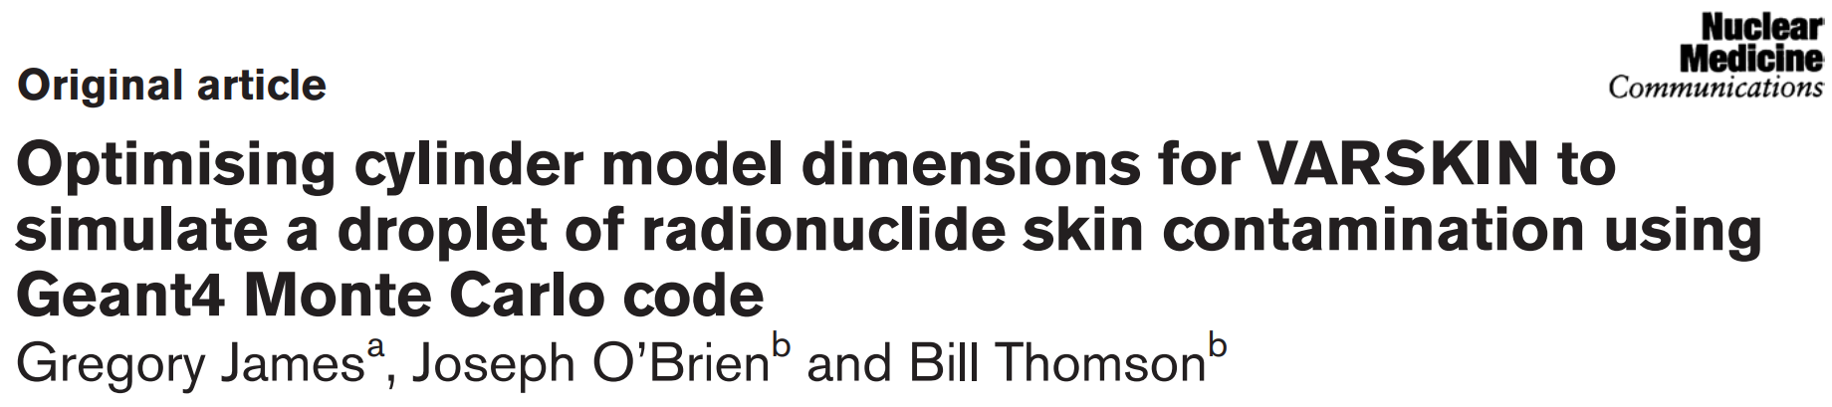
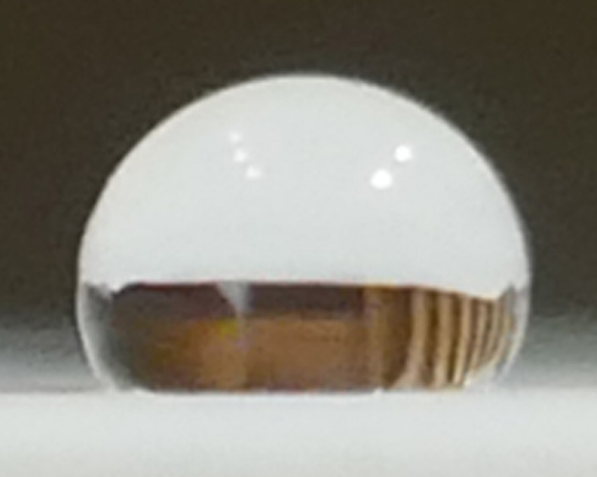
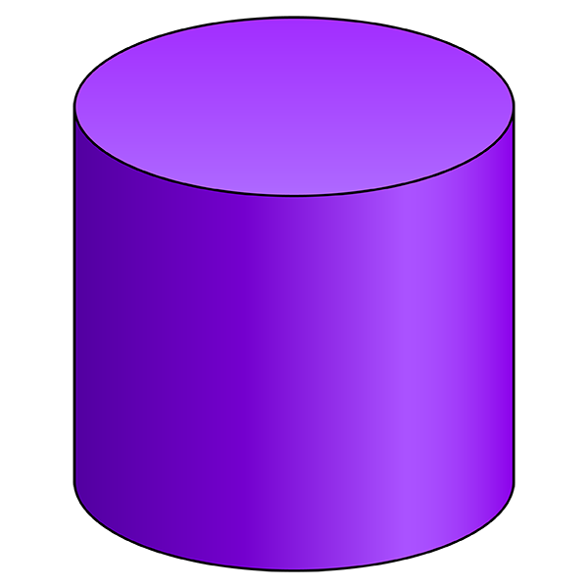
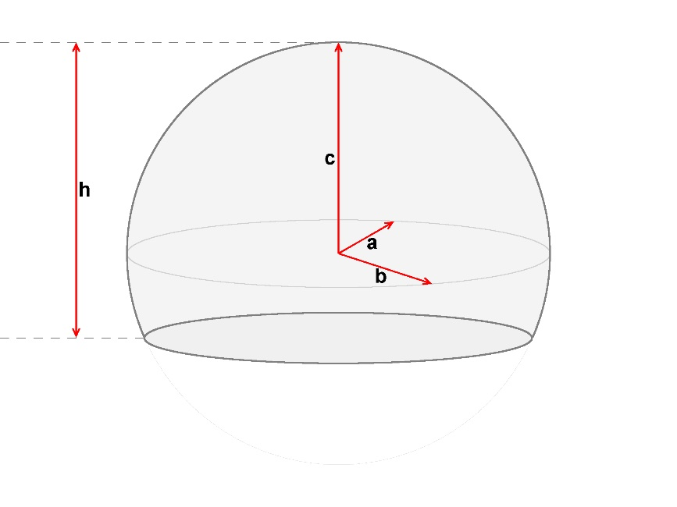
Nuclear Medicine Communications 2023, 44:366–374

Slide 9
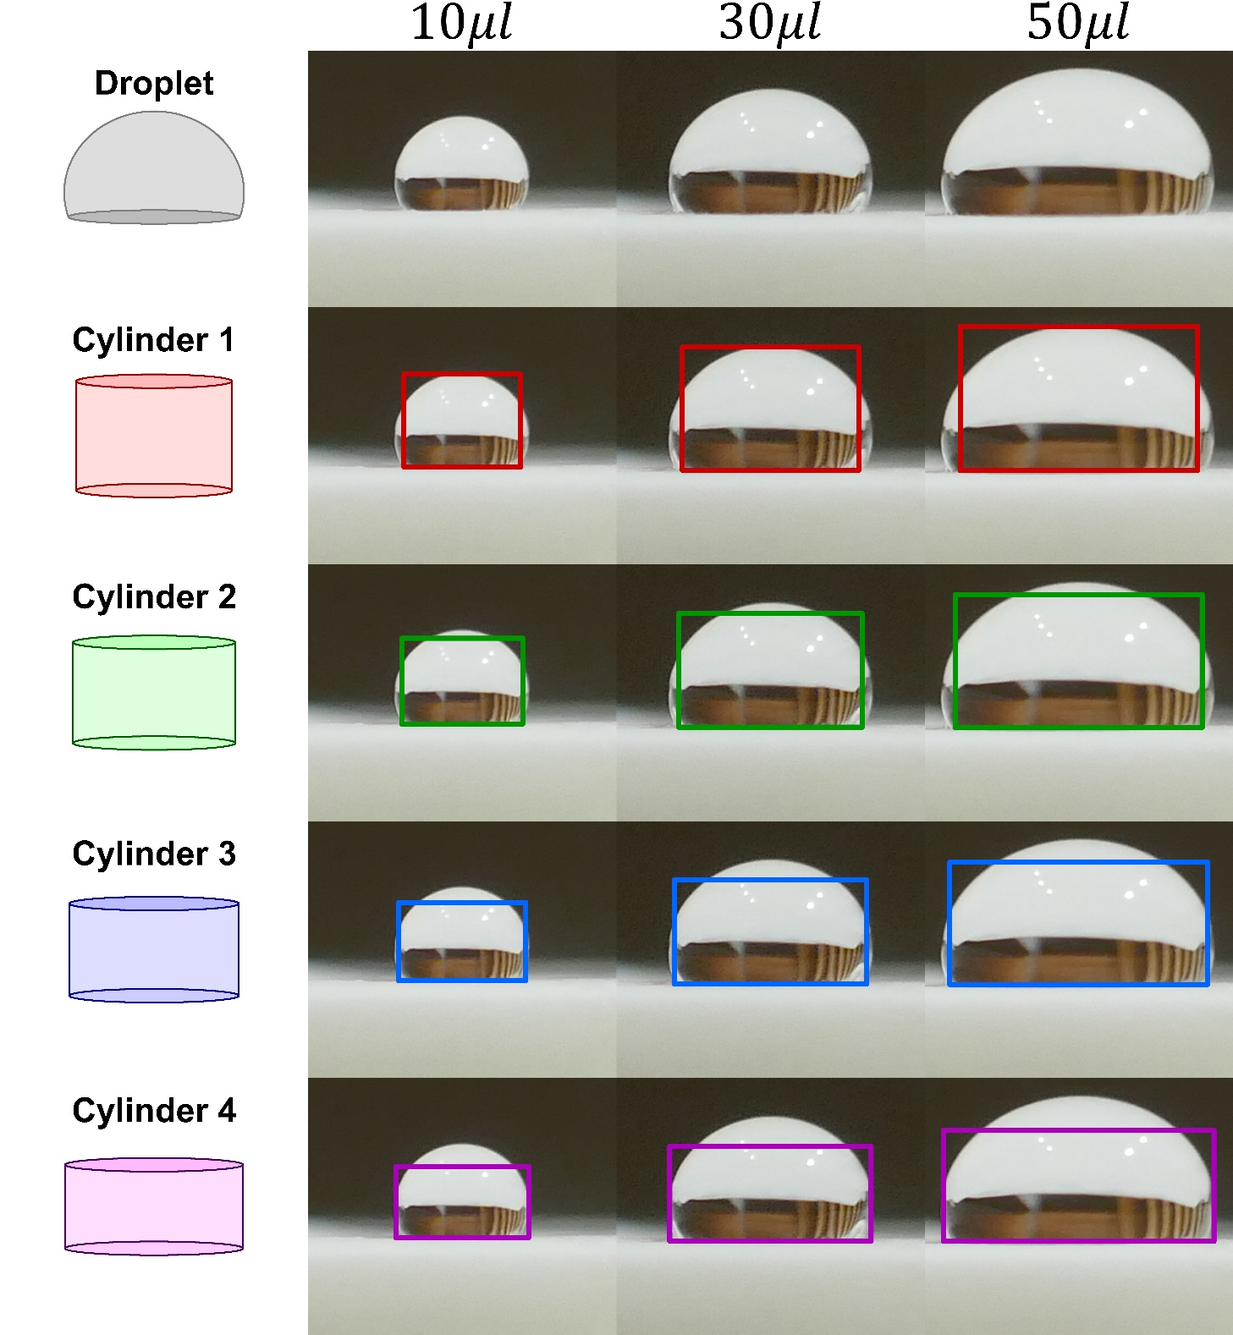
Initial Cylinder
Approximations
Cylinder 1: 99% of the height
Cylinder 2: ⅓ of the height difference
Cylinder 3: ⅔ of the height difference
Cylinder 4: 99% of the diameter

Slide 10
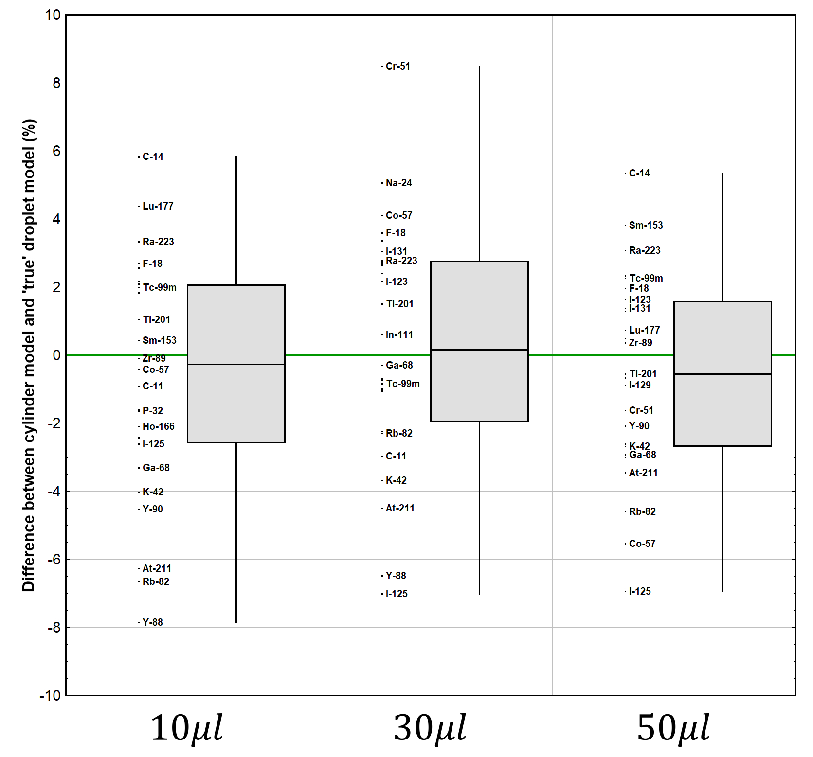
Final Cylinder
Recommendations
Volume | Diameter | Height
10 μl | 2.52 mm | 2.01 mm
30 μl | 4.04 mm | 2.35 mm
50 μl | 5.02 mm | 2.53 mm

Slide 11
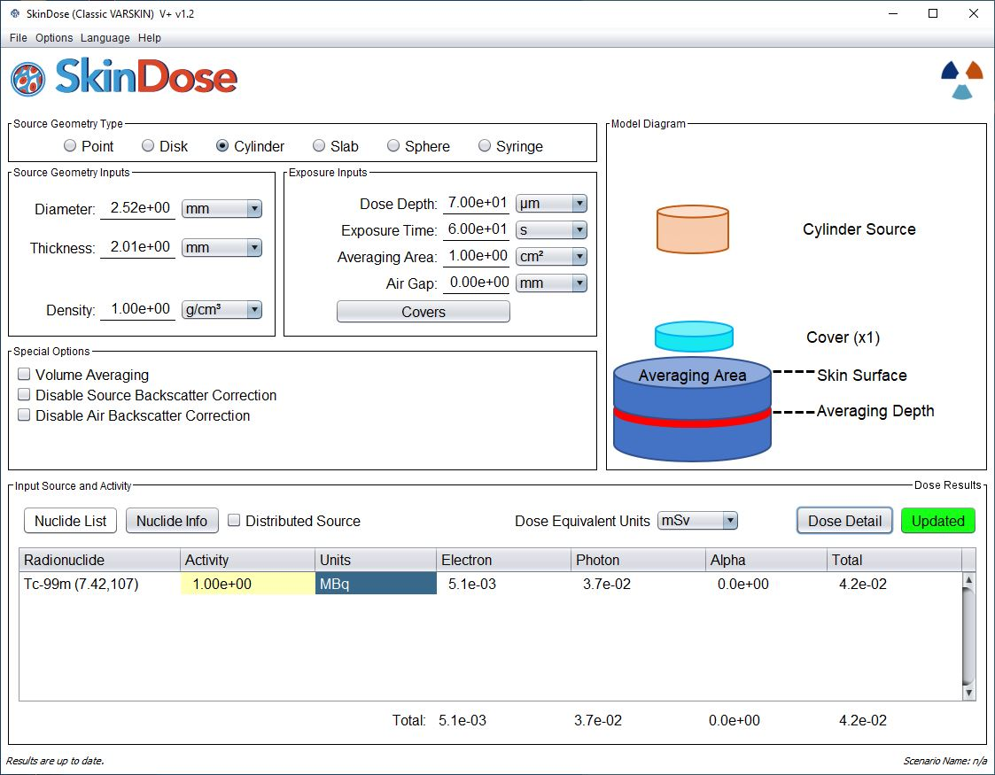
VARSKIN
Geometry
Volume | Diameter | Height
10 μl | 2.52 mm | 2.01 mm
30 μl | 4.04 mm | 2.35 mm
50 μl | 5.02 mm | 2.53 mm
Nuclear Medicine Communications 2023, 44:366-374

Slide 12


Results
1344 rows of data!
(28 radionuclides × 48 geometries)
 |  |  |  | Dose Rate (mSv/MBq/hr)
Radionuclide | Geometry | Glove Layer | Basal Depth | Geant4 | VARSKIN | Difference
^{99m}Tc | 1cm² Disk | - | Hp(0.07) | 200 | 206 | +3%
 |  |  | Hp(0.14) | 40.9 | 55.6 | +36%
 |  |  | Hp(0.22) | 3.45 | 4.11 | +19%
 |  |  | Hp(0.37) | 2.69 | 2.76 | +3%
 |  | 0.1 mm | Hp(0.07) | 20.8 | 23.7 | +14%
 |  |  | Hp(0.14) | 3.35 | 3.66 | +9%
 |  |  | Hp(0.22) | 2.86 | 3.01 | +5%
 |  |  | Hp(0.37) | 2.46 | 2.49 | +1%
 |  | 0.2 mm | Hp(0.07) | 2.85 | 3.29 | +16%
 |  |  | Hp(0.14) | 2.75 | 2.95 | +7%
 |  |  | Hp(0.22) | 2.64 | 2.64 | +0%
 |  |  | Hp(0.37) | 2.35 | 2.28 | -3%
!
!
!
!

Slide 13
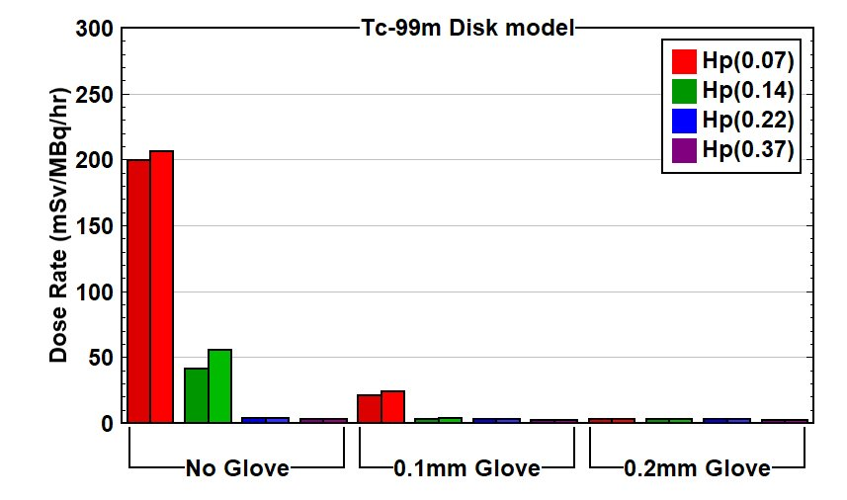
Geant4
VARSKIN

Slide 14
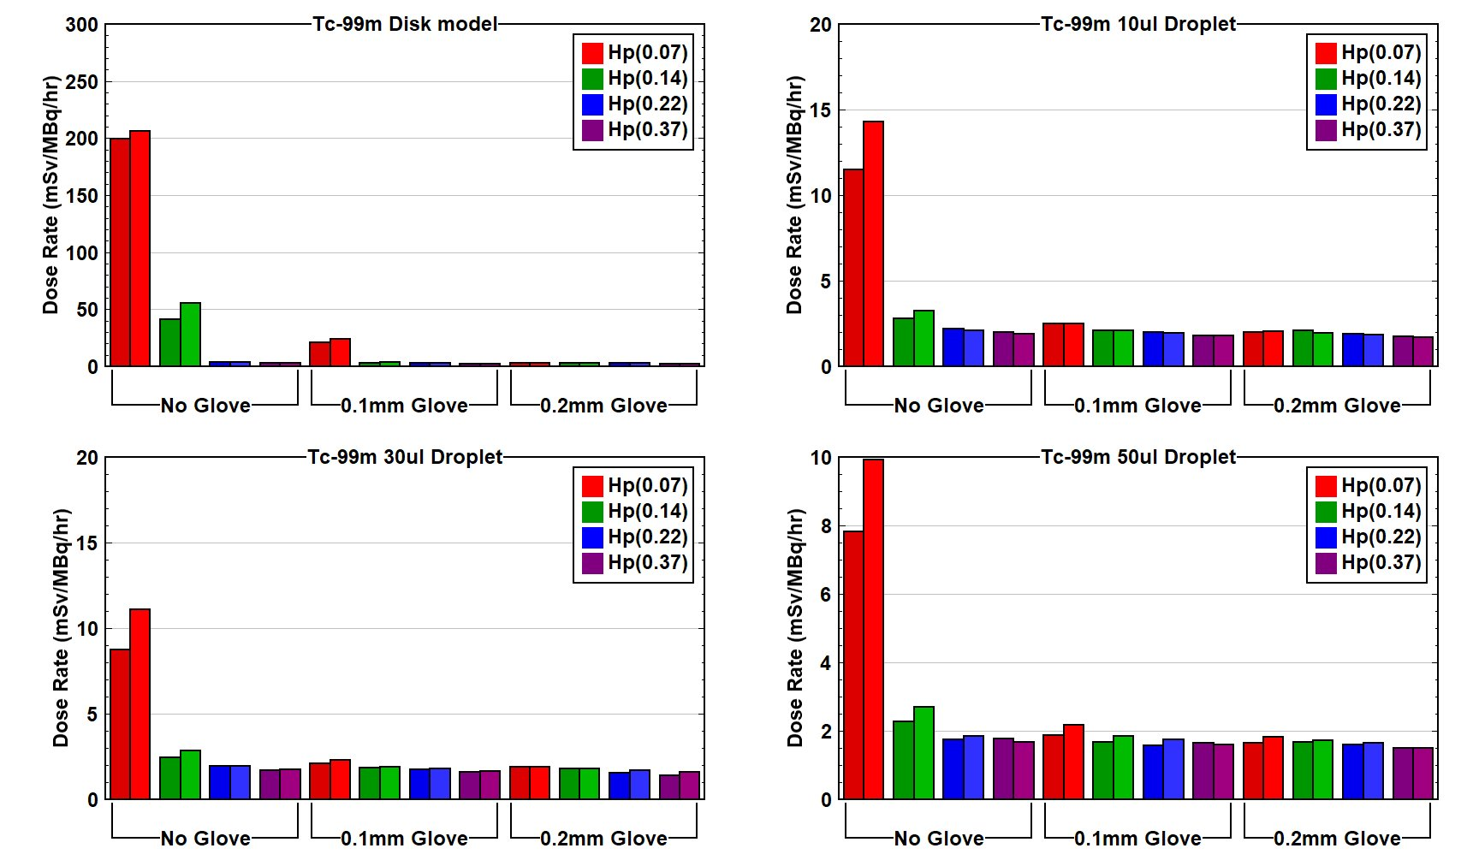

Slide 15
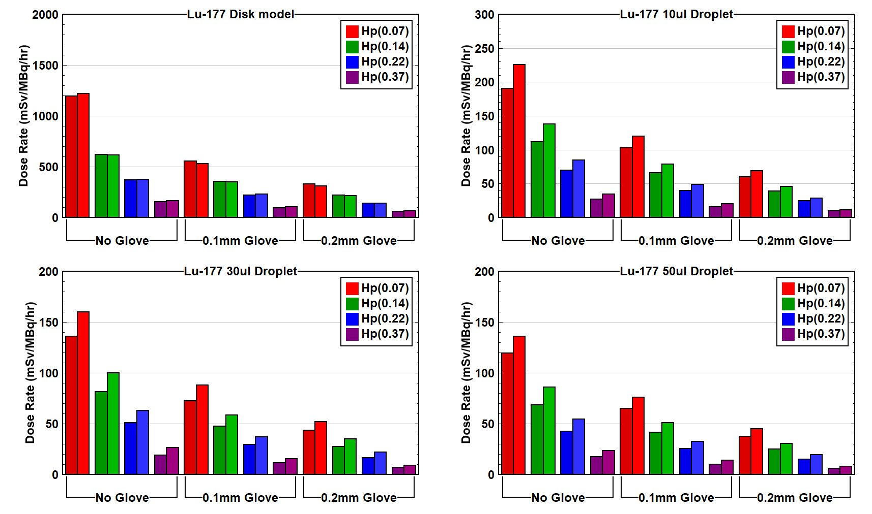

Slide 16
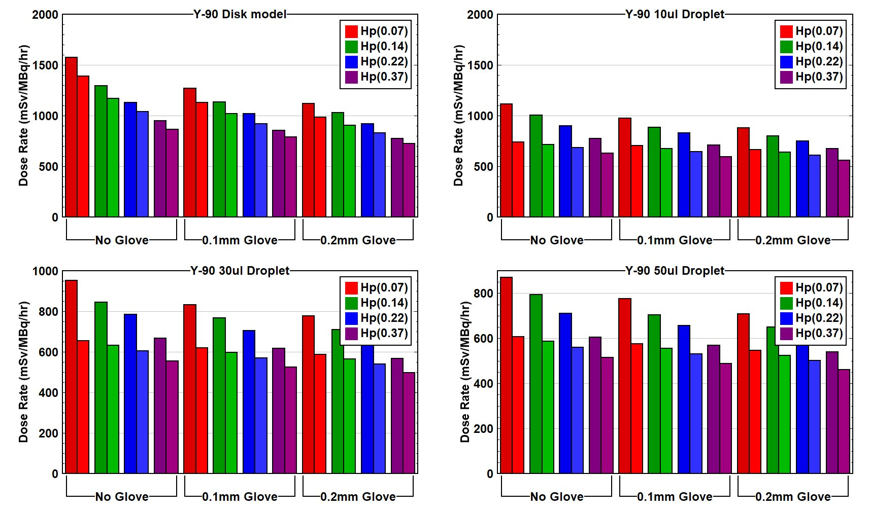

Slide 17
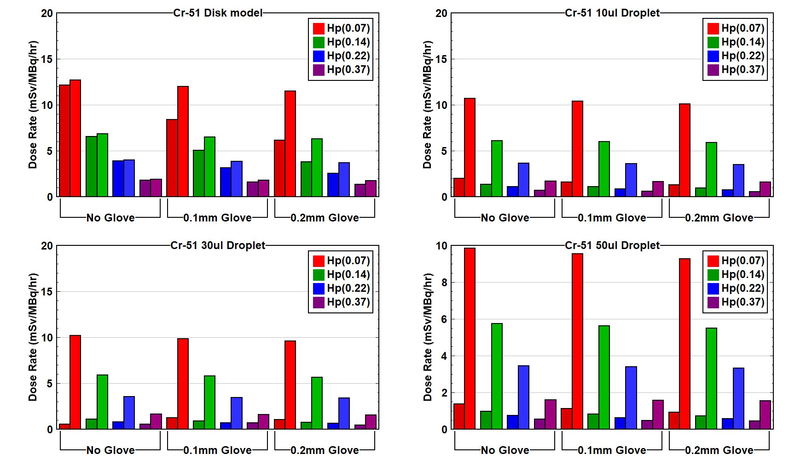

Slide 18
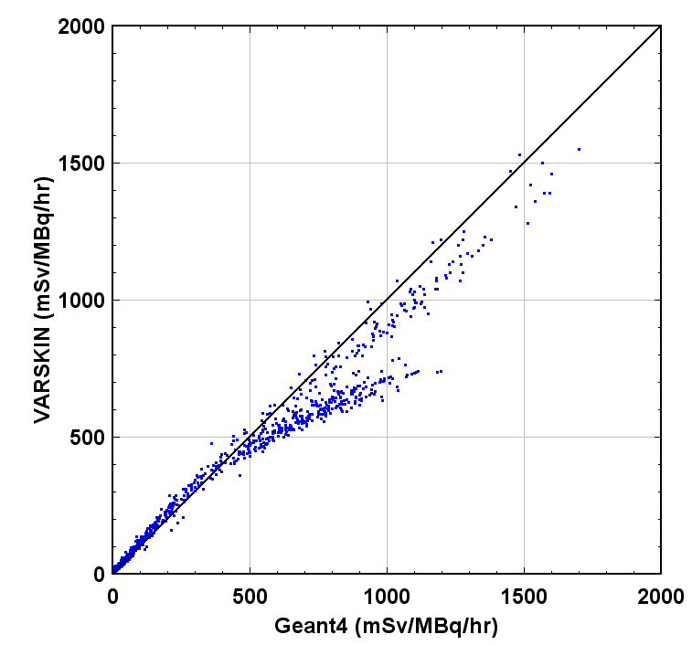
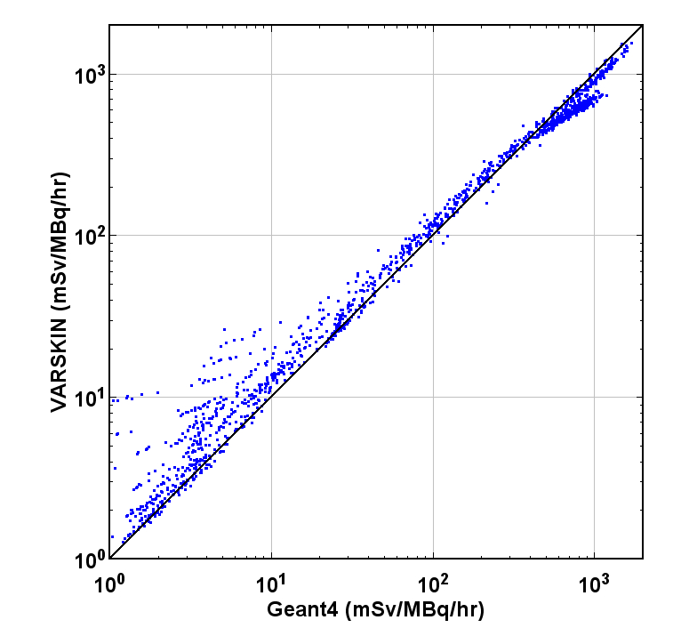
Linear Scale
Log Scale

Slide 19
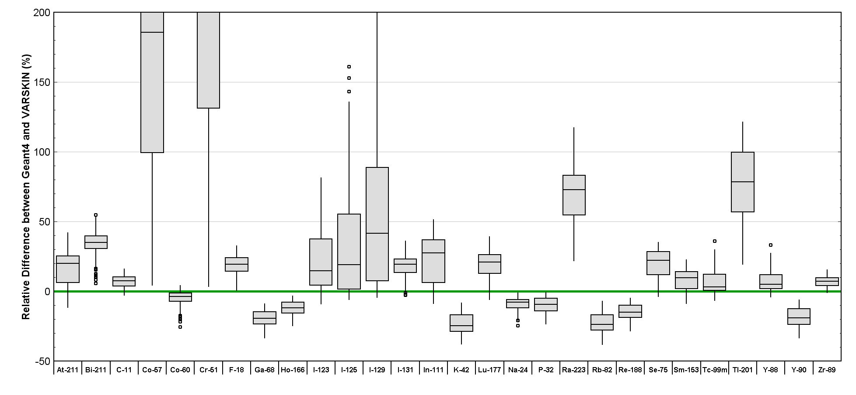
Results – Relative Difference
VARSKIN higher than Geant4
VARSKIN lower than Geant4

Slide 20
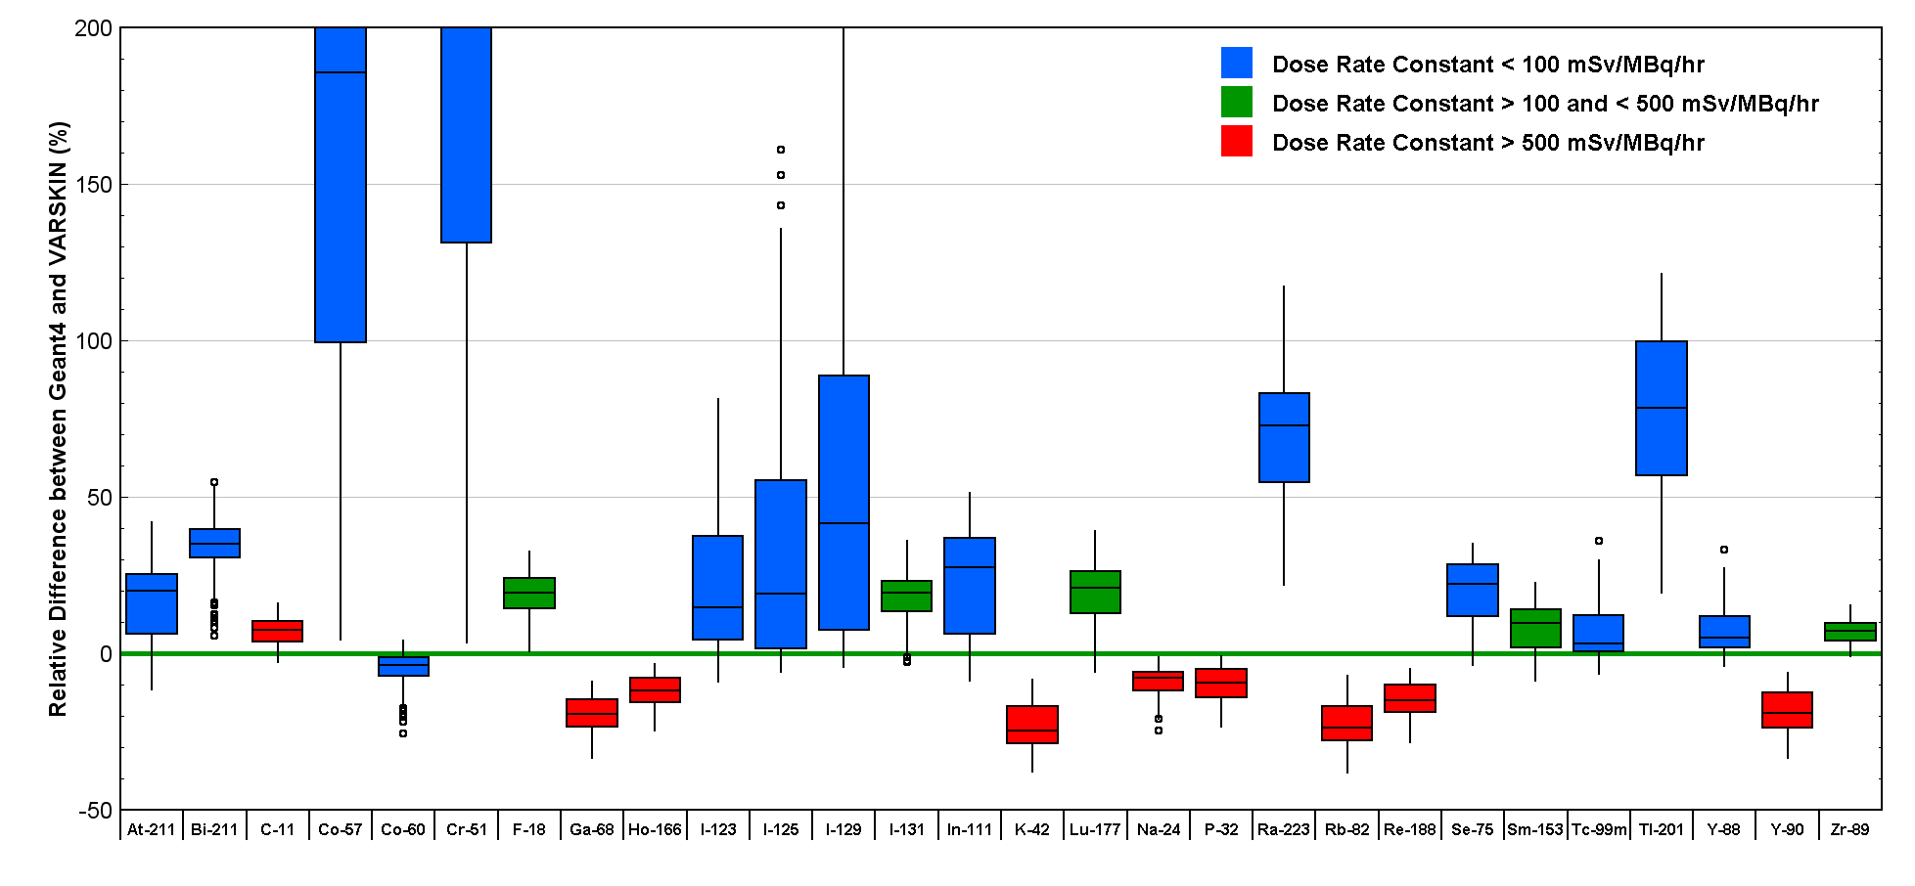
Results – Relative Difference
VARSKIN higher than Geant4
VARSKIN lower than Geant4

Slide 21
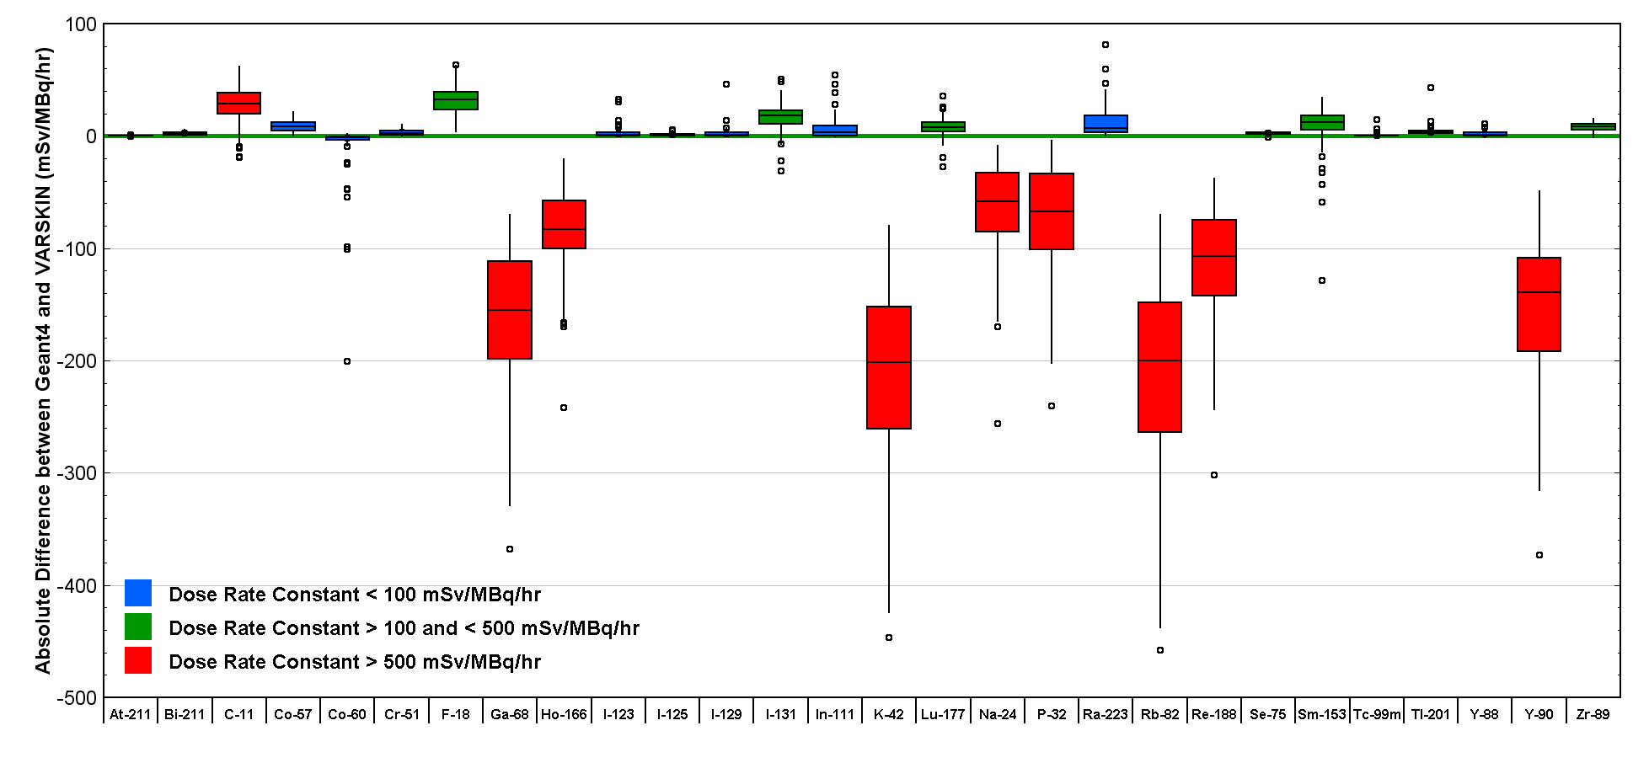
Results – Absolute Difference
VARSKIN higher than Geant4
VARSKIN lower than Geant4

Slide 22
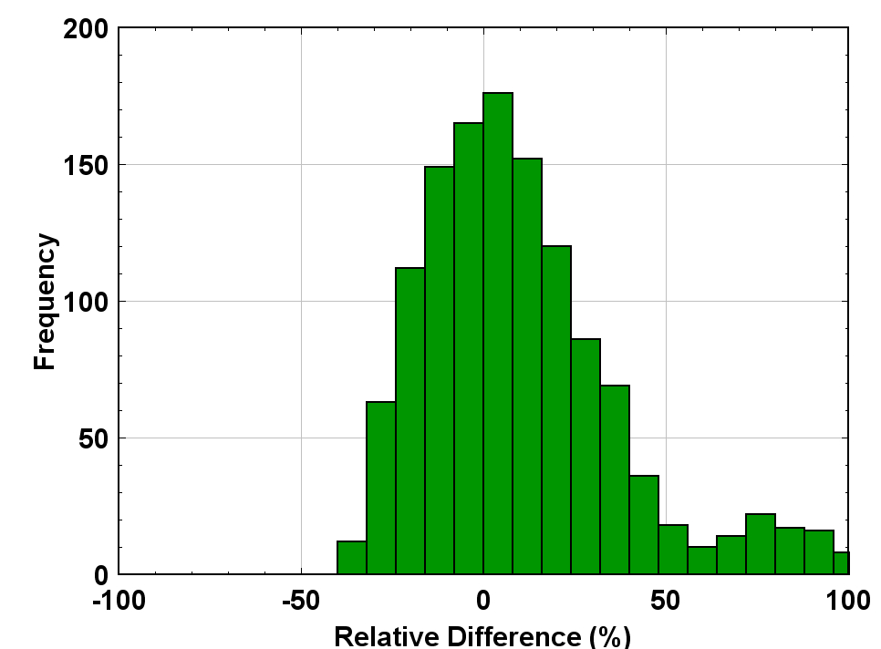
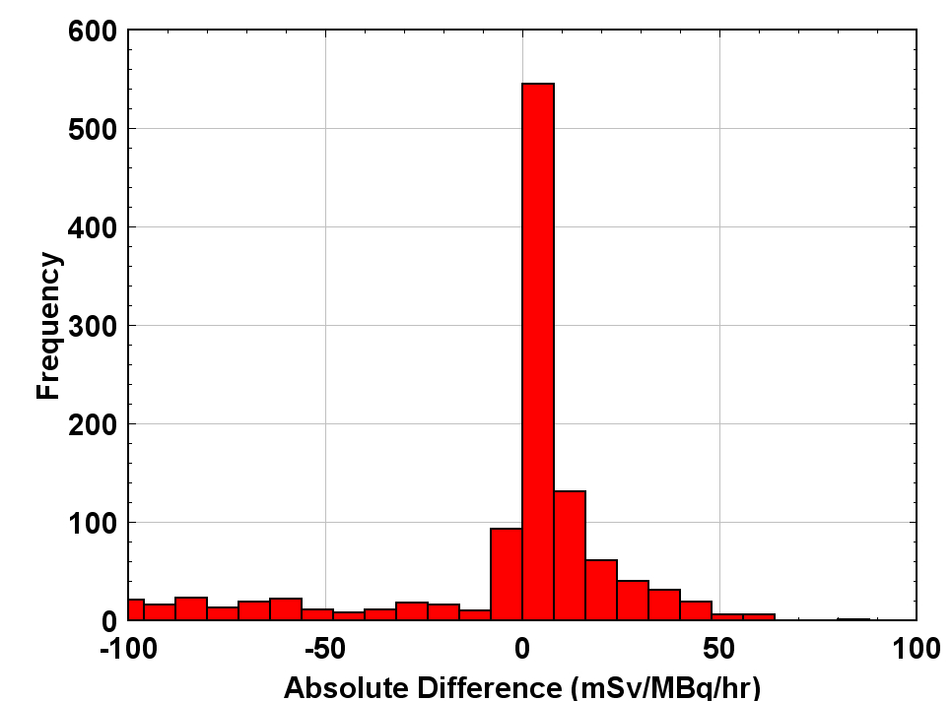
Results – All Data (N=1248)
 | Relative Difference (%) | Absolute Difference (mSv/MBq/hr)
Median | +7% | +0.8
95% CI | -30% to +270% | -260 to +40
Skewness | 7.1 | -2.0

Slide 23
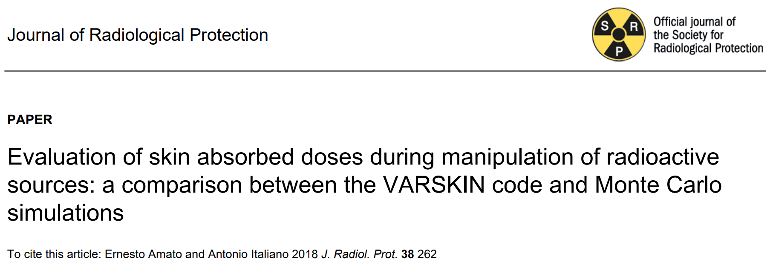
Literature
Review
⁵¹Cr
Factor Difference for Point Source |  | Factor Difference for Cylinder Source
No absorber | 0.96 | No absorber | 14
0.2mm Plastic | 1.8
1.0mm Plastic | 9.3 | 1.0mm Plastic | 29
2mm Glass | 30 | 2mm Glass | 41
10mm Glass | 22

Slide 24
Conclusion
Reasonable agreement between VARSKIN and Geant4 for most radionuclides.
Large relative differences observed for low dose radionuclides ( ⁵⁷Co and ⁵¹Cr)
Large absolute differences observed for high dose radionuclides (⁶⁸Ga, ⁴²K, ⁸²Rb and ⁹⁰Y)
VARSKIN tends to underestimate the dose from high energy β-emitters and overestimate the dose from both low energy β-emitters and photon emitters.
This work indicates that VARSKIN v1.2 is a reliable tool for skin dose assessment for a variety of geometries and radionuclides.

Slide 25

Thank you!
Are there any questions?

