Slide 1
Extravasation Dosimetry Update
Roland Benke, PhD, CHP
Director – Technologies Division
roland.benke@rcdsoftware.com

Slide 2

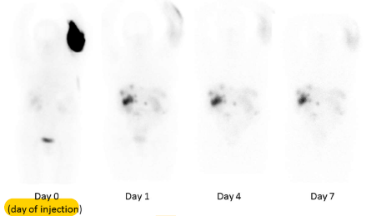

−
Extravasation dosimetry software module
Calculates 3D dose distributions in tissue with interfaces and flexibility appropriate for radionuclide extravasations
Extravasation occurs when radiopharmaceutical intended for the bloodstream leaks into surrounding tissue
Temporary condition that elevates absorbed radiation dose to healthy tissue without a medical benefit

Slide 3
models
Flow Model
Movement of radioactive extravasated fluid in tissue
3D activity concentration in tissue over time
3D local tissue dose over time
Activity Concentration Model
Dosimetry Model

Slide 4
Flow Model

Slide 5
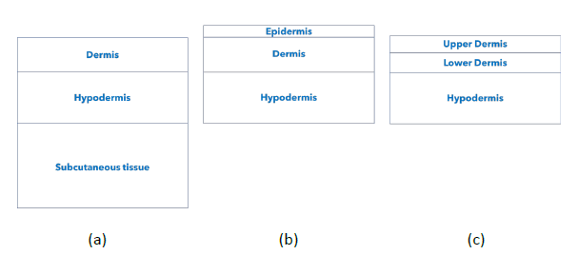
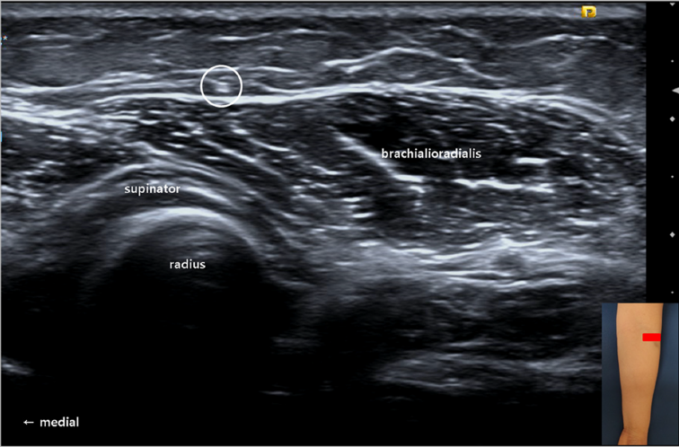
Flexible tissue layering
(a) (b) (c)
accommodates
  Deep infiltration without appreciable extravasation in epidermis
  Dermal extravasation with explicit infiltration into the epidermis
  Confined extravasation within multiple dermal layers
Kwak and Chang (2020) Compression of the lateral antebrachial cutaneous nerve due to leakage of iron after an intravenous iron infusion. Diagnostics 2020, 10, 516. Figure 1(C).

Slide 6
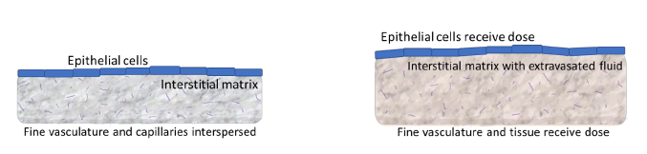
Homogeneous tissue matrix
Interstitial components include fine vascular bathed in extracellular fluid.
before extravasation
after extravasation
In initial model, fluid movement is tracked in a stationary grid without tissue shape changes.

Slide 7
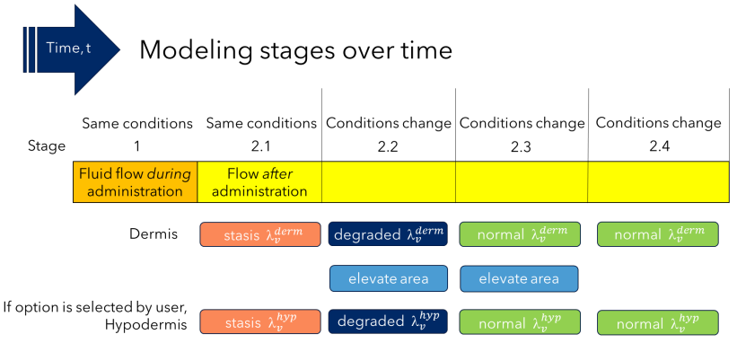
Flow primarily driven by pressure
STAGE 1
External driving force to flow
Theis equation for confined flow
2D lateral calculation initially
+ vertical fluid distribution
STAGE 2
No external driving force
Darcy flow with hydrostatic pressure from fluid in tissue
3D calculation

Slide 8
Activity Concentration Model

Slide 9
Activity concentration model
Top layer
Middle layer
Bottom layer
Extravasated fluid volume conc. [ml cm⁻³]
Converts extravasated fluid in tissue (test flow result above) into activity per unit volume
Applies 3D computational grid with unit tissue density that does not flex or deform
Option to specify F (unitless fraction of nonradioactive fluid in tissue displaced during extravasation)

Slide 10


Transfer to dosimetry model
Activity concentration model
transfers spatial- and time-dependent concentration data to the dosimetry model
includes time-integrated activity concentration
Activity concentration in tissue ≤ Activity concentration of administered radiopharmaceutical

Slide 11
Dosimetry Model

Slide 12

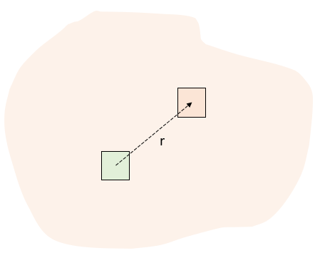
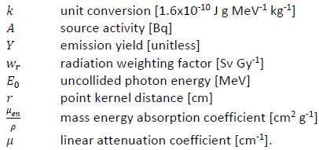
Photon Dose Rate
Point kernel for uncollided photons (no scatter) with cell center to cell center distance r
Point-pair distribution for 26 target cells immediately surrounding source cell (next slide)

Slide 13

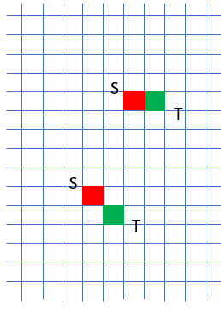
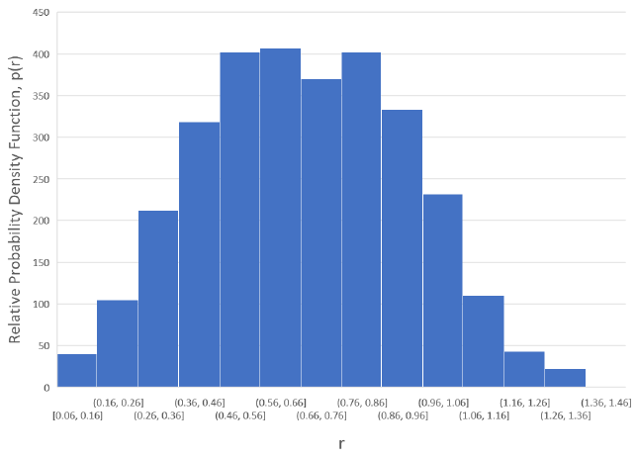
Point-Pair Distribution
Source cell S
Target cell T

Slide 14


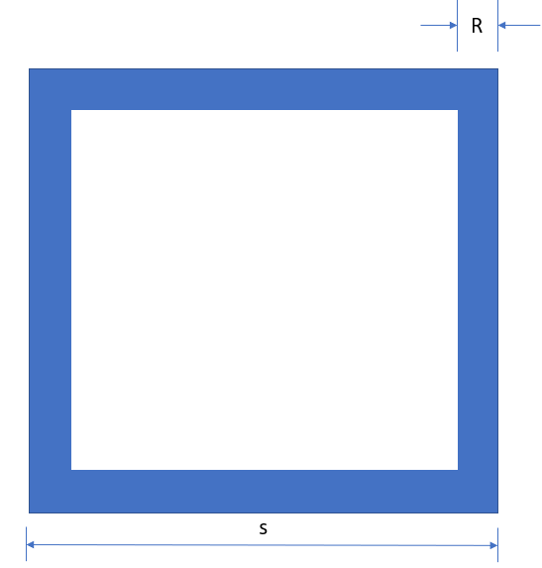
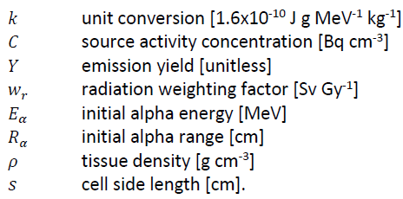
Alpha Particle Dose Rate
To source cell (self-irradiation)
To adjacent cells sharing a planar face

Slide 15
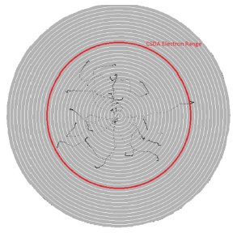

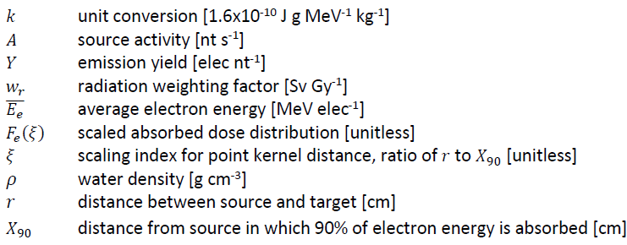
Electron Dose Rate
Based on SkinDose in VARSKIN+ 1.0 computer code
Details in NUREG/CR-6918, Revision 4 (July 2021)
Scaled absorbed dose distribution

Slide 16
Questions?

