Slide 1
Needlesticks and Implications for the Wound Dose Module in VARSKIN+v1.3
Bill Thomson , Holly Benderz
City Hospital , Birmingham , UK
Fortunately, uncommon!
But they do happen, and we need a dosimetry model
UK VARSKIN User group - Bill.Thomson@nhs.net

Slide 2
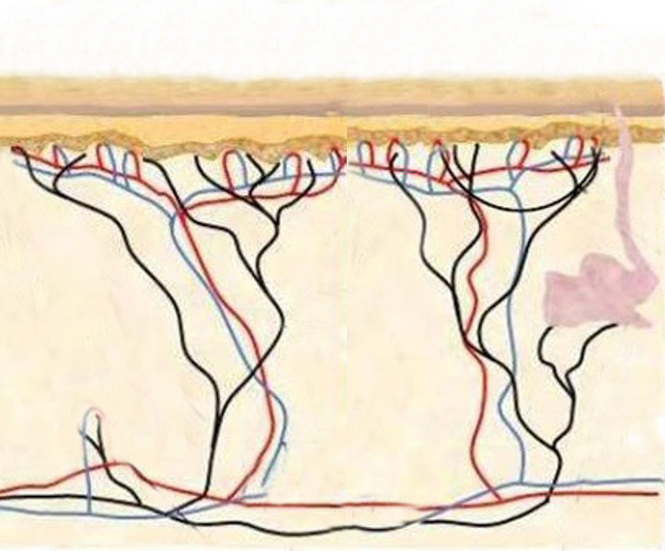
Skin Dose Diagram
Epidermis, average thickness 70µm
Sensitive Basal layer
Vascular dermal layer
Staff - 500mSv annual limit
Notes:
National Training Scheme for the Use of Radioiodine in Benign Thyroid Disease
2

Slide 3
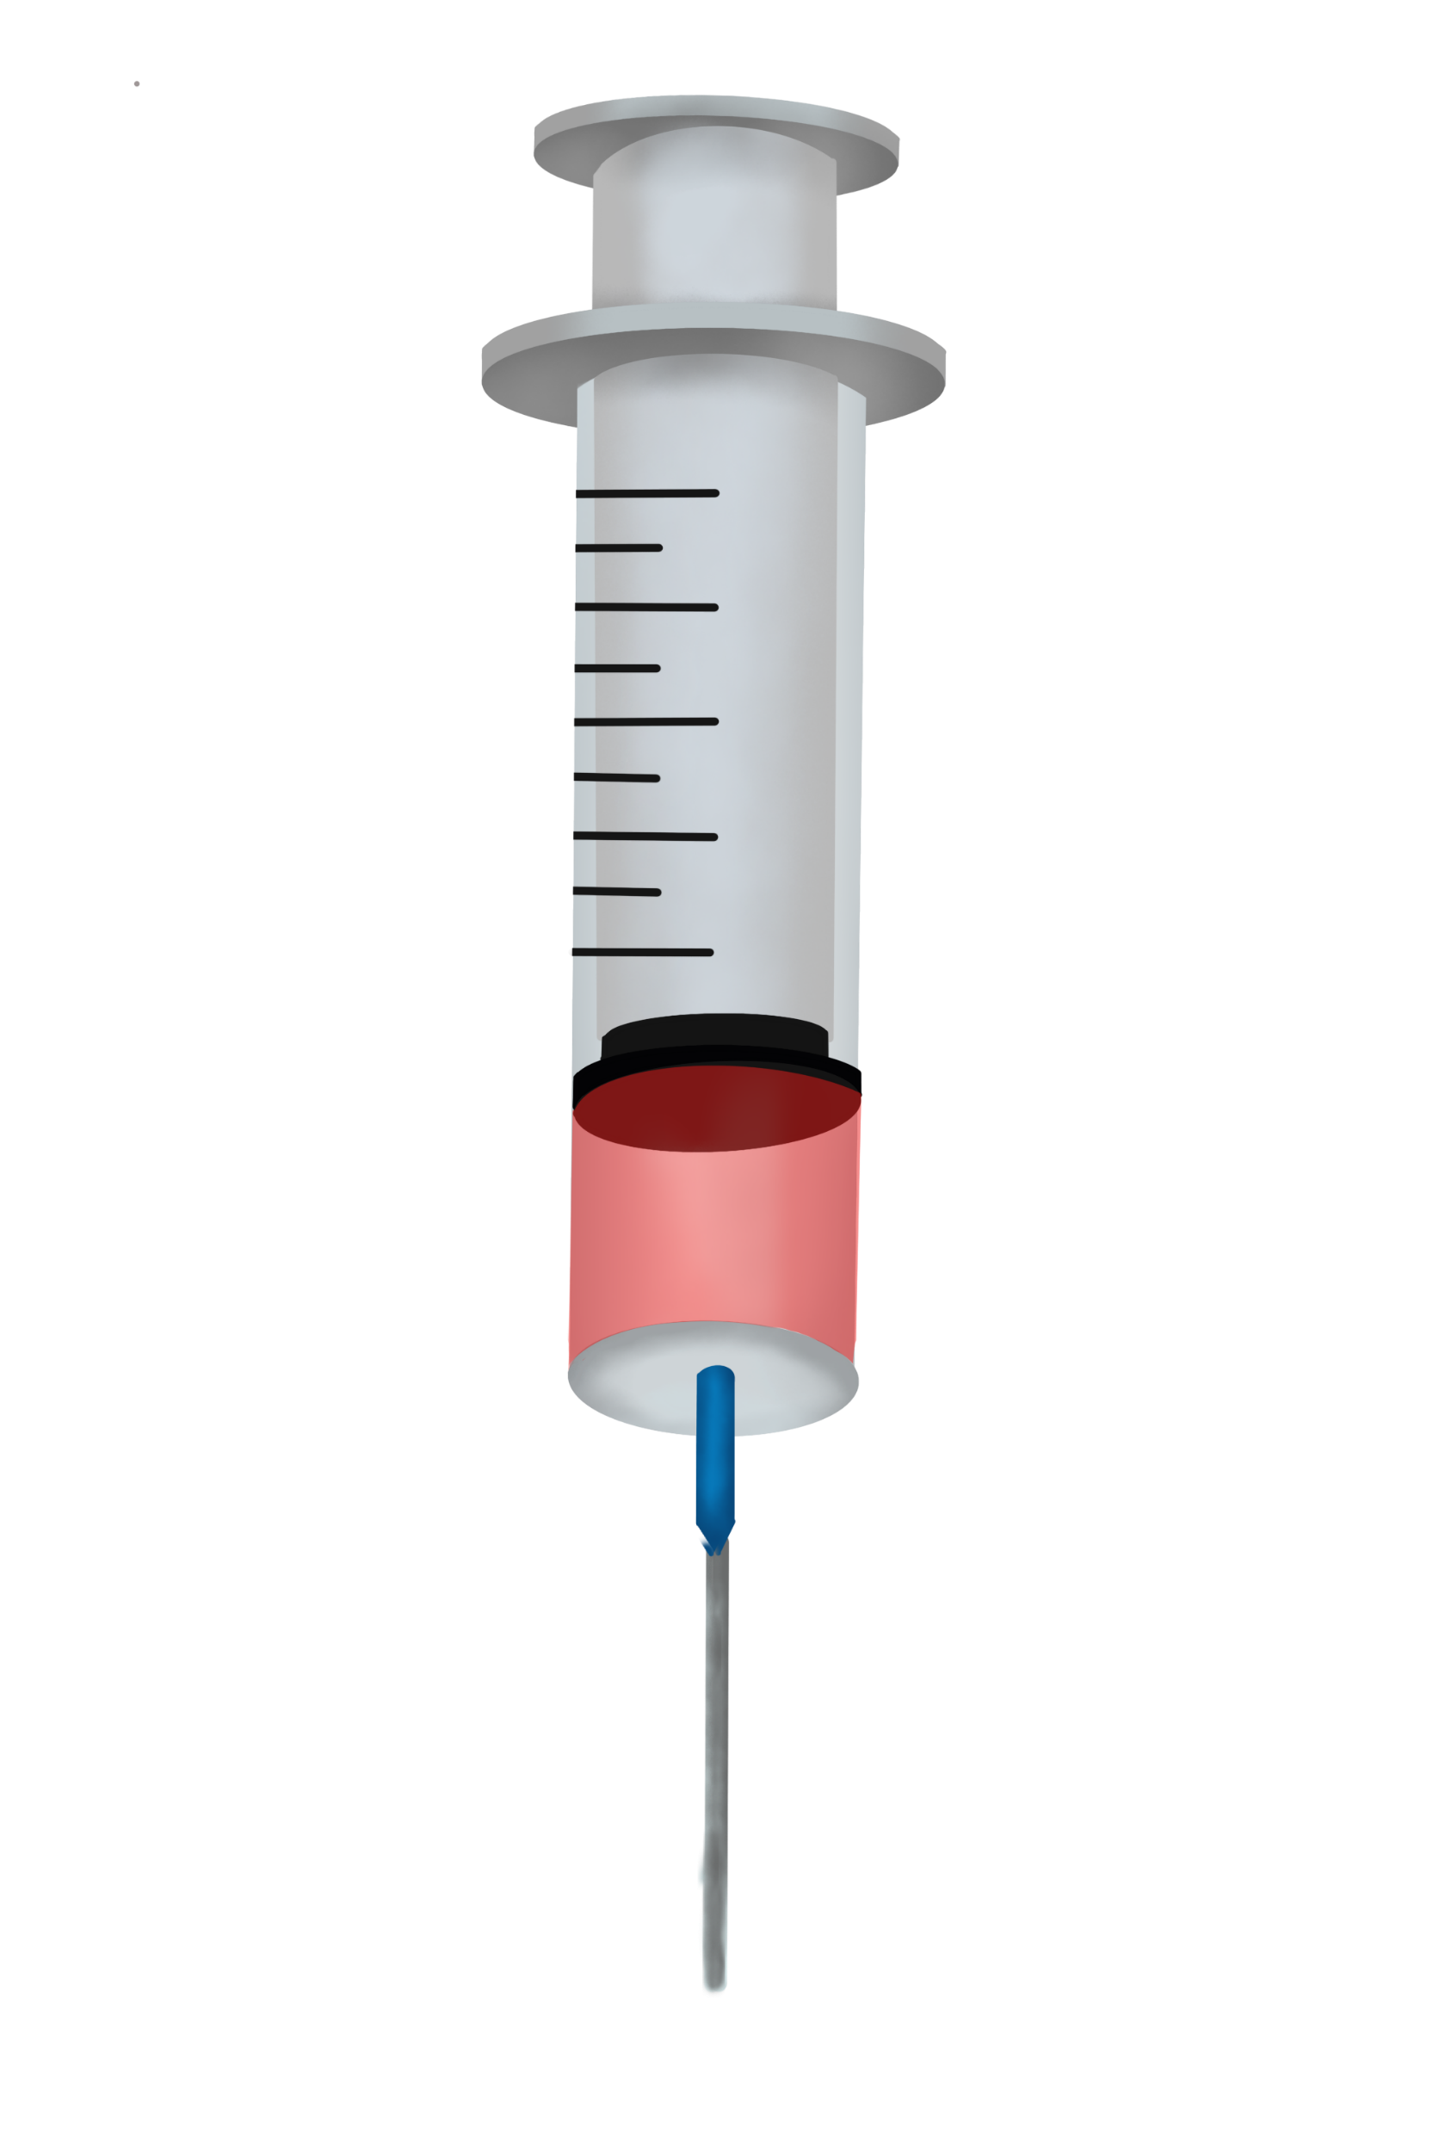
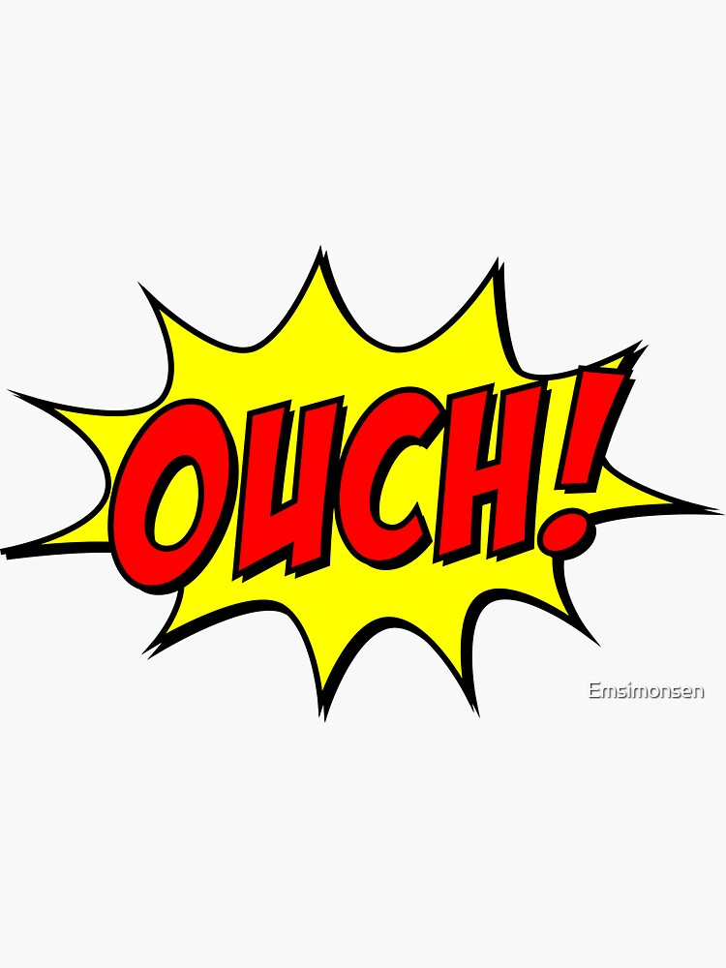
Needlestick?
Puncture wound through Basal layer
Activity deposited
Possibly 2 – 6mm depth
2mm used as worse case
(Other phrases are available!)
Not to Scale!
Notes:
National Training Scheme for the Use of Radioiodine in Benign Thyroid Disease
3

Slide 4
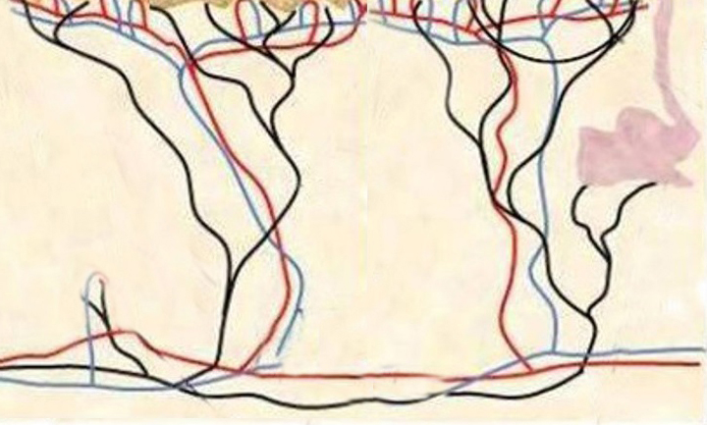
Scale Perspective
Skin Surface
70µm (diameter of
human hair!)
If drawn to scale ? -
Basal layer
2mm
Big distance from basal layer in radiation protection terms
Needlestick depth
Notes:
National Training Scheme for the Use of Radioiodine in Benign Thyroid Disease
4

Slide 5
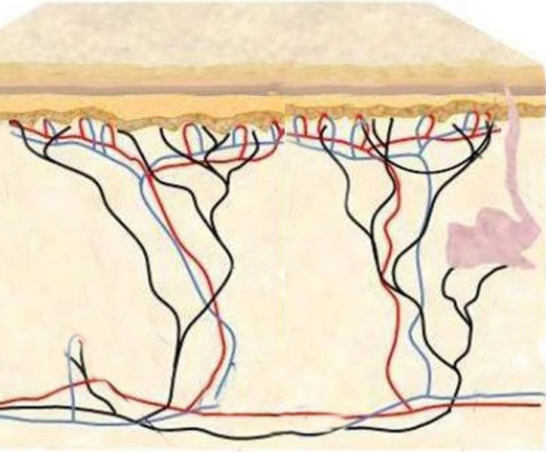
VARSKIN+v1.3 Wound Dose
Provides 2 Dose Components
Needle tract
Activity deposited uniformly
(line source)
2mm
Activity deposited at ‘needle tip’
(point source)
N.B. for alphas, range is ≈ 70 - 80 µm
No alphas at ‘needle tip’ will reach basal layer
Notes:
National Training Scheme for the Use of Radioiodine in Benign Thyroid Disease
5

Slide 6
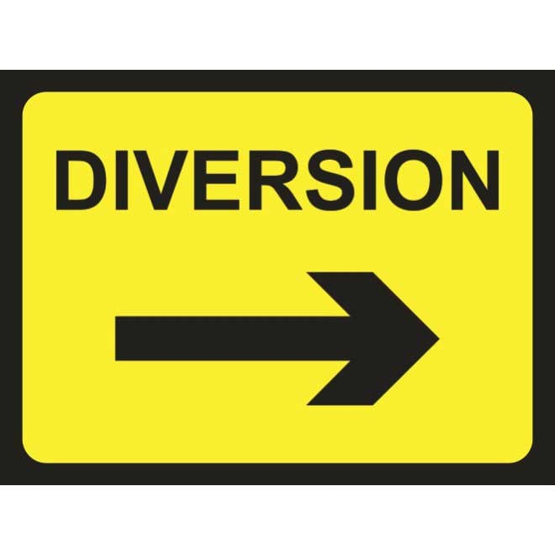
VARSKIN+v1.3 Wound Dose and Alpha Emitters
The 107D database is not available in Wound Dose
Individual radionuclides of the decay scheme must be used
BUT need to be aware of the decay scheme
Example - Ra223
Notes:
National Training Scheme for the Use of Radioiodine in Benign Thyroid Disease
6

Slide 7
²²³Ra daughters daughters in equilibrium with Ra223 – use 11.4d half-life
CANNOT use calculated doses for the individual radionuclides
11.4d
²²³Ra
100%
²¹¹Po
4s
²¹⁹Rn
0.5s
0.28%
100%
100%
²⁰⁷Pb
stable
2min
²¹¹Bi
1.8ms
²¹⁵Po
100%
100%
100%
99.7%
²⁰⁷Tl
²¹¹Pb
4.8min
36min
Notes:
National Training Scheme for the Use of Radioiodine in Benign Thyroid Disease
7

Slide 8
VARSKIN+v1.3 Wound Dose and Alpha Emitters
Use the instantaneous dose-rates for each of the daughters (from ‘Dose Detail’)
Add these with percentage from the decay scheme
Gives the total instantaneous dose-rate for Ra223 + daughters
Integrate with an effective T½
[ physical T½ (11.4d) ; biological T½ for needlestick e.g. 6hrs ]
N.B. VARSKIN+v1.3 uses a tissue density of 1.1g/cc for alpha dose
Nuclear Medicine Communications. 45(3):159-168, March 2024
Notes:
National Training Scheme for the Use of Radioiodine in Benign Thyroid Disease
8

Slide 9
VARSKIN Models - Instantaneous Dose Rates mSv/h/kBq
N.B. for 1cm² averaging area - UK + Europe
mSv/h/kBq | Tc99m | F18 | ²²³Ra Incl. daughters
Point source (2mm deep) | 0.0013 | 0.011 | 0.25
Line Source (2mm length) | 0.04 | 0.49 | 1980
Ratio | x30 | x44 | x8050
2mm
Notes:
National Training Scheme for the Use of Radioiodine in Benign Thyroid Disease
9

Slide 10
Focus on Ra223
Which Needlestick Model ?
Point source?
(some argue bleeding leaves this)
line source?
Some Combination of
% of line + % of point ?
e.g.
5% of line + 95% of point
1980 mSv/h/kBq
0.25 mSv/h/kBq
100 mSv/h/kBq (x400)
Examine some factors which might influence the model
Notes:
National Training Scheme for the Use of Radioiodine in Benign Thyroid Disease
10

Slide 11
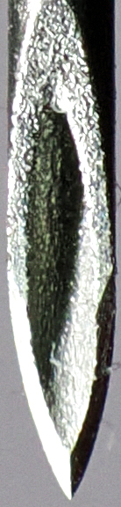
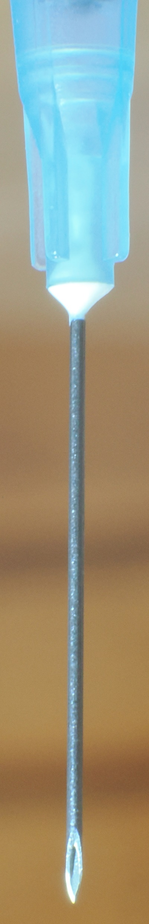
Impact of needle design on
Activity Distribution?
Scale Perspective - Needle
70µm
Skin Surface
Basal layer
Lance shape of needle is > 2mm!
‘Wipes’ along skin layers as punctures through tissue
activity is very likely distributed along the needle track.
2mm
Notes:
National Training Scheme for the Use of Radioiodine in Benign Thyroid Disease
11

Slide 12
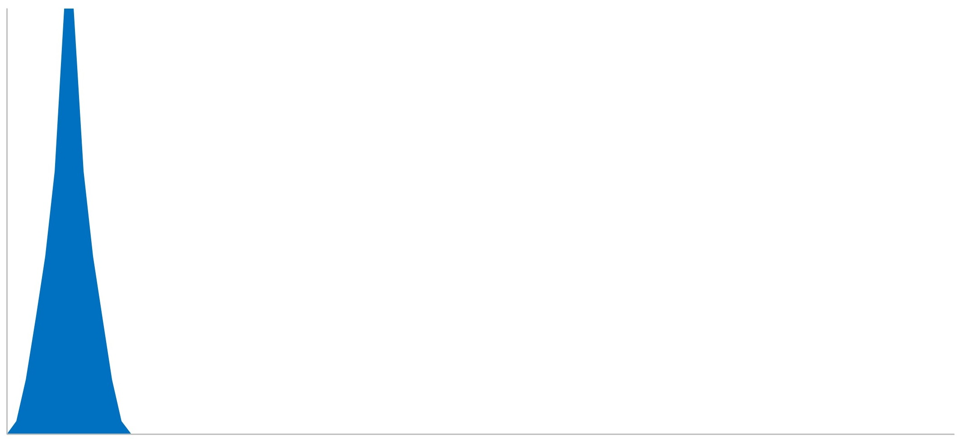
Doserate distribution with depth - ²²³Ra
Basal Layer Doserate/ µm-depth
70µm
0-150µm
Skin Surface
>99.5% dose is from activity in 0 - 150µm depth!
SO, if activity is not uniform ?
Reduced activity in 0-150µm -
Smaller dose
BUT
Increased activity in 0-150µm - Larger dose
Which is it?
Basal layer
2mm
Uniform activity along wound
Notes:
National Training Scheme for the Use of Radioiodine in Benign Thyroid Disease
12

Slide 13

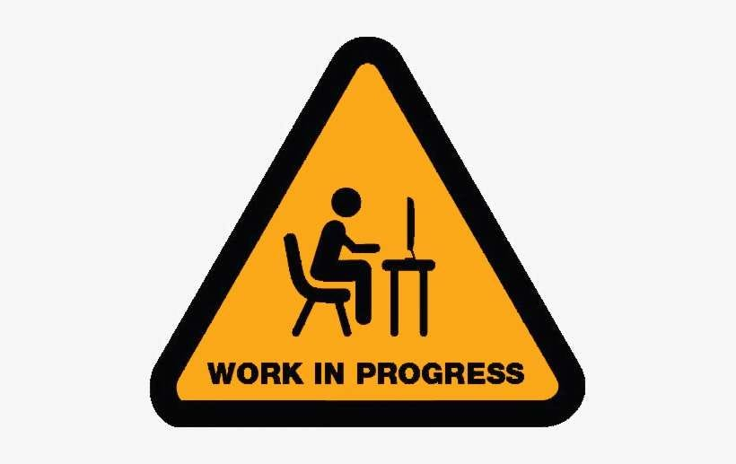
Critical Question for dosimetry
What is distribution of activity along the needletrack, particularly around the basal layer, 0-150µm ?
(Apologies! A UK quiz programme!)
Notes:
National Training Scheme for the Use of Radioiodine in Benign Thyroid Disease
13

Slide 14
Measure activity along needlestick wound?
(No volunteers!)
Use Agar gel - tissue mimic
insert needle into gel with fixed depths
using microtome mechanism, ‘immediately’ get thin slices through the needlestick (open razor)
Microtome accuracy 2um.
However, overall mechanics allow about 50-100um
Slices are weighed for accurate thickness
Notes:
National Training Scheme for the Use of Radioiodine in Benign Thyroid Disease
14

Slide 15
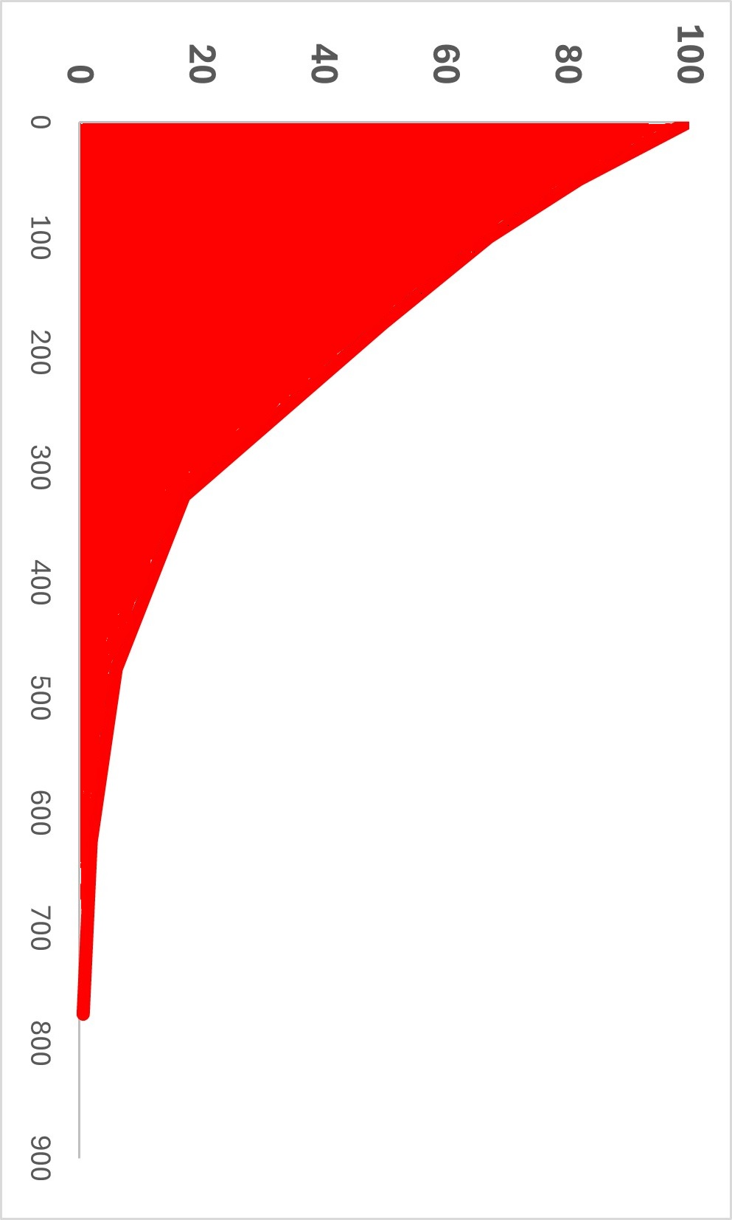
Simulated Needlestick
Activity %
70µm
0-150µm
Skin Surface
0 20 40 60 80 100
~ 50% activity in
0 – 150µm
Basal layer
2mm
0% after ~800µm
0% at ‘Needletip’
Notes:
National Training Scheme for the Use of Radioiodine in Benign Thyroid Disease
15

Slide 16
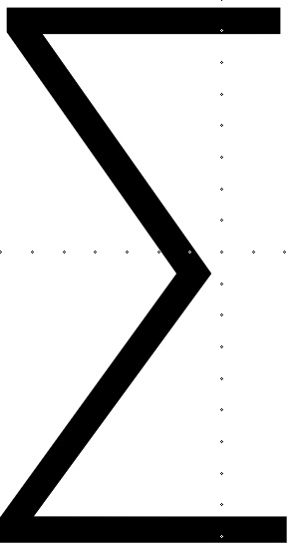
New Needlestick Dosimetry Model
0 -
X
µm
=
Needlestick
Doserate
500 -
Sum over depth
Ra223 doserate profile
with depth
Activity with depth
1000 -
1500 -
Potentially, a radionuclide factor independent of needlestick depth?
(May need different factors for needle going through gloves)
Notes:
National Training Scheme for the Use of Radioiodine in Benign Thyroid Disease
16

Slide 17
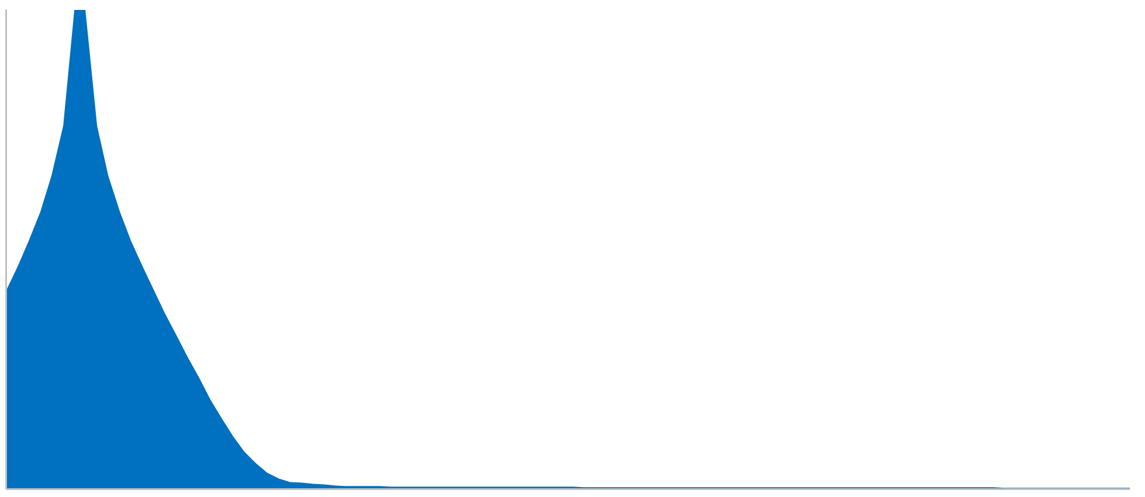
Tc99m
0 -
X
µm
=
Needlestick
Doserate
500 -
Doserate profile with depth
Tc99m
Sum over depth
1000 -
1500 -
Notes:
National Training Scheme for the Use of Radioiodine in Benign Thyroid Disease
17

Slide 18
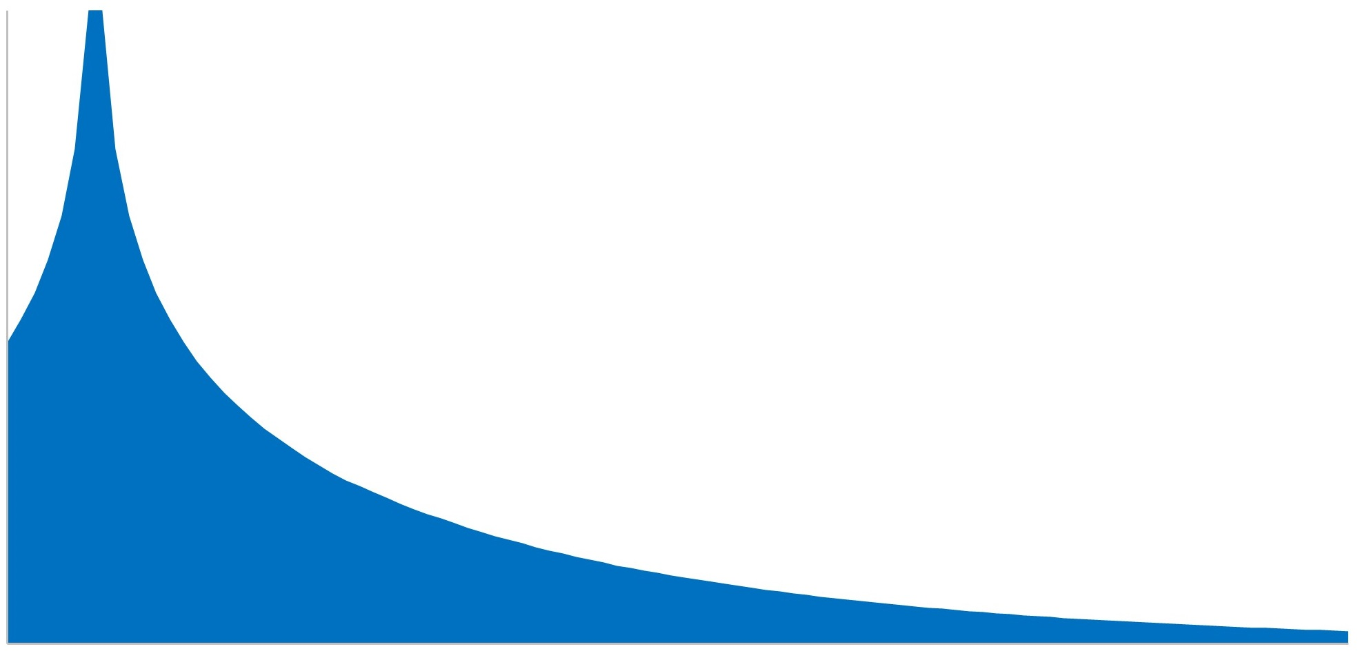
F18
0 -
X
µm
=
Needlestick
Doserate
500 -
Sum over depth
Doserate profile with depth
F18
1000 -
1500 -
Notes:
National Training Scheme for the Use of Radioiodine in Benign Thyroid Disease
18

Slide 19
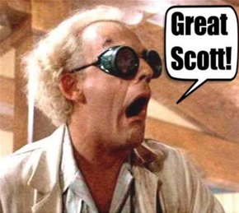
Needlestick Dose – mSv/kBq
(using a 6hr retention)
mSv/kBq | Tc99m | F18 | ²²³Ra + daughters
VARSKIN 2mm Line | 0.17 | 1 | 17,000
New model | 1.6 | 5.8 | 191,000
Ratio | x9.4 | x6 | x11
Notes:
National Training Scheme for the Use of Radioiodine in Benign Thyroid Disease
19

Slide 20
My New Model – Doses from Typical Needlestick Activities
Tc99m | F18 | ²²³Ra + daughters
1.6 mSv/kBq | 5.6 mSv/kBq | 191,000 mSv/kBq
Needlestick activity based on 0.1µl vol.
40 kBq | 15 kBq | 0.1 kBq
64 mSv | 84 mSv | 19 Sv
Not
Definitive!
below 500mSv
‘Never Event’ classification?
BUT -
Cannot disprove any ‘washout’ from bleeding
Percutaneous absorption likely occurs – will reduce doses
N Banks et al ; IPEM Translation Open access Volumes 10–11, June 2024, ,
Notes:
National Training Scheme for the Use of Radioiodine in Benign Thyroid Disease
20

Slide 21
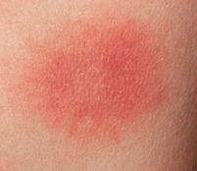
Risks of 500mSv Needlestick?
Erythema?
^{99m}Tc , F18 etc. ; 2 to 5 Gy threshold for transient erythema
Alphas ; need to remove the weighting factor Wr of x20 (only for stochastic)
500mSv becomes 25 mGy for deterministic events
No Erythema
ICRP nos. 59 ; 92 ; 103 ; 147
M Charles :- Skin dose from Ra-226 contamination: Dose estimation & comments. November 2008 (sepa.org.uk)
Notes:
National Training Scheme for the Use of Radioiodine in Benign Thyroid Disease
21

Slide 22
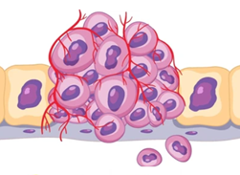

Risks of 500mSv Needlestick?
Stochastic?
“Back of the Envelope” calculation
Total skin area of body is approx. 20,000 cm²
Total Skin is included in effective dose, factor = 0.01
BUT - stochastic risk for skin is proportional to area
Only small skin area is irradiated , < 1 cm²
So, risk is reduced by 1 in 20,000
Calculated Risk for 500 mSv is < 10⁻⁷ ; or < 1 µSv effective dose
Risks are extremely low ( CONTROVERSIAL ? - no need to remove staff from work)
Risks?
Extremely Low!
Carcinogenic Risk of Hot-Particle Exposures M. Charles et.al .2003 J.Radiol.Prot. 23;5
M Charles :- Skin dose from Ra-226 contamination: Dose estimation & comments. November 2008 (sepa.org.uk)
Notes:
National Training Scheme for the Use of Radioiodine in Benign Thyroid Disease
22

Slide 23
79 technologists’ responses
Score 1 – no concerns , 10 - extremely concerned
500mSv skin dose?
Anxiety
Stochastic
Tc99m
Alpha

Slide 24
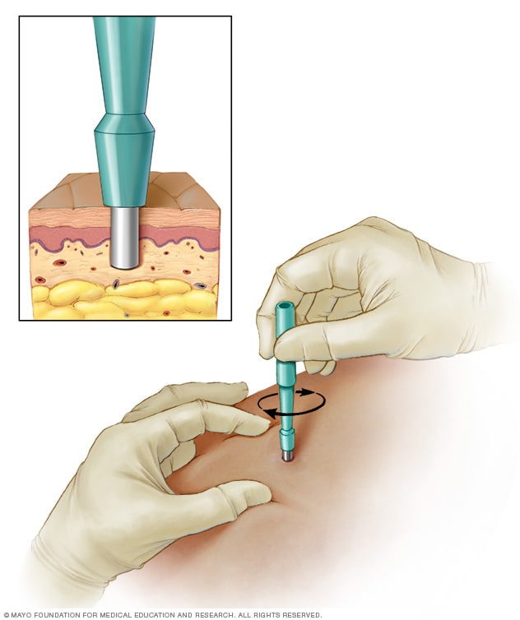
Another Controversial Concept!
70µm
0-150µm
Dose
Dose is all within 0-150um
For a very high dose event ,
Potentially can remove that tissue.
Dermatology punch biopsy, 3mm diameter and <0.5mm deep will totally remove the dose !
Skin Surface
Basal layer
2mm
MUST be the individual’s decision, not ‘regulatory’.
Notes:
National Training Scheme for the Use of Radioiodine in Benign Thyroid Disease
24

Slide 25
Conclusions
Needlestick activity seems weighted towards the 0-150µm depth,
increasing doses compared to uniform line model
Potentially, radionuclide dose factor independent of needlestick depth?
Staff awareness – particularly of very low risks (no need to remove from work?)
In very high dose cases, potential for the member of staff to consider dermatological removal? (their decision and consent!)
Specific Risk Assessments for dispensing/administration alpha emitters
Notes:
National Training Scheme for the Use of Radioiodine in Benign Thyroid Disease
25

Slide 26
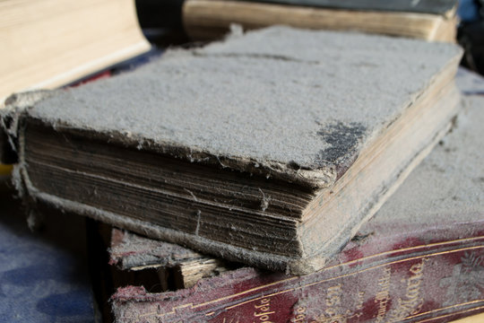
Hopefully Never Needed!
Bill’s Needlestick Model
UK VARSKIN User group - Bill.Thomson@nhs.net

Slide 27
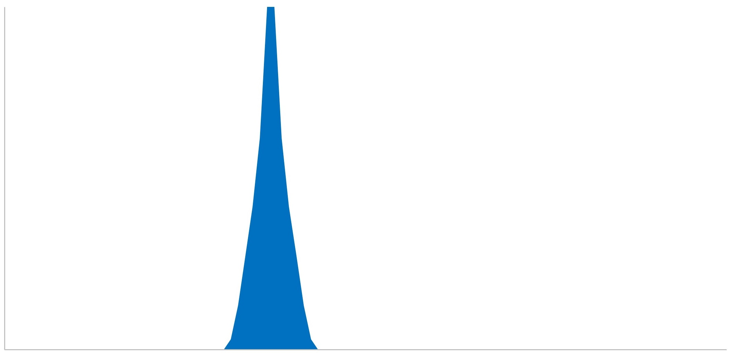
Basal Layer depth
70µm
0 -
370µm
X
µm
=
Needlestick
Doserate
500 -
Finger pulp
Sum over depth
1000 -
1500 -
Notes:
National Training Scheme for the Use of Radioiodine in Benign Thyroid Disease
27

Slide 28
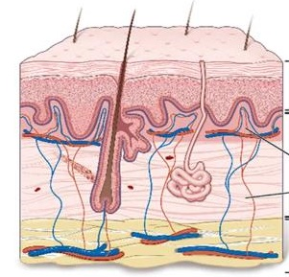
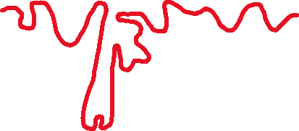
Alpha doses Significance - Deterministic
500mSv is essentially a deterministic limit
VARSKIN applies W_{r} of x20
ICRP do not recommend using this for deterministic purposes
Significant fraction of basal stem cells deeper than alpha threshold, so are ‘spared’ .
These cells can migrate following irradiation of upper basal cells
This significantly increases the threshold for deterministic events - 1kGy for erythema
“High skin doses calculated from alpha exposure to superficial layers of skin should not be compared directly with the skin dose limit”

Slide 29
Risks of 500mSv Needlestick?
Stochastic?
Risks?
Extremely Low!
Stochastic risk for skin is proportional to area
Only small skin area irradiated , < 1 cm²
Total area of skin is approx. 20,000 cm²
So, risk is reduced by 1 in 20,000
Also, skin is included in effective dose calculations, factor = 0.01
Risk for 500 mSv is < 10⁻⁷ ; or < 1 µSv effective dose
Risks are extremely low ; - no need to remove staff from work
Carcinogenic Risk of Hot-Particle Exposures M. Charles et.al .2003 J.Radiol.Prot. 23;5
M Charles :- Skin dose from Ra-226 contamination: Dose estimation & comments. November 2008 (sepa.org.uk)
Notes:
National Training Scheme for the Use of Radioiodine in Benign Thyroid Disease
29

