Slide 1
Dose Coefficients for Discrete Radioactive Particles
David M. Hamby, PhD
david.hamby@rcdsoftware.com
w/ R. Benke, C. Mangini and C. Rose
October 24, 2024

Slide 2
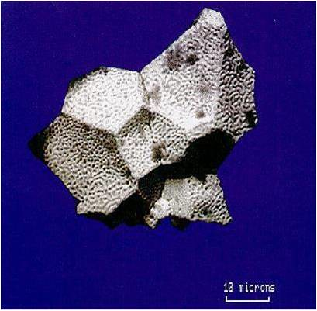
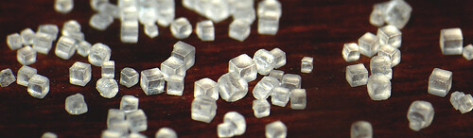
… aka “Hot Particles”
DRP definition
  10 – 1,000 µm in any dimension
  insoluble in water
  of high specific activity
DRPs are potentially harmful
  if on the skin [for a significant length of time]
  if inhaled or ingested and become stuck in the upper respiratory or gastrointestinal tract [for a significant length of time]
The harm is generally deterministic and related to tissue ulceration or necrosis
Uranium oxide from Chernobyl
Table Salt (~ 300 microns)

Slide 3
Context: Site Release
A decontaminated nuclear facility may contain residual radioactivity in the form of small “specks” in the soil
These specks (DRPs) are usually located by intense site-closure surveys, but the possibility exists that a small number of DRPs could go undetected
After site release, if one of these undetected DRPs is taken into one’s body or becomes attached to the skin, the resulting local dose could be significant

Slide 4
DRP Exposure Scenarios
Skin Surface
  Shallow Dose Equivalent
  Effective Dose Equivalent
Upper Respiratory Tract
  Local Dose Equivalent (ulceration)
  Effective Dose Equivalent (stationary particle)
Small & Large Intestine
  Local Dose Equivalent (ulceration)
  Effective Dose Equivalent (stationary particle)
  Ingestion CEDE

Slide 5
Ulceration Threshold Dose
3.5 - 5 Gy for erythema and edema (HHS 2022)
25 Gy for deep ulceration and necrosis (IAEA 2020)
25 Gy for ulcers and necrosis (Iddins et al. 2022)
1 Gy for acute ulceration (ICRP 1992)
5 - 10 Gy for erythema, desquamation, necrosis (ICRP 2012)
Risk of ulcers and fibrosis
5% at 55 Gy; 50% at 70 Gy
(EPA 1992)
20 Gy for deep ulceration
(CDC 2020)
30 Gy ulceration anticipated
(DiCarlo et al., 2020)
Dose (Gy)
1 5
10 20 30 40 50 60 70 80 90 100
Recommendation:
25 Gy ulceration threshold

Slide 6
Critical Tissue Depths
Recommended Ulceration Dose Threshold
  25 Gy – average absorbed dose delivered to 1 cm² at the critical depth
Critical Tissue (basal cell) Depths
  Upper Respiratory Tract – 4.5 mg/cm²
  Small Intestine – 14 mg/cm²
  Large Intestine – 29 mg/cm²

Slide 7
DRP Materials & Nuclides
Stellite (cobalt alloy)
Inconel (nickel alloy)
Regulatory concrete
Fuel fragment
Thoriated welding rod
  … w/ decay progeny

Slide 8
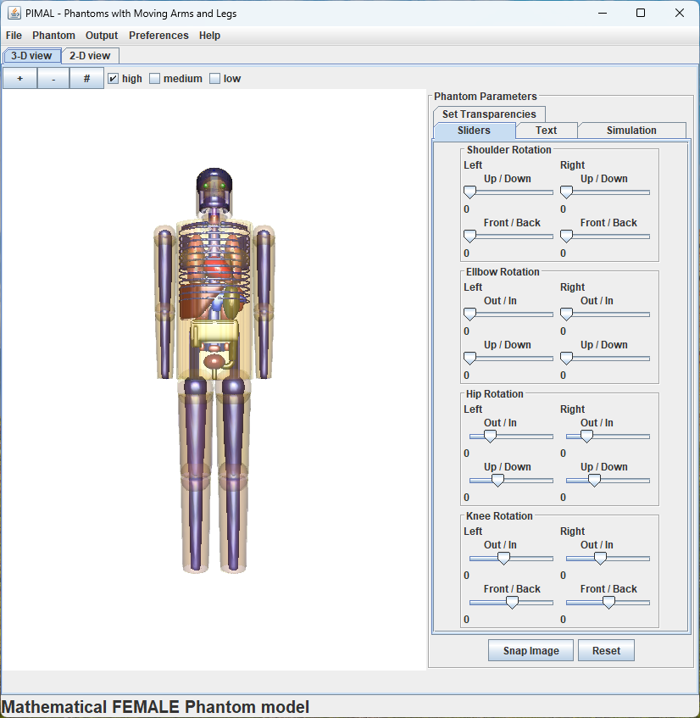
External DRP: Skin Surface
Particle resting on the skin surface
Modeled as spherical source w/ diameters from 10 to 1,000 µm
Bulk density and effective Z considered for self-shielding
Shallow Dose Equivalent (SkinDose)
  tissue depth of 7 mg/cm²; 10 cm² averaging
Effective Dose Equivalent (PiMAL/MCNP)
  particle situated at the mid-torso results in largest EDE
  weighted (ICRP 26/30) sum of organ dose equivalents

Slide 9
Internal DRP: Local Dose
Also, using the V+ SkinDose module
Particle assumed to be stuck on the inner surface of the upper respiratory tract, small intestine, or large intestine
Inner surface assumed to have no curvature (i.e., modeled as flat)
  focusing on highest local dose
Local Dose Equivalent determined at critical depths
Dose rate coefficients can be used to determine exposure time (or activity) required to exceed an ulceration threshold dose (25 Gy)

Slide 10
Internal DRP: EDE
Again, using coupled PiMAL/MCNP
DRP locations
  upper respiratory tract (nasopharynx, larynx)
  small and large intestine (various locations)
DRP assumed to remain whole and stationary

Slide 11
Internal DRP: CEDE - Ingestion
ICRP 30 gastrointestinal tract biokinetic model
  not originally intended for single-particle events
  assumed here to be valid for a DRP that moves with GI contents
  ICRP 26/30 tissue weighting factors
CEDE coefficients for ingestion developed using IMBA 5.0.1
DRP remains whole and is moving through the body
  no activity to the bloodstream, i.e., f₁ = 0
  except for fuel fragments (f₁ = 0.1)

Slide 12
Internal DRP: CEDE - Inhalation
Large particles will be captured in the nasopharynx (NP) region
In ICRP 30, particles with physical dimensions greater than 10 µm are assumed not to go deeper than the NP region
  thus, most likely outcome for DRPs is removal through physical excretion (i.e., sneezing)
  and the DRP would not travel through the respiratory system
A committed dose coefficient is not appropriate in this case

Slide 13
Stellite (Co-60)
Source Location | Dose Quantity | Dose Coefficient | Reasonable Maximum Exposure Time [d] | Estimated Maximum Dose Eq. [mSv] | Time Required for 0.5 Sv [d] | Time Required for 25 Gy [d]
Skin Surface | SDE | 3.7x10⁻⁸ [Sv/Bq h] | 1 | 44 | 11 | 560
(mid torso) | EDE | 5.8x10⁻¹⁰ [Sv/Bq h] | 1 | 0.70 | 720 | -
Upper Resp Tract | Local DE | 4.8x10⁻⁷ [Sv/Bq h] | 2 | 1,200 | 0.86 | 43
 | EDE | 8.8x10⁻⁸ [Sv/Bq h] | 2 | 210 | 4.7 | -
Small Intestine | Local DE | 1.7x10⁻⁷ [Sv/Bq h] | 0.5 | 100 | 2.5 | 120
Large Intestine | Local DE | 5.9x10⁻⁸ [Sv/Bq h] | 5 | 350 | 7.0 | 350
GI Tract | EDE | 2.7x10⁻⁹ [Sv/Bq h] | 5 | 16 | 150 | -
Ingestion | CEDE | 1.8x10⁻⁹ [Sv/Bq] | - | 0.090 | - | -
*in this example, the DRP is assumed to have a diameter of 100 microns and Co-60 activity of 50 kBq

Slide 14
Fuel Fragment (Eu-154)
Source Location | Dose Quantity | Dose Coefficient | Reasonable Maximum Exposure Time [d] | Estimated Maximum Dose Eq. [mSv] | Time Required for 0.5 Sv [d] | Time Required for 25 Gy [d]
Skin Surface | SDE | 8.1x10⁻⁸ [Sv/Bq h] | 1 | 16 | 32 | 1,600
(mid torso) | EDE | 3.1x10⁻¹⁰ [Sv/Bq h] | 1 | 0.060 | 8,400 | -
Upper Resp Tract | Local DE | 9.6x10⁻⁷ [Sv/Bq h] | 2 | 370 | 2.8 | 140
 | EDE | 4.3x10⁻⁸ [Sv/Bq h] | 2 | 17 | 60 | -
Small Intestine | Local DE | 5.6x10⁻⁷ [Sv/Bq h] | 0.5 | 45 | 4.6 | 230
Large Intestine | Local DE | 3.5x10⁻⁷ [Sv/Bq h] | 5 | 340 | 7.4 | 370
GI Tract | EDE | 1.5x10⁻⁹ [Sv/Bq h] | 5 | 1.4 | 1,700 | -
Ingestion | CEDE | 1.9x10⁻⁹ [Sv/Bq] | - | 0.015 | - | -
*in this example, the DRP is assumed to have a diameter of 100 microns and Eu-154 activity of 8 kBq

