Slide 1
Evaluation of Dose Coefficients Implemented in MACCS
Audrey T. Nguyen
SNL – Nuclear Engineer

Slide 2
Highlights
MACCS DCF Report
Health Physics Historical Review
Changes Implemented for MACCS 4.2
Opportunities for Improvement
Sandia National Laboratories
This written work is authored by an employee of NTESS. The employee, not NTESS, owns the right, title and interest in and to the written work and is responsible for its contents. Any subjective views or opinions that might be expressed in the written work do not necessarily represent the views of the U.S. Government. The publisher acknowledges that the U.S. Government retains a non-exclusive, paid-up, irrevocable, world-wide license to publish or reproduce the published form of this written work or allow others to do so, for U.S. Government purposes. The DOE will provide public access to results of federally sponsored research in accordance with the DOE Public Access Plan.
SAND2024-13653C

Slide 3

MACCS DCF Report
Why?​
  Missing information about past health physics decisions for MACCS work​
  New updates to MACCS DCF files: inclusion of ICRP 30 based TEDE values and rework of skin dose pathway calculation

Slide 4
Health Physics Historical Review
Notes:
​What was included:​
Full documentation review of legacy MACCS code creation, justification, and methodology reports​
Review of FGR 11, 12, and 13 and NRC health physics documents, as well as ICRP 26 and 60 methodology and other pertinent reports​
MACCS source code and DCF file creation source code review​

Slide 5
Documents and Methods Reviewed
​Full documentation review of legacy MACCS code creation, justification, and methodology reports​
Review of FGR 11, 12, and 13 and NRC health physics documents, as well as ICRP 26 and 60 methodology and other pertinent reports​
MACCS source code and DCF file creation source code review​

Slide 6
EDE versus ED versus TEDE
Effective Dose Equivalent
ICRP 26
Tissue weighting factor multiplied by mean dose equivalent to organ or tissue, which has had a quality factor applied to it
Effective Dose
ICRP 60 and 106
Tissue weighting factor multiplied by equivalent dose in organ or tissue, which has had a radiation weighting factor applied to it
Total Effective Dose Equivalent
10 CFR 20.1003 – Standards for Protection Against Radiation, Definitions.
“the sum of the EDE for external exposures and the CEDE for internal exposures”

Slide 7
Documents and Dosimetry Models
U.S. Federal Guidance Reports for Radiation Protection | ICRP Dosimetry Model
11 (1988): Limiting Values of Radionuclide Intake and Air Concentration and Dose Conversion Factors for Inhalation, Submersion, and Ingestion | 26 (1977): Recommendations of the International Commission on Radiological Protection
12 (1993): External Exposure to Radionuclides in Air, Water, and Soil | 26 (1977): Recommendations of the International Commission on Radiological Protection
13 (1999): Cancer Risk Coefficients for Environmental Exposure to Radionuclides | 60 (1991): 1990 Recommendations of the International Commission on Radiological Protection
15 (2019): External Exposure to Radionuclides in Air, Water, and Soil | 103 (2007): The 2007 Recommendations of the International Commission on Radiological Protection

Slide 8
Opportunity for Improvement: Dosimetry Models Represented
​Minimum health physics requirements in the U.S. are outlined in the FGR
Note that 11, 12, 13 follow: internal, external, and cancer risk. 15: external.
When is it appropriate to consider a new dosimetry model appropriate to adopt as the minimum standard?
  When the half of the available intake pathways’ DCF values have been approved?
  When derived values are accepted as fact (cancer risk from ICRP 60 dosimetry models → should the ICRP 60 internal and external DCF values been elevated as the standard then?
FGR | ICRP
11 (1988) | 26 (1977)
12 (1993) | 26 (1977)
13 (1999) | 60 (1991)
15 (2019) | 103 (2007)

Slide 9
FGR 13 Statement on DCF Models
  “Although many of the biokinetic and dosimetric models used here are updates of models used in Federal Guidance Report No. 11, the present report does not replace either that document or Federal Guidance Report No. 12 or affect their use for radiation protection purposes. The dose coefficients given in Federal Guidance Report No. 11 and Report No. 12 continue to be recommended for determining conformance with the radiation protection guidance to Federal agencies issued by the President and will be updated in the future as warranted. The risk coefficients tabulated in the present report have a different purpose -they are intended for use in assessing risks from radionuclide exposure, in a variety of applications ranging from analyses of specific sites to the general analyses that support rule making. Although the application of these risk coefficients for purposes such as cost/benefit analysis, environmental impact statements (EISs ), and environmental assessments (EAs)- especially by Federal agencies- is encouraged to promote consistency in risk assessment, such use is discretionary.”
FGR 13: https://www.epa.gov/sites/default/files/2015-05/documents/402-r-99-001.pdf

Slide 10
DCFs for MACCS
DOSFAC2 | FGRDCF | IDCF2
60 radionuclides important for commercial NPPs – LWR Includes acute inhalation dose coefficients ICRP 26 and ICRP 60 DCFs | FGR 11 and 12 data 825 radionuclides Used for lifetime dose calculations Preprocessor was preferred source of DCFs for DOE applications Not adequate for acute early health effects | Generates acute dose coefficients 800 radionuclides DCFs from INL’s IDCF code Focuses on radionuclides for fusion power reactors Inhalation DCFs based on ICRP 30 model
DOS Data | FGR13 Files
File set generated from DOSFAC2 | FGR 13 data 825 radionuclides Different options with different radiation weighting factors

Slide 11
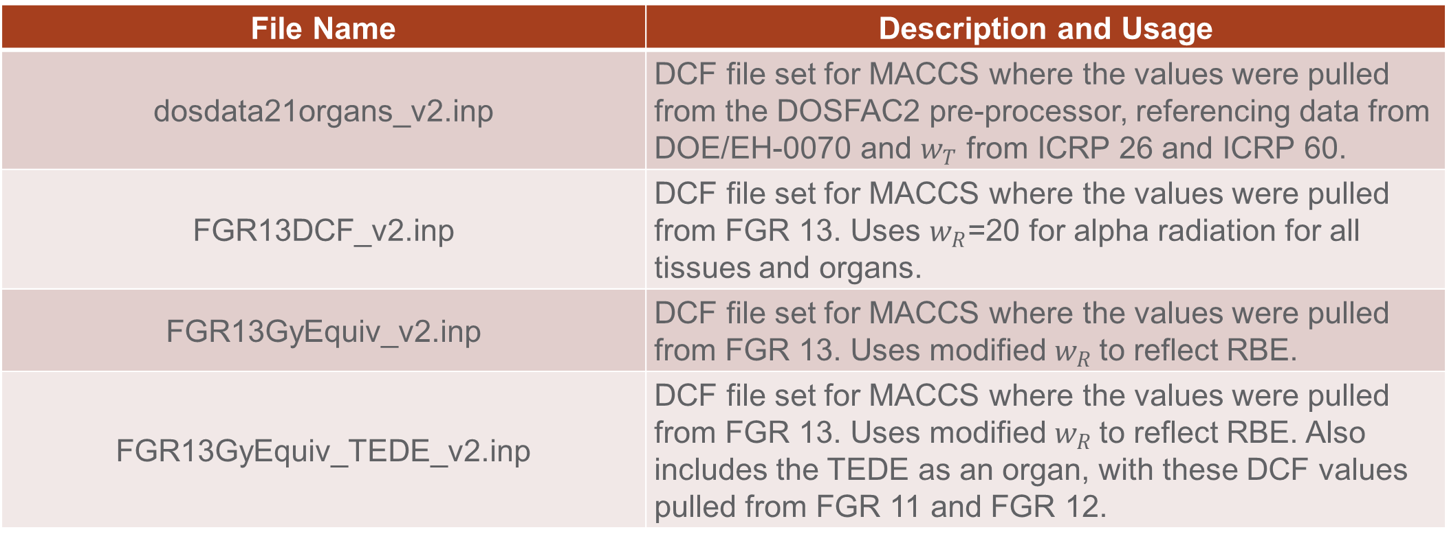
Opportunity for Improvement:
DCFs shipped with MACCS
File Name | Description and Usage
dosdata21organs_v2.inp | DCF file set for MACCS where the values were pulled from the DOSFAC2 pre-processor, referencing data from DOE/EH-0070 and $w_{T}$ from ICRP 26 and ICRP 60.
FGR13DCF_v2.inp | DCF file set for MACCS where the values were pulled from FGR 13. Uses $w_{R}$=20 for alpha radiation for all tissues and organs.
FGR13GyEquiv_v2.inp | DCF file set for MACCS where the values were pulled from FGR 13. Uses modified $w_{R}$to reflect RBE.
FGR13GyEquiv_TEDE_v2.inp | DCF file set for MACCS where the values were pulled from FGR 13. Uses modified $w_{R}$to reflect RBE. Also includes the TEDE as an organ, with these DCF values pulled from FGR 11 and FGR 12.

Slide 12
Dose Coefficient Databases
Dose and Risk Calculation (DCAL) software
  Oak Ridge National Laboratories
  Initially created for EPA to support EPA FGR 12 and 13
  DCAL to make FGR values
DCFPAK
  Originally Oak Ridge National Laboratories
  Currently Sandia National Laboratories
R. W. Leggett and K. F. Eckerman

Slide 13
Opportunity for Improvement:
One Living U.S. Database
DCFPAK
Currently maintained by Sandia National Laboratories
Allows for particle size choices
Updates since initial database creation to:
  Correct code issues initially present
  Update values that the dose coefficients depend on to match current state data
  Allow for more specificity of the dose coefficient when choosing which to use
Additional updates could account for:
  New ICRP dosimetry model/new FGR release
  Additional age groups
  Gender differentiated dose coefficient factors

Slide 14
Choices for a DCF
Exposure Type | Distribution | Clearance Class | Coefficient Type | Intake Type | Age Group | Particle Size (μm) | f1 Value
[external] Chronic Acute | [external] Lognormal Monodispersed | D/W/Y S/M/F G V | External Inhalation Ingestion Vapors | 1 cm Soil 15 cm Soil 5 cm Soil Air Submersion Infinite Soil Surface Source Water Immersion | 100 D 365 D 1835 D 3650 D 5475 D 9125 D | 0.001 0.003 0.001 0.003 0.1 0.3 1.0 3.0 5.0 10.0 30.0 | 5E-4 2E-4 1E-4 0.005 0.002 0.001 0.05 0.02 0.01 0.8 0.5 0.4 0.3 0.2 0.1 1.0

Slide 15
Opportunity for Improvement: Chemical Form
10 CGR 20.1204 - Determination of Internal Exposure
(c) When specific information on the physical and biochemical properties of the radionuclides taken into the body or the behavior or the material in an individual is known, the licensee may—
  (1) Use that information to calculate the committed effective dose equivalent, and, if used, the licensee shall document that information in the individual's record; and
  (2) Upon prior approval of the Commission, adjust the DAC or ALI values to reflect the actual physical and chemical characteristics of airborne radioactive material (e.g., aerosol size distribution or density); and
  (3) Separately assess the contribution of fractional intakes of Class D, W, or Y compounds of a given radionuclide (see appendix B to part 20) to the committed effective dose equivalent.

Slide 16
MACCS 4.2 Health Physics Changes
Notes:
​What was included:​
Full documentation review of legacy MACCS code creation, justification, and methodology reports​
Review of FGR 11, 12, and 13 and NRC health physics documents, as well as ICRP 26 and 60 methodology and other pertinent reports​
MACCS source code and DCF file creation source code review​

Slide 17
Addition of TEDE Values to DCF File
Decisions needed to be made balancing updated ICRP 30 model-based dose coefficients and ICRP 26 dosimetry model choices
Important notes:
  ICRP 26 dosimetry model has a different definition of clearance classes
  Clearance classes are consistent across the inhalation and ingestion pathways
  DCFPAK version 2007a used

Slide 18

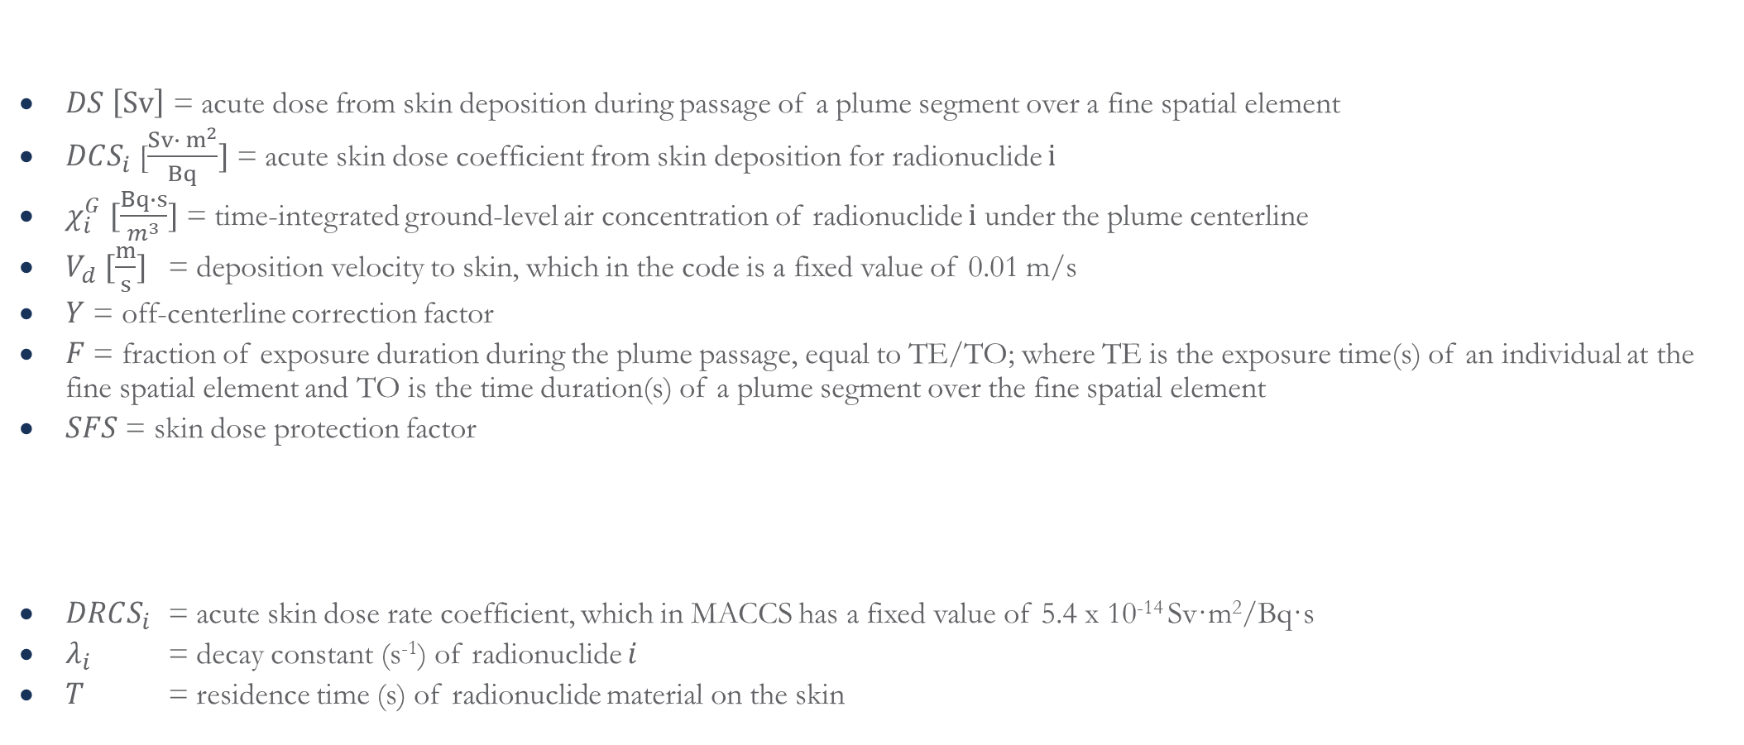
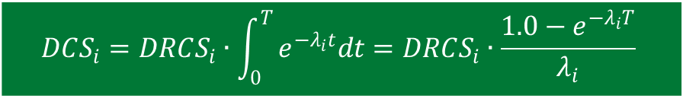
Acute Skin Deposition Pathway
$$DS=\left(\sum_{i}{DCS_{i}∙χ_{i}^{G}}\right)V_{d}∙Y∙F∙SFS$$
$DS$ $\left[Sv\right]$ = acute dose from skin deposition during passage of a plume segment over a fine spatial element
$DCS_{i}$ [$\frac{Sv∙ m^{2}}{Bq}]$ = acute skin dose coefficient from skin deposition for radionuclide $i$
$χ_{i}^{G}$ $[\frac{Bq∙s}{m^{3}}]$ = time-integrated ground-level air concentration of radionuclide $i$ under the plume centerline
$V_{d}$ $[\frac{m}{s}]$ = deposition velocity to skin, which in the code is a fixed value of 0.01 m/s
$Y$ = off-centerline correction factor
$F$ = fraction of exposure duration during the plume passage, equal to TE/TO; where TE is the exposure time(s) of an individual at the fine spatial element and TO is the time duration(s) of a plume segment over the fine spatial element
$SFS$ = skin dose protection factor
$DRCS_{i}$ = acute skin dose rate coefficient, which in MACCS has a fixed value of 5.4 x 10⁻¹⁴ Sv·m²/Bq·s
$λ_{i}$ = decay constant (s⁻¹) of radionuclide $i$
$T$ = residence time (s) of radionuclide material on the skin
$$DCS_{i}=DRCS_{i}∙\int_{0}^{T}{e^{−λ_{i}t}dt=DRCS_{i}∙\frac{1.0−e^{−λ_{i}T}}{λ_{i}}}$$

Slide 19
Resources
Evaluation of Dose Coefficients Implemented in MACCS – Audrey T. Nguyen – SAND2024-08408 – July 2024 – https://doi.org/10.2172/2429905
FGR Technical Report List: https://www.epa.gov/radiation/federal-guidance-radiation-protection
FGR 13: https://www.epa.gov/sites/default/files/2015-05/documents/402-r-99-001.pdf
FGR 15: https://www.epa.gov/radiation/federal-guidance-report-no-15-external-exposure-radionuclides-air-water-and-soil and https://www.epa.gov/sites/default/files/2019-08/documents/fgr_15_final_508_2019aug02.pdf
https://www.ecfr.gov/current/title-10/chapter-I/part-20 : radiation protection guidance
Dosimetric Significance of the ICRP’s Updated Guidance and Models, 1989-2003, and Implication for U.S. Federal Guidance – R.W. Leggett and K. F. Eckerman – ORNL/TM-2003/207 - August 2003 -https://www.info.ornl.gov/sites/publications/Files/Pub57371.pdf

