Slide 1
NRC-RADTRAN –Introduction/ Exercise
Jonathan Napier, PhD
Health Physicist, CHP
PNNL-SA-204711

Slide 2
Outline
Introduction
NRC-RADTRAN Concepts
NRC-RADTRAN Installation
NRC-RADTRAN Guided Exercise
User Awareness Issues
Current Updates

Slide 3
Introduction
NRC – Radioactive Material Transport (NRC-RADTRAN)
Risk and consequence analysis of radioactive material (RAM) transportation
Modes of transportation: rail, trucks, barge, aircraft
First released in 1977 (SNL)
6 versions released to date
GUI compatibility added to RADTRAN 6.02.1 → NRC-RADTRAN v1.0

Slide 4
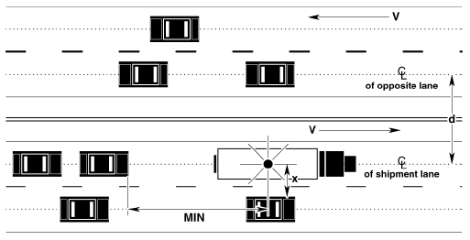
NRC-RADTRAN Concepts
Calculations
  With traffic
  Opposing traffic
  Population
Treats shipment as a stationary object
  Relative velocity used for everything
Taken From RADTRAN 6 Technical Manual SAND2014-0780

Slide 5
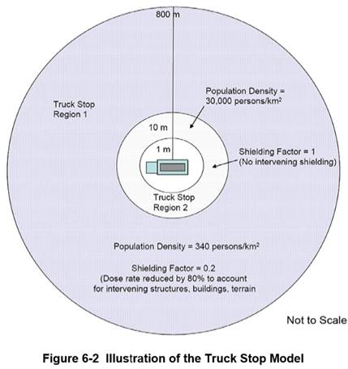
NRC-RADTRAN Concepts (cont.)
Example Truck Route Stop Figure from page 6-29 of U.S. NRC Environmental Impact Statement for an Early Site Permit (ESP) at the Clinch River Nuclear Site
NUREG-2226, Vol. 1

Slide 6
NRC-RADTRAN Concepts (cont.)
Two types of exposures modeled:
  Direct exposure from loss of shielding
  Exposure associated with release of particulates, gases, volatiles, and crud; several pathways:
    Inhalation
    Cloudshine
    Resuspension
    Groundshine

Slide 7
NRC-RADTRAN Concepts (cont.)
Doses are calculated and summed for all appropriate exposure pathways for all isotopes in each material for the shipment(s) being analyzed and for all downwind isopleths for each accident severity to yield a consequence (total dose) per accident of each severity
Probability of occurrence of each accident severity class is calculated from input values for accident rate, fractional occurrence, and distance traveled
Total Dose is multiplied by probability of occurrence for each accident severity to yield Dose-Risk
Results and intermediate calculations are included in the output file

Slide 8
NRC-RADTRAN Concepts (cont.)
Changes in RADTRAN 6
  Command line is no longer used for any functionalities
  RadCat is no longer maintained, distributed, or used
  NRC-RADTRAN 1.0 is current version
    Runs RADTRAN 6.02.1
    New Graphic User Interface for Inputs
  RADTRAN/RadCat 6 User Guide and Technical Manual are still valid references

Slide 9
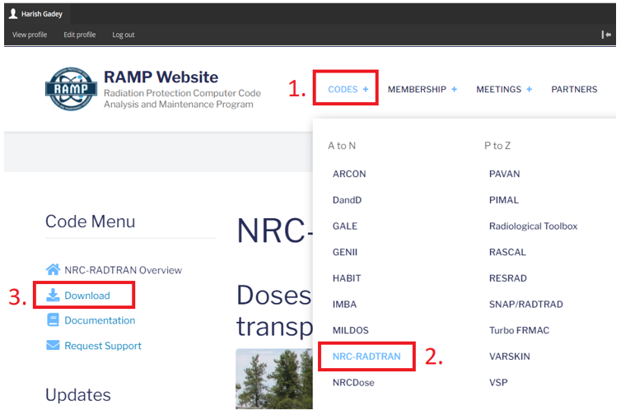
NRC-RADTRAN Installation
Login to NRC-RAMP
  Codes
  NRC-RADTRAN
  Download

Slide 10
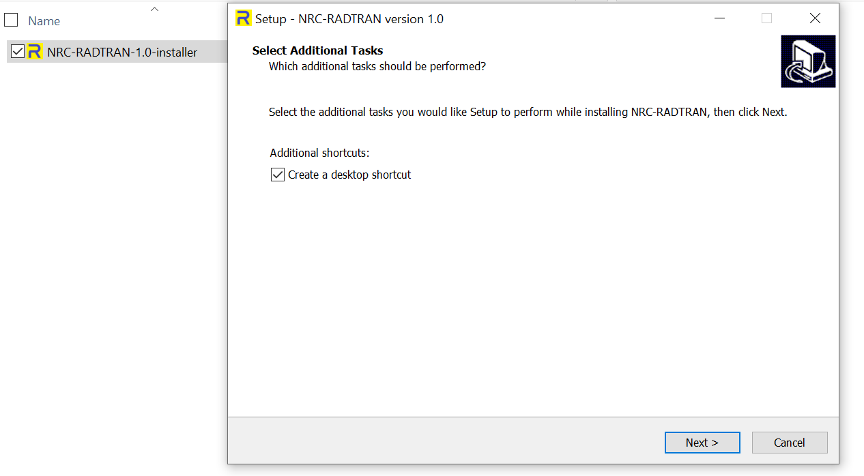
NRC-RADTRAN Installation (cont.)
Double click on the downloaded file to install

Slide 11
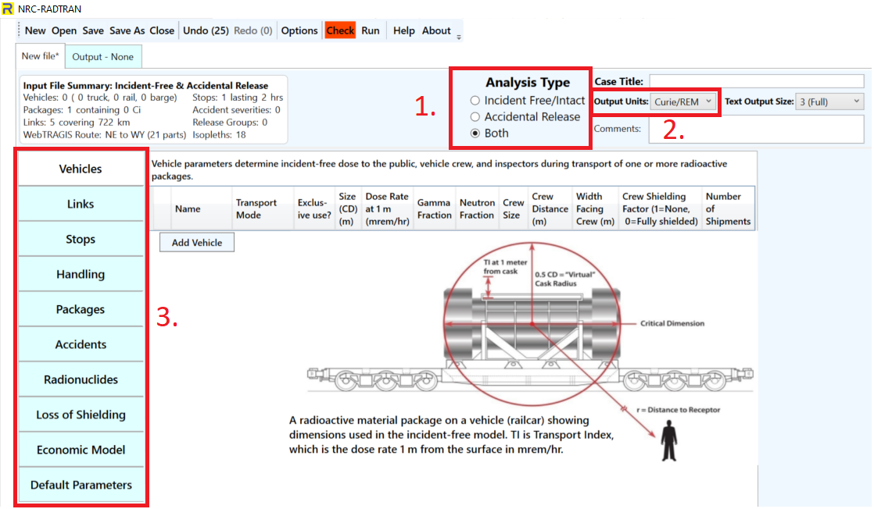
NRC-RADTRAN Basics
Defining the problem:
Type of Analysis
Units
  Curies/ Rem
  Bq/Sv
Item 1 selection dictates available input panels

Slide 12
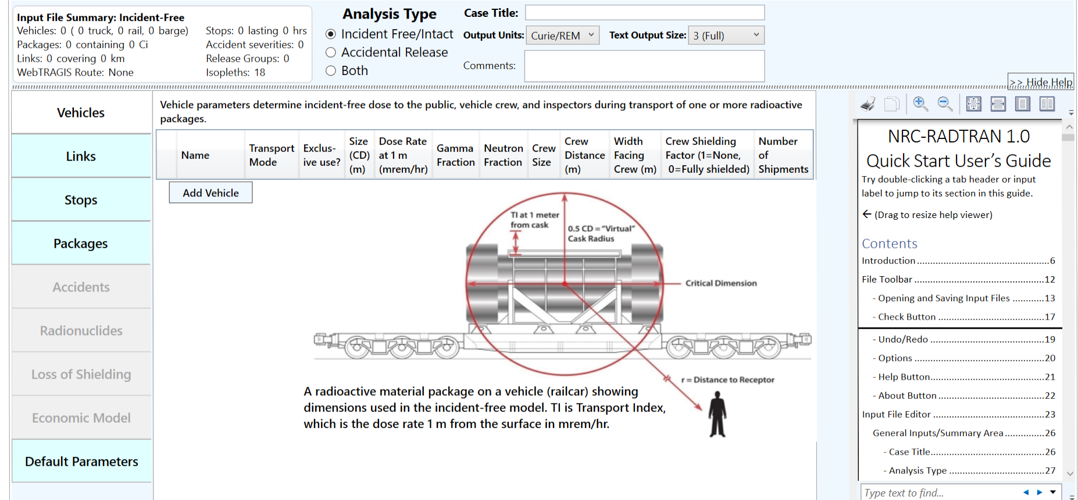
NRC-RADTRAN Basics (cont.)
Basic functions: opening, closing, and saving files
Undo/ Redo: maintains list of prior 99 actions
Options: display, file, open/save, and other legacy options
Check: Indicates any file errors (errors, warnings)
Help/ About: opens the viewer and provides basic information about NRC-RADTRAN
Help Viewer

Slide 13

NRC-RADTRAN Guided Exercise
Open NRC-RADTRAN
Use ‘Save’ or ‘Save As’ to name your file
Define
  Analysis Type - ‘Both’
  Define Units - ‘Cure/REM’
Optional
  Add a Case Title
  Add additional Comments
The example may be loaded in its entirety using Example File.input
Reference Notes
  RT6 TM – RADTRAN 6 Technical Manual (SAND2014-0780)
  RT6 UM – RADTRAN6/RadCat6 User Manual (SAND2013-8095)
  NUREG-2266 Appendix D – Data and Parameter Vales for Transportation Evaluation

Slide 14
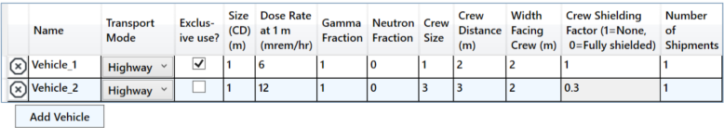
NRC-RADTRAN Exercise (cont.)
Transport Mode: highway, rail, waterway
Size (CD): Largest dimension of package (max. 9 m)
Gamma/ Neutron Fraction: split between gamma and neutron external package dose (must add to unity)
Crew Distance: Average distance of crew to nearest radioactive package
Width Facing Crew: largest dimension of the cargo facing crew
Crew Shielding Factor: fraction of radiation exposed to the crew
Number of Shipments: values calculated for single shipment and multiplied

Slide 15
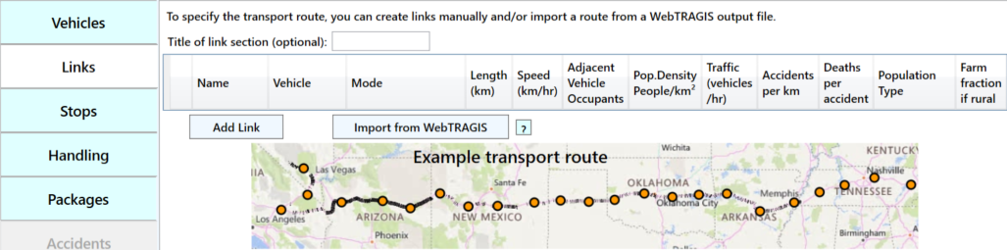
NRC-RADTRAN Exercise (cont.)
Importing a WebTRAGIS File
  Click ‘Import from WebTRAGIS’ button and select highway_route_1.kml

Slide 16
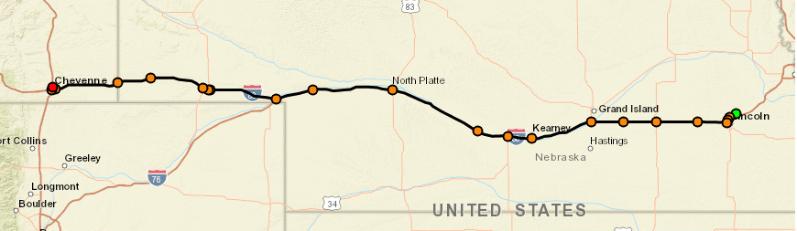
NRC-RADTRAN Exercise (cont.)
Creation of Links using WebTRAGIS
  Limited to contiguous 48 states
  Requires US Government Sponsorship
  Populations are not currently being updated
Creation of Links in Google Earth
  Requires population density files
Manual Entry
Alternative Methods
  Creation of Links in Google Earth
    Requires population density files
  Manual Entry
New import methods in development

Slide 17
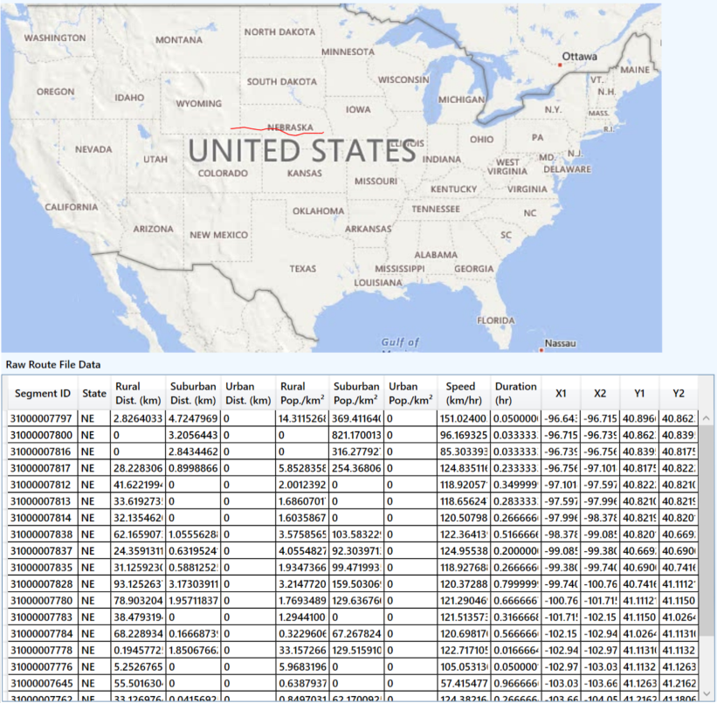
NRC-RADTRAN Exercise (cont.)
WebTRAGIS information is intersection based
Each link is the distance between two intersections
  Uses known
    Population density
    Distance
    Speed
    Time of transit

Slide 18
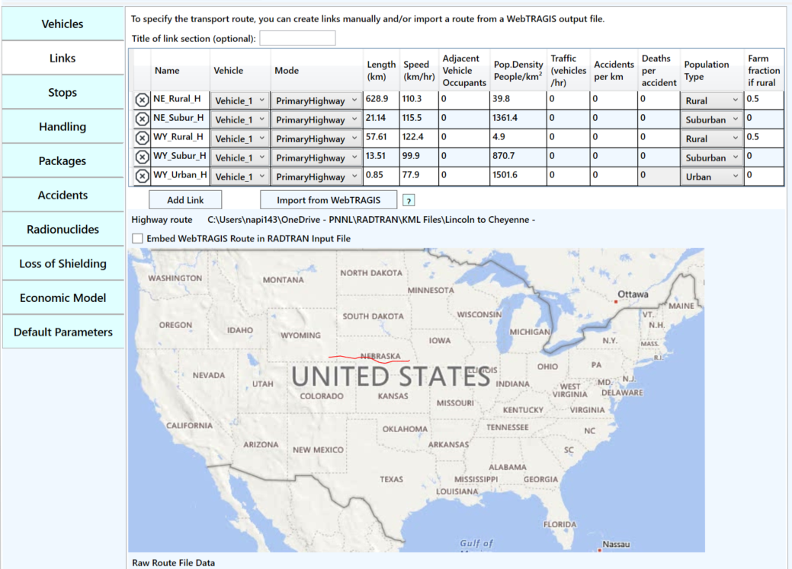
NRC-RADTRAN Exercise (cont.)
Summarized into three links per state
  Rural
  Urban
  Suburban
Does not include
  Traffic
  Accidents/km
  Deaths per Accident
NUREG-2266 Population Density Adjustments

Slide 19
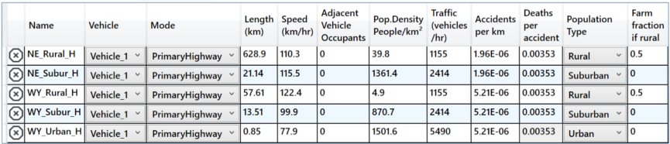
NRC-RADTRAN Exercise (cont.)
Mode: highway, secondary road/ nonroad. Do not select unknown
Adjacent Vehicle Occupants: average number in vehicles
Traffic: number of vehicles travelling per hour on the link
Default values found in RT6-TM Table 2-3 (SAND 2014-0780))
Accidents per km and Deaths per accident are user defined
Default values found in Table 3 and Section 8.9 of RT6-UM (SAND2013-8095)

Slide 20
NRC-RADTRAN Exercise (cont.)
Population Type: Either rural, suburban or urban. Affects shielding factors and dose to pedestrians
Farm fraction if rural: fraction of surrounding area used for agriculture (only for rural)

Slide 21
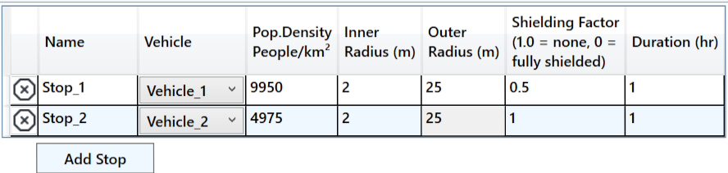
NRC-RADTRAN Exercise (cont.)
Vehicle: select any vehicle defined in the vehicles tab
Population Density: the population density in # per km² (9950 RT6-TM pg 36)
Inner Radius: minimum distance from where dose to public is calculated
Outer Radius: maximum distance till where dose to public is calculated
Shielding Factor: used for dose calculations during a stop
Duration: time period for a given stop in hours

Slide 22
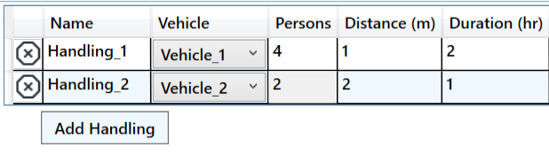
NRC-RADTRAN Exercise (cont.)
Persons: Number of Individuals
Distance: Distance between
Duration: Length of handling time
Note: Handling is not currently used in conjunction with available route options. Current updates my change this tab or its availability

Slide 23
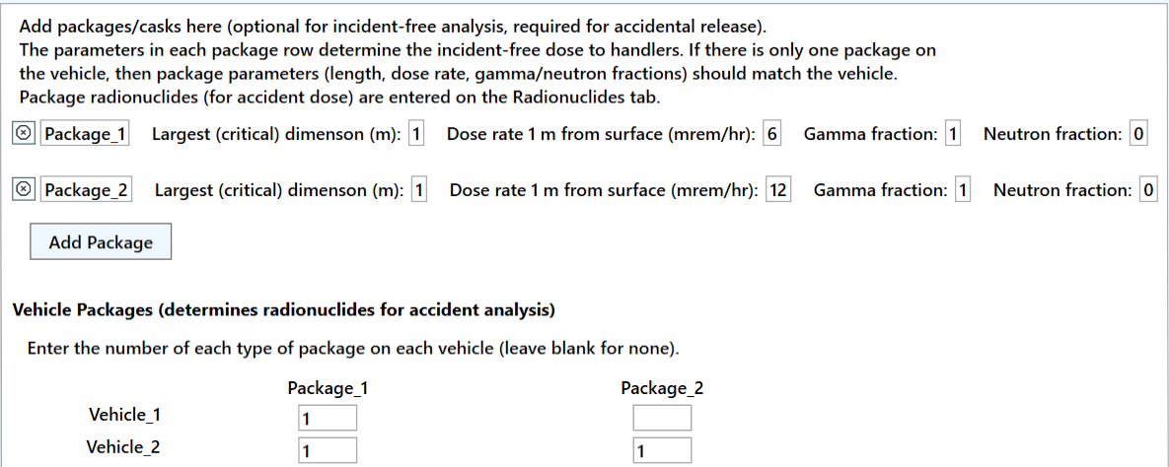
NRC-RADTRAN Exercise (cont.)
Optional for incident free analysis
Required for accident analysis
Enter the critical dimension in meters
Package Dimensions greater than 9 m should not be used
Enter dose at 1 m from surface and gamma/ neutron fraction
Enter number of packages of given type in each vehicle

Slide 24
Break Time!
Currently at the End of Incident-Free Shipping
Please Ask Any Questions
Next Up NRC-RADTRAN Portions Specific to Accident Analysis

Slide 25
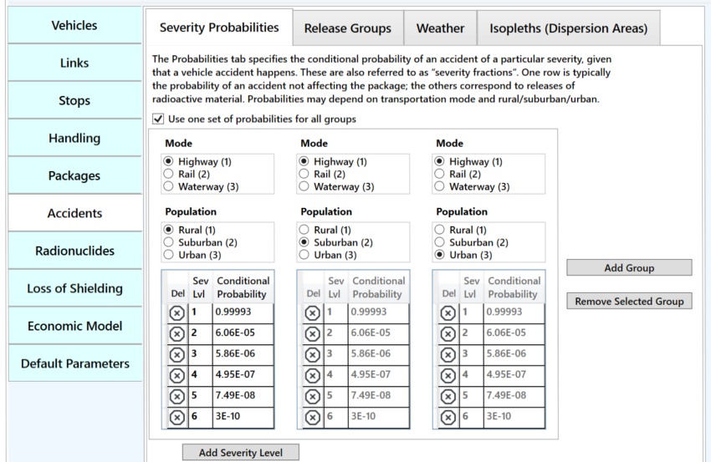
NRC-RADTRAN Exercise (cont.)
Optional for incident free analysis
Required for accident analysis
RT6-UM (SAND2013-8095) Figure 18 for Truck Accident Rates
Conditional Probabilities shown are from Table 5 of RT6-UM for uncanistered truck transported PWR spent fuel.

Slide 26
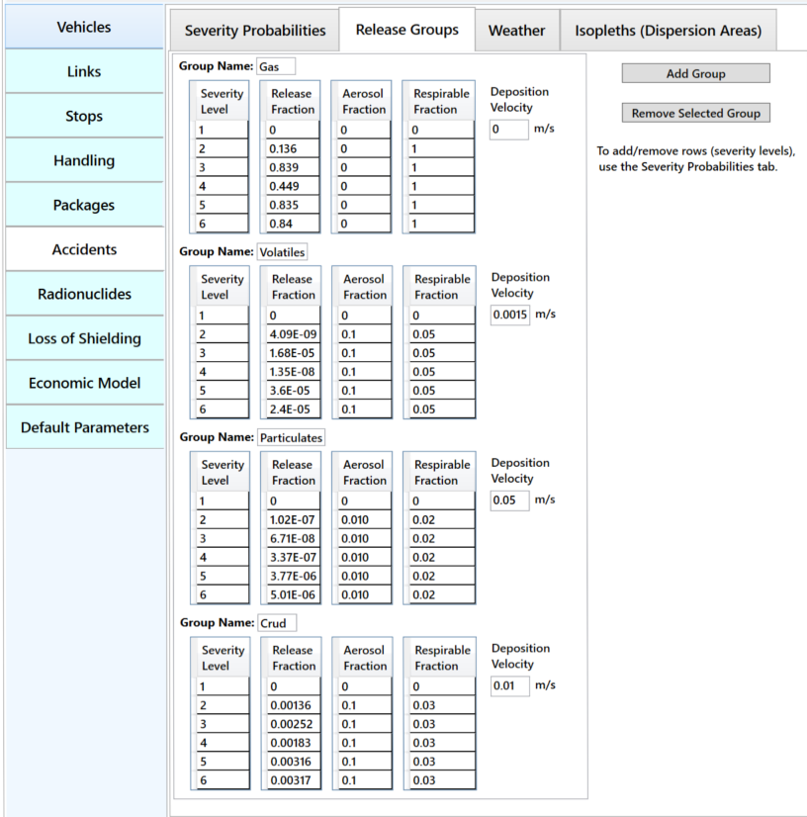
NRC-RADTRAN Exercise (cont.)
Release Fractions taken from RT6-UM Table 5 (SAND2013-8095)
Aerosol fractions are user defined
  Listed values are
Respirable fractions are user defined
  Recommended values are listed as 0.02 to 0.05 (RT6-UM Section 11.5 page 48)

Slide 27
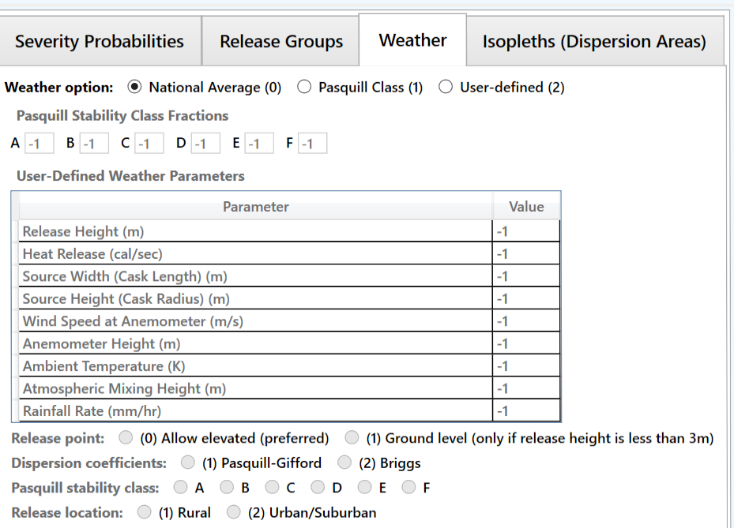
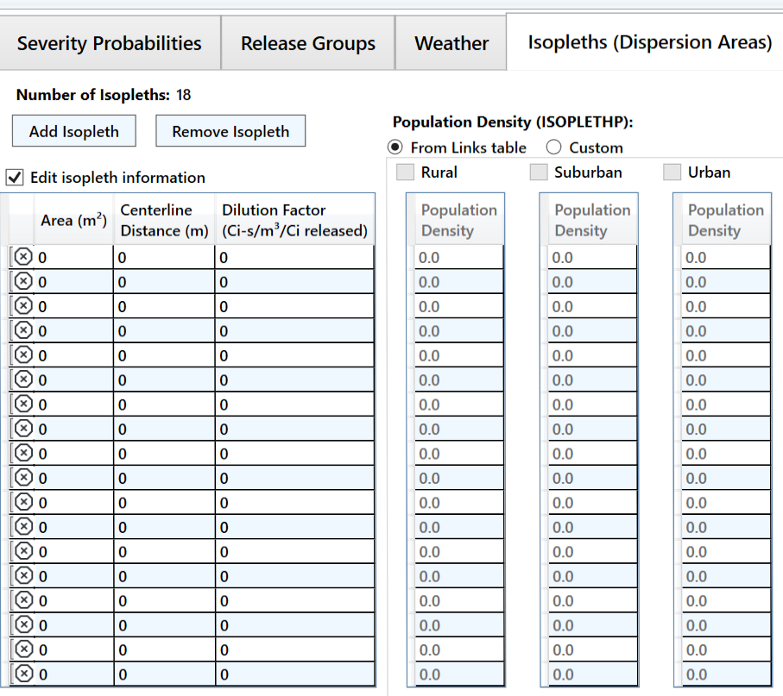
NRC-RADTRAN Exercise (cont.)
National Average (0): simplest and requires no inputs
Pasquill Class (1): requires values for each Pasquill stability class
User-Defined (2): allows more detailed analysis
Define area, centerline distance, and dilution factor of each isopleth (max. number of isopleths: 18)
NOTE: if population density is being used, first two isopleths shall have same population density

Slide 28
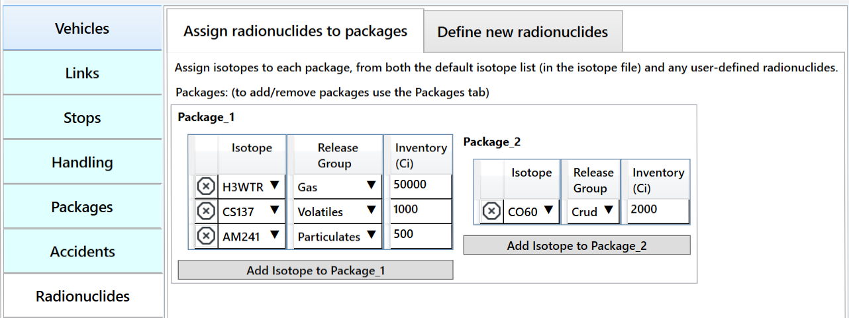
NRC-RADTRAN Exercise (cont.)
Radionuclide inventory can be defined for package
Isotope inventory assigned according to release group
Each package has independent isotope inventory
User-defined radionuclides can also be defined
Half-lives, energies, and Dose Conversion Factors (DCFs) are required to be specified

Slide 29
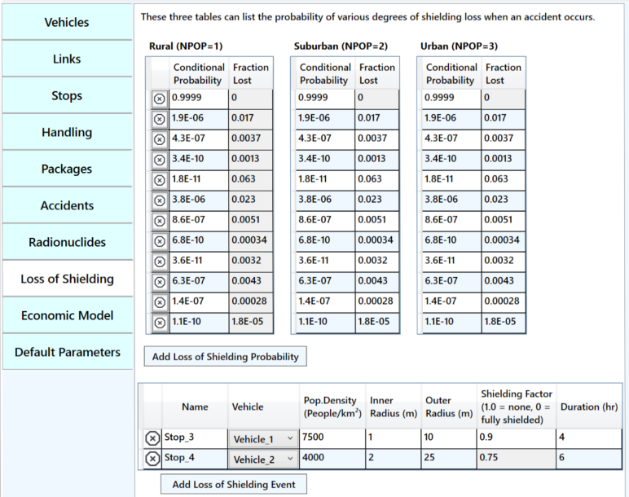
NRC-RADTRAN Exercise (cont.)
Conditional Probability and Fractional Loss are user defined
Probability for all scenarios shall sum to unity
Values taken from Table 7 of RT6-UM (SAND2013-8095)
Parameters for stop are user defined

Slide 30
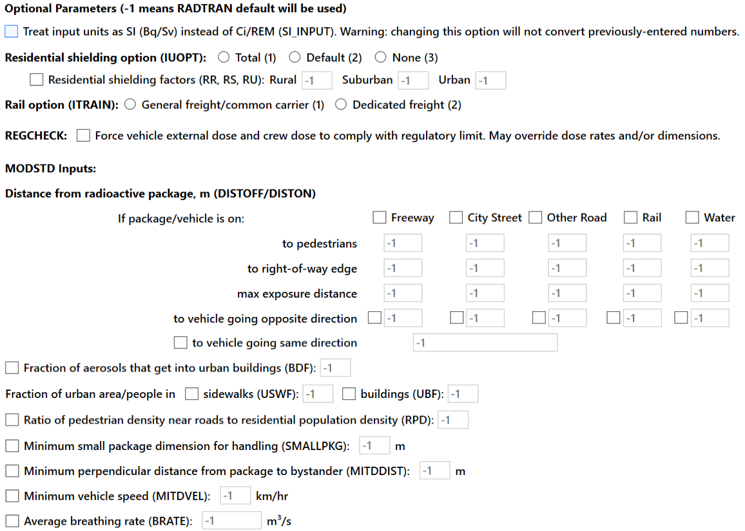
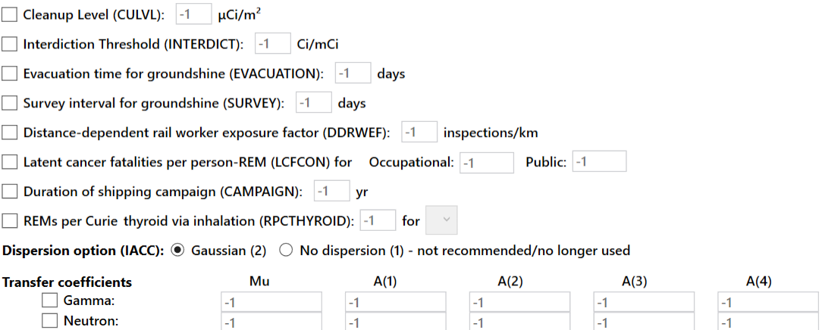
NRC-RADTRAN Exercise (cont.)
Values of “-1” mean NRC-RADTRAN defaults shall be used
Potential user defined options include:
  Residential shielding factors
  Distance from radioactive packages
  Dispersion options
  Transfer coefficients
REGCHECK: used to force regulatory limits for external dose and crew dose

Slide 31
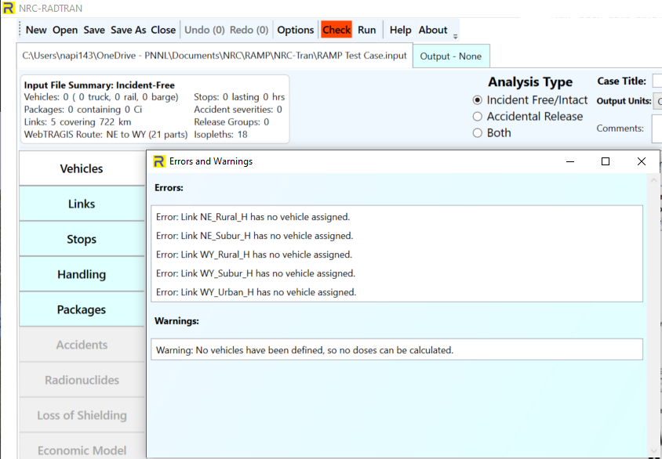
NRC-RADTRAN Exercise (cont.)
Check button changes color based on potential Errors and Warnings
Be certain to resolve errors/ warnings before running or saving
  Some saved files may not be recoverable without editing the saved text files
Default save location is not OneDrive

Slide 32
NRC-RADTRAN Exercise (cont.)
Click the Run button
Output window will populate
  Input Echo – text version of all inputs into the GUI
  NRC-RADTRAN Output – standard text output also viewable in spreadsheet form
    Non-rad incident summary
    Exposure Summary for links and Rural, Suburban, Urban transit zones
    Input sensitivity analysis (effect of 1% change of input value)
Automatically saves each run in a new output file

Slide 33
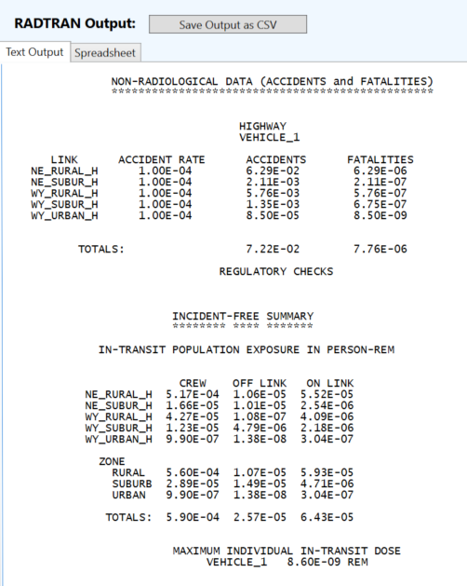
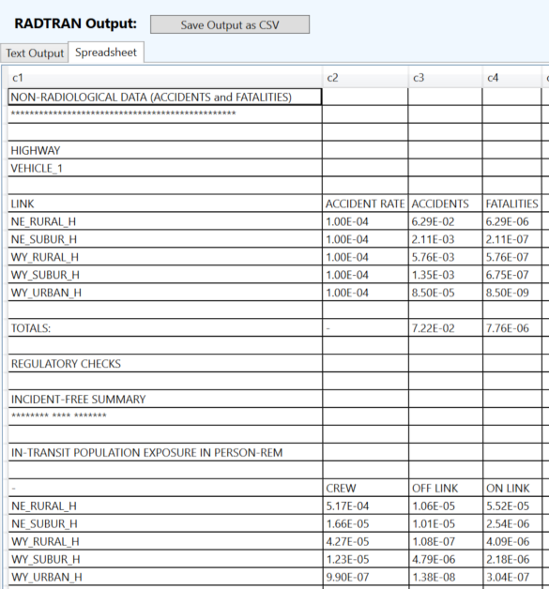
NRC-RADTRAN Exercise (cont.)

Slide 34
NRC-RADTRAN User Awareness
Shielding Factors: two runs should be completed using 100% neutron or 100% gamma emissions and the results ratioed externally
Incident-Free Off-Link Neutron Doses: hand-calculated MEI results do not match NRC-RADTRAN results. Until this issue is investigated and resolved, it is recommended that NRC-RADTRAN should be used to estimate incident-free off-link doses through gamma radiation only
Rail Crew Doses: for the rail crew gamma and neutron doses calculating a stop with duration of transit will provide a more representative crew dose estimate
MEI In-Transit Doses: the MEI in-transit doses estimated by NRC-RADTRAN cannot be duplicated using spreadsheet calculations. In addition, gamma and neutron MEI in-transit doses are estimated using the same equations. For this reason, it is recommended that the MEI in-transit doses not be used currently

Slide 35
NRC-RADTRAN User Awareness
The LOS model was developed for gamma radiation exposures and does not consider neutron radiation exposures
The LOS model was based on modeling simulations performed for a generic 5.21-meter-long steel-lead-steel spent nuclear fuel truck transportation cask, and Dennis et al. (2009) states that the model should only be applied to truck transportation casks
For the inhalation, resuspension, and immersion pathways, NRC-RADTRAN calculates doses using the geometric mean of the depleted atmospheric dilution factors (χ/Qs). For the groundshine pathway, NRC-RADTRAN calculates doses using the depleted χ/Qs, not the geometric mean of the depleted χ/Qs
For accident risks, NRC-RADTRAN output does not provide totals for the expected values of population risks across all links, and users must sum these quantities externally.

Slide 36
NRC-RADTRAN Updates
PNNL is actively working to identify solutions to issues marked for User Awareness
Activities to update NRC-RADTRAN were initiated in late Q3 of CY2023.
The activities were split into two tasks.
Task – 1 activities have been initially delivered for internal testing.
Task – 2 activities and end-to-end testing to be completed by mid-Q2 of CY2025.

Slide 37
NRC-RADTRAN Current Updates
Task – 1 activities:
  Speed and population density errors (segment and state level data)
    Challenges reading KML files (change in file format)
    Relatively high population density values
    Fix: Updated the population density equation to match the user manual; modifying code to accept latest KML files.
  Adding functionality to accept START files
    Stakeholder Tool for Assessing Radioactive Transportation (OUO status)
    Redundant data sources, alternative to WebTRAGIS
    Status: Data mapping between START and WebTRAGIS completed; coding efforts completed to accept START generated KML files

Slide 38
NRC-RADTRAN Current Updates
Task – 1 activities (cont.):
  Population risk summing across all links
    Only link wise dose data (inhalation, cloud shine, ground shine, and re-suspension is presented.
    Fix: The code was modified to output total doses from all 4 exposure pathways for all the links thereby improving user experience.
  Display not used values values
    Currently ‘-1’ is displayed in the code where no values are used for the field.
    Displaying ‘-1’ is not intuitive from a user experience standpoint
    Fix: changed ‘-1’ to ‘Not a Number (NaN)’ to show that no numbers are being used in the field.

Slide 39
NRC-RADTRAN Current Updates
Task – 1 activities (cont.):
  Implementing GUI changes to include Alternative Transportation
    Current air transportation modes not available on the GUI
    Can be implemented by modifying the text file generated by the GUI
    Fix: add an option on the GUI to include ship, air, and cargo van
  Errors with >9 rail links
    Scenarios with >9 rail links were assumed to be air transportation
    The outputs were different based on number of links as opposed to mode of transportation
    Fix: Coding changes are being implemented to print out the accurate description of the scenario being run by the user.

Slide 40
NRC-RADTRAN Current Updates
Task – 1 activities (cont.):
    Hard coded conversion factors
    There are several hard coded conversion factors used in the NRC-RADTRAN source code
    Makes it challenging to debug and streamline code maintenance/ development
    Fix: Modifying the source code to replace conversion factors with variables
    Quality Assurance activities
    Develop test suites for cases, activity wise unit-testing
    End-to-end as well as integration testing
    Software grading and Verification and Validation

Slide 41
NRC-RADTRAN Coming Updates
Task – 2 activities (Q4 of CY2024 to Q1 of CY2025):
    Investigate and implement incident free neutron dose corrections
    Investigate and implement MEI neutron and gamma dose corrections
    Investigate variable neutron and gamma shielding factors
    Update user guide to implement updated rail crew dose methodology
    Investigate, implement, and update user manual for LOS model
    Investigate and implement atmospheric dispersion factors and model corrections

