Slide 1
IMBA Bioassay Introduction
Roland Benke, PhD, CHP
Director – Technologies Division
roland.benke@rcdsoftware.com

Slide 2

Why IMBA?
Internal dosimetry software
  Committed organ doses from radionuclide intakes
  Committed effective doses from radionuclide intakes
  Radionuclide intakes from bioassay data

Slide 3
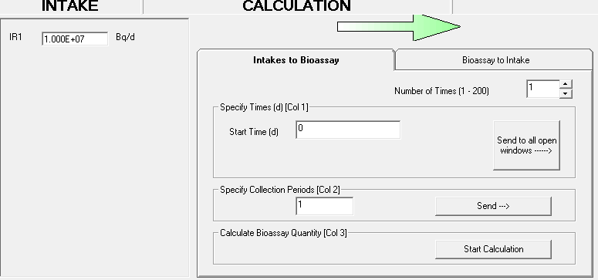
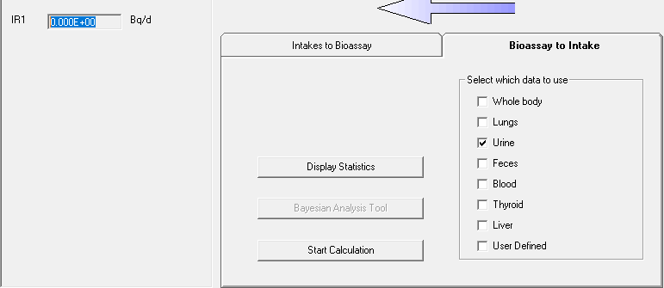
IMBA Bioassay
Two directions for calculations
Calculate expected bioassay activities from known or hypothetical intake activities.
Intake activities → Bioassay expectation data
Estimate intake activities based on bioassay measurement data.
Measured bioassay data → Intake activities

Slide 4
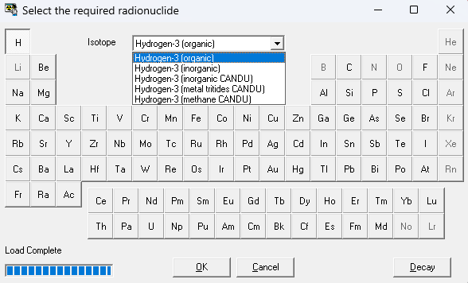
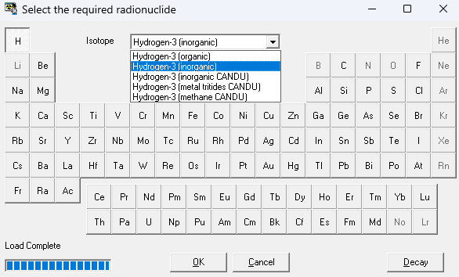
Examples for organic & inorganic tritium
Committed effective dose calculation

Slide 5
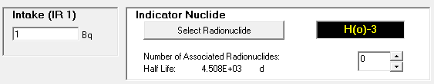
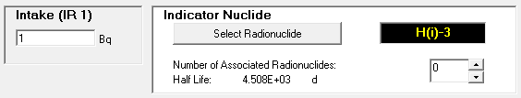
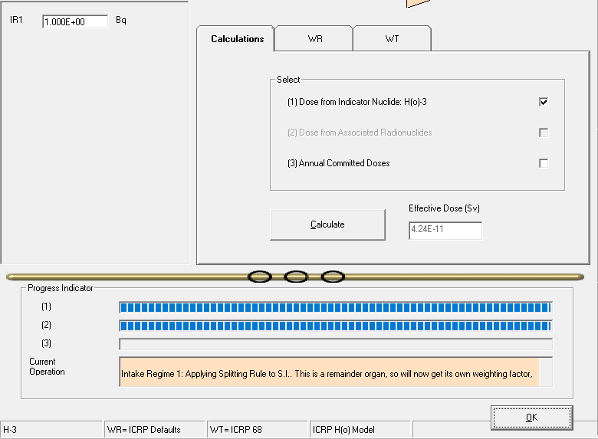
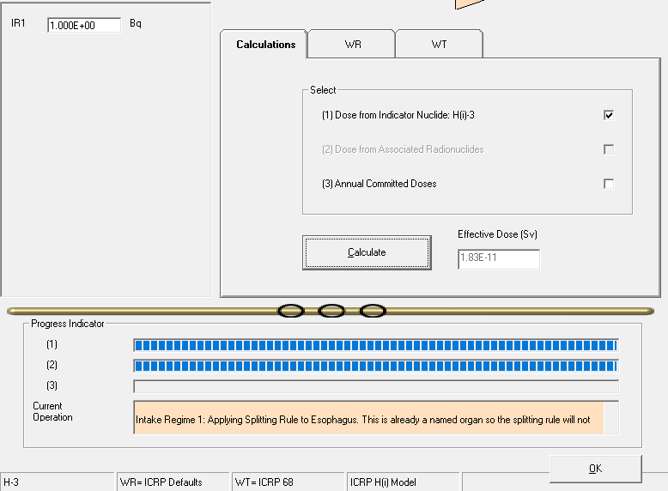
Organically bound
Committed effective doses from tritium ingestion
Tritiated water
Result for unit activity intake
Result for unit activity intake

Slide 6
Two Hypothetical Example Problems
Facility worker exposure to tritiated water (HTO)
Medical worker intake of ⁸⁹Sr from needlestick wound

Slide 7
What bioassay results indicate that worker exposure and intakes must be reduced to avoid exceeding the regulatory limit?
Hypothetical worker exposure to tritiated water
Continuous occupational intake possible
Work tasking anticipated for 300 days
Bioassay planned: Urine collection & tritium activity measurements
Example Problem 1

Slide 8
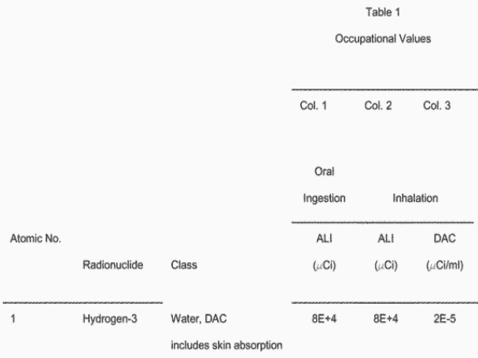
Tritiated water limits
10 CFR Part 20
Annual limits on intake
Tritium ingestion ALI
0.08 Ci ≈ 3 GBq
Same ALI for inhalation

Slide 9
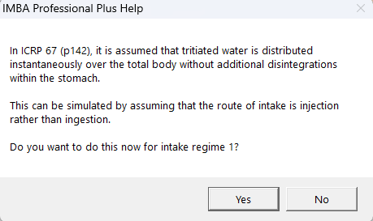
IMBA invites user to accept ICRP modeling

Slide 10
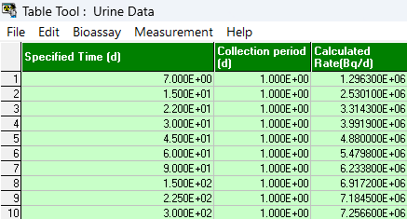
Example IMBA bioassay results
Assumed maximum continuous intake yields 1 ALI during entire work task
IMBA calculates maximum tritium activities in urine at different bioassay times (right)
IMBA provides basis for operational restrictions or corrective actions before regulatory limit is exceeded

Slide 11
What effective doses are expected for comparison to 10 CFR Part 20 limits?
Hypothetical medical worker intake
Needlestick of ⁸⁹Sr chloride
Wound intake
Example Problem 2

Slide 12
⁸⁹Sr Chloride Needlestick
Typical 1 mCi/mL radiopharmaceutical concentration
Assume 2 µL ( 2 µCi = 74 kBq ) enters wound
IMBA implements wound model in NCRP Report 156 (2007).
Effective dose equivalent strongly depends on wound retention.

Slide 13
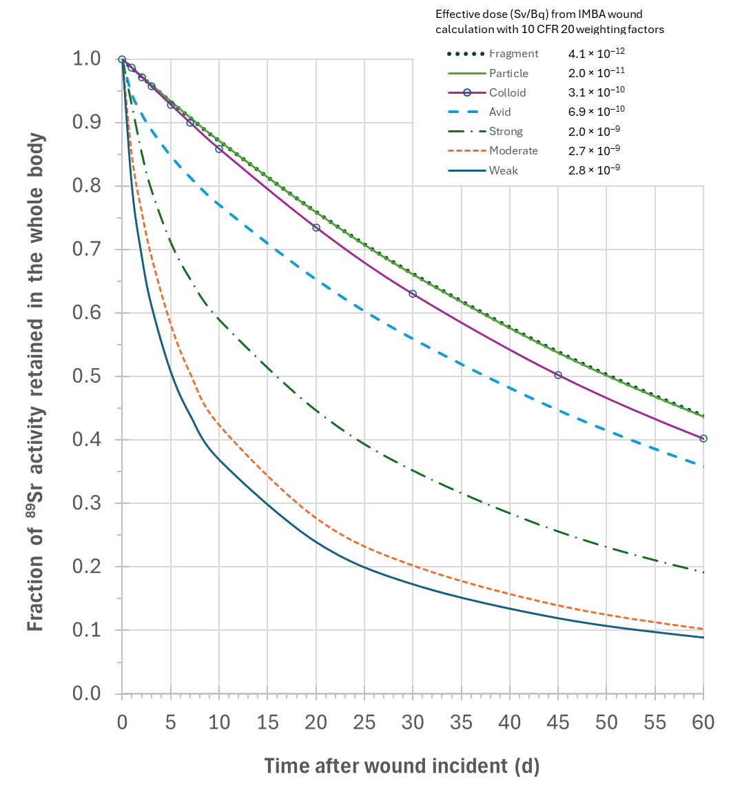
Wound biokinetics
IMBA calculates
Radioactivity in whole body & excreta over time
Effective dose equivalent with 10 CFR Part 20 weighting factors (more recent dosimetry also available)
Organ committed dose equivalents
No direct output in IMBA for activity retained in the wound
Tissue dose at wound site, consult other approaches or software
Medical response & wound treatment can invalidate
Bioassay assumptions
Wound activities inferred from bioassay measurements

Slide 14
Questions?

