Slide 1
Skin Dose from Hair Contamination Event
Glen Vickers, CHP
Constellation RP Technical Lead

Slide 2
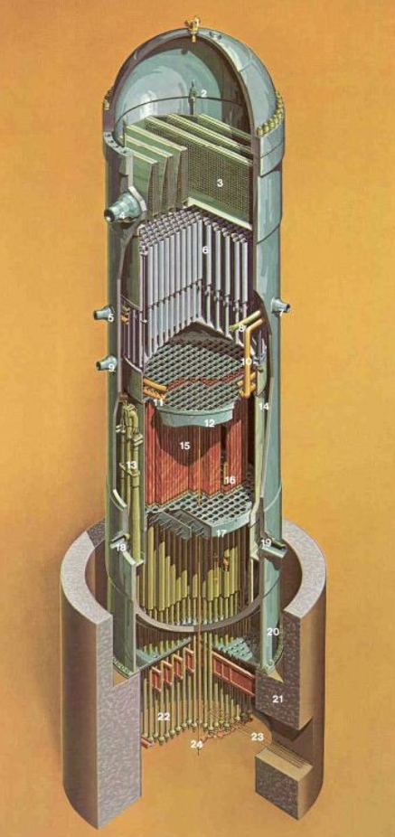
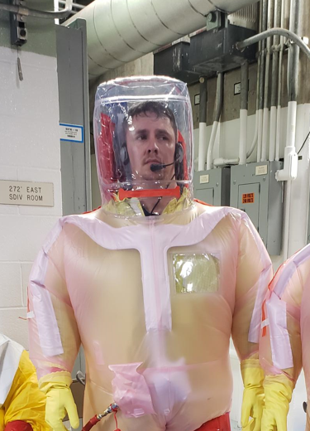
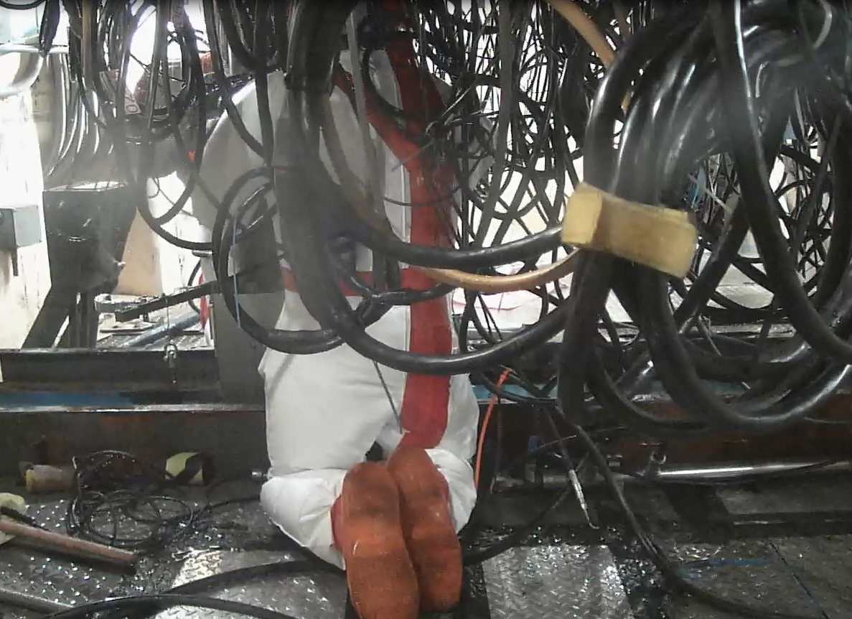
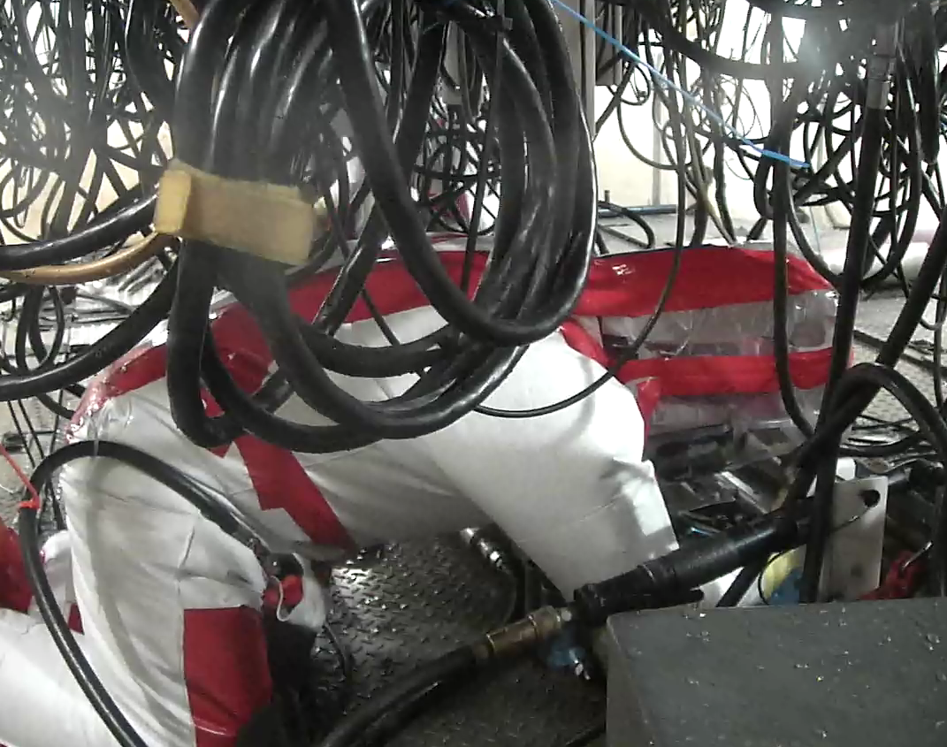
Control Rod Drive (CRD) Exchange
Water from the reactor vessel fills the control rod drive tube encasing the drive approximately 6 inch inner diameter and approximately 17 ft long
Water will flow down on workers as CRD is lowered from bolted flange. Flange about head level +/- 1ft at different plants
Top of suit above worker’s head became torn and water flowed down into worker’s suit from above

Slide 3
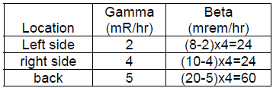
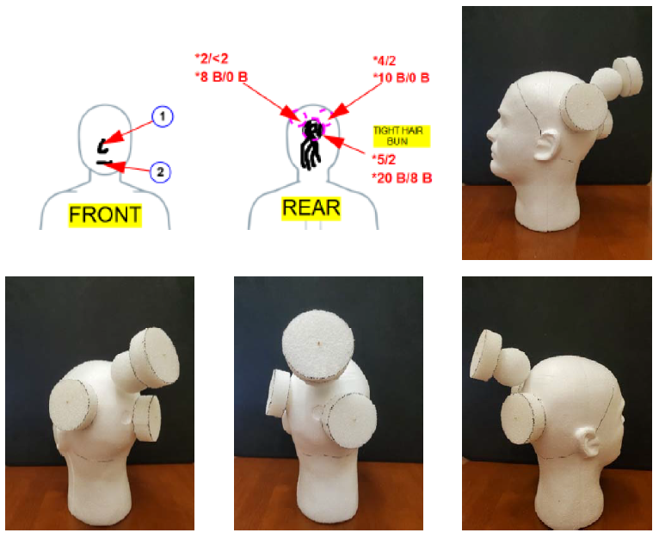
Contamination Geometry
Geometry reconstruction performed with technician. Disks are ion chamber measurement locations and sphere is location of hair ball.
Hair thickness was estimated to be 3 cm and 6 cm for diameter of hair ball.
Hair filtered and concentrated particulate from the water. Contamination on skin on face was only 20 and 30 kdpm/swipe and no issue
Unknown level of beta self-absorption in hair, so gamma measurements were used to determine source activity
Gamma measurements combined with a point-kernel code to calculate the dose-to-curie factor for the mix in the hair volume.
Dose-to-curie factor mCi/mrem/hr multiplied by measured dose rate to determine final activity.
Standard software to calculate activity in volumes from external dose rates for radiological shipping or shielding.
MCNP not a typical tool and that level of detail typically not needed for good agreement with measurements

Slide 4
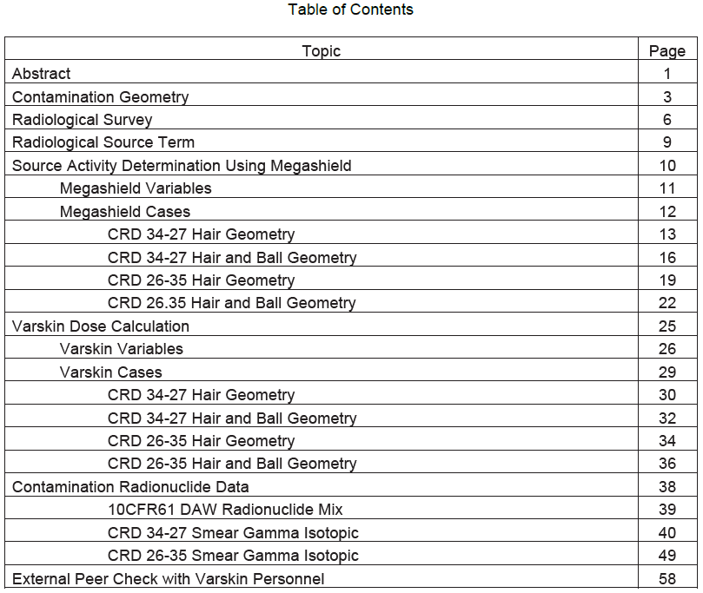
Structure of Calculation
Radionuclide mix was gamma spec of smears from two different Control Rod Drives (CRD)
Used Point-Kernel code Megashield to determine concentration of source term in two different hair thicknesses from gamma ion chamber measurements
Determined source term for two mixes and two geometries (hair, hair+ball) for a total of four source terms and geometry combinations for Varskin
Shallow and Deep dose cases were calculated for the four source terms and geometries for a total of 8 cases. The final whole body shallow and deep dose was the maximum of the cases.
Show all cases so no ambiguity

Slide 5
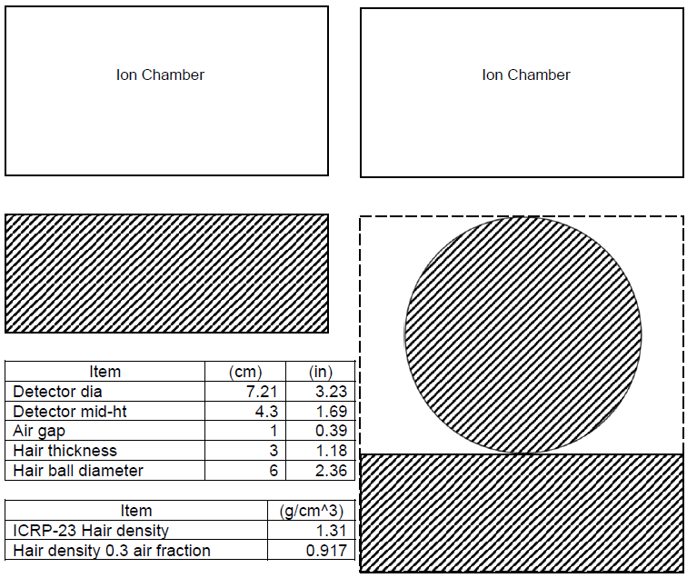
Modeling Source Term
Technician estimated measurement area over curved surface of the head approximate to that of the diameter of the ion chamber window
Diameter of the source was the diameter of the ion chamber. There may be some unknown level contribution from outside the diameter of the ion chamber. Concentrating the dose rate over a smaller defined geometry would provide a higher concentration since a smaller volume is resulting in the same dose rate
Hair and ball modeled as a single cylinder due to geometry limitations
Hair density from ICRP-23

Slide 6
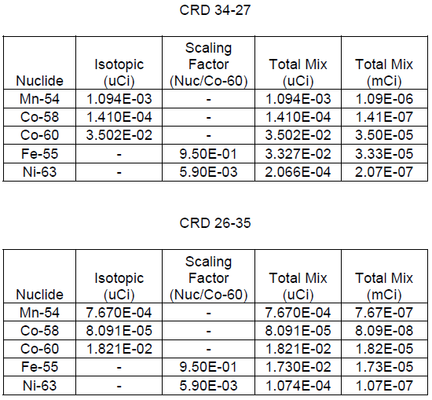
Radiological Source Term
Gamma isotopic analysis of smears from two different CRDs was used as the source term
Non-gamma emitting radionuclides scaled in from Dry Active Waste Stream (e.g. Fe-55, Ni-63). Others such as Sr-90 were <LLD
Fe-55 doesn’t have a significant beta dose factor but can contribute from x-rays to SDE in cases where other beta emitters are attenuated by covering.
Ni-63 is low-energy beta only and too low of an energy to provide any dose but was included for the sake of completeness

Slide 7
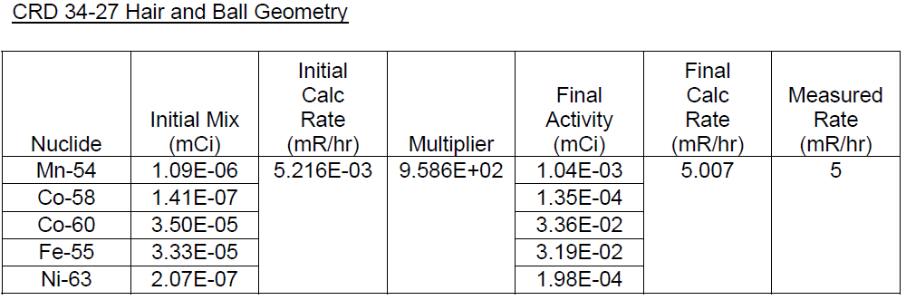
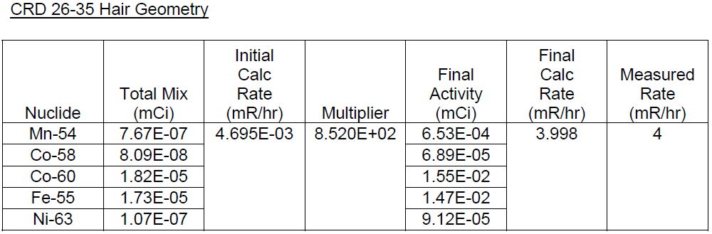
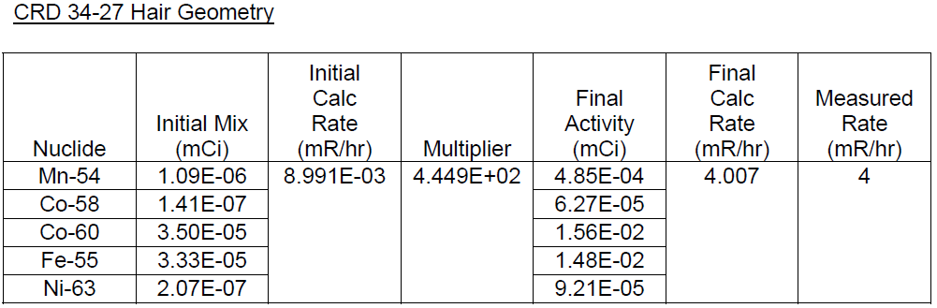
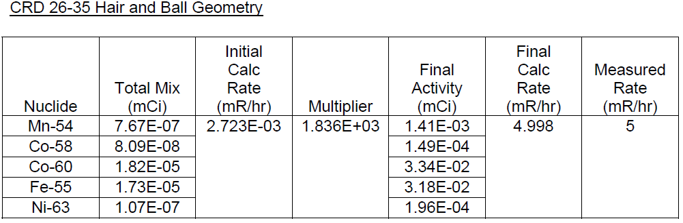
Use of Megashield Point-Kernel Code to Determine Source Term
Isotopic mix used to calculate dose rate
Ratio of measured/calculated dose rate used as a multiplier to scale the concentration to a level to generate radiation levels equaling the measured value
Cases run a second time with revised source term to see how close calculated dose rate comes to measured dose rate
Final source terms to be used for Varskin Shallow and Deep dose calculations

Slide 8
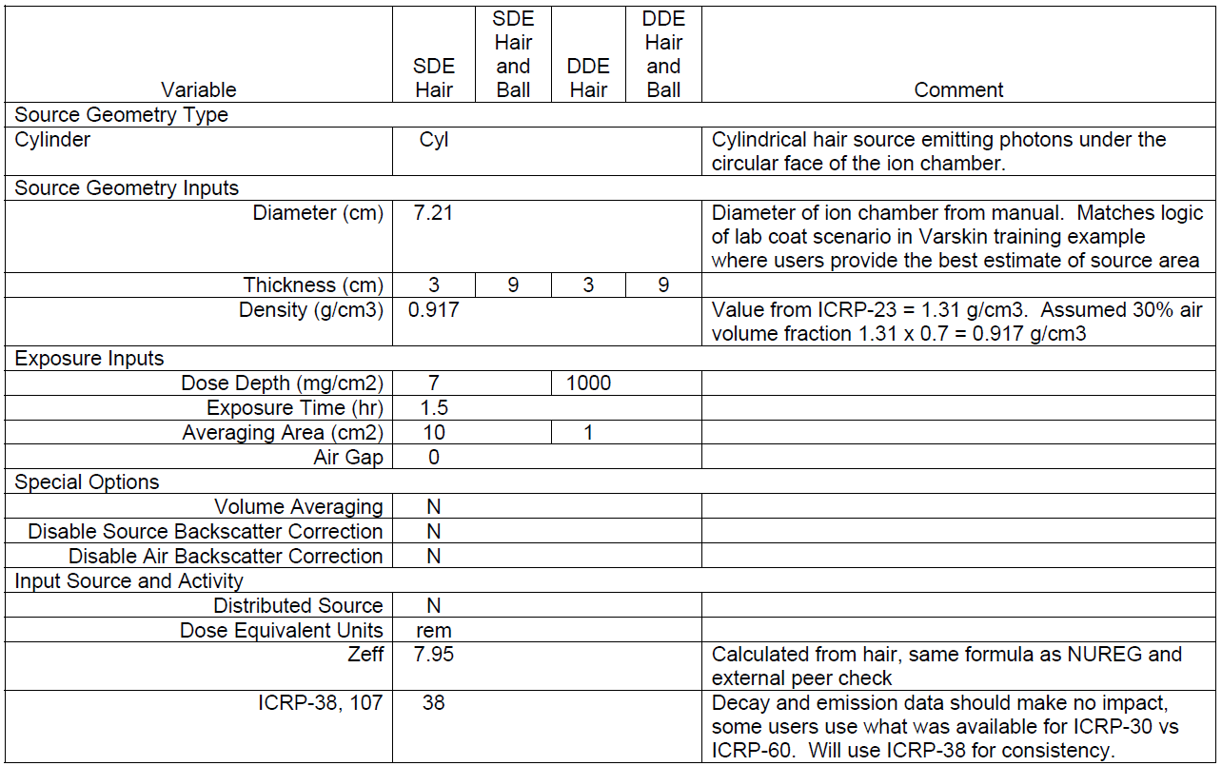
Varskin+ v1.1 Inputs

Slide 9
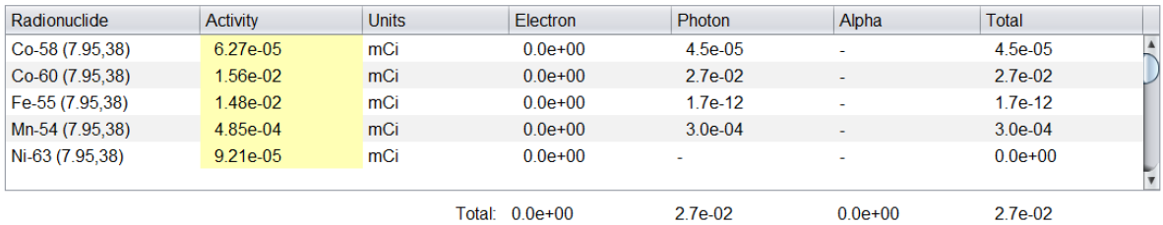
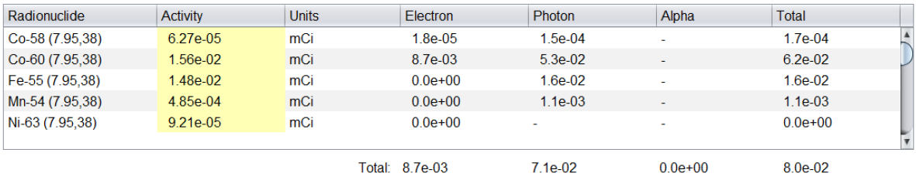
Varskin Dose Calculation
Units of dose are rem. First case is Deep Dose averaged over 1 cm^2. Second case is Shallow Dose averaged over 10 cm^2
Fe-55 contributed 16 mrem SDE due to x-rays depositing energy in skin

Slide 10
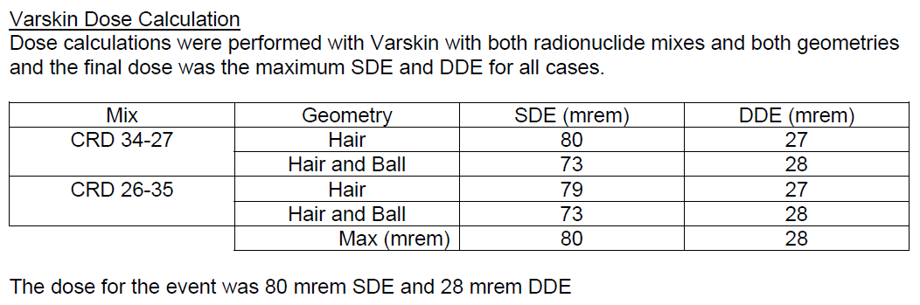
Varskin Dose Calculation

Slide 11
Issues Requiring Clarification
ICRP-38 vs ICRP-107
  NUREG implies ICRP-38 and ICRP-107 have different emission data that can yield different dose results. Need improved logic on when and why to use. Stay with ICRP-38 if you’re an ICRP-30 user and ICRP-107 if an ICRP-60 user?
No discussion about target area for Deep Dose. Used 1 cm^2 to be consistent with historical practices. Regulation 10CFR20 now averages shallow dose over 10 cm^2, but no mention of any change for deep dose.

Slide 12
Issues Requiring Clarification
Beta Model and Volumetric Sources
  NUREG Limitation 3.1.7 states source dimensions when exceed eight times the x99 beta distance in a source code may give unreliable results. No error messages were received but there is no measure to show how close. The X99 distance for Co-60 and tissue is 0.032 cm with actual source thicknesses of 3 and 9 cm for hair.
Photon Model and Volumetric Sources
  NUREG Limitation 3.2.6 states, “There is a trade-off between attenuation and charged particle build-up. The user should exercise caution when modeling large-volume sources (i.e. i the source is large enough to impact self-absorption of photons).” In this case there was some attenuation such that the actual dose would be less than the calculated dose having no attenuation. No logic to assess build-up/attenuation trade off.

Slide 13
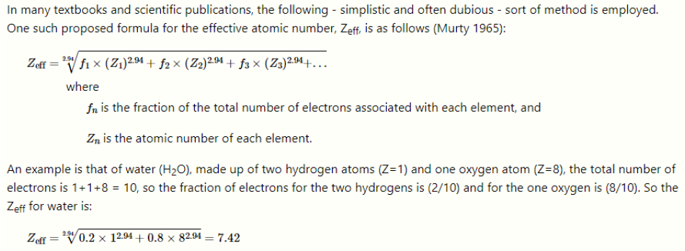
Issues Requiring Clarification
Calculation of Effective Z for volumetric hair source
  The NUREG provided an example value of 7.42 for water but did not show the actual formula.
  Recommend put the formula in the NUREG to prevent users from using a different approximation
  It was recommended to use Carbon for fabric and plastic coverings where users do not know the molecular formula. Put a constant in the code instead for lesser complexity for users?

Slide 14
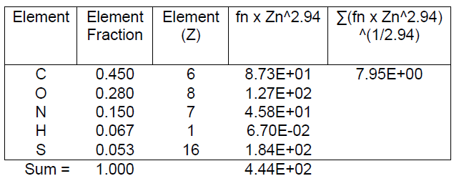
Issues Requiring Clarification
Calculation of Effective Z for volumetric hair source
  The elemental make up of hair was not in ICRP-23 and came from a secondary source
  A calculated value of 7.95 was determined for Zeff

Slide 15
Recommendations
Generate a concise user guide for the different modules with clear branching logic and end points. The current NUREG is much like a research document with statements qualitative in nature for items of further study without distinct end points resulting in the user not sure if a precaution applies or the way to resolve the issue. Refer to RAMP if not bounded by manual.
Consider complexity vs accuracy. If items like calculating the Effective Z enables the user to go from 3 sig figs to 4 sig figs, that extra level of complexity isn’t needed for an effective dosimetry program. It may be useful for further exploration, but occupational users have different needs. Also the molecular make up of coverings will essentially never be know and the recommended material was Carbon, so maybe make that a baseline value instead of users chasing molecular formulas they cant find.

Slide 16
Summary
Great example of how an end user recognized they were outside the bounds of the program and to seek consultation with RAMP
Occupational cases are on a time clock so quick interaction is key
RAMP personnel key in providing technical recommendations on how to best use the Varskin+ 1.1 code

