Slide 1
Assessment of Current MACCS Capabilities for Modeling Atmospheric Physical and Chemical Transformations
Mariah Garcia
October 21-25, 2024
International RAMP and MACCS User Group Meeting
SAND2024-13010C

Slide 2
Motivation and Purpose
The US Nuclear Regulatory Commission’s Non-Light Water Reactor Vision and Strategy Volume 3 report identifies a need to understand the atmospheric physical and chemical transformations that can occur once a radionuclide is released into the atmosphere and how deposition behavior and dosimetry could be affected as a result.
Previous work (SAND2022-12766) identified MACCS can account for variable chemical forms through using alternate dose coefficients but did not investigate the ability of transformation from one form to another.
Objectives
  Identify physical and chemical transformations relevant to consequence modeling
  Assess MACCS capabilities concerning atmospheric physical and chemical transformation after release
  Explore other state-of-practice atmospheric transport and dispersion models capabilities related to transformations

Slide 3
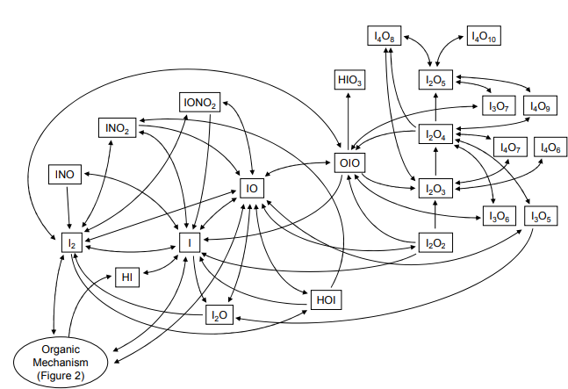
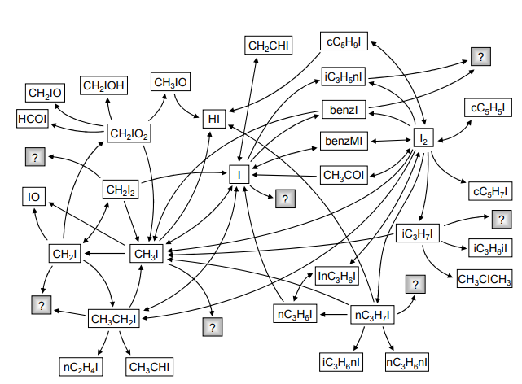
Potential Atmospheric Physical and Chemical Transformation Processes
Key processes affecting deposition and dosimetry include:
  Agglomeration
  Hygroscopic growth
  Chemical reactions with available reactants in the atmosphere, such as those involving iodine
These processes are not exhaustive, and radionuclides may undergo other transformations based on source terms and release environment characteristics
Inorganic
Organic
Source: Trincal, J., Cantrel, L., Cousin, F., Fevre-Nollet, V., Lebeque, P., 2015. Impact of atmospheric species reactivity on radioactive gaseous iodine transport in severe accident conditions. WIT Transactions on Ecology and the Environment, Vol. 198. DOI:10.2495/AIR150071.

Slide 4
Current MACCS Capabilities
Radioactive Transformation and Dosimetry
  MACCS uses the Bateman equation and a predefined decay chain database (INDEXR.DAT) to account for radioactive transformations.
  MACCS applies appropriate aerosol sizes and deposition rates for progeny at the time of release. Additional decay and ingrowth adjustments are made after atmospheric transport modeling.
  MACCS defines a dose coefficient factor for only one chemical form and particle size per radionuclide, lacking the capability to handle multiple chemical forms or particle sizes.
Dry Deposition Model
  MACCS uses Chamberlain’s source depletion method with particle-size-dependent deposition velocities.
  It defines particle size distributions for each plume segment (up to 20 bins) and applies the dry deposition equation separately to each bin.
  The system adjusts aerosol fractions in each bin after a segment leaves a radial interval but cannot repartition particle size bins to account for transformations over time.
Wet Deposition Model
  All chemical groups, except non-depositing species, are subject to wet deposition using a common washout coefficient.
  The washout coefficient, based on the 50th quantile for 1-micron particles, is applied uniformly without accounting for changes in particle size due to physical and chemical transformations.

Slide 5
Review of Atmospheric Physical and Chemical Transformations Capabilities within the Current State-of-Practice
Model | Models Multiple Depositing Species | Models Multiple Dosimetry Forms | Models Physical/Chemical Transformations | Models Physical/Chemical and Radioactive Transformation Together
MACCS | Yes | No | No | No
HYSPLIT | Yes | No | Some | No
CMAQ | Yes | No | Yes | No
WRF-CHEM | Yes | No | Yes | No
SCIPUFF/SCICHEM | Yes | No | Yes | No
AERMOD | Yes | No | Some | No
GENII | Yes | Yes | Tritium only | No
RATCHET | Yes | Yes | No | No
RASCAL | Yes | Yes | No | No
HGSYSTEM/UF6 | Yes | No | UF₆ only | No
UFOTRI/ETMOD | Yes | Yes | Tritium only | No

Slide 6
Chemical Transport Models
HYSPLIT | Can incorporate simple accounting of physical and chemical transformations, using conversion rates between pollutants to track changes in concentration over time. Can also model oxidation of sulfur dioxide, and the chemical transformation of semi-volatile pollutants.
AERMOD | Includes the Generic Reaction Set Method to account for the equilibrium between NO, NO2, and ozone, using reaction rates and a fifth-order Runge-Kutta scheme with adaptive time-stepping to solve for concentrations at each receptor.
CMAQ | Accounts for gas-phase chemistry, aqueous chemistry (cloud droplet formation), and aerosol formation. It includes three gas-phase chemical mechanisms, such as the Regional Acid Deposition Model, version 2 (RADM2), to address ozone formation and acidic deposition, using reaction rates in mass conservation equations to determine species concentration changes.
WRF-CHEM | WRF-CHEM uses the same atmospheric chemical mechanism (RADM2) and dry deposition method as CMAQ. The key difference is that WRF-CHEM is an online model, integrating chemical processes with the meteorological model, whereas CMAQ is an offline model.
SCIPUFF /SCHICHEM | Historically, SCIPUFF accounts for linear chemical transformations using user-input exponential decay, similar to HYSPLIT. Recently, the SCICHEM model has been developed to incorporate complete gas-phase, aqueous, and aerosol-phase chemistry into SCIPUFF, consistent with CMAQ's modules.

Slide 7
Radionuclide Transport Models
Identified transformation capabilities of radionuclide atmospheric transport and dispersion models are very much radionuclide specific.
UFOTRI/ETMOD | Tritium modeling includes conversion of gas into vapor and biological conversion of both into organically bound tritium.
GENII
RATCHET | Uniquely partitions iodine into nonreactive gas, reactive gas, and particulate components, assuming constant partitioning independent of travel time. It models dry deposition individually for each form and computes a weighted-average dry deposition velocity if multiple forms coexist.
RASCAL
HGSYSTEM/UF6 | Handles transport and dispersion of dense gases, plume thermodynamics, and simulates UF6 chemical reactions with water vapor. It sequentially solves dispersion, chemistry, and thermodynamics in each integration step, with interactions between these processes.

Slide 8
Applicability of Including Physical and Chemical Transformations within the Current MACCS Framework
Based on review of other atmospheric transport and dispersion models, it is believed MACCS falls within the current state-of-practice for handling physical and chemical transformations of radionuclides save for some specific cases.
There still is interest in determining if MACCS is already capable of including physical and chemical transformations if such information were to ever become available.
Two investigations were completed:
  Modeling multiple physical-chemical forms in one MACCS simulation
  Feasibility of incorporating transformations processes within the current MACCS framework
These exercises are simply an exploration of what may be possible when MACCS is exercised by an expert user.

Slide 9
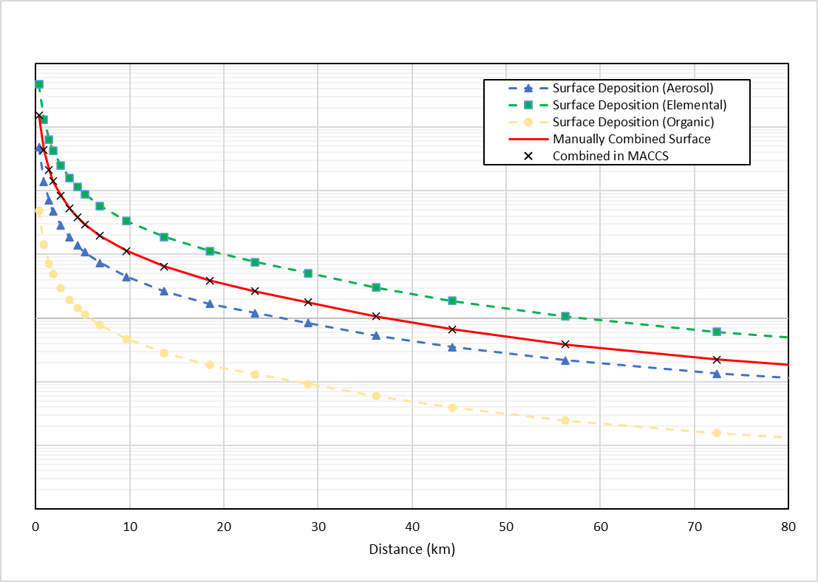
Modeling Multiple Physical-Chemical Forms in One MACCS Simulation
MACCS can model multiple physical and chemical forms in one simulation through modification of pertinent MACCS files.
Used previous analysis (1) that documented an approach to modeling different forms of iodine (elemental, organic, and particulate) in MACCS separately.
INDEXR.DAT File | DCF File
Any additional radionuclides/forms and their decay chains need to be added to the bottom of the list. Each name must be unique, the same radionuclide cannot be defined twice. Name can only be a maximum of 7 characters. The second character in the name must be lowercase. If there is an “m” in the 4–7-character position, it needs to be lowercase. A maximum of 999 radionuclides are allowed. | The title “### NUCLIDES DEFINED IN THIS FILE” at the top of the file must match the total number of radionuclides defined. Order does not matter in this file, but the order must match between where clearance classes are defined and where the dose coefficient information is defined. A maximum of 999 radionuclides are allowed.
Assumes the following chemical speciation:
25% particulate iodine
30% elemental iodine
45% organic iodine
(1) Kim, S. Y., Bixler, N. E., Ahn, K. I., & Hwang, S. W. (2020). An approach to incorporate multiple forms of iodine in radiological consequence analysis. Journal of Environmental Radioactivity, 213, 106139. https://doi.org/10.1016/j.jenvrad.2019.106139

Slide 10
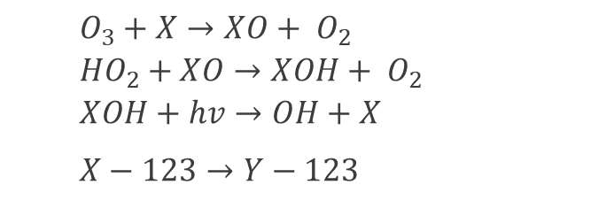
Incorporation of Transformation Processes Within the Current MACCS System
If transformation information is available as a first-order reaction rate (similar to HYSPLIT), a rate equation in the same format as radioactive decay can be used.
Reminder: this exercise is provided as an illustrative example only.
Assumptions for Investigation:
Three species to consider: X, XO, XOH
X transforms into XO at a rate of 30% per hour
XO transforms into XOH at a rate of 60% per hour
XOH transforms back into X at a rate of 75% per hour
Half-life of radioisotope X-123 is 4 hours and all the chemical forms of X decay into radioisotope Y-123
Xtemp-123 is identical to X-123 (the same radionuclide can not be defined twice in the INDEXR.DAT file)
Transformation | Rates and Fractions
X-123 → XO-123 (X_{R1}) + Y-123 (1-X_{R1}) | CT₁ → Half-life – 116 min (λ_{CT1} = 9.96E-05) X_{R1} = λ_{CT1} /(λ_{D}+λ_{CT1}) = 6.74E-01 Rate for CT₁ → Half-life – ln(2)/(λ_{D}+λ_{CT1}) = 78.2 min
XO-123 → XOH-123(X_{R2}) + Y-123 (1-X_{R2}) | CT₂ → Half-life – 45 min (λ_{CT2} = 2.57E-04) X_{R2} = λ_{CT2} /(λ_{D}+λ_{CT2}) = 8.42E-01 Rate for CT₂ → Half-life – ln(2)/(λ_{D}+λ_{CT2}) = 37.9 min
XOH-123 → Xtemp-123(X_{R3}) + Y-123(1-X_{R3}) | CT₃ → Half-life – 30 min (λ_{CT3} = 4.33E-04) X_{R3} = λ_{CT3} /(λ_{D}+λ_{CT3}) = 8.89E-01 Rate for CT₃ → Half-life – ln(2)/(λ_{D}+λ_{CT3}) = 26.7 min
Xtemp-123 → Y-123 | Half-life – 4 hours (λ_{D} = 4.81E-05)
$O_{3}+X→XO+ O_{2}$
$${HO}_{2}+XO→XOH+ O_{2}$$
$XOH+hv→OH+X$
$$X−123→Y−123$$

Slide 11
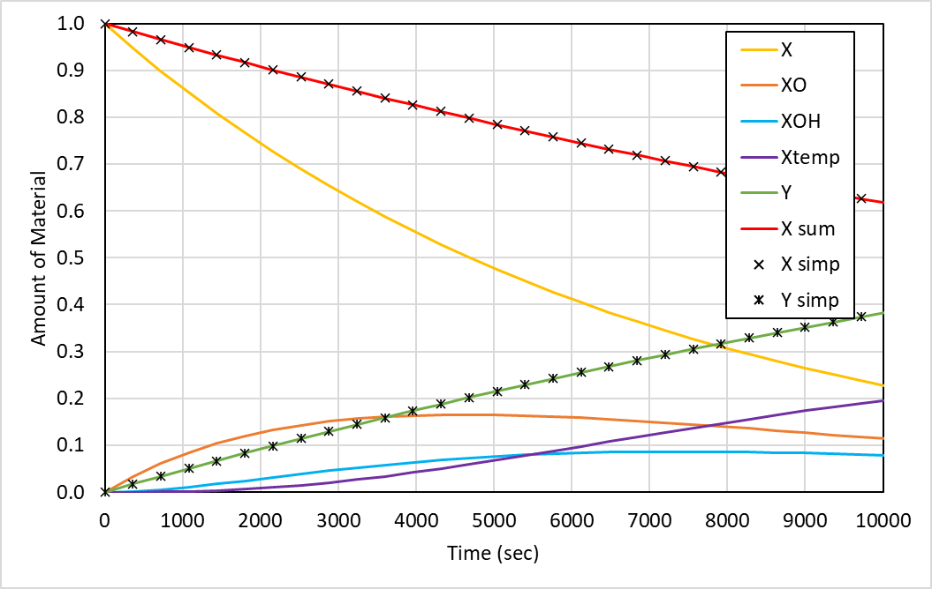
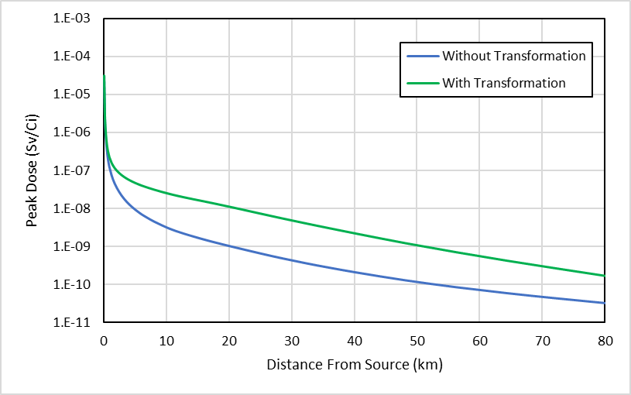
Incorporation of Transformation Processes Within the Current MACCS System (CONT)
Using example transformation information and some representative deposition velocities and inhalation dose coefficients, MACCS can include parallel physical/chemical and radioactive transformations together.
X sum = the sum of X-123, XO-123, XOH-123 and Xtemp-123 over time
X simp = amount of X-123 over time without chemical transformations included
Y simp = amount of Y-123 over time without chemical transformations included

Slide 12
Conclusions and Recommendations
Conclusions
This analysis evaluated the current capabilities of the MACCS code for handling physical and chemical transformations, noting that the inclusion of physical and chemical transformations in the current state-of-practice is limited to specific radionuclides.
A state-of-practice model capable of performing parallel physical/chemical and radioactive transformations for a generic chemically reactive radioactive compound was not identified.
The MACCS code architecture can accommodate multiple physical and chemical forms in a single simulation and model transformations between forms with some adjustment.
  User modification to the INDEXR.DAT and DCF files should be approached with extreme caution
  This analysis does not generally recommend user modification of these files
Recommendations
Update the MACCS framework to better enable users to model multiple physical and chemical forms in one simulation, such as iodine.
Investigate the feasibility of implementing parallel physical/chemical and radioactive transformations using the Bateman equation and current INDEXR.DAT setup, especially if reaction rate data for chemically reactive radioactive species becomes available.

