Slide 1
NRCDose3
Jon Napier, PhD
Health Physicist, CHP
PNNL-SA-204581

Slide 2
Topics
NRCDose3 Overview
Overview of Features
XOQDOQ Modeling and Use/Screens
GASPAR Modeling and Use/Screens
LADTAP Modeling and Use/Screens
NRCDose3 Code Planning Discussions

Slide 3
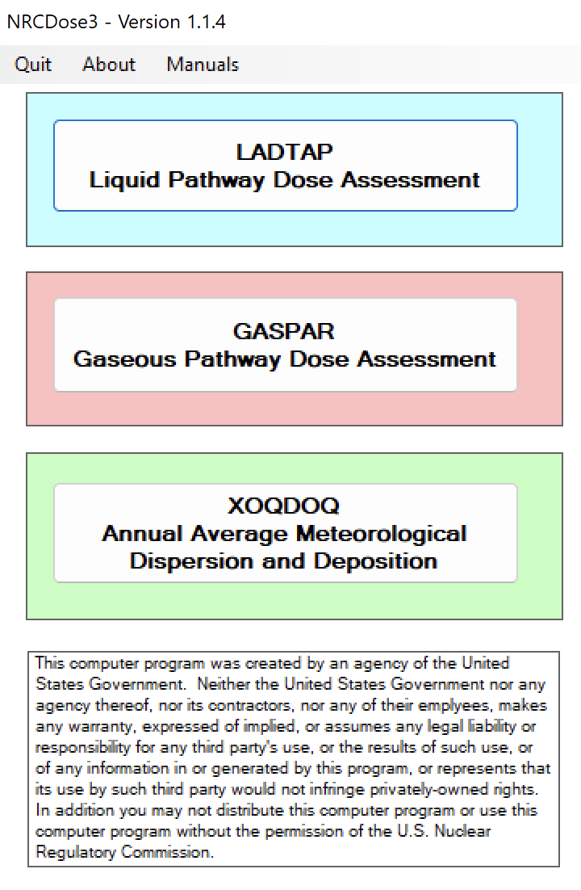
NRCDose3 Overview

Slide 4
Purpose of Code
NRC Licensing Evaluation:
Exposure pathway dose modeling, primarily for reactors to demonstrate compliance with:
  10 CFR Part 20
  Appendix I to 10 CFR Part 50
  40 CFR Part 190
With expanded source term applicable to other fuel cycle facilities
Not suitable for short term releases; accident dose assessment

Slide 5
NRC Guidance
NRC guidance on reactor effluent dose calculations is contained in:
  RG 1.109, Calculation of Annual Doses to Man from Routine Releases of Reactor Effluents for the Purpose of Evaluating Compliance with 10 CFR Part 50, Appendix I
  RG 1.111, Methods of Estimating Atmospheric Transport and Dispersion of Gaseous Effluents in Routine Releases from Light Water Cooled Reactors
  RG 1.113, Estimating Aquatic Dispersion of Effluents from Accidental and Routine Reactor Releases for the Purposes of Implementing Appendix I

Slide 6
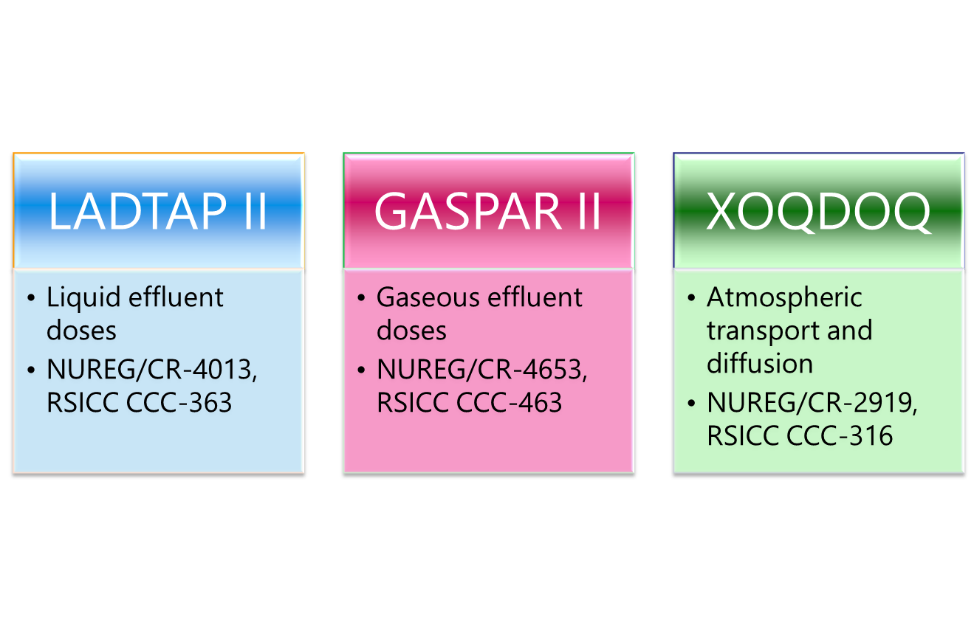
FORTRAN Codes

Slide 7
XOQDOQ
Evaluation of transport, diffusion, and deposition of airborne radiological effluents
Routine releases
Intermittent releases
Non-emergency
Calculates atmospheric dispersion factors (χ/Q) and deposition factors (D/Q)
Predefined segmented distances by compass sectors out to 50 miles
User defined points of interest

Slide 8
XOQDOQ
Straight-line trajectory Gaussian plume model. Considers:
  Dry deposition
  Radioactive decay
  Plume recirculation (stagnation)
Calculates effective plume height
  Physical release height
  Aerodynamic downwash
  Plume rise
  Terrain features

Slide 9
GASPAR II
Estimates airborne effluent doses
  Routine
  Non-emergency
  Individuals or populations
Requires:
  Source term released (Ci/yr)
  Atmospheric dispersion (XOQDOQ)
  Demographics

Slide 10
GASPAR II
Internal Exposure Pathways
  Inhalation (of plume)
  Ingestion of contaminated food
    leafy vegetables
    vegetables and grains
    meat
    milk
External Exposure Pathways
  Plume
  Ground Plane

Slide 11

LADTAP II
Estimates liquid effluent doses
  Routine
  Non-emergency
  Individuals, populations or biota
Hydrologic model represents mixing in the effluent impoundment system and surface waters

Slide 12
LADTAP II
Internal Exposure Pathways:
  Drinking water (freshwater site)
  Fish
  Invertebrates
  Aquatic plants
  Irrigated crops
External Exposure Pathways:
  Shoreline
  Boating
  Swimming

Slide 13
GASPAR II and LADTAP II
ICRP-2 DCFs (1950s)
Four (4) Age Groups:
  Infant
  Child
  Teen
  Adults
Seven (7) Organs
  Total Body
  Bone
  Liver
  Thyroid
  Kidneys
  Lungs
  GI-LLI

Slide 14
NRC and Industry End Uses
NRC licensing reviews
  Design Certification, Combined License, and Early Site Permit Applications
  License Amendment Requests
NRC health physics reactor inspections
  Independent assessment of potential doses from effluent releases
  Independent assessment of ODCM dose conversion factors and effluent dose calculations

Slide 15
NRC and Industry End Uses
Calculate doses at locations of interest
Evaluate Land Use Census
  Public interest
Annual dose assessments
  Actual receiving water body flows and dilutions
  Meteorology with effluents for evaluated year
ODCM dose conversion factors

Slide 16
Why Update to NRCDose3
Updates the NRCDose 2.3.20 (CCC-684) code
Significant increase in flexibility and functionality
Need for a licensing tool to support reactor application submittals
Provides an acceptable method for evaluating exposure pathway doses from reactor effluents
Improves efficiency in reactor licensing process, and NRC safety and environmental reviews

Slide 17
Overview of Updates
Improved functionality
  Updated Windows interface
Option to select ICRP-2, ICRP-30, or ICRP-72 Dose Conversion Factors (DCFs)
  Age range
  Organs
Expanded license application ready reports
User-modifiable parameter values
  Bioaccumulation factors
  Consumption rates
  Usage factors
  Other parameters
Previous versions of NRCDose (and FORTRAN codes) did not allow for edits to parameters

Slide 18
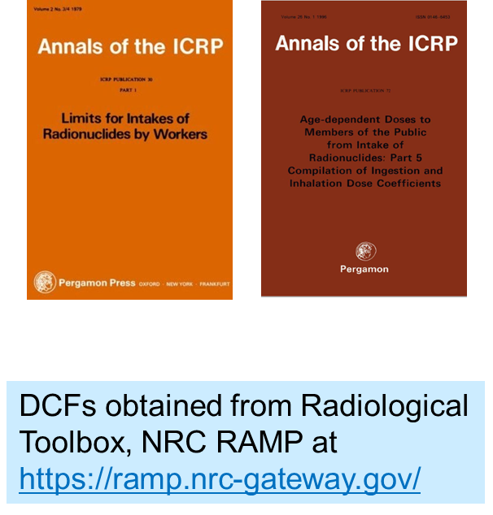
Updates – DCFs
Expanded ICRP-2 DCFs
ICRP-30 DCFs
ICRP-72 DCFs
Ingestion DCFs: Gastrointestinal Absorption Fractions (f1)
Inhalation DCFs: Lung Clearance Classes for Chemical Compounds
  ICRP-30: D/W/Y
  ICRP-72: F/M/S

Slide 19
Updates – Biota Dose
Biota dose added to GASPAR and expanded in LADTAP
Biota dose calculated at all user defined special location (GASPAR)
Biota dose based on species mass, effective radius, primary food eaten (produce or meat) and consumption rate
LADTAP
  Algae
  Muskrat
  Racoon
  Duck
  Heron
  User defined
GASPAR
  Same as LADTAP plus
  Cow (herbivore)
  Fox (carnivore)
  User defined

Slide 20
Documentation and Release
NRCDose3 Quick Start Guide
  How to install, run, and view output
DRAFT NUREG on NRCDose3 Code: User Guide and Technical Manual
  Technical basis
Distribution by NRC RAMP

Slide 21
Overview of Features and Enhancements

Slide 22
Installation and Operation
Double-click NRCDose3_v114_Setup.exe
Follow prompts
NRCDose3 will install in C:\directory (unless changed by the user)

Slide 23
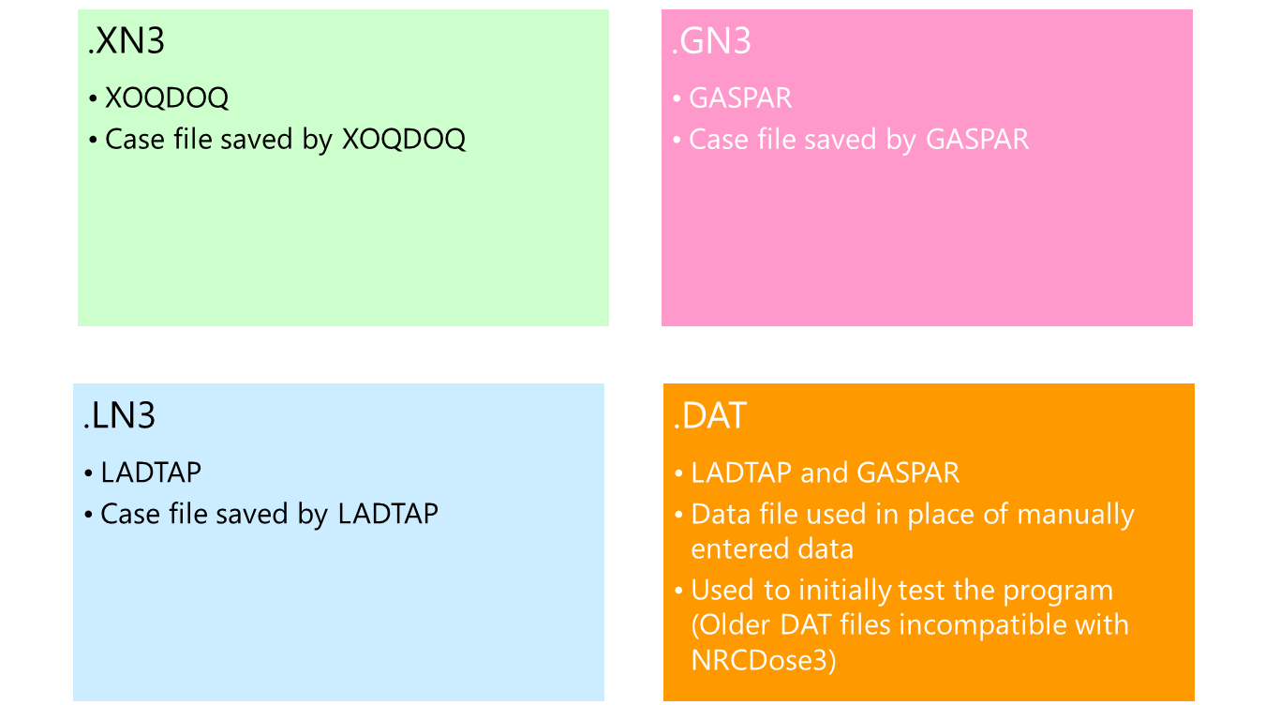
Installation and Operation

Slide 24
File Structure
When a code is opened, it will be loaded with the last case file from the database
When first opened, an example case file will be pre-loaded
If a different case is desired, select File->Open LN3 File from the menu to load a saved case
Or “Open GN3 File” or “Open XN3 File” as applicable
When saving a case, it will be saved to the database as well as a case file (.xn3, .gn3, .ln3 file type, as applicable)

Slide 25
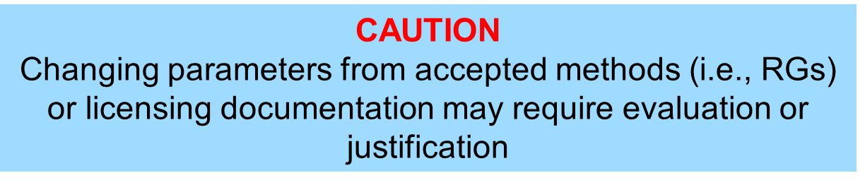
Hard-Coded Parameters
Previous versions of codes had many hard-coded parameters that are now user-editable
Editing may be appropriate for site-specific conditions

Slide 26
XOQDOQ Expanded Editable Parameters
Building wake constant
  Though not recommended without a sound technical bases
Essentially all other key modeling parameters (input values to the meteorological model) were already user defined or user controlled

Slide 27
LADTAP Expanded Editable Parameters
Population age group fractions
Food and water consumption rates
Bioaccumulation and transfer factors
Various environmental exposure times and vegetable production and storage times

Slide 28
GASPAR Expanded Editable Parameters
Population age group fractions
Human consumption and inhalation rates
Bioaccumulation factors
Various environmental times, vegetable production, and storage times
Meat and milk animal consumption rates

Slide 29
Dose Conversion Factors
Expanded ICRP-2 DCFs from:
  RG 1.109, Revision 1, Calculation of Annual Doses to Man From Routine Releases of Reactor Effluents for the Purpose of Evaluating Compliance with 10 CFR Part 50, Appendix I (October 1977)
  NUREG-0172, Age Specific Radiation Dose Commitment Factors for One-Year Chronic Intake (November 1977)
  NUREG-0172, Errata (August 1983)
  NUREG/CR-2384, Age Specific Inhalation Radiation Dose Commitment Factors for Selected Radionuclides (August 1982)
  EMP-155, Review and Expansion of USNRC Regulatory Guide 1.109 Models for Computing Dose Conversion Factors (February 1983)

Slide 30
DCFs
Some radionuclides in those sources were not included in LADTAP II/GASPAR II
NRCDose3 includes
  203 radionuclides
  ICRP-2 DCFs for ALL radionuclides
  ICRP-30 DCFs for ALL radionuclides
  ICRP-60/72 DCFs for ALL radionuclides

Slide 31
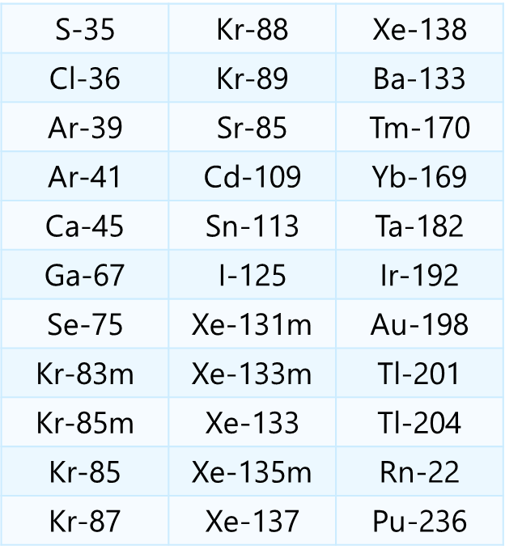
Additional Radionuclides

Slide 32
DCFs
NRCDose3 allows only one chemical form, inhalation class or ingestion class for each radionuclide
Multiple ingestion DCFs based on f1 value
Multiple inhalation DCFs based on inhalation class
  D/W/Y for ICRP-30
  F/M/S for ICRP-72
Nuclear power plant effluents are assumed to be oxides; other fuel cycle facilities may have different states

Slide 33
Age and Organs
ICRP-30
  Adult Only
    Occupational DCFs
ICRP-72
  Adult
  15 year old
  10 year old
  5 year old
  1 year old
  Newborn
ICRP-30
  24 Organs, including remainder
ICRP-72
  27 Organs, including remainder
    Colon, ETA, skin(ext)

Slide 34
XOQDOQ Modeling and Use

Slide 35
XOQDOQ – Atmospheric Transport and Dispersion
Implements the straight-line Gaussian modeling of RG 1.111
Calculates ground-level concentrations
Accounts release points characteristics (height, plume rise)
Additional plume dispersion due to building wakes
Plume depletion via dry deposition and radioactive decay

Slide 36
XOQDOQ – Atmospheric Transport and Dispersion
Annual average relative dispersion (χ/Q) and deposition (D/Q) values at user specified locations (MEI doses) and standard radial distances and segments (population doses) for routine releases
Intermittent releases (e.g., containment purge, waste gas tank)
Elevated, ground level, or mixed mode releases
Meteorological modeling considerations: building wake effects, plume depletion (dry deposition), and radioactive decay

Slide 37
XOQDOQ – Atmospheric Transport and Dispersion
Wind direction in 16 compass directions (22.5° sectors), 14 wind speed classes, and 7 atmospheric stability classes (A-G)
Three different dispersion χ/Q values; one deposition D/Q value
  Undecayed, Undepleted χ/Q
  Decayed, Undepleted χ/Q (2.26-day half-life)
  Decayed, Depleted χ/Q (8-day half-life)
  Deposition D/Q (2.26-day and 8-day half-lives)
Output used as meteorological data input to GASPAR

Slide 38
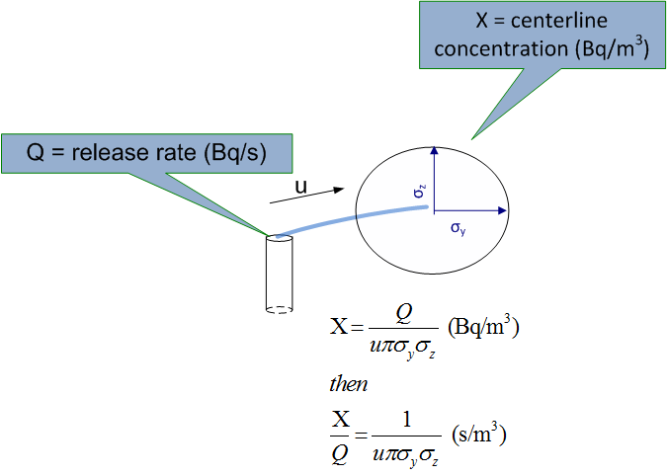
Basic Meteorology Dispersion – χ/Q

Slide 39
Basic Meteorology Dispersion – χ/Q

Slide 40
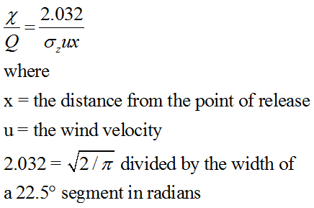
Gaussian Model – Sector Average
Dividing the area surrounding a point source into 16 segments gives 360°/16 = 22.5° per segment
For averaging condition (over time), the plume is assumed to meander, spreading uniformly over the 22.5° sector

Slide 41
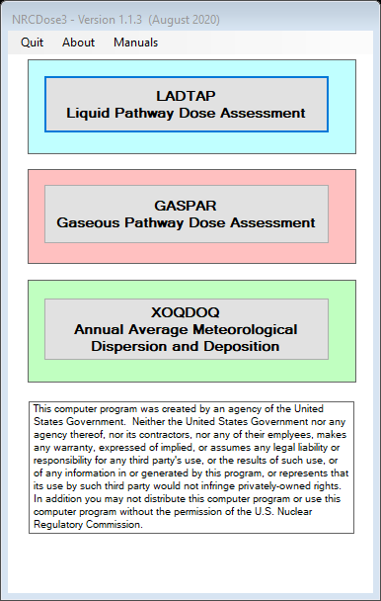
Starting and Running XOQDOQ
Double click “XOQDOQ”

Slide 42
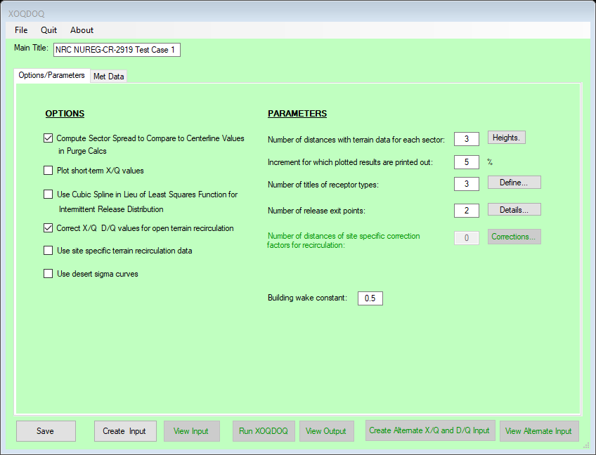
XOQDOQ – Atmospheric Transport and Dispersion
XOQDOQ Module Main Screen opens with case data that is saved in the database
Contains three main functional areas:
  toolbar and initial setup area,
  data input tabs
  code execution and reports

Slide 43
XOQDOQ – File Management
New ─ New XOQDOQ case. Clears the databases.
Open XN3 File ─ open an existing “*.XN3” file previously created with NRCDose3
Open Legacy Input File ─ Opens Windows Explorer; navigate to “*.dat” file
  Uses a file created with the original XOQDOQ
  “Create input” not needed; select run XOQDOQ. Input screens and options cannot be used

Slide 44
XOQDOQ – File Management
Save to Database ─ Choose this option to save current case to the database. When XOQDOQ is opened with “Current Project” selected, the information in the database, as last saved before exiting, initially populates all XOQDOQ screens and windows.
Save to XN3 File ─ Choose this option to save the completed case to a “*.XN3” file
Delete ─ Choose this option to open an explorer window that will allow the user to delete any previously saved “*.XN3” files

Slide 45
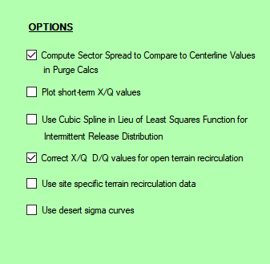
XOQDOQ Main Screen – Options
Various options
  Purge calc (short term releases) printout compares sector spread to centerline values
  Printout plot of short-term X/Q values (not very useful)
  Open terrain recirculation: correction is applied uniformly to all directional sectors out to 10 km (NUREG/CR-2919, Figure 3.2)
  Use site-specific terrain recirc values (user input under Parameters)
  Desert sigma curves (specialized dispersion values developed for desert environment)

Slide 46
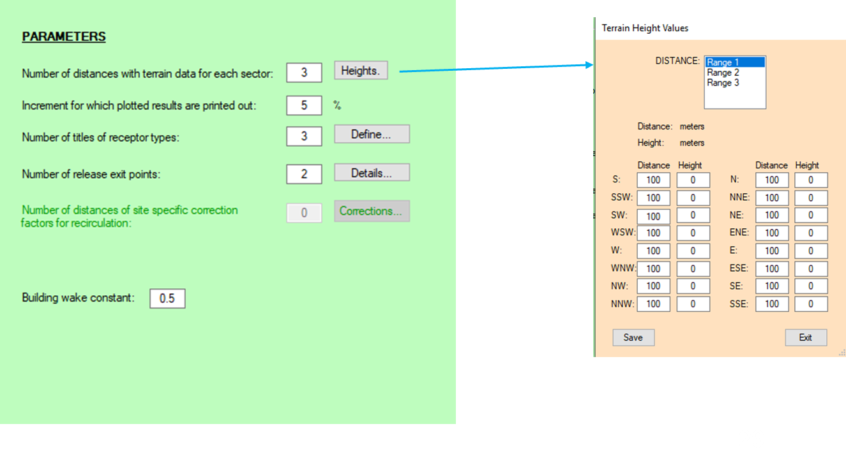
XOQDOQ Options/Parameters

Slide 47
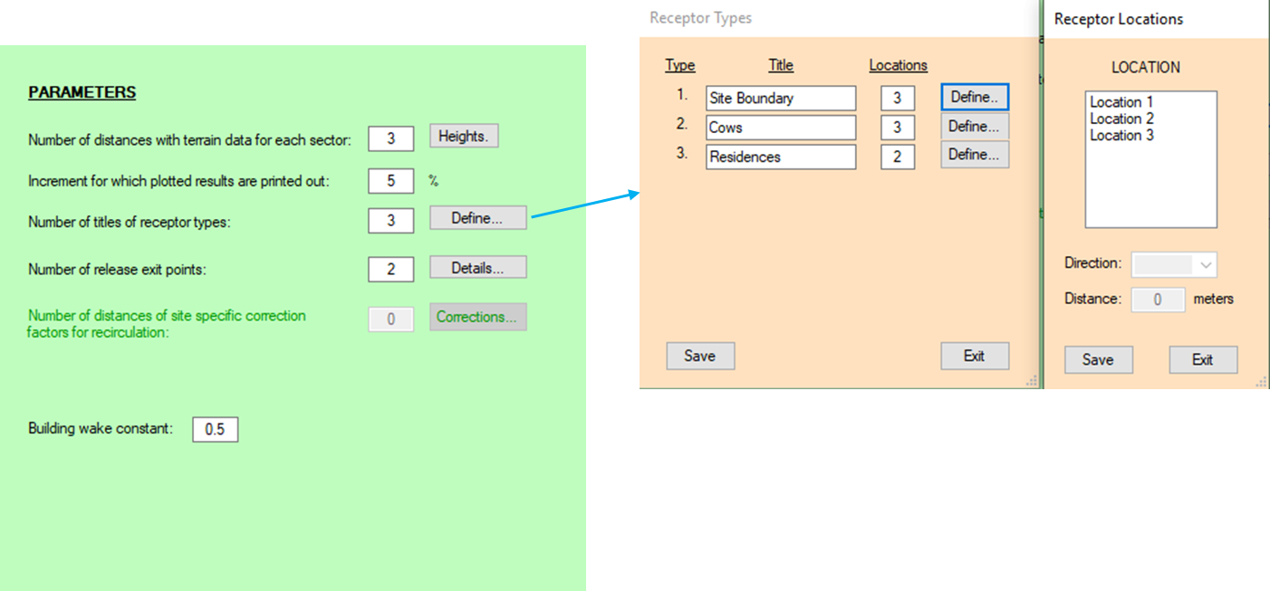
XOQDOQ Main Screen - Parameters

Slide 48
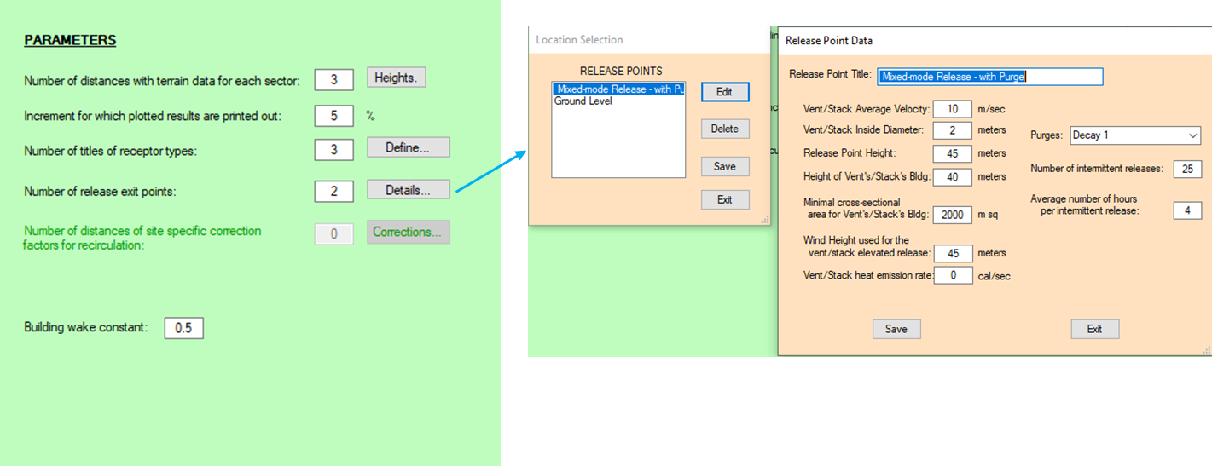
XOQDOQ Main Screen - Parameters

Slide 49
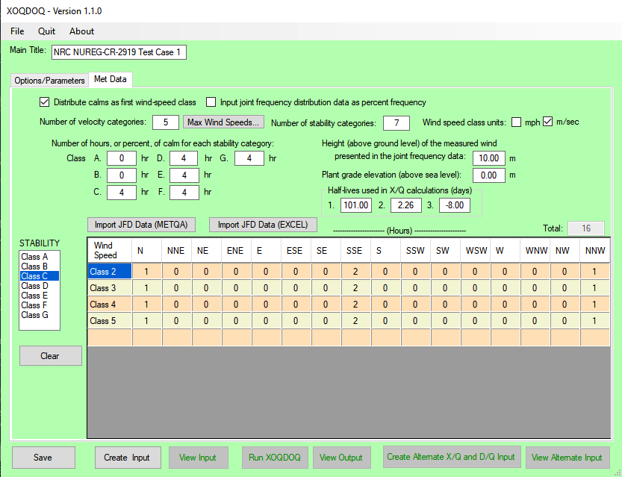
Met Data Input
Calms
Met data: hours or % frequency
Height of measurement
Plant grade
Half-lives (do not change)
Inputting joint frequency distribution (JFDs)
  Line-by-line entering for each Stability Class

Slide 50
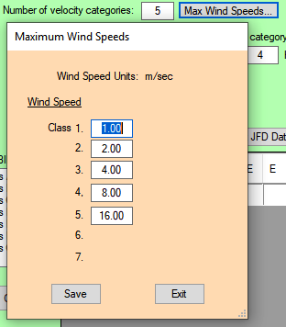
Windspeed Input
Enter the “Number of velocity categories” (maximum 13), and then select “Max Wind Speeds…” to enter the maximum wind speed of each category

Slide 51
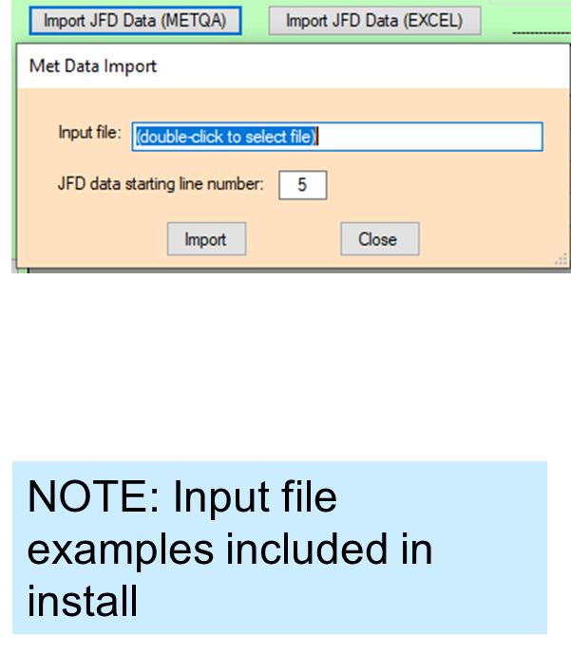
Import Met Data
Met data (JFD) can be imported using 2 standard file formats
  MetQA: file format generated by an internal (NRC) application MetQA (Version 2.0), which represents the NRC staff’s implementation of NUREG-0917
  EXCEL: specific data array by wind direction, wind speed range, and atmospheric stability classes ranging, in sequence, from extremely unstable (Class A) thru extremely stable (Class G)

Slide 52
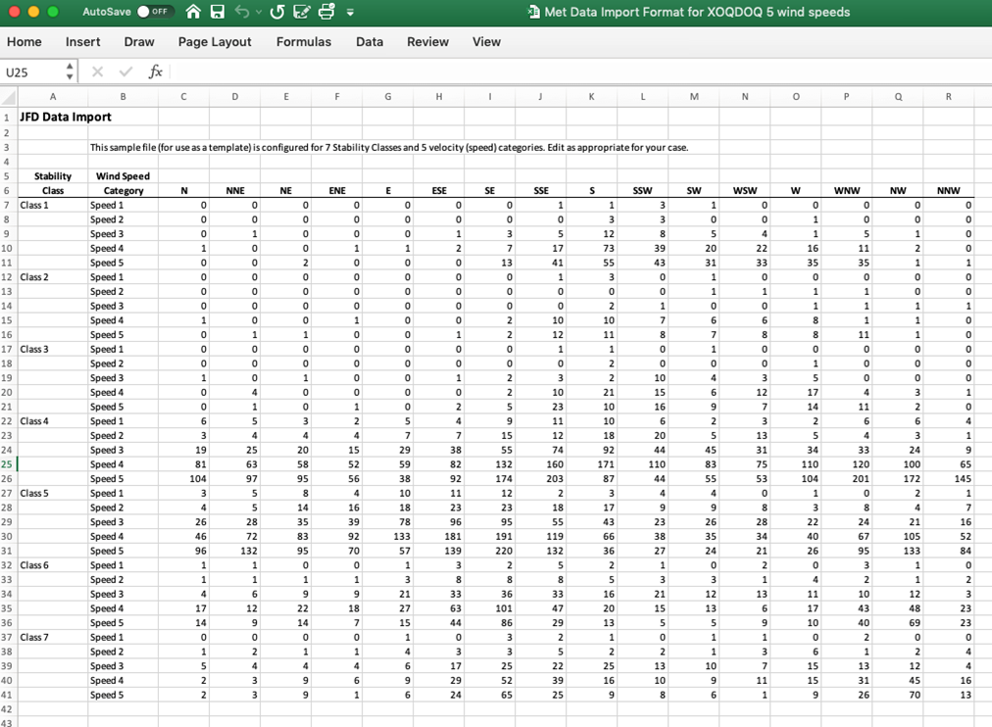
Import Met Data – Example File Format

Slide 53
XOQDOQ – Save, Create Input, Run
Save to save the dataset to any file name as being used.
Create Input to create the dataset in the format required by the FORTRAN code
View Input to view created input file
Run XOQDOQ

Slide 54
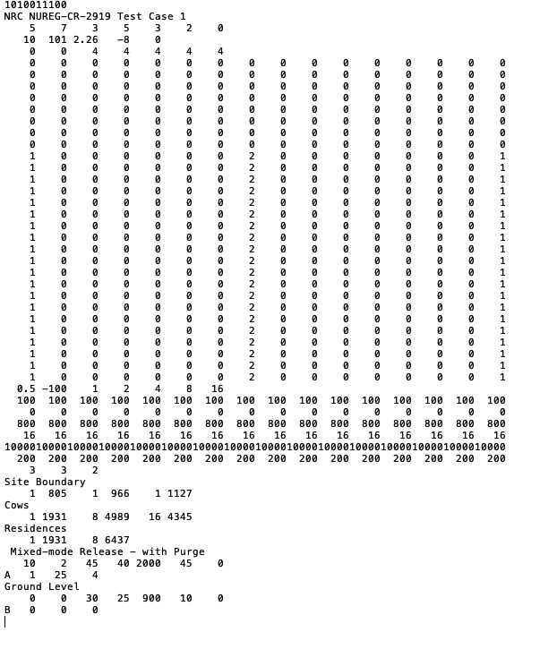
View Input
Shows the input deck as used by the FORTRAN code
Follows the card format as described in NUREG/CR-2919

Slide 55
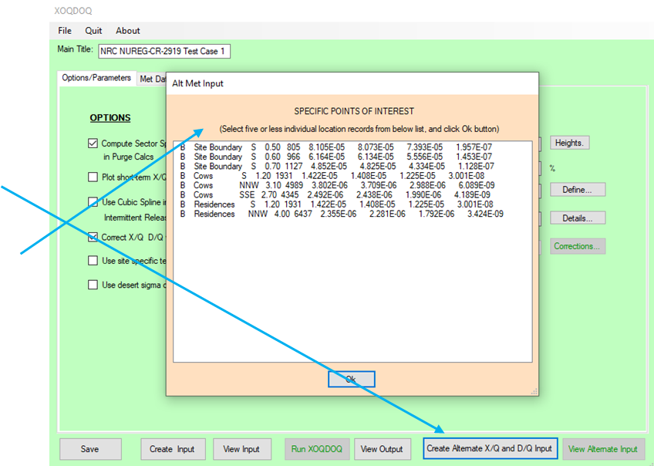
Windspeed Input
A meteorological dataset suitable for import by GASPAR can be created
  Select Create Alternate X/Q and D/Q Input
Pop-up screen to select up to 5 locations
An input file will be created internal which may be referenced during the GASPAR run
Only applicable to XOQDOQ for single release point runs

Slide 56
GASPAR Modeling and Use

Slide 57
GASPAR
Performs dose assessments for gaseous radioactive effluents released into the atmosphere
Implements dose assessment methods described in RG 1.109
Calculates the radiation dose to individuals, population groups, and biota from:
  inhalation of contaminated air,
  direct exposure from contaminated ground, and
  consumption of contaminated foods
Basic calculation methods are described in NUREG/CR-4653

Slide 58
GASPAR
Calculated doses support
  NEPA evaluations
  Compliance with the NRC public dose limits in 10 CFR Part 20
  EPA public dose limits in 40 CFR Part 190
  NRC ALARA design objectives and numerical guides in 10 CFR Part 50, Appendix I

Slide 59
Starting and Running GASPAR
Double click “GASPAR”

Slide 60
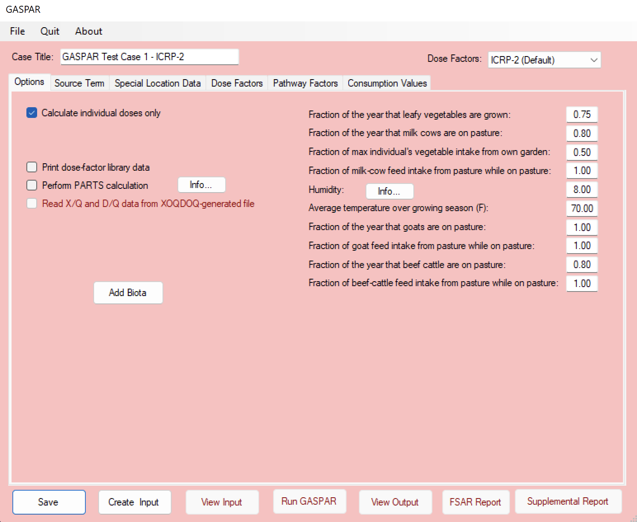
GASPAR Main Screen
Contains three main functional areas:
  the toolbar and initial setup area,
  data input tabs area and
  code execution and reports area
NOTE: GASPAR opens with the last saved database

Slide 61
GASPAR Start-up
New ─ Select this option to begin a new GASPAR case. This will clear the database from any previously input information.
Open GN3 File ─ Select this option to access and open a “*.GN3” file that was previously created with NRCDose3.
Save to Database ─ Choose this option to save the current case to the database. When GASPAR starts, it loads the data that was last saved (typically from the last, previous run), populating all GASPAR screens and windows.
Save to GN3 File ─ Choose this option to save the completed case to a “*.GN3” file. This allows the file to be saved for later use, or for sharing with others.
Delete ─ Choose this option to open an explorer window that will allow the user to delete any previously saved “*.GN3” files.

Slide 62
GASPAR Main Screen
Enter a Case Title
Select dose factors:
  ICRP-2 (Default)
  ICRP-30
  ICRP-72
Option for individual doses only
Printing cumulative or detailed reports
Printing dose factor library
PARTS calculations (dose conversion factors for site-specific modeling; used in ODCM)
NOTE: Changing DCFs will re-initialize the source term

Slide 63
GASPAR Main Screen
Seven data input tabs:
  Options
  Source Term
  Pop/Prod Data
  Special Locations
  Dose Factors
  Pathway Factors
  Consumption Values

Slide 64
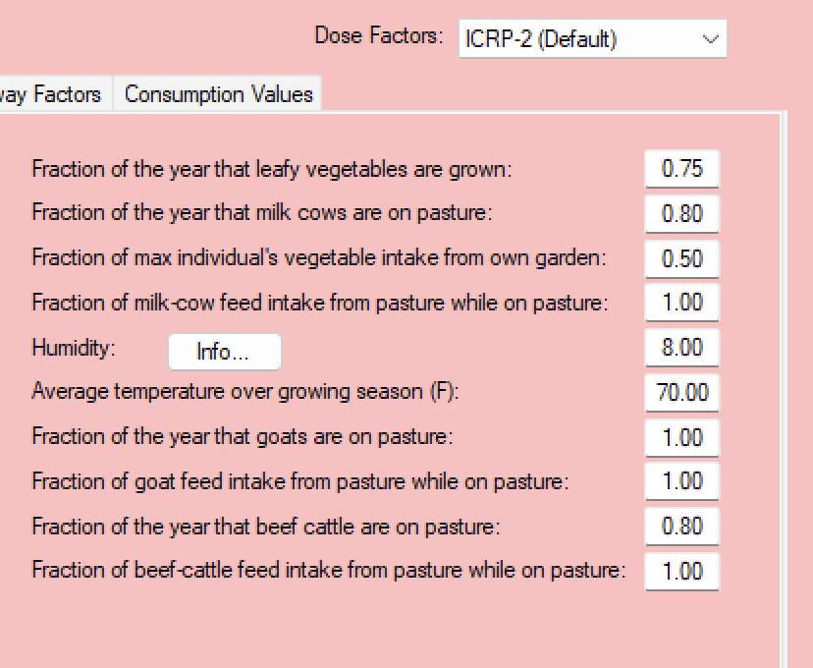
GASPAR Options
Input site-specific for pathway modeling assumptions

Slide 65
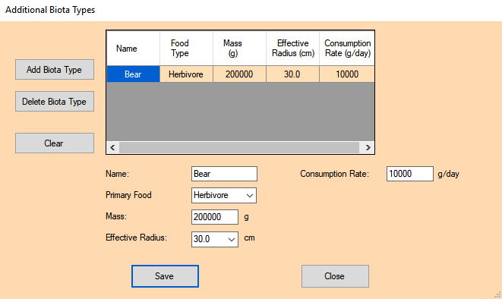
GASPAR - Biota
Modeling based on BNWL-1754 (same as LADTAP)
Six (6) biota types automatically included
  muskrat, racoon, duck, heron, cow, and fox
Option for user defined biota
  Food type (limited to either herbivore or carnivore)

Slide 66
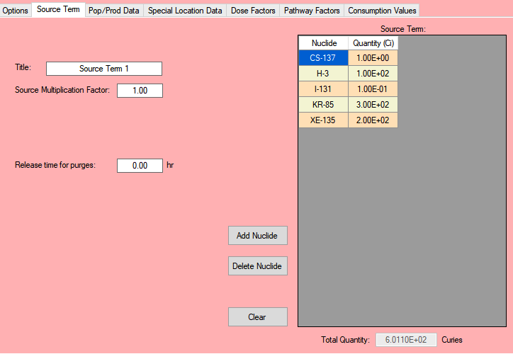
GASPAR – Source Term
Title
Source term multiplication
Add, delete or clear options
NOTE: Only a single source term may be used for each case

Slide 67
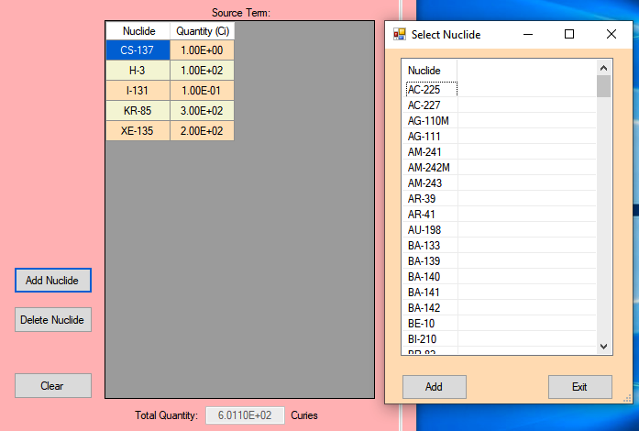
GASPAR – Source Term
Select: Add Nuclide
  Pop-up menus with nuclide list
  Highlight desired nuclide; use ”control” key to select multiple nuclides
Selecting Add will add them to list
Delete Nuclide will delete selected nuclide
Clear will clear all nuclides in the source term

Slide 68
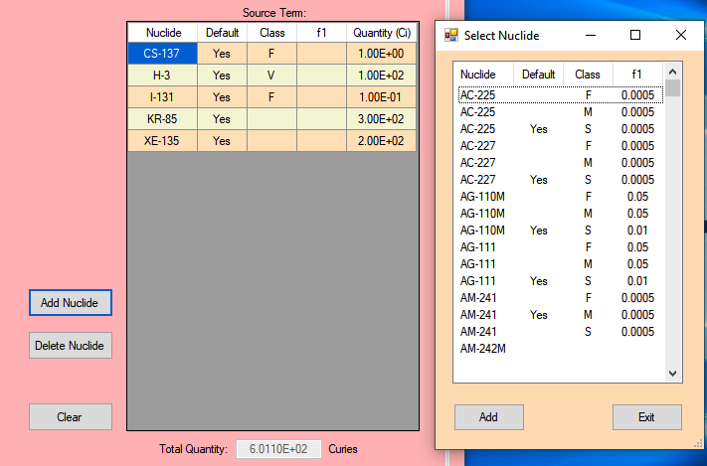
GASPAR – ICRP-30 and ICRP-72 DCFs
ICRP-30 and ICRP-72 DCFs, select the applicable solubility (f1) or lung clearance type (F, M, S) for each radionuclide
NOTE: Only one solubility or inhalation class allowed per radionuclide

Slide 69
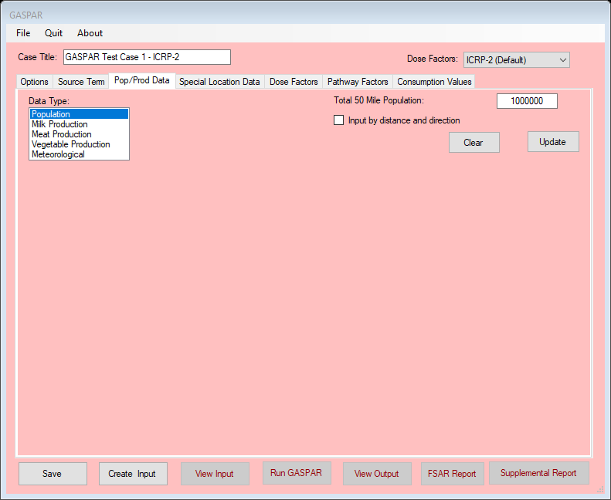
GASPAR – Population/Production Data
Used for population dose calculations only
Dropdown menu for data type
  Population
  Milk
  Meat
  Vegetable
  Meteorology
Except for meteorology, 50 mile data may be entered rather than sector segmented data

Slide 70
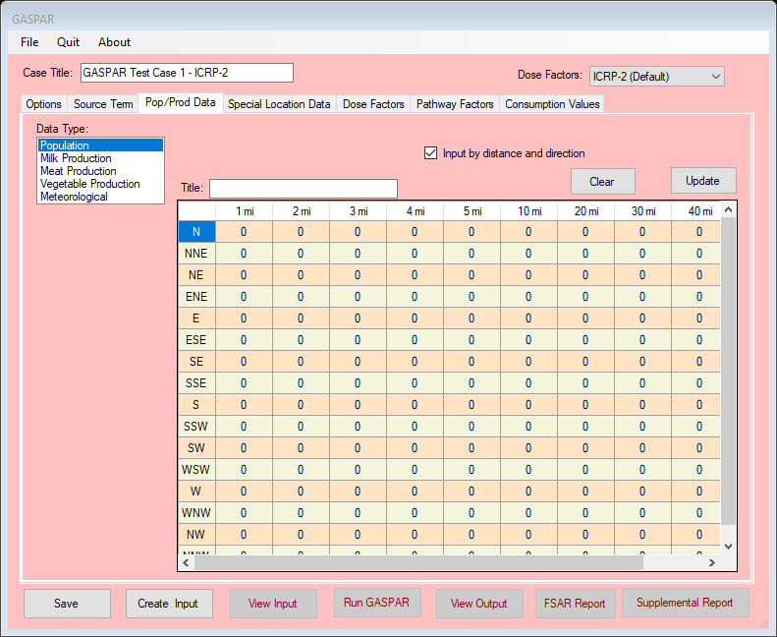
GASPAR – Population/Production Data
Applies for population, milk, meat, and vegetable production
Input population or production data by meteorological sector and distance (data typically found in applicant’s Safety Analysis Report or Environmental Report)

Slide 71
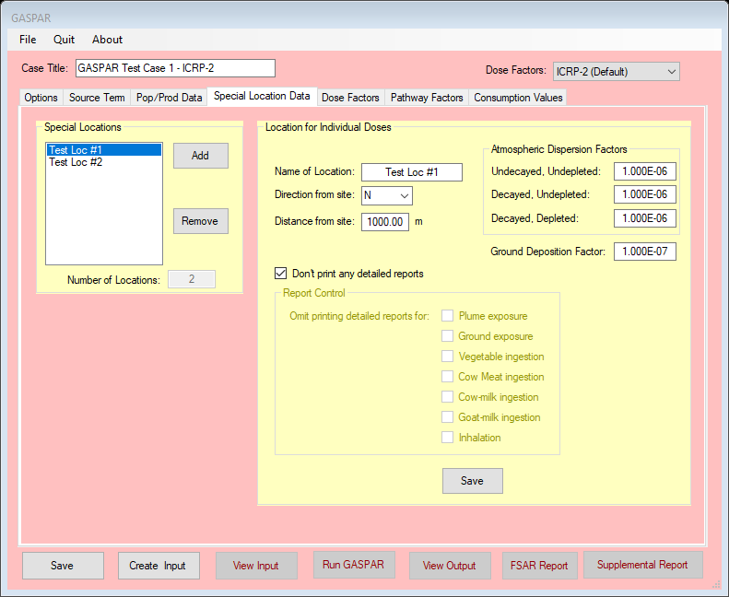
GASPAR – Special Location Data
Select Add to add new location (will clear fields)
  Identified the location where individual doses will be calculated
Location data
  Name
  Distance/Direction (information use only)
Atmospheric dispersion factors
Detailed Reports
Save

Slide 72
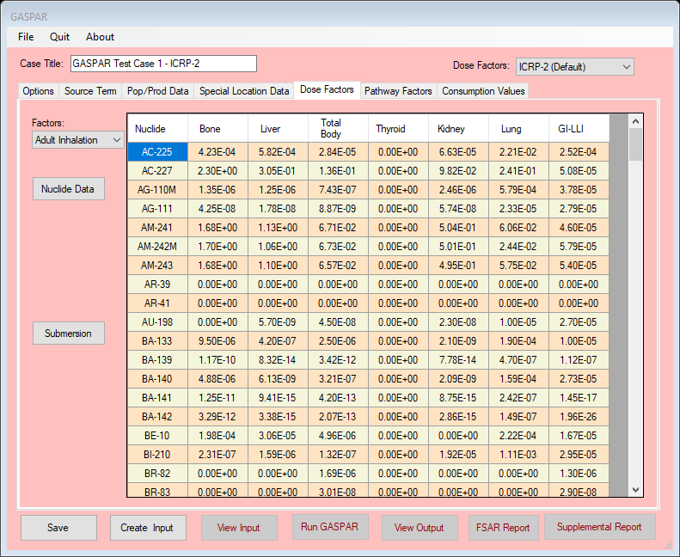
GASPAR – Dose Factors – Nuclide Data
Dropdown menu for displaying dose factors
  Inhalation
  Ingestion
  By age group
Values for the Dose Factors being used (mrem per pCi, inhaled or ingested)
  ICRP-2
  ICRP-30
  ICRP-72
NOTE: Dose factor data is not editable

Slide 73
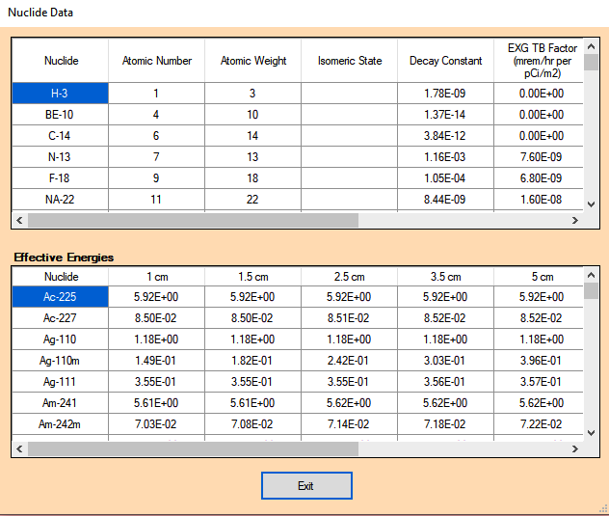
GASPAR – Dose Factors – Nuclide Data
Nuclide decay data
External dose factors
Absorbed Energies
  For biota calculations
  Effective radii
  Units (MeV/Bq s)
NOTE: Dose factor data is not editable

Slide 74
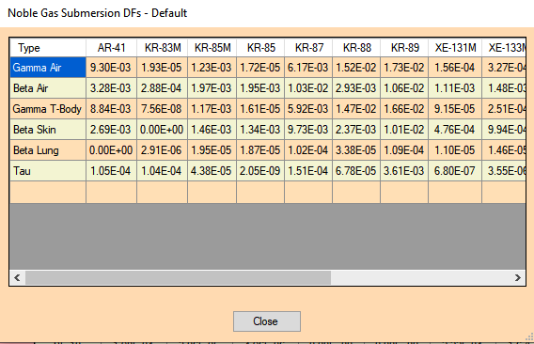
GASPAR – Dose Factors Submersion
Submersion (semi-infinite plume) dose factors for noble gases
  (mrad or mrem per year per pCi/m³)
NOTE: GASPAR calculates airborne submersion dose only from noble gas

Slide 75
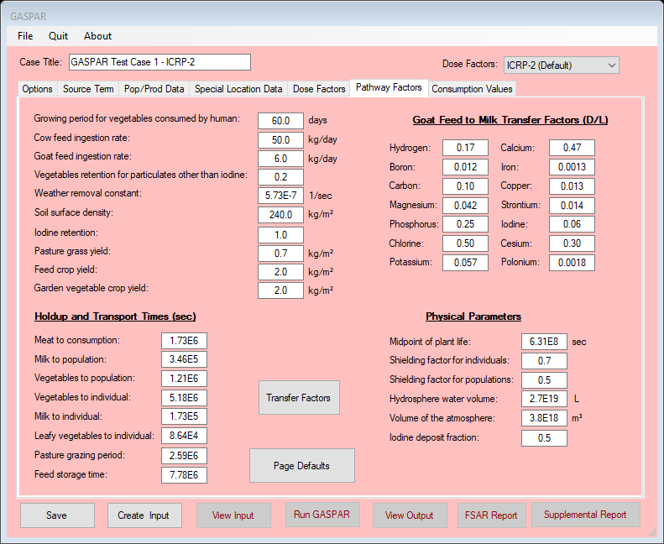
GASPAR – Special Location Data
Default values included for various environmental pathway modeling parameters
Goat milk transfer factors
Hold-up and Transport Times
Physical parameters
Option to reset to default values

Slide 76
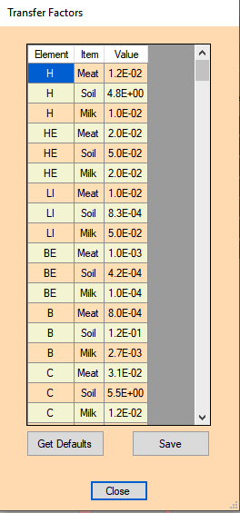
GASPAR – Dose Factors Submersion
By element
  Feed-to-meat (cow, day/kg)
  Soil-to-vegetation
  Grass-to-milk (cow, day/liter)
Can be edited to address site-characteristic data
Tab to reset to Default values
Save – any changed

Slide 77
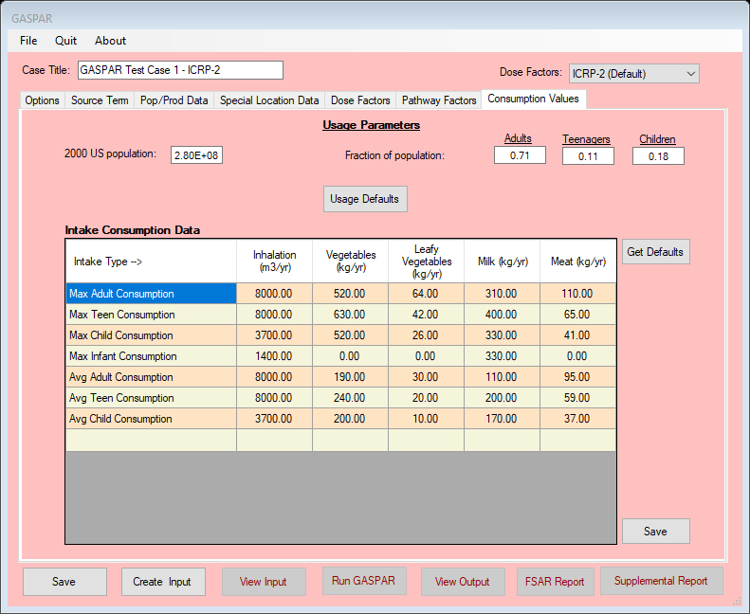
GASPAR – Consumption Values
U.S. (country) population
  Artifact of FORTRAN code; required input but not used
Population fractions
Maximum and average individual consumption values; by age group
Get Defaults to reset
Save changes

Slide 78
Running GASPAR – Outputs/Reports
Can be Saved and Run from any screen
  Save
  Create Input
  View Input
  Run GASPAR
  View Output
  FSAR Report
  Supplemental Report

Slide 79
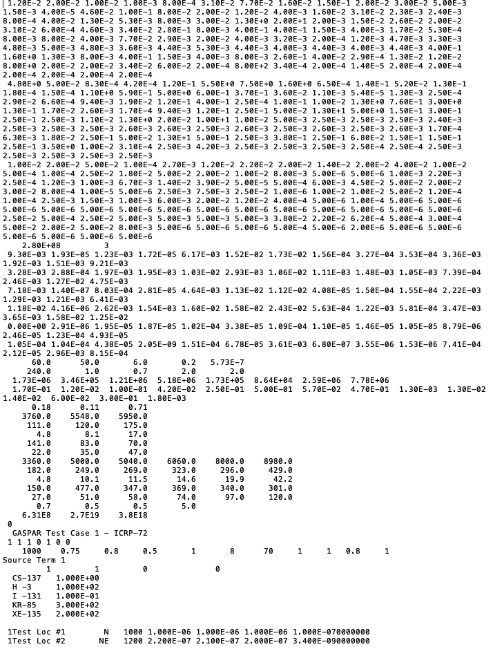
Running GASPAR – Input
Input follows the format of the “card deck” as described in NUREG/CR-4653
The datasets reflect modeling under the “Pathway factors” tab, such as transfer factors, exposure and transfer assumptions
The bottom section is the standard format for GASPAR input (individual doses only), containing the Selections inputs, source term, Special Location assumptions
If population doses performed, would also include the population, production and meteorological data

Slide 80
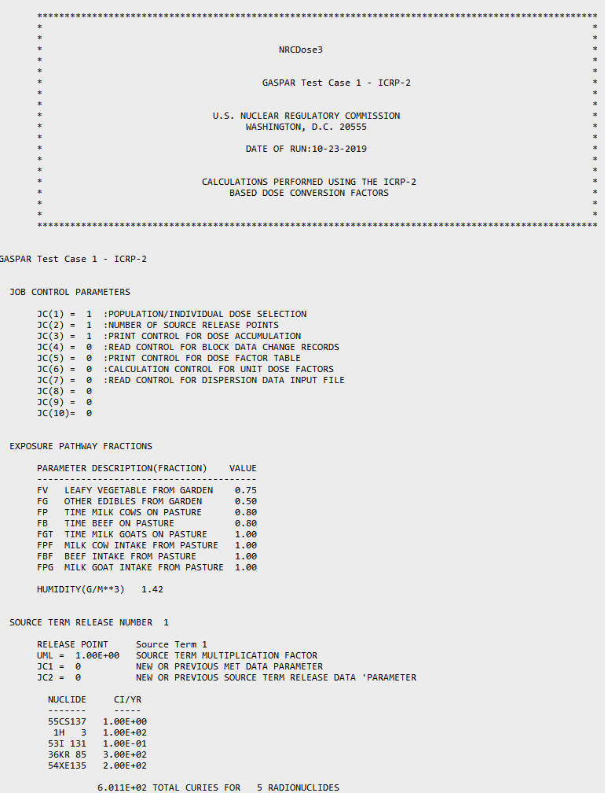
Running GASPAR – Output
Basic assumptions used for calculations
Lists the Source Term
Followed by Doses
  Population (if performed)
  Individual by Special Locations
If selected “Print Dose Factor Library,” output will include all nuclides

Slide 81
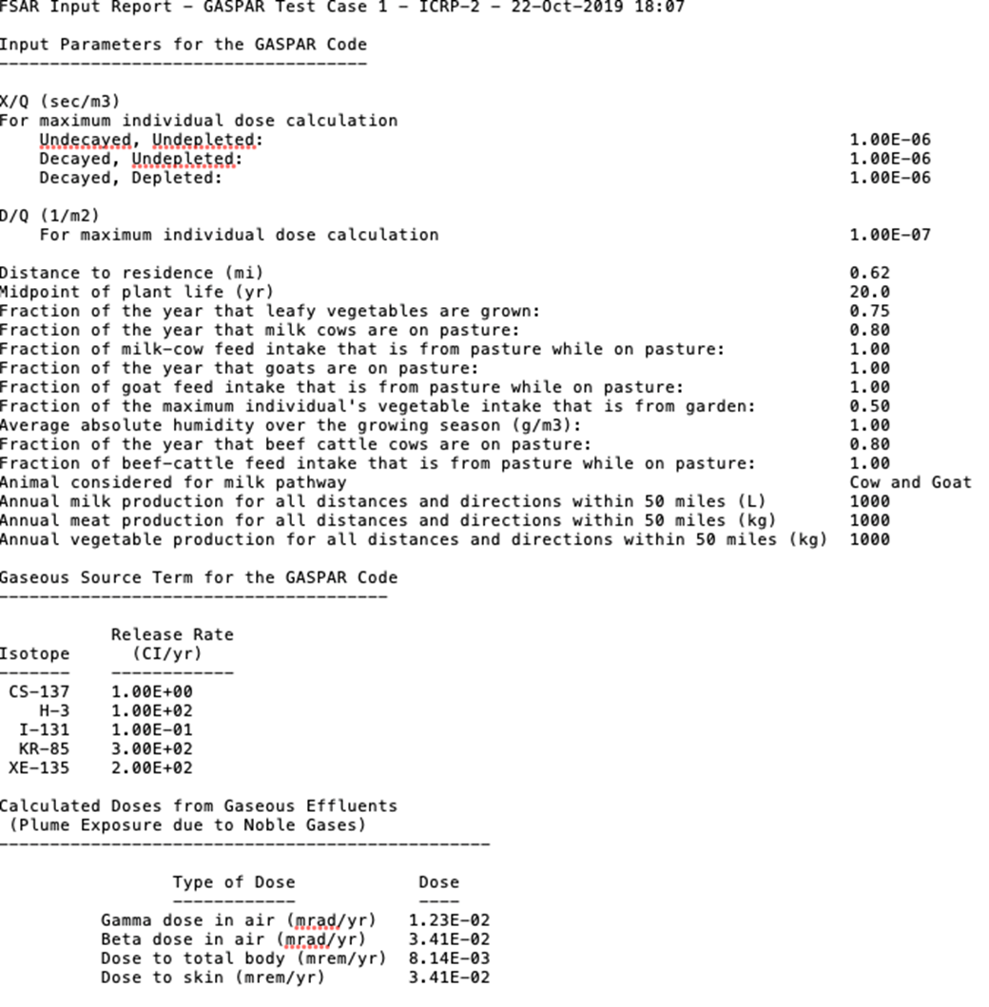
Running GASPAR – Output
Provides a summary report of assumptions and doses
Suitable for use in creating input for safety analyses and licensing support

Slide 82
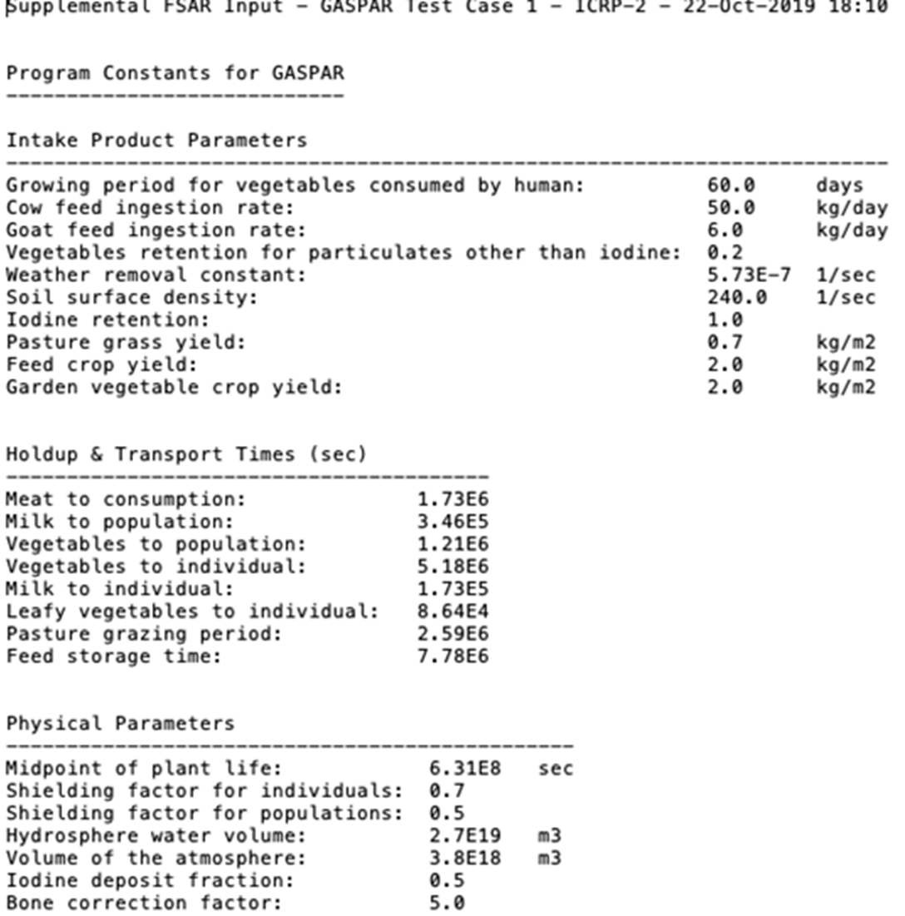
GASPAR – Supplemental Report
Provides additional information that may not be included in the GASPAR output or the FSAR Report

Slide 83
LADTAP Modeling and Use

Slide 84
LADTAP Dose Modeling
Routine liquid effluent releases – not for short-term accident
Modeling assumes annual average conditions
  Average dispersion in receiving water body
  Average radioactive effluents over time
RG 1.109, Calculation of Annual Doses to Man from Routine Releases of Reactor Effluents for the Purpose of Evaluating Compliance with 10 CFR Part 50, Appendix I, Rev. 1, October 1977

Slide 85
LADTAP Dose Modeling
Exposure pathways to maximum exposed individual and to population:
  Potable water (downstream supply),
  Aquatic foods (fresh and saltwater water fish, invertebrate (crustacea and shellfish), and aquatic plants (seaweed)
  Shoreline deposits (build-up to mid-point of plant life (assumed 40-year life)
  Swimming and boating from direct exposure,
  Irrigated foods, and
  Non-human biota (7 surrogate species)

Slide 86
LADTAP Dose Modeling
Models from RG 1.113:
  Plug-Flow Model - uniform, constant flow through pond; negligible evaporation
  Partially Mixed Model - applicable where blowdown and plant pumping significant
  Completely Mixed Model - estimates effluent concentration at midpoint of plant life
Refer to NUREG/CR-4013, Section 3.1.1 for more detail

Slide 87
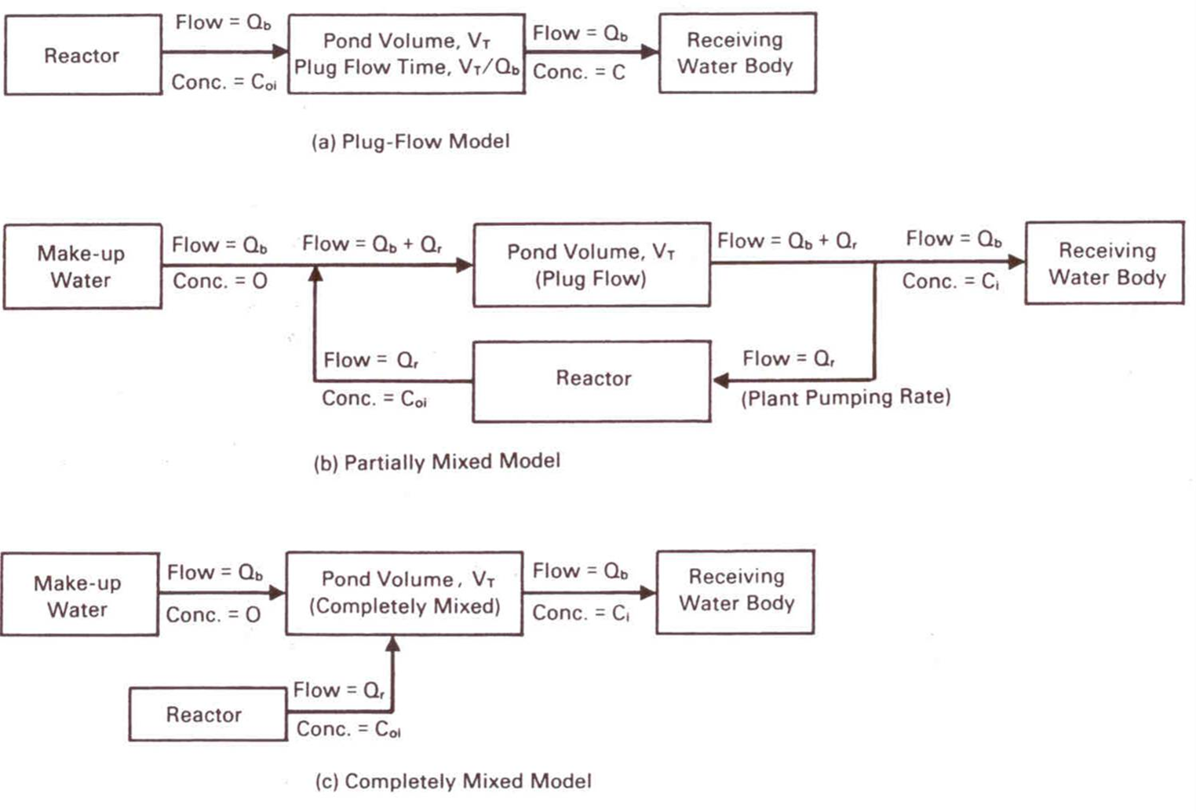
LADTAP Dose Modeling
Figure 3.2 from NUREG-4013, LADTAP II - Technical Reference and User Guide

Slide 88
Starting and Running LADTAP
Double click “LADTAP”

Slide 89
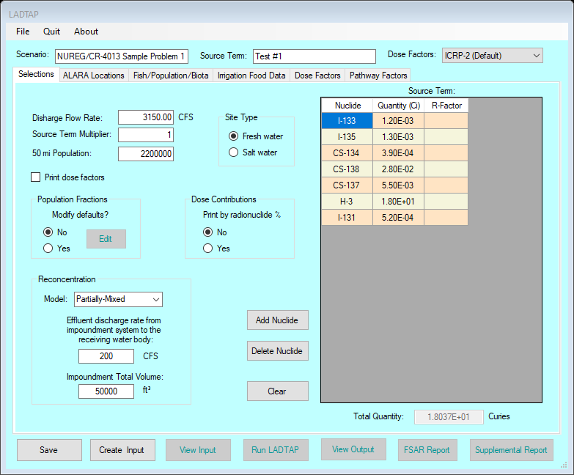
LADTAP Main Screen
LADTAP opens with data saved in the database
Contains three main functional areas:
  the toolbar and initial setup area,
  data input tabs area and
  code execution and reports area

Slide 90
LADTAP Start-up
New ─ Select this option to begin a new LADTAP case. This will clear the database from any previously input information.
Open LN3 File ─ Select this option to access and open a “*.LN3” file that was previously created with NRCDose3.
Save to Database ─ Choose this option to save the current case to the database. When LADTAP starts, it loads the data that was last saved (typically from the last, previous run), populating all LADTAP screens and windows.
Save to LN3 File ─ Choose this option to save the completed case to a “*.LN3” file. This allows the file to be saved for later use, or for sharing with others.
Delete ─ Choose this option to open an explorer window that will allow the user to delete any previously saved “*.LN3” files.

Slide 91
LADTAP Basic Information
Scenario Name
Source Term Identifier
Dose Factor Library
  ICRP-2 (Default)
  ICRP-30
  ICRP-72

Slide 92
LADTAP Selections
Release/site information
Fresh or saltwater
Print dose factors
Dose contribution by nuclide
Modify Population Fractions
  (ICRP-2/ICRP-72)
    Adult (71%)
    Teen (11%)
    Child (18%)
  ICRP-30
    Adult (100%)

Slide 93
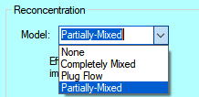
LADTAP Reconcentration
Drop down menus for the three (3) models
  Alternatively, nuclide specific R-Factors can be assigned manually

Slide 94
LADTAP Reconcentration Models
Plug-Flow Model
Partially Mixed Model
Completely Mixed Model

Slide 95
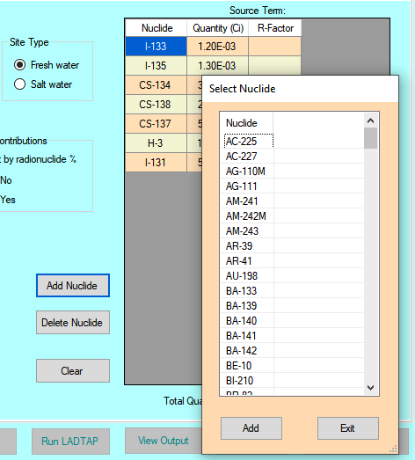
LADTAP Source Term
Select: Add Nuclide
Pop-up menus with nuclide list
Highlight desired nuclide; use ”control” key to select multiple nuclides
  Select “Add” to add to list
“Delete Nuclide" will delete selected nuclide
“Clear” will clear all nuclides in the Source Term

Slide 96
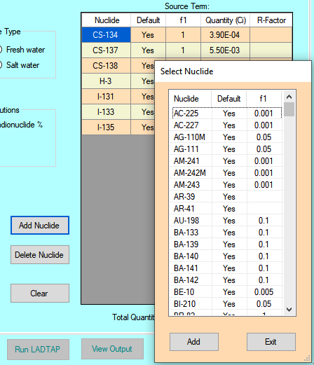
LADTAP Source Term
ICRP-30 and ICRP-72 DCFs
  For radionuclides with more than one solubility class, select the applicable one
  The same nuclide with more than one solubility class is not allowed

Slide 97
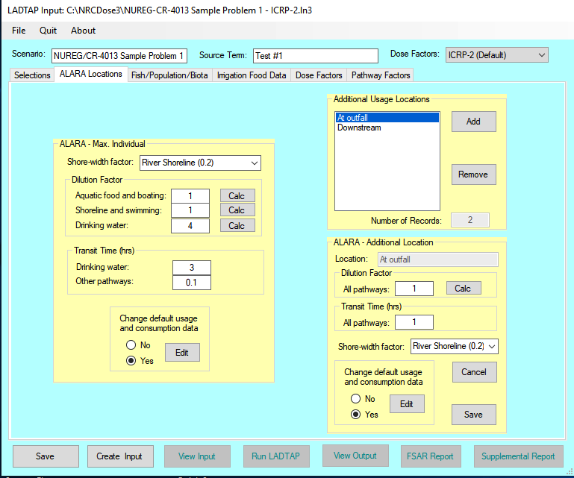
ALARA Locations (Individual Doses)
Defines the exposure assumptions for individual dose calculations
Enter data
  Shore width factor defines the geometry for the shoreline exposure
  Dilution factors by pathway
  Transit time by pathways

Slide 98
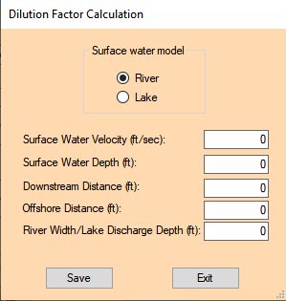
LADTAP Dilution Factor Calculation
Using the “Calc” options, a dilution factor will be calculated based on receiving water body parameters
  Based on RG 1.113
  For nontidal uniform flow and steady-state conditions, diffusive transport in the flow direction negligible compared with advective transport

Slide 99
LADTAP Dilution Calculation
Surface Water Model ─ Select the appropriate hydrological model by clicking on either River or Lake model option
Surface Water Velocity ─ surface water velocity in units of feet per second (ft/s)
Surface Water Depth ─ surface water depth in units of ft
Downstream Distance ─ downstream distance in units of ft
Offshore Distance ─ offshore distance in units of ft
River Width/Lake Discharge Depth ─ either the river width or lake discharge depth depending on the model selected in units of ft

Slide 100
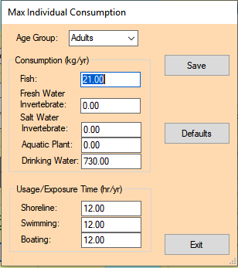
Individual Age Group Exposure Assumptions
Drop down menu to select age group
  ICRP-2 DCFs: four age groups: Adult, Teen, Child, Infant
  ICRP-30 DCFs: Adult age group only
  ICRP-72 DCFs: Adult, 15-year, 10-year, 5-year, 1-year and newborn
Remember to Save before Exit

Slide 101
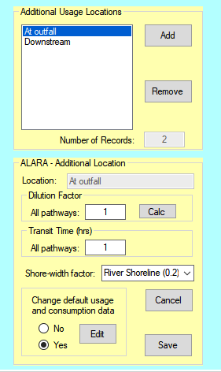
Additional Locations (Individual Doses)
Add/remove additional locations of interest – by name
Define exposure assumptions
  Dilution
  Transit time
  Shore width factor
Ability to change exposure times and consumption rates

Slide 102
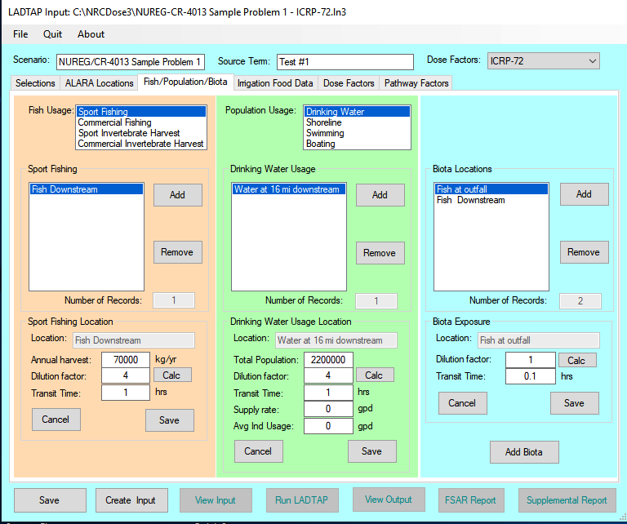
LADTAP Population Doses: Fish and Shellfish
Select pathway from dropdown menu
Add location
Define harvest, dilution and transit time

Slide 103
LADTAP Population Usages
From drop down, select:
  drinking water,
  shoreline,
  swimming or
  boating
Add location
For drinking water, define the population served or the supply rate
  For others, define person-hours annual usage
  Define dilution and transit time
  Add additional locations as needed

Slide 104
LADTAP Population Usages
Add locations for calculating doses to biota
Add additional locations as needed
Define dilution and transit time
A “new” biota can be defined and added

Slide 105
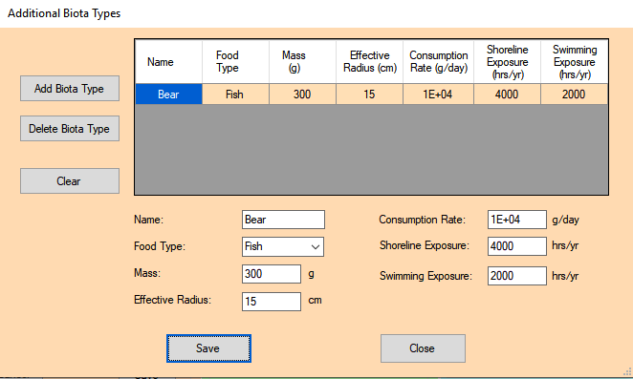
LADTAP Biota Doses
Select the “Add Biota Type” button
Enter the name and exposure assumptions for the new biota type.
Select the “Save” button
Up to five (5) new biota may be added

Slide 106

LADTAP Irrigated Foods

Slide 107



LADTAP Irrigated Foods
From dropdown menu select food type
Total production within 50 miles
Add irrigation rate
Option to change default consumption rates
For milk and meat, add non-contaminated water fractions
Save: adds Food type to list.

Slide 108


LADTAP Irrigated Foods
ICRP-2
ICRP-72

Slide 109

LADTAP Irrigated Foods, Farm Data
For each farm location:
  Dilution, Production and Transit Time
Save: adds food type to list
Add locations for selected farms for production
Option to change default consumption rates

Slide 110

LADTAP Dose Factors

Slide 111

LADTAP Dose Factors
Nuclide Data
  External TB and skin DFs from
  Ground Surface
  Water Submersion
  Absorbed Energies
  For biota calculations
  Effective radii
NOTE: Nuclide Data is non-editable

Slide 112

LADTAP Pathway Factors

Slide 113

LADTAP Bioaccumulation Factors
Bioaccumulation factors (fresh and saltwater):
  Fish
  Invertebrate
  Plants
Transfer factors:
  Soil-to-vegetables
  Grass-to-meat
  Grass-to-milk
NOTE: All bioaccumulation factors are editable for site-specific data

Slide 114

Pathway Factors - Usage/Consumption
Consumption Rates
  Fish
  Invertebrate
  Plants
  Drinking water
  Shoreline
  Swimming
  Boating
Irrigated Food Consumption:
  Vegetables
  Leafy vegetables
  Milk
  Meat
  Transit and hold-up times
NOTE: All consumption rates are editable for site-specific data

Slide 115
Running LADTAP – Viewing Outputs/Reports
Save
Create Input
View Input
Run LADTAP
View Output
FSAR Report
Supplemental Report

Slide 116
Running LADTAP – Input
Input follows the format of the “card deck” as described in NUREG/CR-4013
The datasets at beginning reflect assumptions that could have been changed under the “Pathway factors” tab
The bottom section is standard LADTAP input:
  Selections inputs
  Source Term
  ALARA Location assumptions
  Fish/population/biota inputs
  irrigated foods

Slide 117

Running LADTAP – Output

Slide 118

Running LADTAP – FSAR
Provides a summary report of assumptions and doses
Suitable for use in creating input for safety analyses and licensing support

Slide 119

LADTAP – Supplemental Report
Provides additional information that may not be included in the LADTAP output or the FSAR Report

Slide 120
NRCDose Future Planning

Slide 121
NRCDose3 Transition to PNNL
Retirement of Current Code Developer and pending retirement of Code knowledgeable expert.
Establishment of PNNL as knowledge center for NRCDose3 functions and intended uses.
Integration of NRCDose3 environmental calculations into SIERRA Code as part of the RAMP Code consolidation effort.

Slide 122
NRCDose3 Integration into SIERRA
Short Term (next few months)
  Receive and review program files, documentation, and associated materials
Intermediate Term (<2 years)
  Continue as the knowledgeable experts on NRCDose3
  Complete code maintenance and updates as directed by the NRC
Long Term Integration into SIERRA (2+ years)
  Expected retirement of NRCDose3 (Transition to legacy code hosted by RSICC)
  Complete Integration of GASPAR II and LADTAP II into SIERRA
  Update Carbon and Tritium Models to address known issues

Slide 123

SIERRA Integration Plan

Slide 124
SIERRA Integration Plan

Slide 125

Complete SIERRA Functionality

