Slide 1
Investigating the impact of applying different grid resolutions of NWP data in probabilistic accident consequence assessments
Wednesday 23rd October 2024
Peter Bedwell
Peter.Bedwell@ukhsa.gov.uk

Slide 2
Emergency preparedness & response at UKHSA
Assessment of impacts in emergency preparedness, response & recovery because of accidents & incidents involving releases of radioactivity into the environment
Development of methods, tools & guidance in relation to assessments of public health consequences during emergency situations
Accident consequence assessments (both deterministic & probabilistic)
Continual development and application of the PACE software for much of our emergency preparedness activities

Slide 3
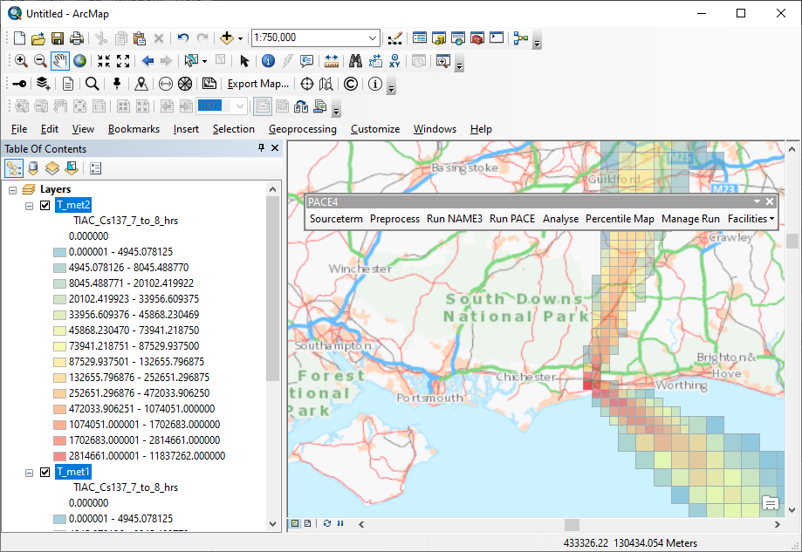
PACE
PACE toolbar
PACE
Probabilistic Accident Consequence Evaluation
Performs Level-3 PRA/PSA:
offsite consequences of accidents at nuclear power stations and similar facilities
Integrates atmospheric dispersion, external exposure, food chain, internal exposure and economics models
Terrestrial releases and pathways only
The probabilistic element comes from consideration of different weather conditions only
Implemented as an Add-in to ArcGIS Desktop 10.4.1+
ArcGIS desktop
PACE output displayed on background mapping

Slide 4
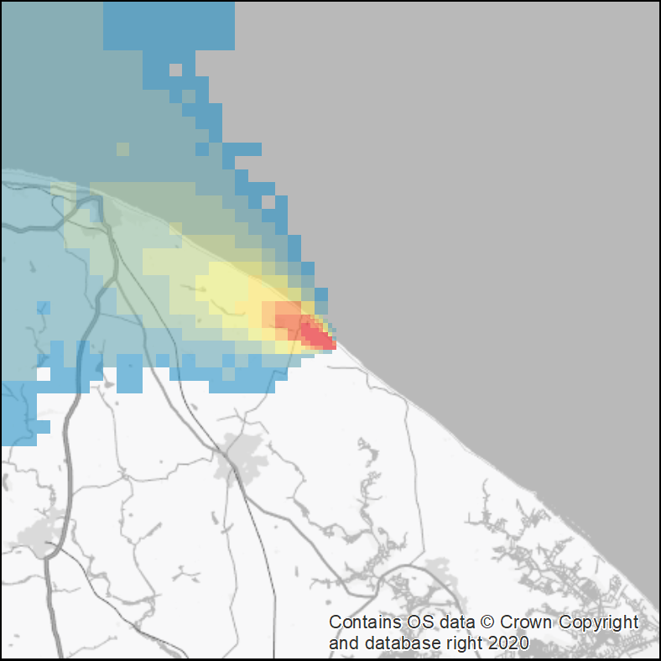
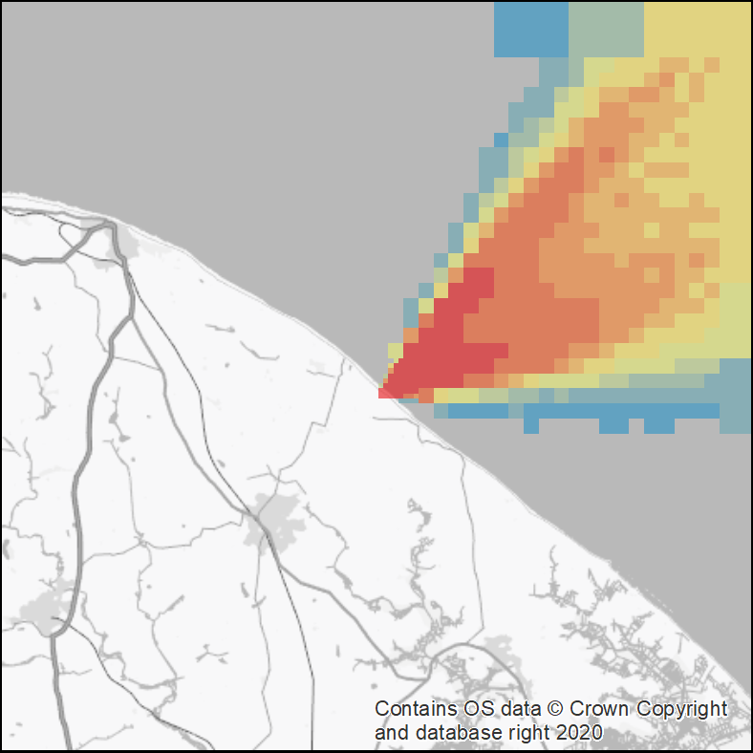
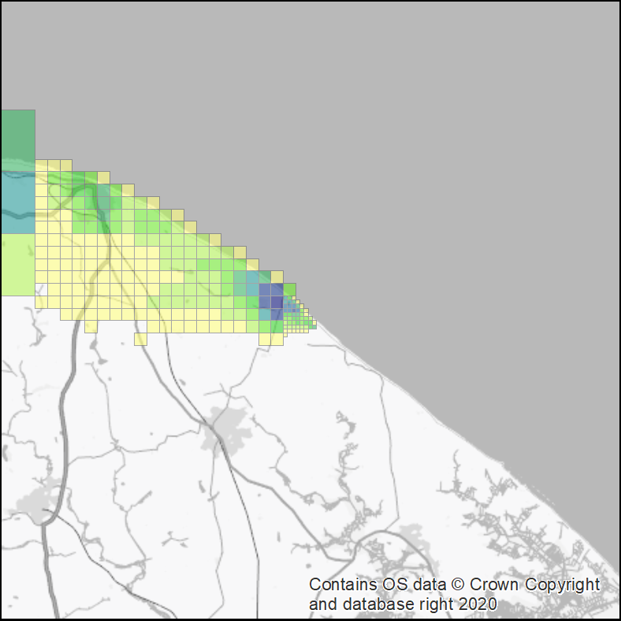
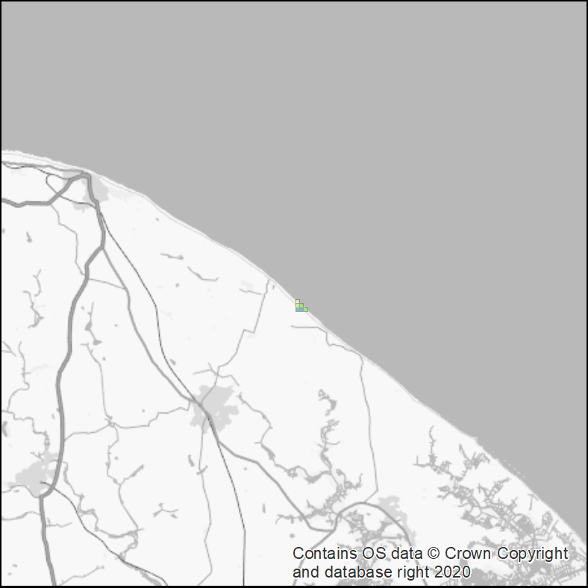
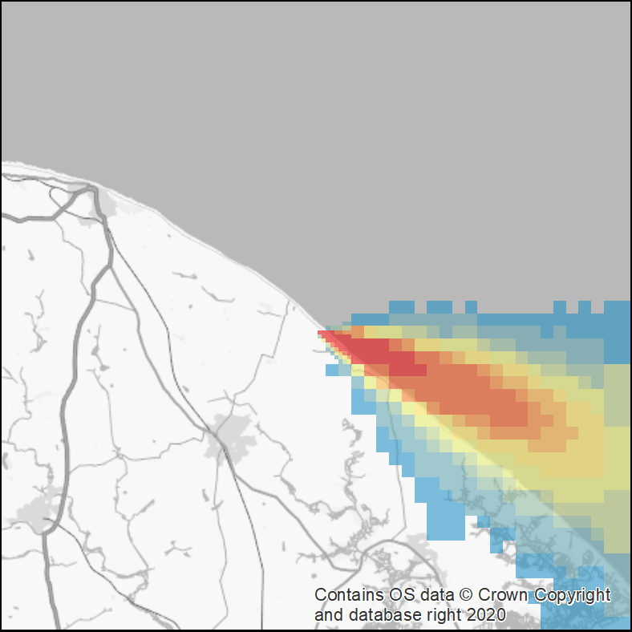
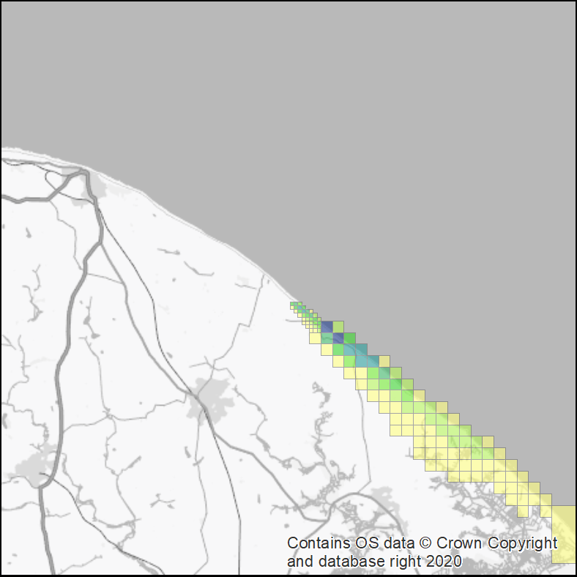
PSA calculation overview
Model atmospheric dispersion of source term
100s or 1000s sets of meteorological conditions (“met-sequences”) from historical weather database
Evaluate consequences for each met-sequence
Doses, risk/numbers health effects, extent/duration protective actions*, economic impacts
Summarise over
met-sequences
Source term
A defined release of radionuclides: - amounts,
- height,
- duration,
- probability,
- location
e.g.
Maximum extent of evacuation
95th percentile external dose at 3km
Mean number of fatalities
Area/yield of milk production lost
etc
Met 45
Met 311
Met 45
Met 311
e.g. ¹³⁷Cs Deposition
e.g. expected fatalities with no protective actions
Met 910
Met 910
* Evacuation, sheltering, stable iodine, food-restriction, relocation and clean-up
Fictional example

Slide 5
Problem posed
Meteorological (met) station sites may be too far from, & situated in differing topography to, the release location(s) & thus met station derived data may be unrepresentative of a study area.
Quality & availability of numerical weather prediction (NWP) model data is continuously improving => NWP model data is becoming more widely used as input to atmospheric dispersion models (ADM).
The resolution of NWP model data has been improving with the advances in predictive algorithms and computing power:
  Met Office Unified Model (UM) NWP data resolution was 60 km prior to 2004, then down to 12 km in 2004, 4 km in 2007 and 1.5 km in 2013.
What are the consequences of using different spatial and temporal resolution of NWP met data on ADM endpoints and subsequent modelling?

Slide 6
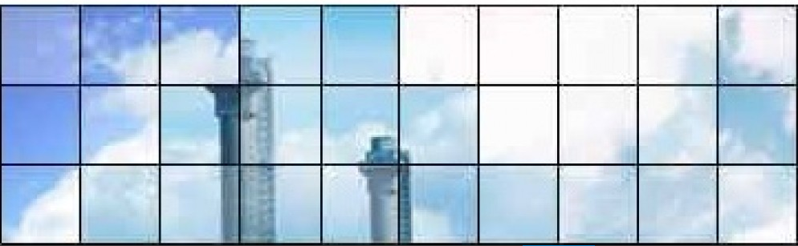
ADMLC funded study
The ADMLC funded an investigation into the consequence of using different spatial and temporal resolution of NWP met data on:
  model predictions of annual mean concentration and high percentile hourly concentrations for a regulatory assessment.
  model endpoints derived by way of probabilistic accident consequence assessments.
  Cambridge Environmental Research Consultants (CERC) addressed part (a) of the study:
  Introduction to NWP models
  Review of meteorological models and atmospheric dispersion modelling
  NWP datasets for evaluation
  Meteorological evaluation results
  Regulatory dispersion evaluation
  Double counting terrain effects
Atmospheric Dispersion Modelling Liaison Committee www.admlc.com

Slide 7
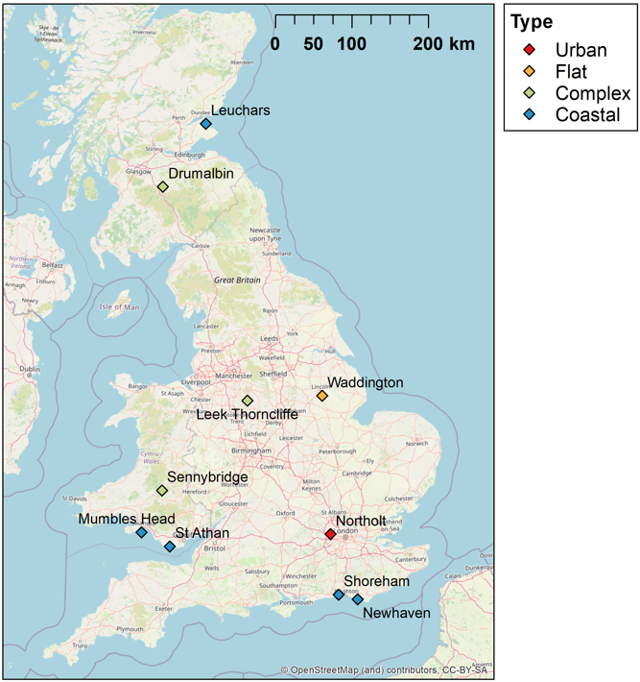
Methodology: Source term & site locations
  Three source terms:
  ¹³⁷Cs (& ^{137m}Ba)
  ¹³¹I
  ²³⁸Pu and ²³⁹Pu
  Release amount = unit release (Bq)
  Physicochemical form: 1µm particle size & iodine in elemental vapour form
  Release height: 10 metres (no plume rise)
  Release duration: 1 hour (24 hours for sensitivity)
  Release location: Sennybridge (primary); 4 other secondary sites

Slide 8
Methodology: ADM & meteorological data
  UK Met Office ADM: the NAME model; a Lagrangian particle approach.
  Data taken from UK Met Office’s Unified Model (UM); Numerical Weather Prediction (NWP) model.
  Two (analysis) data configurations:
  UKV; 1.5 km x 1.5 km horizontal resolution; 57 vertical levels up to 12 km; 1 hour temporal resolution.
  Global; 10 km x 10 km horizontal resolution; 59 vertical levels up to 29 km; 3 hour temporal resolution.
  Terrain and surface roughness included.
  Data for 2019 primarily used; 2020 data for sensitivity.

Slide 9
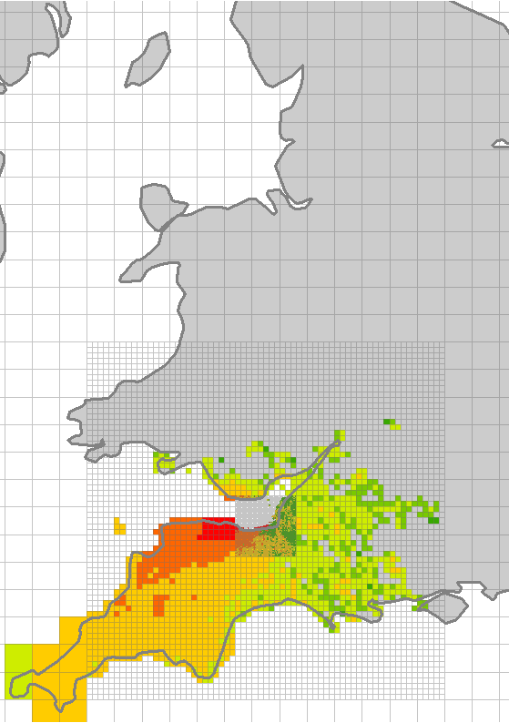
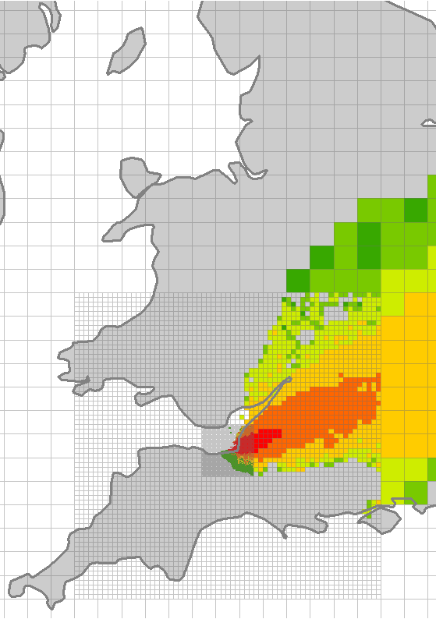
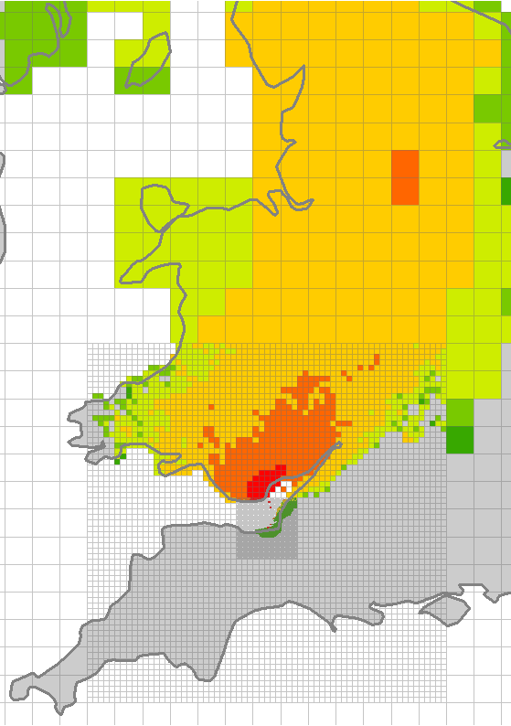
Methodology: application of PACE
  Cyclic sampling approach:
  194 different meteorological (met) sequences (45 hours between each sequence).
  Environmental concentrations (and dose):
    a single maximum value identified for each met sequence (radial distances of 1, 3, 5, 10, 30 & 50 km);
    194 “maximum” values were modelled;
    mean, median, and percentile values subsequently derived.
  Protective actions:
    a single outcome was identified for each met sequence;
    194 values were modelled;
    mean, median, and percentile values subsequently derived.
Met 1
Met 2 …
…Met n
Frequency
Dose
Hypothetical scenario

Slide 10
Results & analysis: Comparison of environmental concentrations across all scenarios
  For almost all scenarios & model endpoints considered, UKV NWP data > Global NWP data.
Ratio of UKV to Global NWP data derived results | Percent of cases
 | TIACs | Deposition Concentrations
< 0.333 | 0 | 0
0.333 - 0.5 | 0 | 0
0.5 - 0.667 | 0 | 0
0.667 - 0.8 | 0 | 0
0.8 - 1.0 | 1.9 | 1.2
1.0 - 1.25 | 57 | 27
1.25 - 1.5 | 40 | 37
1.5 - 2.0 | 1.2 | 28
2.0 - 3.0 | 0 | 6.8
>= 3.0 | 0 | 0
  For example, for derived maximum radioactivity concentrations in air & maximum radioactivity concentrations of deposition on the ground…
  …in 98.5% of cases model endpoints derived using UKV NWP data were greater.

Slide 11
Results & analysis: why env concs estimated using UKV NWP data > Global NWP data?
  Improved modelling of scales of motion, notably small-scale turbulence & unresolved mesoscale motions, when using UKV NWP:
  greater degree of parameterisation in coarser Global NWP model,
  tendency for Global NWP model to overestimate plume spread & underestimate peak concentrations,
  Scale of impact? Other factors: orography, cold and warm fronts, boundary conditions, grids?
  Differences more pronounced for deposition concentrations (than TIACs):
  in 1.2% of cases TIACs > 1.5 when applying UKV versus global NWP data; in almost 35% of cases deposition concentrations > 1.5,
  in 0% of cases TIACs > 2 when applying UKV versus global NWP data; in 6.8% of cases deposition concentrations > 2.

Slide 12
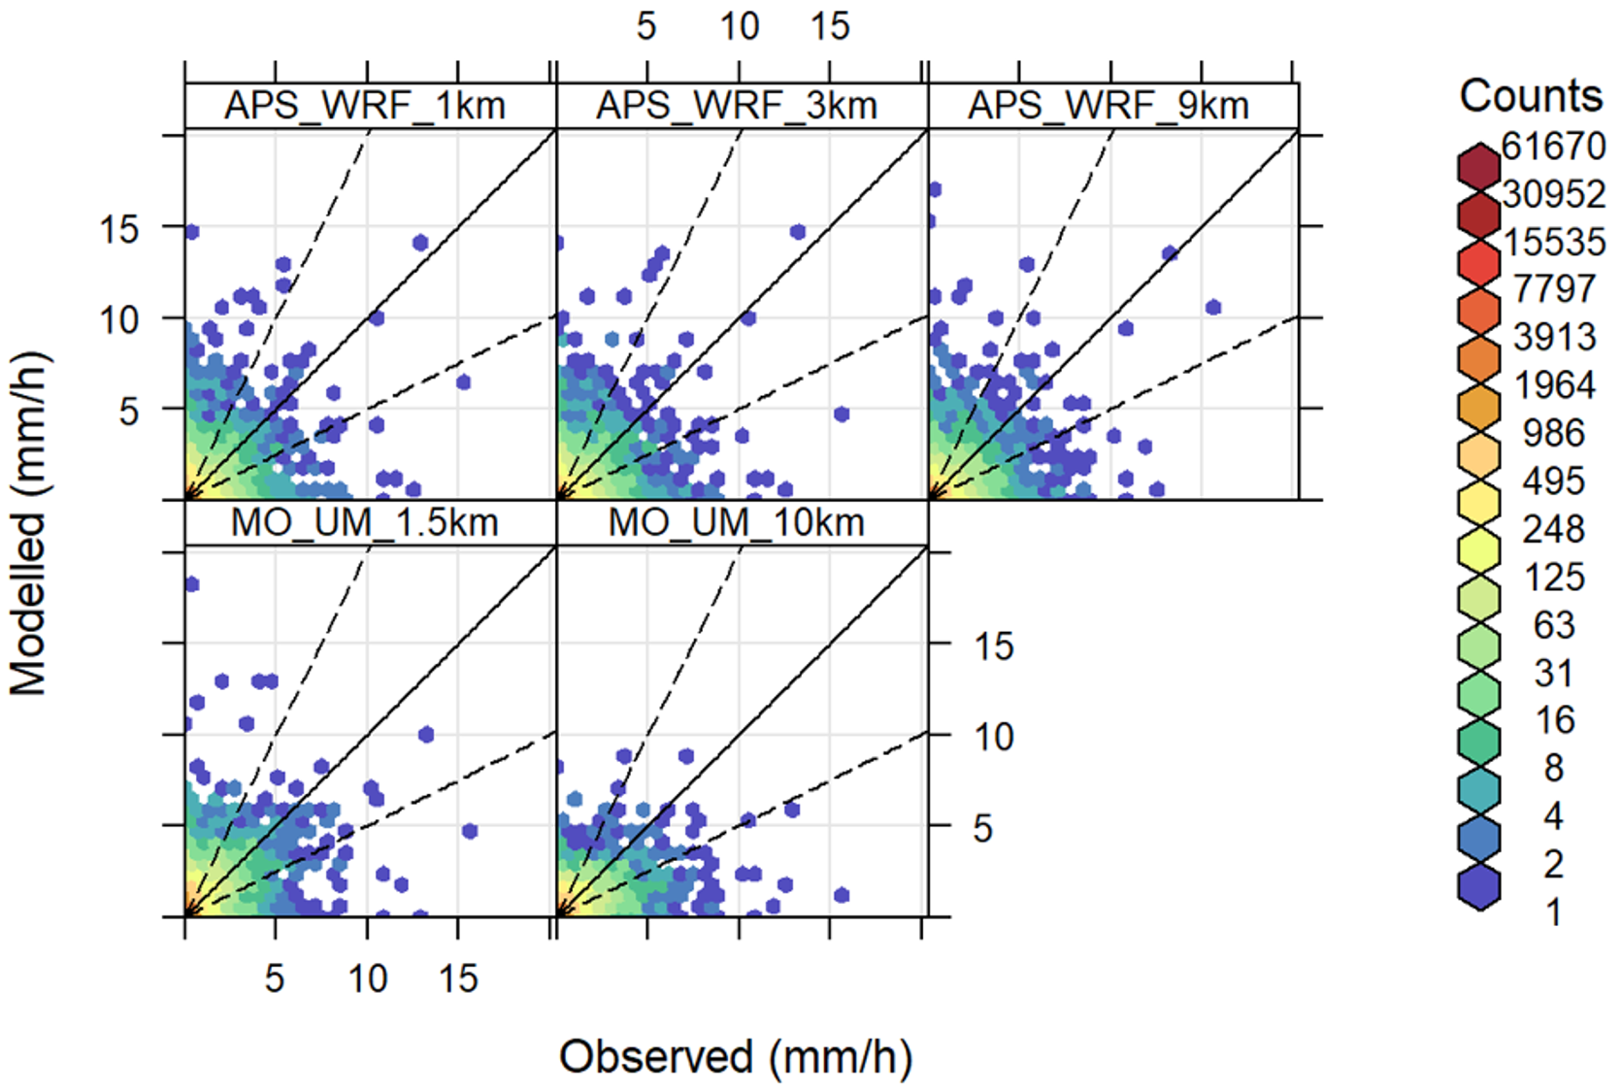
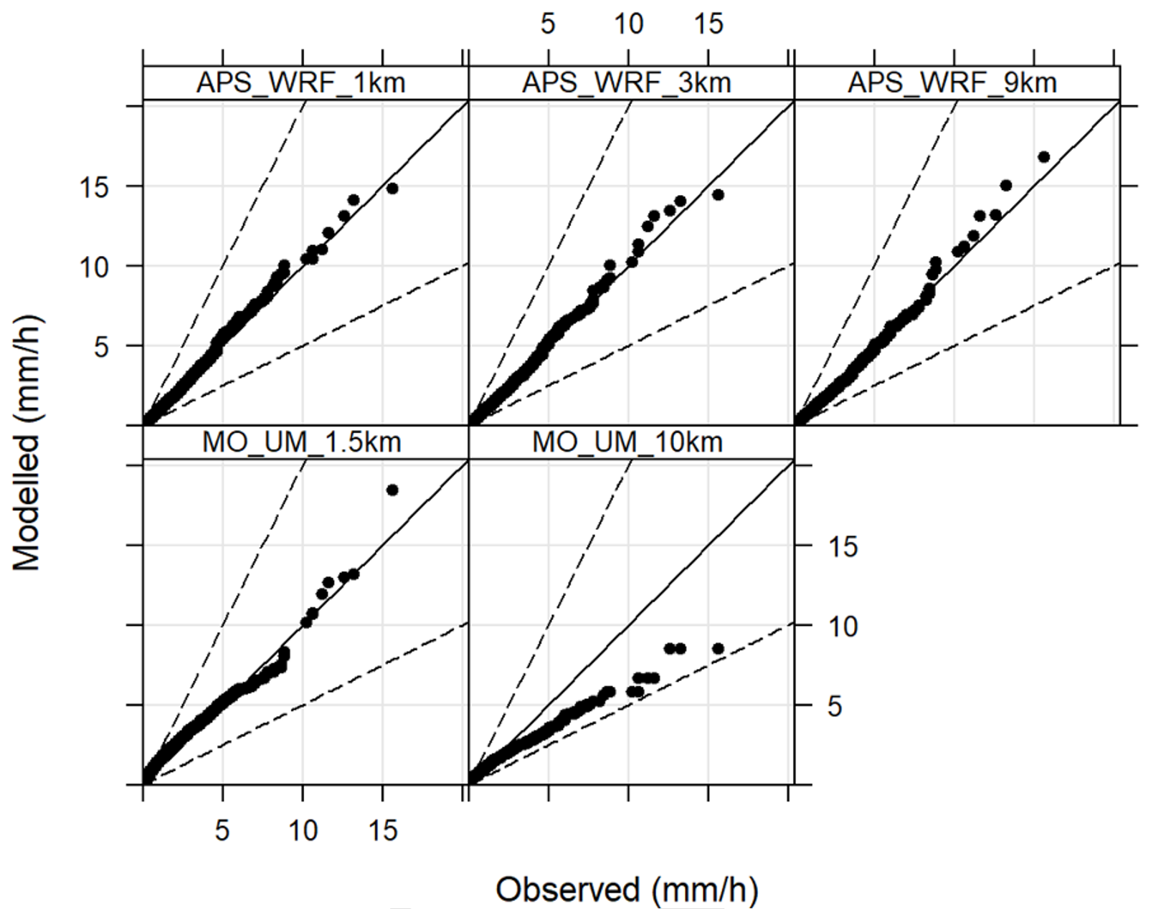
Results & analysis: why env concs estimated using UKV NWP data > Global NWP data ? (cont’d)
  Improved modelling of precipitation & convection, when using UKV NWP:
  Coarser NWP data tended to result in over predicting relatively low precipitation rates & underpredicting moderate to high precipitation rates.
  Finer NWP data tended to over predict at all precipitation rate thresholds (including too much heavy rain and not enough light rain).
  Further improvements required in modelling & understanding:
  Finer NWP models found to: lag observational precipitation onset times, generate too few small showers & produce too large & too circular convective cells.
  Scale of impact? Other factors: soil hydrology, description of cloud amounts, derivation of aerosol concentrations & determination of cloud droplet number.

Slide 13
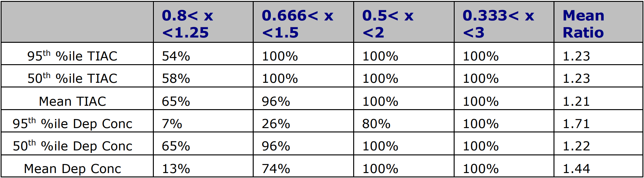
Results & analysis: Comparison of environmental concentrations across statistical endpoints
  Differences in deposition concentration estimates vary, whilst differences in TIAC estimates were very similar across the statistical endpoints considered primarily due to:
  significantly greater impact of precipitation on deposition concentrations compared to TIACs, and
  convective precipitation is described differently in the two NWP datasets considered.
  For light rainfall, modelled deposition concentrations are 30-40 times greater than if no rain occurred.
  Precipitation observed to occur 13% of the time & was modelled to occur 22% & 40% of the time, for UKV & Global NWP models, respectively.
  => 95th percentile of deposition concentrations associated with, and dominated by, precipitation events,
  => 50th percentile of deposition concentrations associated with dry conditions (no precipitation).

Slide 14
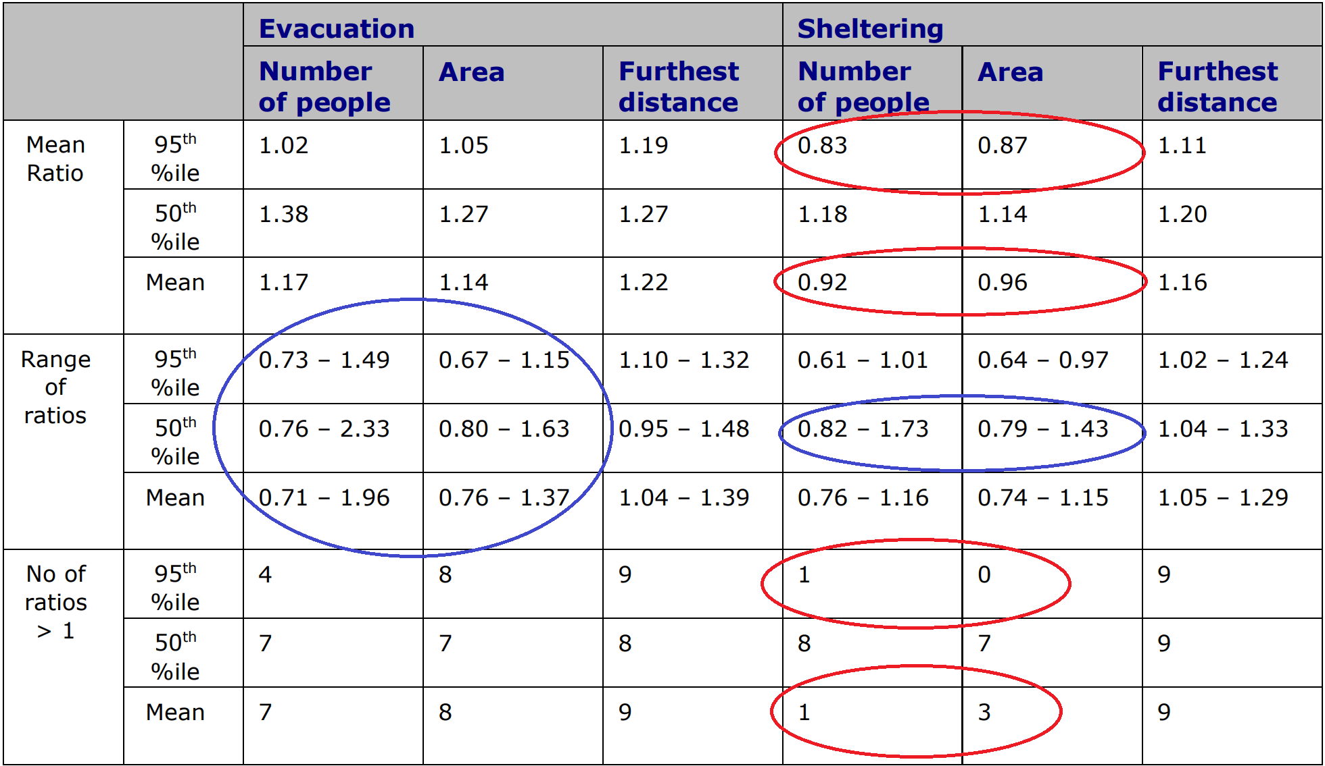
Results & analysis: Comparison for sheltering and evacuation impacts
Differences of evacuation impacts predominantly follow a similar pattern to the environmental concentrations
Differences of the 95th percentile of sheltering impacts, notably the total number of people affected and total area affected by sheltering, tended to be greater when applying Global NWP data.

Slide 15
Results & analysis: explanation of the comparison for sheltering and evacuation impacts
  Dose thresholds of 30 & 3 mSv for implementing evacuation & sheltering, respectively.
  Source terms, tended to result in relatively small evacuation impacts & relatively large sheltering impacts.
  Finer NWP data tended to increase peak environmental concentrations, & narrow & extend the plume; coarser NWP data tended to smooth the peaks, & broaden & reduce the extent of the plume.
  Assessments based on UKV NWP data lead to evacuation & sheltering at further distances from the release.
  UKV NWP data lead to more doses above the relatively high 30 mSv threshold which resulted in relatively large areas & numbers of people being affected by evacuation.
  Conversely, Global NWP data tended to result in large geographical spread of doses above the relatively low 3 mSv threshold, & lead to relatively large areas & numbers of people being affected by sheltering.

Slide 16
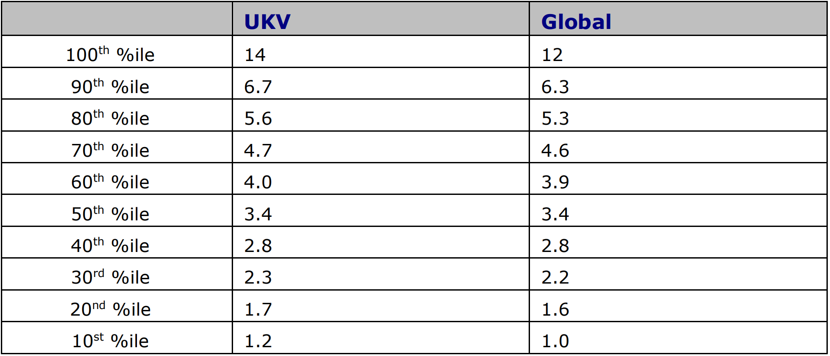
Results & analysis: explanation of the comparison for sheltering and evacuation impacts (cont’d)
  No distinct pattern of number of people evacuated can be found related to use of UKV or Global NWP data
  This variability (lack of a distinct pattern) is likely caused by threshold effects & the inhomogeneous nature of the distribution of the UK population.
  Degree of impact of meteorological factors:
  Precipitation was not the dominant process in determining the scale of the relative differences for sheltering & evacuation impacts.
  Likewise other met parameters eg wind speed (see table right) contributed to the differences observed, but were not the dominant process.
    Propensity for lower wind speeds when applying the Global NWP model (e.g. Sennybridge site).
    Lower wind speeds are commonly associated with broader plumes.

Slide 17
Comparison of NAME in PACE model run times when using UKV and Global NWP datasets
  Run time can be affected by many factors:
    number of concurrent runs & users,
    parallelisation & number of threads,
    number of geographical sub-domains (“cut-outs”).
  UKV NWP “cut-outs”:
    one or two cut-outs considered, depending on the release location (16 cut-outs comprise the full dataset),
    a single “cut-out” ranged from 10,000 – 17,000 KB in size (one hour of data).
  Global NWP “cut-outs”:
    only one cut-out was necessary (Europe, and parts of Greenland, north Africa, & Middle-East) (14 cut-outs comprise the full dataset),
    domain of NWP data considerably larger than the atmospheric dispersion model domain.
    a single cut-out ranged from 163,000 – 180,000 KB in size (three hours of data).
  Difficult to isolate the difference that is being made solely by the choice of NWP data type.
  UKV NWP runs sometimes quicker / Global NWP runs sometimes quicker; difference always less than a factor of two.

Slide 18
Conclusions
  Impact of changing NWP resolution on probabilistic accident consequence modelling outputs was investigated.
  Differences in precipitation predictions between different NWP resolutions drive the variation in deposition concentrations & relevant doses.
  Differences in parameterisation of relatively large scales of motion between different NWP resolutions drive the variation in air concentrations & relevant doses.
  In general, finer-resolution NWP data led to longer, narrower plumes than coarser resolution NWP, with increased protective action maximum distances.
  NWP dataset resulting in greater numbers of people & areas affected as a result of the implementation of protective actions depends on the magnitude of the source term & the magnitude of the dose thresholds applied.

Slide 19
Further conclusions
  For probabilistic accident consequence assessments, importance of spatial & temporal resolution of NWP data is determined by the acceptable level of uncertainty in the results.
  Findings of this study suggest that NWP data grid resolutions considered lead to differences of less than a factor of three in most model endpoints calculated.
  However, the importance of NWP data grid resolution will be greater if any of the following are relevant to an assessment:
    scenarios with a focus on precipitation events;
    model endpoints dictated by contributions from deposition onto surfaces;
    statistical endpoints in the extreme tail of the distribution, for example the 100th percentile.
  It is recommended that finer spatial and temporal resolution NWP data is used where practical.
  More information can be found at https://admlc.com/publications/ - ADMLC-R15

