Slide 1
Overview of MACCS
Status and Development – Oct 2024
Dan Clayton
Sandia National Laboratories
International MACCS User Group Meeting
October 21-25, 2024
SAND2024-12956C

Slide 2
Contents
Current versions
MACCS background
MACCS version 4.0
MACCS version 4.1
MACCS version 4.2
MACCS modernization
Supporting documents
Auxiliary and supporting files

Slide 3
Current Versions
MACCS/WinMACCS
  Current version is v4.2 (March 2023)
MACCS/MACCS-UI
  Current version is v5.0 (September 2024)
MACCS-HYSPLIT tools
  Current version is v1.2 (March 2023)
SecPop
  Current version is v4.4.0 (September 2024)
MelMACCS
  Current version is v4.0 (September 2022)
AniMACCS
  Current version is v1.3.1 (January 2022)

Slide 4
Purpose for MACCS
Created by Sandia to support NRC research and regulatory applications
  Origins go back to the mid-1970s
Typically used for prospective analyses, e.g.,
  Probabilistic risk assessments (NUREG-1150 and NRC’s Level 3 PRA)
  Probabilistic consequence assessments (SOARCA)
  Cost/benefit analyses (required for environmental analyses in licensing)
Very versatile with a large set of user inputs
Intended to run rapidly for PRA applications
  Large set of weather trials (hundreds or thousands)
  Significant set of source term categories (ten or twenty) plus additional sensitivity studies

Slide 5
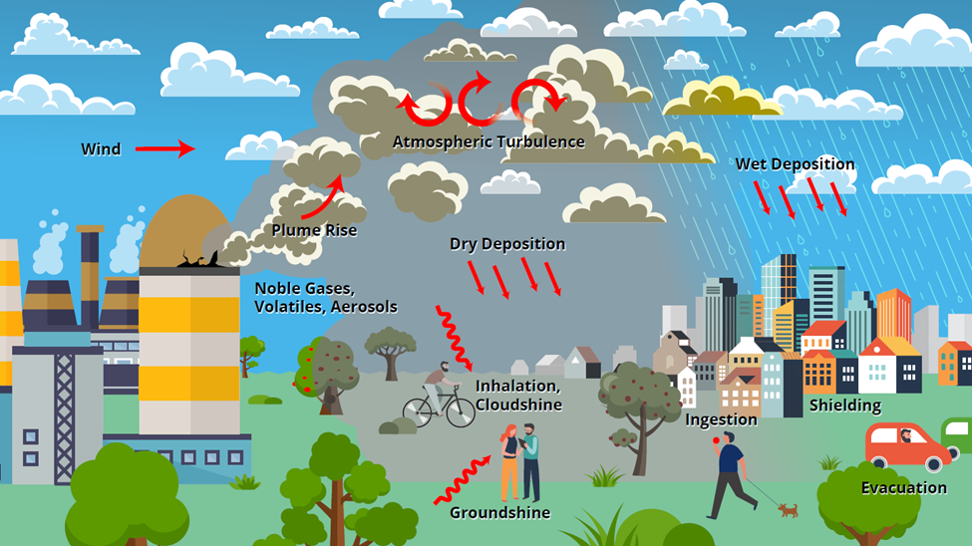
Processes Modeled in MACCS

Slide 6
Phenomena Treated by MACCS
Representation of source term
  Magnitude, characteristics, and timing of release
  Very flexible
Atmospheric dispersion
  Gaussian Plume segment model
  Lagrangian Particle tracking model
  Wet and dry deposition
Exposure pathways to humans
  Inhalation
  Cloudshine
  Groundshine
  Resuspension
  Ingestion
Uncertainty Characterization
Emergency actions
  Sheltering
  Evacuation
  KI ingestion
  Relocation
Long-term remedial actions
  Decontamination
  Temporary or permanent interdiction of property
  Crop disposal
Economic losses
  Evacuation and relocation per diem costs
  Long-term relocation cost
  Decontamination costs
  Loss of property use
  Depreciation during interdiction
  Condemnation
  GDP Losses

Slide 7
MACCS Code Modules
ATMOS
  Calculates transient air and ground concentrations
  Option for Gaussian Plume Segment or Lagrangian Particle models
EARLY
  Treats emergency phase (up to 40 days, usually one week)
  Models emergency response actions
  Estimates doses from exposure pathways
  Estimates health effects
CHRONC
  Treats intermediate phase (up to 30 years, usually one year)
  Treats long-term phase (up to 300 years, usually 50 years)
  Estimates long-term doses from exposure pathways
  Estimates health effects
  Estimates economic losses

Slide 8
MACCS 4.0 Improvements (06/2020)
Optional capability to perform high-fidelity atmospheric transport modeling with HYSPLIT (Lagrangian)
Optional state-of-practice, GDP-based model (RDEIM) to account for economic losses (database currently supports contiguous USA)
Support for special files needed by animation tool, AniMACCS
Limits extended on a large set of input parameters
Input parameters can be exported, including distribution definitions
Results for each weather trial are used to define quantile results

Slide 9
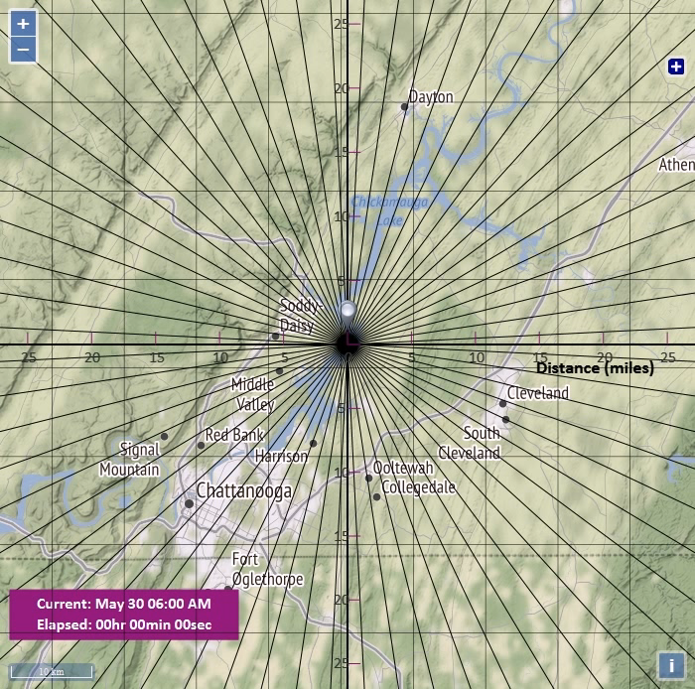
Animation of Plume Segments

Slide 10
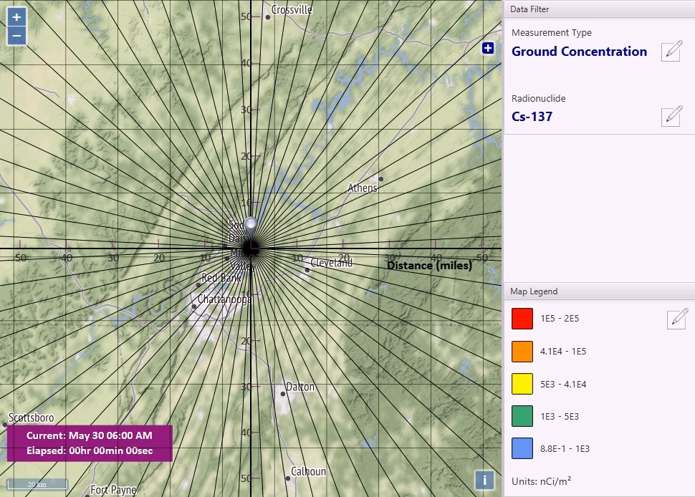
Animation of Ground Deposition (Gaussian)

Slide 11
MACCS 4.1 Improvements (07/2021)
Near-field modeling improvements:
  Comparison of several near-field atmospheric transport and dispersion codes including QUIC, ARCON96, and AERMOD concluded MACCS provides a conservatively bounding assessment in the near-field
  MACCS v4.1 enhancements added for plume meander and trapping and downwash to simulate or bound near-field assessments of other codes
New projective peak dose output option
Documentation added to help menu in WinMACCS
Updates to the RDEIM economic model
Mixing layer information for each time period
Time synchronization between local time and UTC
Pop-up window for converting previous version
Linux version of MACCS 4.1

Slide 12
MACCS 4.0/4.1 Licensing Process
MACCS 4.0/4.1 contains new licensing features
  Software is locked to a specific computer
  Licenses are for one-year duration
Steps to activate license
  Run WinMACCS 4.X.0 Setup.exe (no installation key required)
  Open WinMACCS 4.X.0
    A popup screen briefly describes the licensing process
    Readme file provides more details on licensing process
  Run CreateLicenseRequestFile.exe in folder C:\Users\Public\WinMACCS to create license.request
  Send a copy of license.request to wg-maccs-entity@sandia.gov
  Once approved, Sandia sends product.key to user
  License key is linked to WinMACCS

Slide 13
MACCS 4.2 Improvements (03/2023)
Remove node locking from license
  Only time limit for licenses
  Removes three steps from process
  License included in 4.2 installer expired March 2024, new one issued through March 2025
Up to 999 radionuclides
  Still limited to six member decay chain length
  Need dose coefficient data for radionuclides
Split indirect costs in economic model
Dual dose criteria
Relocation dose projection and timing
Decontamination in habitable areas
Skin pathway standardization

Slide 14
MACCS Modernization Motivation
Working collaboratively with the US NRC to determine the future vision for MACCS
  Effectively tackle the consequence analysis challenges of the future
  Incorporate modern programming languages and techniques
  Be compatible with modern computing platforms
  Increased flexibly and modularity
  Support advanced reactor consequence analysis and future model updates
Divided into two main efforts
  User Interface (WinMACCS)
  Analysis code (MACCS)

Slide 15
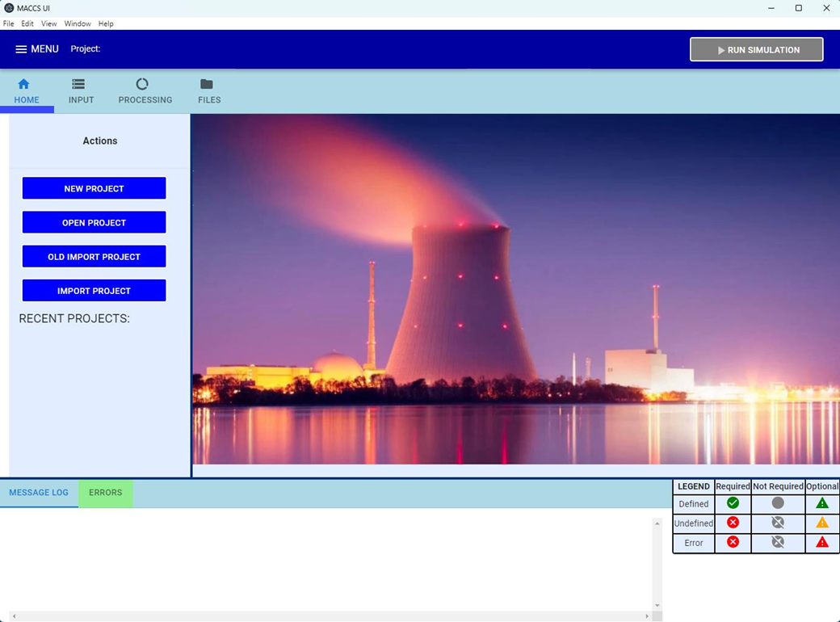
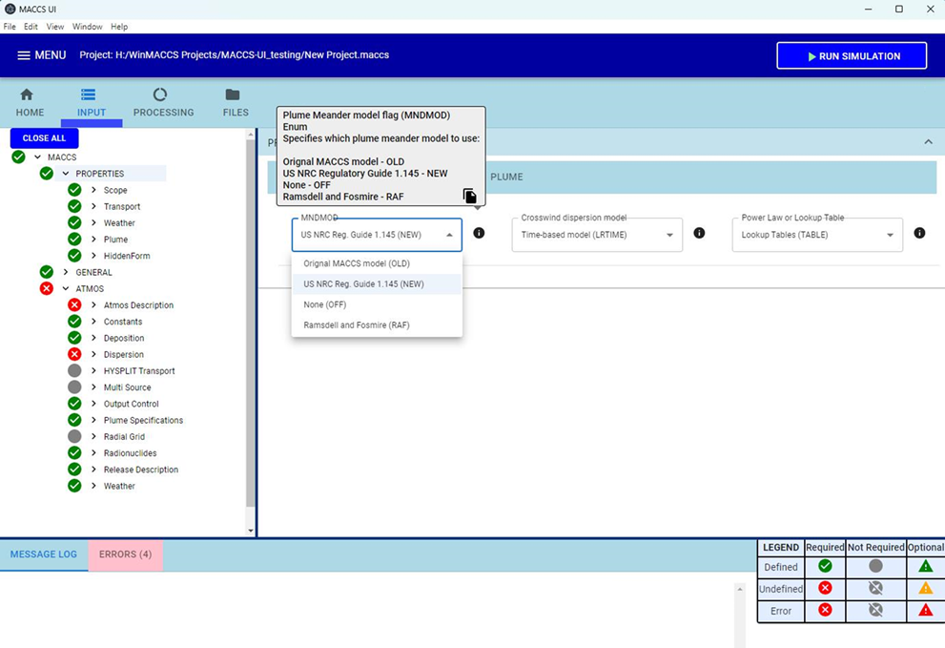
MACCS-UI/User Interface Modernization
Visual Basic 6 no longer supported
  Java, JavaScript and other modern tools
MACCS-UI to have the same functionality as current WinMACCS
  Ability to add more capabilities in the future
Same interface with MACCS
  Atmos.inp, Early.inp, Chronc.inp
  Model1.out, Model1.bin
  Import previous WinMACCS 4.x projects

Slide 16
Analysis Code Modernization
Goals and benefits
  Maintain backwards compatibility
  Compatible with what users currently use
    MACCS UI
    Command line
  Better readability and easier modification of code
  Improve and modify input functionality
  Increase output capabilities
  Work to support potential improvements and model capabilities
Modern programming practices will be used for enhanced readability and modification of MACCS code
  Convert mix of Fortran 77 & 90+ portions of code to modern Fortran
  Clean up memory use by using dynamic memory
  Modularize to facilitate adding or replacing models
Implement such that MACCS remains in a release-ready state

Slide 17
Supporting Documents
All MACCS related documents can be found at https://maccs.sandia.gov/maccs.aspx
WinMACCS & MACCS User Guides
  MACCS User’s Guide and Reference Manual Report (consistent with Version 4.2) (SAND2023-01315)
  MACCS User’s Guide and Reference Manual Report (consistent with Version 4.0) (SAND2022-07112)
  MACCS Theory Manual (consistent with Version 3.10) (SAND2021-11535)
  Other legacy guides
Technical Bases for Consequence Analyses Using MACCS (NUREG/CR-7270)
MACCS-HYSPLIT Tools documentation
Benchmark, verification and validation reports
Complete set of published SOARCA reports

Slide 18
Auxiliary and Supporting Files
Dose coefficient (DCF) files for LNT and non-LNT applications
  FGR-13 (based on FGR-13 using standard radiation weighting factors)
  FGR-13 Gray Equivalent (Rev. A) (based on FGR-13 using relative biological effectiveness (RBE) factors consistent with FGR-13 cancer induction modeling and with all SOARCA analyses)
  Updated versions accompany MACCS 4.2
COMIDA2 files to go with each type of dose coefficient file
  Exposure duration (LASTACUM) set to 50 years
NRC and DOE sample problems
Tutorials based on NRC sample problems
Fogbugz used for problem reporting and corrective actions – https://ersdt.fogbugz.com/

Slide 19
Summary
MACCS performs prospective consequence analysis of potential atmospheric releases of nuclear materials
Multiple supporting documents and auxiliary files
MACCS 4.0 was released in June 2020
  HYSPLIT capability added
  RDEIM economic model added
  AniMACCS capability added
MACCS 4.1 was released in July 2021
  Nearfield updates for plume meander models
MelMACCS 4.0 was released September 2022
MACCS 4.2 was released March 2023
  Removal of node locking
  Increase in number of radionuclides that can be included
  Increased flexibility in projected dose
  Additional output for RDIEM (economic model)
MACCS-UI 5.0 was released September 2024
  MACCS-UI has same functionality as WinMACCS
  Enhanced user interface
  MACCS 4.2 analysis code

