Slide 1


Welcome to the
2020 Summer International Webinar

Slide 2
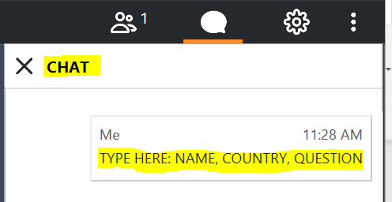
Logistics
Recording – Webinar is being recorded. The recorded webinar and presentations will be uploaded on the RAMP website within 2 weeks.
Audio – All participants will be muted.
Questions –
  Questions will be addressed at the end of the presentations.
  Please type your name, country, the question, and the person the question is directed to in the CHAT (see image below):
  If we don’t get to your question, it will be posted with an answer on the RAMP website.
  If you have questions after the meeting, please email the questions to RAMP.ADMIN@pnnl.gov

Slide 3
Welcome!
Welcome to the 1st RAMP Webinar
Over 200 participants at this RAMP Meeting
  Representatives from 17 Countries
  Government Agencies – NRC, EPA, NIST, DHS, DOE, local governments, and others
  National Laboratories
  Agreement States
  Universities and Industry
Thank you for being part of the RAMP Community!
Thank you for attending today!

Slide 4
Agenda
Welcome: Michael Case (U.S. NRC RES)
RAMP Update: Vered Shaffer (NRC RAMP Program Manager)
Facilitator: Bruce McDowell (PNNL RAMP Program Manager)
Introduction and Welcome (U.S. NRC)
What’s Been Happening in RAMP? (U.S. NRC RAMP Program Manager)
Technical Symposium: Modeling Resuspension of Radionuclides
Role of SSTC NRS in response to the wildfires in Chernobyl Exclusion Zone
SSTC NRS: Yurii Kyrylenko and Yuliya Balashevska
Modeling Resuspension during Forest Fires Using GENII
PNNL: Bruce Napier and Caitlin Condon
Member feedback and Q&A

Slide 5
The Office of Nuclear Regulatory Research:
Division of Systems Analysis
Michael Case, Director
RAMP Summer 2020 International Webinar
June 25, 2020

Slide 6
Again Welcome!
We are glad you are here!

